Slide 1
FIFA WORLD CUP 2026
Team Performance Analysis Using MySQL, SQL and Power BI
MySQL • SQL • Power BI • DAX
Presented by Chandrapal Solanki

Slide 2
Executive Summary
Purpose, tools and outputs
Purpose & Focus
Tools & Key Outputs
Analyze team performance in the World Cup 2026 dataset
Scoring, goals conceded, goal difference, wins and draws
Player goals, assists, clean sheets, shooting accuracy
Venue attendance
MySQL database with 8 related tables
SQL queries answering 10 business questions
Power BI data model and DAX measures
Two interactive dashboards: Team Performance and Team Comparison
FIFA World Cup 2026 • Team Performance Analysis | 2

Slide 3
Project Objectives
1
Evaluate team performance
2
Compare attack and defense
Wins, draws, points, goal difference
Goals scored vs goals conceded
3
Study shooting efficiency
4
Communicate visually
Shots, shots on target, accuracy, xG
Interactive Power BI dashboards
FIFA World Cup 2026 • Team Performance Analysis | 3

Slide 4
Database and Methodology
Data model and analysis workflow
Database Tables
Teams
Matches
Players
Player statistics
Match events
Venues
Attendance
Managers
Workflow
Data
›
MySQL
›
SQL analysis
›
Power BI
›
Insights
FIFA World Cup 2026 • Team Performance Analysis | 4

Slide 5
Business Questions Answered
Ten questions answered with SQL and Power BI
1
Which teams scored the most goals?
6
Which players scored the most goals?
2
Which teams conceded the most goals?
7
Which players recorded the most assists?
3
Which teams had the highest goal difference?
8
Which teams had the most clean sheets?
4
Which teams recorded the most wins?
9
Which teams had the highest shooting accuracy?
5
Which teams recorded the most draws?
10
Which venues had the highest average attendance?
FIFA World Cup 2026 • Team Performance Analysis | 5

Slide 6
Tournament-Wide Overview
Key figures from the project dataset
48
104
308
2.96
Teams
Matches
Goals from match results
Average goals per match
308 goals across 104 matches gives 2.96 goals per match (308 ÷ 104)
1,248 player records and approximately 87,000 completed passes in the dataset
Figures come from official FIFA statistics
FIFA World Cup 2026 • Team Performance Analysis | 6

Slide 7
Attacking Performance
Top scoring teams in the dataset
Highlights
England and France: 20 goals each
Argentina: 19 goals
Spain: 14 goals
Tournament: 2,571 shots, 887 on target, 223 assists, xG 265.62
FIFA World Cup 2026 • Team Performance Analysis | 7

Slide 8
Defensive Performance
Goals conceded and clean sheets, project dataset
What it shows
Spain: 1 goal conceded and 7 clean sheets
Argentina: 8 conceded, 2 clean sheets
France: 10 conceded, 4 clean sheets
Goals conceded and clean sheets describe results, not tactics
FIFA World Cup 2026 • Team Performance Analysis | 8

Slide 9
Shooting Accuracy and Expected Goals
Shots, shots on target and xG
2,571
887
265.62
Total shots
Shots on target
Expected goals (xG)
Shooting accuracy: shots on target ÷ total shots
Shots on target: shots that test the goalkeeper or score
xG: estimated scoring chance of each shot, summed
Argentina: 46 shots on target; France: 59
Source: Team Performance dashboard
FIFA World Cup 2026 • Team Performance Analysis | 9

Slide 10
SQL Analysis Results
Verified outputs only
Metric | Verified result
Team goals | England 20, France 20, Argentina 19, Spain 14
Goals conceded | England 12, France 10, Argentina 8, Belgium 7, Spain 1
Goal difference | Argentina +11, France +10
Wins | Argentina 7, France 6
Clean sheets | Spain 7, France 4, Argentina 2, England 2, Belgium 1
Player-level | 1,248 player records; 294 player-stat goals; 223 assists (totals)
Player rankings, draws and venue attendance rankings are not shown because their outputs were not verified for this deck.
FIFA World Cup 2026 • Team Performance Analysis | 10

Slide 11
Data Quality and Limitations
Reconciling goal totals
Goal Count Reconciliation
Limitations
308
Goals from match results
Results depend on the completeness and accuracy of the project dataset
The dataset is not official FIFA data
Player-stat goals exclude own goals, which is consistent with the 14-goal gap
294
Goals in player statistics
14
Difference, consistent with own goals
FIFA World Cup 2026 • Team Performance Analysis | 11

Slide 12
Key Findings and Recommendations
Key Findings (descriptive)
Future Work (not yet completed)
England and France scored 20 goals each; Argentina scored 19
Argentina: +11 goal difference, 8 conceded, 7 wins
France: 4 clean sheets and 42.45% shooting accuracy
Spain: 1 goal conceded and 7 clean sheets
Tournament average: 2.96 goals per match
Add verified event data
Add richer defensive metrics
Deeper player-level analysis
FIFA World Cup 2026 • Team Performance Analysis | 12

Slide 13
Dashboard Introduction
From SQL results to interactive insights
SQL results loaded into Power BI
Two dashboards
Team Performance Overview
Team Comparison (head-to-head)
Data model links teams, matches and player statistics
DAX measures calculate totals, goal difference and accuracy
Slicers let users filter by team and compare two teams
FIFA World Cup 2026 • Team Performance Analysis | 13

Slide 14
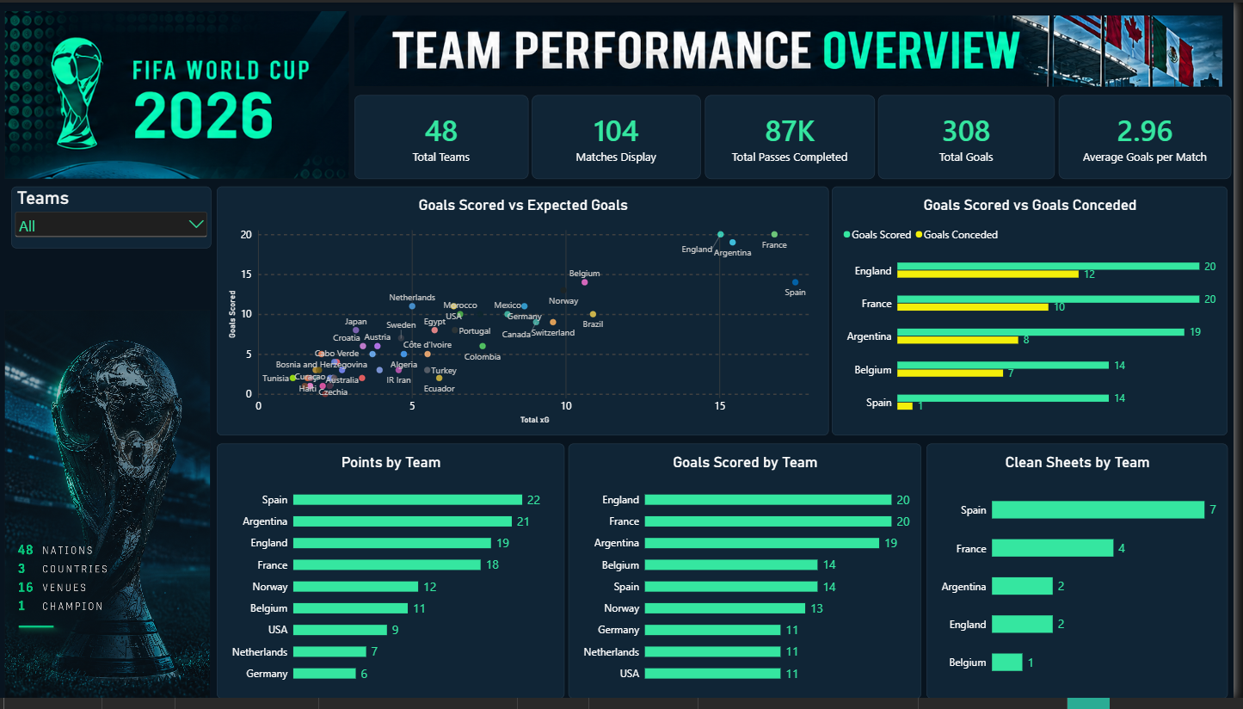
Team Performance Dashboard
Power BI overview: goals, xG, points and clean sheets by team
FIFA World Cup 2026 • Team Performance Analysis | 14

Slide 15
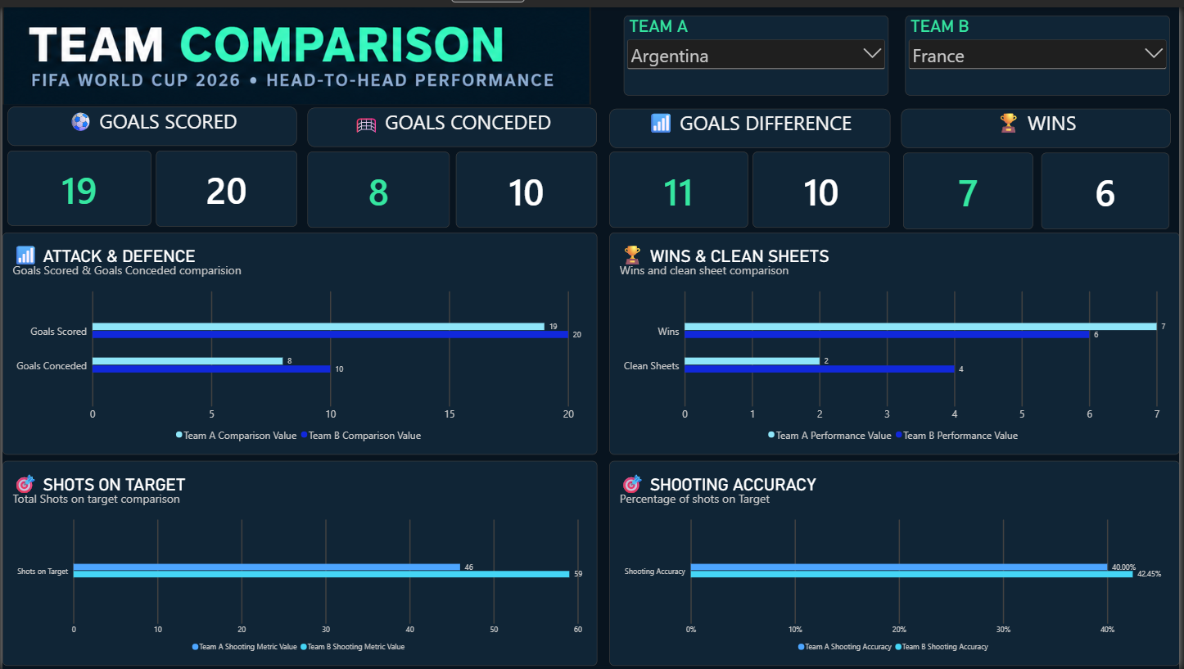
Team Comparison Dashboard and Conclusion
Conclusion
Turned raw match data into clear performance insights
Skills: MySQL, SQL, DAX, data modeling, Power BI
Delivered descriptive analysis of attack, defense and efficiency
Head-to-head view: Argentina vs France
FIFA World Cup 2026 • Team Performance Analysis | 15

Slide 16
Thank You
GitHub
https://github.com/chandrapal67
LinkedIn
linkedin.com/in/chandrapal-solanki67

