Slide 1
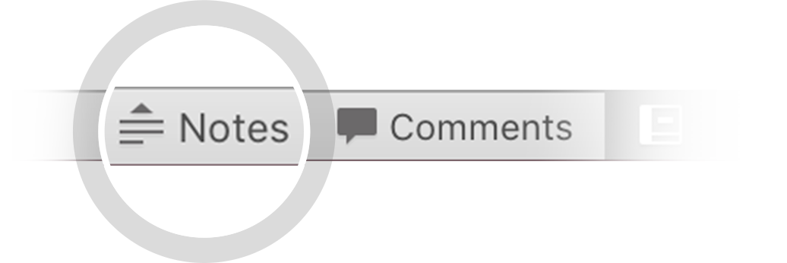

Here's your outline to get started
Key facts about your topic
A software review is "A process or meeting during which a software product is examined by a project personnel, managers, users, customers, user representatives, or other interested parties for comment or approval".
See more: Open the Notes below for more information.
Notes:
QuickStarter has created an outline to help you get started on your presentation. Some slides include information here in the notes to provide additional topics for you to research.

Slide 2
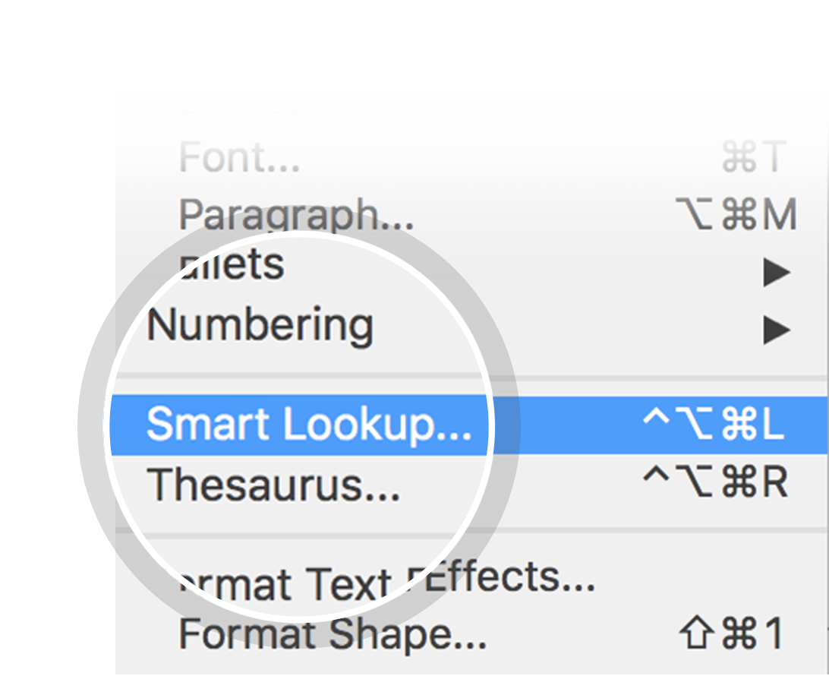
Related topics to research
Code Review
Static Program Analysis
Software Peer Review
Use Smart Lookup to learn more
1
Highlight one of the related topics
Right-click on the topic
Choose "Smart Lookup"
2
3

Slide 3
Software Review

Slide 4
Contents
Varieties of software review
Different types of Peer reviews
Formal versus informal reviews
IEEE 1028 generic process for formal reviews
Value of reviews

Slide 5
Varieties of software review

Slide 6
Different types of Peer reviews

Slide 7
Formal versus informal reviews

Slide 8
IEEE 1028 generic process for formal reviews

Slide 9
Value of reviews

Slide 10
Works cited

