Slide 1
PBL Review 3
Student Academic Risk
Prediction System
Binary Classification: At Risk — YES / NO
Case-based scenario • Practical EDA • Logistic Regression implementation • Evaluation
TEAM MEMBERS
Chandra Prakash Verma
Harshith Sirpuri
Roll No.: 2500031353
Roll No.: 2520030572
Prototype dataset: 1,000 synthetic student records

Slide 2
1. Case-Based Scenario
A practical situation where the proposed system can act as an early-warning support tool.
College scenario
Inputs
A college wants to identify students who may be academically at risk before their performance deteriorates significantly. Faculty can review academic indicators such as attendance, previous grades, assignment performance, internal marks, participation and backlog subjects. The proposed model uses these indicators to predict whether a student falls into the At-Risk or Not-At-Risk category.
6 academic indicators
Output
At Risk = YES / NO
Purpose
Early-warning / decision support
Important: The prototype supports academic review; it does not predict a guaranteed future failure.
PBL Review 3 • Student Academic Risk Prediction

Slide 3
2. Problem Statement & Objectives
Translate the real-world scenario into a machine-learning problem.
Problem Statement
Objectives
Build a binary classification prototype that predicts whether a student is academically at risk using six measurable academic indicators. The aim is to provide an early-warning signal that can help faculty consider timely academic support.
1. Identify and inspect a student academic dataset.
2. Perform EDA and data-quality checks.
3. Preprocess numerical features using StandardScaler.
4. Train a Logistic Regression classifier.
5. Evaluate with Accuracy, Precision, Recall, F1-score and a Confusion Matrix.
6. Demonstrate prediction on a new student record.
PBL Review 3 • Student Academic Risk Prediction

Slide 4
3. Dataset Identification
Synthetic prototype dataset used to demonstrate the complete ML workflow.
1,000
7
6 + 1
500 / 500
Student records
Columns
Features + target
No / Yes classes
Column | Type | Role / Meaning
Attendance_Percentage | Numerical | Attendance percentage
Previous_Grades | Numerical | Previous academic performance
Assignment_Performance | Numerical | Assignment performance
Internal_Marks | Numerical | Internal examination marks
Participation_Score | Numerical | Participation score (1–10)
Backlog_Subjects | Numerical | Number of backlog subjects
Target: At_Risk
Categorical binary target → No / Yes
PBL Review 3 • Student Academic Risk Prediction

Slide 5
4. Practical EDA — Program & Data Quality
The EDA program checks structure, quality and class balance before model training.
Core EDA code
Observed output
df = pd.read_csv("Student_Academic_Risk_Dataset.csv")
print(df.shape)
print(df.isnull().sum())
print(df.duplicated().sum())
print(df["At_Risk"].value_counts())
Shape → (1000, 7)
Missing values → 0 in every column
Duplicate rows → 0
Class distribution → No = 500, Yes = 500
Numerical inputs
Categorical target
Data quality
6 numerical features
At_Risk → Yes / No
No missing values
No duplicate rows
EDA takeaway: the dataset is complete, balanced at the target level, and ready for the modelling stage.
PBL Review 3 • Student Academic Risk Prediction

Slide 6
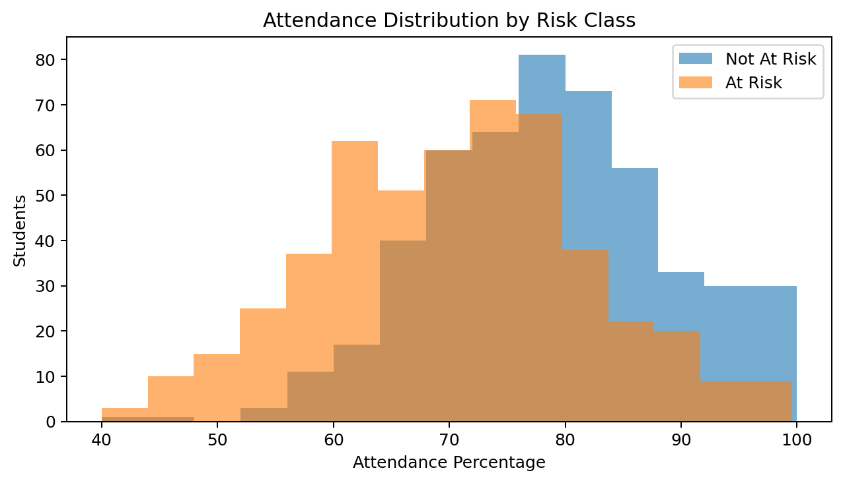
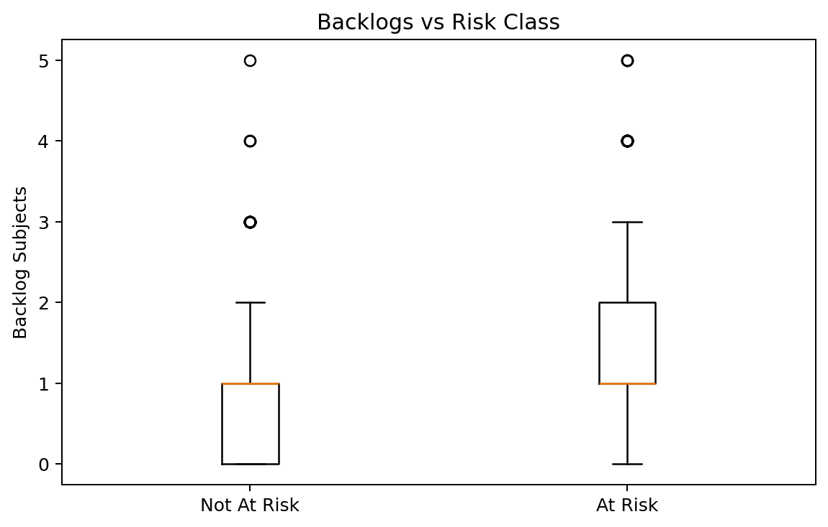
5. EDA Visual Findings
Two feature-level views plus the target-class distribution.
Attendance pattern
Backlog pattern
The two classes overlap, but they show different attendance distributions. Attendance is useful, but not sufficient by itself.
The At-Risk class shows a tendency toward higher backlog counts. This is an association observed in the prototype dataset.
PBL Review 3 • Student Academic Risk Prediction

Slide 7
6. Algorithm Demonstration — Logistic Regression
Binary classification pipeline used in the prototype.
1
Six features
2
Train / Test
3
StandardScaler
4
Logistic Regression
5
0.5 threshold
Attendance
Grades
Assignments
Internals
Participation
Backlogs
80% train
20% test
stratify=y
Fit on train
Transform train + test
Weighted sum
Sigmoid probability
≥ 0.5 → YES
< 0.5 → NO
Model equation
Decision rule
z = b₀ + b₁x₁ + b₂x₂ + … + b₆x₆
P(At Risk) = 1 / (1 + e⁻ᶻ)
P(At Risk) ≥ 0.5 → YES
P(At Risk) < 0.5 → NO
0.5 is the classification threshold, not an input feature.
PBL Review 3 • Student Academic Risk Prediction

Slide 8
7. Practical ML Implementation
Key code used to train, predict and evaluate the model.
Prepare X and y
Train the model
features = [
"Attendance_Percentage", "Previous_Grades",
"Assignment_Performance", "Internal_Marks",
"Participation_Score", "Backlog_Subjects"
]
X = df[features]
y = df["At_Risk"].map({"No": 0, "Yes": 1})
X_train, X_test, y_train, y_test = train_test_split(
X, y, test_size=0.20, stratify=y, random_state=42
)
scaler = StandardScaler()
X_train_scaled = scaler.fit_transform(X_train)
X_test_scaled = scaler.transform(X_test)
model = LogisticRegression(random_state=42)
model.fit(X_train_scaled, y_train)
Predict + evaluate
Implementation note
y_pred = model.predict(X_test_scaled)
y_prob = model.predict_proba(X_test_scaled)[:, 1]
accuracy = accuracy_score(y_test, y_pred)
precision = precision_score(y_test, y_pred)
recall = recall_score(y_test, y_pred)
f1 = f1_score(y_test, y_pred)
The scaler is fitted only on training data to avoid test-set leakage. The model uses only the six academic features; there is no Risk_Score column.
PBL Review 3 • Student Academic Risk Prediction

Slide 9
8. Performance Evaluation
Results from the 200-record synthetic test split.
88.50%
87.38%
90.00%
88.67%
Accuracy
Precision
Recall
F1 Score
Confusion Matrix
Metric calculations
Pred. No
Pred. Yes
Accuracy = (TP + TN) / 200 = (90 + 87) / 200 = 88.50%
Precision = TP / (TP + FP) = 90 / 103 = 87.38%
Recall = TP / (TP + FN) = 90 / 100 = 90.00%
F1 = 2 × (Precision × Recall) / (Precision + Recall) = 88.67%
Actual No
TN = 87
FP = 13
Actual Yes
FN = 10
TP = 90
These figures are prototype test-split results, not real-world institutional performance.
PBL Review 3 • Student Academic Risk Prediction

Slide 10
9. Worked Example — How the 99.99% is Calculated
The StandardScaler mean and standard deviation come from the 800 training records only.
1. Training-set parameters
3. StandardScaler calculations
Feature | Mean (μ) | Std (σ)
Attendance | 74.86225 | 11.58473
Previous Grades | 63.72100 | 15.15947
Assignment Performance | 68.32413 | 15.08191
Internal Marks | 66.32138 | 13.64777
Participation Score | 5.88125 | 1.95515
Backlog Subjects | 1.17375 | 1.05998
Attendance: (55 − 74.86225) / 11.58473 = −1.7145
Previous Grades: (45 − 63.72100) / 15.15947 = −1.2349
Assignment: (48 − 68.32413) / 15.08191 = −1.3476
Internal Marks: (42 − 66.32138) / 13.64777 = −1.7821
Participation: (2 − 5.88125) / 1.95515 = −1.9851
Backlogs: (3 − 1.17375) / 1.05998 = +1.7229
4. Logistic Regression weighted sum
z = 0.05145 + (−1.26624×−1.7145) + (−0.91054×−1.2349) + (−0.65600×−1.3476)
+ (−0.90048×−1.7821) + (−0.44003×−1.9851) + (1.34537×1.7229)
z ≈ 9.0271
2. Example student
Attendance 55 | Previous Grades 45 | Assignment 48 | Internal 42 | Participation 2 | Backlogs 3
5. Sigmoid + decision
P(At Risk) = 1 / (1 + e^−9.0271) = 0.99988 ≈ 99.99% → 99.99% ≥ 50% → YES (At Risk)
PBL Review 3 • Worked example uses the final six-feature Logistic Regression model

Slide 11
10. Research Support for the Algorithm
Previous studies demonstrate the relevance of early student prediction and machine-learning classification.
Martins et al. (2021)
Early prediction of higher-education student outcomes using academic, demographic and socio-economic information.
https://doi.org/10.1007/978-3-030-72657-7_16
Yakubu & Abubakar (2021)
Educational-performance prediction using student information-system data; Logistic Regression was among the approaches.
https://doi.org/10.1108/K-12-2020-0865
Villar & de Andrade (2024)
Comparative study of Decision Tree, Random Forest, SVM, XGBoost, CatBoost and LightGBM with imbalance handling and SHAP.
https://doi.org/10.1007/s44163-023-00079-z
Connection to our project
We use a simpler binary At-Risk / Not-At-Risk formulation with Logistic Regression as an interpretable baseline aligned with the current syllabus.
PBL Review 3 • Student Academic Risk Prediction

Slide 12
11. Conclusion, Limitations & Future Scope
What Review 3 demonstrates and what remains for the next iteration.
What is completed
Current limitation
Future scope
• Case-based problem formulation
• Dataset identification
• Practical EDA program + visuals
• Data-quality checks
• Logistic Regression implementation
• Performance evaluation
• New-student prediction demonstration
• Dataset is synthetic
• Results are prototype test-split results
• One simple baseline algorithm is used
• Real institutional validation has not yet been performed
• Validate on a suitable real/public dataset
• Compare Decision Tree / Random Forest / boosting methods
• Tune decision threshold based on intervention goals
• Add explainability and deployment through an API/dashboard
Review-3 takeaway: problem → data → EDA → algorithm → implementation → evaluation → prediction
PBL Review 3 • Student Academic Risk Prediction

