Slide 1
STUDENT ACADEMIC RISK
PREDICTION SYSTEM
Binary Classification: At Risk — YES / NO
Mini Hackathon 1 • Machine Learning
S. Harshith — 2520030572 | Chandra Prakash Verma — 2500031353

Slide 2
1. Problem Statement
2
Educational institutions collect multiple academic indicators such as attendance, marks, assignments, participation and backlogs.
Manually checking all these indicators for many students makes early identification of academic difficulty difficult.
Our system uses Machine Learning to predict whether a student is likely to be academically at risk.
The output is simple: At Risk = YES or At Risk = NO.
The prediction is decision support for timely academic support, not a definitive judgment.
Mini Hackathon 1 • Student Academic Risk Prediction

Slide 3
2. Objectives
3
IDENTIFY
PREDICT
SUPPORT
Use academic indicators to identify students who may need additional academic attention.
Build a binary classification model that predicts At Risk = YES / NO.
Use predictions to support timely monitoring, tutoring and academic intervention.
Mini Hackathon 1 • Student Academic Risk Prediction

Slide 4
3. Dataset Identification
4
TYPE
RECORDS
INPUTS
Synthetic prototype dataset created for demonstration.
1,000 student records.
6 academic input features.
TARGET
BALANCE
PURPOSE
At_Risk: Yes / No.
500 Yes and 500 No records.
Prototype only; real-world validation is future work.
Mini Hackathon 1 • Student Academic Risk Prediction

Slide 5
4. Dataset Features
5
Attendance Percentage
Previous Grades
Percentage of classes attended.
Previous academic performance.
Assignment Performance
Internal Marks
Performance in assignments.
Internal assessment marks.
Participation Score
Backlog Subjects
Classroom participation, 1–10.
Number of backlog subjects.
Mini Hackathon 1 • Student Academic Risk Prediction

Slide 6
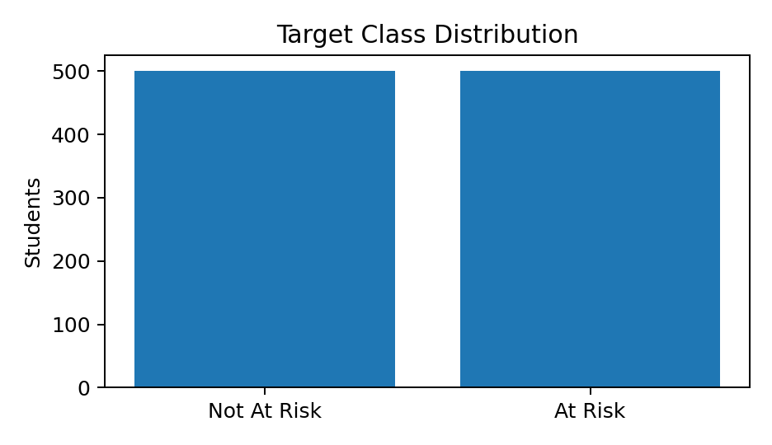
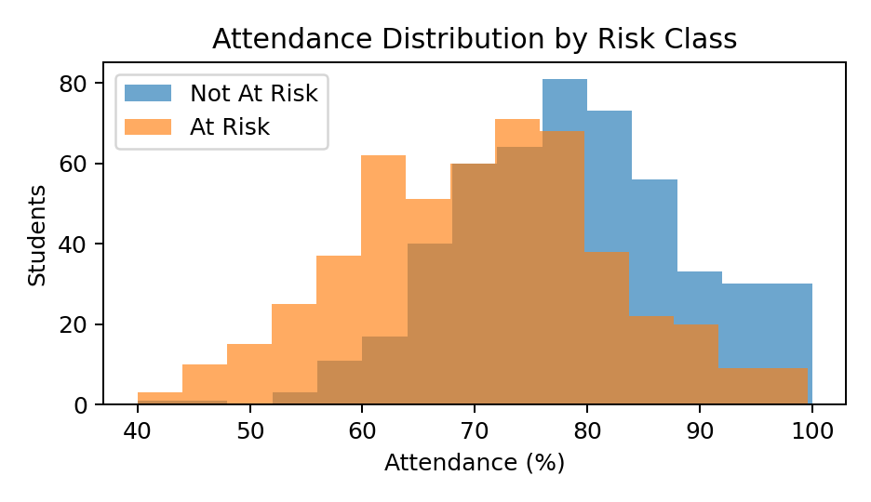
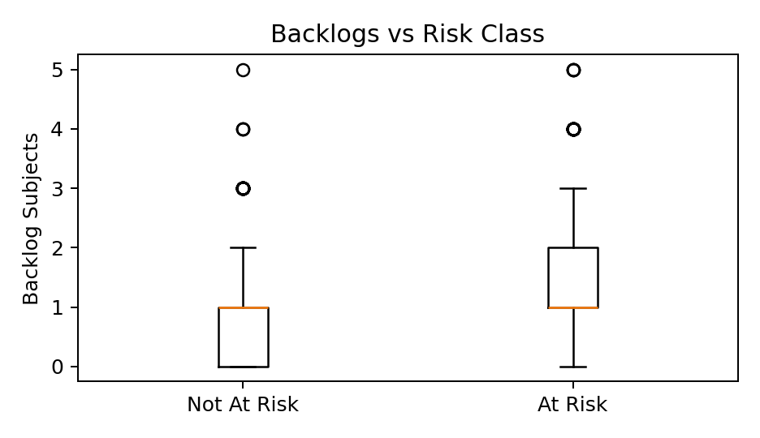
5. Exploratory Data Analysis (EDA)
6
Target distribution: 500 At Risk and 500 Not At Risk → balanced classes.
Attendance shows a visible difference between the two groups.
Backlog counts are generally higher for the At-Risk group.
Checked for missing values, duplicates and unusual values before training.
Mini Hackathon 1 • Student Academic Risk Prediction

Slide 7
6. Machine Learning Approach
7
INPUT
SCALING
MODEL
OUTPUT
DECISION
6 academic features
StandardScaler
Logistic Regression
At-Risk probability
≥ 0.5 → YES
< 0.5 → NO
→
→
→
→
Training: 800 records | Testing: 200 records | Stratified split | random_state = 42
Mini Hackathon 1 • Student Academic Risk Prediction

Slide 8
7. How the Prediction Is Calculated
8
Step 1: Standardize each input feature
Step 2: Form the weighted sum
z = (x − mean) / standard deviation
z = b₀ + b₁x₁ + … + b₆x₆
Step 3: Convert to probability
Step 4: Apply decision threshold
P(At Risk) = 1 / (1 + e⁻ᶻ)
P ≥ 0.5 → YES | P < 0.5 → NO
IMPORTANT
The model uses only the six academic features. No Risk_Score is used as an input.
Mini Hackathon 1 • Student Academic Risk Prediction

Slide 9
8. Training & Evaluation Setup
9
1. SPLIT
2. SCALE
3. TRAIN
80% training (800) and 20% testing (200), using stratification.
StandardScaler is fitted on training data, then applied to test data.
Logistic Regression learns coefficients from the scaled training features.
4. TEST
5. MEASURE
Predictions are generated for the unseen 200 test records.
Accuracy, Precision, Recall, F1-score and Confusion Matrix.
Mini Hackathon 1 • Student Academic Risk Prediction

Slide 10
9. Model Evaluation Results
10
Accuracy
Precision
Recall
F1-score
88.50%
87.38%
90.00%
88.67%
Prototype results on the synthetic 20% test split; not real-world performance claims.
Mini Hackathon 1 • Student Academic Risk Prediction

Slide 11
10. Confusion Matrix
11
 | Predicted NO | Predicted YES
Actual NO | 87 | 13
Actual YES | 10 | 90
INTERPRETATION
TN = 87 | FP = 13 | FN = 10 | TP = 90
True Positive: correctly identified At-Risk student.
False Negative: At-Risk student predicted as Not At Risk.
Recall matters because missing an At-Risk student can delay needed support.
Mini Hackathon 1 • Student Academic Risk Prediction

Slide 12
11. Prototype Prediction Output
12
EXAMPLE STUDENT
MODEL CALCULATION
SYSTEM OUTPUT
Attendance: 55%
Previous Grades: 45
Assignment: 48
Internal Marks: 42
Participation: 2/10
Backlogs: 3
Standardize the six values → apply learned Logistic Regression coefficients → sigmoid probability.
P(At Risk) = 99.99%
AT RISK = YES
Possible support:
• Attendance monitoring
• Learning resources
• Tutoring / faculty follow-up
Mini Hackathon 1 • Student Academic Risk Prediction

Slide 13
12. Research Papers / Existing Work
13
Martins et al. (2021)
Yakubu & Abubakar (2021)
Villar & de Andrade (2024)
Early Prediction of student's Performance in Higher Education: A Case Study.
Focus: early prediction of student outcomes.
Learned: early-warning prediction can support timely academic support.
Limitation: case-study/institution-specific setting; not directly our binary prototype.
Applying machine learning approach to predict students’ performance in higher educational institutions.
Focus: early indicators such as age, gender, high-school scores, region and CGPA.
Learned: ML can support early identification and remediation.
Limitation: based on a Nigerian university; context-specific variables may not transfer directly.
Supervised ML algorithms for predicting student dropout and academic success: a comparative study.
Focus: DT, SVM, RF and boosting models with imbalance handling.
Learned: boosting models performed strongly on their dataset.
Limitation: single dataset limits generalizability; boosting is less directly interpretable.
Mini Hackathon 1 • Student Academic Risk Prediction

Slide 14
13. Research Gap & Proposed Contribution
14
EXISTING WORK
OUR PROTOTYPE
• Many studies predict dropout, academic success or multi-class outcomes.
• Several compare many ML algorithms.
• Early-warning prediction is a common motivation.
• Simple binary target: At Risk / Not At Risk.
• Six easy-to-understand academic indicators.
• Logistic Regression chosen as an interpretable baseline.
• Prediction is connected to practical early academic support.
Mini Hackathon 1 • Student Academic Risk Prediction

Slide 15
14. Future Scope & Conclusion
15
FUTURE SCOPE
CONCLUSION
• Validate on a suitable real/public student dataset.
• Compare Logistic Regression with Decision Trees and ensemble models.
• Tune probability threshold and study calibration.
• Add explainability/feature analysis.
• Build a dashboard or FastAPI service.
• Add monitoring and retraining.
• The project is a binary supervised-learning problem.
• Six academic features are model inputs.
• Logistic Regression converts them into an At-Risk probability.
• A 0.5 threshold gives the YES/NO output.
• The prototype demonstrates an early-warning decision-support workflow.
Mini Hackathon 1 • Student Academic Risk Prediction

Slide 16
References
16
Martins, M.V., Tolledo, D., Machado, J., Baptista, L.M.T., & Realinho, V. (2021). Early Prediction of student's Performance in Higher Education: A Case Study. WorldCIST 2021. DOI: 10.1007/978-3-030-72657-7_16
Yakubu, M.N. & Abubakar, A.M. (2021). Applying machine learning approach to predict students’ performance in higher educational institutions. Kybernetes, 51(2), 916–934. DOI: 10.1108/K-12-2020-0865
Villar, A. & de Andrade, C.R.V. (2024). Supervised machine learning algorithms for predicting student dropout and academic success: a comparative study. Discover Artificial Intelligence, 4, 2. DOI: 10.1007/s44163-023-00079-z
Project dataset: student_academic_risk_realistic_binary_prototype.csv (synthetic prototype created for demonstration).
Implementation: Python, Pandas, Scikit-learn, StandardScaler and LogisticRegression.
Mini Hackathon 1 • Student Academic Risk Prediction

