Slide 1
Customizing the Magento one page checkout
Vinai Kopp

Slide 2
Get prepared
With the workshop VirtualBox image:
Install VirtualBox and copy the Magento image
Fire up VirtualBox
Without the workshop VirtualBox image:
Install Magento
Configure a single shipping method
Open Firefox and visit http://workshop.dev/

Slide 3



Who are we?
Vinai Kopp (@VinaiKopp) Manager of Developer Education, Magento Inc.
Ben Marks (@BenMarks) Magento U Trainer, Magento Inc.
Vitaliy Korotun Consultant & Development Manager, Magento Inc.

Slide 4
Magento is an ecommerce system – right?
Background
Modular, configuration based PHP framework
Configuration via XML
Customizable without modifying core code
Class-name to file-name mapping
Code is organized in multiple directory trees

Slide 5
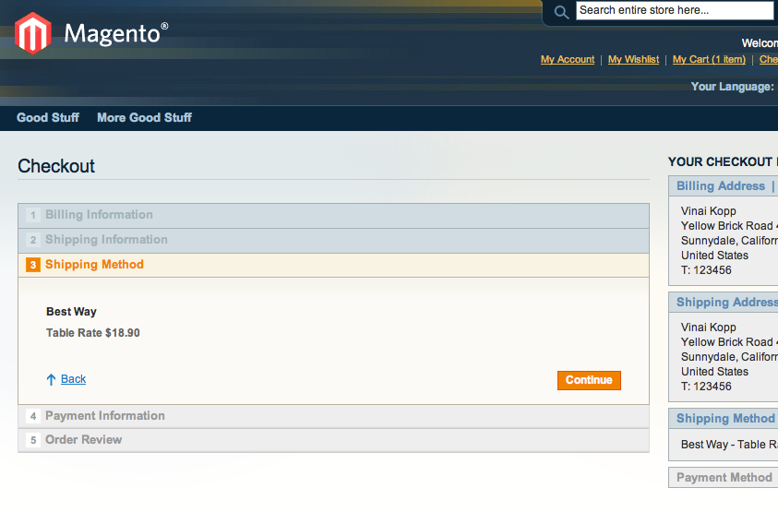
The One Page Checkout
Research shows fewer clicks mean more conversions
No choice, not even take-it-or-leave-it
Skip this step if possible

Slide 6
Objectives
Build a Magento extension
Customize the One Page Checkout
Follow best practices
Don’t modify core code (or a kitten dies)

Slide 7
What will we build today?
Tasks
Create a new extension
Configure a controller override
Hook into the flow of control
Add custom logic to check the number of shipping methods
Select a single shipping method automatically
Forward customer to the next checkout step

Slide 8
Lab 1 – Create a new module
Register our module
Create module directories
Create (empty) module configuration file
Begin Lab 1

Slide 9
Lab 2 – Rewrite the checkout
Add configuration XML to rewrite the OnepageController class
Create new (empty) controller class
Begin Lab 2

Slide 10
Lab 3 – Hook into the flow of control
Create the code for the replacement class
Begin Lab 3

Slide 11
Lab 4 – Check available shipping methods
Create a list of available shipping methods
Check if there is only one available
Begin Lab 4

Slide 12
Lab 5 – Skip the shipping method step
Select the only available shipping method
Forward the customer to the next step
Begin Lab 5

Slide 13
Recap
Extensions are modules (like the core)
Knowing the XML configuration is essential
Know the entity class modeling (C.R.U.D.)
Configuration based dependency injection (class rewrites)
Event observers (event listeners)
To customize Magento knowing where > knowing how

Slide 14
Other resources
Websites
Knowledge Base Articles http://www.magentocommerce.com/knowledge-base
Magento Answers http://www.magentocommerce.com/answers/
Magento Forums http://www.magentocommerce.com/boards/
Magento Connect Extension Marketplace http://www.magentocommerce.com/magento-connect
Blogs, tumblr, Stack Overflow, IRC, …

Slide 15
Magento U Training
Core Principals of Theming in Magento
Fundamentals of Magento Development
On Demand Video Training
http://www.magentocommerce.com/services/training

Slide 16
Contact
Vinai Kopp
eMail: vinai.kopp@magento.com
twitter: @VinaiKopp

Slide 17
Thank You

