Slide 1
PayPal Sandbox
Tips and Best Practices

Slide 2
Agenda
Setup PayPal Developer Account
Creating and Maintaining Test Accounts
Lab 1 – Construct my first SetExpressCheckout call
Lab 2 – Complete my first GetExpressCheckout call
Lab 3 – Construct my first DoExpressCheckout call
Lab 4 – Construct my first Pay call
Lab 5 – Construct my first PaymentDetails call

Slide 3
PayPal Developer Account
https://developer.paypal.com
Let’s walk through setting up your account now if you do not have one.
Encapsulates the Sandbox System
No real emails go out
Must login here first
Must precede all Sandbox PayPal site (including mobile) logins

Slide 4
PayPal Developer Account
Create as many test PayPal accounts as you need
Different types of accounts, different funding sources
Do not mix transaction activity across developer accounts
Developer account A has test account X
Developer account B has test account Y
Do not transact between test accounts X and Y

Slide 5
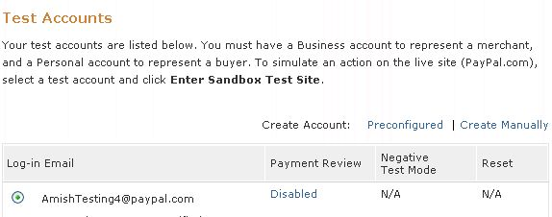
Creating and Maintaining Test Accounts
Preconfigured
Automatically setup with Bank Account, Credit Card, Balance
Create Manually
Use only for countries not supported by Preconfigured

Slide 6
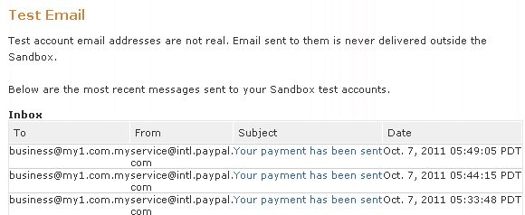
Creating and Maintaining Test Accounts
PayPal generated emails listed here
Plain text only, no HTML formatting

Slide 7
Lab 1 - Construct my first SetExpressCheckout call
Extract the GettingStarted.zip file
Extract all into the same folder where GettingStarted.zip exists
Start.php
Represents payment page that will post to Lab1.php
Lab1.php
All of the code necessary is there
Comments indicate the coding you would initiate
All static content in this lab code
Let’s walk through this now, line by line

Slide 8
Lab 2 - Construct my first GetExpressCheckout call
Lab2.php
Buyer lands here after completing flow on PayPal.com
Comments indicate the coding you would initiate
Your UI, be it desktop or mobile would present this data
Let’s walk through this now, line by line

Slide 9
Lab 3 - Construct my first DoExpressCheckout call
Lab3.php
Commits payment
Comments indicate the coding you would initiate
Required for PayPal to finalize payment
Let’s walk through this now, line by line

Slide 10
Lab 4 - Construct my first Pay call
Lab4.php
Pay API is part of Adaptive Payments service
Comments indicate the coding you would initiate
We will do a simple payment, easy to extend
Let’s walk through this now, line by line

Slide 11
Lab 5 - Construct my first PaymentDetails call
Lab5.php
PaymentDetails API is part of Adaptive Payments service
Comments indicate the coding you would initiate
Returns detailed payment information, most importantly the status
Let’s walk through this now, line by line

