Slide 1
Freemium to Premium: Monetizing with PayPal
Matt Cole
Integration Engineer, PayPal

Slide 2
Setup
paypal-dg-subscriptions.zip – please copy to your desktop
Text editor and WordPress required
Please ask TAs for instructions on setting up WordPress if you don't already have it installed
Windows XAMPP users: make sure cURL support is turned on!

Slide 3
About Me
Matt Cole
Originally from Lincoln, NE
Integration Engineer with PayPal for 2 years
Programmer for 20+ years

Slide 4


Objectives
Understand how to write WordPress plugins
Understand how to use hooks in WordPress
Working with PayPal API
Understand how Express Checkout works
Understand how Digital Goods Checkout works
Use jQuery/AJAX to dynamically modify content
+

Slide 5
What is WordPress?
Open source blogging tool and content management system
Written in PHP and uses MySQL for database storage
First released in 2003
Has been downloaded over 9 million times just since July 4th, 2011!
22 out of every 100 new active domains are running WordPress
Powers 14.9% of Alexa's top 1 million websites
The #1 content management software on the web today

Slide 6
How to Write a WordPress Plugin
WordPress scans the header of each file in its plugins folder to determine which PHP files contain plugins
Plugin Name is the only required piece of information <?php /* Plugin Name: Empty Plugin */ // This plugin does nothing! ?>

Slide 7
Using WordPress Hooks
Everything in WordPress is done through hooks
Main hook types:
Activation/Deactivation hooks
Action hooks
Filter hooks

Slide 8
Activation/Deactivation Hooks
Run when a plugin is activated/deactivated
Generally used to set up options or database tables that the plugin will need
Registered using register_activation_hook and register_deactivation_hook function myplugin_activate() { // Do stuff here! } register_activation_hook( __FILE__, 'myplugin_activate' );

Slide 9

Action Hooks
Run when something happens in WordPress
Examples:
admin_menu – Run when the user is viewing the admin panel. Useful for adding custom menu items to the admin panel.
wp_enqueue_scripts – Run when rendering the page header. Useful for adding JavaScript files or CSS files to a page.
wp_ajax_* – Run when WordPress's AJAX script is called. * is replaced with the "action" parameter from the HTTP request. Useful for defining custom AJAX actions
Registered using the add_action function add_action( 'admin_menu', 'setup_my_menus' );

Slide 10
Filter Hooks
Run when rendering different pieces of content
Allows you to modify how the page is rendered in real-time
Examples:
the_content – Applied to the content of posts before being displayed to the user.
the_title – Applied to the title of a post, before being displayed to the user.
Registered using the add_filter function add_filter( 'the_content', 'my_content_filter' );

Slide 11
Lab 1
Install the plugin
Make accommodations for PayPal-specific configuration information

Slide 12
Lab 1 Objectives
Learn how WordPress stores information
Install a plugin
Activate/deactivate a plugin
Run your first PayPal API call

Slide 13
Lab 1 – Install the plugin
Create a new "Premium Content" category
Install the plugin
Add the Premium Content category to the plugin's list of regulated categories
Create a sample post
We'll use this post to test our code throughout the rest of this workshop!
Verify that the content is blocked
Test out the subscription process
Unsubscribe
Deactivate the plugin

Slide 14
Lab 1 – Add PayPal-specific fields
Open paypal-dg-subscriptions.php
Add options for the API username, API password, API signature, Sandbox flag, and subscription name
Make sure you use pdgs_api_username, pdgs_api_password, and pdgs_api_signature for the option names for your API username, API password, and API signature
Add fields to the admin page to represent these options
If you'd like, include a block of text telling the user that they'll need API credentials from PayPal

Slide 15
Lab 1 – Add PayPal-specific fields
Collect and validate the information from the admin page
Update the options in WordPress's configuration
Run a GetPalDetails call to validate the API credentials
The pdgs_run_api_call function has been provided to you to help you run API calls.

Slide 16
End of Lab 1

Slide 17
Lab 2
Prepare the page for the Digital Goods Experience

Slide 18
Lab 2 Objectives
Add the PayPal button
Add PayPal's Digital Goods JavaScript
Use PayPal's Digital Goods JavaScript to open a lightbox and initiate a purchase

Slide 19


Lab 2 – Prepare for Digital Goods Experience
Remove the dummy subscription elements
Remove the "Click Here to Subscribe" link
Remove getPremiumContact JavaScript
Add the Digital Goods button
Add the Digital Goods JavaScript file
Create the DGFlow object
Add a function to display error messages
This will come in handy later

Slide 20
End of Lab 2

Slide 21
Lab 3
Get the buyer to PayPal

Slide 22
Lab 3 Objectives
Make a SetExpressCheckout API call
Redirect the buyer to PayPal
Add your first action

Slide 23
Lab 3 – Add the SetExpressCheckout Call
Add a function to run a SetExpressCheckout call and redirect the buyer to PayPal
SetExpressCheckout needs:
A return URL and cancel URL
For item purchases, a rough subtotal
For recurring payments, the recurring payments flag and a description of the recurring payment
For Digital Goods, line item details and the "Digital" item category flag

Slide 24
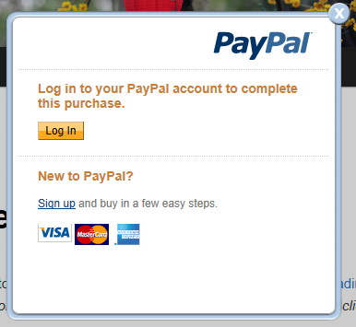
Lab 3 – Add the SetExpressCheckout Call
Tie the new function to an AJAX action using add_action
AJAX actions start with wp_ajax_
Make sure the PayPal pop-up appears

Slide 25
End of Lab 3

Slide 26
Lab 4
Handle what happens when the buyer returns from PayPal

Slide 27
Lab 4 Objectives
Make a DoExpressCheckoutPayment call
Make a CreateRecurringPaymentsProfile call
Make a RefundTransaction call
Learn how to interact with the parent page (the one underneath the lightbox)
Learn how to close the lightbox

Slide 28
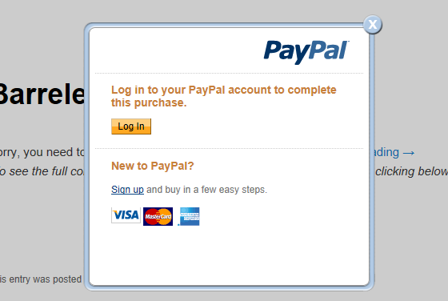
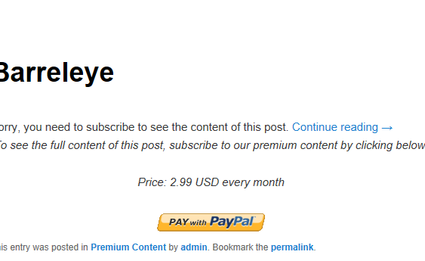
Lab 4 – Handle Checkout Cancellation
Add a function to close the lightbox
Tie the new function to an AJAX action
Make sure the lightbox closes when you close the PayPal pop-up

Slide 29
Lab 4 – Handle successful returns
Run the DoExpressCheckoutPayment call
DoExpressCheckoutPayment needs:
For item purchases, token, payer ID, and final amount
For Digital Goods, line item details and the "Digital" item category flag

Slide 30
Lab 4 – Handle successful returns
Run the CreateRecurringPaymentsProfile call
Why do it this way? Because we want to be sure the buyer has paid before delivering the content. CreateRecurringPaymentsProfile doesn't run a payment immediately, it just queues it up to be run later.
CreateRecurringPaymentsProfile needs:
Token
Payment period/frequency (e.g., every 1 months, every 5 weeks, etc.)
Payment amount
Starting date

Slide 31
Lab 4 – Handle successful returns
Run a RefundTransaction call if the CreateRecurringPaymentsProfile call fails
RefundTransaction needs:
Transaction ID from original transaction
Refund type (full or partial)
If partial refund is being given, amount to refund
Deliver the content
Close the lightbox
Closing the lightbox must be the last step in the process – you can't access your parent page after that!
Test your code – you should now have a fully functional checkout!

Slide 32
End of Lab 4

Slide 33
Lab 5
If the buyer cancels their subscription, cancel it on PayPal as well

Slide 34
Lab 5 Objectives
Run a ManageRecurringPaymentsProfileStatus call

Slide 35
Lab 5 – Add unsubscribe functionality
Add a ManageRecurringPaymentsProfileStatus call to pdgs_unsubscribe_user

Slide 36
End of Lab 5

Slide 37
Questions?

