Slide 1
XDevCAMP AuctionHouse Sample
Saleem Shafi

Slide 2
Agenda
Brief overview of X.commerce integration model
Overview of lab application
Labs
Lab 1: Setup the Fabric
Lab 2: Run AuctionHouse application
Lab 3: Create new capability
Lab 4: Register capability with the Fabric
Lab 5: Start Receiving Messages
Lab 6: Start Publishing Messages

Slide 3

Overview of X.commerce Integration
Point-to-Point
Async, Bi-directional
Multiple third-party integrators
Failure tolerance
Independent evolution, pluggability
HTTP + Avro serialization
Asynchronous, bi-directional messaging
De-centralized data

Slide 4
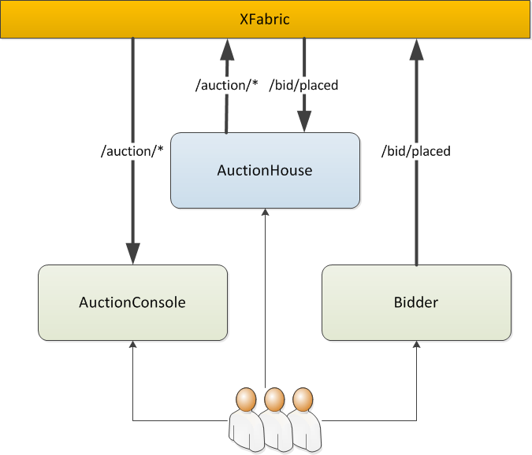
Overview of AuctionHouse application
AuctionHouse publishes new listings and processes bids
AuctionConsole displays auction messages
Bidder publishes bids
All systems are multi-tenant
Message routing: capability, topic, tenant

Slide 5
Labs
Lab 1: Setup the Fabric (5 min – Instructor Led)
Get the Fabric up and running locally
Lab 2: Run AuctionHouse application (10 min – Instructor Led)
Get provided version of AuctionHouse running and sending messages
Lab 3: Create new capability (15 min – Self-study)
Define your own capability
Lab 4: Register capability with the Fabric (10 min – Self-study)
Configure your capability within the Fabric
Lab 5: Start Receiving Messages (15 min – Self-study)
Build AuctionConsole to process incoming messages
Lab 6: Start Publishing Messages (15 min – Self-study)
Build Bidder to produce and publish messages
Notes:
Add separate slides for each lab that explains what just happened and maybe some tips for future work.

Slide 6
Lab notes
Notice the token in the authorization logic. See how it matches the XFABRIC_TOKEN for the capability in the Manager UI
After a bid, use the message GUID to find the message in the Manager UI for tracing
Trace the second bid and find the related outbid message and match it up with what’s going on in the AuctionConsole window

