Slide 1

WAP - Wireless Application Protocol
Goals
deliver Internet content and enhanced services to mobile devices and users (mobile phones, PDAs)
independence from wireless network standards
open for everyone to participate, protocol specifications will be proposed to standardization bodies
applications should scale well beyond current transport media and device types and should also be applicable to future developments
Platforms
e.g., GSM (900, 1800, 1900), CDMA IS-95, TDMA IS-136, 3rd
generation systems (IMT-2000, UMTS, W-CDMA, cdma2000 1x EV-DO, …)
Forum
was: WAP Forum, co-founded by Ericsson, Motorola, Nokia, Unwired Planet, further information www.wapforum.org
now: Open Mobile Alliance www.openmobilealliance.org (Open Mobile Architecture + WAP Forum + SyncML + …)
1
WAP - scope of standardization
Browser
“micro browser”, similar to existing, well-known browsers in the Internet
Script language
similar to Java script, adapted to the mobile environment
WTA/WTAI
Wireless Telephony Application (Interface): access to all telephone functions
Content formats
e.g., business cards (vCard), calendar events (vCalender)
Protocol layers
transport layer, security layer, session layer etc.
Prof. Dr.-Ing. Jochen Schiller, http://www.jochenschiller.de/
10.22

Slide 2
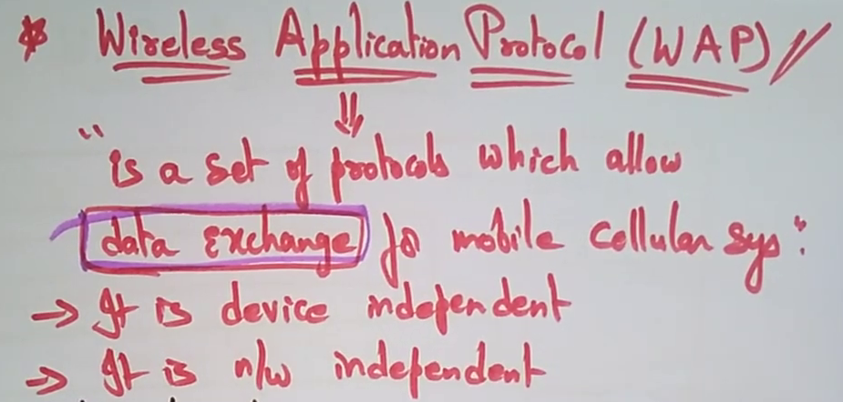
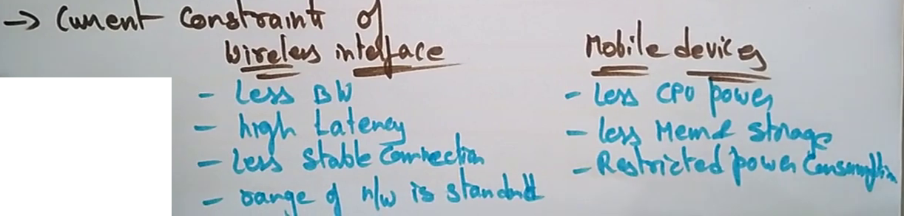

Slide 3
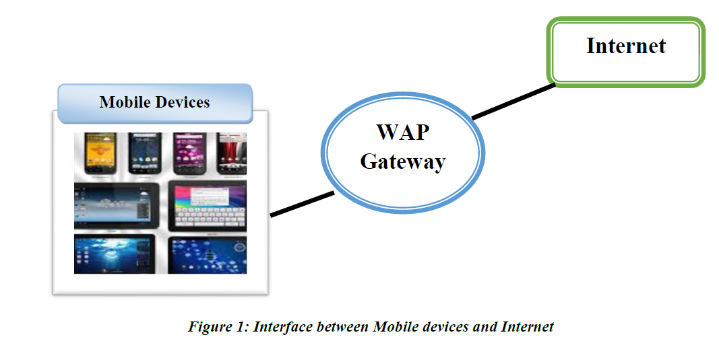

Slide 4
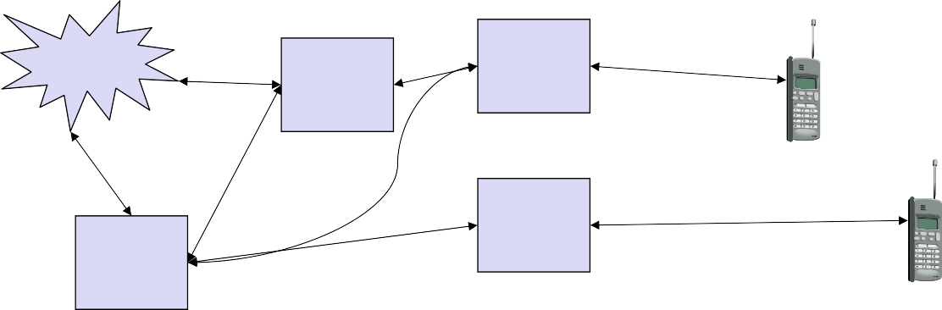
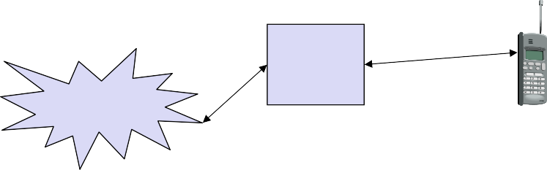
WAP 1.x - reference model and protocols
Internet WAP
A-SAP
HTML, Java Application Layer (WAE)
additional services and applications
HTTP
S-SAP
Session Layer (WSP)
TR-SAP
Transaction Layer (WTP)
SSL/TLS
SEC-SAP
Security Layer (WTLS)
TCP/IP, UDP/IP,
media
T-SAP
Transport Layer (WDP)
WCMP
Bearers (GSM, CDPD, ...)
WAE comprises WML (Wireless Markup Language), WML Script, WTAI etc.
WAP - network elements
fixed network
wireless network
Internet
HTML
WML
WAP
Binary WML
filter
proxy
HTML
HTML
WML
filter/
Binary WML
web server
HTML
WAP
proxy
WTA
Binary WML
server
PSTN
Binary WML: binary file format for clients
10.24

Slide 5


WDP - Wireless Datagram Protocol
Protocol of the transport layer within the WAP architecture
uses directly transports mechanisms of different network technologies
offers a common interface for higher layer protocols
allows for transparent communication using different transport technologies (GSM [SMS, CSD, USSD, GPRS, ...], IS-136, TETRA, DECT, PHS, IS-95,
...)
Goals of WDP
create a worldwide interoperable transport system with the help of WDP adapted to the different underlying technologies
transmission services such as SMS, GPRS in GSM might change, new services can replace the old ones
Additionally, WCMP (wireless Control Message Protocol) is used for control/error report (similar to ICMP in the TCP/IP protocol suite)
Prof. Dr.-Ing. Jochen Schiller, http://www.jochenschiller.de/
MC SS02
10.25
WDP - Service Primitives
T-DUnitdata.req
(DA, DP, SA, SP, UD)
T-SAP
T-SAP
T-DUnitdata.ind (SA, SP, UD)
T-DUnitdata.req
(DA, DP, SA, SP, UD)
T-DError.ind (EC)
Prof. Dr.-Ing. Jochen Schiller, http://www.jochenschiller.de/
10.26

Slide 6

Usage of WDP
WTLS
Wireless Data Gateway
WTLS
GSM-SMS
WTLS
WTLS
WDP &
Adaptation
WDP &
Adaptation
WDP &
Adaptation
WDP &
Adaptation
SMS
SMS
Tunnel
Tunnel
SMS
SMS
Tunnel
Tunnel
Subnetwork
Subnetwork
Subnetwork
Subnetwork
GSM-CSD
WAP
Proxy
WTLS
WTLS
WTLS
Internet Service Provider Remote Access Service
WTLS
UDP
UDP
UDP
UDP
IP
Interworking Function
IP
IP
IP
IP
IP
PPP
PPP
Subnetwork
Subnetwork
PPP
PPP
Subnetwork
Subnetwork
CSD-RF
CSD-RF
PSTN
Circuit
PSTN
Circuit
CSD-RF
CSD-RF
PSTN
Circuit
PSTN
Circuit
Prof. Dr.-Ing. Jochen Schiller, http://www.jochenschiller.de/
MC SS02
10.27
WTLS - Wireless Transport Layer Security
Goals
data integrity
prevention of changes in data
privacy
prevention of tapping
authentication
creation of authenticated relations between a mobile device and a server
protection against denial-of-service attacks
protection against repetition of data and unverified data
WTLS
is based on the TLS (Transport Layer Security) protocol (former SSL, Secure Sockets Layer)
optimized for low-bandwidth communication channels
Prof. Dr.-Ing. Jochen Schiller, http://www.jochenschiller.de/
10.28

Slide 7
Secure session, full handshake
originator SEC-SAP
peer SEC-SAP
SEC-Create.req
(SA, SP, DA, DP, KES, CS, CM)
SEC-Create.ind
(SA, SP, DA, DP, KES, CS, CM)
SEC-Create.res
(SNM, KR, SID, KES‘, CS‘, CM‘)
SEC-Exchange.req
SEC-Create.cnf
(SNM, KR, SID, KES‘, CS‘, CM‘)
SEC-Exchange.ind
SEC-Exchange.res (CC)
SEC-Commit.req
SEC-Exchange.cnf (CC)
SEC-Commit.ind
SEC-Commit.cnf
Prof. Dr.-Ing. Jochen Schiller, http://www.jochenschiller.de/
MC SS02
10.29
SEC-Unitdata - transferring datagrams
sender SEC-SAP
receiver SEC-SAP
SEC-Unitdata.req (SA, SP, DA, DP, UD)
SEC-Unitdata.ind (SA, SP, DA, DP, UD)
Prof. Dr.-Ing. Jochen Schiller, http://www.jochenschiller.de/
10.30

Slide 8
WTP - Wireless Transaction Protocol
Goals
different transaction services, offloads applications
application can select reliability, efficiency
support of different communication scenarios
class 0: unreliable message transfer
class 1: reliable message transfer without result message
class 2: reliable message transfer with exactly one reliable result message
supports peer-to-peer, client/server and multicast applications
low memory requirements, suited to simple devices (< 10kbyte )
efficient for wireless transmission
segmentation/reassembly
selective retransmission
header compression
optimized connection setup (setup with data transfer)
Prof. Dr.-Ing. Jochen Schiller, http://www.jochenschiller.de/
MC SS02
10.31
Details of WTP I
Support of different communication scenarios
Class 0: unreliable message transfer
Example: push service
Class 1: reliable request
An invoke message is not followed by a result message
Example: reliable push service
Class 2: reliable request/response
An invoke message is followed by exactly one result message
With and without ACK
Example: typical web browsing
No explicit connection setup or release is available Services for higher layers are called events
Prof. Dr.-Ing. Jochen Schiller, http://www.jochenschiller.de/
10.32

Slide 9
Details of WTP II
Used Mechanisms
Reliability
Unique transaction identifiers (TID)
Acknowledgements
Selective retransmission
Duplicate removal
Optional: concatenation & separation of messages
Optional: segmentation & reassembly of messages
Asynchronous transactions
Transaction abort, error handling
Optimized connection setup (includes data transmission)
Prof. Dr.-Ing. Jochen Schiller, http://www.jochenschiller.de/
MC SS02
10.33
WTP Class 0 transaction
initiator TR-SAP
responder TR-SAP
TR-Invoke.req
(SA, SP, DA, DP, A, UD, C=0, H)
TR-Invoke.ind
(SA, SP, DA, DP, A, UD, C=0, H‘)
Invoke PDU
Prof. Dr.-Ing. Jochen Schiller, http://www.jochenschiller.de/
10.34

Slide 10
WTP Class 1 transaction, no user ack & user ack
initiator TR-SAP
responder TR-SAP
TR-Invoke.req
(SA, SP, DA, DP, A, UD, C=1, H)
TR-Invoke.ind
(SA, SP, DA, DP, A, UD, C=1, H‘)
Invoke PDU
TR-Invoke.cnf (H)
Ack PDU
initiator TR-SAP
responder TR-SAP
TR-Invoke.req
(SA, SP, DA, DP, A, UD, C=1, H)
TR-Invoke.ind
(SA, SP, DA, DP, A, UD, C=1, H‘)
TR-Invoke.res (H‘)
Invoke PDU
TR-Invoke.cnf (H)
Ack PDU
Prof. Dr.-Ing. Jochen Schiller, http://www.jochenschiller.de/
MC SS02
10.35
WTP Class 2 transaction, no user ack, no hold on
initiator TR-SAP
responder TR-SAP
TR-Invoke.req
(SA, SP, DA, DP, A, UD, C=2, H)
TR-Invoke.ind
(SA, SP, DA, DP, A, UD, C=2, H‘)
TR-Result.req (UD*, H‘)
Invoke PDU
TR-Invoke.cnf (H)
TR-Result.ind (UD*, H)
TR-Result.res (H)
Result PDU
Ack PDU
TR-Result.cnf (H‘)
Prof. Dr.-Ing. Jochen Schiller, http://www.jochenschiller.de/
10.36

Slide 11
WTP Class 2 transaction, user ack
initiator TR-SAP
responder TR-SAP
TR-Invoke.req
(SA, SP, DA, DP, A, UD, C=2, H)
TR-Invoke.ind
(SA, SP, DA, DP, A, UD, C=2, H‘)
TR-Invoke.res (H‘)
TR-Result.req (UD*, H‘)
Invoke PDU
TR-Invoke.cnf (H)
TR-Result.ind (UD*, H)
TR-Result.res (H)
Ack PDU
Result PDU
Ack PDU
TR-Result.cnf (H‘)
Prof. Dr.-Ing. Jochen Schiller, http://www.jochenschiller.de/
MC SS02
10.37
WTP Class 2 transaction, hold on, no user ack
initiator TR-SAP
responder TR-SAP
TR-Invoke.req
(SA, SP, DA, DP, A, UD, C=2, H)
TR-Invoke.ind
(SA, SP, DA, DP, A, UD, C=2, H‘)
Invoke PDU
TR-Invoke.cnf (H)
TR-Result.ind (UD*, H)
TR-Result.res (H)
Ack PDU
TR-Result.req (UD*, H‘)
Result PDU
Ack PDU
TR-Result.cnf (H‘)
Prof. Dr.-Ing. Jochen Schiller, http://www.jochenschiller.de/
10.38

Slide 12
WSP - Wireless Session Protocol
Goals
HTTP 1.1 functionality
Request/reply, content type negotiation, ...
support of client/server, transactions, push technology
key management, authentication, Internet security services
session management (interruption, resume,...)
Open topics
QoS support)
Group communication
Isochronous media objects
management
Prof. Dr.-Ing. Jochen Schiller, http://www.jochenschiller.de/
MC SS02
10.39
WSP protocols
WSP
Connection mode (uses WTP)
Connectionless mode (uses WDP or WTLS)
Session Management (class 0, 2)
Method Invocation (Kl. 2)
Error Report
Push (class 0)
Confirmed Push (class 1)
Session suspend/resume (class 0, 2)
Method Invocation
Push
(in general unreliable)
Prof. Dr.-Ing. Jochen Schiller, http://www.jochenschiller.de/
10.40

Slide 13
WSP/B session establishment
client S-SAP
server S-SAP
S-Connect.req (SA, CA, CH, RC)
S-Connect.ind (SA, CA, CH, RC)
S-Connect.res (SH, NC)
Connect PDU
S-Connect.cnf (SH, NC)
ConnReply PDU
WTP Class 2 transaction
Prof. Dr.-Ing. Jochen Schiller, http://www.jochenschiller.de/
MC SS02
10.41
WSP/B session suspend/resume
client S-SAP
server S-SAP
S-Suspend.req
S-Suspend.ind (R)
S-Suspend.ind (R)
Suspend PDU
WTP Class 0 transaction
S-Resume.req (SA, CA)
~
~
S-Resume.ind (SA, CA)
S-Resume.res
Resume PDU
S-Resume.cnf
Reply PDU
WTP Class 2 transaction
Prof. Dr.-Ing. Jochen Schiller, http://www.jochenschiller.de/
10.42

Slide 14
WSP/B session termination
client S-SAP
server S-SAP
S-Disconnect.req (R)
S-Disconnect.ind (R)
S-Disconnect.ind (R)
Disconnect PDU
WTP Class 0 transaction
Prof. Dr.-Ing. Jochen Schiller, http://www.jochenschiller.de/
MC SS02
10.43
WSP/B method invoke
client S-SAP
server S-SAP
S-MethodInvoke.req (CTID, M, RU)
S-MethodInvoke.ind (STID, M, RU)
S-MethodInvoke.res (STID)
S-MethodResult.req (STID, S, RH, RB)
Method PDU
S-MethodInvoke.cnf (CTID)
S-MethodResult.ind (CTID, S, RH, RB)
S-MethodResult.res (CTID)
Reply PDU
S-MethodResult.cnf (STID)
WTP Class 2 transaction
Prof. Dr.-Ing. Jochen Schiller, http://www.jochenschiller.de/
10.44

Slide 15
WSP/B over WTP - method invocation
client S-SAP
initiator TR-SAP
responder TR-SAP
server S-SAP
S-MethodInvoke.req TR-Invoke.req
Invoke(Method)
TR-Invoke.ind S-MethodInvoke.ind
TR-Invoke.res S-MethodInvoke.res
S-MethodInvoke.cnf
TR-Invoke.cnf
Ack PDU
Result(Reply)
TR-Result.req S-MethodResult.req
S-MethodResult.ind
TR-Result.ind
S-MethodResult.res
TR-Result.res
Ack PDU
TR-Result.cnf S-MethodResult.cnf
Prof. Dr.-Ing. Jochen Schiller, http://www.jochenschiller.de/
MC SS02
10.45
WSP/B over WTP - asynchronous, unordered requests
client S-SAP
server S-SAP
S-MethodInvoke_1.req S-MethodInvoke_2.req
S-MethodInvoke_2.ind S-MethodInvoke_1.ind S-MethodResult_1.req S-MethodInvoke_3.ind
S-MethodResult_3.req S-MethodResult_2.req
S-MethodInvoke_3.req
S-MethodResult_1.ind S-MethodResult_3.ind S-MethodInvoke_4.req
S-MethodResult_4.ind S-MethodResult_2.ind
S-MethodInvoke_4.ind S-MethodResult_4.req
Prof. Dr.-Ing. Jochen Schiller, http://www.jochenschiller.de/
10.46

Slide 16
WSP/B - confirmend/non-confirmed push
client S-SAP
server S-SAP
S-Push.req (PH, PB)
S-Push.ind (PH, PB)
Push PDU
WTP Class 0 transaction
client S-SAP
server S-SAP
S-ConfirmedPush.req (SPID, PH, PB)
S-ConfirmedPush.ind (CPID, PH, PB)
S-ConfirmedPush.res (CPID)
ConfPush PDU
S-ConfirmedPush.cnf (SPID)
WTP Class 1 transaction
Prof. Dr.-Ing. Jochen Schiller, http://www.jochenschiller.de/
MC SS02
10.47
WSP/B over WDP
S-Unit-MethodInvoke.req (SA, CA, TID, M, RU)
client S-SAP
server S-SAP
S-Unit-MethodInvoke.ind (SA, CA, TID, M, RU)
S-Unit-MethodResult.req (CA, SA, TID, S, RH, RB)
Method PDU
S-Unit-MethodResult.ind (CA, SA, TID, S, RH, RB)
Reply PDU
S-Unit-Push.req
(CA, SA, PID, PH, PB)
S-Unit-Push.ind
(CA, SA, PID, PH, PB)
Push PDU
WDP Unitdata service
Prof. Dr.-Ing. Jochen Schiller, http://www.jochenschiller.de/
10.48

Slide 17
WAE - Wireless Application Environment
Goals
network independent application environment for low-bandwidth, wireless devices
integrated Internet/WWW programming model with high interoperability
Requirements
device and network independent, international support
manufacturers can determine look-and-feel, user interface
considerations of slow links, limited memory, low computing power, small display, simple user interface (compared to desktop computers)
Components
architecture: application model, browser, gateway, server
WML: XML-Syntax, based on card stacks, variables, ...
WMLScript: procedural, loops, conditions, ... (similar to JavaScript)
WTA: telephone services, such as call control, text messages, phone book, ... (accessible from WML/WMLScript)
content formats: vCard, vCalendar, Wireless Bitmap, WML, ...
Prof. Dr.-Ing. Jochen Schiller, http://www.jochenschiller.de/ MC SS02 10.49
WAE logical model
Origin Servers
Gateway
Client
web server
response with content
encoded response with content
WTA
user agent
encoders & decoders
other content server
WML
user agent
push content
encoded push content
other WAE
user agents
request
encoded request
Prof. Dr.-Ing. Jochen Schiller, http://www.jochenschiller.de/
10.50

