Slide 1
Collections Analytics Generation Engine
(CAGE)

Slide 2
Need for CAGE
Observations:
  High Cost Actions (Agency, Repossession, Legal) probably leads to faster collections
  Low Cost Actions (Notifications) may lead to delay in collections
  Sequential execution of Actions based on cost may delay collections
Two Identified Problems to Solve:
  Problem Statement 1: (What Channel)
    To Identify Customers who would respond/pay to Low Cost Actions
    To Identify Customers who would respond/pay only to High Cost
  Problem Statement 2: (Whom to Prioritize)
      With limited Resources (Tele-Callers, Budgets to spend on Agency Commission), whom do we focus first

Slide 3
Predictive Analytics
Machine Learning Model 1:
Problem Statement: What is the most efficient collections channel, that will be cost effective, will help collect faster and
will help collect more
Solution: Use the Follow-up/Collections Action history and Cure data.
Last Collections Channel resulting in Account cure is considered most effective
Machine Learning models to predict for existing and a first-time defaulters
Existing Data:
Customer Data (from loan origination system)
Application Data (from loan origination system)
Debt Collections Data
  Action Dates/Time
  Overdue Days when Action Taken
  Cure Dates / Payment Dates / Payment Amount
  Days between Cure and Action
Collections Channel:
Self Cure: Pays within 5 days of Delinquency, with or without reminders
Digital Channel – Pays after SMS, Emails, Voice & Chat Bots, WhatsApp, Voice Blast reminders
Pays after Tele Calling
Pays after Field Visit by External Agency
Pays after Legal Collections Actions

Slide 4
Predictive Analytics
Existing Data:
Customer Profile (from LOS)
Application Profile (From LOS)
Ability Score
  Customers re-payment History patterns
  (High Ability – Max Bucket History not greater than 1 or 2, Check )
Willingness Score
  Analyze other account of customers
  (Low Willingness – If other accounts are written off or > 4 buckets or Paid after Legal/Field)
Propensity Score: Models to determine propensity based on Ability and Willingness of the customer to re-pay the overdue amount
Machine Learning Model 2:
Problem Statement: Which accounts should we Action first, so that we make best use of available scare resources
Solution: Analyze the Ability and Willingness of the customer, to know the probability of customer Paying
Machine Learning models to predict payment propensity for existing and the first timer customers in Debt Collections
Propensity Score on Tele Calling:
High Propensity – (Business Strategy) Tele Calling
Medium Propensity – (Business Strategy) Intensify Digital Collections
Propensity Score on Field Collections:
High Propensity – (Business Strategy) Tele Calling first (Try to collect as much, to reduce field collections cost)
Medium & Low Propensity – (Business Strategy) Field Collections
Left over of High Propensity – (Business Strategy) Field Collections

Slide 5
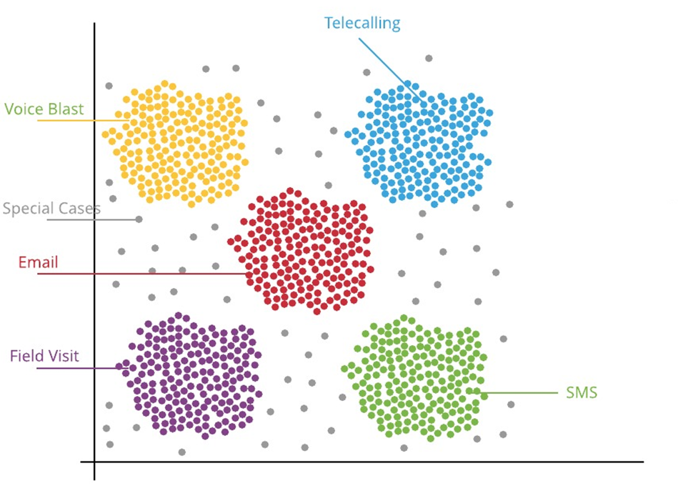


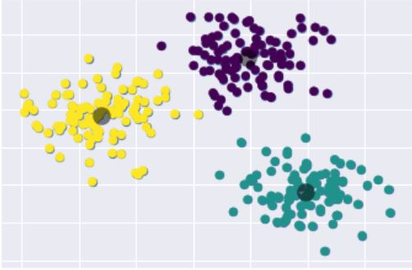







Recommend Optimum Collections Channel (through Classification)
Possible
Next Channel
Best Possible
Channel

Slide 6
Predictive Analytics – Technically Explained
Business Understanding
Define problem statement --
What is the most efficient collections channel, that will be cost effective, will help collect faster and will help collect more
Data Mining
Process to discovering patterns from --Application Data, Demographics, Family, Employment Details, Financial Details, Property details, Channels/Source of leads, Legal Factors, Market conditions
Customer Behavior: Transaction/Payment/Usage pattern, Collections behavior
Data Cleaning
Handling missing, duplicate values, treat NA values in the data set.
Data Exploration
Analyze the correlation, feature scaling and apply different data normalization techniques. on different variable, and the attributes of variables which have more weightage , sampling, transformation of data.
Feature Engineering
Get the insights from the EDA process, to identify the different variables, these feature variables can be used to improve the performance measure criteria. Apply Imputation, Handling outliers, Binning, Log transform, one-hot encoding etc.
Predictive Modeling & Visualization
Build the different models like - Logistic Regression, Decision Tree, Random Forest etc. Measure the performance of the models using metrics (Confusion Matrix, RMSE, Precision & Recall, accuracy score etc.)

Slide 7
High Level Plan ( 8 to 10 weeks)
Workshop ( 2 Days)
- Meeting Stake holders
- Review on the Problem Statements
- KPI & Success definition
- Data Insights with Business
- Discussion with IT team on Data Requirements / Data anonymization
High Level Design & Plan ( 1 week)
- Share high level Design and Project plan
- Share Detailed Data requirements
Data Exploration ( 4 weeks)
- Slice the data in different ways
- Counts, Graphs, distribution, histograms
Modelling (2 weeks)
Build ETL, Train Models, Evaluate Models with different metrices & baselines, Sanity check of the Models
Productization (2 weeks)
Configuration / Customization requirements in Collection product,
Production Movement
(2 days)
Production Usage of Models
Result Review & Model Optimization
Review model performance,
Recalibration requirements to be assessed
Overall 2 to 3 weeks

Slide 8
Implementation of Analytics in Debt Collections
Create 2 UDF in Collections System - Collections Channel & Propensity to Pay
The Machine learning model will provide:
  “Collections Channel“ for accounts with DPD >0 and <= 3
  “Propensity to Pay” for all Accounts
Accounts will be updated with the values provided by the Model
For an existing Collections Segment – Create a Challenger Segment with 10% random accounts in it
On Challenger Segment:
  follow Strategy - “Collections Channel” as suggested by Model
    Self cure accounts – Need no action
    Digital Collections – Automated Notifications
    Tele-Calling
    Field Collections
  Implement Prioritization Rules based on “Propensity to Pay”
Month End Report to compare Champion and Challenger for Bucket 1 (DPD 1-30)
  Compare Cost of Collections versus Collections
  % of Cure
  % of Flow to Bucket 2 (DPD 31-60)
  Time to Collect Indicators
Model Performance Assessment
  On the Challenger Segment: Validate the Models for Accuracy on “Collections Channel”
  On the Entire base validate the “Propensity to Pay”
  Re-calibrate as necessary to fine tune the Models

Slide 9
Commercials
Professional Services | Amount (INR)
License - Collections Analytics Generation Engine (CAGE) | Free of Cost
Professional Fees for Delivery of Models | Free of Cost
Implementation of Models in Ebix Debt Collections Configuration & Integration Testing Support | Free of Cost
Post-Production Model Assessment- 3 months | Free of Cost
4th Month onwards AMC (Quarterly Mode Assessment and Recalibration) | 8 Lakhs per year
Travel & Living Expense | Approx. 1 to 1.5 Lakhs (billed at actuals)

Slide 10
T H A N K Y O U

