Slide 1

#LifeKoKaroLift
Data Science Program

Slide 2


Course : Data Science
Lecture On : EDA: QnA
Instructor : Sumit Shukla

Slide 3
Topics:
1
How to impute missing values
2
Data Imbalance
3
QNA

Slide 4
Missing Value Imputation
In reality, Imputing a missing value is not a easy task and there is no best method available in our Data Science world that can actually take care of missing value imputation. When we talk about imputing a missing value, we are actually adding some biase to the data and this can lead to biased results.
Why Data is missing?
Due to failure of device that collects it: Example Telecom
Due to non-availability of the field: Example: Filling up a online form.
Due to merging multiple files.
Due to data transfer.
Due to non-supported unicode: Example: Hindi Language
What to do when data is missing? Let’s try to answer this question.

Slide 5
Missing Value Imputation
Do Nothing.
Some algorithms available are well capable of handling missing values. They remove them first then run the model, predict the missing values, impute them and then run the final model. Xgboost, LightGBM. But SKLearn needs data cleaned with no missing values.
Removing or Dropping the missing values.
It’s good to remove missing values, but not always. We should only remove the missing values when:
If the data available for analysis is limited. Remember huge data means great results.
If the column doesn’t make any business sense.
Should we drop a column with more than 20% to 30% missing values? Well, it totally depends on the case to case. Suppose there is column ‘X’ with 50% missing values and you think that the column is super important for the analysis, then please don’t drop the column.We have to impute it.
I have seen cases where after imputing the results we great. The titanic problem in Kaggle has variable age which has around 20% missing values, but we considered it and imputed it.

Slide 6
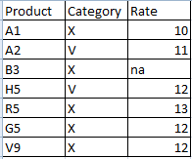
Missing Value Imputation
Imputing with mean, median.
Now this is the laziest method out of all the methods available. What we do here is we basically impute the missing values by the mean or media of the column.
The method is easy for data science beginners but not for experts.
Not good for Huge datasets as it reduces the variance of the data.
It doesn’t consider the impact of other variables or columns.
Intelligent method to impute by mean/median.
There is one missing value for product ‘B3’ but it belong to category ‘X’,
So we should take the mean of X category and use it to impute the ‘NA’

Slide 7
Missing Value Imputation
Imputing with mode.
This is used when we have missing value for categorical data. We take the count of each category present in our column and then impute the missing value with the category with the highest count. Is the method biased?
When to use mean vs median?
Mean should be used when the data is free from outliers. If there are outliers your mean value will be not correct. Media should be used if the column consist of so many outliers.
Intelligent way?
Mode: Divide the data into top level category and then check for mode.
Mean VS Median: If there are outliers: Divide the data and then calculate the mean.

Slide 8
Missing Value Imputation
When to impute with ZERO?
We tend to consider a missing value as 0 for most of the cases, but it’s not true always. Be very careful while imputing a missing with 0. If the minimum value is zero, then we can impute zero. If your are super sure that a missing is a zero.
Smart Ways:
Linear Regression
KNN
MICE

Slide 9
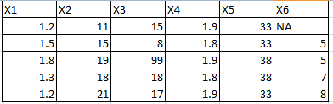
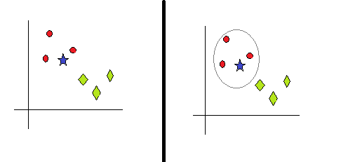
Missing Value Imputation
Linear Regression:
Find the highly correlated variables with X6
Use them to model the missing value.
Say B1, B2 and B3 are selected
X6 = B0+B1X1+B2X2+B3X3
KNN:

Slide 10
Missing Value Imputation
Multivariate Imputation by Chained Equation (MICE):
This technique imputes the missing value multiple times and measures the goodness of imputed values.
MICE uses chained equations to carry out the process. Multiple Linear regression models are used to predict the missing values.

Slide 11
Data Imbalance
What is Data Imbalance:
Classification task: Data with more number of one class than other. Suppose there are 100 rows in data with 80 rows labelled as class 1 and 20 as class 2. Now this data is imbalanced.
How to handle it?
Oversampling
Let the algorithm handle it: Penalize algo(class_weight = ‘balanced’)
Use Tree based algorithms: Random forest.

Slide 12
EDA Steps
How to proceed with EDA?
Data Collection
Data Cleaning
  Missing values
  outliers
  Duplicate values
  Incorrect data types
Uni-variate analysis – one variable/column analysis
Bi-variate analysis – pair of columns analysis (correlation between variables)
Derived metrics – adding extra column for analysis(If required)

Slide 13
#LifeKoKaroLift
Thank You!

