Slide 1
Collections Analytics Generation Engine
(CAGE)

Slide 2
Approach for Implementing Predictive Analytics
Debt Collections Observations:
  Low Cost Actions leads to delay in Collections
  High Cost Leads to collect Faster
  Following Actions sequentially based on cost i.e. delaying high cost actions, would not only delay Collections but may lead to Customers non ability to pay
  Problem Statement 1: (What Channel)
    To Identify Customers who would respond/pay to Low Cost Actions
    To Identify Customers who would respond/pay only to High Cost
    Problem Statement 2: (Whom to Prioritize)
      With limited Resources (Tele-Callers, Budgets to spend on Agency Commission), whom do I focus first and what Action combination to perform

Slide 3
Predictive Analytics
Existing Data:
Customer Profile (from LOS)
Application Profile (From LOS)
Collections Channels
  Days Past Due
  Action Dates/Time
  Overdue Days when Action Taken
  Cure Dates / Payment Dates / Payment Amount
  Days between Cure and Action
  Cost of this Action
  Channel Score
Channel Score: Analytics to determine most cost-effective Action, that would yield a fastest cure on the Account..
Machine Learning Model 1:
Problem Statement: What is the most efficient collections channel, that will be cost effective, will help collect faster and
will help collect more
Solution: Use the Follow-up/Collections Action History, Payment Data to analyze what Actions are effective on which groups of customers
Machine Learning models to predict for existing and a first timer in Debt collections, what should be the Most Effective Collections Channel
Collections Channel:
Self Cure: Pays within 5 to 8 days of Delinquency, with or without reminders
Digital Channel – SMS, Emails, Voice & Chat Bots, WhatsApp, Voice Blast
Tele Calling
Field Visit by External Agency
Legal Collections

Slide 4
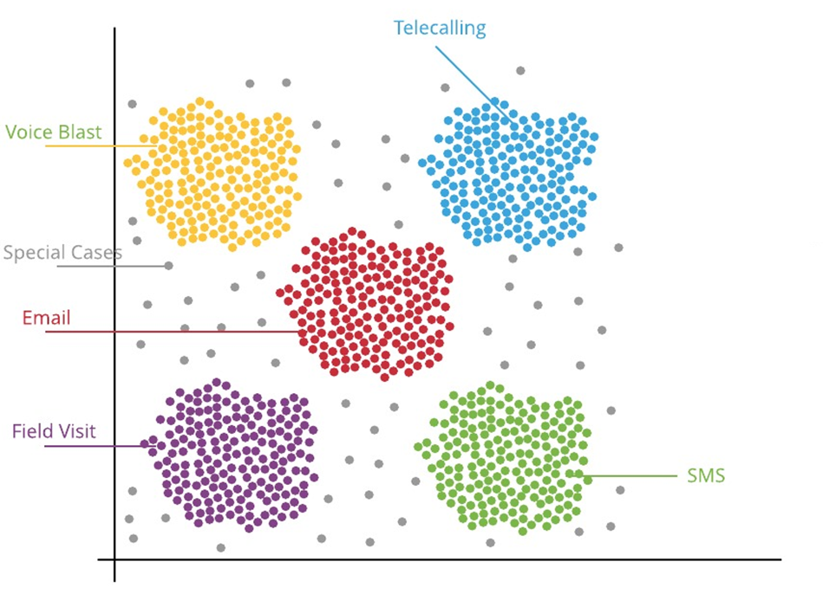


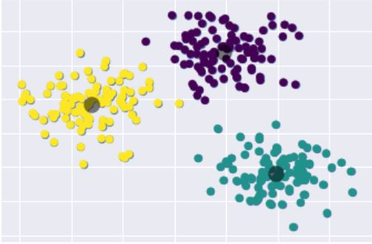







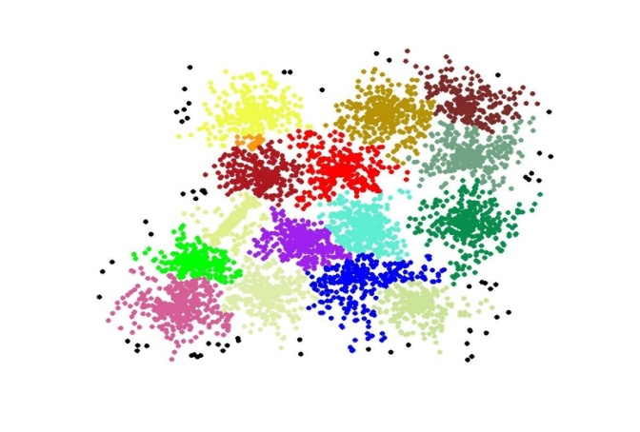








Recommended Optimum Collections Channel (through Classification)
Possible Next Actions
Best Possible Action
Possible Allocation Options
Best Possible Collector

Slide 5
Recommended Optimum Strategy (…2 of 2)
IMPROVED CUSTOMER EXPERIENCE
REDUCED COST OF COLLECTION
  OPERATIONAL EFFICIENCY
  INCREASED AND FASTER RECOVERIES

Slide 6
Predictive Analytics
Existing Data:
Customer Profile (from LOS)
Application Profile (From LOS)
Ability Score
  Debt Service coverage ratio
  Other Customer Demographic, Financial, Social Parameters
Willingness Score
  Credit Bureau Score
  Repayment behavior/track with bank
  Collections behavior with bank in past
Propensity Score: Models to determine propensity based on Ability and Willingness of the customer to re-pay the overdue amount
Machine Learning Model 2:
Problem Statement: Maximization of existing Resources.
From the Tele-Calling and/or Field Collections, with limited Tele-calling staff / Field Collections expense budgets, which cases should I prioritize for Tele-calling/agency allocation so that the Collections Increases
Solution: Analyze the Ability and Willingness of the customer, to know the probability of customer Paying
Machine Learning models to predict for existing and the first timer in Debt Collections, what would be the payment propensity for prioritization of actions
Propensity Score on Tele Calling:
High Propensity – (Business Strategy) Tele Calling
Medium Propensity – (Business Strategy) Intensify Digital Collections
Propensity Score on Field Collections:
High Propensity – (Business Strategy) Tele Calling first (Try to collect as much, to reduce field collections cost)
Medium & Low Propensity – (Business Strategy) Field Collections
Left over of High Propensity – (Business Strategy) Field Collections

Slide 7
Predictive Analytics – Technically Explained
Business Understanding
What is the most efficient collections channel, that will be cost effective, will help collect faster and will help collect more
Data Mining
Application Data, Demographics, Family, Employment Details, Financial Details, Property details, Channels/Source of leads, Legal Factors, Market conditions
Customer Behavior: Transaction/Payment/Usage pattern, Collections behavior
Data Cleaning
Handling missing values, treat NA values, duplicate values in the data set
Data Exploration
To find out the different variable correlation, along with the attributes of variables which have more weightage using different exploration methods.
Feature Engineering
Get the insights from the EDA process, to identify the different variables and there scaling range for feature engineering.
Predictive Modeling & Visualization
Build the different models like - Logistic Regression, Decision Tree, Random Forest etc. Major the performance of the models using metrics (Confusion Matrix, RMSE, Precision & Recall, accuracy score etc.)

Slide 8
High Level Plan ( 3 to 4 months including assessment)
Overall 6 to 8 weeks
Workshop ( 2 Days)
- Meeting Stake holders
- Review on the Problem Statements
- KPI & Success definition
- Data Insights with Business
- Discussion with IT team on Data Requirements / Data Security matters
High Level Design & Plan ( 1 week)
Share high level Design and Project plan
Share Data requirements
Data Exploration ( 2 weeks)
- Slice the data in different ways
- Counts, Graphs, distribution, histograms
Modelling ( 6 weeks)
Build ETL, Train Models, Evaluate Models with different metrices & baselines, Sanity check of the Models
Product Planning ( 1 weeks)
Configuration / Customization requirements in Collection product
Productization ( 5 weeks)
Code Development / Configuration, Review,
Optimization,
Testing ( 2 weeks)
Deployment of Models & Code / Configuration and Testing for acceptance & regressions
Production Movement (1 Week)
Production Usage of Models
Result Review & Model Optimization ( Monthy)
(monthly activity)
Review model performance
Recalibration requirements to be assessed

Slide 9
Commercials
 | Amount (INR)
License - Collections Analytics Generation Engine (CAGE) | Free of Cost
Professional Fees for Delivery of Models | Free of Cost
Implementation of Models in Ebix Debt Collections Configuration & Integration Testing Support | 2.5 Lakhs
Post-Production Model Assessment- 3 months | Free of Cost
4th Month onwards AMC | 2.5 Lakhs per year
Travel & Living Expense | At Actuals

Slide 10
T H A N K Y O U

