Slide 1
Unit 1: Number Systems & Codes · Boolean Algebra & Logic Gates
1
Digital Logic Design
CHANDRAS EDU
Never stop learning
Notes:
Welcome to Unit 1 of Digital Logic Design. This unit covers number systems and codes, then Boolean algebra and logic gates.

Slide 2
Outline
1.1 Number Systems: Binary, Octal, Decimal, Hexadecimal
1.2 Fixed-Point & Floating-Point Representation
1.3 Complements of Numbers
1.4 Error Detection & Correction: Parity, Hamming Code
1.5 Boolean Algebra: Axioms, Theorems & Properties
1.6 Boolean Functions: Canonical & Standard Forms
1.7 Digital Logic Gates Overview
Notes:
Seven topics in order. The first four cover number systems, complements and codes, and the last three cover Boolean algebra, canonical forms and logic gates.

Slide 3
1.1 Number Systems: Binary, Octal, Decimal, Hexadecimal
Topic 1.1
IN SIMPLE TERMS
Every number system multiplies each digit by the base raised to its position; binary, octal and hex are just different bases, and octal and hex are shorthand for groups of 3 or 4 bits.
Notes:
Every digital circuit works with two voltage levels, but the numbers it represents need not be written in binary. This topic covers four number systems and how to convert between them. Read the box aloud and ask students to restate it in their own words.

Slide 4
Positional number systems
Topic 1.1
All four systems are positional (radix) systems: a digit’s value depends on the digit and on its position
A system with radix (base) r uses r digit symbols, 0 through r − 1
A number is a weighted sum of powers of r: N = Σ d_{i} × r^{i}
d_{i} is the digit at position i, counting from 0 at the radix point going left
This one formula covers all four systems: only r changes
Notes:
The single formula is the key to every conversion in this topic. Work out 1011 in binary using this formula on the board.

Slide 5
The four number systems
Topic 1.1
System | Radix | Digit set
Decimal | 10 | 0–9
Binary | 2 | 0, 1
Octal | 8 | 0–7
Hexadecimal | 16 | 0–9, A–F (A = 10 … F = 15)
Notes:
Hexadecimal uses the letters A to F for the values 10 to 15. Octal and hexadecimal are mainly shorthand for binary.

Slide 6
Why octal and hexadecimal?
Topic 1.1
Octal and hexadecimal exist purely for human convenience
No circuit computes in base 8 or base 16 internally
3 binary digits map exactly onto 1 octal digit
4 binary digits map exactly onto 1 hex digit
Long bit strings become far easier to read and write without losing the binary structure
Notes:
The grouping idea is used in the last conversion method of this topic. Hardware stays binary; only people use the shorthand.

Slide 7
Converting any base to decimal
Topic 1.1
1011₂ = 1×2³ + 0×2² + 1×2¹ + 1×2⁰ = 8 + 0 + 2 + 1 = 11₁₀
2AF₁₆ = 2×16² + A×16¹ + F×16⁰
= 2×256 + 10×16 + 15×1 = 512 + 160 + 15 = 687₁₀
Directly apply the weighted-sum formula, evaluating in decimal
Notes:
The first line is binary to decimal and the second is hexadecimal to decimal. Ask students to repeat the method for an octal number.

Slide 8
Converting decimal to any base
Topic 1.1
Use repeated division by the target radix
Read the remainders from bottom to top
The last remainder computed is the most significant digit
The next slide converts decimal 45 to binary and to octal
Notes:
The first remainder is the least significant digit. Fractions use repeated multiplication instead, but this topic uses whole numbers.

Slide 9
Worked example: decimal 45 to binary and octal
Topic 1.1
45 ÷ 2 = 22 remainder 1 (LSB)
22 ÷ 2 = 11 remainder 0
11 ÷ 2 = 5 remainder 1
5 ÷ 2 = 2 remainder 1
2 ÷ 2 = 1 remainder 0
1 ÷ 2 = 0 remainder 1 (MSB)
Reading remainders bottom-to-top: 45₁₀ = 101101₂
45 ÷ 8 = 5 remainder 5 (LSB)
5 ÷ 8 = 0 remainder 5 (MSB) → 45₁₀ = 55₈
Check: 101101₂ = 32 + 8 + 4 + 1 = 45 ✓, and 55₈ = 5×8 + 5 = 45 ✓
Notes:
Both conversions use the same method with a different divisor. Remember to read the remainders from the last to the first.

Slide 10
Direct grouping: binary ↔ octal and hex
Topic 1.1
Because 8 = 2³ and 16 = 2⁴, no decimal step is needed
Binary → octal: group bits in 3s from the radix point outward, pad with zeros if needed, convert each group
Binary → hexadecimal: group bits in 4s from the radix point outward, same padding rule
Octal/hex → binary: expand each digit back into its fixed-width bit group and concatenate
Notes:
Grouping starts from the radix point. For an integer this means starting from the rightmost bit.

Slide 11
Worked example: binary to octal and hex by grouping
Topic 1.1
10 110 101₂ (grouped in 3s from the right)
2 6 5 = 265₈
1011 0101₂ (grouped in 4s from the right)
B 5 = B5₁₆
Notes:
The same eight bits give two different groupings. Both results come from the same eight bits.

Slide 12
Conversion summary
Topic 1.1
Conversion | Method
Any base → decimal | Weighted sum: Σ d_{i} × r^{i}
Decimal → any base | Repeated division by the target radix; read remainders bottom-to-top
Binary ↔ octal | Group bits in 3s from the radix point
Binary ↔ hexadecimal | Group bits in 4s from the radix point
Notes:
Use this table as the summary of the topic. Each conversion is one row of this table.

Slide 13
1.2 Fixed-Point & Floating-Point Representation
Topic 1.2
IN SIMPLE TERMS
Fixed point keeps the binary point in one place; floating point stores the digits and, separately, where the point goes, like scientific notation.
Notes:
So far every number was a whole number. Real systems also need fractions and very large or very small magnitudes, and hardware uses two opposite strategies for this. Read the box aloud and ask students to restate it in their own words.

Slide 14
Fixed-point representation
Topic 1.2
A fixed-point number puts the binary point at a permanently agreed position within a fixed-width word
Some bits hold the integer part and the rest the fractional part, decided once at design time
Bits to the right of the point carry negative powers of 2: b₋₁b₋₂b₋₃…
Each fractional bit b₋ᵢ contributes b₋ᵢ × 2⁻ⁱ
Trade-off: more fractional bits mean finer precision but fewer integer bits and a smaller maximum magnitude
Range and precision are locked in at design time
Notes:
This is the same weighted-sum idea as before, extended to negative exponents. Compare this with floating point on the next slides.

Slide 15
Worked example: a fixed-point binary fraction
Topic 1.2
1011.101₂ = (1×2² + 0×2¹ + 1×2⁰) + (1×2⁻¹ + 0×2⁻² + 1×2⁻³)
= (4 + 0 + 1) + (0.5 + 0 + 0.125)
= 5 + 0.625 = 5.625₁₀
Notes:
Evaluate the integer part and the fractional part separately and add them. The fractional bits have weights 0.5, 0.25, 0.125 and so on.

Slide 16
Floating-point representation
Topic 1.2
A floating-point number stores a sign, a mantissa (significand) and an exponent, like scientific notation
The exponent says how far, and in which direction, to shift the binary point: the point “floats”
Value = (−1)^{sign} × 1.mantissa × 2^{exponent − bias}
A number is normalized when exactly one nonzero digit sits before the binary point
In binary that leading digit is always 1, so it need not be stored: the implied leading 1 (hidden bit) gives one extra bit of precision for free
Notes:
The fixed-point and floating-point strategies trade off in opposite directions. Normalisation is the step that gives the hidden bit.

Slide 17
IEEE 754 single precision (32-bit)
Topic 1.2
Field | Width | Purpose
Sign | 1 bit | 0 = positive, 1 = negative
Exponent | 8 bits | Stored with a bias of 127, so it can represent both positive and negative exponents using only unsigned bits
Mantissa (fraction) | 23 bits | The bits after the implied leading 1
Notes:
The three fields add up to 32 bits. The bias of 127 avoids a separate sign bit for the exponent.

Slide 18
Worked example: encoding 5.625 in IEEE 754 single precision
Topic 1.2
5.625₁₀ = 101.101₂ (from the fixed-point example above)
Normalize: 101.101₂ = 1.01101 × 2²
Sign = 0 (positive)
Exponent = 2 + 127 = 129 = 10000001₂
Mantissa = 01101000000000000000000 (23 bits, padded with 0s)
Final layout: 0 10000001 01101000000000000000000
sign exponent(8) mantissa(23)
Notes:
Go through the steps in order: convert, normalise, then fill each field. The exponent field stores 2 + 127, which is 129.

Slide 19
Fixed-point versus floating-point
Topic 1.2
 | Fixed-point | Floating-point
Range | Fixed, limited by word width | Very wide: the exponent lets it represent tiny and huge magnitudes
Precision | Constant across the whole range | Relative: more precise near zero, coarser for huge magnitudes
Hardware cost | Cheap: plain integer adders/multipliers work directly | Expensive: needs dedicated floating-point units (FPUs) for normalization and exponent alignment
Typical use | Embedded/DSP systems with known, bounded value ranges | General-purpose computing, scientific calculation
Notes:
Use this table as the summary of the topic. Fixed point is cheaper, and floating point has a wider range.

Slide 20
1.3 Complements of Numbers
Topic 1.3
IN SIMPLE TERMS
Flip every bit for the 1’s complement, then add 1 for the 2’s complement; the computer uses it to subtract by adding.
Notes:
A subtractor and an adder are two different pieces of hardware, and building both costs more gates than building one. Complements let one adder handle subtraction as well. Read the box aloud and ask students to restate it in their own words.

Slide 21
Two kinds of complement
Topic 1.3
For radix r there are two standard complements of an n-digit number N
The (r−1)’s complement: subtract each digit of N from (r−1)
The r’s complement: the (r−1)’s complement plus 1 added to the least significant digit
In binary (r = 2) these are the 1’s complement and the 2’s complement
Negative numbers are represented so that “subtract B” becomes “add the complement of B”
Notes:
These two forms are the focus of the rest of this topic. The two complements differ only by the added 1.

Slide 22
1’s complement
Topic 1.3
The 1’s complement is found by flipping every bit: 0 becomes 1, 1 becomes 0
This is “subtract each digit from 1”, phrased as bitwise NOT
It has two representations of zero: 00000000 (positive zero) and 11111111 (negative zero)
This complicates hardware comparison and arithmetic logic, which 2’s complement fixes
Notes:
The next slide shows a 1’s complement example. The double zero is the reason 1’s complement is rarely used in hardware.

Slide 23
Example: 1’s complement
Topic 1.3
N = 1010 0110₂
1’s comp = 0101 1001₂ (every bit flipped)
Notes:
Every bit of N is flipped. Check each bit against the original.

Slide 24
2’s complement
Topic 1.3
2’s complement = (1’s complement) + 1
It has exactly one representation of zero: the +1 makes the complement of 11111111 wrap around to 00000000
This is why essentially every real computer uses 2’s complement for signed integers
Shortcut: scan from the least significant bit, copy every bit up to and including the first 1, then flip every bit after that
Both methods always agree; the shortcut is faster by hand
Notes:
Compare this with the two zeros of 1’s complement. The shortcut gives the same answer as flipping and adding 1.

Slide 25
Example: 2’s complement
Topic 1.3
N = 1010 0110₂
1’s comp = 0101 1001₂
+1 = 0000 0001
---------------------
2’s comp = 0101 1010₂
Notes:
Add 1 to the 1’s complement to get the 2’s complement. Compare the last line with the 1’s complement result above it.

Slide 26
Subtraction via complement addition
Topic 1.3
To compute A − B with n-bit r’s complement arithmetic: add A to the r’s complement of B
Then apply the end-carry rule:
Carry out of the MSB: discard it; the remaining n bits are the correct, positive result
No carry: the result is negative and is itself in r’s complement form; take its r’s complement to read the magnitude
Notes:
The next two slides work one example of each case. The same adder performs both addition and subtraction.

Slide 27
Worked example: 9 − 6 using 2’s complement (4-bit)
Topic 1.3
A = 9 = 1001₂
B = 6 = 0110₂
2’s complement of B = 1010₂
1001
+ 1010
------
1 0011 ← carry out of MSB: discard it
Result: 0011₂ = 3. Check: 9 − 6 = 3 ✓
Notes:
The carry out of the MSB is discarded, and the sum is positive. Check the result against 9 − 6 = 3.

Slide 28
Worked example: 6 − 9 using 2’s complement (4-bit, negative result)
Topic 1.3
A = 6 = 0110₂
B = 9 = 1001₂
2’s complement of B = 0111₂
0110
+ 0111
------
1101 ← no carry out of MSB: result is negative
2’s complement of 1101₂ = 0011₂ = 3. Result: −3. Check: 6 − 9 = −3 ✓
Notes:
Without a carry the result is negative, so take the 2’s complement to read its magnitude. The magnitude is 3, so the result is −3.

Slide 29
1.4 Error Detection & Correction: Parity, Hamming Code
Topic 1.4
IN SIMPLE TERMS
A parity bit tells you an error happened; a Hamming code adds a few more parity bits so it can also tell you which bit to fix.
Notes:
Every stored or transmitted bit can be corrupted by a voltage glitch, interference or a scratched disk. This topic covers parity checking, which detects errors, and Hamming code, which corrects them. Read the box aloud and ask students to restate it in their own words.

Slide 30
Parity check
Topic 1.4
A parity bit is one extra bit appended to a group of data bits
It makes the total number of 1-bits in the whole group (data + parity) match an agreed convention
Even parity: the total count of 1s is even
Odd parity: the total count of 1s is odd
The even parity bit is the XOR of all the data bits
The receiver recomputes parity: a mismatch means at least one bit was corrupted, but not which one
Notes:
XOR gives a 1 exactly when an odd number of its inputs are 1, which is what is needed to force the total to be even. Parity detects an odd number of flipped bits.

Slide 31
Worked example: even parity
Topic 1.4
Data: 1011000 (four 1s: already even)
Even parity bit = 0
Transmitted: 1011000 0
Data: 1011001 (five 1s: odd)
Even parity bit = 1
Transmitted: 1011001 1
Notes:
The parity bit is chosen to make the total number of 1s even. The parity bit is appended after the data bits.

Slide 32
Hamming code
Topic 1.4
Parity tells you that an error happened
Hamming code uses multiple parity bits, each covering a carefully chosen overlapping subset of positions
This pinpoints exactly which bit is wrong
Knowing the location of a single-bit error is enough to fix it: just flip that bit
So Hamming code can self-correct single-bit errors without retransmission
Notes:
This is the difference from simple parity. The next slides show where the parity bits go and how to use them.

Slide 33
Placing the parity bits
Topic 1.4
Number the bit positions of the codeword starting at 1
Parity bits go at every position that is a power of 2 (1, 2, 4, 8, …); data bits fill every other position
For 4 data bits: 3 parity bits (positions 1, 2, 4) and a 7-bit codeword: Hamming(7,4)
p₁ covers every position with bit 0 set: 1, 3, 5, 7
p₂ covers every position with bit 1 set: 2, 3, 6, 7
p₄ covers every position with bit 2 set: 4, 5, 6, 7
Notes:
Each parity bit is the even-parity XOR of the positions it covers. The next slide shows the layout as a table.

Slide 34
Hamming(7,4) layout
Topic 1.4
Position | 1 | 2 | 3 | 4 | 5 | 6 | 7
Role | p1 | p2 | d1 | p4 | d2 | d3 | d4
Notes:
Parity bits sit at the power-of-two positions. Positions 3, 5, 6 and 7 hold the data bits d1 to d4.

Slide 35
Worked example: encoding data 1011
Topic 1.4
Positions: 1 2 3 4 5 6 7
Role: p1 p2 d1 p4 d2 d3 d4
Data placed: ? ? 1 ? 0 1 1
p1 (covers 1,3,5,7) = d1⊕d2⊕d4 = 1⊕0⊕1 = 0
p2 (covers 2,3,6,7) = d1⊕d3⊕d4 = 1⊕1⊕1 = 1
p4 (covers 4,5,6,7) = d2⊕d3⊕d4 = 0⊕1⊕1 = 0
Final codeword: 0 1 1 0 0 1 1
Notes:
Place the data bits first, then compute each parity bit. Check each parity bit against the positions it covers.

Slide 36
Worked example: detecting and correcting a single-bit error
Topic 1.4
Sent: 0 1 1 0 0 1 1 Received (position 5 flipped): 0 1 1 0 1 1 1
c1 = XOR of positions 1,3,5,7 = 0⊕1⊕1⊕1 = 1 (mismatch)
c2 = XOR of positions 2,3,6,7 = 1⊕1⊕1⊕1 = 0 (match)
c4 = XOR of positions 4,5,6,7 = 0⊕1⊕1⊕1 = 1 (mismatch)
Syndrome = c4 c2 c1 = 1 0 1 = binary 101 = 5
→ Position 5 is the error. Flip it back: 1 → 0
→ Corrected codeword: 0 1 1 0 0 1 1 (matches the original)
The syndrome, read as a binary number, gives the position of the flipped bit; all 0s means no error
Notes:
No searching is needed: the syndrome is the position number. Position 5 is the only position covered by both c1 and c4 but not by c2.

Slide 37
1.5 Boolean Algebra: Axioms, Theorems & Properties
Topic 1.5
IN SIMPLE TERMS
Boolean algebra is ordinary algebra for 0 and 1; a short list of rules lets you simplify any logic expression.
Notes:
Whether a design is correct, whether two circuits compute the same thing and how far an expression can be simplified all trace back to a small set of formal rules. That is Boolean algebra. Read the box aloud and ask students to restate it in their own words.

Slide 38
Huntington’s postulates
Topic 1.5
A Boolean algebra is a set of elements with two binary operators (+ for OR, · for AND) and one unary operator (′ for NOT)
It must satisfy a list of postulates (E. V. Huntington, 1904)
The distributive law’s OR form, x + (y·z) = (x+y)·(x+z), has no equivalent in ordinary algebra
It is a defining feature of Boolean algebra
Notes:
In real-number arithmetic a + (b × c) is not equal to (a + b) × (a + c) in general. The next slide lists the postulates in a table.

Slide 39
The postulates
Topic 1.5
Postulate | OR form | AND form
Closure | x + y is in the set | x · y is in the set
Identity element | x + 0 = x | x · 1 = x
Commutative | x + y = y + x | x · y = y · x
Distributive | x + (y·z) = (x+y)·(x+z) | x·(y+z) = x·y + x·z
Complement | x + x′ = 1 | x · x′ = 0
Notes:
Every row has an OR form and an AND form. The distributive row in the OR form has no equivalent in ordinary algebra.

Slide 40
The duality principle
Topic 1.5
Every postulate comes in a matched pair
In any true Boolean statement, swap every + with ·, every · with +, every 0 with 1 and every 1 with 0
The result, its dual, is also guaranteed true
This is not a coincidence to memorise: it follows from the symmetric pairs of postulates
Notes:
Check it on the postulate table: each OR form is the dual of the AND form beside it. Applying duality to a true statement gives another true statement.

Slide 41
Basic theorems
Topic 1.5
Theorems are derived from the postulates, but are used just as heavily for simplification.
Theorem | OR form | AND form
Idempotent | x + x = x | x · x = x
Null (annulment) | x + 1 = 1 | x · 0 = 0
Involution | (x′)′ = x
Associative | x + (y+z) = (x+y) + z | x·(y·z) = (x·y)·z
Absorption | x + xy = x | x(x+y) = x
DeMorgan’s | (x+y)′ = x′y′ | (xy)′ = x′+y′
Notes:
Involution has only one form. These theorems are used constantly for simplification.

Slide 42
DeMorgan’s laws in plain language
Topic 1.5
“NOT (A OR B)” is the same as “(NOT A) AND (NOT B)”
“NOT (A AND B)” is the same as “(NOT A) OR (NOT B)”
A NOR gate can be redrawn as an AND gate with both inputs inverted
A NAND gate can be redrawn as an OR gate with both inputs inverted
You will use this constantly once gate-level implementation comes up
Notes:
The same pair of laws appears in the last topic when NAND gates are used to build an OR gate. Say each law aloud in words to remember it.

Slide 43
Proving the absorption theorem: x + xy = x
Topic 1.5
x + xy = x·1 + x·y (identity: x = x·1)
= x·(1 + y) (distributive)
= x·1 (null theorem: 1 + y = 1)
= x (identity)
Notes:
The theorem is proved from the postulates, step by step. Each step uses one postulate or theorem.

Slide 44
Worked example: simplifying F = AB + AB′ + A′B
Topic 1.5
F = AB + AB′ + A′B
= A(B + B′) + A′B (distributive, factoring A out of the first two terms)
= A·1 + A′B (complement: B + B′ = 1)
= A + A′B (identity)
= A + B (absorption-style identity: x + x′y = x + y)
Three terms and multiple gates collapse into a simple two-variable OR
Notes:
This kind of reduction is why simplification is worth doing before drawing a circuit. The last step uses the identity x + x′y = x + y.

Slide 45
1.6 Boolean Functions: Canonical & Standard Forms
Topic 1.6
IN SIMPLE TERMS
A truth table can be written as a sum of the rows where F = 1 (minterms) or a product of the rows where F = 0 (maxterms).
Notes:
Given a truth table, canonical forms give a mechanical way to write down the exact Boolean expression it describes. Standard forms are the more compact versions used once you are ready to simplify. Read the box aloud and ask students to restate it in their own words.

Slide 46
Minterms and maxterms
Topic 1.6
For n variables, a minterm is an AND term that includes every variable exactly once: uncomplemented if the variable is 1 in that row, complemented if 0
A maxterm is the dual: an OR term including every variable, uncomplemented if 0 in that row, complemented if 1
mᵢ = Mᵢ′ for every row: a minterm and its same-numbered maxterm are complements
This is what DeMorgan’s law produces when an AND of literals is complemented
Notes:
The next slide lists all eight minterms and maxterms for three variables. The next slide lists them for three variables.

Slide 47
Minterms and maxterms of three variables
Topic 1.6
A | B | C | Minterm | Maxterm
0 | 0 | 0 | m₀ = A′B′C′ | M₀ = A+B+C
0 | 0 | 1 | m₁ = A′B′C | M₁ = A+B+C′
0 | 1 | 0 | m₂ = A′BC′ | M₂ = A+B′+C
0 | 1 | 1 | m₃ = A′BC | M₃ = A+B′+C′
1 | 0 | 0 | m₄ = AB′C′ | M₄ = A′+B+C
1 | 0 | 1 | m₅ = AB′C | M₅ = A′+B+C′
1 | 1 | 0 | m₆ = ABC′ | M₆ = A′+B′+C
1 | 1 | 1 | m₇ = ABC | M₇ = A′+B′+C′
Notes:
Compare each minterm with the maxterm in the same row: they are complements. Minterm m3 and maxterm M3 are complements of each other.

Slide 48
Canonical sum-of-products (SOP)
Topic 1.6
F(A,B,C) is 1 for rows 1, 4 and 7
(A′B′C, AB′C′, ABC)
F = A′B′C + AB′C′ + ABC = Σm(1,4,7)
The canonical SOP is the OR of the minterms of every row where F = 1
Read directly off a truth table with zero algebraic work
Σm(…) lists the row numbers where the function is 1
Notes:
The shorthand Σm lists the rows without writing out every term. The expression is read directly off the truth table.

Slide 49
Canonical product-of-sums (POS)
Topic 1.6
The same F is 0 for rows 0, 2, 3, 5 and 6
F = M₀·M₂·M₃·M₅·M₆ = ΠM(0,2,3,5,6)
The canonical POS is the AND of the maxterms of every row where F = 0
ΠM(…) lists the row numbers where the function is 0
SOP lists where F = 1 and POS lists where F = 0: together they cover every row exactly once
Both forms describe the exact same function
Notes:
Either form can be derived from the other just by knowing which rows are not listed. POS uses the rows where the function is 0.

Slide 50
Standard forms
Topic 1.6
Canonical forms are mechanical but rarely the simplest, because every term includes every variable
A standard SOP is a sum of AND terms that need not include all the variables
A standard POS is the equivalent for OR terms
Standard forms are what you get after simplification (algebraic or K-map, Unit 2)
Canonical forms are the unsimplified starting point
Notes:
The next slide shows the same function in both forms. A K-map automates the simplification that gives a standard form.

Slide 51
Worked example: canonical versus standard SOP
Topic 1.6
Canonical SOP: F = A′B′C + AB′C′ + AB′C
Standard SOP: F = A′B′C + AB′
(AB′C′ + AB′C = AB′(C′ + C) = AB′)
Same function, fewer literals: from 9 literals to 5
Two minterms that differ in only one variable were combined: the pattern K-maps are built to spot
Notes:
Combining two minterms that differ in one variable removes that variable. The saving is four literals.

Slide 52
1.7 Digital Logic Gates Overview
Topic 1.7
IN SIMPLE TERMS
A gate is a tiny circuit for one logic operation; NAND (or NOR) alone can build all the others.
Notes:
The theorems and canonical expressions on the previous pages describe what a circuit should compute. Logic gates are the components that compute it. Read the box aloud and ask students to restate it in their own words.

Slide 53
The seven basic gates
Topic 1.7
A logic gate takes one or more binary inputs and produces one binary output, essentially instantly, based on the present inputs
Standard shapes: a flat-backed, rounded-front “D” for AND, a curved pointed shield for OR, a triangle plus bubble for NOT
A small bubble on a gate’s output means “and then invert the result”
The next slides show each symbol, then its truth table
Notes:
The seven gates are AND, OR, NOT, NAND, NOR, XOR and XNOR. Each gate gets its own slide, then the truth tables follow.

Slide 54
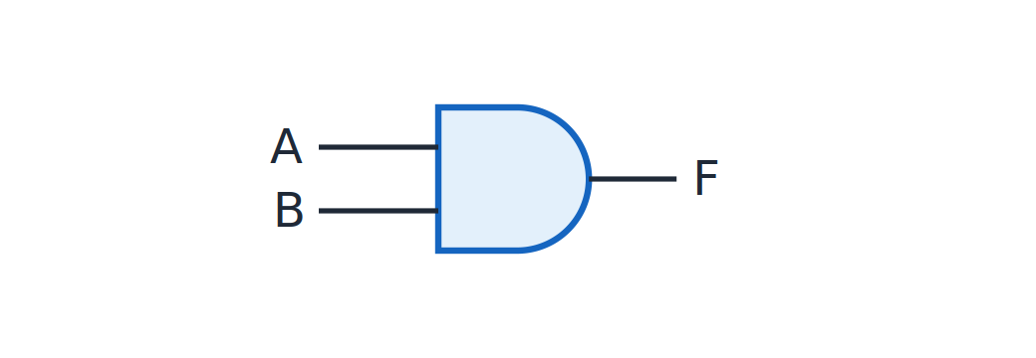
AND
Topic 1.7
AND
Notes:
F = 1 only when both inputs are 1. The truth table is on a later slide.

Slide 55
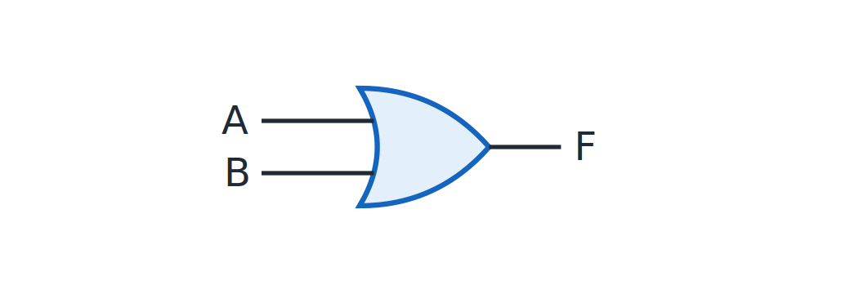
OR
Topic 1.7
OR
Notes:
F = 1 when at least one input is 1. The OR output is 0 only when both inputs are 0.

Slide 56
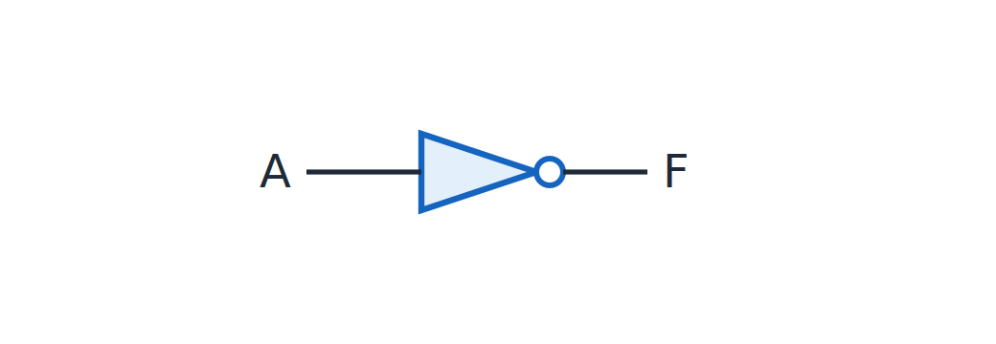
NOT
Topic 1.7
NOT
Notes:
F is the inverse of A. The bubble on the output of the triangle shows the inversion.

Slide 57
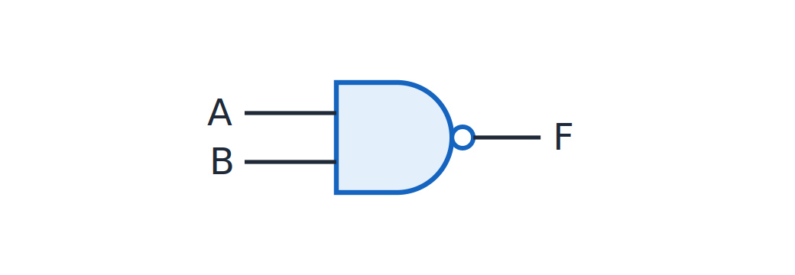
NAND
Topic 1.7
NAND
Notes:
An AND gate followed by an inversion, shown by the bubble. The NAND output is 0 only when both inputs are 1.

Slide 58
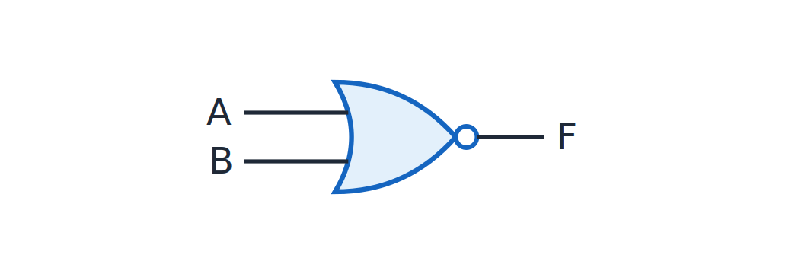
NOR
Topic 1.7
NOR
Notes:
An OR gate followed by an inversion, shown by the bubble. The NOR output is 1 only when both inputs are 0.

Slide 59
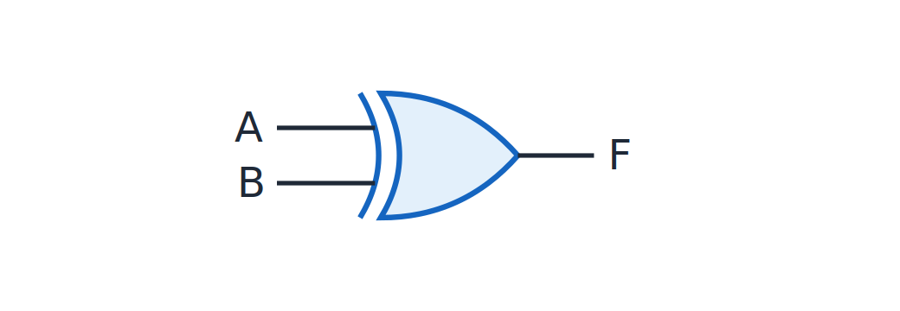
XOR
Topic 1.7
XOR
Notes:
F = 1 when the inputs differ. XOR is the “differs” gate.

Slide 60
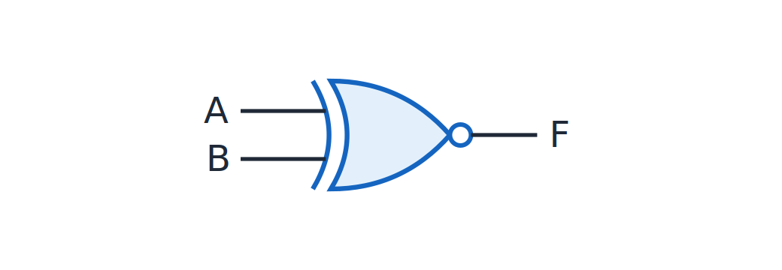
XNOR
Topic 1.7
XNOR
Notes:
F = 1 when the inputs are equal. XNOR is the inverse of XOR.

Slide 61
Truth tables of the two-input gates
Topic 1.7
A | B | AND | OR | NAND | NOR | XOR | XNOR
0 | 0 | 0 | 0 | 1 | 1 | 0 | 1
0 | 1 | 0 | 1 | 1 | 0 | 1 | 0
1 | 0 | 0 | 1 | 1 | 0 | 1 | 0
1 | 1 | 1 | 1 | 0 | 0 | 0 | 1
Notes:
These are the truth tables listed beneath each gate symbol on the lesson page. Check NAND against AND and NOR against OR: each is the inverse.

Slide 62
Truth table of NOT
Topic 1.7
A | F
0 | 1
1 | 0
Notes:
NOT is the only one-input gate of the seven. The output is the complement of the input.

Slide 63
Derived gates
Topic 1.7
AND, OR and NOT are the gates the postulates and theorems were written in terms of
NAND, NOR, XOR and XNOR are all derived from those three
NAND = AND then invert; XOR = “differs”, built from AND, OR and NOT
They are common enough in real designs and chips to be treated as first-class gates with their own symbols
Notes:
The XOR construction from AND, OR and NOT is shown in the Unit 2 design-procedure example. These four are built from the first three gates.

Slide 64
NAND and NOR are universal gates
Topic 1.7
A gate (or set of gates) is functionally complete (“universal”) if any Boolean function can be built using only that gate, in any quantity
NAND alone is universal, and so is NOR alone
Every AND, OR and NOT gate you need can be built from nothing but NAND gates (or from nothing but NOR gates)
The next slides build NOT, AND and OR from NAND only
Notes:
This is why NAND-only and NOR-only implementations are possible. The next three slides show the NAND constructions.

Slide 65
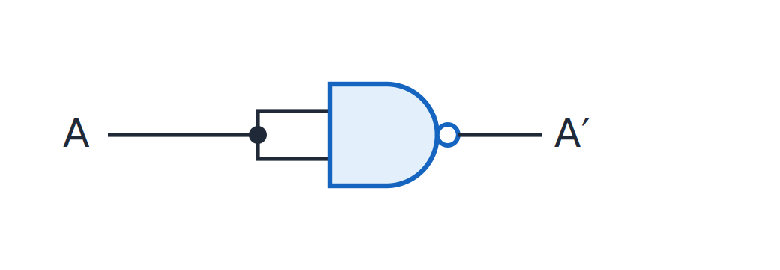
NOT from NAND
Topic 1.7
NOT from a single NAND with tied inputs.
Notes:
Tie both inputs of a NAND gate to the same signal: NAND(A,A) = (A·A)′ = A′. The tied inputs make the NAND act as an inverter.

Slide 66
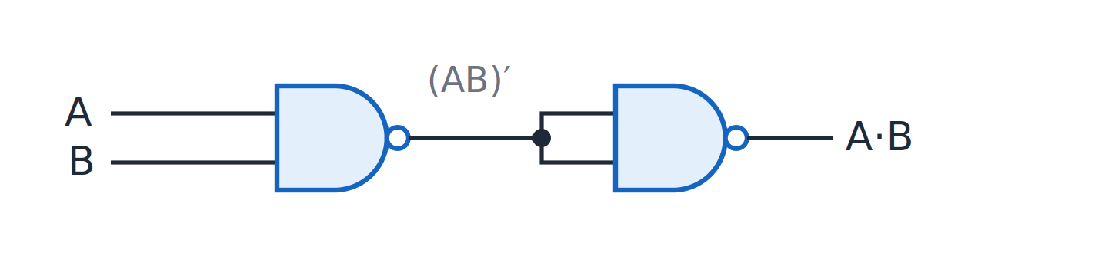
AND from NAND
Topic 1.7
AND from two NANDs: the second NAND inverts the first.
Notes:
A NAND followed by a NAND-built NOT: AND(A,B) = NOT(NAND(A,B)). The second NAND undoes the inversion of the first.

Slide 67
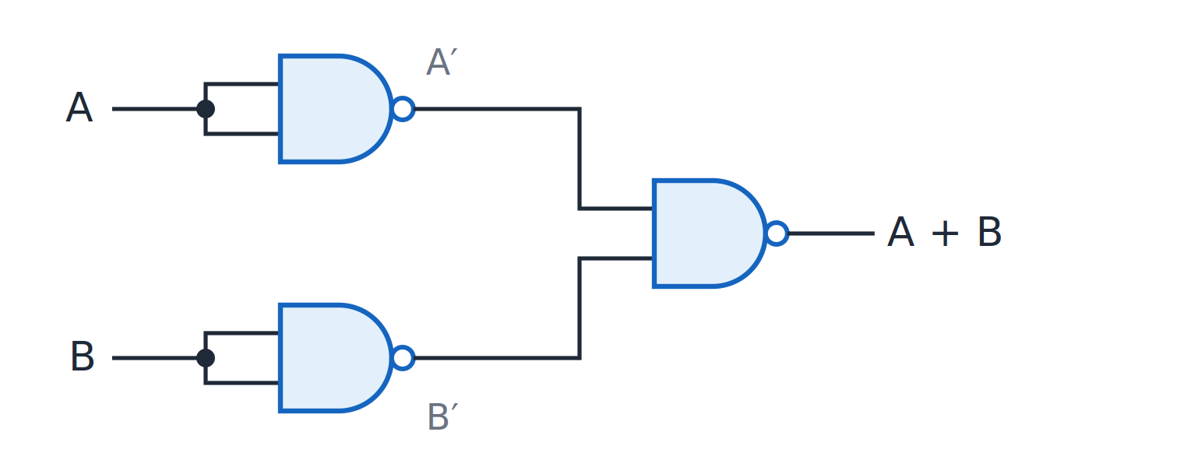
OR from NAND
Topic 1.7
OR from three NANDs: invert A and B, then NAND them (DeMorgan).
Notes:
Invert A and B first (each via a tied-input NAND), then NAND the two inverted signals: (A′·B′)′ = A + B, which is DeMorgan’s law at gate level. This construction uses three NAND gates.

Slide 68
Unit 1 summary
1.1 Number systems: positional notation with radix r; repeated division and grouping for conversions
1.2 Fixed and floating point: a fixed binary point, or a sign, mantissa and exponent (IEEE 754)
1.3 Complements: 1’s complement flips bits; 2’s complement adds 1; subtract by adding, with the end-carry rule
1.4 Error detection and correction: parity detects an error; Hamming code locates and corrects it
1.5 Boolean algebra: postulates, duality, basic theorems and simplification
1.6 Canonical and standard forms: minterms and maxterms, Σm and ΠM
1.7 Logic gates: seven basic gates; NAND and NOR are universal
Notes:
Recap in one line per topic. Ask students to convert a decimal number to binary and write its 2’s complement.

Slide 69
Review questions (1 of 2)
Q1. Convert decimal 45 to binary, octal and hexadecimal
Q2. Find the 1’s and 2’s complement of 1010 0110 and explain why 2’s complement has one zero
Q3. Compute 6 − 9 using 4-bit 2’s complement and apply the end-carry rule
Q4. Encode 5.625 in IEEE 754 single precision
Notes:
These questions cover topics 1.1 to 1.3. Answers: Q1 is 101101, 55 and 2D; Q2 is 0101 1001 and 0101 1010, and the +1 makes 11111111 wrap to 00000000; Q3 is 1101 with no carry, giving −3; Q4 is 0 10000001 followed by 01101 and zeros.

Slide 70
Review questions (2 of 2)
Q5. Encode data 1011 in Hamming(7,4) and locate a flipped bit using the syndrome
Q6. Simplify F = AB + AB′ + A′B using the theorems
Q7. Write F = Σm(1,4,7) as a canonical POS
Q8. Build NOT, AND and OR from NAND gates only
Notes:
These questions cover topics 1.4 to 1.7. Answers: Q5 is codeword 0110011 and syndrome 101 gives position 5; Q6 is A + B; Q7 is ΠM(0,2,3,5,6); Q8 uses tied inputs for NOT, a second NAND for AND and inverted inputs for OR.

Slide 71
References
Textbook: M. Morris Mano and Michael D. Ciletti, Digital Design
Adapted figures: none of the figures on these pages carries an “Adapted from” credit
Notes:
The textbook is the reference for this unit. The figures in this deck are original gate diagrams.

