Slide 1
Unit 2: Gate-Level Minimization (K-Maps)
2
Digital Logic Design
CHANDRAS EDU
Never stop learning
Notes:
Welcome to Unit 2 of Digital Logic Design. This unit covers Karnaugh maps, don’t-care conditions and NAND and NOR implementation.

Slide 2
Outline
2.1 K-Maps: 2 & 3 Variables
2.2 4-Variable K-Maps
2.3 Product-of-Sums (POS) Simplification
2.4 Don’t-Care Conditions
2.5 NAND/NOR Implementation
Notes:
Five topics in order. We start with K-maps for two, three and four variables, then POS simplification, don’t-cares and NAND and NOR implementation.

Slide 3
2.1 K-Maps: 2 & 3 Variables
Topic 2.1
IN SIMPLE TERMS
A K-map lays out a truth table so that neighbouring cells differ by one variable; circling neighbouring 1s removes that variable.
Notes:
Unit 1 gave the canonical sum of minterms, which is mechanical but rarely minimal. The Karnaugh map replaces trial-and-error algebra with a visual procedure. Read the box aloud and ask students to restate it in their own words.

Slide 4
The key idea: adjacency
Topic 2.1
Algebraic simplification needs the right theorem at each step, and it is easy to stop too early or make a mistake
A K-map arranges the rows of a truth table in a grid so that physically adjacent cells differ in exactly one variable
Row and column headers are written in Gray code order: 00, 01, 11, 10, never 00, 01, 10, 11
Two cells that differ in exactly one variable combine algebraically: the differing variable cancels (x + x′ = 1)
A K-map lets you see which cells qualify
Notes:
The Gray code order is what makes neighbouring cells exactly one bit-flip apart. Two cells one bit-flip apart can always be combined.

Slide 5
2-variable K-map
Topic 2.1
A 2-variable map has 4 cells: one per row of a 2-variable truth table
The next example is F(A,B) = Σm(0,1,3)
The figure shows the map with its two groups of adjacent 1s
Notes:
Each cell is labelled with its minterm number, m0 to m3. The two groups of adjacent 1s appear on the next slide.

Slide 6
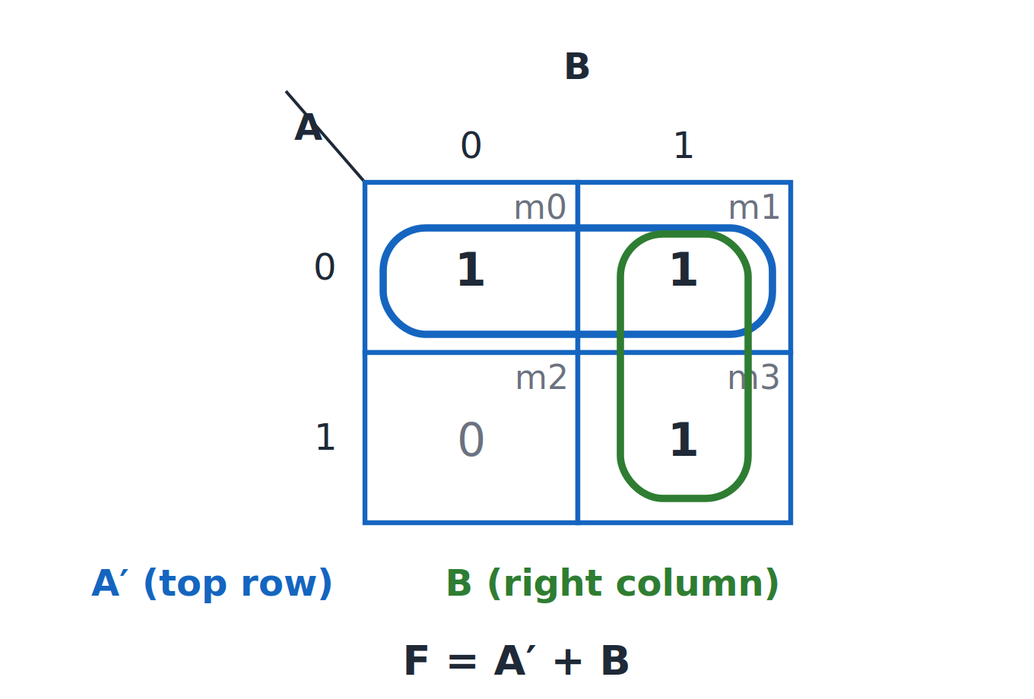
Two-variable K-map
Topic 2.1
Two-variable K-map for F = Σm(0,1,3): F = A′ + B.
Notes:
F = Σm(0,1,3). The top row (m0, m1) and the right column (m1, m3) are the two groups.

Slide 7
Worked example: F(A,B) = Σm(0,1,3)
Topic 2.1
Top row (A = 0, B varies): term = A′
Right column (B = 1, A varies): term = B
F = A′ + B
Each group of size 2 drops one variable, leaving only the variables that stay constant
Cell m1 belongs to both groups: completely normal
A group only needs to cover a 1; a 1 may be covered by more than one group
Notes:
The overlap on m1 produces fewer, larger groups. Compare the result with the canonical sum of three minterms.

Slide 8
3-variable K-map
Topic 2.1
A 3-variable map has 8 cells: 2 rows (the first variable) by 4 columns
The column header is in Gray-code order: 00, 01, 11, 10
The leftmost and rightmost columns are also adjacent: the grid wraps around like a cylinder
The next example is F(A,B,C) = Σm(0,1,2,3,5)
Notes:
Wraparound is the main new idea compared with the 2-variable map. The next slide shows the map.

Slide 9
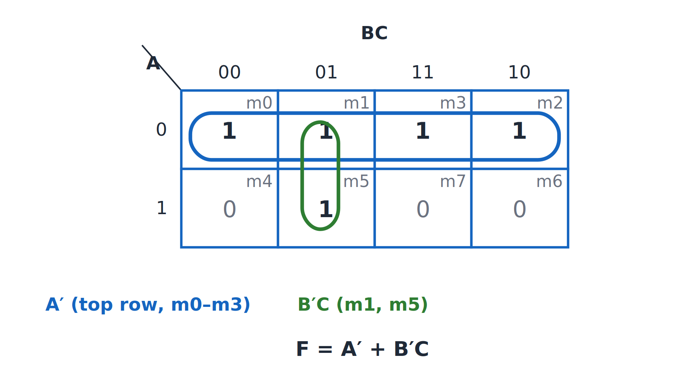
Three-variable K-map
Topic 2.1
Three-variable K-map for F = Σm(0,1,2,3,5): F = A′ + B′C.
Notes:
F = Σm(0,1,2,3,5). The whole A = 0 row is a group of four, and {m1, m5} is a pair.

Slide 10
Worked example: F(A,B,C) = Σm(0,1,2,3,5)
Topic 2.1
Top row, all 4 cells (A = 0; B and C vary): term = A′
Pair {m1, m5} (B = 0, C = 1; A varies): term = B′C
F = A′ + B′C
Check against the canonical form: minterms 0, 1, 2, 3 are exactly the A = 0 row (A′)
Minterm 5 is covered by B′C: together {0,1,2,3,5} matches the target exactly ✓
Notes:
Read each group’s constant variables to get its term. The group of four removes two variables.

Slide 11
Grouping rules
Topic 2.1
A group’s size is always a power of 2: 1, 2, 4, 8, … Groups of 3, 5, 6 or 7 cells are not valid
A group of size 2ⁿ eliminates exactly n variables from the term
Every 1 must be covered by at least one group, or the expression is wrong
Make groups as large as possible: a bigger group gives a shorter term
Use the fewest groups that cover every 1; overlap is fine and often necessary
A group covering the whole map means F = 1
Notes:
A single isolated 1 keeps every variable. The next topic extends the same rules to four variables.

Slide 12
2.2 4-Variable K-Maps
Topic 2.2
IN SIMPLE TERMS
With four variables the map is a 4 × 4 grid whose edges wrap around: top meets bottom, left meets right, so even the four corners are neighbours.
Notes:
Everything from the previous topic carries over to four variables. The only real difference is scale and wraparound in two directions at once. Read the box aloud and ask students to restate it in their own words.

Slide 13
The grid layout
Topic 2.2
A 4-variable map has 16 cells in a 4 × 4 grid
Both the rows (AB) and the columns (CD) use Gray-code order: 00, 01, 11, 10
Rows wrap top-to-bottom (row 00 is adjacent to row 10)
Columns wrap left-to-right (column 00 is adjacent to column 10)
The map behaves like the surface of a torus, not a flat rectangle
Notes:
The next example is F(A,B,C,D) = Σm(0,2,5,7,8,10,13,15). The next slide shows the 4 × 4 map.

Slide 14
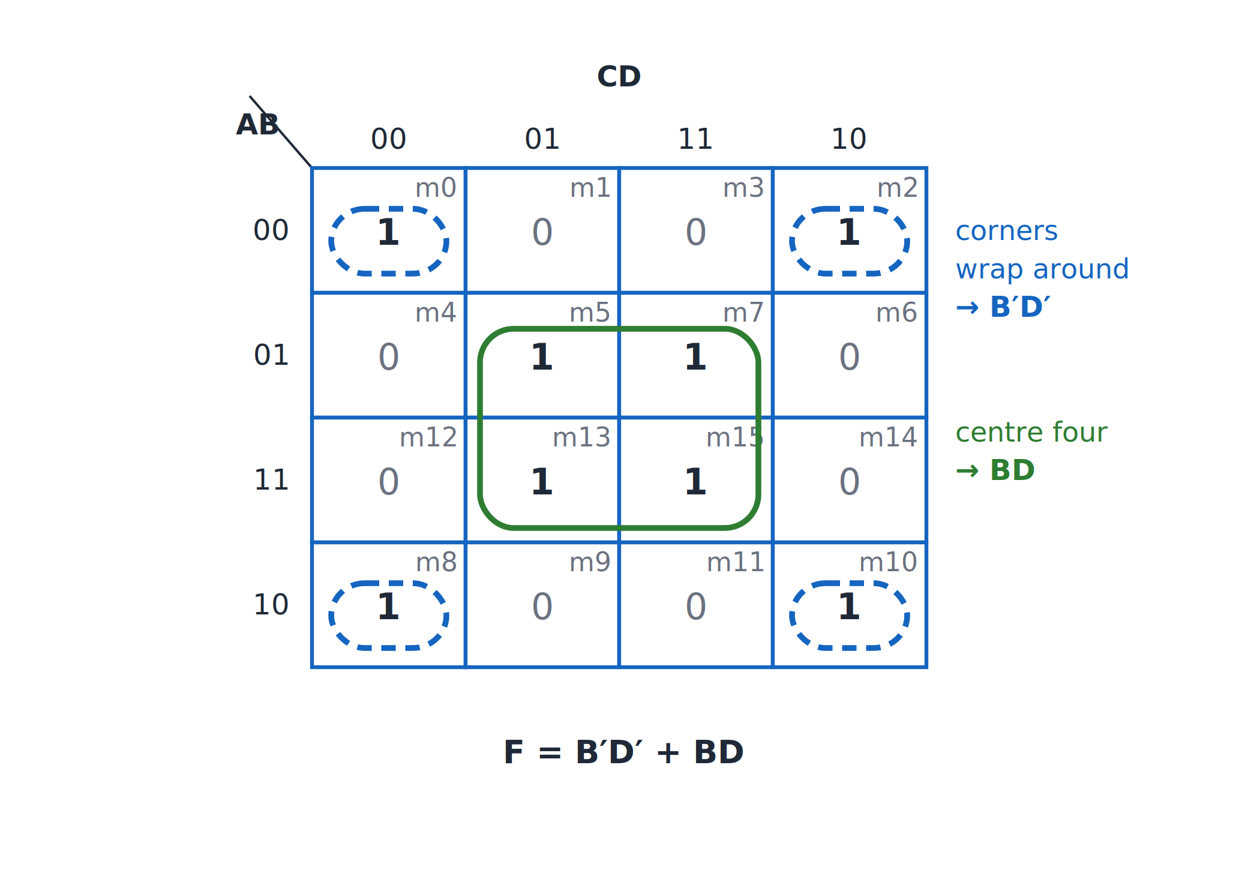
Four-variable K-map
Topic 2.2
Four-variable K-map: the corners wrap around to give B′D′; the centre four give BD.
Notes:
The corners wrap around to give B′D′, and the centre four give BD. The four corners are drawn as separate boxes because they wrap around.

Slide 15
Worked example: F = Σm(0,2,5,7,8,10,13,15)
Topic 2.2
Corners {m0, m2, m8, m10}: B = 0, D = 0 → B′D′
Quad {m5, m7, m13, m15}: B = 1, D = 1 → BD
F = B′D′ + BD
In both groups A and C vary, so they drop out
The four corners are drawn as four separate boxes because a wraparound group cannot be enclosed by one loop on a flat page; they are still one logical group
All four corners are mutually adjacent: row 00/row 10 wrap vertically and column 00/column 10 wrap horizontally
Every 1 is covered by exactly one of the two quads, so the result is minimal
Notes:
Each quad eliminates two variables and leaves a two-literal term. The result B′D′ + BD means B and D agree.

Slide 16
Grouping sizes at 4 variables
Topic 2.2
The pattern from the 3-variable page continues: each doubling of group size eliminates one more variable.
Group size | Variables eliminated | Term length
1 cell | 0 | 4 literals (the full minterm)
2 cells (pair) | 1 | 3 literals
4 cells (quad) | 2 | 2 literals
8 cells (octet) | 3 | 1 literal
16 cells (whole map) | 4 | F = 1 (constant)
Notes:
Larger groups always give shorter terms. Use this table to predict the literals in each term.

Slide 17
2.3 Product-of-Sums (POS) Simplification
Topic 2.3
IN SIMPLE TERMS
Circle the 0s instead of the 1s and you get the function as a product of sums.
Notes:
Every grouping so far minimised a sum of products. A K-map can minimise the other canonical form, the product of sums, by grouping the opposite cells. Read the box aloud and ask students to restate it in their own words.

Slide 18
The flip: group the zeros
Topic 2.3
Apply the same K-map procedure: Gray-code adjacency, power-of-2 groups, as large and as few as possible
But group the 0-cells instead of the 1-cells
Each group gives one sum (OR) term, and the final expression ANDs those terms together
The only change is the read-off convention (next slide)
Notes:
Everything else about the procedure stays the same. The next slide gives the read-off convention.

Slide 19
Read-off convention
Topic 2.3
This mirrors how a maxterm Mᵢ is built from the minterm mᵢ in Unit 1: the same complementation rule, applied group by group instead of cell by cell.
 | Variable = 0 in group | Variable = 1 in group
SOP (grouping 1s) | write complemented (x′) | write uncomplemented (x)
POS (grouping 0s) | write uncomplemented (x) | write complemented (x′)
Notes:
Memorise the flip: for POS a variable that is 1 across the group is complemented. It mirrors how a maxterm is built from a minterm.

Slide 20
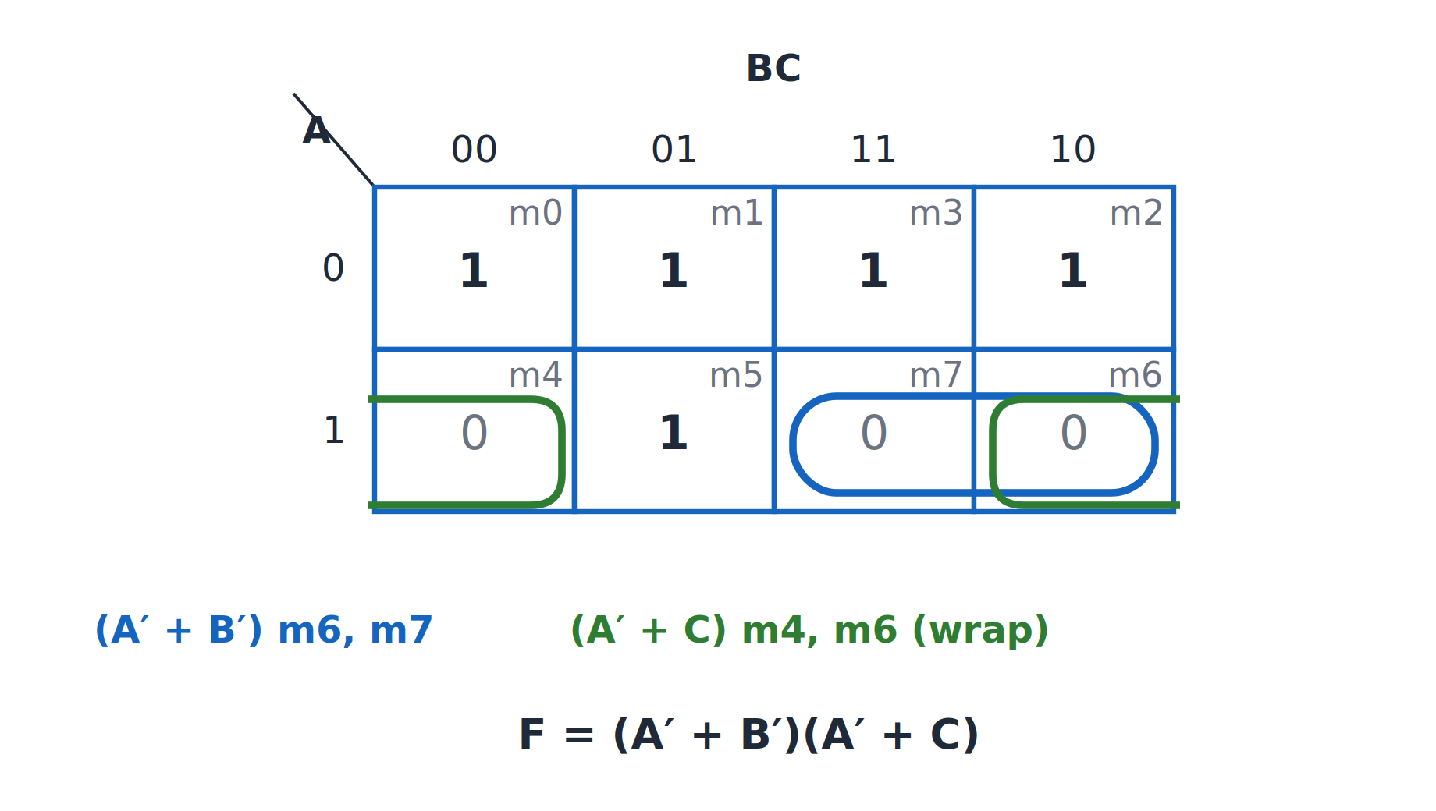
Grouping the 0s
Topic 2.3
Grouping the 0s of F = Σm(0,1,2,3,5): F = (A′ + B′)(A′ + C).
Notes:
F = Σm(0,1,2,3,5), so the 0-cells are {4, 6, 7}. Two overlapping pairs cover them.

Slide 21
Worked example: F = Σm(0,1,2,3,5), grouping the 0s
Topic 2.3
Pair {m6, m7}: A = 1, B = 1 → (A′ + B′)
Pair {m4, m6}: A = 1, C = 0 → (A′ + C)
F = (A′ + B′)(A′ + C)
In the first pair C varies; in the second pair B varies
The three 0-cells cannot all go in one group: m4 and m7 are not adjacent
m4 and m6 are adjacent because the two ends of a row wrap around
Notes:
This is the same function that gave A′ + B′C in the SOP topic. Both pairs use the A = 1 row.

Slide 22
Checking the POS result
Topic 2.3
Test A=0, B=0, C=0 (m0, expect F=1): (1+1)(1+0) = 1 ✓
Test A=1, B=0, C=0 (m4, expect F=0): (0+1)(0+0) = 0 ✓
Expand: (A′ + B′)(A′ + C) = A′ + B′C ✓
The expansion is the same function as the SOP result
F = 0 at exactly {4, 6, 7} and 1 everywhere else, which is what grouping only the 0-cells guarantees
Notes:
Plug in a couple of input combinations as a sanity check. The check confirms the POS and SOP forms are the same function.

Slide 23
SOP and POS are two realisations
Topic 2.3
SOP and POS are two different, equally valid circuit realisations of the same function
They are not two different functions
Which is better depends on the circuit: sometimes SOP uses fewer gates or literals, sometimes POS
Both are worth computing when gate count genuinely matters
Notes:
Compute both and compare the gate counts when it matters. Choose the one with fewer gates.

Slide 24
2.4 Don’t-Care Conditions
Topic 2.4
IN SIMPLE TERMS
A don’t-care is an input that never happens, so you may treat it as 1 or 0, whichever makes the groups bigger.
Notes:
Some circuits are only ever fed a subset of the possible inputs. For the combinations that cannot occur, the designer may choose whichever output makes the circuit simplest. Read the box aloud and ask students to restate it in their own words.

Slide 25
What a don’t-care is
Topic 2.4
A don’t-care condition is an input combination whose output is unspecified
Either the input never occurs in the system, or the application does not care what the output is
Example: BCD only uses 0000 through 1001; patterns 1010 to 1111 are invalid BCD digits that a correct system never produces
A circuit that processes BCD digits can treat those six patterns as don’t-cares
Don’t-cares are marked X (or sometimes d), distinct from 0 and 1
Notes:
This links back to the BCD code covered in Unit 1. An X is neither 0 nor 1.

Slide 26
Using don’t-cares in a K-map
Topic 2.4
When forming a group, treat each X as either a 0 or a 1, whichever gives a larger, more useful group
Decide this independently for each group
An X does not have to be in any group at all: it is optional
Use an X only where it makes the result better
Notes:
The next example uses the six invalid BCD patterns as don’t-cares. The next example applies this rule.

Slide 27
Worked example: setting up the function
Topic 2.4
F(A,B,C,D) = Σm(1,3,5,7,9) + d(10,11,12,13,14,15)
F is 1 for the odd BCD digits 1, 3, 5, 7, 9
F is 0 for the even BCD digits 0, 2, 4, 6, 8
The six invalid patterns (10–15) are marked as don’t-cares
Notes:
The don’t-cares are written with a lowercase d in the function. The K-map for this function is on the next slide.

Slide 28
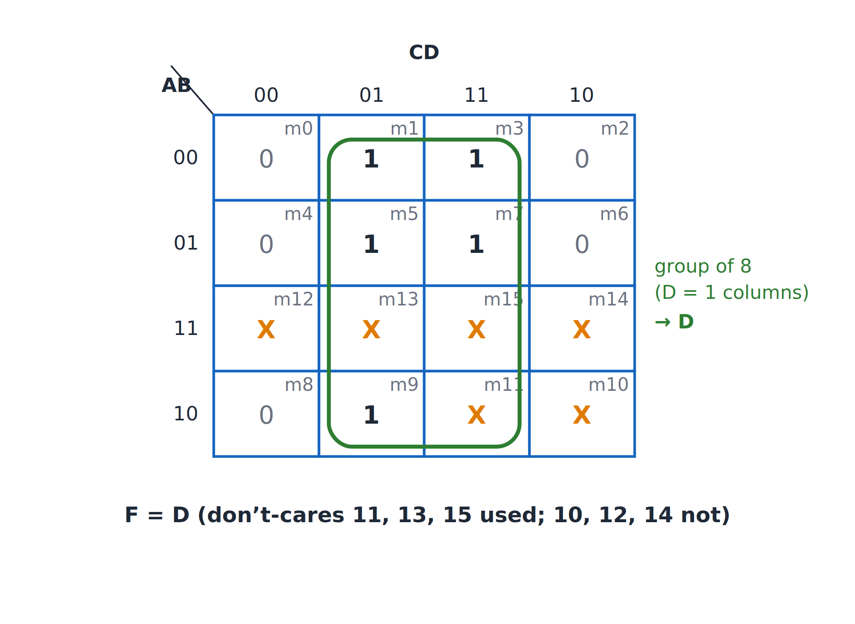
K-map with don’t-cares
Topic 2.4
With don’t-cares 11, 13, 15 taken as 1s, the two D = 1 columns form one group of eight
The group is {m1, m3, m5, m7, m9, d11, d13, d15}
The term is D: A, B and C all vary
d10, d12 and d14 are not needed and are left as 0
With don’t-cares 11, 13, 15 taken as 1s, the two D = 1 columns form one group of eight: F = D.
Notes:
The don’t-cares 11, 13 and 15 are taken as 1s, giving a group of eight. The don’t-care cells are shown in orange.

Slide 29
Worked example: result
Topic 2.4
Without don’t-cares: m9 can only pair with m1 → F = A′D + B′C′D
With don’t-cares: treat m11, m13, m15 as 1s
Group of 8 {m1, m3, m5, m7, m9, d11, d13, d15}
F = D
In the group D = 1 and A, B, C all vary
d10, d12 and d14 are not needed and are left as 0
The function collapses to a single variable: a dramatically simpler circuit
Notes:
This is made possible entirely by choosing the don’t-care values strategically. Without don’t-cares the function needs two terms.

Slide 30
Verifying, and don’t-cares in POS
Topic 2.4
Verify: F = D must equal 0 for every specified 0 (even digits 0, 2, 4, 6, 8: D = 0 for all) and 1 for every specified 1 (odd digits 1, 3, 5, 7, 9: D = 1 for all)
The don’t-care cells (10–15) take whatever value D has there: since those inputs never occur, it does not matter
The same freedom applies to POS: each X can independently be treated as a 0 (joining a 0-group) or a 1 (excluded)
Choose whichever produces the largest, most useful 0-groups
Notes:
Verification only checks the specified rows, never the don’t-care rows. The same rule works for the zeros.

Slide 31
2.5 NAND/NOR Implementation
Topic 2.5
IN SIMPLE TERMS
Any AND-OR circuit can be built from NAND gates alone, and any OR-AND circuit from NOR gates alone: just swap every gate.
Notes:
Unit 1 showed that NAND and NOR are each universal. This topic gives a direct, mechanical way to redraw a minimal SOP or POS expression using only NAND or only NOR gates. Read the box aloud and ask students to restate it in their own words.

Slide 32
SOP → NAND-NAND: the two-level conversion
Topic 2.5
For a two-level SOP circuit (AND gates feeding a single OR gate): replace every gate, both the AND gates and the final OR gate, with a NAND gate
Keep all the same connections
The circuit computes the exact same function
No algebra is required: it is just a wiring pattern
Notes:
The reason this works is DeMorgan’s law, shown on the next slide. Keep every connection exactly as it was.

Slide 33
Why it works: DeMorgan’s law
Topic 2.5
F = XY + ZW
Replace every gate with NAND:
((XY)′ · (ZW)′)′ = XY + ZW
The equality is DeMorgan’s law, (A′B′)′ = A + B, with A = XY and B = ZW
The double inversion at the second level cancels, leaving the original SOP function
Notes:
The inner NANDs invert each product term, and the outer NAND inverts again. This is the dual of the NOR-NOR proof.

Slide 34
Worked example: F = AB + BC
Topic 2.5
Two first-level NAND gates compute (AB)′ and (BC)′
B fans out to both gates: a shared input feeding two gates is completely normal
The final NAND combines them: ((AB)′ · (BC)′)′ = AB + BC
Every gate in the circuit is a NAND: nothing else
Notes:
The next slide shows the circuit. The shared input B feeds both first-level gates.

Slide 35
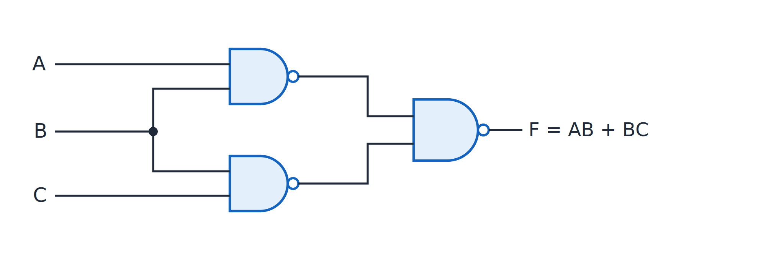
Two-level NAND implementation of F = AB + BC
Topic 2.5
Two-level NAND implementation of F = AB + BC.
Notes:
Two first-level NANDs and one second-level NAND, with B shared by both first-level gates. Count the three NAND gates.

Slide 36
POS → NOR-NOR: the mirror conversion
Topic 2.5
The same idea, dualised: for a two-level POS circuit (OR gates feeding a single AND gate), replace every gate with a NOR gate
The justification is the dual DeMorgan law: (A′ + B′)′ = AB
The circuit again computes exactly the same function
Notes:
This is the dual of the NAND-NAND conversion. The roles of AND and OR are swapped.

Slide 37
Worked example: F = (A + B)(B + C)
Topic 2.5
Two first-level NOR gates compute (A + B)′ and (B + C)′
The final NOR combines them: ((A + B)′ + (B + C)′)′ = (A + B)(B + C)
This is the same DeMorgan pattern as before, dualised
Every gate is a NOR: nothing else
Notes:
The next slide shows the NOR circuit. The shared input B feeds both first-level gates.

Slide 38
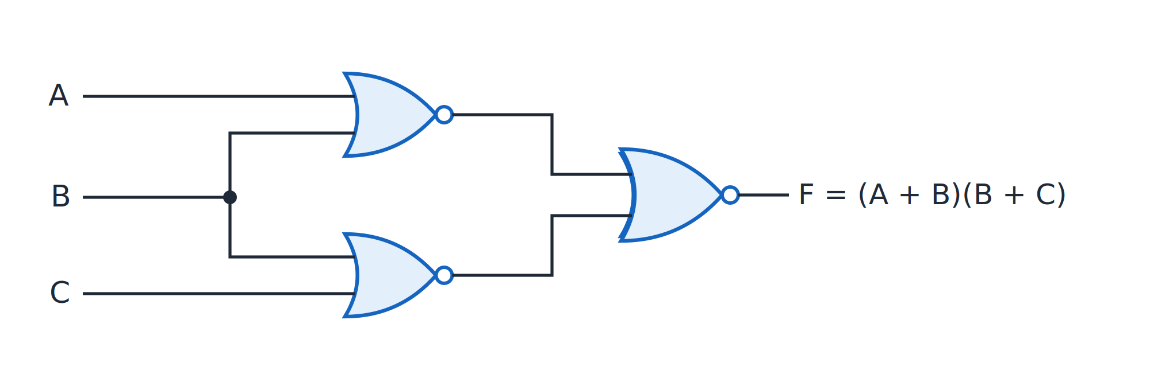
Two-level NOR implementation of F = (A + B)(B + C)
Topic 2.5
Two-level NOR implementation of F = (A + B)(B + C).
Notes:
Two first-level NORs and one second-level NOR, with B shared by both first-level gates. Count the three NOR gates.

Slide 39
Unit 2 summary
2.1 K-maps (2 and 3 variables): Gray-code adjacency; group 1s in powers of 2; fewest, largest groups
2.2 4-variable K-maps: the edges wrap in two directions, so the four corners are neighbours
2.3 POS simplification: group the 0s; variables that are 1 in the group are complemented in the sum term
2.4 Don’t-cares: treat each X as 0 or 1, whichever enlarges a group
2.5 NAND/NOR implementation: replace every gate in a two-level SOP with NAND, or in a POS with NOR
Notes:
Recap in one line per topic. Ask students why the K-map columns are written in Gray code order.

Slide 40
Review questions (1 of 2)
Q1. Why are K-map headers written in Gray code order, and what does adjacency mean?
Q2. Simplify F(A,B,C) = Σm(0,1,2,3,5) with a K-map
Q3. Simplify F(A,B,C,D) = Σm(0,2,5,7,8,10,13,15) and explain the corner group
Q4. State the rules for valid groups
Notes:
These questions cover topics 2.1 and 2.2. Answers: Q1 neighbouring cells differ in exactly one variable; Q2 is A′ + B′C; Q3 is B′D′ + BD, where the corners are adjacent through wraparound; Q4 power-of-2 sizes, cover every 1, largest groups, fewest groups.

Slide 41
Review questions (2 of 2)
Q5. Find the minimal POS of F = Σm(0,1,2,3,5) by grouping the 0s
Q6. Simplify F = Σm(1,3,5,7,9) + d(10,11,12,13,14,15)
Q7. Implement F = AB + BC with NAND gates only
Q8. Implement F = (A + B)(B + C) with NOR gates only
Notes:
These questions cover topics 2.3 to 2.5. Answers: Q5 is (A′ + B′)(A′ + C); Q6 is D, using don’t-cares 11, 13 and 15; Q7 is three NAND gates, two first-level and one second-level; Q8 is three NOR gates in the same pattern.

Slide 42
References
Textbook: M. Morris Mano and Michael D. Ciletti, Digital Design
Adapted figures: none of the figures on these pages carries an “Adapted from” credit
Notes:
The textbook is the reference for this unit. The K-map and gate figures in this deck are original.

