Slide 1
Unit 3: Combinational Logic Circuits
3
Digital Logic Design
CHANDRAS EDU
Never stop learning
Notes:
Welcome to Unit 3 of Digital Logic Design. This unit builds the standard combinational circuits: adders, subtractors, comparators, decoders, encoders and multiplexers.

Slide 2
Outline
3.1 Combinational Circuit Analysis & Design
3.2 Binary Adder & Subtractor
3.3 BCD Adder & Binary Multiplier
3.4 Magnitude Comparator
3.5 Decoders & Encoders
3.6 Multiplexers & Demultiplexers
Notes:
Six topics in order. The first covers the analysis and design procedures, and the other five apply them to standard building blocks.

Slide 3
3.1 Combinational Circuit Analysis & Design
Topic 3.1
IN SIMPLE TERMS
Analysis goes from circuit to function; design goes from a word description to a truth table, a simplified function and finally the circuit.
Notes:
Unit 3 builds the standard combinational building blocks. This first topic gives the two skills used for every block that follows: analysis and design. Read the box aloud and ask students to restate it in their own words.

Slide 4
Combinational circuits
Topic 3.1
A combinational circuit has outputs that depend only on its present inputs: never on past inputs and never on a clock
n binary inputs go in and m binary outputs come out
Every output is a Boolean function of the inputs, built from logic gates with no feedback loop
Adders, comparators, decoders and multiplexers in this unit are all combinational
Unit 4 is where memory enters the picture
Notes:
The same inputs always give the same outputs. Memory, and so dependence on the past, comes only in Unit 4.

Slide 5
Analysis procedure
Topic 3.1
Analysis starts from a circuit diagram and recovers the Boolean function it computes
1. Label every wire: name the output of every gate, from the inputs toward the outputs, not just the final output
2. Write each gate’s output as a Boolean expression in terms of the wires feeding it; substitute until only the circuit inputs remain
3. Build a truth table (optional but recommended) by evaluating the final expression for every input combination
Notes:
The truth table catches transcription errors and makes the circuit’s behaviour easy to check. Label first, substitute second.

Slide 6
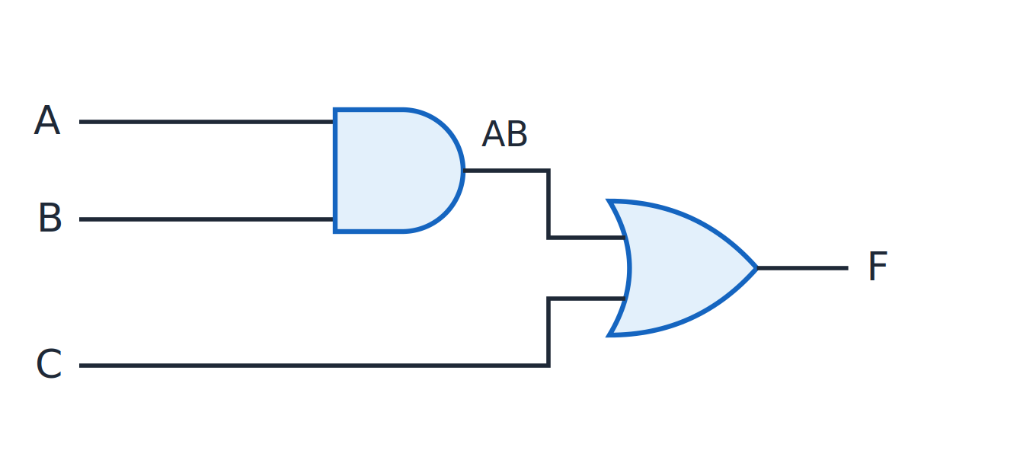
Analysis example circuit
Topic 3.1
Circuit for the analysis example: F = AB + C.
Notes:
The circuit has three inputs A, B, C and one output F. Label the AND gate output first, then write the OR gate expression.

Slide 7
Worked example: analysing a 2-gate circuit
Topic 3.1
Step 1 — label the AND gate’s output: w1 = AB
Step 2 — the OR gate combines w1 and C: F = w1 + C
Step 3 — substitute: F = AB + C
Evaluating F = AB + C for all 8 input combinations gives the truth table
F is 1 whenever C is 1 (regardless of A, B), or whenever both A and B are 1
Notes:
Three steps give the function. C alone is enough to make F equal 1.

Slide 8
Design procedure
Topic 3.1
Design starts from a written specification and produces a minimal circuit
1. State the problem precisely; identify the number of inputs and outputs
2. Assign letter symbols to each input and output variable
3. Derive the truth table
4. Obtain the minimal Boolean function for each output, usually with a K-map (Unit 2)
5. Draw the logic diagram from the minimal SOP or POS expression and verify it against the specification
Notes:
Every remaining topic in this unit applies this procedure to one standard building block. Step 4 usually uses a K-map from Unit 2.

Slide 9
Worked example: 3-input majority function
Topic 3.1
Specification: inputs A, B, C; output F
F = 1 whenever a majority (2 or more) of the inputs are 1
Truth table → minterms: m3 (011), m5 (101), m6 (110), m7 (111)
F(A,B,C) = Σm(3,5,6,7)
F is 1 for the input combinations with two or three 1s
Notes:
The majority function is a good first design example because its K-map groups overlap. Next we group these minterms on a K-map.

Slide 10
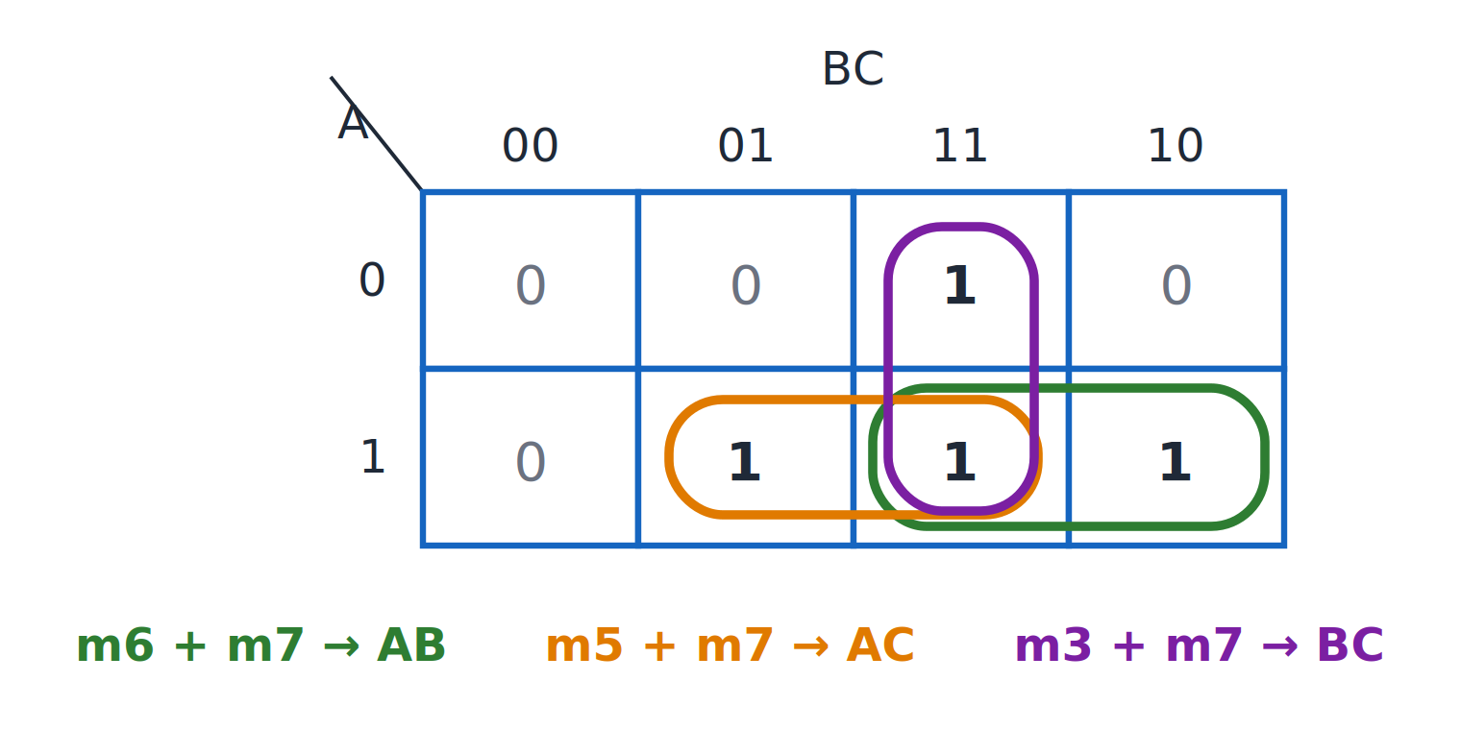
Majority function: K-map
Topic 3.1
K-map for the majority function: F = AB + AC + BC.
Notes:
Three pairs of cells give three product terms. All three pairs share cell m7.

Slide 11
Majority function: minimal SOP and circuit
Topic 3.1
Pair {m6, m7} (A=1, B=1, C varies): term = AB
Pair {m5, m7} (A=1, C=1, B varies): term = AC
Pair {m3, m7} (B=1, C=1, A varies): term = BC
F = AB + AC + BC
The three pairs share cell m7: a normal overlap, since a group only needs to cover a 1
Circuit: three 2-input AND gates (one per term) feeding a 3-input OR gate, or two cascaded 2-input ORs: five gates in total
No further simplification: every group is already a maximal pair
Notes:
The same 1-cell may be covered by more than one group. Each pair is maximal, so the expression is minimal.

Slide 12
3.2 Binary Adder & Subtractor
Topic 3.2
IN SIMPLE TERMS
A half adder adds two bits; a full adder also adds the incoming carry; chain full adders to add whole numbers, and an XOR per bit lets the same circuit subtract.
Notes:
Addition is the most common operation in a digital system. We build the adder in three stages: half adder, full adder and the n-bit ripple-carry adder, then extend it to subtract. Read the box aloud and ask students to restate it in their own words.

Slide 13
Half adder
Topic 3.2
S = A ⊕ B C = AB. A half adder takes two bits and has no way to accept a carry-in.
A | B | S (Sum) | C (Carry)
0 | 0 | 0 | 0
0 | 1 | 1 | 0
1 | 0 | 1 | 0
1 | 1 | 0 | 1
Notes:
The sum column is the XOR truth table and the carry column is AND. No K-map is needed. The sum is XOR and the carry is AND.

Slide 14
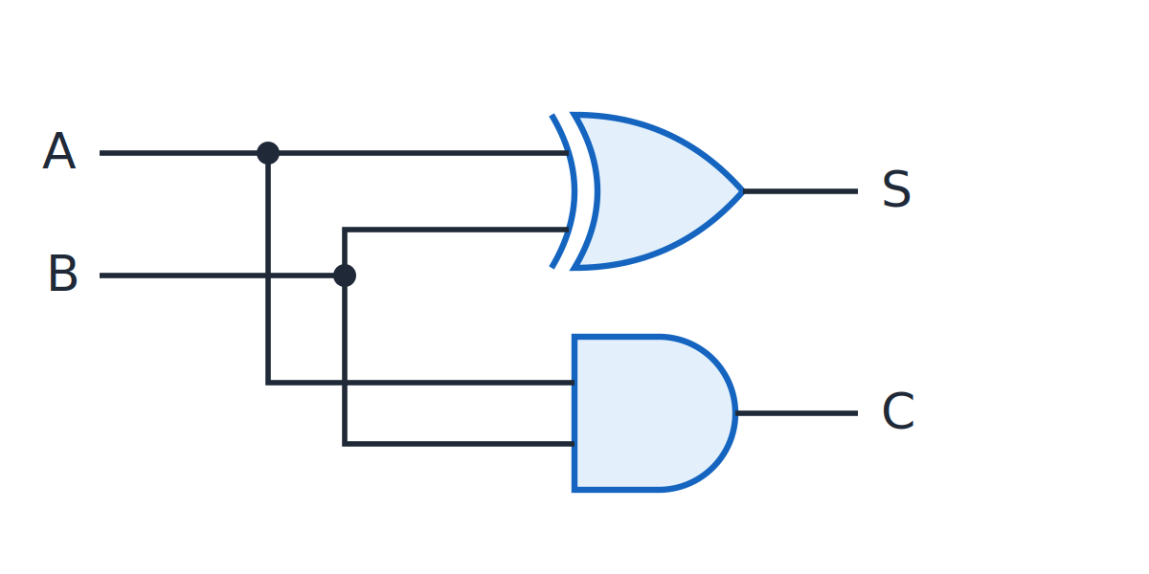
Half adder
Topic 3.2
Half adder: S = A ⊕ B, C = AB.
Notes:
An XOR gate gives the sum and an AND gate gives the carry. Compare the two gates with the S and C columns of the truth table.

Slide 15
Full adder
Topic 3.2
S = A ⊕ B ⊕ C_{in} C_{out} = AB + BC_{in} + AC_{in}
A | B | C_{in} | S | C_{out}
0 | 0 | 0 | 0 | 0
0 | 0 | 1 | 1 | 0
0 | 1 | 0 | 1 | 0
0 | 1 | 1 | 0 | 1
1 | 0 | 0 | 1 | 0
1 | 0 | 1 | 0 | 1
1 | 1 | 0 | 0 | 1
1 | 1 | 1 | 1 | 1
Notes:
S is 1 whenever an odd number of the three inputs are 1. C_out is the 3-input majority function from the previous topic: it is 1 when two or more inputs are 1.

Slide 16
Full adder from two half adders
Topic 3.2
Reuse two half adders plus one OR gate rather than building the SOP expressions with fresh gates
HA₁ adds A and B: partial sum S₁ and carry C₁
HA₂ adds S₁ and C_{in}: final sum S and a second carry C₂
C₁ and C₂ can never both be 1, because S₁ is a single bit
OR-ing them gives C_{out} without a 3-input gate
Notes:
Getting a carry from both stages would need A + B ≥ 2 and S₁ + C_in ≥ 2, which is impossible. Reusing the half adder avoids designing a new circuit from scratch.

Slide 17
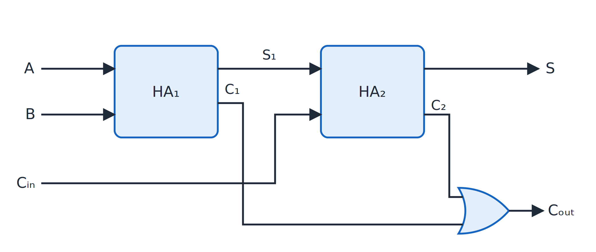
Full adder from two half adders
Topic 3.2
Full adder from two half adders and an OR gate. Adapted from M. Morris Mano and Michael D. Ciletti, Digital Design, Fig. 4.8.
Notes:
Follow A and B into HA₁, then S₁ and C_in into HA₂, and finally the OR gate for C_out. The figure has no three-input gate: only two half adders and one OR gate.

Slide 18
Ripple-carry binary adder
Topic 3.2
Chain n full adders: each stage’s C_{out} feeds the next stage’s C_{in}
The result adds two n-bit binary numbers
The carry “ripples” from the least significant bit to the most significant, one full-adder delay at a time
Drawback: the most significant sum bit is not valid until the carry has passed through every stage
Notes:
Speed is the cost of this simple structure: the delay grows with the number of bits. Adding two n-bit numbers needs n full adders.

Slide 19
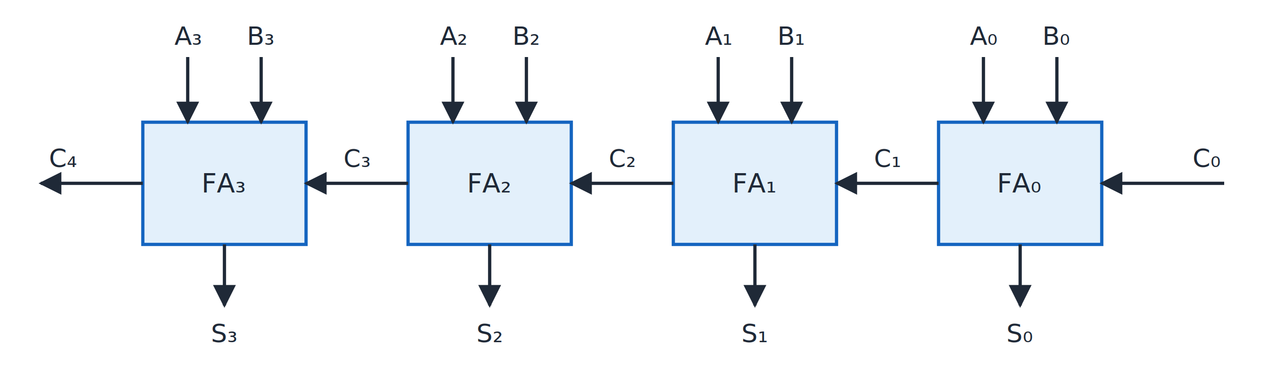
4-bit ripple-carry adder
Topic 3.2
Four-bit ripple-carry adder. Adapted from M. Morris Mano and Michael D. Ciletti, Digital Design, Fig. 4.9.
Notes:
Four full adders in a chain. C₀ enters the least significant stage and C₄ leaves the most significant stage.

Slide 20
Worked example: 4-bit addition, 0110 (6) + 0011 (3)
Topic 3.2
Bit position: 3 2 1 0
A : 0 1 1 0
B : 0 0 1 1
carry-in : 1 1 0 0 (C3 C2 C1 C0)
------------------------
Sum : 1 0 0 1
carry-out : 0 1 1 0 (C4 C3 C2 C1)
Result: S = 1001 (9), C₄ = 0: no overflow. 6 + 3 = 9 ✓
Notes:
Trace the carry from C₀ to C₄ one stage at a time. Check the result against 6 + 3 = 9.

Slide 21
Binary subtractor
Topic 3.2
Subtraction A − B is done by adding A to the 2’s complement of B (Unit 1)
Add one control line M (0 = add, 1 = subtract) and one XOR gate per bit of B
M = 0: each XOR passes B_{i} unchanged and C_{in} = 0: the circuit computes A + B
M = 1: each XOR inverts B_{i} and C_{in} = 1 supplies the “+1”: A + B′ + 1 = A − B
All XOR gates share the same M line, and C_{in} of the adder is also tied to M
Notes:
A single circuit adds or subtracts, depending on M. Recall from Unit 1 that A − B = A + B′ + 1.

Slide 22
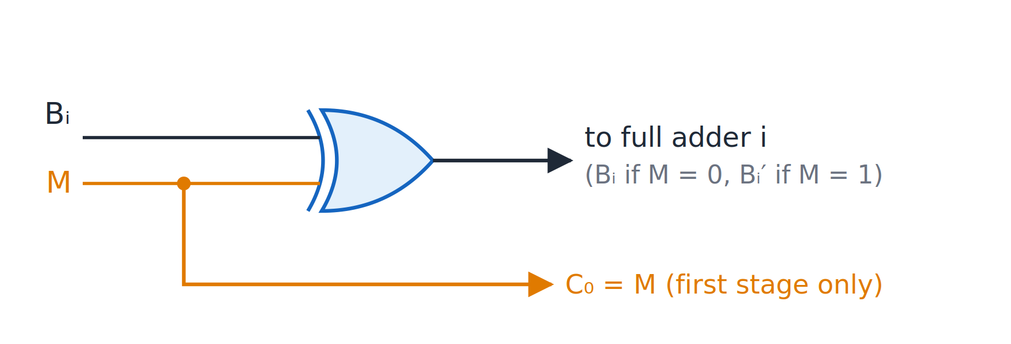
One XOR gate per bit of B
Topic 3.2
One XOR gate per bit of B: M = 0 passes B_{i}, M = 1 inverts it; M is also C₀.
Notes:
M = 0 passes B_i and M = 1 inverts it. M is also the carry into the first stage.

Slide 23
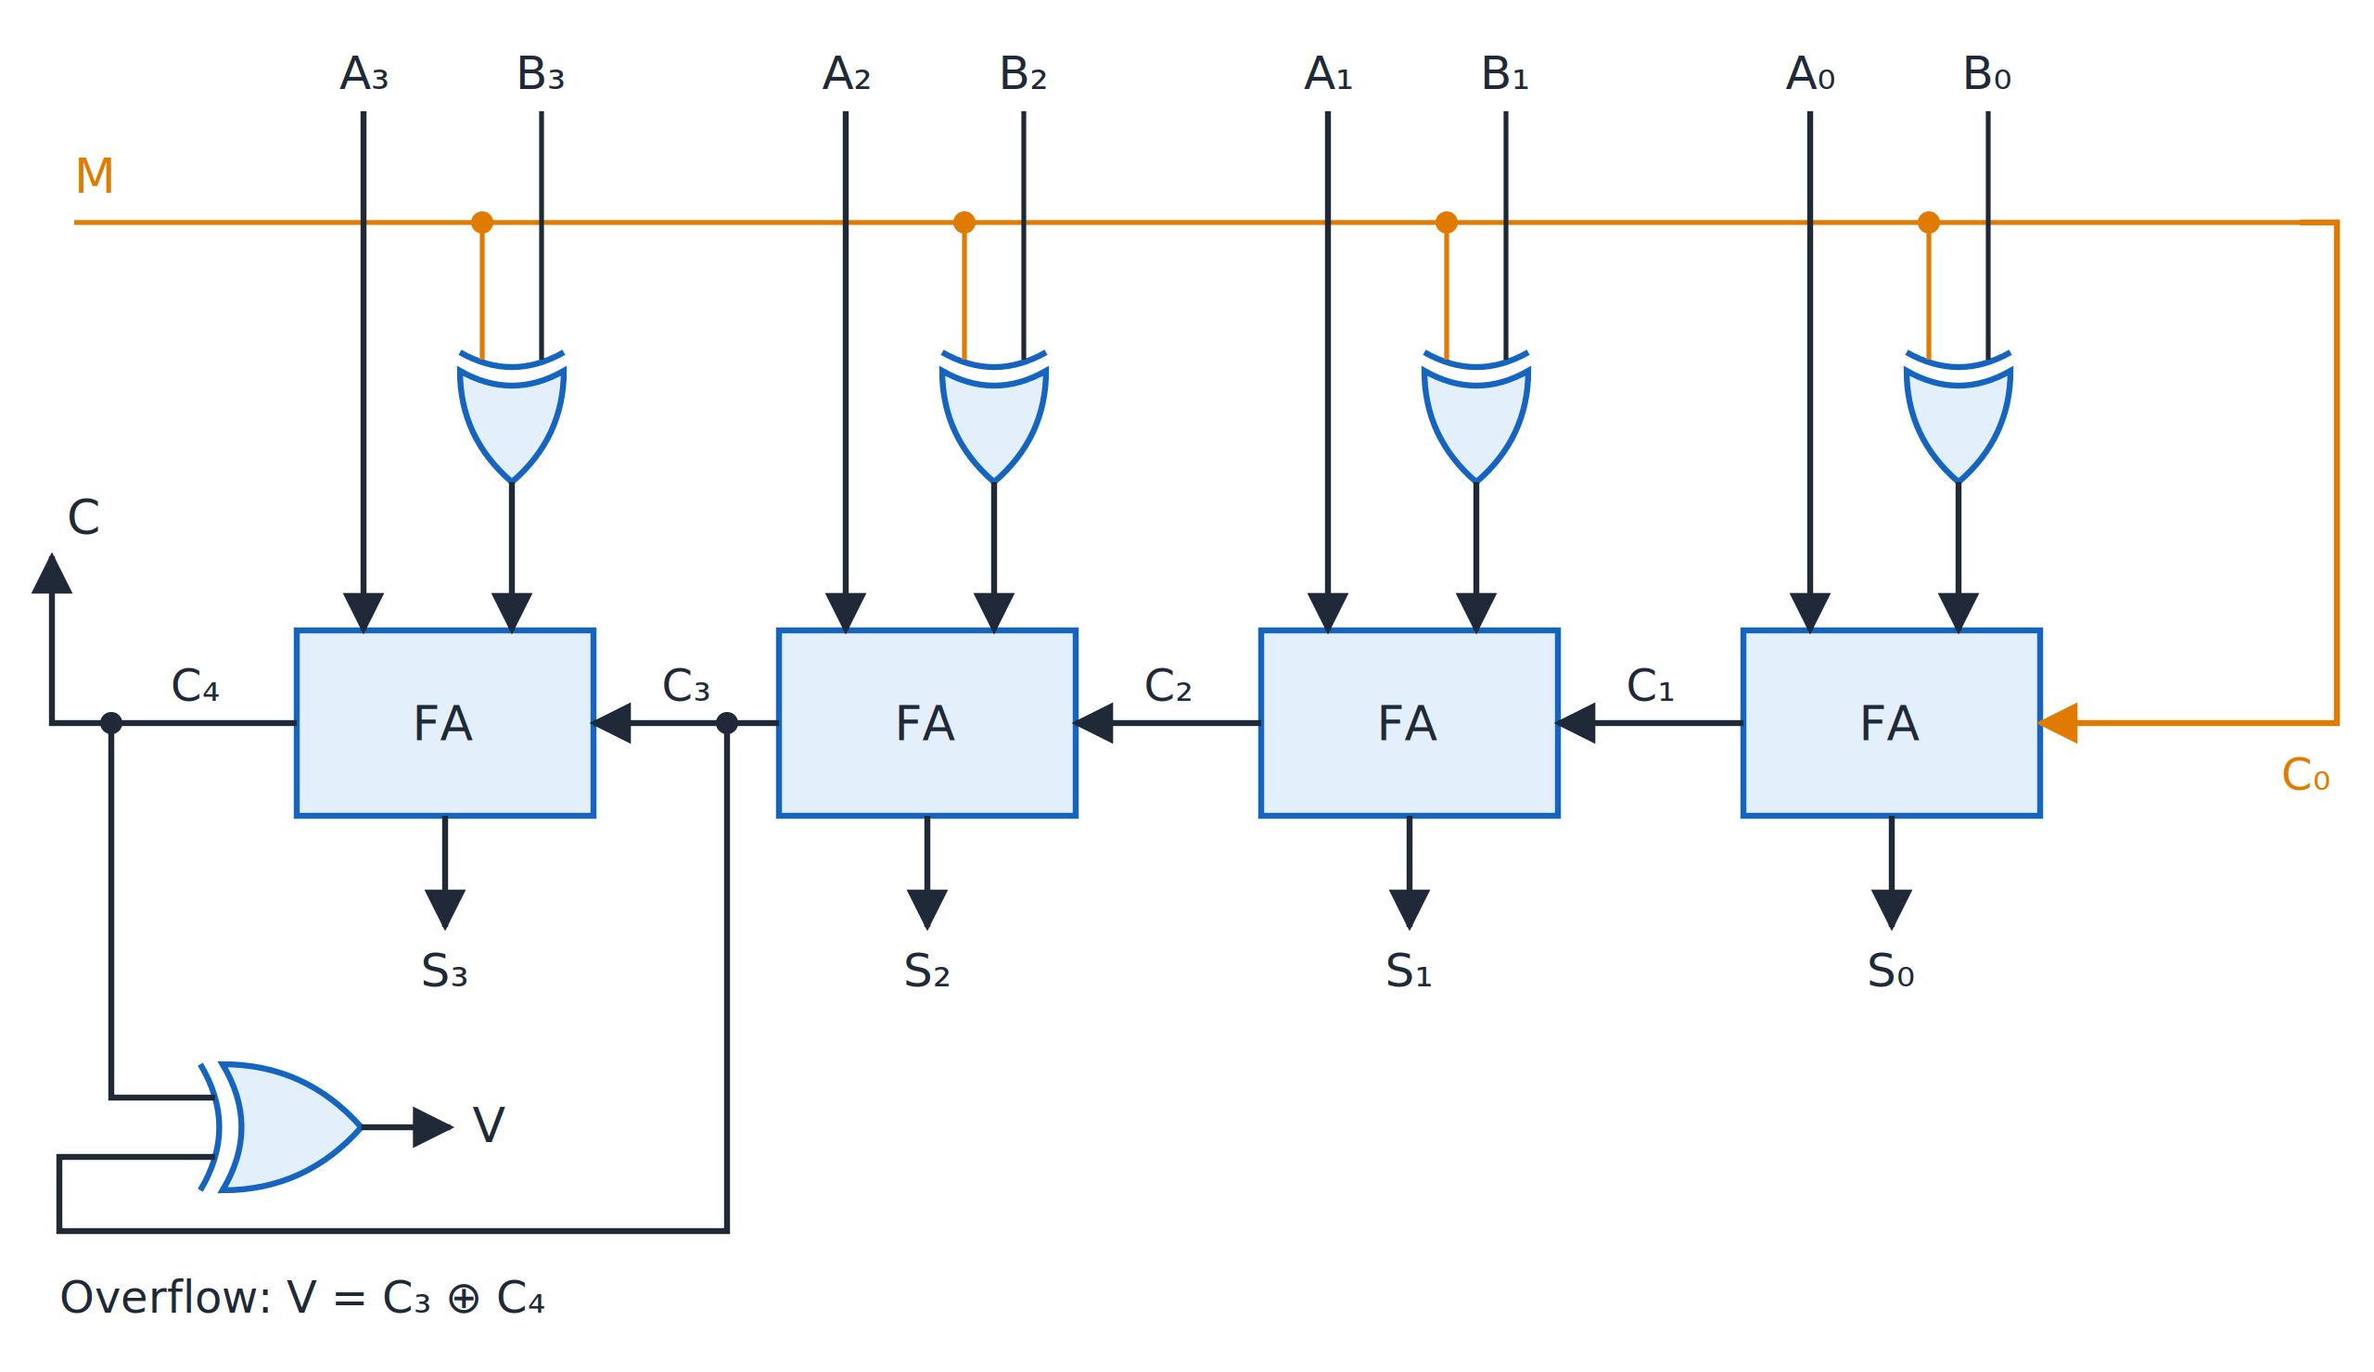
Four-bit adder-subtractor
Topic 3.2
Four-bit adder-subtractor: M = 0 adds, M = 1 subtracts; V = C₃ ⊕ C₄ flags overflow. Adapted from M. Morris Mano and Michael D. Ciletti, Digital Design, Fig. 4.13.
Notes:
This is the same chain of full adders as the ripple-carry adder, with one XOR gate added in front of each B input. V = C₃ ⊕ C₄ flags overflow.

Slide 24
3.3 BCD Adder & Binary Multiplier
Topic 3.3
IN SIMPLE TERMS
Add BCD digits in binary, then add 6 when the result is over 9; multiplying bits is just AND, followed by adders for the partial products.
Notes:
Two more arithmetic circuits finish the arithmetic part of the unit. The BCD adder reuses the binary adder with a correction step, and the multiplier arranges AND gates and adders in a new pattern. Read the box aloud and ask students to restate it in their own words.

Slide 25
BCD adder: the correction rule
Topic 3.3
BCD codes each decimal digit 0–9 as 0000–1001; patterns 1010–1111 never occur
Adding two BCD digits in a 4-bit binary adder works only if the result is 0–9; 9 + 9 = 18 is 10010, not valid BCD
Feed both digits (plus any carry-in) into a binary adder: raw sum K (0–19) and carry C
If K ≤ 9 and C = 0: already valid BCD, use as is
If K ≥ 10, or C = 1: add 0110 (6); its carry-out becomes the carry into the next decade
Z = C + K₃K₂ + K₃K₁; Z = 1 means “add 6”
Notes:
The condition K ≥ 10 covers the six patterns 1010–1111, which K-map to K₃K₂ + K₃K₁ (the BCD don’t-cares from Unit 2). The next slide shows the circuit that implements this rule.

Slide 26
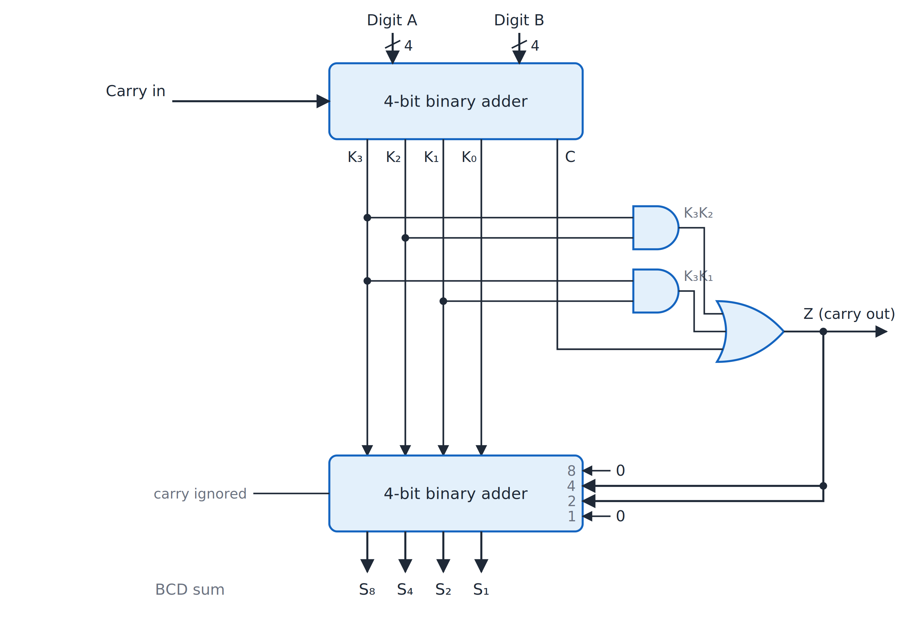
BCD adder
Topic 3.3
BCD adder: Z = C + K₃K₂ + K₃K₁ adds 0110 when the binary sum exceeds 9. Adapted from M. Morris Mano and Michael D. Ciletti, Digital Design, Fig. 4.14.
Notes:
The second adder adds 0110 if Z = 1, or 0000 if Z = 0. Z is wired straight to the 4 and 2 inputs, and the 8 and 1 inputs are tied to 0, so no extra gates are needed. The output S is guaranteed valid BCD, and Z is the carry into the next decade.

Slide 27
Worked example: 8 + 7 in BCD
Topic 3.3
A = 1000 (8), B = 0111 (7), C_{in} = 0
Binary adder: 1000 + 0111 = 1111 → K = 1111 (15), C = 0
K₃K₂ = 1·1 = 1 → Z = C + K₃K₂ + K₃K₁ = 0 + 1 + 1 = 1 (add 6)
Correction adder: 1111 + 0110 = 1 0101 → S = 0101 (5), C_{out} = 1
Result: S = 5 with C_{out} = 1 into the next decade → “15” ✓ (8 + 7 = 15)
Notes:
The raw sum 15 is a valid 4-bit pattern but not a valid BCD digit, so the correction is needed. The result digit is 5 and the carry 1 goes to the next decade.

Slide 28
Binary multiplier
Topic 3.3
Binary multiplication works like decimal long multiplication, bit by bit
Each multiplier bit gives one partial product row: the multiplicand ANDed with that bit, shifted left by its position
The rows are summed to give the product
Each partial-product bit is one 2-input AND gate: 0×0 = 0, 0×1 = 0, 1×0 = 0, 1×1 = 1
An m-bit × n-bit multiplier needs m × n AND gates plus an array of adders
Notes:
Multiplying bits is the same as ANDing them. The adders then sum the shifted rows column by column.

Slide 29
2-bit × 2-bit multiplier: layout
Topic 3.3
A1 A0
× B1 B0
-------------------
A1B0 A0B0 ← row 0 (×B0)
A1B1 A0B1 ← row 1 (×B1), shifted left 1
-------------------
P3 P2 P1 P0
Column P₀: A₀B₀ directly
Column P₁: A₁B₀ + A₀B₁ → a half adder: sum = P₁, carry into the next column
Column P₂: A₁B₁ + that carry → another half adder: sum = P₂, final carry = P₃
Notes:
The layout is the same as pencil-and-paper long multiplication. Compare it with pencil-and-paper long multiplication.

Slide 30
Worked example: A = 11 (3) × B = 11 (3)
Topic 3.3
A₁B₀ = 1, A₀B₁ = 1 → HA₁: sum = 0, carry = 1 → P₁ = 0
A₁B₁ = 1 → HA₂ adds 1 + 1 (carry):
sum = 0, carry = 1 → P₂ = 0, P₃ = 1
Product = 1001 (9) = 3 × 3 ✓
Wider multipliers follow the same pattern: more AND gates and a bigger adder array
Full adders are used once three or more bits land in the same column
Notes:
Column by column, the half adders produce P₁, P₂ and P₃. Both partial product rows have both bits set.

Slide 31
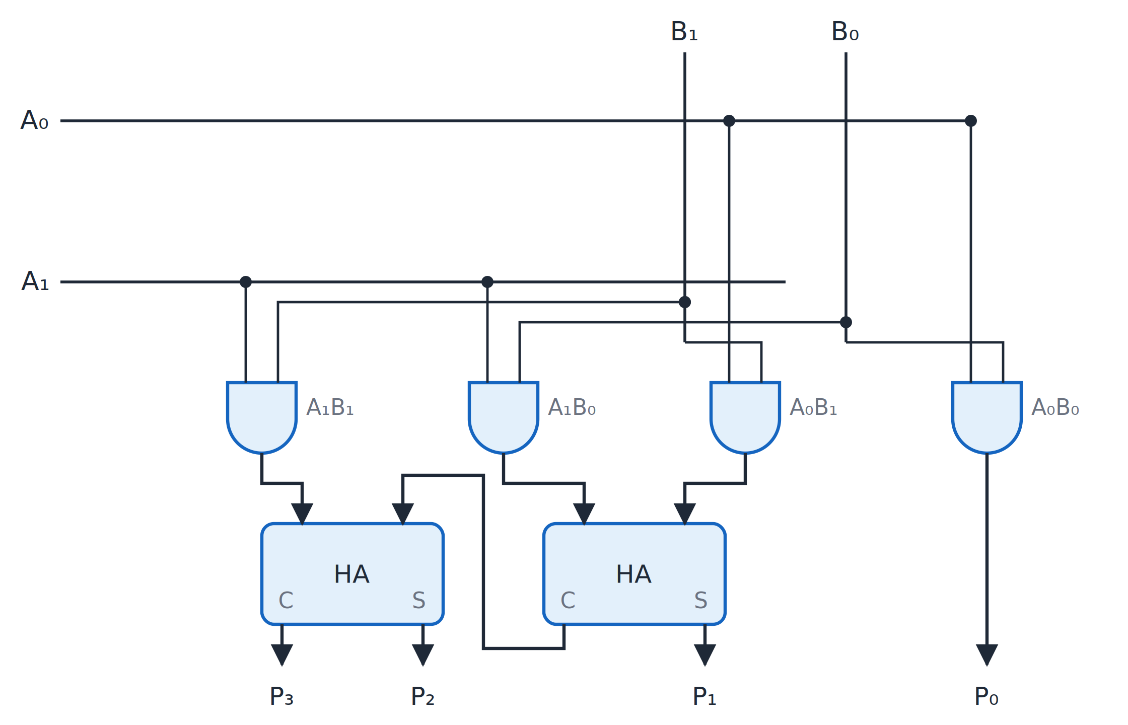
Two-bit by two-bit binary multiplier
Topic 3.3
Two-bit by two-bit binary multiplier. Adapted from M. Morris Mano and Michael D. Ciletti, Digital Design, Fig. 4.15.
Notes:
Four AND gates form the partial products, and two half adders sum the columns to give P₃P₂P₁P₀. Count the four AND gates and two half adders in the figure.

Slide 32
3.4 Magnitude Comparator
Topic 3.4
IN SIMPLE TERMS
Compare from the most significant bit down: the first bit where the numbers differ decides which is larger.
Notes:
A magnitude comparator tells which of two binary numbers is larger. It has three mutually exclusive outputs, and exactly one of them is 1. Read the box aloud and ask students to restate it in their own words.

Slide 33
1-bit comparator
Topic 3.4
(A>B) = AB′ (A<B) = A′B (A=B) = A′B′ + AB = (A ⊕ B)′ (the XNOR of A and B). All three read off directly: no K-map needed.
A | B | A>B | A=B | A<B
0 | 0 | 0 | 1 | 0
0 | 1 | 0 | 0 | 1
1 | 0 | 1 | 0 | 0
1 | 1 | 0 | 1 | 0
Notes:
Exactly one output is 1 for any pair of input bits. Only one of the three outputs is 1 for any input pair.

Slide 34
Cascading to n bits
Topic 3.4
Comparison must start at the most significant bit: if the MSBs differ, no lower bit can change the outcome
Only when a pair of bits is equal does the comparison continue to the next bit
With x_{i} = (A_{i} = B_{i}), for A = A₁A₀ against B = B₁B₀:
(A>B) = A₁B₁′ + x₁·A₀B₀′
(A<B) = A₁′B₁ + x₁·A₀′B₀ (A=B) = x₁·x₀
The pattern extends to any width
Notes:
Read the first line as: A > B if bit 1 alone decides it, or bit 1 is tied and bit 0 decides it. The next two slides show the circuit form of this rule.

Slide 35
Two cascaded 1-bit stages
Topic 3.4
In hardware: two 1-bit comparator stages cascaded, bit 1 (the higher-order bit) first
CMP₁ compares A₁ with B₁ and outputs (GT, EQ, LT); its EQ output is the x₁ signal
If CMP₁ already decided (not EQ), CMP₀ passes that decision through as the final answer
Only if CMP₁ says EQ does CMP₀’s own comparison of A₀ and B₀ decide
This is exactly what “x₁ gates whether bit 0’s comparison counts” means in circuit form
Notes:
The next slide shows this two-stage circuit. Look at the figure on the next slide while reading these points.

Slide 36
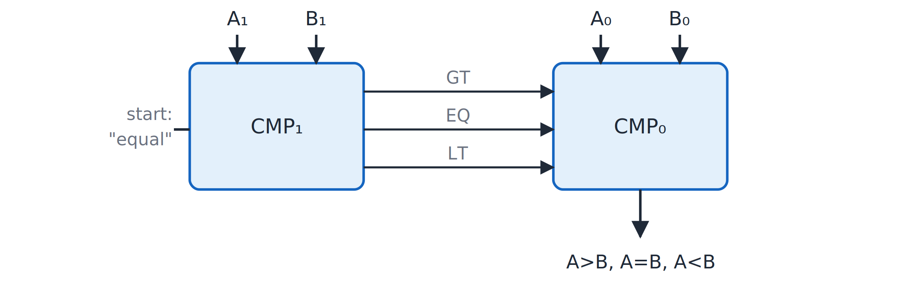
Two-bit comparison: two cascaded stages
Topic 3.4
Two-bit comparison as two cascaded 1-bit stages, most significant bit first.
Notes:
CMP₁ handles the most significant bit and passes (GT, EQ, LT) into CMP₀. The EQ line from CMP₁ decides whether CMP₀ matters.

Slide 37
Chain of 1-bit stages
Topic 3.4
Extend the idea to 4 bits: a chain of 1-bit stages, most significant bit first
Each cascade line carries the full running (GT, EQ, LT) decision from every bit compared so far, not just a “still tied” flag
The cascade entering CMP₃ is fixed at (0, 1, 0): “equal so far”, vacuously true
If the incoming cascade already says GT or LT, the stage passes it straight through
Only if it says EQ does the stage’s own bit comparison update the result
Only the final stage’s outputs are the overall result
Notes:
A single tied bit alone could not tell a later stage which way an earlier bit decided. That is why the full (GT, EQ, LT) triple is carried.

Slide 38
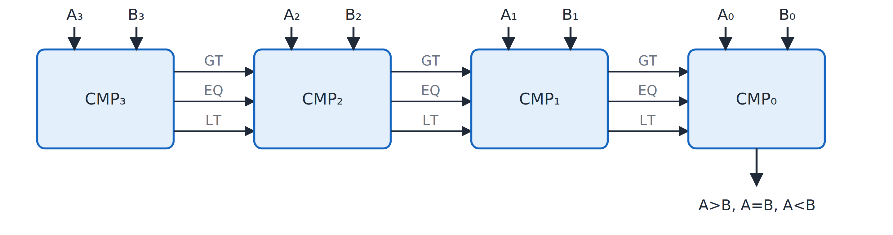
Four-bit comparison: chain of stages
Topic 3.4
Four-bit comparison as a chain of 1-bit stages, each passing GT, EQ, LT to the next.
Notes:
Each stage passes GT, EQ and LT to the next. Every earlier stage’s outputs are consumed internally by the next stage.

Slide 39
Worked example: A = 1011 (11), B = 1010 (10)
Topic 3.4
Bit 3: A3=1, B3=1 → equal, cascade “still equal” to bit 2
Bit 2: A2=0, B2=0 → equal, cascade “still equal” to bit 1
Bit 1: A1=1, B1=1 → equal, cascade “still equal” to bit 0
Bit 0: A0=1, B0=0 → A0 > B0, and every higher bit was tied
Result: A > B (11 > 10) ✓
Decided entirely by the least significant bit, because every bit above it matched
Notes:
Walk down from bit 3 to bit 0 and note where the first difference appears. Only the last bit comparison decides the result.

Slide 40
3.5 Decoders & Encoders
Topic 3.5
IN SIMPLE TERMS
A decoder turns a binary number into one active output line; an encoder does the reverse; a priority encoder picks the highest active input.
Notes:
Decoders and encoders are inverses of each other. A decoder expands an n-bit code into one active line out of 2ⁿ, and an encoder compresses one active line back into an n-bit code. Read the box aloud and ask students to restate it in their own words.

Slide 41
2-to-4 decoder
Topic 3.5
An n-to-2^{n} decoder has n inputs and up to 2^{n} outputs; exactly one output is 1. Each output is one minterm: D₀ = A′B′ D₁ = A′B D₂ = AB′ D₃ = AB
A | B | D₀ | D₁ | D₂ | D₃
0 | 0 | 1 | 0 | 0 | 0
0 | 1 | 0 | 1 | 0 | 0
1 | 0 | 0 | 0 | 1 | 0
1 | 1 | 0 | 0 | 0 | 1
Notes:
Each decoder output is literally one minterm of the inputs. Each output is one minterm, so a decoder generates every minterm of its inputs.

Slide 42
Enable input
Topic 3.5
Most real decoder chips add an enable input E
Every output AND gate gets a third input tied to E
All outputs stay 0 whenever E = 0, regardless of A and B
This makes decoders useful as chip-select logic: only the addressed chip’s enable line goes active
The next slides show D₂ = AB′E built out, then the whole decoder as a block
Notes:
The other three outputs are built the same way, with different true and complemented combinations of A and B. Think of E as a master switch for the whole decoder.

Slide 43
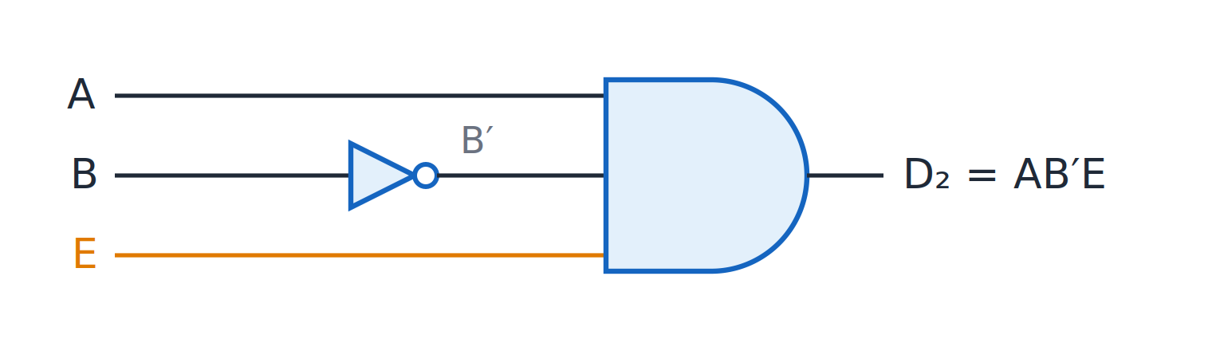
One decoder output with enable
Topic 3.5
One decoder output with enable: D₂ = AB′E.
Notes:
The gate for D₂ = AB′E: A, an inverted B and E feed one AND gate. The other outputs are built the same way, with different complemented inputs.

Slide 44
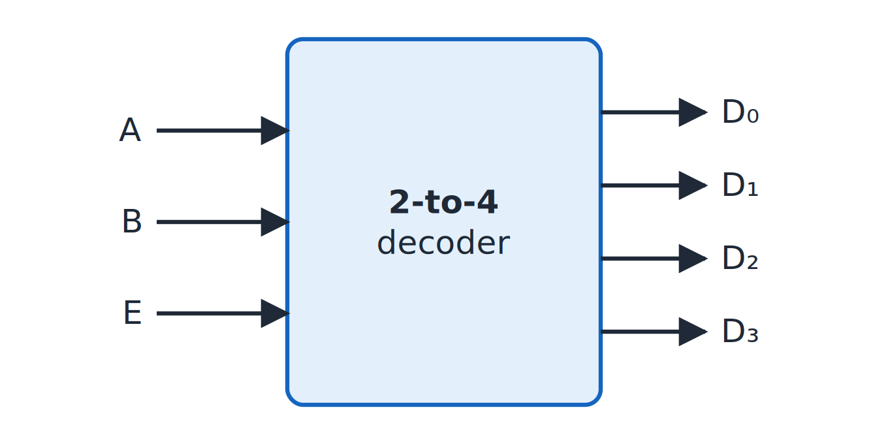
2-to-4 decoder with enable
Topic 3.5
2-to-4 decoder with enable, as a block.
Notes:
The gate detail from the previous slide is what is inside this block. The enable input E is the third input of every output gate.

Slide 45
Decoders implement any Boolean function
Topic 3.5
Every decoder output already is one minterm
To implement an n-variable function: feed the n variables into an n-to-2^{n} decoder and OR the outputs for the function’s minterms
This is the canonical-SOP idea from Unit 1, built in hardware with no simplification
Example: F(A,B) = Σm(1,2): m₁ = A′B = D₁ and m₂ = AB′ = D₂, so F = D₁ + D₂
One 2-input OR gate is enough; no separate AND-gate array is needed
Notes:
The decoder has already built every minterm, so only the OR gate remains. This is the sum-of-minterms form from Unit 1 in hardware.

Slide 46
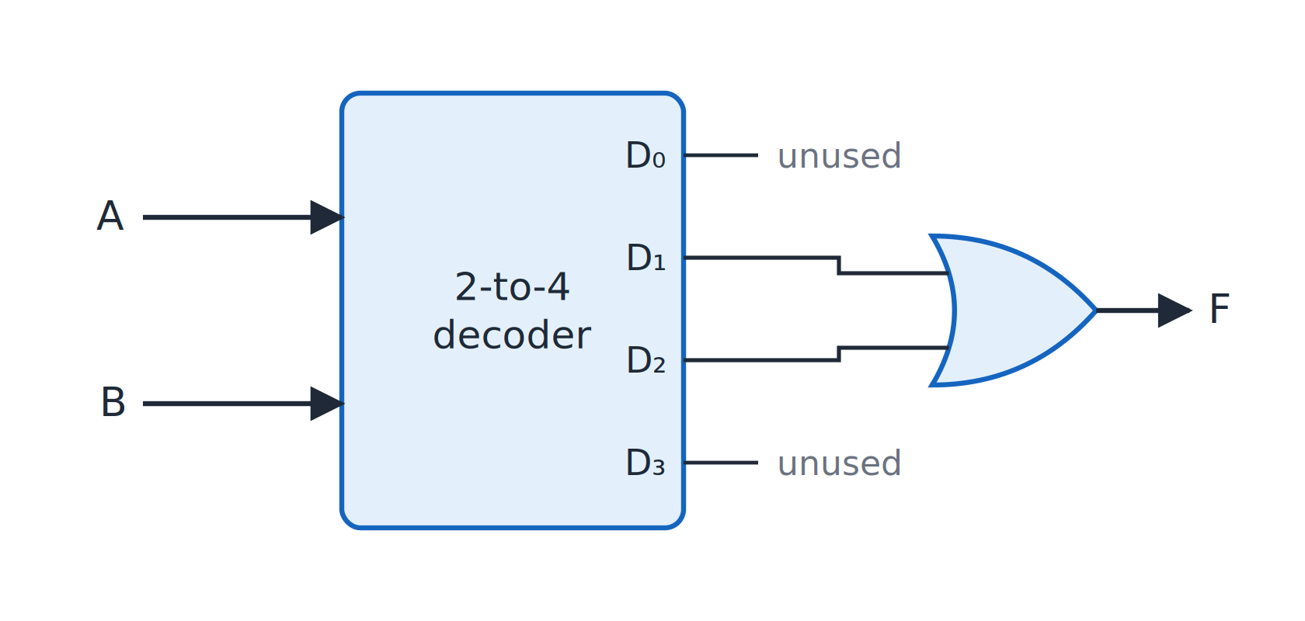
F = Σm(1,2) from a decoder
Topic 3.5
F = Σm(1,2) = D₁ + D₂ from a 2-to-4 decoder and one OR gate.
Notes:
A 2-to-4 decoder and one OR gate; D₀ and D₃ are not used. Only the outputs for the function’s minterms are connected to the OR gate.

Slide 47
8-to-3 (octal-to-binary) encoder
Topic 3.5
A0 = D1 + D3 + D5 + D7 (inputs whose index has bit 0 set)
A1 = D2 + D3 + D6 + D7 (inputs whose index has bit 1 set)
A2 = D4 + D5 + D6 + D7 (inputs whose index has bit 2 set)
An encoder does the reverse job: 2^{n} inputs (only one active at a time) go in, and n outputs carry that input’s binary index
Each output is an OR of the four inputs whose index has that bit set: three 4-input OR gates, no AND gates, no K-maps
Notes:
The octal-to-binary encoder has eight one-hot inputs D₀–D₇ and three outputs A₂A₁A₀. Each equation lists the inputs whose index has that bit set.

Slide 48
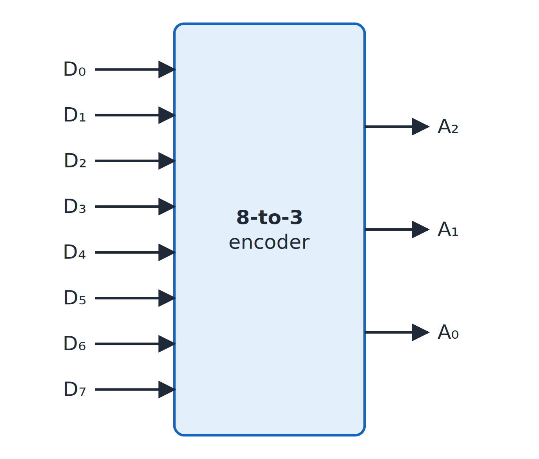
8-to-3 encoder
Topic 3.5
Eight one-hot inputs D₀–D₇; three outputs A₂A₁A₀
Each output is an OR of the four inputs whose index has that bit set
A₀ = D₁ + D₃ + D₅ + D₇
A plain encoder needs only three 4-input OR gates
8-to-3 encoder: A₂A₁A₀ give the number of the active input.
Notes:
Every input and output of the encoder is drawn individually. Check that D₅ makes A₂ and A₀ equal to 1, giving 101.

Slide 49
Priority encoder
Topic 3.5
A plain encoder assumes exactly one input is active; real systems cannot guarantee that
A priority encoder always encodes the highest-indexed active input and ignores lower ones
The X entries are don’t-cares: once D₃ = 1, D₂, D₁ and D₀ do not matter
V is a valid-output flag: 0 only when no input is active
V is needed because A₁ = A₀ = 0 is otherwise ambiguous: “D₀ active” or “nothing active”?
Notes:
Two devices might request service in the same cycle. The priority encoder resolves the conflict.

Slide 50
4-input priority encoder
Topic 3.5
X means don’t-care. The highest active input always wins.
D₃ | D₂ | D₁ | D₀ | A₁ | A₀ | V
0 | 0 | 0 | 0 | X | X | 0
0 | 0 | 0 | 1 | 0 | 0 | 1
0 | 0 | 1 | X | 0 | 1 | 1
0 | 1 | X | X | 1 | 0 | 1
1 | X | X | X | 1 | 1 | 1
Notes:
Read the table from the bottom up: D₃ wins whatever the other inputs are. V is 0 only in the first row.

Slide 51
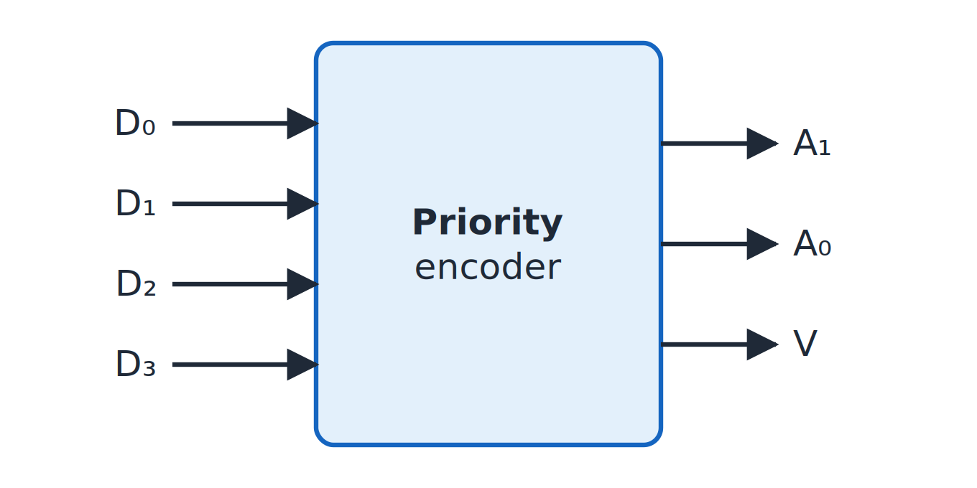
Four-input priority encoder
Topic 3.5
Four-input priority encoder: A₁A₀ name the highest-numbered active input; V = 1 when any input is active.
Notes:
As a block it looks like a plain encoder with one extra output pin, V. The block has the same inputs as a plain encoder plus the extra output V.

Slide 52
3.6 Multiplexers & Demultiplexers
Topic 3.6
IN SIMPLE TERMS
A multiplexer is a selector switch from many inputs to one output; a demultiplexer sends one input to one of many outputs.
Notes:
This topic closes the unit with the last pair of standard building blocks. A multiplexer selects and a demultiplexer distributes. Read the box aloud and ask students to restate it in their own words.

Slide 53
4-to-1 multiplexer
Topic 3.6
A 4-to-1 MUX has four data inputs I₀–I₃, two select lines S₁, S₀ and one output Y. Y = S₁′S₀′I₀ + S₁′S₀I₁ + S₁S₀′I₂ + S₁S₀I₃
S₁ | S₀ | Y
0 | 0 | I₀
0 | 1 | I₁
1 | 0 | I₂
1 | 1 | I₃
Notes:
The select code picks which single data input is copied through to Y. Y copies exactly one data input.

Slide 54
A MUX is a decoder with data lines
Topic 3.6
The four terms S₁′S₀′, S₁′S₀, S₁S₀′ and S₁S₀ are exactly the four outputs of a 2-to-4 decoder
A MUX is essentially a decoder in which every output gate’s third input is a data line instead of a shared enable
The next slide shows the I₁ term, S₁′S₀I₁, built out explicitly
The other three terms are identical, and all four feed one 4-input OR gate to produce Y
Notes:
This links the multiplexer back to the decoder from the previous topic. A decoder gives one-hot select signals and the data lines then gate them.

Slide 55
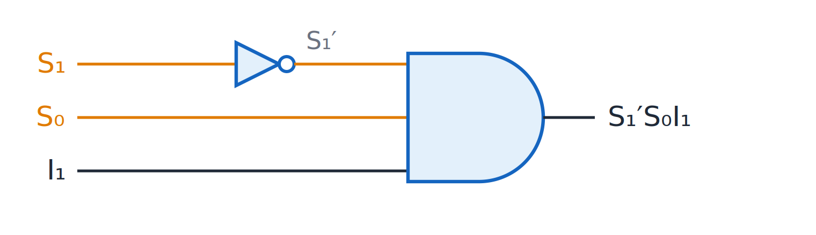
One multiplexer term
Topic 3.6
One multiplexer term: S₁′S₀I₁.
Notes:
S₁ is inverted, S₀ and I₁ pass straight, and one AND gate forms S₁′S₀I₁. The other three terms use different true and complemented forms of S₁ and S₀.

Slide 56
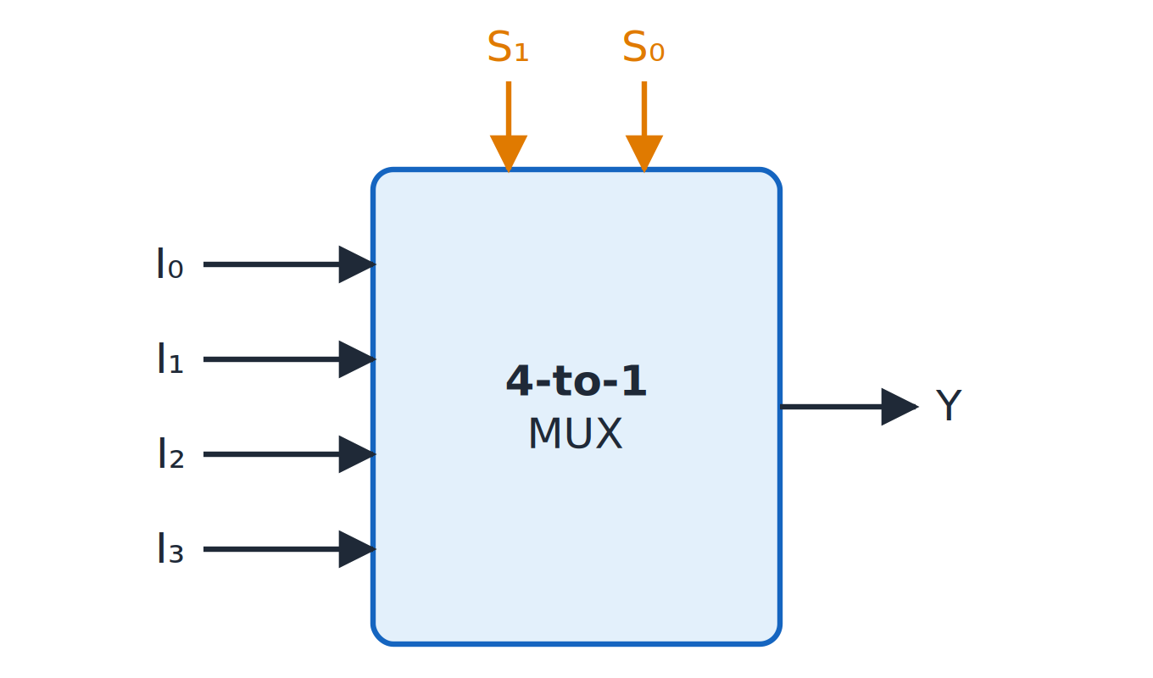
4-to-1 multiplexer
Topic 3.6
4-to-1 multiplexer as a block.
Notes:
The whole 4-to-1 MUX as a single block with two select lines. The select lines S₁S₀ choose which input I₀–I₃ reaches Y.

Slide 57
A MUX as a universal function generator
Topic 3.6
A 2^{n}-to-1 MUX can implement any function of n + 1 variables
Use n of the variables as select lines
Wire each data input to 0, 1, the last variable or its complement
Decide each input by checking what the function reduces to once the select variables are fixed
No K-map, no separate AND/OR array and no minimisation is needed
Notes:
This is a different implementation strategy from every other circuit in the unit: a MUX routes an already-known signal to the right place. The next slide gives a full example.

Slide 58
Worked example: F(A,B,C) = Σm(1,3,5,6) on a 4-to-1 MUX
Topic 3.6
Select lines: S₁ = A, S₀ = B
AB = 00 (m0, m1): F(0,0,0)=0, F(0,0,1)=1 → F = C → I0 = C
AB = 01 (m2, m3): F(0,1,0)=0, F(0,1,1)=1 → F = C → I1 = C
AB = 10 (m4, m5): F(1,0,0)=0, F(1,0,1)=1 → F = C → I2 = C
AB = 11 (m6, m7): F(1,1,0)=1, F(1,1,1)=0 → F = C′ → I3 = C′
Wire I₀ = I₁ = I₂ = C and I₃ = C′
Notes:
For each AB combination, look at how F depends on C alone. Each data input is 0, 1, C or C′.

Slide 59
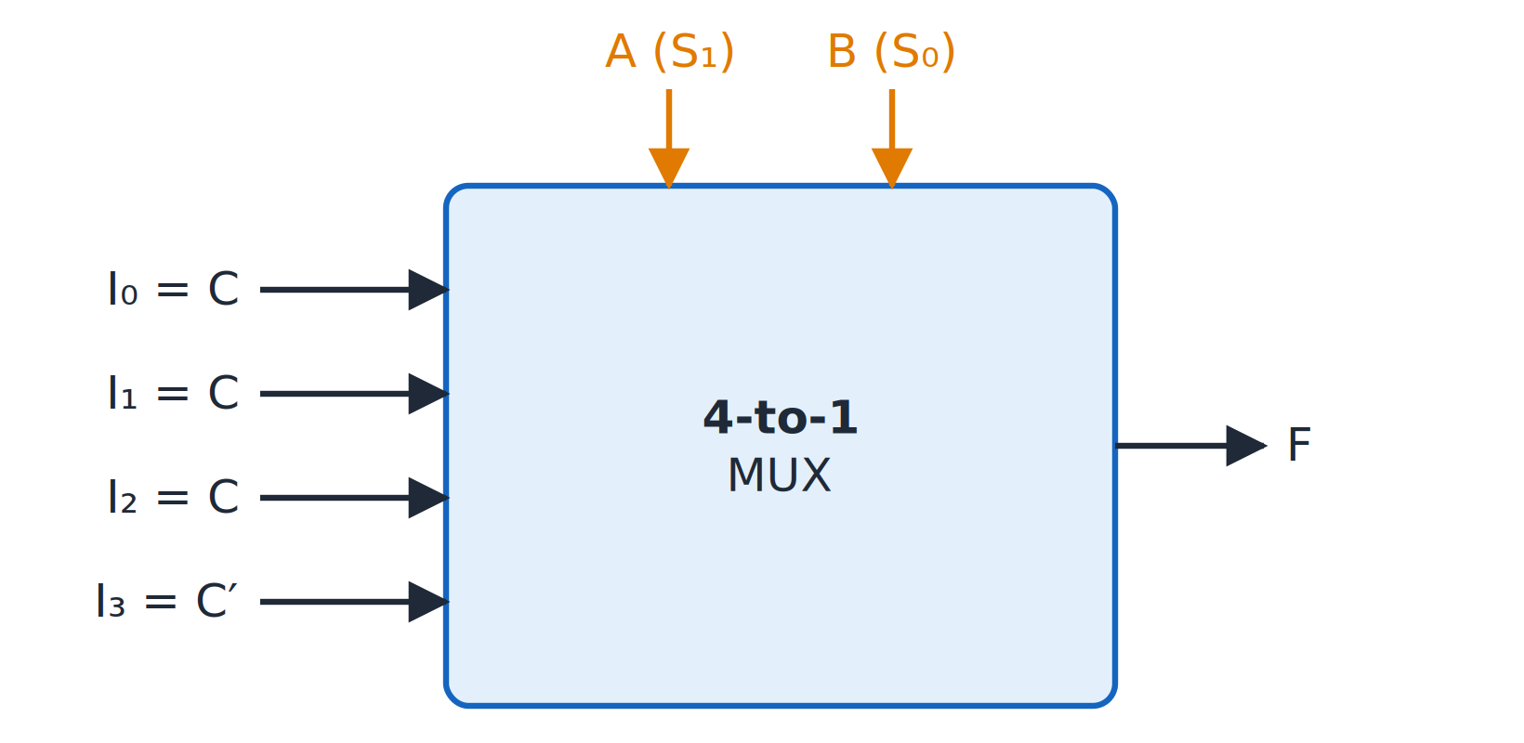
F = Σm(1,3,5,6) on a multiplexer
Topic 3.6
F = Σm(1,3,5,6) on a 4-to-1 multiplexer: I₀ = I₁ = I₂ = C, I₃ = C′.
Notes:
A and B drive the select lines S₁ and S₀. Inputs are I₀ = I₁ = I₂ = C and I₃ = C′.

Slide 60
Demultiplexer (data distributor)
Topic 3.6
A 1-to-4 DEMUX takes one data input D and two select lines S₁, S₀
It routes D to exactly one of four outputs Y₀–Y₃; all other outputs stay 0
Y₀ = S₁′S₀′D Y₁ = S₁′S₀D Y₂ = S₁S₀′D Y₃ = S₁S₀D
A demultiplexer is a decoder: the data line D takes the place of the shared enable input
Any decoder with an enable pin can be used as a demultiplexer, and vice versa
Notes:
They are the same circuit under two names, depending on how the extra input is used. A decoder with enable can be used directly as a demultiplexer.

Slide 61
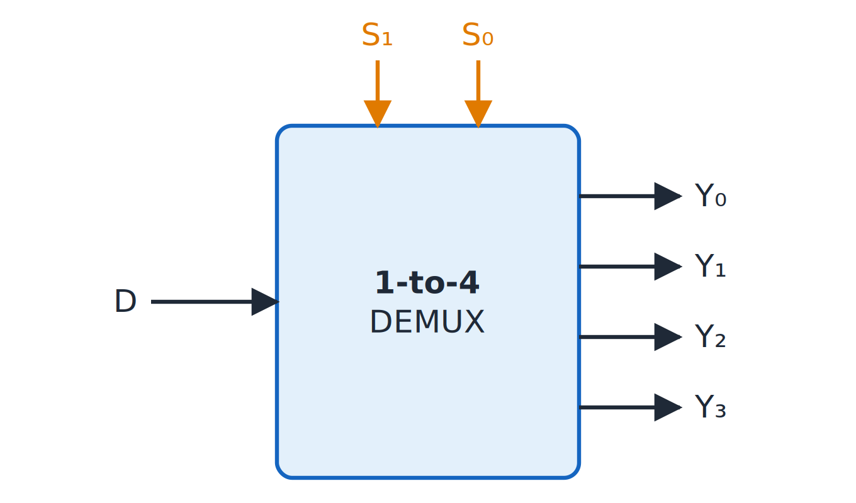
1-to-4 demultiplexer
Topic 3.6
1-to-4 demultiplexer: D appears on the output chosen by S₁S₀.
Notes:
D appears on the output chosen by S₁S₀. D goes to Y₀ for S₁S₀ = 00, to Y₁ for 01, and so on.

Slide 62
Unit 3 summary
3.1 Analysis and design: label wires, write expressions; specification → truth table → minimal function → circuit
3.2 Adder and subtractor: half adder, full adder, ripple-carry chain; XOR per bit and M make an adder-subtractor
3.3 BCD adder and multiplier: add 6 when Z = C + K₃K₂ + K₃K₁ = 1; AND gates give partial products
3.4 Magnitude comparator: compare from the MSB; cascade (GT, EQ, LT) through 1-bit stages
3.5 Decoders and encoders: decoder outputs are minterms; priority encoder picks the highest active input
3.6 Multiplexers and demultiplexers: select one of many inputs; a DEMUX is a decoder with D as enable
Notes:
Recap in one line per topic. Ask students which block they would use to select one of eight memory chips, and which to add two BCD digits.

Slide 63
Review questions (1 of 2)
Q1. List the steps of the analysis procedure for a combinational circuit
Q2. Derive the full adder equations S and C_{out} and show how two half adders and an OR gate build it
Q3. In a 4-bit ripple-carry adder, why is the most significant sum bit valid last?
Q4. How does one control line M turn an adder into an adder-subtractor?
Notes:
These questions cover topics 3.1 and 3.2. Answers are in the topic slides: Q1 the three analysis steps, Q2 the full adder slide, Q3 the carry ripples through every stage, Q4 XOR gates with M = 1 give B′ and C_in = 1.

Slide 64
Review questions (2 of 2)
Q5. Add 8 and 7 in BCD and show when the correction of 0110 is applied
Q6. Why must a magnitude comparator start at the most significant bit?
Q7. Implement F(A,B) = Σm(1,2) with a 2-to-4 decoder and one gate
Q8. Implement F(A,B,C) = Σm(1,3,5,6) on a 4-to-1 multiplexer
Notes:
These questions cover topics 3.3 to 3.6. Answers: Q5 is 1111 plus 0110 giving 0101 with a carry, Q6 a differing MSB decides the result, Q7 is F = D₁ + D₂, Q8 is I₀ = I₁ = I₂ = C and I₃ = C′.

Slide 65
References
Textbook: M. Morris Mano and Michael D. Ciletti, Digital Design
Adapted figures:
Full adder from two half adders and an OR gate (Fig. 4.8)
Four-bit ripple-carry adder (Fig. 4.9)
Four-bit adder-subtractor (Fig. 4.13)
BCD adder (Fig. 4.14)
Two-bit by two-bit binary multiplier (Fig. 4.15)
Notes:
The textbook is the reference for this unit. The figures listed are adapted from it; the other figures in this deck are original.

