Slide 1
Unit 4: Sequential Logic Circuits
4
Digital Logic Design
CHANDRAS EDU
Never stop learning
Notes:
Welcome to Unit 4 of Digital Logic Design. This unit adds memory to digital circuits: latches, flip-flops, counters and shift registers.

Slide 2
Outline
4.1 Latches
4.2 Flip-Flops & Timing
4.3 Asynchronous (Ripple) Counters
4.4 Synchronous Counters
4.5 Shift Registers & Applications
Notes:
Five topics in order. We start with latches and flip-flops, then study asynchronous and synchronous counters, and finish with shift registers.

Slide 3
4.1 Latches
Topic 4.1
IN SIMPLE TERMS
A latch is two gates feeding each other, so it remembers one bit; with an enable input, it copies D only while EN = 1.
Notes:
Everything in Units 1 to 3 was combinational. This topic introduces memory in its simplest form: the latch. Read the box aloud and ask students to restate it in their own words.

Slide 4
Combinational versus sequential logic
Topic 4.1
Units 1–3 were combinational: output depends only on the present inputs, with no memory
A sequential circuit adds memory: its output depends on the present inputs and the current state
The state comes from feeding an output signal back into the input logic
Next State (Q_{next}) = f(Inputs, Current State Q)
A latch is the simplest sequential element: a 1-bit memory cell built from ordinary gates wired with feedback
Notes:
The key difference from earlier units is feedback. The output now depends on history, not only on the present inputs.

Slide 5
The SR latch (Set-Reset)
Topic 4.1
Cross-couple two NOR gates: each gate’s output feeds back as one of the other gate’s inputs
The circuit has two stable states, which is exactly what is needed to remember one bit
Top gate: Q = NOR(R, Q′). Bottom gate: Q′ = NOR(S, Q)
The two feedback paths cross, which is why S ends up wired to the gate that produces Q′, not Q
Notes:
Cross-coupled means each gate’s output loops back into the other gate. The next slide shows the circuit.

Slide 6
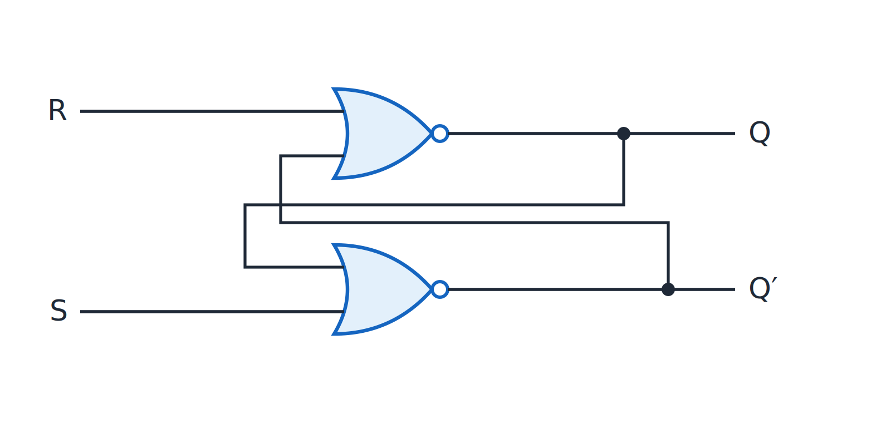
SR latch
Topic 4.1
SR latch with two cross-coupled NOR gates.
Notes:
Follow the output of each NOR gate back to the input of the other gate. The crossing of the two feedback paths is what makes the circuit store a bit.

Slide 7
SR latch functionality
Topic 4.1
S (Set) | R (Reset) | Q_{next} | State | Behavior
0 | 0 | Q | Hold | No change: holds current state
1 | 0 | 1 | Set | Forces Q to 1
0 | 1 | 0 | Reset | Forces Q to 0
1 | 1 | Invalid | Forbidden | Both Q and Q′ driven to 0, breaking the complement relationship. Must be avoided
Notes:
The forbidden row forces both outputs to 0, so Q and Q′ are no longer complements. Always avoid S = R = 1.

Slide 8
Worked example: tracing S = 1, R = 0
Topic 4.1
Bottom gate: S = 1 → Q′ = NOR(1, anything) = 0
Feed Q′ = 0 back into the top gate with R = 0
Top gate: Q = NOR(0, 0) = 1
So S = 1 forces Q = 1
S = 1 first forces the other gate’s output low, then that value feeds forward
Notes:
Trace the signal through both gates in order. The latch sets by forcing Q′ low first.

Slide 9
The gated D latch
Topic 4.1
The SR latch has two problems: the forbidden S = R = 1 state, and no control over when it updates
The gated D latch fixes both
Drive the inputs from one data line D: S = D and R = D′; S and R are always complements, so S = R = 1 can never happen
Add an Enable (EN) input: two AND gates give S = D·EN and R = D′·EN
When EN = 0, both S and R are 0 and the SR latch holds its last state
Notes:
The forbidden state is eliminated by construction. The enable input controls when the latch is allowed to change.

Slide 10
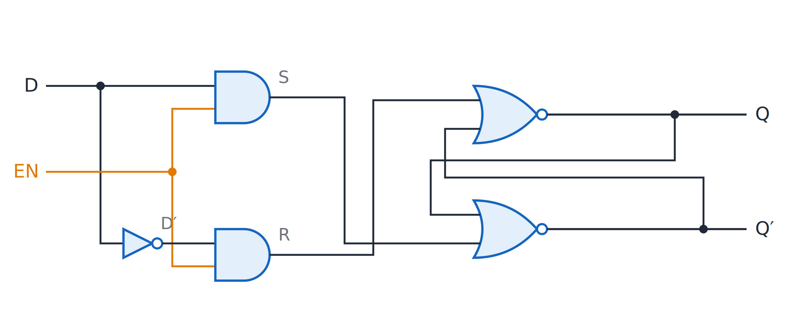
Gated D latch
Topic 4.1
Gated D latch: S = D·EN and R = D′·EN drive the NOR latch, so S = R = 1 can never occur.
Notes:
The same NOR latch, now fed by D and D′ through two enable-gated AND gates. The two AND gates pass D and D′ only while EN is 1.

Slide 11
Transparent versus latched mode
Topic 4.1
EN = 1 (transparent): Q follows D continuously; any change on D shows up on Q immediately
EN = 0 (latched): Q holds its last value and ignores further changes on D
While EN is high the output tracks D; dropping EN freezes whatever was there
This circuit behaves as pure 1-bit data storage
Notes:
Level-sensitive means the latch responds for the whole time EN is high. A flip-flop, in the next topic, responds only at a clock edge.

Slide 12
4.2 Flip-Flops & Timing
Topic 4.2
IN SIMPLE TERMS
A flip-flop is a latch that changes only at the clock edge, so every flip-flop in a system updates at the same instant.
Notes:
A flip-flop is edge-triggered. That single change is what makes reliable counters, registers and state machines possible. Read the box aloud and ask students to restate it in their own words.

Slide 13
Latch versus flip-flop
Topic 4.2
The gated D latch is level-sensitive: for the entire time EN is high, Q tracks D
A flip-flop is edge-triggered: it samples its inputs and updates Q only when the clock transitions (↑ rising or ↓ falling edge)
It ignores its inputs the rest of the time
That single change makes counters, registers and state machines reliable
Every stage changes at the same defined instant, instead of drifting with how long a level stays high
Notes:
The next slide shows the graphic symbols of the four flip-flop types. Edge-triggering is what lets every stage change at the same instant.

Slide 14
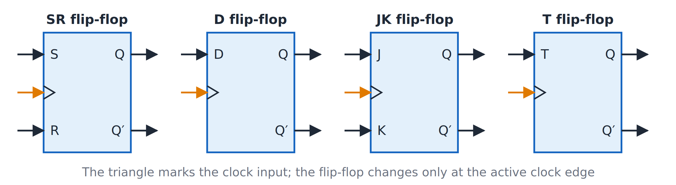
Flip-flop graphic symbols
Topic 4.2
Graphic symbols of the SR, D, JK and T flip-flops; the triangle marks the clock input.
Notes:
SR, D, JK and T flip-flops. The triangle marks the clock input.

Slide 15
Characteristic equations and excitation tables
Topic 4.2
A characteristic equation gives the next state Qₙ₊₁ as a function of the inputs and the present state Qₙ
An excitation table flips this around: for a desired Qₙ → Qₙ₊₁ transition, which inputs are required
Excitation tables link “what sequence of states do I want” to “how do I wire the inputs”
They are the basis of synchronous counter design in the next topic
Notes:
The next two slides list the equations and tables for the D, T, JK and SR flip-flops. Excitation tables are read in the opposite direction to characteristic equations.

Slide 16
Characteristic and excitation tables (1 of 2)
Topic 4.2
Type | Characteristic equation | Q_{n} → Q_{n+1} | Required input(s)
D | Q_{n+1} = D | 0 → 0 | D = 0
 |  | 0 → 1 | D = 1
 |  | 1 → 0 | D = 0
 |  | 1 → 1 | D = 1
T | Q_{n+1} = T ⊕ Q_{n} | 0 → 0 | T = 0
 |  | 0 → 1 | T = 1
 |  | 1 → 0 | T = 1
 |  | 1 → 1 | T = 0
Notes:
D and T have no don’t-cares: every transition fixes the input exactly. Read each row as: to go from Qₙ to Qₙ₊₁, apply these inputs.

Slide 17
Characteristic and excitation tables (2 of 2)
Topic 4.2
Type | Characteristic equation | Q_{n} → Q_{n+1} | Required input(s)
JK | Q_{n+1} = JQ_{n}′ + K′Q_{n} | 0 → 0 | J = 0, K = X
 |  | 0 → 1 | J = 1, K = X
 |  | 1 → 0 | J = X, K = 1
 |  | 1 → 1 | J = X, K = 0
SR | Q_{n+1} = S + R′Q_{n} (SR = 0) | 0 → 0 | S = 0, R = X
 |  | 0 → 1 | S = 1, R = 0
 |  | 1 → 0 | S = 0, R = 1
 |  | 1 → 1 | S = X, R = 0
Notes:
X means don’t-care. For SR the inputs S and R must never both be 1.

Slide 18
Why don’t-cares matter
Topic 4.2
The X (don’t-care) entries are the point of using JK or T over D in counter design
Whenever an input can be 0 or 1 without affecting the transition, a later K-map step can exploit that freedom
D has no don’t-cares: every transition pins down D exactly
SR has two (0 → 0 and 1 → 1), fewer than JK
S and R must never both be 1: the forbidden state inherited from the latch
Notes:
The don’t-cares give more room to simplify the input equations of a counter. The next topic uses these don’t-cares in a K-map.

Slide 19
The race-around problem
Topic 4.2
A level-triggered JK latch with J = K = 1 should toggle
If the clock pulse stays high longer than the gate propagation delay t_{pd}, the output toggles again, and again
The final state depends on how many times it toggled: unpredictable
This is the race-around condition
Notes:
From the designer’s point of view the final state is effectively random. The fix is the master-slave structure on the next slide.

Slide 20
The master-slave solution
Topic 4.2
Chain two latches, a master and a slave, controlled by opposite phases of the clock
The two halves are never transparent at the same time
CLK = 1: the master is transparent and absorbs J, K into its state Y; the slave is latched and isolates Q
CLK = 0: the master locks Y; the slave becomes transparent and copies Q = Y
Q changes only on the falling edge; the master is already locked, so there is no race
Notes:
No race occurs however long either clock phase lasts, because the master cannot be affected by its own output. Q changes only on the falling edge of the clock.

Slide 21
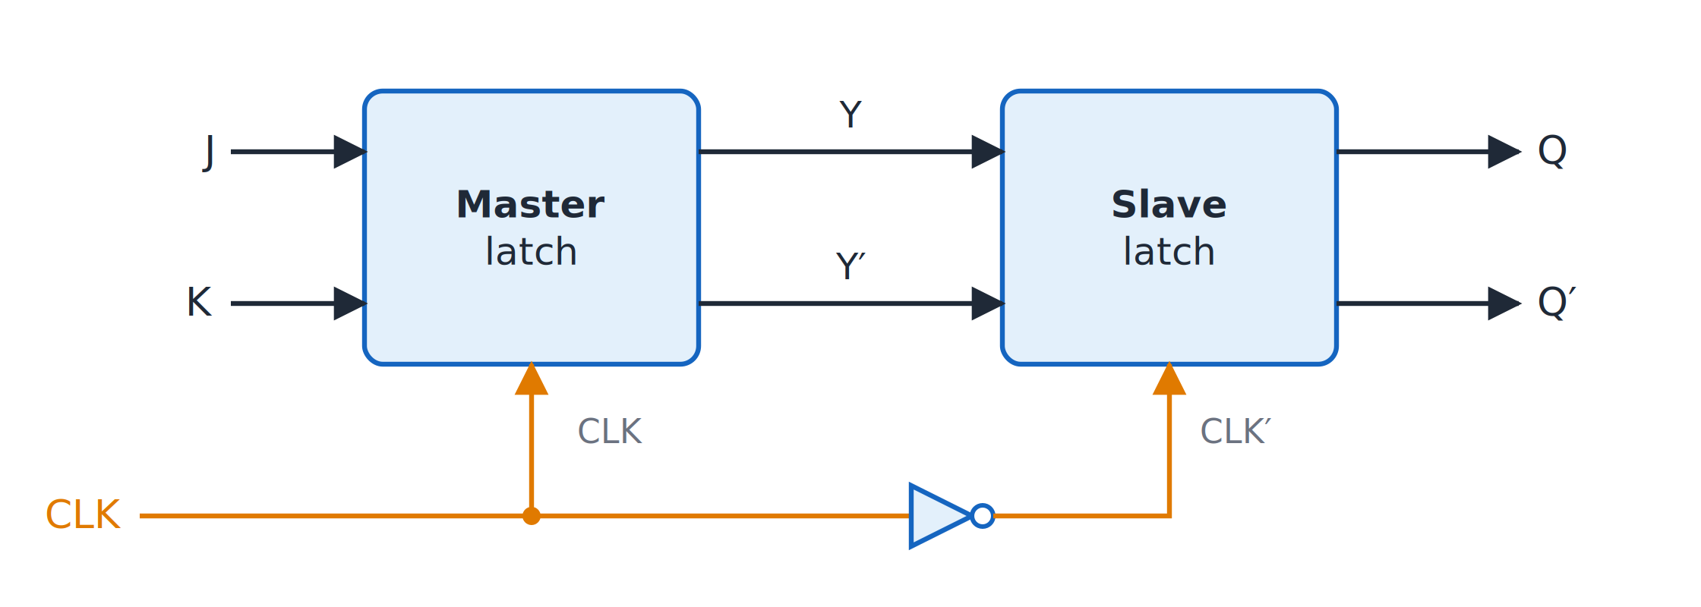
Master-slave flip-flop
Topic 4.2
Master-slave flip-flop: the master follows J, K while CLK = 1; the slave copies it while CLK = 0.
Notes:
The slave’s clock is the inverted clock, so the two latches take turns being transparent. While CLK = 1 the master follows J and K, and while CLK = 0 the slave copies the master.

Slide 22
Setup time, hold time and clock skew
Topic 4.2
Setup time (t_{su}): the minimum time D must be stable before the active clock edge
Hold time (t_{h}): the minimum time D must stay stable after the active clock edge
Clock skew: the difference in clock arrival time at different flip-flops, caused by unequal interconnect delay
Skew eats into the setup and hold margin
Violating setup or hold time risks metastability: the output hovers between 0 and 1 before resolving unpredictably
Notes:
Real designs budget setup and hold margin explicitly, rather than treating it as an afterthought. Metastability means the output sits between 0 and 1 for an unpredictable time.

Slide 23
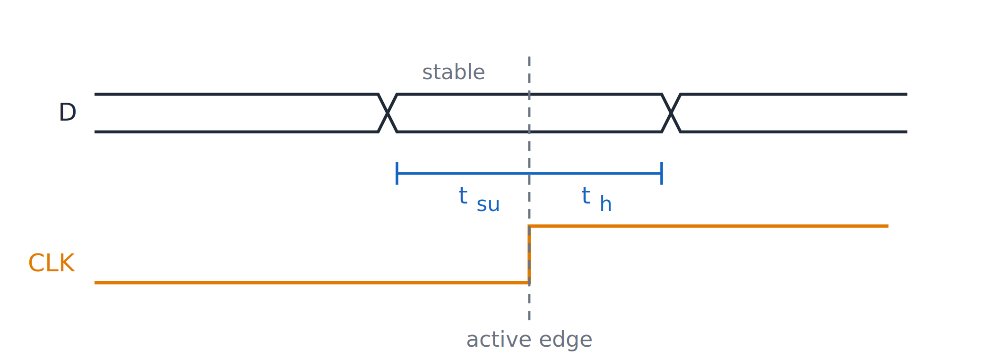
Setup and hold time
Topic 4.2
Setup time t_{su} and hold time t_{h} around the active clock edge.
Notes:
The diagram shows the setup time before the dashed active clock edge and the hold time after it. D must stay stable throughout the window that surrounds the active edge.

Slide 24
4.3 Asynchronous (Ripple) Counters
Topic 4.3
IN SIMPLE TERMS
In a ripple counter each flip-flop toggles the next one, so a count change ripples down the chain instead of happening all at once.
Notes:
A counter cycles through a fixed sequence of binary states. In a ripple counter only the first flip-flop receives the external clock. Read the box aloud and ask students to restate it in their own words.

Slide 25
What makes a counter asynchronous?
Topic 4.3
A counter is a sequential circuit that cycles through a fixed sequence of binary states on every clock pulse
In an asynchronous (ripple) counter only the first flip-flop receives the external clock
Every later stage is clocked by the output of the stage before it
The new count “ripples” through the chain one stage at a time
Notes:
Each stage updates only after the one before it has already toggled. The next slides build a 3-bit asynchronous up-counter.

Slide 26
3-bit asynchronous up-counter
Topic 4.3
Cascade three negative-edge triggered T flip-flops, each wired T = 1 (toggle every clock)
FF₀ is the LSB and toggles on every external clock pulse
FF₁ toggles only when Q₀ falls; FF₂ only when Q₁ falls
Each stage runs at half the frequency of the one before: exactly binary counting
Sequence: 000 → 001 → 010 → 011 → 100 → 101 → 110 → 111 → 000 …
Notes:
The next two slides show the circuit and the timing diagram. FF₁ and FF₂ are not connected to the external clock.

Slide 27
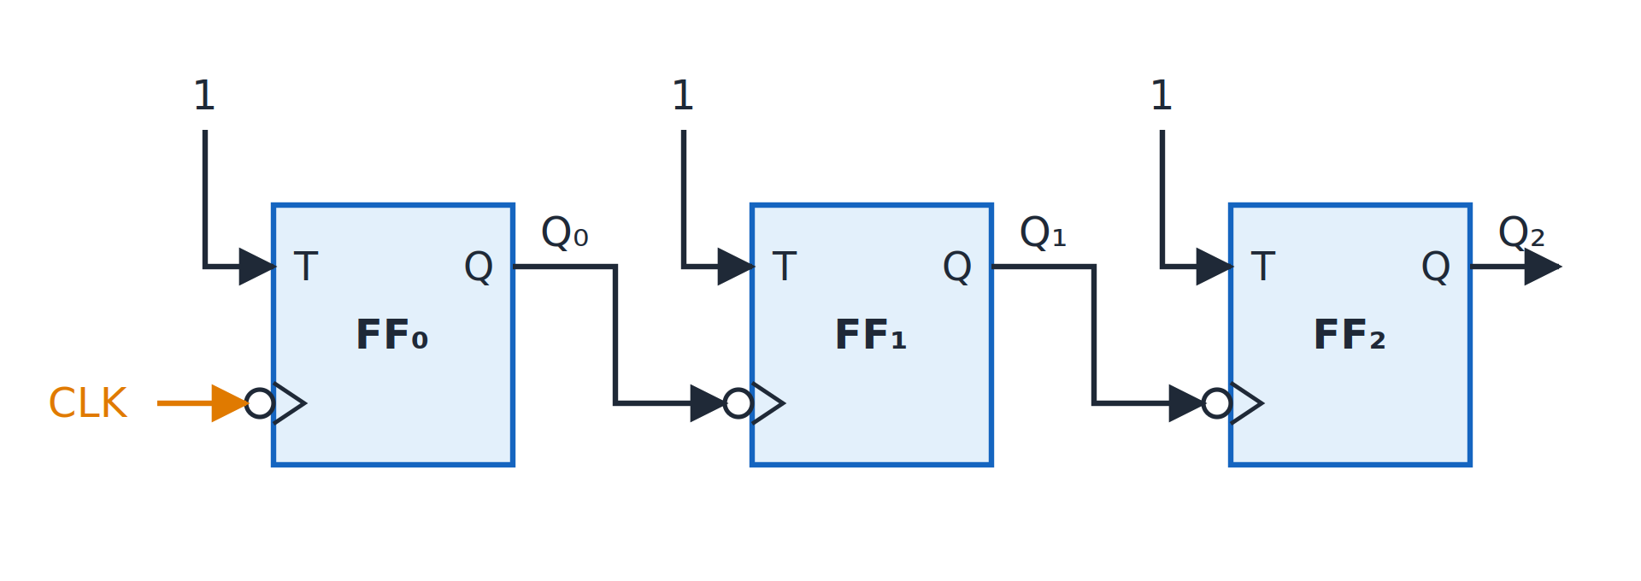
3-bit ripple up-counter
Topic 4.3
Three-bit ripple up-counter: negative-edge T flip-flops, each clocked by the previous Q.
Notes:
Negative-edge T flip-flops, each clocked by the previous Q. Follow the clock from the external pin into FF₀ and then from each Q into the next stage.

Slide 28
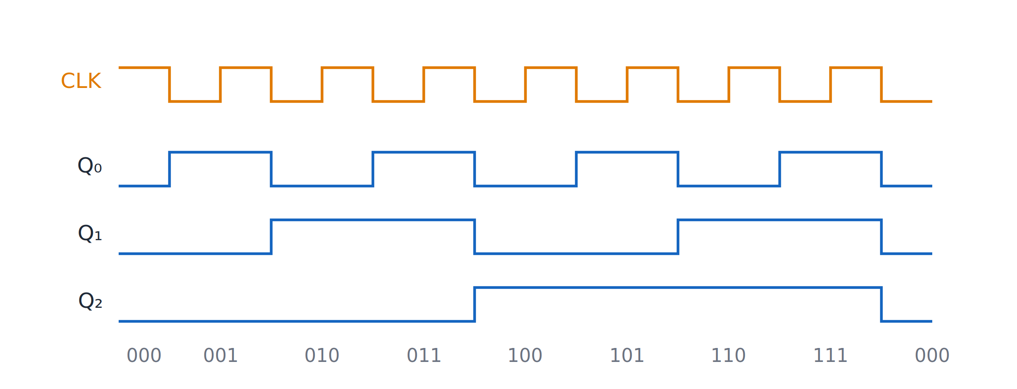
Ripple counter timing
Topic 4.3
Timing of the ripple counter: each output toggles on the falling edge of the one before, so Q₂Q₁Q₀ counts 000 to 111.
Notes:
Each output toggles on the falling edge of the one before, so Q₂Q₁Q₀ counts from 000 to 111. Each waveform has half the frequency of the one before it.

Slide 29
Up and down counter rules
Topic 4.3
Up or down depends on two choices: the clock edge each flip-flop triggers on, and whether the next stage is driven by Q or Q′. Negative-edge + Q, or positive-edge + Q′, count up; the other two count down.
Clock triggering | Next stage driven by | Counter mode
Negative edge (↓) | Q | UP
Negative edge (↓) | Q′ | DOWN
Positive edge (↑) | Q | DOWN
Positive edge (↑) | Q′ | UP
Notes:
Q′ falls exactly when Q rises, so driving the next stage from Q′ flips which transition ripples the carry forward. Check the four rows against the figure of the up-counter.

Slide 30
Designing a modulo-10 (BCD) counter
Topic 4.3
Required FFs: 2^{n} ≥ 10 ⟹ n = 4 flip-flops (Q₃Q₂Q₁Q₀)
Reset state: Q₃Q₂Q₁Q₀ = 1010 (Q₃ = 1 and Q₁ = 1)
Clear logic: CLR′ = (Q₃ · Q₁)′
A plain 4-bit ripple counter is mod-16 (0000 through 1111)
It must reset to 0000 the instant it would reach 10 (1010₂)
At 1010, Q₃ and Q₁ are both 1, so the NAND output CLR′ drops to 0 and asynchronously clears every flip-flop
The count never settles at 1010: it flashes through it as a brief reset trigger
Notes:
Q₃ and Q₁ are the only bits that are 1 at count 10. The NAND gate detects that pattern.

Slide 31
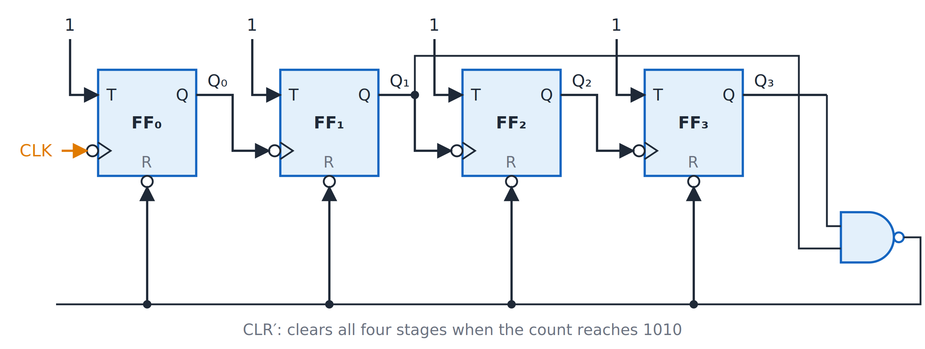
Mod-10 ripple counter
Topic 4.3
Mod-10 ripple counter: the NAND gate detects 1010 (Q₃ = Q₁ = 1) and clears all four stages.
Notes:
The NAND gate detects 1010 (Q₃ = Q₁ = 1) and clears all four stages. CLR′ runs back to the clear input of every flip-flop.

Slide 32
4.4 Synchronous Counters
Topic 4.4
IN SIMPLE TERMS
In a synchronous counter every flip-flop hears the same clock tick; gates decide which ones toggle, so all bits change together.
Notes:
In a synchronous counter every flip-flop shares one clock. This removes the accumulated ripple delay but needs extra logic for each stage. Read the box aloud and ask students to restate it in their own words.

Slide 33
What is a synchronous counter?
Topic 4.4
Every flip-flop connects to the same common clock
Every stage samples and updates at the exact same instant, instead of rippling through
This removes the accumulated propagation delay of a ripple counter
The cost: extra combinational logic to work out each stage’s inputs, so all stages land on the correct next state together
Notes:
All bits change together, so the output never shows a temporary wrong count. The price of removing the ripple delay is extra gates.

Slide 34
The design procedure
Topic 4.4
State table: map every present state to its required next state
Excitation table: apply each flip-flop type’s excitation rules (previous topic) to find the inputs each transition requires
K-map minimisation: treat each flip-flop input as its own Boolean function of the present-state variables and simplify
Circuit diagram: wire the simplified gate logic to each flip-flop’s inputs and tie every clock input to the same common line
Notes:
These four steps are followed in the worked example for a 3-bit up-counter. Steps 1 and 2 are combined in the table on the next slide.

Slide 35
3-bit up-counter with JK flip-flops
Topic 4.4
Three JK flip-flops, state AₙBₙCₙ (A = MSB), counting 000 through 111. Steps 1 and 2 combined: the required next state and the JK excitation values.
A_{n}B_{n}C_{n} | A_{n+1}B_{n+1}C_{n+1} | J_{A},K_{A} | J_{B},K_{B} | J_{C},K_{C}
000 | 001 | 0, X | 0, X | 1, X
001 | 010 | 0, X | 1, X | X, 1
010 | 011 | 0, X | X, 0 | 1, X
011 | 100 | 1, X | X, 1 | X, 1
100 | 101 | X, 0 | 0, X | 1, X
101 | 110 | X, 0 | 1, X | X, 1
110 | 111 | X, 0 | X, 0 | 1, X
111 | 000 | X, 1 | X, 1 | X, 1
Notes:
Each row gives the present state, the next state and the J and K values that produce the transition. X marks a don’t-care.

Slide 36
Step 3: K-maps for J and K of flip-flop A
Topic 4.4
Read the J_{A} and K_{A} columns onto 3-variable K-maps (rows = A, columns = BC in Gray-code order)
Every A = 1 entry is a don’t-care in both maps
That leaves a single 1 in each: ABC = 011 for J_{A} and ABC = 111 for K_{A}
Each 1 is free to pair up with the don’t-care directly below it
Both maps group the same pair (BC = 11, both A rows): the constant variables are B = 1 and C = 1, so J_{A} = K_{A} = BC
Notes:
Both maps have 1s and don’t-cares in complementary places, so they give the same group. Pairing a 1 with a don’t-care gives a bigger group and a simpler term.

Slide 37
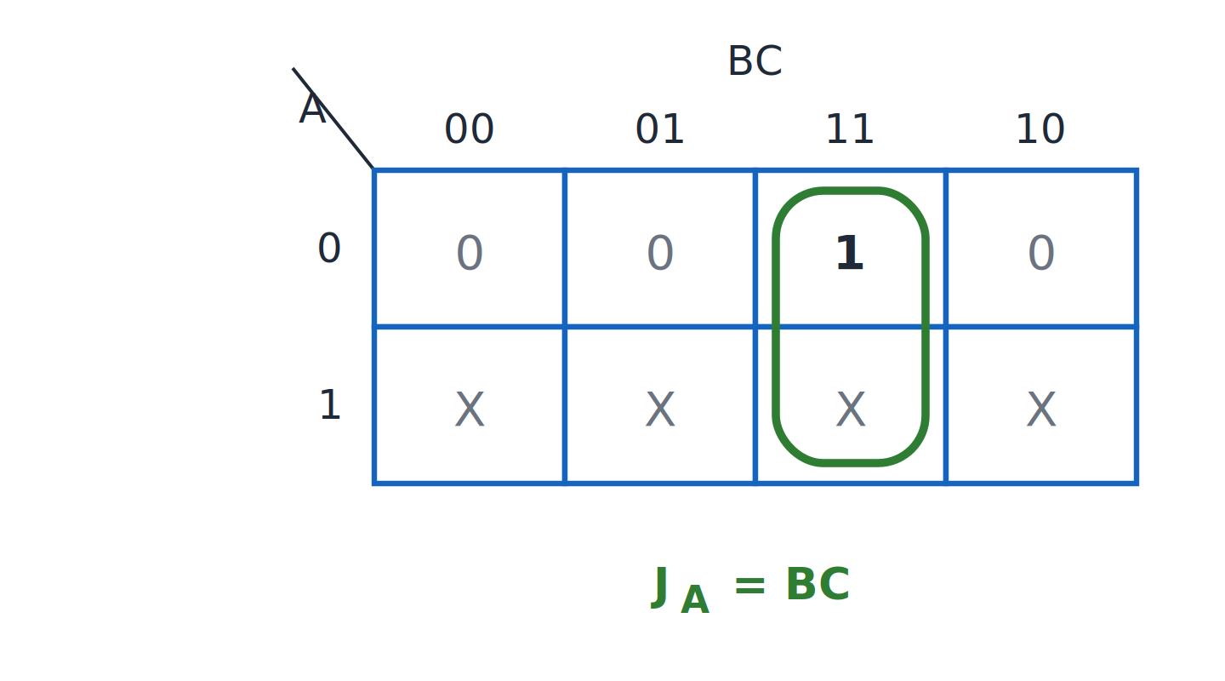
K-map for J of flip-flop A
Topic 4.4
K-map for J_{A}: J_{A} = BC.
Notes:
The single 1 at ABC = 011 pairs with the don’t-care below it: J_A = BC. The group covers both A rows of the BC = 11 column.

Slide 38
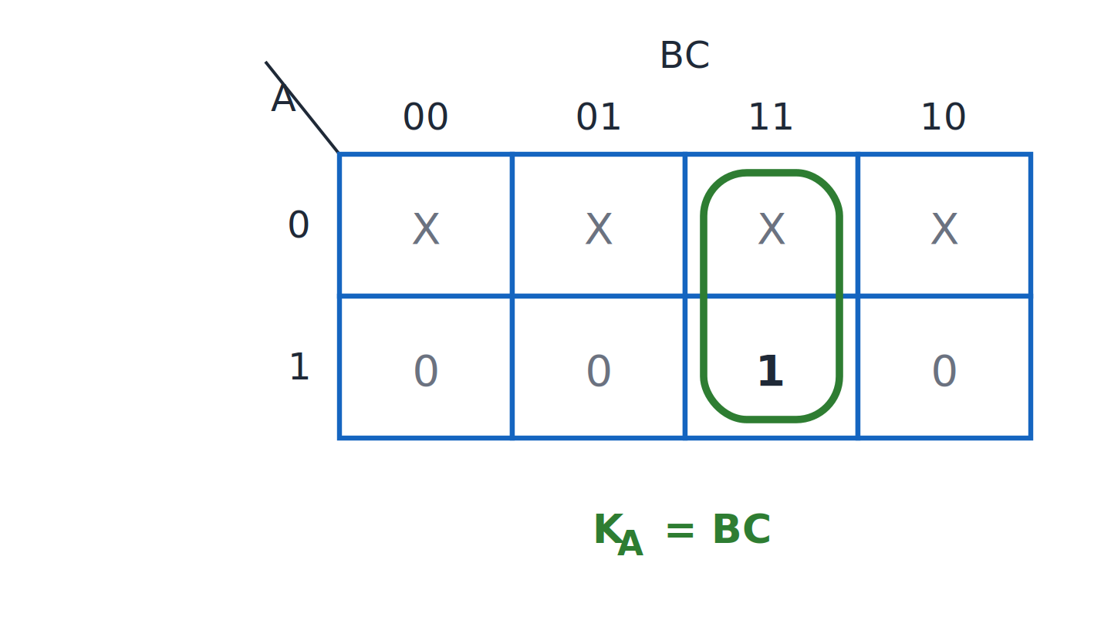
K-map for K of flip-flop A
Topic 4.4
K-map for K_{A}: K_{A} = BC.
Notes:
The single 1 at ABC = 111 pairs with the don’t-care above it: K_A = BC. It is the same group as the J map, so K_A = J_A = BC.

Slide 39
Stages B and C, by inspection
Topic 4.4
The other two stages can be read directly from the excitation table without separate maps
J_{C} = 1, K_{C} = 1: C toggles every single clock, just like the LSB of the ripple counter
J_{B} = C, K_{B} = C: B’s J/K columns are 0 when C = 0 and 1 or X when C = 1, so B toggles precisely when C is 1
Notes:
These two stages are simple enough to read off the table without drawing a K-map. The next slide wires all three stages together.

Slide 40
Step 4: the circuit
Topic 4.4
Every clock triangle taps the same horizontal CLK line: the structural difference from the ripple counter’s staggered chain
FF(C) always toggles
FF(B): J and K both come straight from C
FF(A): J and K both come from one AND gate combining B and C
Feeding the same signal to both J and K means “toggle when this condition is true”
Notes:
For a JK flip-flop, J and K together decide the toggle, so tying them together gives a toggle flip-flop with a condition. This is the only step that turns the equations into a diagram.

Slide 41
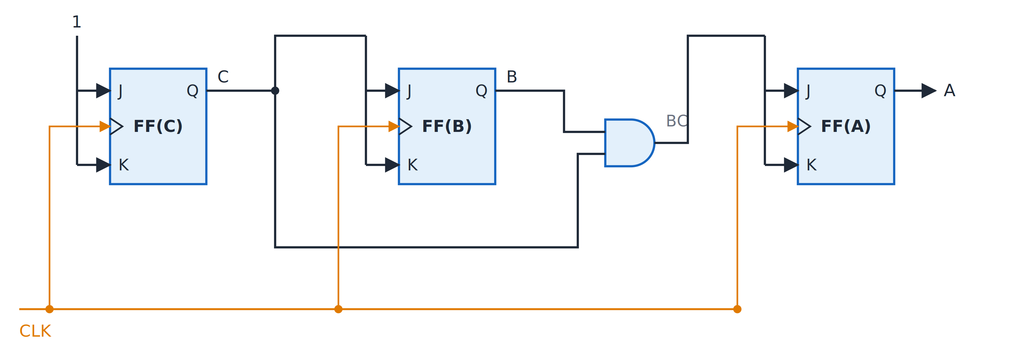
3-bit synchronous up-counter
Topic 4.4
Three-bit synchronous up-counter: J and K of each flip-flop are tied together; all clocks share CLK.
Notes:
J and K of each flip-flop are tied together, and all clocks share CLK. Trace the AND gate of B and C into FF(A).

Slide 42
4.5 Shift Registers & Applications
Topic 4.5
IN SIMPLE TERMS
A shift register passes its bits one place along on every clock, like a bucket brigade for bits; feed the end back to the start and it becomes a counter.
Notes:
A shift register is a chain of flip-flops with one common clock. Serial or parallel describes only how data enters and leaves. Read the box aloud and ask students to restate it in their own words.

Slide 43
What is a shift register?
Topic 4.5
A shift register is a cascade of flip-flops sharing one common clock
Each stage’s D input is simply the previous stage’s Q
On every clock pulse every stored bit moves one position down the chain
Serial or parallel on each side is purely about how data gets in and out; the internal shifting structure never changes
Notes:
The next slide shows a four-bit shift register. The structure is the same for every shift register type.

Slide 44
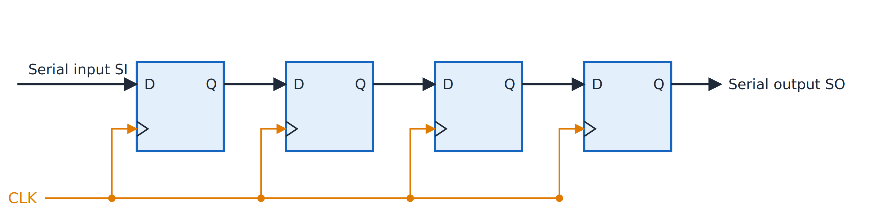
Four-bit shift register
Topic 4.5
Four-bit shift register: each Q feeds the next D on every clock edge. Adapted from M. Morris Mano and Michael D. Ciletti, Digital Design, Fig. 6.3.
Notes:
Each Q feeds the next D on every clock edge. After four clock pulses the first bit entered has reached the last stage.

Slide 45
Four data transfer modes
Topic 4.5
SIPO taps every stage’s Q as a separate output pin; PISO adds a way to force each stage to an external bit before shifting. Both are the same shift-register core with extra access points.
Type | Name | Data in | Data out | Typical use
SISO | Serial-In / Serial-Out | 1 bit/clock | 1 bit/clock | Time delay, signal buffering
SIPO | Serial-In / Parallel-Out | 1 bit/clock | All bits at once | Serial-to-parallel conversion (UART receive)
PISO | Parallel-In / Serial-Out | All bits at once | 1 bit/clock | Parallel-to-serial conversion (UART transmit)
PIPO | Parallel-In / Parallel-Out | All bits at once | All bits at once | Fast temporary register storage
Notes:
These four types differ only in how data is loaded and read. The shifting core is identical.

Slide 46
Ring counter
Topic 4.5
Feed the last stage’s output straight back into the first stage’s input, with no external serial data
The register becomes a self-contained counter: a ring counter
Number of states: N states for N flip-flops; the single 1 (or single 0) just circulates
4-bit sequence, pre-loaded to 1000: 1000 → 0100 → 0010 → 0001 → 1000 …
Must be pre-loaded: reset alone gives 0000, a stuck state (Q₃ = 0 feeds D₀ = 0 forever)
Notes:
Without pre-loading, the register never starts circulating on its own. Pre-loading 1000 starts the single 1 circulating.

Slide 47
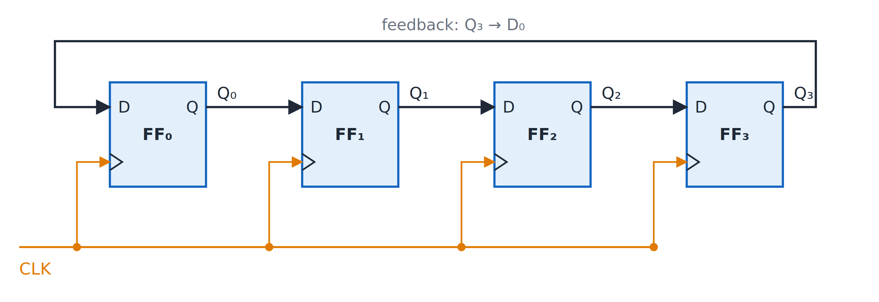
Four-bit ring counter
Topic 4.5
Four-bit ring counter: Q₃ feeds back to D₀.
Notes:
Q₃ feeds back to D₀. The feedback wire runs from Q₃ back to D₀.

Slide 48
Johnson counter (twisted-ring counter)
Topic 4.5
Feed back the inverted last output instead of the plain one
The circulating bit becomes a spreading and retreating band of 1s and 0s
Number of states: 2N states for N flip-flops: twice the ring counter
4-bit sequence from reset (0000): 0000 → 1000 → 1100 → 1110 → 1111 → 0111 → 0011 → 0001 → 0000 …
Self-starting from 0000: Q₃′ = 1 feeds D₀ = 1 on the very next clock
Notes:
The inverted feedback takes twice as long to return to the starting pattern, which gives 2N states. The first state after reset is 1000, as soon as the first clock arrives.

Slide 49
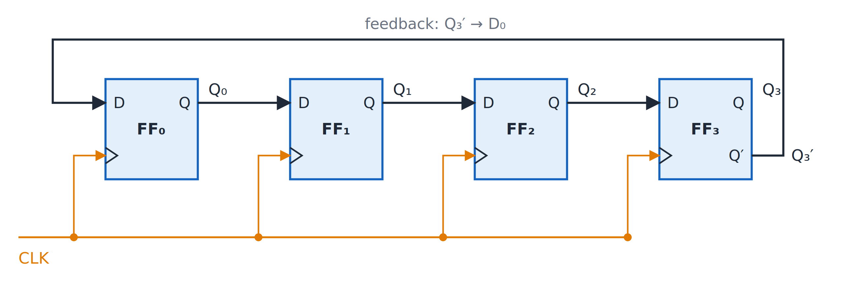
Four-bit Johnson counter
Topic 4.5
Four-bit Johnson counter: Q₃′ feeds back to D₀.
Notes:
Q₃′ feeds back to D₀. The only difference from the ring counter is the inversion on the feedback wire.

Slide 50
Ring versus Johnson counter
Topic 4.5
Feature | Ring counter | Johnson counter
Number of states | N | 2N
Feedback connection | D₀ = Q_{N-1} | D₀ = Q′_{N-1}
Initialization | Requires pre-loading (e.g., 1000) | Self-starting from reset (0000)
Decoding next state | Single bit is already the decoded output | Needs a 2-input gate per state to decode
Notes:
Compare the two counters on number of states, feedback, start-up and decoding. The table summarises both counters side by side.

Slide 51
Unit 4 summary
4.1 Latches: cross-coupled NOR gates hold a bit; the gated D latch is level-sensitive
4.2 Flip-flops and timing: edge-triggered; characteristic and excitation tables; master-slave; setup and hold
4.3 Asynchronous counters: each stage clocks the next; up or down by edge and Q or Q′; mod-10 by NAND reset
4.4 Synchronous counters: one shared clock; state table, excitation table, K-map, circuit
4.5 Shift registers: SISO, SIPO, PISO, PIPO; ring counter (N states) and Johnson counter (2N states)
Notes:
Recap in one line per topic. Ask students to state the difference between a latch and a flip-flop, and between a ripple and a synchronous counter.

Slide 52
Review questions (1 of 2)
Q1. Explain the difference between a level-sensitive latch and an edge-triggered flip-flop
Q2. Why is S = R = 1 forbidden in an SR latch, and how does the gated D latch avoid it?
Q3. What is the race-around condition and how does the master-slave structure fix it?
Q4. Write the excitation table entries for a JK flip-flop and explain the don’t-cares
Notes:
These questions cover topics 4.1 and 4.2. Answers: Q1 a latch follows D while EN is high and a flip-flop updates only at the clock edge; Q2 both outputs go to 0, and S = D and R = D′ are always complements; Q3 repeated toggling when J = K = 1 and the clock is high, fixed by two latches on opposite clock phases; Q4 the JK table slide.

Slide 53
Review questions (2 of 2)
Q5. Which combinations of clock edge and Q or Q′ give an up-counter in a ripple counter?
Q6. Design a modulo-10 ripple counter: how many flip-flops and what reset logic?
Q7. Derive J_{A} and K_{A} for a 3-bit synchronous up-counter using K-maps
Q8. Compare ring and Johnson counters for N flip-flops
Notes:
These questions cover topics 4.3 to 4.5. Answers: Q5 negative edge with Q, or positive edge with Q′; Q6 four flip-flops and CLR′ = (Q₃·Q₁)′; Q7 J_A = K_A = BC; Q8 N versus 2N states, pre-loading versus self-starting.

Slide 54
References
Textbook: M. Morris Mano and Michael D. Ciletti, Digital Design
Adapted figure:
Four-bit shift register (Fig. 6.3)
Notes:
The textbook is the reference for this unit. The shift register figure is adapted from it; the other figures in this deck are original.

