Slide 1
Unit 5: State Machines, Memory & PLDs
5
Digital Logic Design
CHANDRAS EDU
Never stop learning
Notes:
Welcome to Unit 5 of Digital Logic Design. This unit covers finite state machines, programmable logic devices and memory.

Slide 2
Outline
5.1 Moore vs. Mealy Finite State Machines
5.2 State Diagrams & State Tables
5.3 State Reduction & State Assignment
5.4 FSM Design Procedure: Sequence Detector
5.5 Programmable Logic Devices
5.6 Memory: RAM and ROM
5.7 FSM Case Studies: Traffic Light & Vending Machine
Notes:
Seven topics in order. We start with Moore and Mealy machines and the design procedure, then study programmable logic and memory, and finish with two case studies.

Slide 3
5.1 Moore vs. Mealy Finite State Machines
Topic 5.1
IN SIMPLE TERMS
A Moore machine’s output depends only on which state it is in; a Mealy machine’s output also depends on the input arriving now.
Notes:
Every synchronous sequential circuit in Unit 4 is a case of a finite state machine. This topic names the two standard models and compares them on one example. Read the box aloud and ask students to restate it in their own words.

Slide 4
From sequential circuit to finite state machine
Topic 5.1
Every counter and shift register in Unit 4 is a special case of a finite state machine (FSM)
An FSM is described by five things: a finite set of states, a set of inputs, a set of outputs, a next-state function (present state + input → next state) and an output function
What the output function may depend on is the one design choice that splits every FSM into one of two standard models
Notes:
The two models are Moore and Mealy. The next slides define each one.

Slide 5
The Moore model
Topic 5.1
In a Moore machine the output depends only on the present state, never directly on the input
The flip-flops of the state register hold an n-bit code that identifies the current state
The output logic reads only that state
So the output is stable for the whole clock period and changes only right after a clock edge, in sync with the state
Notes:
The figure on the next slide shows the next-state logic, the state register and the output logic. The state register holds an n-bit code for the current state.

Slide 6
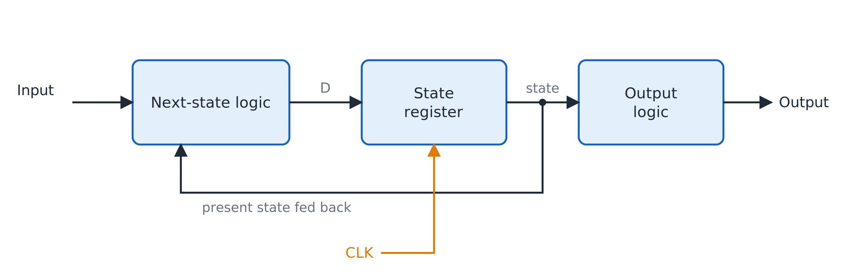
Moore machine
Topic 5.1
Moore machine: the output logic sees only the present state.
Notes:
The output logic sees only the present state held in the state register. Trace the signals: state register, then output logic, then output.

Slide 7
The Mealy model
Topic 5.1
A Mealy machine adds one wire: the output logic also reads the current input directly, not just the state
The output logic is purely combinational
So a Mealy output can change the instant the input changes, even between clock edges
That is why Mealy outputs are not guaranteed stable for a full clock cycle, unlike Moore outputs
Notes:
Compare the figure with the Moore figure: the only difference is the extra input wire into the output logic. The Mealy output can therefore react to a changing input within a clock cycle.

Slide 8
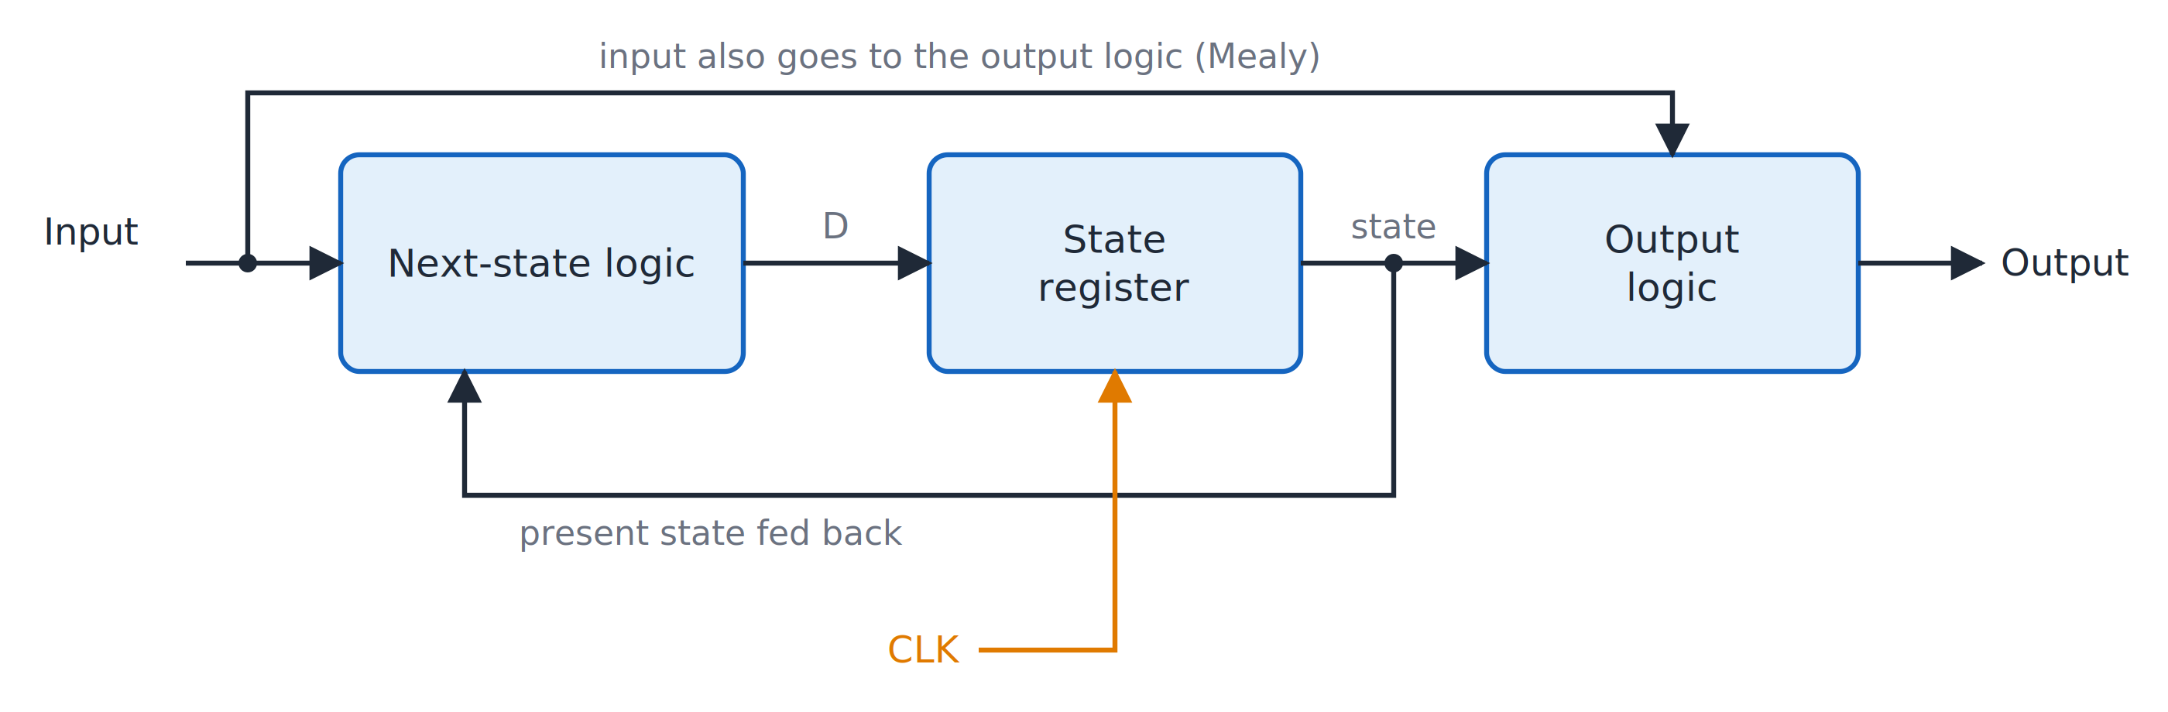
Mealy machine
Topic 5.1
Mealy machine: the output logic also sees the input.
Notes:
The extra wire from the input into the output logic makes the machine Mealy. The extra input wire to the output logic is the only change from the Moore figure.

Slide 9
Moore version: detecting two consecutive 1s (3 states)
Topic 5.1
Build a circuit whose output goes to 1 whenever the last two bits on a serial input were both 1
The two models solve this with a different number of states
S0 = “no 1 seen yet”, S1 = “last bit was 1”, S2 = “last two bits were 11”
S2 is the only state whose output z is 1
The machine stays in S2 (self-loop on input 1) so the output keeps reading 1 across a longer run of 1s
Notes:
The output is attached to the states, so a third state is needed to remember that the output should be high. Count the states in the figure on the next slide.

Slide 10
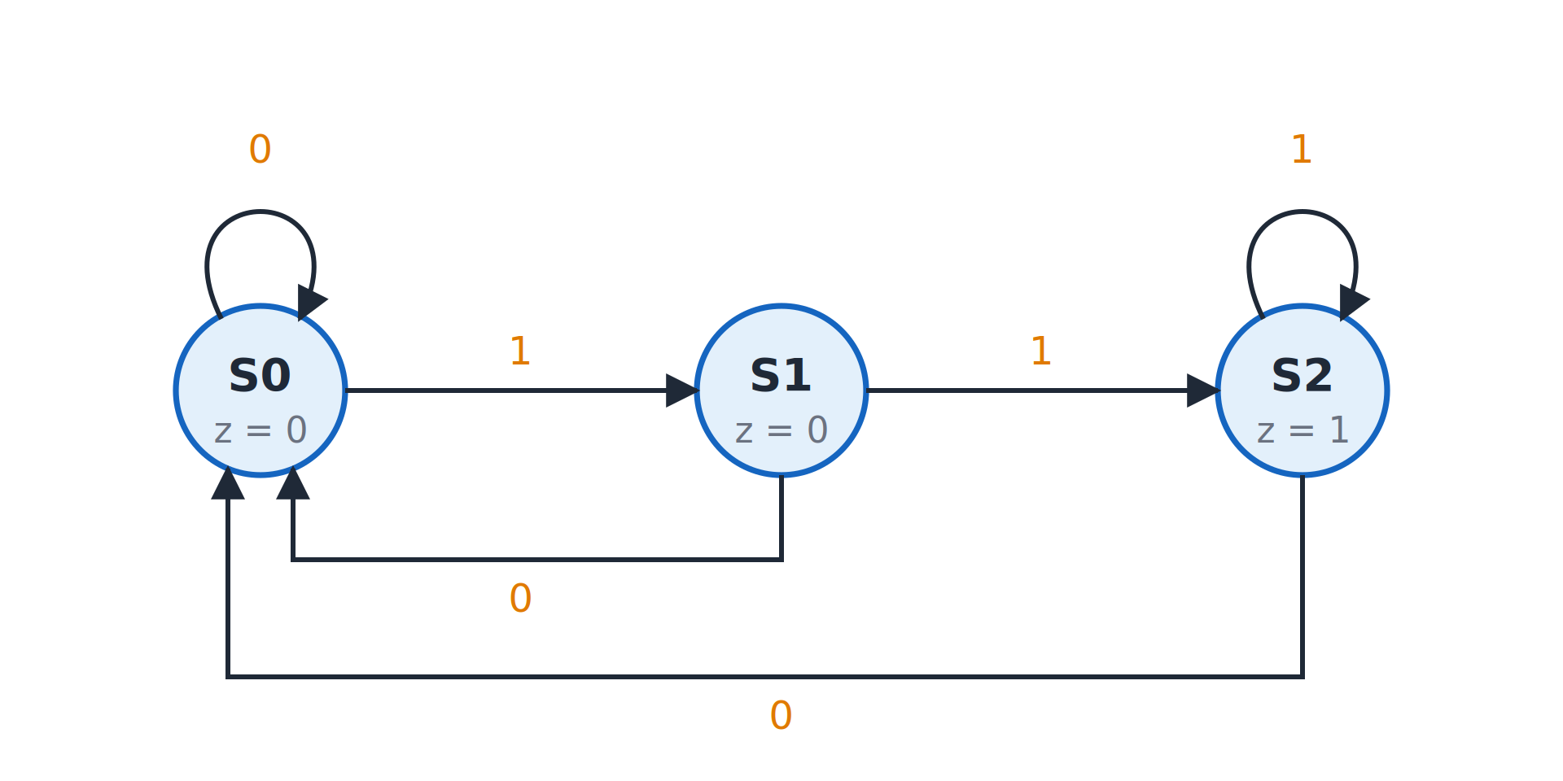
Moore detector: three states
Topic 5.1
Moore detector for two consecutive 1s: three states, output z shown in each state.
Notes:
The output z is shown inside each state; only S2 has z = 1. Only S2 has the output z = 1.

Slide 11
Mealy version: detecting two consecutive 1s (2 states)
Topic 5.1
Each arrow is labelled input/output
S0 = “last bit wasn’t 1” (or no history yet), S1 = “last bit was 1”
The output is 1 only on the transition S1 → S1 driven by input 1: the second 1 of a “11” pair
It reverts to 0 as soon as the input changes
No dedicated third state is needed to remember that the output should be high
Notes:
The Mealy machine uses the input directly to decide the output, which saves one state. Compare this with the three-state Moore version.

Slide 12
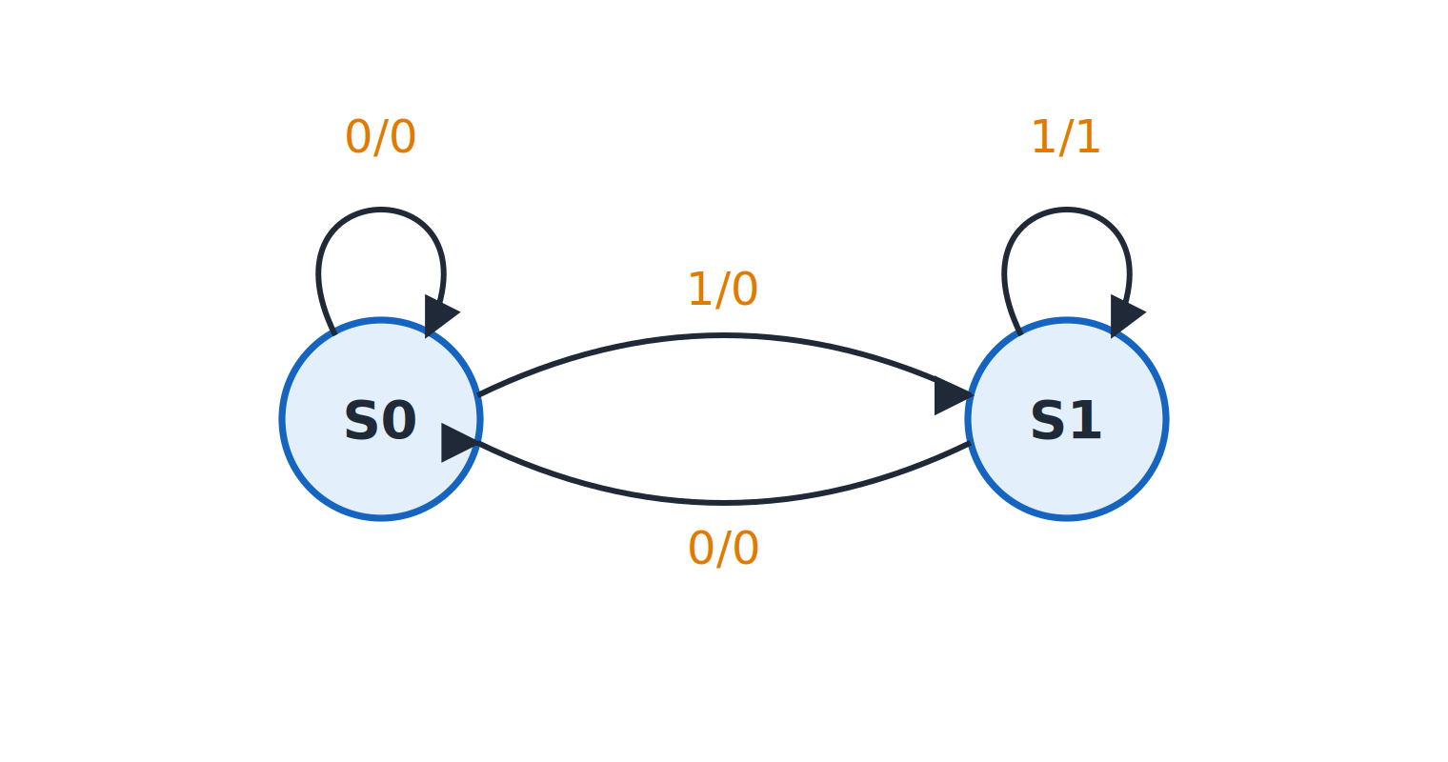
Mealy detector: two states
Topic 5.1
Mealy detector for two consecutive 1s: two states, arrows labelled input/output.
Notes:
Arrows are labelled input/output; the 1/1 on S1 marks a match. Only the transition S1 to S1 on input 1 has the output 1.

Slide 13
Moore versus Mealy
Topic 5.1
Property | Moore | Mealy
Output depends on | State only | State and input
States needed (this example) | 3 | 2
Output changes | Only at clock edges | Can change mid-cycle with the input
Output stability | Stable for the full clock period | Can glitch if input is noisy
Notes:
Use this table as the summary. Moore is safer for stable outputs and Mealy needs fewer states.

Slide 14
5.2 State Diagrams & State Tables
Topic 5.2
IN SIMPLE TERMS
A state diagram draws the machine as circles and arrows; a state table lists the same information row by row. One is easy to read, the other easy to design from.
Notes:
A state diagram and a state table describe exactly the same machine. Nothing is lost converting between them in either direction. Read the box aloud and ask students to restate it in their own words.

Slide 15
State table format
Topic 5.2
A state table has one row per state
Moore: Present State | Next State for each input value | Output (one value per state)
Mealy: Present State | Next State / Output pair for each input value
A Moore table has the output as its own column, because the output depends only on the state
A Mealy table folds the output into each next-state cell, because the output depends on the transition
The diagram is easier to read; the table is what you build excitation tables and K-maps from
Notes:
This is the one structural difference to remember between Moore and Mealy tables. The next slides show one Moore and one Mealy conversion.

Slide 16
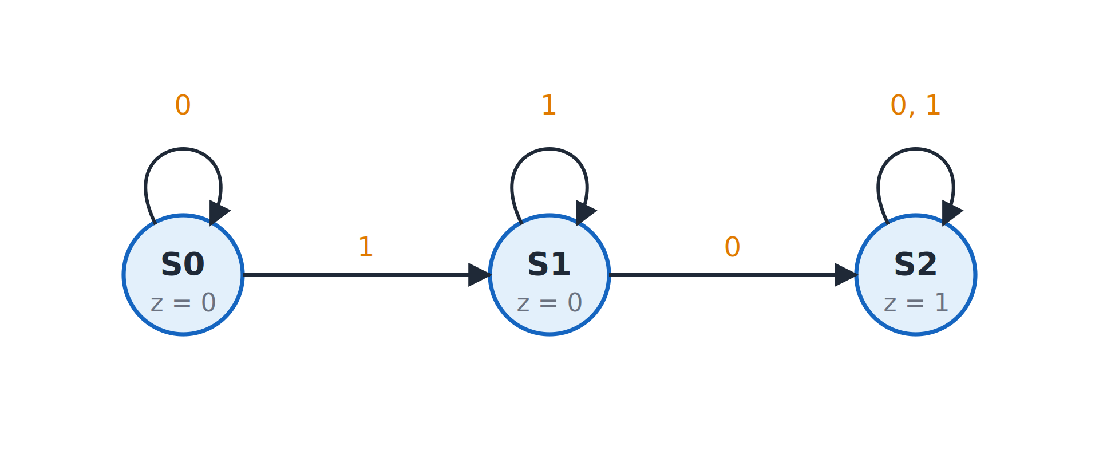
Moore example: a 1 followed later by a 0
Topic 5.2
Moore detector for a 1 followed later by a 0.
Notes:
The output goes to 1 once the input has shown a 1 followed later by a 0, and stays 1 forever. S2 has a self-loop labelled 0,1, so once the pattern is seen the output stays 1.

Slide 17
Diagram → table: a Moore example
Topic 5.2
S0 = “haven’t seen a 1 yet”, S1 = “saw a 1, waiting for a 0”, S2 = “saw 1-then-0: done”. S2’s self-loop is labelled “0,1” because either input keeps it in S2.
Present state | Next state (x=0) | Next state (x=1) | Output z
S0 | S0 | S1 | 0
S1 | S2 | S1 | 0
S2 | S2 | S2 | 1
Notes:
Each row is read mechanically off the diagram. Once the pattern has been seen, nothing that follows changes the output.

Slide 18
Diagram → table: the rule
Topic 5.2
For each state (row), follow the arrow leaving it for every possible input value
Write down where that arrow lands: the next-state column
For a Moore machine, copy the state’s own output into the output column
The conversion is entirely mechanical
Notes:
The same four steps work for any Moore diagram. Apply it to every row, one input value at a time.

Slide 19
Table → diagram: a Mealy example
Topic 5.2
The “detect two consecutive 1s” Mealy machine from the previous topic, given as a table first.
Present state | Next state/Output (x=0) | Next state/Output (x=1)
S0 | S0 / 0 | S1 / 0
S1 | S0 / 0 | S1 / 1
Notes:
Each cell holds the next state and the output for that input. The next slide redraws this table as a diagram.

Slide 20
Table → diagram: redrawing the Mealy machine
Topic 5.2
Draw one circle per row: S0 and S1
For each cell draw an arrow from the row’s state to the next state named in the cell, labelled input/output
Row S0: x = 0 cell “S0/0” → self-loop on S0 labelled 0/0; x = 1 cell “S1/0” → arrow S0 → S1 labelled 1/0
Row S1: x = 0 cell “S0/0” → arrow S1 → S0 labelled 0/0; x = 1 cell “S1/1” → self-loop on S1 labelled 1/1
This is exactly the two-state diagram from the previous topic, rebuilt from the table with no guessing
Notes:
Go through the four cells one at a time and check each arrow against the Mealy diagram. Check the result against the two-state Mealy figure.

Slide 21
5.3 State Reduction & State Assignment
Topic 5.3
IN SIMPLE TERMS
If two states always behave the same way, merge them; then give each remaining state a binary code for the flip-flops.
Notes:
A state table built from a word problem often has more states than the behaviour needs. Merging redundant states before the design shrinks the hardware without changing the behaviour. Read the box aloud and ask students to restate it in their own words.

Slide 22
Why reduce states first?
Topic 5.3
A state table built directly from a word problem often has more states than the behaviour strictly requires
Sometimes two states are completely indistinguishable from the outside
Every state costs flip-flops, and every extra flip-flop costs excitation logic
Merging redundant states before the design shrinks the hardware with zero change in observable behaviour
Notes:
Reduction comes before the excitation equations in the design procedure. Fewer states can mean fewer flip-flops.

Slide 23
Equivalent states
Topic 5.3
Two states are equivalent if, starting from either one, every possible input sequence gives exactly the same output sequence
States P and Q are equivalent if:
1. Their outputs match for every input (immediately for Mealy; their own state output for Moore), and
2. For every input value, the next states they go to are themselves equivalent (possibly recursively)
In practice: group states by matching output, then compare next-state columns within each group; merge, and repeat until no more merges are possible
Notes:
If two rows land in the same group, merge them, even if the state names differ. The test is recursive: equivalent states must lead to equivalent states.

Slide 24
Worked example: a 5-state table
Topic 5.3
Reduce 5 states to 3.
State | Next (x=0) | Next (x=1) | Output
A | B | C | 0
B | D | E | 1
C | D | E | 1
D | D | D | 0
E | D | D | 0
Notes:
We group by output first, then compare the next-state columns. The next slide applies the equivalence test to it.

Slide 25
Worked example: merging states
Topic 5.3
Group by output first: {A, D, E} have output 0 and {B, C} have output 1
Within {B, C}: both rows read exactly (D, E), so B ≡ C
Within {A, D, E}: A’s row is (B, C), but D’s and E’s rows both read (D, D), so D ≡ E
A stays on its own
Merging B with C (call it B′) and D with E (call it D′) gives the reduced table
Notes:
D and E are identical to each other and different from A, so only D and E merge in that group. The result is a three-state table.

Slide 26
The reduced table
Topic 5.3
Five states collapsed to three. This table describes exactly the same input/output behaviour as the original.
State | Next (x=0) | Next (x=1) | Output
A | B′ | B′ | 0
B′ | D′ | D′ | 1
D′ | D′ | D′ | 0
Notes:
The redundancy is gone, and the behaviour is unchanged. The reduced machine is drawn on the next slide.

Slide 27
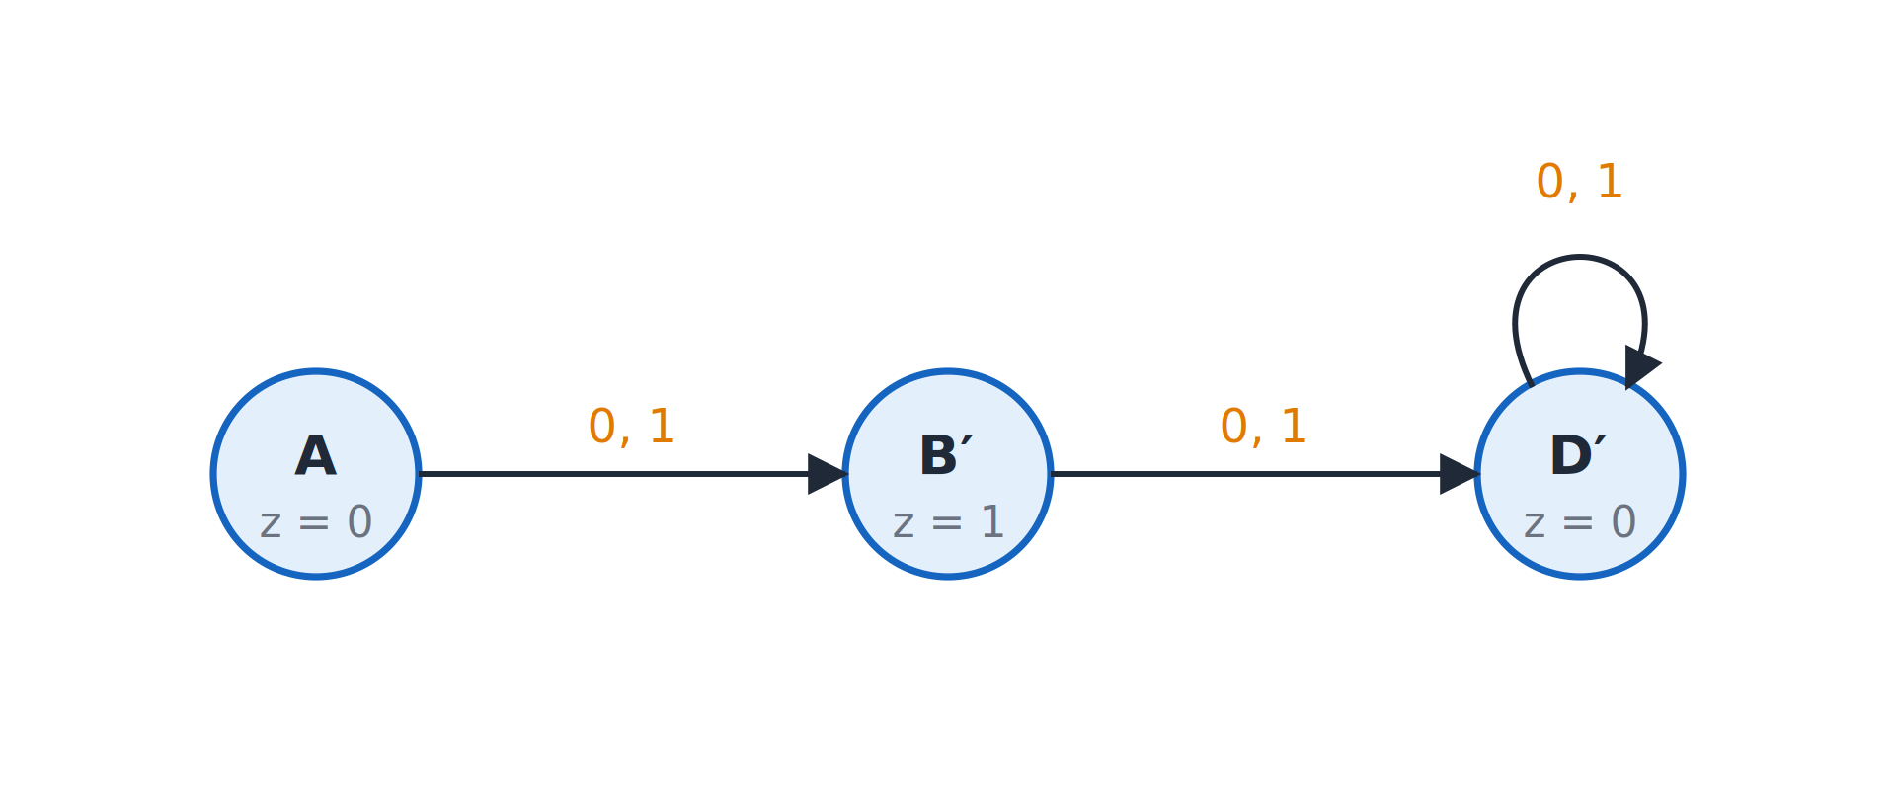
The reduced three-state machine
Topic 5.3
The reduced three-state machine.
Notes:
A, B′ and D′ with outputs 0, 1 and 0; D′ holds on both inputs. D′ holds its state on both inputs.

Slide 28
State assignment
Topic 5.3
A flip-flop stores a bit, not a letter: every remaining state needs a unique binary code
For k states, the minimum number of flip-flops is ⌈log₂ k⌉: 3 states need 2 flip-flops (one code left unused)
Which code goes to which state is a free choice that never changes the external behaviour
The choice changes how simple the excitation equations turn out; the optimal assignment is a hard search in general
Real designs use a straightforward sequential assignment (as in this course) or CAD tool heuristics
Notes:
Any assignment with no two states sharing a code gives a functionally correct machine. Two flip-flops can code up to four states, so one code stays unused here.

Slide 29
Worked example: assigning codes
Topic 5.3
Code 11 is unused: a don’t-care input combination for the excitation K-maps.
State | Code (Q₁Q₀)
A | 00
B′ | 01
D′ | 10
Notes:
These codes replace the state names in the reduced table. Any choice of codes would work; this one is simply sequential.

Slide 30
The reduced table in binary
Topic 5.3
Q₁Q₀ = 00 (A): Next (x=0) = 01, Next (x=1) = 01, Output = 0
Q₁Q₀ = 01 (B′): Next (x=0) = 10, Next (x=1) = 10, Output = 1
Q₁Q₀ = 10 (D′): Next (x=0) = 10, Next (x=1) = 10, Output = 0
This is the form the next topic’s excitation tables and K-maps start from
Notes:
Substituting the codes turns the table into one written entirely in binary. The unused code 11 becomes a don’t-care in the K-maps.

Slide 31
5.4 FSM Design Procedure: Sequence Detector
Topic 5.4
IN SIMPLE TERMS
To build any state machine, go diagram → table → state codes → flip-flop input table → K-maps → gates.
Notes:
The synchronous counter design procedure generalises to any finite state machine. This topic runs the complete procedure on a real problem. Read the box aloud and ask students to restate it in their own words.

Slide 32
Problem: the overlapping 1101 detector
Topic 5.4
Design a serial circuit that flags every occurrence of the bit pattern 1101 in an input stream
Overlapping occurrences count: in 1101101 both the first four bits and the last four bits are valid matches, sharing one bit
The procedure: state table → excitation table → K-map → circuit, as for counters
Notes:
The same procedure as the synchronous counter design, applied to an arbitrary finite state machine. Overlap makes the design more interesting than a simple counter of bits.

Slide 33
Step 1: state diagram
Topic 5.4
Use a Mealy machine: each state tracks how much of “1101” has been matched by the tail of the input
On a mismatch, do not necessarily fall back to “nothing matched”: check whether the tail still matches a shorter prefix of the pattern
S0 = matched “”, S1 = matched “1”, S2 = matched “11”, S3 = matched “110”
On input 1, S3 outputs 1 (match) and jumps back to S1, not S0: the bit that completed “1101” is itself the start of a possible new match
From S3 on a 0, and from S1 on a 0, the machine falls all the way back to S0
Notes:
This is what makes overlapping matches work correctly. The next slide shows the diagram.

Slide 34
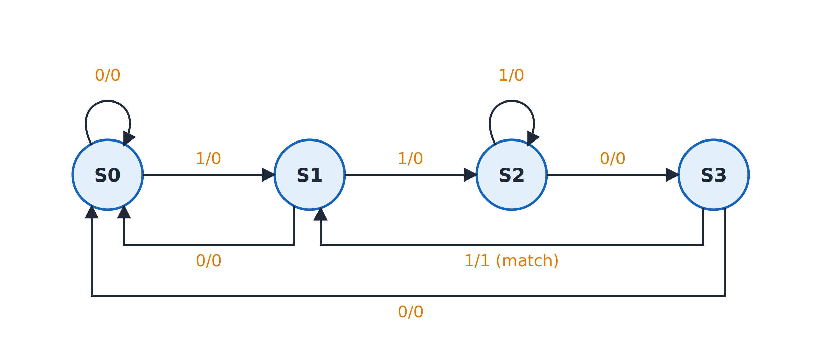
Mealy state diagram of the 1101 detector
Topic 5.4
Mealy state diagram of the overlapping 1101 detector.
Notes:
Follow S0 → S1 → S2 → S3 on the input 1, 1, 0, then the match on the final 1. Note the arrow from S3 back to S1 with the label 1/1.

Slide 35
Full state table
Topic 5.4
Present state | Next (x=0) | Next (x=1) | Output (x=0) | Output (x=1)
S0 | S0 | S1 | 0 | 0
S1 | S0 | S2 | 0 | 0
S2 | S3 | S2 | 0 | 0
S3 | S0 | S1 | 0 | 1
Notes:
The only 1 in the output columns is in the S3 row on input 1. This table is read directly off the diagram.

Slide 36
Step 2: state assignment
Topic 5.4
Four states need ⌈log₂ 4⌉ = 2 flip-flops
Use straightforward sequential assignment (from the previous topic): S0 = 00, S1 = 01, S2 = 10, S3 = 11
Call the two state bits A (MSB) and B (LSB)
Use JK flip-flops
Notes:
The next step builds the excitation table for these two bits. The next step finds the J and K inputs for these codes.

Slide 37
Step 3: excitation table
Topic 5.4
A | B | x | A⁺ | B⁺ | J_{A} | K_{A} | J_{B} | K_{B} | y
0 | 0 | 0 | 0 | 0 | 0 | X | 0 | X | 0
0 | 0 | 1 | 0 | 1 | 0 | X | 1 | X | 0
0 | 1 | 0 | 0 | 0 | 0 | X | X | 1 | 0
0 | 1 | 1 | 1 | 0 | 1 | X | X | 1 | 0
1 | 0 | 0 | 1 | 1 | X | 0 | 1 | X | 0
1 | 0 | 1 | 1 | 0 | X | 0 | 0 | X | 0
1 | 1 | 0 | 0 | 0 | X | 1 | X | 1 | 0
1 | 1 | 1 | 0 | 1 | X | 1 | X | 0 | 1
Notes:
The next-state bits are read straight off the state table. For example, row AB = 11, x = 1 is S3 on input 1, which goes to S1 = 01, so A⁺B⁺ = 01. The J and K columns apply the JK excitation rule to each bit’s own transition independently.

Slide 38
Step 4: K-map for J of flip-flop A
Topic 5.4
Each of J_{A}, K_{A}, J_{B}, K_{B} is its own 3-variable function of (A, B, x).
A \ Bx | 00 | 01 | 11 | 10
0 | 0 | 0 | 1 | 0
1 | X | X | X | X
Notes:
The single required 1 pairs with the don’t-care directly below it, giving J_A = Bx. The next three slides give the other maps.

Slide 39
Step 4: K-map for K of flip-flop A
Topic 5.4
A \ Bx | 00 | 01 | 11 | 10
0 | X | X | X | X
1 | 0 | 0 | 1 | 1
Notes:
The two required 1s group with the two don’t-cares above them into the whole B = 1 half of the map, giving K_A = B. Both J_A and K_A use the don’t-cares in the A = 1 and A = 0 rows.

Slide 40
Step 4: K-map for J of flip-flop B
Topic 5.4
A \ Bx | 00 | 01 | 11 | 10
0 | 0 | 1 | X | X
1 | 1 | 0 | X | X
Notes:
J_B needs two pairs, A′x and Ax′. The two pairs are A′x and Ax′, which together form an XOR.

Slide 41
Step 4: K-map for K of flip-flop B
Topic 5.4
A \ Bx | 00 | 01 | 11 | 10
0 | X | X | 1 | 1
1 | X | X | 0 | 1
Notes:
The all-don’t-care A = 0 row gives a group of four (A′) and the x = 0 cells give another (x′), so K_B = A′ + x′ = (Ax)′, a single NAND gate. (Ax)′ is a single NAND gate.

Slide 42
Step 4: the equations
Topic 5.4
J_{A} = Bx
K_{A} = B
J_{B} = A′x + Ax′
K_{B} = A′ + x′
y = ABx
The output y needs no map: a single required 1 at A = 1, B = 1, x = 1, with no don’t-cares to exploit
Notes:
Collect the five equations from the K-maps. The output depends on the state and on x, so this is a Mealy machine.

Slide 43
Step 5: the circuit
Topic 5.4
Two JK flip-flops (A, B) hold the state
A small block of combinational logic, built from the five equations, drives the J/K inputs and the output
The J, K logic block: J_{A} = Bx, K_{A} = B, J_{B} = A′x + Ax′, K_{B} = A′ + x′
The output logic is the single gate y = ABx, reading the state and x directly
That is why this is a Mealy machine and not a Moore one
Notes:
This is the general Mealy structure from the first topic, filled in with this design’s details. The next slide shows the full circuit.

Slide 44
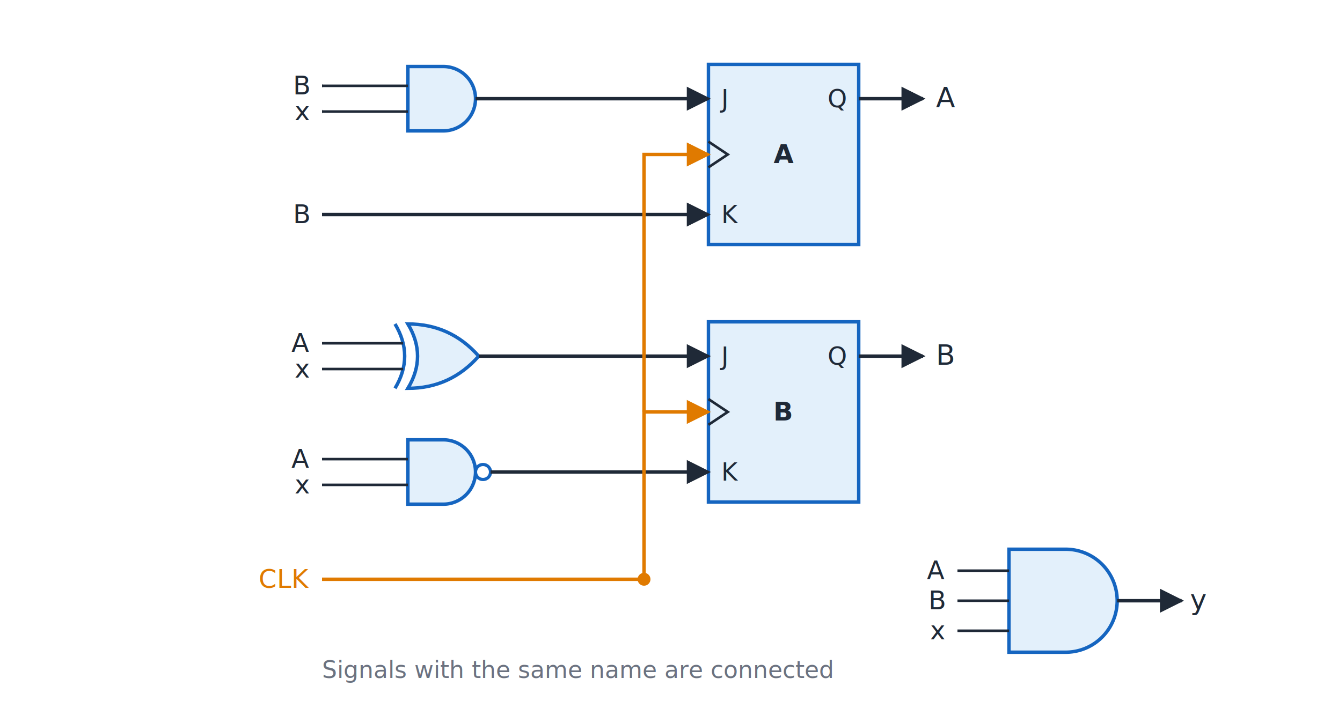
Circuit of the 1101 detector
Topic 5.4
Circuit of the 1101 detector: J_{A} = Bx, K_{A} = B, J_{B} = A ⊕ x, K_{B} = (Ax)′, y = ABx.
Notes:
The J and K logic, the state register of two JK flip-flops, and the single output gate y = ABx. The output gate takes A, B and x directly, which makes the machine Mealy.

Slide 45
5.5 Programmable Logic Devices
Topic 5.5
IN SIMPLE TERMS
Programmable logic chips contain a grid of AND and OR gates; you program which connections to keep. ROMs, PLAs and PALs differ in which of the two grids is programmable.
Notes:
Any Boolean function can be written as a sum of minterms, which is an AND-OR structure. A programmable logic device builds that structure as reconfigurable hardware. Read the box aloud and ask students to restate it in their own words.

Slide 46
The AND-OR structure
Topic 5.5
Any Boolean function is a canonical sum of minterms: a layer of AND gates producing product terms, feeding a layer of OR gates
A programmable logic device (PLD) is that AND-OR structure built as reconfigurable hardware
Instead of wiring discrete gates for one function, you “program” (or the manufacturer pre-wires) which connections exist
The three classic families, ROM, PLA and PAL, differ in one thing: which of the two arrays, if either, is fixed or programmable
Notes:
This is the AND-OR form from Unit 1 as a chip. The three families are compared in the next slides.

Slide 47
ROM: fixed AND, programmable OR
Topic 5.5
A ROM used as combinational logic treats its n address inputs as a full decoder
The AND array is fixed and always generates all 2^{n} minterms, whether or not a function needs them
Only the OR array is programmable: each output sums any subset of the minterms
This is a truth table in hardware: address in, the row’s data out
Cost: size grows as 2^{n}: practical for few inputs, exponentially wasteful for many
Notes:
Most functions need only a handful of the possible product terms, so a ROM wastes most of its AND array when n is large. The next slide shows a ROM implementing two functions.

Slide 48
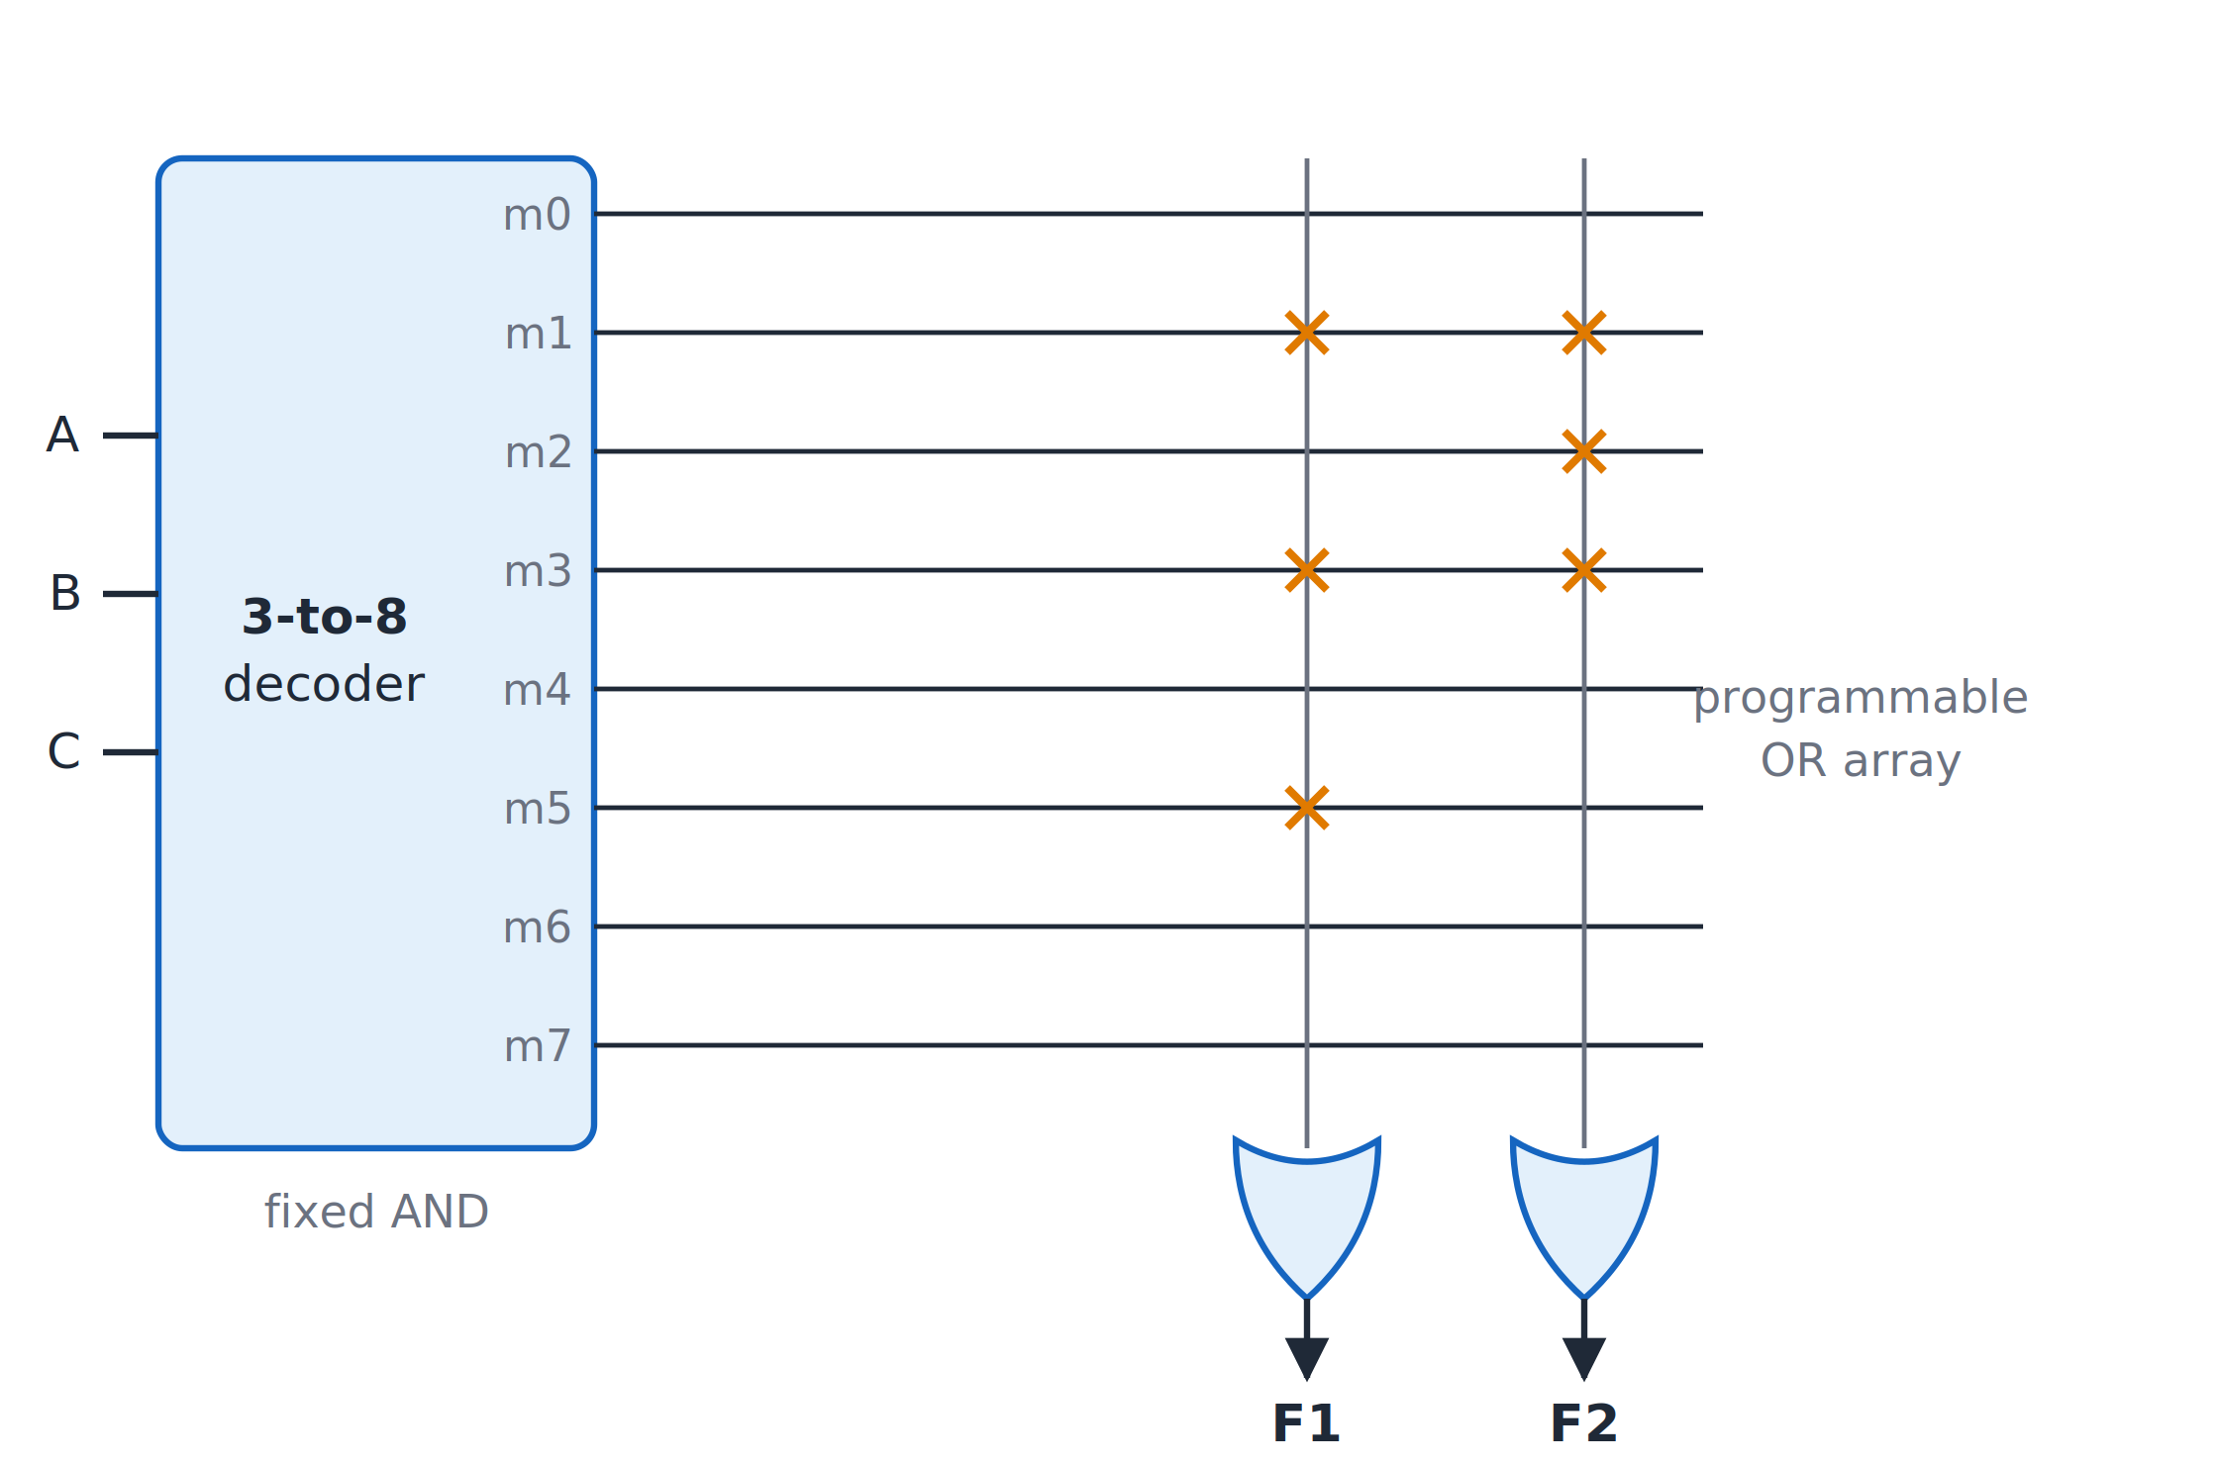
ROM
Topic 5.5
ROM: a fixed decoder makes every minterm; the programmable OR array picks m1, m3, m5 for F1 and m1, m2, m3 for F2.
Notes:
The fixed decoder makes every minterm, and the programmable OR array picks m1, m3, m5 for F1 and m1, m2, m3 for F2. The crosses in the OR array show which minterms each output sums.

Slide 49
PLA: programmable AND, programmable OR
Topic 5.5
A Programmable Logic Array makes both layers programmable
The AND array generates only the product terms some output actually uses, not all 2^{n}
A product term computed once can feed multiple OR gates, so outputs that share a term do not pay for it twice
It is the most flexible of the three
The programmable OR array is more complex and historically more expensive to make reliably than a fixed one
Notes:
That cost is the trade-off that the PAL is built around. The figure on the next slide shows a shared product term.

Slide 50
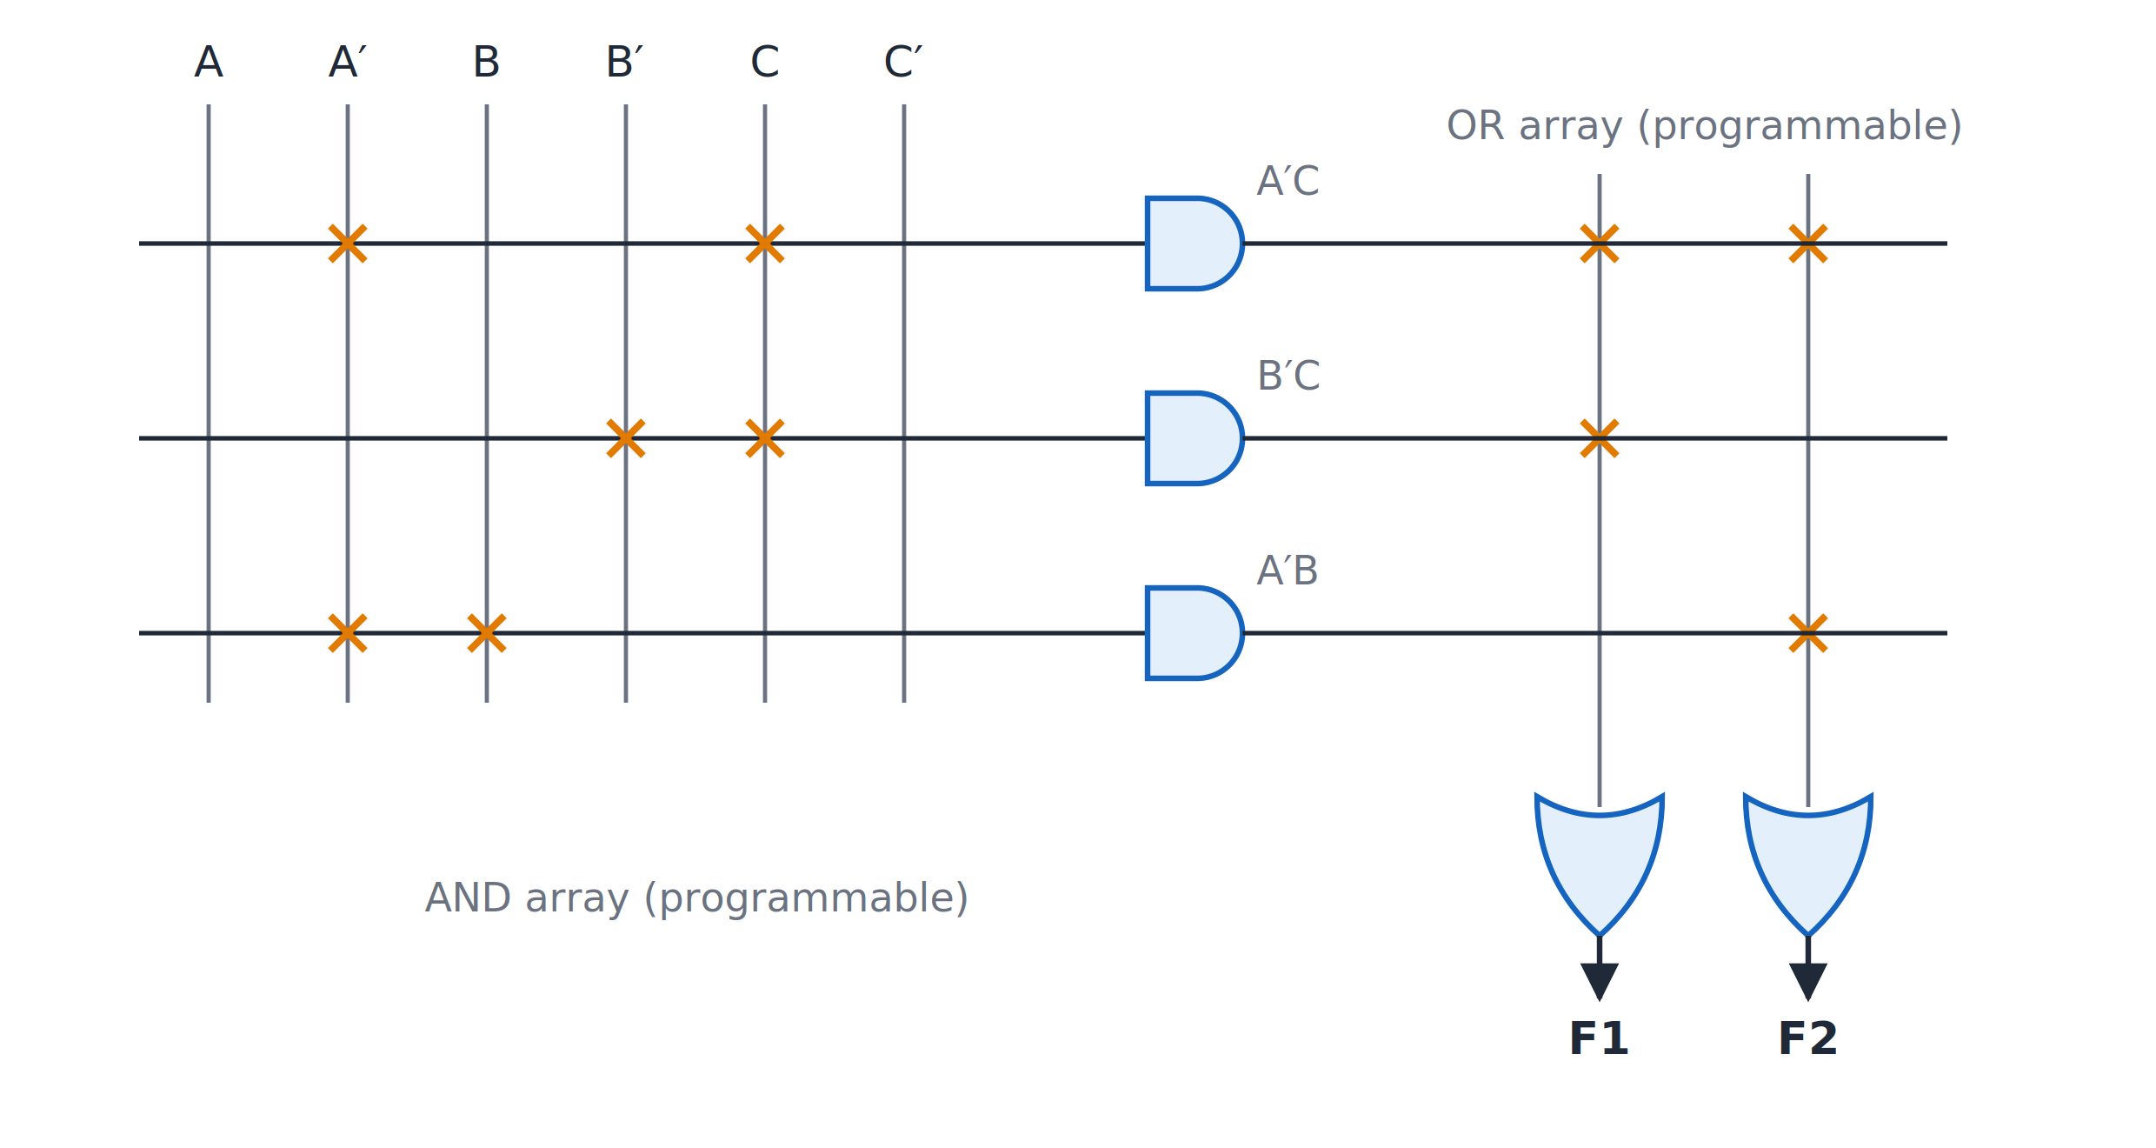
PLA
Topic 5.5
PLA: three product terms, with A′C shared by both outputs.
Notes:
Three product terms, with A′C shared by both outputs. A′C feeds both OR gates, so it is built only once.

Slide 51
PAL: programmable AND, fixed OR
Topic 5.5
A Programmable Array Logic device programs only the AND array
The OR array is fixed at manufacture: each output has its own dedicated, fixed-size bank of AND-array lines
No programmable OR crosspoints makes the PAL cheaper and faster than an equivalent PLA
Trade-off: a product term needed by two outputs must be generated twice, once in each output’s bank
Notes:
A PAL’s fixed OR wiring gives it no way to share a term between outputs. The shared term must therefore be repeated.

Slide 52
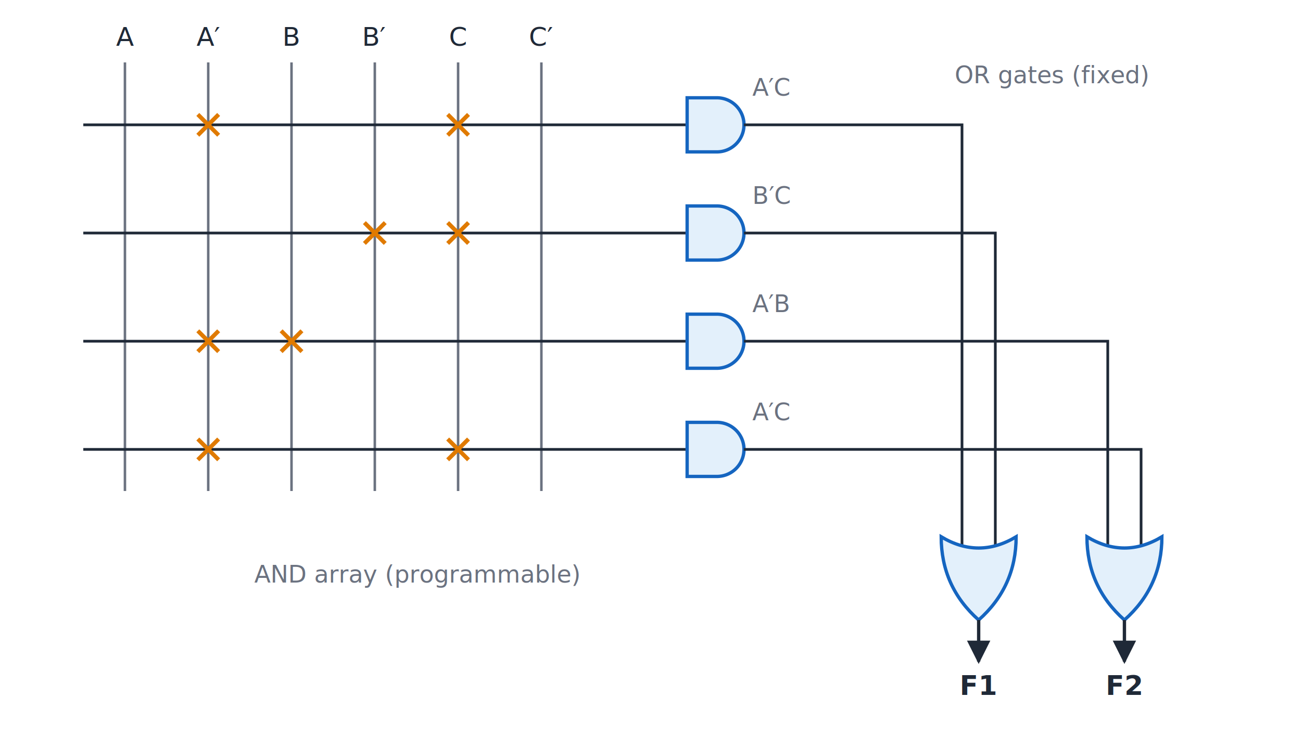
PAL
Topic 5.5
PAL: fixed OR gates, so A′C must be built twice.
Notes:
The OR gates are fixed, so A′C must be built twice. Count the four AND gates, including the repeated A′C.

Slide 53
ROM, PLA and PAL compared
Topic 5.5
Device | AND array | OR array | Product-term sharing
ROM | Fixed (all 2^{n}) | Programmable | Free (every term always exists)
PLA | Programmable | Programmable | Free (any term can feed any output)
PAL | Programmable | Fixed | None (each output needs its own copy)
Notes:
The three devices differ only in which array is programmable and whether terms can be shared. Use this table as the summary of the topic.

Slide 54
Worked example: efficiency comparison
Topic 5.5
F1(A,B,C) = Σm(1,3,5) F2(A,B,C) = Σm(1,2,3)
Minterms 1 and 3 are needed by both functions
ROM: the fixed decoder builds all 8 minterms → 8 AND lines
PLA: three distinct terms A′C, B′C, A′B; A′C feeds both ORs → 3 AND lines
PAL: F1 needs A′C and B′C; F2 needs A′B and A′C; A′C built twice → 4 AND lines
PLA (3) beats PAL (4) beats ROM (8) here, because the example has shared minterms and does not need every possible one
Notes:
A ROM pays for a complete AND array and a PAL pays for non-sharing. This example triggers both costs.

Slide 55
5.6 Memory: RAM and ROM
Topic 5.6
IN SIMPLE TERMS
A memory is a large set of numbered boxes, each holding one word. Give it an address and it either stores the word you supply (write) or hands back the word already there (read).
Notes:
A memory unit is a large collection of storage cells with the circuits that move information in and out. This topic covers organisation, read and write, the RAM structure and the memory types. Read the box aloud and ask students to restate it in their own words.

Slide 56
What a memory unit is
Topic 5.6
A memory unit is a collection of binary storage cells plus the circuits that move information in and out
It stores information in groups of bits called words; each word has an address from 0 to 2^{k} − 1
A memory of 2^{k} words of n bits has k address lines, n data input lines, n data output lines and control inputs for read or write
Memories are named by size: 1K = 2¹⁰ = 1,024 words, 1M = 2²⁰, 1G = 2³⁰
A “1K × 16” memory has 1,024 words of 16 bits: 10 address lines and 16 data lines in each direction
Notes:
The block diagram on the next slide shows the lines of a memory unit. The next slide shows the lines of a memory unit.

Slide 57
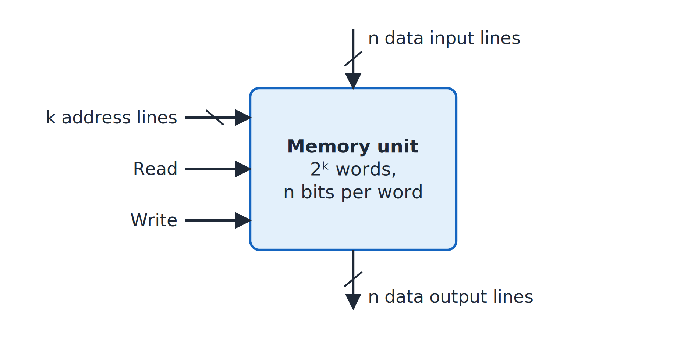
Block diagram of a memory unit
Topic 5.6
Block diagram of a memory unit. Adapted from M. Morris Mano and Michael D. Ciletti, Digital Design, Fig. 7.2.
Notes:
k address lines, read and write controls, n data input lines and n data output lines. Read and write are control inputs, and the data lines are n bits wide.

Slide 58
Worked example: counting lines
Topic 5.6
Rule: 2^{k} = number of words → k = log₂(words).
Memory | Words | Address lines (k) | Data lines (n) | Capacity
1K × 16 | 1,024 | 10 | 16 | 2,048 bytes
4K × 8 | 4,096 | 12 | 8 | 4,096 bytes
64K × 16 | 65,536 | 16 | 16 | 131,072 bytes
Notes:
Apply the rule to each row: find k from the number of words, and n is the word width. Check the capacity column against words times bytes per word.

Slide 59
Write and read operations
Topic 5.6
Write: (1) put the binary address on the address lines; (2) put the data bits on the data input lines; (3) activate the write control
The word is stored at that address, replacing what was there
Read: (1) put the address on the address lines; (2) activate the read control
The stored word appears on the data output lines; reading does not change it
Memory chips usually have a memory enable (chip select) input and one Read/Write line
Notes:
The next slide gives the control table for enable and Read/Write. Reading does not change the stored word.

Slide 60
Memory enable and Read/Write
Topic 5.6
Memory enable | Read/Write | Operation
0 | X | None (chip not selected)
1 | 0 | Write to the selected word
1 | 1 | Read from the selected word
Notes:
With the enable at 0 the chip ignores the Read/Write line. This is how a chip is selected inside a larger memory.

Slide 61
Inside a RAM
Topic 5.6
Each bit is held in a binary cell (BC): in effect a latch with gating
When its select line is 1, Read/Write = 0 stores the input bit and Read/Write = 1 places the stored bit on the output
A RAM of m words × n bits is an m × n array of cells
A k-to-2^{k} decoder turns the address into one word-select line; every cell in that row is selected
The data inputs go to every column, and an OR gate per column collects the selected row’s bits for output
Notes:
The next two slides show one cell as a block and then a complete 4 × 4 RAM. The next two figures show a cell and a full 4 × 4 RAM.

Slide 62
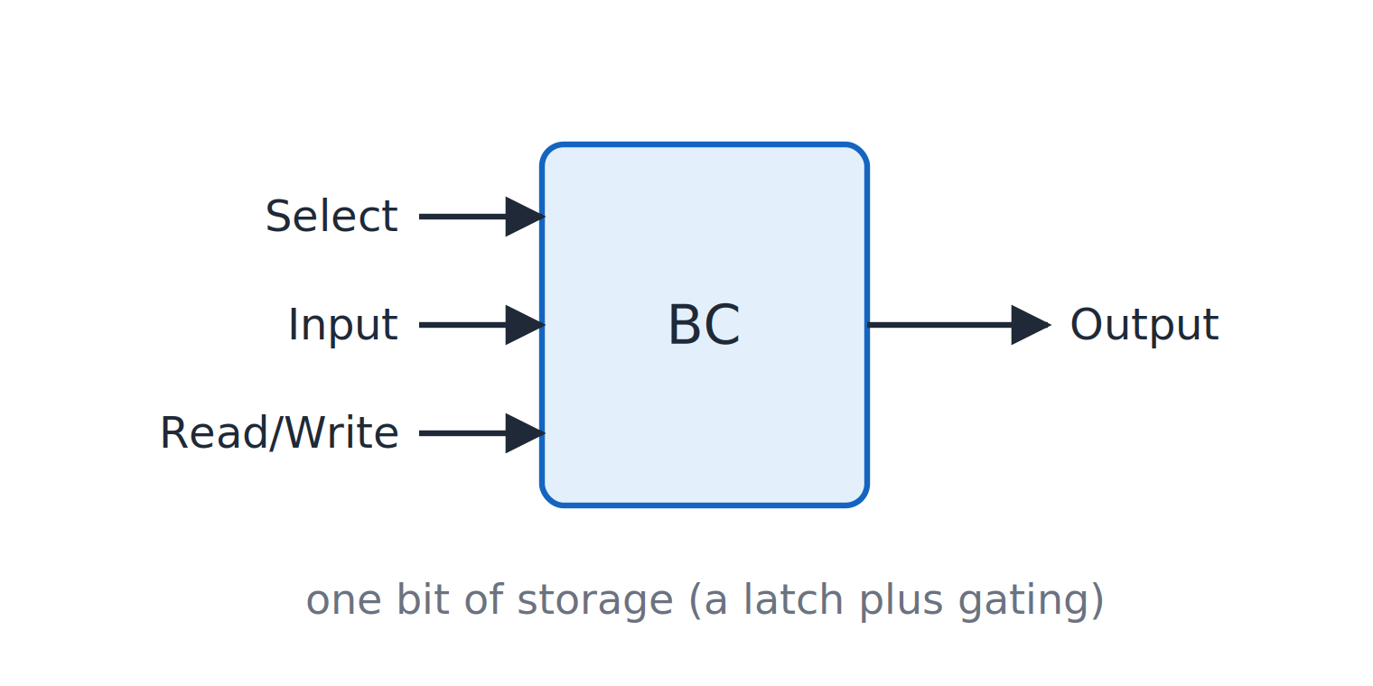
A binary storage cell
Topic 5.6
A binary storage cell as a block.
Notes:
The select, input and Read/Write lines go in, and one output comes out. Think of the cell as a latch with extra gating.

Slide 63
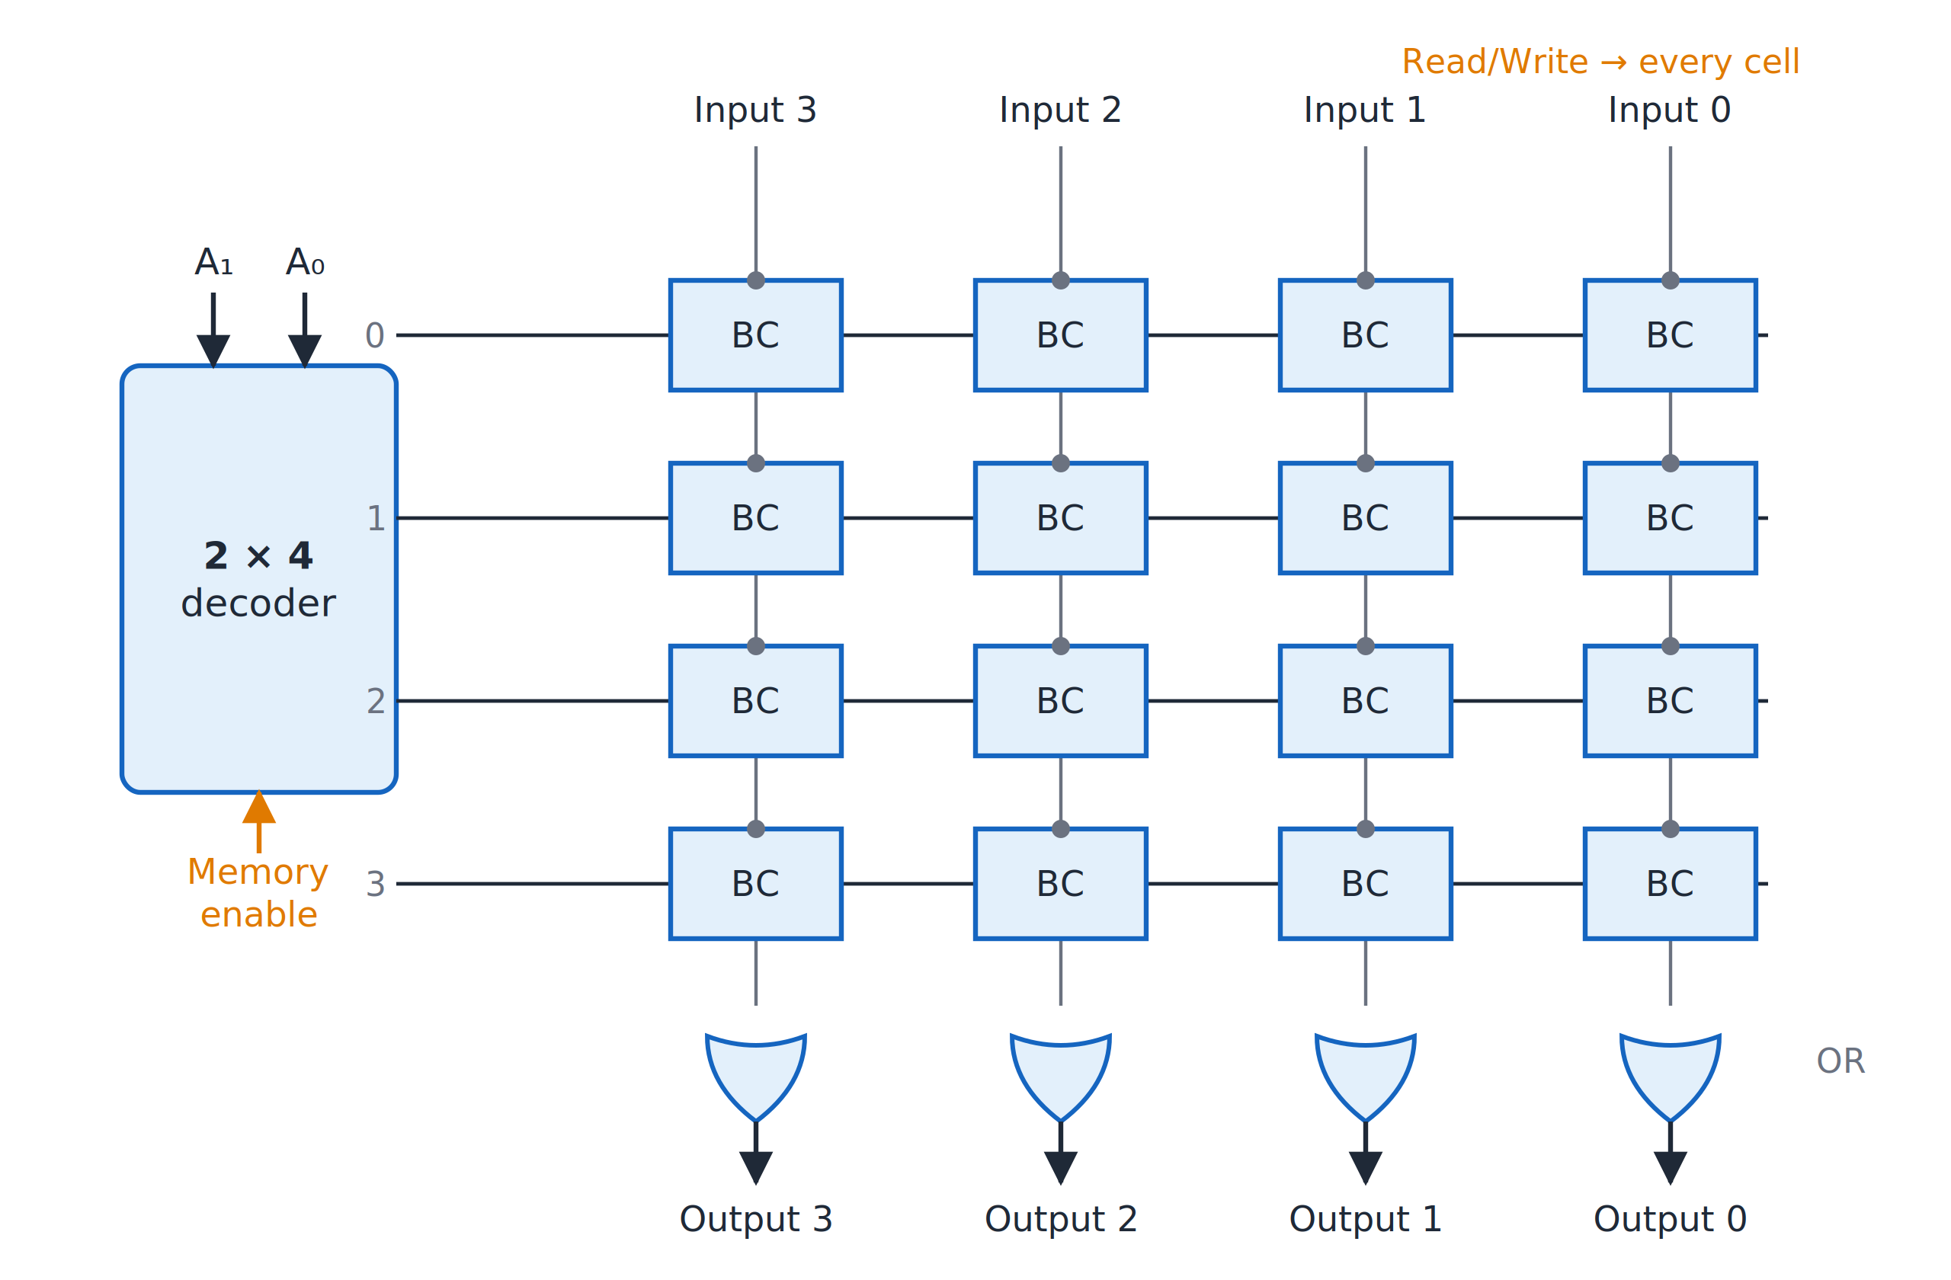
A 4 × 4 RAM
Topic 5.6
A 4 × 4 RAM: the 2 × 4 decoder selects one word of four cells. Adapted from M. Morris Mano and Michael D. Ciletti, Digital Design, Fig. 7.6.
Notes:
The 2 × 4 decoder selects one word of four cells; an OR gate per column collects the output. The decoder selects one row, and the OR gates collect the output of the selected row.

Slide 64
Coincident (two-dimensional) decoding
Topic 5.6
A single decoder for a 1K memory needs 1,024 outputs (1,024 AND gates)
Arrange the words as a 32 × 32 grid instead
Two 5 × 32 decoders do the job: one picks the row (X), the other the column (Y)
The word where they cross is selected: only 64 decoder outputs
1-D: one 10 × 1024 decoder → 1,024 outputs; 2-D: two 5 × 32 decoders → 64 outputs (32 + 32)
Notes:
The next slide shows address 404 selecting a row and a column. It needs far fewer gates for the same memory.

Slide 65
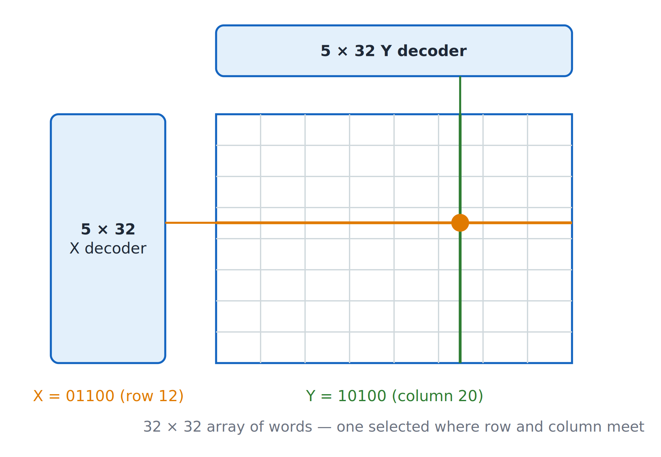
Two-dimensional decoding of a 1K memory
Topic 5.6
Two-dimensional decoding of a 1K memory: address 404 = 01100 10100 selects row 12 and column 20. Adapted from M. Morris Mano and Michael D. Ciletti, Digital Design, Fig. 7.7.
Notes:
Address 404 = 01100 10100 selects row 12 and column 20. The word where the selected row and column cross is the one read or written.

Slide 66
Types of memory
Topic 5.6
Access time: the time to select a word and read it. Cycle time: the time to complete one read or write before the next can start.
Type | Keeps data without power? | How it stores a bit | Typical use
SRAM (static RAM) | No (volatile) | Latch: holds while powered | Cache memory; faster
DRAM (dynamic RAM) | No (volatile) | Charge on a capacitor: must be refreshed every few milliseconds | Main memory; denser, cheaper per bit
ROM (mask-programmed) | Yes (non-volatile) | Fixed at manufacture | Fixed programs and tables
PROM | Yes | Programmed once by the user (fuses) | Small fixed tables
EPROM | Yes | Erased with ultraviolet light, reprogrammed | Development work
EEPROM / Flash | Yes | Erased and rewritten electrically | Firmware, USB drives, SSDs
Notes:
The two timing terms in the intro apply to every memory type in the table. Volatile means the contents are lost when the power is removed.

Slide 67
5.7 FSM Case Studies: Traffic Light & Vending Machine
Topic 5.7
IN SIMPLE TERMS
A traffic light and a vending machine are both just a few states and a rule for moving between them; the same design steps as the sequence detector turn each into flip-flops and gates.
Notes:
Both designs follow the procedure of the sequence detector. Both are Moore machines built with D flip-flops. Read the box aloud and ask students to restate it in their own words.

Slide 68
Two case studies, one procedure
Topic 5.7
Procedure: state diagram → state table → state assignment → flip-flop input equations → output equations
Both are Moore machines: the outputs belong to the states
Both use D flip-flops, so each D input simply equals the next-state bit
Notes:
With D flip-flops there is no excitation table: the input is just the next-state bit. The first case study is a traffic light.

Slide 69
Case study 1: traffic-light controller
Topic 5.7
A junction of a north–south (NS) road and an east–west (EW) road
A timer input T becomes 1 when the current light has been on long enough
Sequence: NS green → NS yellow → EW green → EW yellow → back to NS green
The other road is red throughout
Notes:
The next slide shows the four-state diagram. A timer input T tells the controller when to move on.

Slide 70
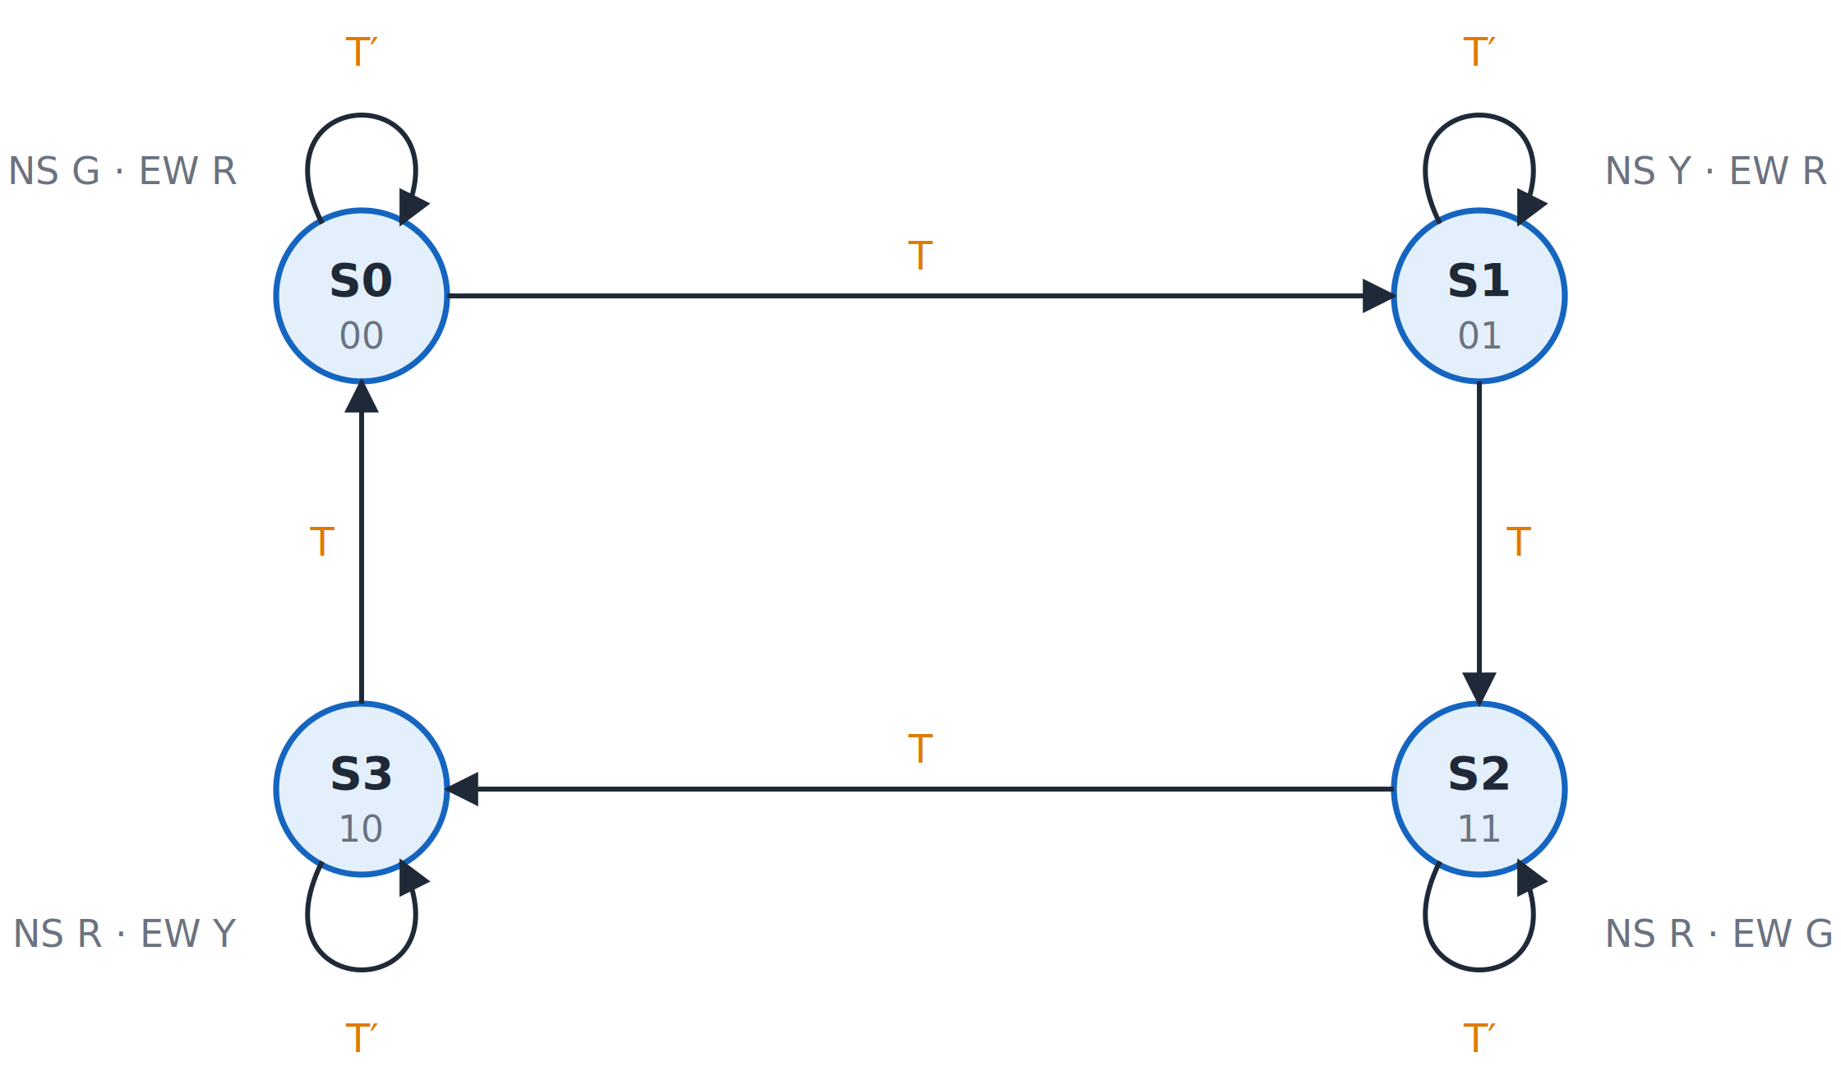
Traffic-light controller
Topic 5.7
Traffic-light controller: four states, each held while T = 0 and left when T = 1.
Notes:
Each state is held while T = 0 and left when T = 1. Each state is held while T = 0 and left when T = 1.

Slide 71
Traffic light: state table
Topic 5.7
State assignment (Gray code, so only one flip-flop changes per step): S0 = 00, S1 = 01, S2 = 11, S3 = 10 (Q₁Q₀).
Present Q₁Q₀ | Next, T = 0 | Next, T = 1 | NS light | EW light
00 (S0) | 00 | 01 | Green | Red
01 (S1) | 01 | 11 | Yellow | Red
11 (S2) | 11 | 10 | Red | Green
10 (S3) | 10 | 00 | Red | Yellow
Notes:
In a Gray code only one flip-flop changes per step, which avoids glitches. Notice that only one bit changes between consecutive states.

Slide 72
Traffic light: equations
Topic 5.7
D1 = T′Q1 + TQ0
D0 = T′Q0 + TQ1′
NS green = Q1′Q0′ NS yellow = Q1′Q0 NS red = Q1
EW green = Q1Q0 EW yellow = Q1Q0′ EW red = Q1′
With T = 0 each bit holds; with T = 1 Q₁ takes the old Q₀ and Q₀ takes the old Q₁′
Check: in S2 (11), NS red = Q₁ = 1 and EW green = Q₁Q₀ = 1; every other lamp is 0 ✓
Notes:
The two D equations are flip-flop inputs, and the six lamp equations are the output equations. The lamp equations read directly from the state code.

Slide 73
Case study 2: vending machine
Topic 5.7
An item costs ₹15
The machine accepts ₹5 coins (input N) and ₹10 coins (input D), one coin per clock at most (N and D are never both 1)
When ₹15 or more has been paid it opens (Open = 1) for one clock and returns to the start
This simple version gives no change; adding a change output is a common extension
Notes:
The state is simply the amount paid so far. The second case study is a vending machine.

Slide 74
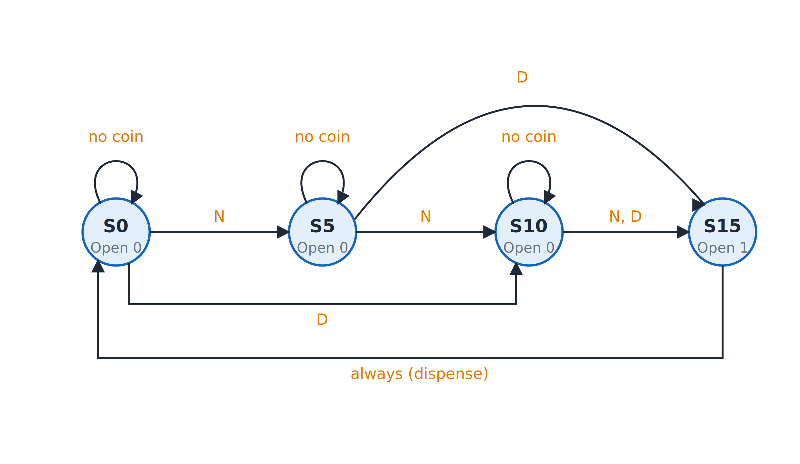
Vending machine
Topic 5.7
Vending machine: the state is the amount paid so far; S15 dispenses and returns to S0.
Notes:
The state is the amount paid so far; S15 dispenses and returns to S0. S15 dispenses and returns to S0.

Slide 75
Vending machine: state table
Topic 5.7
State assignment: S0 = 00, S5 = 01, S10 = 10, S15 = 11 (Q₁Q₀).
Present | No coin | N (₹5) | D (₹10) | Open
S0 (00) | S0 | S5 | S10 | 0
S5 (01) | S5 | S10 | S15 | 0
S10 (10) | S10 | S15 | S15 | 0
S15 (11) | S0 | S0 | S0 | 1
Notes:
S15 is the only state with Open = 1, and it returns to S0 on every input. The state names show the amount paid so far.

Slide 76
Vending machine: equations
Topic 5.7
D1 = Q1′D + Q1Q0′ + Q1′Q0N
D0 = Q0′N + Q1Q0′D + Q1′Q0N′
Open = Q1Q0
From K-maps of Q₁, Q₀, N and D, with ND = 11 as don’t-cares
Check S5 + ₹10 (01, D = 1): D₁ = Q₁′D = 1, D₀ = Q₁′Q₀N′ = 1 → 11 = S15 ✓
Check S15 (11): every term of D₁ and D₀ has Q₁′ or Q₀′, so both are 0 → S0 ✓
Notes:
The input combination ND = 11 never occurs, so it is a don’t-care in the K-maps. The check lines confirm the equations for two transitions.

Slide 77
Unit 5 summary
5.1 Moore vs Mealy: Moore output depends on the state only; Mealy output also on the input
5.2 State diagrams and tables: the same machine in two forms; Moore has an output column, Mealy folds it into each cell
5.3 State reduction and assignment: merge equivalent states; ⌈log₂ k⌉ flip-flops for k states
5.4 Sequence detector design: diagram → table → codes → excitation table → K-maps → gates
5.5 PLDs: ROM (fixed AND), PLA (both programmable), PAL (fixed OR)
5.6 Memory: words and addresses, read and write, RAM structure, 2-D decoding, memory types
5.7 Case studies: a traffic light and a vending machine, both Moore machines on D flip-flops
Notes:
Recap in one line per topic. Ask students which model they would choose for outputs that must be stable for a whole clock period.

Slide 78
Review questions (1 of 2)
Q1. State the difference between a Moore and a Mealy machine, and give an example where Mealy needs fewer states
Q2. How does a Mealy state table differ from a Moore state table?
Q3. When are two states equivalent? Reduce the 5-state table in the lesson to 3 states
Q4. How many flip-flops are needed for k states, and why does the assignment not change the behaviour?
Notes:
These questions cover topics 5.1 to 5.3. Answers: Q1 the two-consecutive-1s detector with 3 versus 2 states; Q2 Moore has a separate output column and Mealy folds the output into each cell; Q3 same outputs and equivalent next states, giving B ≡ C and D ≡ E; Q4 the ceiling of log2 k.

Slide 79
Review questions (2 of 2)
Q5. List the steps of the FSM design procedure using the 1101 detector
Q6. Compare ROM, PLA and PAL for F1 = Σm(1,3,5) and F2 = Σm(1,2,3)
Q7. How many address and data lines does a 4K × 8 memory have?
Q8. How does two-dimensional decoding reduce the decoder size of a 1K memory?
Notes:
These questions cover topics 5.4 to 5.7. Answers: Q5 diagram, table, state codes, excitation table, K-maps, circuit; Q6 8, 3 and 4 AND lines; Q7 12 address lines and 8 data lines; Q8 two 5 by 32 decoders give 64 outputs instead of 1,024.

Slide 80
References
Textbook: M. Morris Mano and Michael D. Ciletti, Digital Design
Adapted figures:
Block diagram of a memory unit (Fig. 7.2)
A 4 × 4 RAM (Fig. 7.6)
Two-dimensional decoding of a 1K memory (Fig. 7.7)
Notes:
The textbook is the reference for this unit. The memory figures listed are adapted from it; the other figures in this deck are original.

