Slide 1
Unit 1: Data Representation and Digital Fundamentals
1
Computer Organization and Architecture
CHANDRAS EDU
Never stop learning
Notes:
Welcome to Unit 1. We start with number systems, complements and the ways computers represent signed and floating-point numbers. Then we cover binary codes, registers, logic gates and K-maps, and finish with the structure and design of a digital computer.

Slide 2
Agenda
1.1 Data Types & Number Systems
1.2 Complements
1.3 Fixed-Point Representation
1.4 Floating-Point Representation
1.5 Binary Codes
1.6 Binary Storage & Registers
1.7 Binary Logic
1.8 Digital Logic Gates
1.9 K-Map Representation
1.10 Introduction to Digital Computers
1.11 Block Diagram of a Digital Computer
1.12 Computer Organization vs Architecture
1.13 Computer Design
Notes:
Thirteen topics. Topics 1.1 to 1.9 cover data representation and logic, and topics 1.10 to 1.13 introduce the digital computer.

Slide 3
1.1 Data Types & Number Systems
Topic 1.1
IN SIMPLE TERMS
Every number system works the same way: each digit is multiplied by the base raised to its position. Octal and hex are just short ways of writing groups of 3 or 4 bits.
Notes:
Unit 1 starts with how numbers, letters and symbols become 0s and 1s. Everything later in the course depends on this. Read the box aloud and ask students to restate it in their own words.

Slide 4
What data does a computer store?
Topic 1.1
Registers hold control information (bits that sequence the hardware’s operations) or data
Data falls into three categories: numbers for arithmetic, letters for text, and other discrete symbols (punctuation, control characters)
Except for numbers already in pure binary, everything is stored in binary-coded form: an agreed mapping from bit patterns to symbols
Notes:
Ask students what a keystroke looks like inside the machine. It is a binary code.

Slide 5
Common number systems
Topic 1.1
A number system of radix (base) r uses r distinct digit symbols, 0 through r − 1.
System | Radix (r) | Digit symbols | Used for
Decimal | 10 | 0 – 9 | Human input/output
Binary | 2 | 0, 1 | Hardware storage
Octal | 8 | 0 – 7 | Shorthand for binary
Hexadecimal | 16 | 0–9, A–F | Compact binary shorthand
Notes:
The radix fixes the symbol set. For example, the digit 9 does not exist in octal.

Slide 6
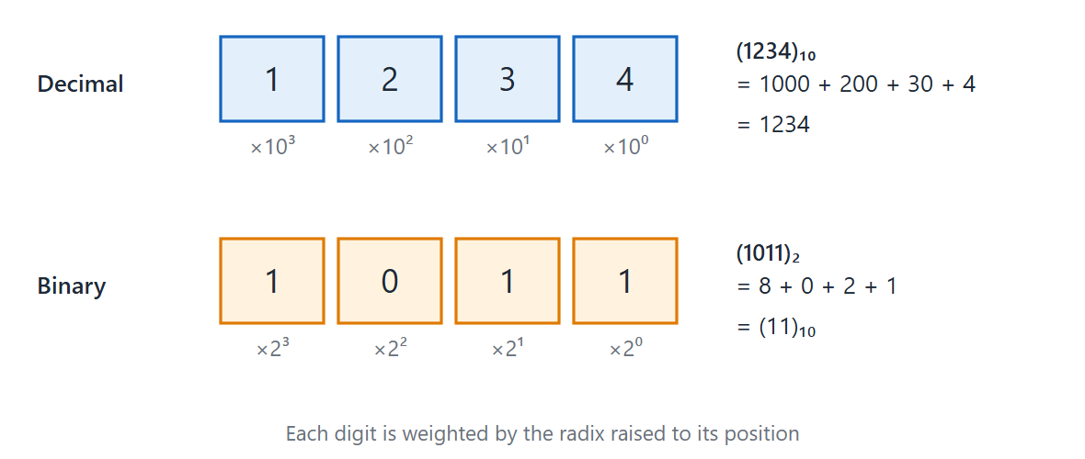
Positional notation
Topic 1.1
Positional notation — same rule, different radix.
Notes:
Each digit contributes its value multiplied by the radix raised to its position. The position index is 0 at the rightmost digit and negative for fractional digits. The formula is value = Σ (digit × radix^position).

Slide 7
Any radix → decimal
Topic 1.1
(101101)₂ = 1×2⁵+0×2⁴+1×2³+1×2²+0×2¹+1×2⁰ = 32+8+4+1 = (45)₁₀
(736.4)₈ = 7×8²+3×8¹+6×8⁰+4×8⁻¹ = 448+24+6+0.5 = (478.5)₁₀
(F3)₁₆ = 15×16¹+3×16⁰ = 240+3 = (243)₁₀
Expand the positional-notation formula and add up the terms
Notes:
Work through one line at a time. Each term is a digit times the radix to the power of its position.

Slide 8
Decimal → any radix
Topic 1.1
Integer part: divide repeatedly by r; read the remainders from last to first (bottom to top)
Fractional part: multiply repeatedly by r; read the carry digits from first to last (top to bottom)
The fractional conversion may not terminate
Notes:
Converting 0.1 (decimal) to binary never ends. This is why 0.1 + 0.2 is not exactly 0.3 in programming languages.

Slide 9
Convert (41.6875)₁₀ to binary
Topic 1.1
(41.6875)₁₀ = (101001.1011)₂
Integer ÷ 2 | Remainder ↑ | Fraction × 2 | Carry ↓
41 ÷ 2 = 20 | 1 | 0.6875 × 2 = 1.375 | 1
20 ÷ 2 = 10 | 0 | 0.375 × 2 = 0.75 | 0
10 ÷ 2 = 5 | 0 | 0.75 × 2 = 1.5 | 1
5 ÷ 2 = 2 | 1 | 0.5 × 2 = 1.0 | 1
2 ÷ 2 = 1 | 0 | (terminates)
1 ÷ 2 = 0 | 1 ← MSB
Notes:
Read the remainders from the bottom up for the integer part and the carries from the top down for the fraction. The result is (101001.1011)₂.

Slide 10
Convert (41.6875)₁₀ to octal and hexadecimal
Topic 1.1
Octal:
Integer: 41 ÷ 8 = 5 rem 1; 5 ÷ 8 = 0 rem 5 → integer = 51
Fraction: 0.6875 × 8 = 5.5 → 5; 0.5 × 8 = 4.0 → 4
Result: (51.54)₈
Hexadecimal:
Integer: 41 ÷ 16 = 2 rem 9; 2 ÷ 16 = 0 rem 2 → integer = 29
Fraction: 0.6875 × 16 = 11.0 → B (terminates)
Result: (29.B)₁₆
Notes:
The same method works for any radix. The fraction terminates after two digits in octal and after one in hexadecimal.

Slide 11
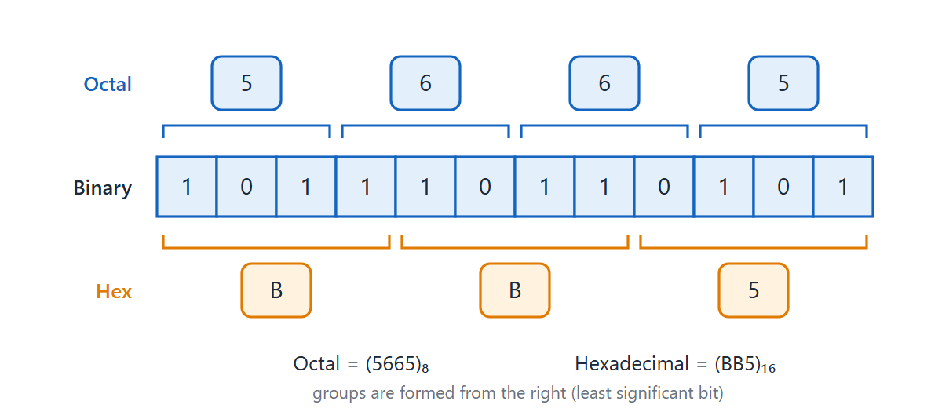
Bit grouping: binary ↔ octal and hexadecimal
Topic 1.1
Bit grouping — binary ↔ octal (3 bits) and hexadecimal (4 bits).
Notes:
Because 8 = 2³ and 16 = 2⁴, each octal digit is 3 bits and each hex digit is 4 bits, so no arithmetic is needed. Always pad with leading zeros to complete the outermost group, or every digit of the result shifts.

Slide 12
1.2 Complements
Topic 1.2
IN SIMPLE TERMS
A complement lets a computer subtract by adding: add the complement of the number you want to take away, then look at the end carry.
Notes:
Digital hardware is built to add, and a separate subtractor costs extra silicon. Complements let one adder do both jobs. Read the box aloud and ask students to restate it in their own words.

Slide 13
What are complements?
Topic 1.2
A complement is defined relative to the radix r and a fixed number of digits n
Every radix has two: the (r − 1)’s complement and the r’s complement
(r − 1)’s complement of N = (r^{n} − 1) − N
r’s complement of N = r^{n} − N = (r − 1)’s complement + 1
The second formula is the first plus 1: the key to computing either quickly
Notes:
Fix the number of digits first. Padding changes the complement.

Slide 14
Complements in decimal and binary
Topic 1.2
Decimal 9’s complement: subtract each digit from 9, or (10^{n} − 1) − N
Decimal 10’s complement: the 9’s complement plus 1
Binary 1’s complement: flip every bit: just inverters, the fastest complement in hardware
Binary 2’s complement: the 1’s complement plus 1; used universally for signed integers
Notes:
Binary complements need almost no hardware, which is why computers use them. The 2’s complement needs only one extra addition of 1.

Slide 15
Examples: finding complements
Topic 1.2
Decimal, N = 546700:
9’s complement = 999999 − 546700 = 453299
10’s complement = 453299 + 1 = 453300
Binary, N = 1011001:
1’s complement: flip every bit → 0100110
2’s complement: 0100110 + 1 → 0100111
Notes:
Both examples follow the same rule: the r’s complement is the (r − 1)’s complement plus 1. Check each result by adding the number to its complement.

Slide 16
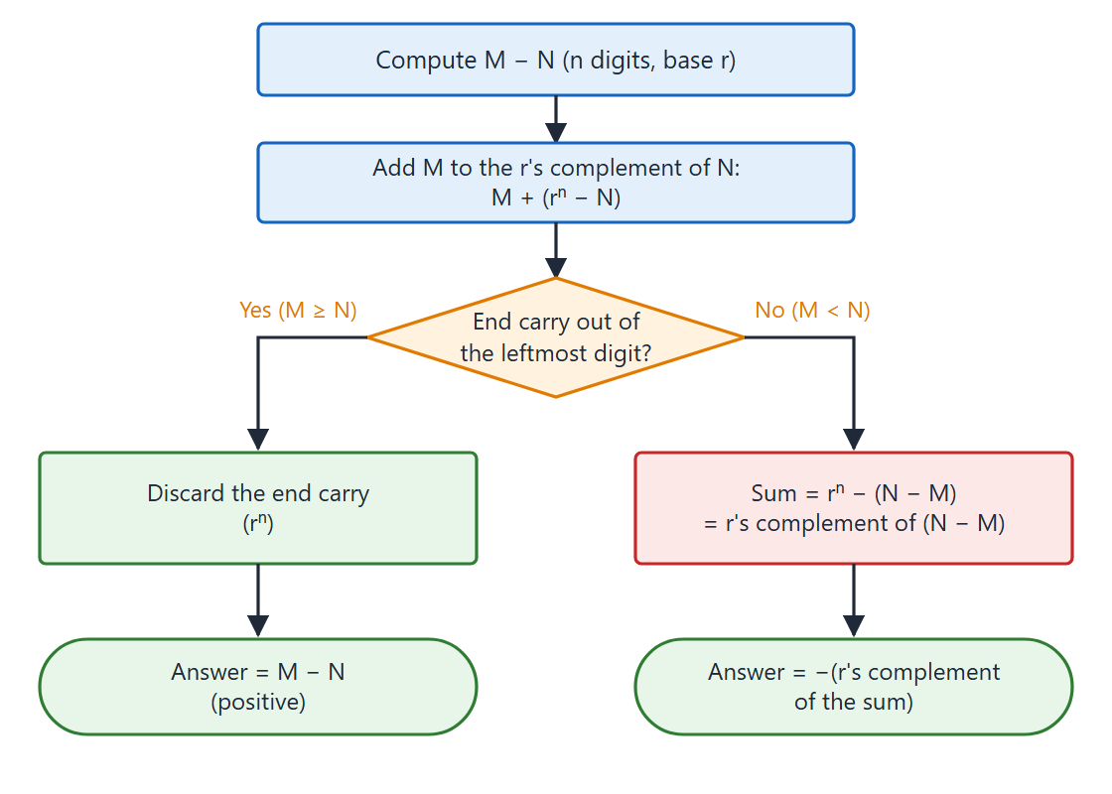
Subtraction with the r’s complement
Topic 1.2
Subtraction of unsigned numbers using the r's complement: the end carry decides the sign of the result.
Notes:
To compute M − N for unsigned n-digit numbers, add M to the r’s complement of N. The end carry decides the sign of the result.

Slide 17
The end carry decides the sign
Topic 1.2
End carry? | Meaning | Action
✅ Yes | M ≥ N → positive result | Discard the carry. Result is M − N.
❌ No | M < N → negative result | Take the r’s complement of the sum and attach a minus sign.
Notes:
The carry logic feels backwards: a carry means the result is already correct and positive. No carry means the result is negative and needs one more complement step.

Slide 18
Example 1: decimal, carry produced (M ≥ N)
Topic 1.2
72532 − 13250:
10’s complement of 13250 = 86750
Sum = 72532 + 86750 = 159282
End carry → discard it → 59282 ✓ (positive)
Notes:
The end carry is dropped and the remaining five digits are the answer. The answer 59282 matches 72532 − 13250.

Slide 19
Example 2: decimal, no carry (M < N)
Topic 1.2
13250 − 72532:
10’s complement of 72532 = 27468
Sum = 13250 + 27468 = 40718
No end carry → negative
10’s complement of 40718 = 59282
Answer = −59282 ✓
Notes:
With no end carry, take the complement of the sum and attach a minus sign. The answer −59282 matches 13250 − 72532.

Slide 20
Example 3: binary, X = 1010100 (84), Y = 1000011 (67)
Topic 1.2
X − Y:
2’s complement of Y = 0111101
Sum = 1010100 + 0111101 = 10010001
End carry → discard → 0010001 = +17 ✓
Y − X:
2’s complement of X = 0101100
Sum = 1000011 + 0101100 = 1101111
No end carry → take 2’s complement → 0010001
Answer = −17 ✓
Notes:
The same pair of numbers gives +17 one way and −17 the other way. Check each against 84 − 67.

Slide 21
1.3 Fixed-Point Representation
Topic 1.3
IN SIMPLE TERMS
A computer has no minus sign, so the leftmost bit becomes the sign. Two’s complement is used because adding and subtracting then work with one simple adder.
Notes:
Hardware has only 0s and 1s, so we must agree on how a pattern means negative. There are three methods, and one clear winner. Read the box aloud and ask students to restate it in their own words.

Slide 22
No minus sign in hardware
Topic 1.3
The leftmost bit is a sign flag: 0 means positive, 1 means negative
In an 8-bit number that leaves 7 bits for the value
Fixed-point: everyone agrees in advance where the binary point goes, and it never moves
Point at the far left → every number is a fraction; point at the far right → every number is a whole number
This course uses whole numbers; the point is never stored as a bit
Notes:
It is just an agreement, like knowing that Rs. in front of a number means rupees.

Slide 23
Three ways to write a negative number
Topic 1.3
All three agree on positive numbers; they differ only when negative
Signed-magnitude: keep ordinary binary and flip only the sign bit to 1
Signed-1’s-complement: flip every bit of the positive version
Signed-2’s-complement: take the 1’s complement, then add 1
Notes:
The next slide shows −14 written all three ways in an 8-bit register. Compare the three patterns bit by bit.

Slide 24
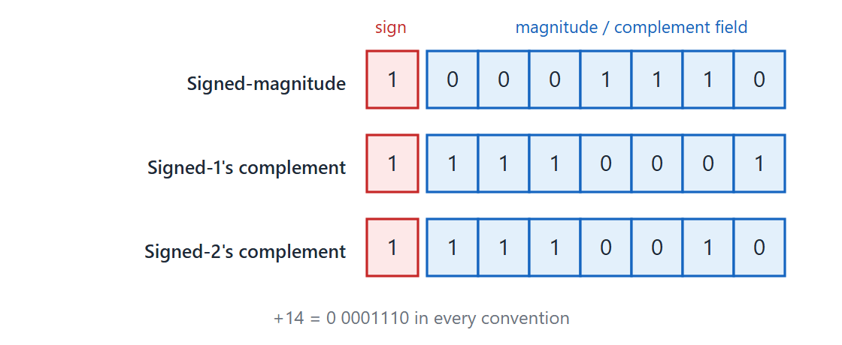
−14 in an 8-bit register
Topic 1.3
−14 in an 8-bit register under all three conventions (compare +14 = 00001110).
Notes:
−14 in an 8-bit register under all three conventions (compare +14 = 00001110). The sign bit is 1 in all three conventions, but the other seven bits differ.

Slide 25
Writing −20, −50 and −100 in 8 bits
Topic 1.3
Steps for −20: 1) write +20 as 00010100 2) signed-magnitude: flip only the sign bit → 10010100 3) 1’s complement: flip every bit → 11101011 4) 2’s complement: add 1 → 11101100
Number | Positive version | Signed-magnitude | 1’s complement | 2’s complement
−20 | 00010100 | 10010100 | 11101011 | 11101100
−50 | 00110010 | 10110010 | 11001101 | 11001110
−100 | 01100100 | 11100100 | 10011011 | 10011100
Notes:
Walk through the four steps for −20, then check the other two rows the same way. Positive numbers are the same in all three methods.

Slide 26
Adding signed numbers
Topic 1.3
Signed-magnitude: same signs → add magnitudes, keep the sign; different signs → subtract the smaller from the larger, keep the bigger’s sign
The hardware needs a comparator and a subtractor, on top of an adder
2’s complement: add the two numbers, sign bits included, like normal addition
If a carry pops out of the leftmost position, throw it away
One rule, one piece of hardware: the reason 2’s complement is used in every real computer
Notes:
Do not split the sign bit out before adding in 2’s complement. It is added along with everything else.

Slide 27
2’s complement addition (8 bits)
Topic 1.3
What we are adding | In 8-bit binary | Result | Matches normal math?
(+6) + (+13) | 00000110 + 00001101 | 00010011 | = +19 ✓
(−6) + (+13) | 11111010 + 00001101 | 00000111 | = +7 ✓
(+6) + (−13) | 00000110 + 11110011 | 11111001 | = −7 ✓
(−6) + (−13) | 11111010 + 11110011 | 11101101 (carry dropped) | = −19 ✓
Notes:
Every combination of signs works with the same addition. In the last row the carry out of the leftmost bit is dropped.

Slide 28
Example: (+30) + (−12)
Topic 1.3
+30 = 00011110
−12 = 11110100
--------------------
sum = 100010010 ← 9 bits! drop the leading carry
keep = 00010010 = +18
Check: 30 − 12 = 18. It matches, using nothing but plain addition
Notes:
This is the standard 2’s complement addition with a dropped carry. The sum has nine bits, and the ninth is discarded.

Slide 29
Overflow: when the answer does not fit
Topic 1.3
An 8-bit signed register holds −128 to +127; an answer outside that range is overflow
Unsigned: overflow shows as an extra carry out of the last bit
Signed: overflow happens exactly when the carry into the sign bit differs from the carry out of it
Positive + negative can never overflow; only two positives or two negatives can
Using the unsigned carry trick on signed numbers gives the wrong answer
Notes:
Overflow checks differ for signed and unsigned numbers. A note on BCD: the sign is stored as 0000 for positive and 1001 for negative, and this returns in the Computer Arithmetic unit.

Slide 30
Example: overflow, (+70) + (+80)
Topic 1.3
+70 = 01000110
+80 = 01010000
--------------------
sum = 10010110 ← looks negative!
It looks negative, but we added two positives: this signals overflow
150 does not fit in 8 signed bits (maximum is +127)
Notes:
The mismatch between the operands’ signs and the result’s sign is the overflow signal. 150 is outside the range −128 to +127.

Slide 31
1.4 Floating-Point Representation
Topic 1.4
IN SIMPLE TERMS
Floating point is scientific notation in binary: a fraction (the digits) and an exponent (where the point goes), so very large and very small numbers fit in the same register.
Notes:
Floating point is the same trick as scientific notation, done in binary inside a computer. We work through several examples. Read the box aloud and ask students to restate it in their own words.

Slide 32
Why not fixed-point? Mantissa and exponent
Topic 1.4
Fixed-point: a huge number needs many bits before the point; a tiny precise fraction needs many after; a fixed register cannot give both
Floating point lets the point float, and stores where it moved to
Mantissa (fraction): the meaningful digits, as a signed value
Exponent: a power of the base (2 for binary): how far and which way to slide the point
value = mantissa × (base)^{exponent}
Only the mantissa and exponent are stored; the base and the point position are conventions
Notes:
The base and the position of the point are agreed, like Rs. meaning rupees. They are never stored as bits.

Slide 33
Examples 1 and 2
Topic 1.4
Example 1: +6132.789 = 0.6132789 × 10⁺⁴
Mantissa = +0.6132789, Exponent = +04
Example 2: binary +1001.11, 8-bit fraction, 6-bit exponent
Mantissa = 01001110, Exponent = 000100
representing +(.1001110)₂ × 2⁺⁴
Notes:
Example 1 is a familiar decimal number already in mantissa and exponent form. Example 2 shows the same idea in binary.

Slide 34
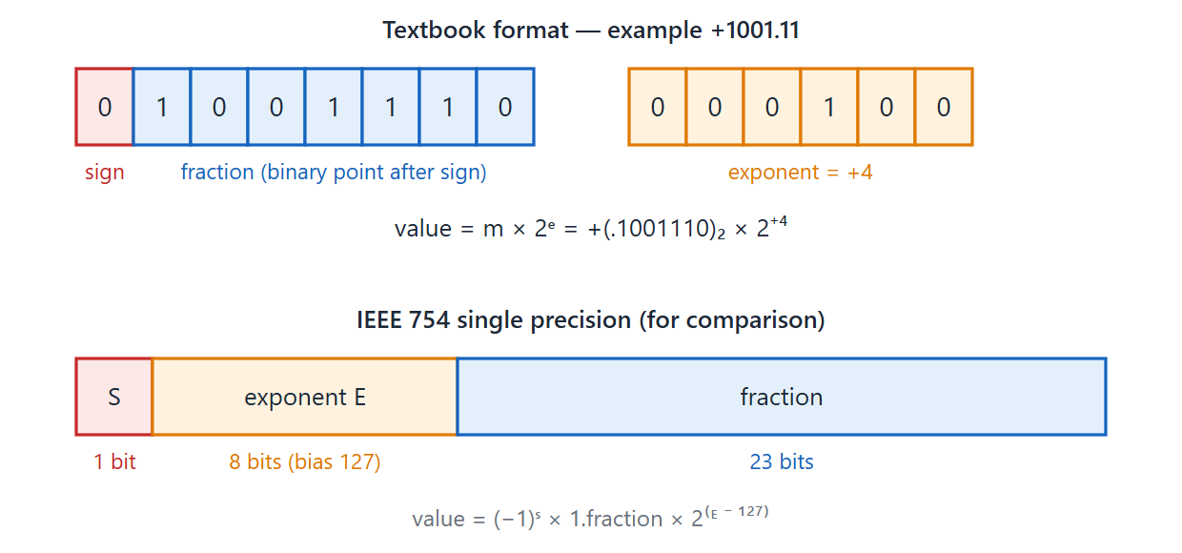
Classic floating-point layout vs. IEEE 754 single precision
Topic 1.4
Classic floating-point layout vs. IEEE 754 single precision.
Notes:
The classic layout stores a signed mantissa and a signed exponent. The IEEE 754 single-precision layout is 1 sign bit, 8 exponent bits and 23 mantissa bits. IEEE 754 stores the exponent with a bias: stored exponent = real exponent + 127, so a stored 127 means exponent zero. This goes a little beyond the textbook and is included only because real hardware uses it.

Slide 35
Example 3: converting +37.25 step by step
Topic 1.4
Step 1: 37.25 in binary is 100101.01
Step 2: slide the point left until only a 1 is before it:
100101.01 → 0.10010101 (slid 6 places)
Step 3: Mantissa = 10010101, Exponent = +6 (000110)
Check: 0.10010101₂ = 0.58203125, and 0.58203125 × 2⁶ (= 64) = 37.25 ✓
Notes:
Each step is mechanical: convert, slide the point, then record the mantissa and exponent. The check at the end multiplies the fraction back by 2⁶.

Slide 36
Normalization and zero
Topic 1.4
A number is normalized when the first digit of the mantissa is 1, not 0
This squeezes the most precision out of a fixed-size mantissa: no bits wasted on leading zeros
Rule: however many places you slide the mantissa left, subtract the same number from the exponent
Example A: 00011010 has 3 leading zeros → shift left 3 → 11010000; exponent reduced by 3
Example B: 00000101 has 5 leading zeros → shift left 5 → 10100000; exponent reduced by 5
Zero cannot be normalized: it is stored as all-zero mantissa and all-zero exponent
Notes:
Zero has no 1 to slide into place, so it gets a special agreement. Normalising means shifting left until the first digit is 1.

Slide 37
1.5 Binary Codes
Topic 1.5
IN SIMPLE TERMS
A binary code just gives each symbol a pattern of bits. BCD codes decimal digits, ASCII codes characters, and Gray code changes only one bit between neighbours.
Notes:
Many things a computer stores are not numbers for arithmetic: a decimal digit on a display, a keystroke, or a shaft position. This topic covers the binary codes made for those jobs. Read the box aloud and ask students to restate it in their own words.

Slide 38
Binary codes and BCD
Topic 1.5
A binary code assigns a group of n bits (up to 2^{n} patterns) to represent a digit, character or position
A code need not use every pattern
BCD (8421): each decimal digit 0–9 is coded separately in 4 bits, with weights 8, 4, 2, 1
Six patterns (1010–1111) are unused in BCD
BCD is not the same as converting the whole decimal number to binary
Notes:
The next slide compares BCD with straight binary. BCD keeps each decimal digit separate.

Slide 39
BCD versus straight binary
Topic 1.5
Decimal | BCD (digit by digit) | Straight binary (whole number)
396 | 0011 1001 0110 | 110001100
99 | 1001 1001 | 1100011
Notes:
Each decimal digit is coded on its own in BCD, so the BCD form is longer than straight binary. Check that 396 is 0011 1001 0110 in BCD.

Slide 40
Self-complementing codes: Excess-3
Topic 1.5
Digit 6 → BCD 0110 → Excess-3 = 0110 + 0011 = 1001
Flip every bit of 1001 → 0110
Decode as Excess-3 (subtract 3): 0110 − 0011 = 0011 = digit 3
Self-complementing: the 9’s complement of a digit is found just by flipping every bit
Excess-3: the BCD value plus 3; the 2421 code (weights 2, 4, 2, 1) is also self-complementing
Check: the 9’s complement of 6 is 9 − 6 = 3 ✓
Notes:
No subtraction is needed: just a bit flip. Excess-3 and 2421 are two examples of self-complementing codes.

Slide 41
Gray code
Topic 1.5
Gray code (reflected binary, unit-distance code): consecutive values differ in exactly one bit
Ordinary binary does not: 0111 → 1000 flips all four bits
Bits can change at slightly different instants; in binary this can give a wildly wrong intermediate value
In Gray code at most one bit is mid-transition: the worst case is one step off
Used in rotary position encoders (motor controllers, robotics, old mechanical mice)
Notes:
This one-bit-change property comes back in the K-map topic. The next slide lists Gray code for 0 to 7.

Slide 42
Binary and Gray code, 0 to 7
Topic 1.5
Decimal | Binary | Gray code
0 | 0000 | 0000
1 | 0001 | 0001
2 | 0010 | 0011
3 | 0011 | 0010
4 | 0100 | 0110
5 | 0101 | 0111
6 | 0110 | 0101
7 | 0111 | 0100
Notes:
Check that each row differs from the one above in exactly one bit of the Gray column. For example, 3 is 0010 and 4 is 0110, which differ only in the second bit.

Slide 43
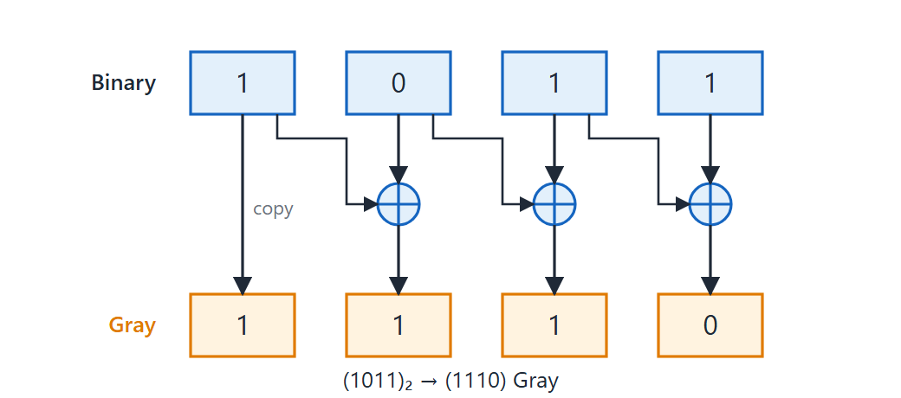
Binary-to-Gray conversion
Topic 1.5
Binary-to-Gray conversion — MSB copied, every other bit is an XOR with its neighbor.
Notes:
Binary-to-Gray conversion: the MSB is copied, and every other Gray bit is the XOR of that binary bit and the one immediately to its left. For 1011 the Gray code is 1110.

Slide 44
ASCII and parity
Topic 1.5
ASCII is the standard alphanumeric code: 7 bits, 128 characters (letters, digits, punctuation, control characters)
A parity bit is one extra bit appended so the total count of 1s follows a fixed rule
Even parity: the total is even; odd parity: the total is odd
It catches a single flipped bit but cannot say which bit flipped
It misses an even number of simultaneous flips
Notes:
Parity is the simplest error-detecting code. An odd number of flipped bits changes the parity and is caught.

Slide 45
1.6 Binary Storage & Registers
Topic 1.6
IN SIMPLE TERMS
A register is a row of one-bit storage cells; n cells can hold any one of 2ⁿ values.
Notes:
Earlier topics described how to interpret a pattern of bits. This short topic covers where the bits live. Read the box aloud and ask students to restate it in their own words.

Slide 46
The storage cell
Topic 1.6
A binary storage cell is a flip-flop: a circuit with exactly two stable electrical states
The state it sits in is the bit: one state means 0 and the other means 1
It holds its state without continuous input, unlike a plain wire
Treat it as a labelled box that stores one bit; how it is built comes in the Sequential Circuits unit
Notes:
A wire carries a signal only while something drives it. A flip-flop remembers.

Slide 47
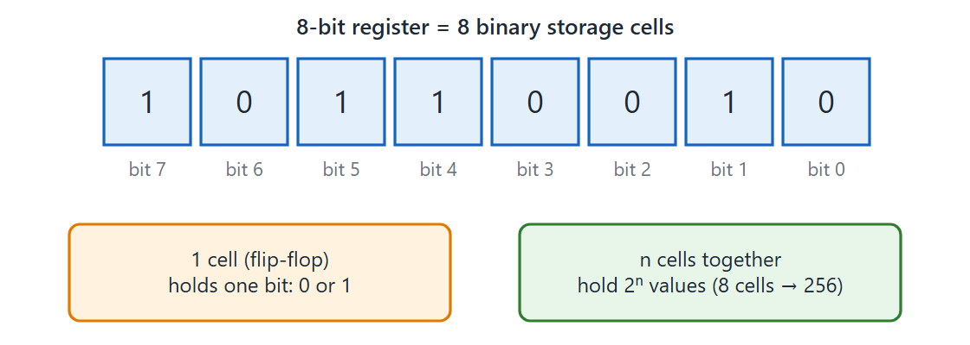
A register of storage cells
Topic 1.6
A register is a group of storage cells; n cells hold one of 2ⁿ possible values.
Notes:
A register is a group of storage cells; n cells hold one of 2ⁿ possible values. An 8-bit register has bits numbered 7 down to 0.

Slide 48
Registers and register transfer
Topic 1.6
A register is an ordered group of storage cells acting together; an 8-bit register is 8 flip-flops side by side
n cells hold any one of 2^{n} values: 2⁸ = 256; 2³² is over 4 billion
A register transfer moves or copies a value from one register to another
A transfer does not necessarily destroy the original
Notes:
Register transfer gets its own topic later in the course. For now only the vocabulary matters.

Slide 49
1.7 Binary Logic
Topic 1.7
IN SIMPLE TERMS
Binary logic has just three basic operations: AND (all must be 1), OR (any can be 1) and NOT (flip it).
Notes:
Until now we treated bits as numbers. Binary logic reads a bit as a true-or-false statement, which is the foundation for the rest of the course. Read the box aloud and ask students to restate it in their own words.

Slide 50
Binary variables and three operations
Topic 1.7
A binary variable takes exactly one of two values: 0 or 1
In binary logic read them as truth values: 1 = true, 0 = false
AND (A·B or AB): 1 only when both A and B are 1
OR (A+B): 1 when at least one of A or B is 1
NOT (A′ or Ā): flips the value: 1 becomes 0 and 0 becomes 1
Notes:
The next slide shows the three truth tables. Notice that OR gives 1 when at least one input is 1.

Slide 51
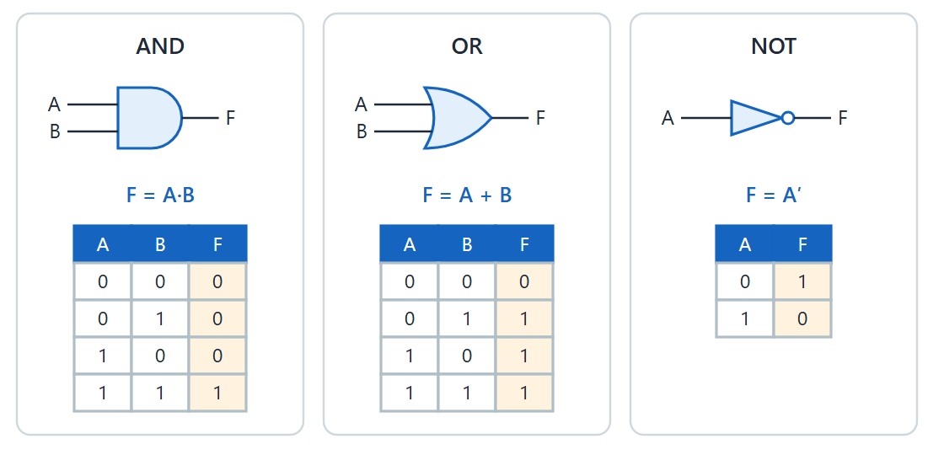
Three basic operations and truth tables
Topic 1.7
The three basic binary logic operations and their truth tables.
Notes:
The three basic binary logic operations and their truth tables. AND is 1 only when both inputs are 1, and NOT flips its input.

Slide 52
Gates, and a warning about symbols
Topic 1.7
A logic gate is the physical circuit that carries out one of these operations electronically
AND, OR and NOT map onto the AND gate, the OR gate and the NOT gate (inverter)
Warning: + does not mean addition and · does not mean multiplication here
In binary logic 1 + 1 = 1 (OR), not 2
Notes:
Keep the logical and arithmetic meanings of the symbols mentally separate. Formal gate symbols come in the next topic.

Slide 53
1.8 Digital Logic Gates
Topic 1.8
IN SIMPLE TERMS
Each gate is a tiny circuit for one logic operation; NAND or NOR alone can build every other gate.
Notes:
This topic turns the abstract operations into physical circuits. It adds NAND, NOR, XOR, XNOR and DeMorgan’s theorem. Read the box aloud and ask students to restate it in their own words.

Slide 54
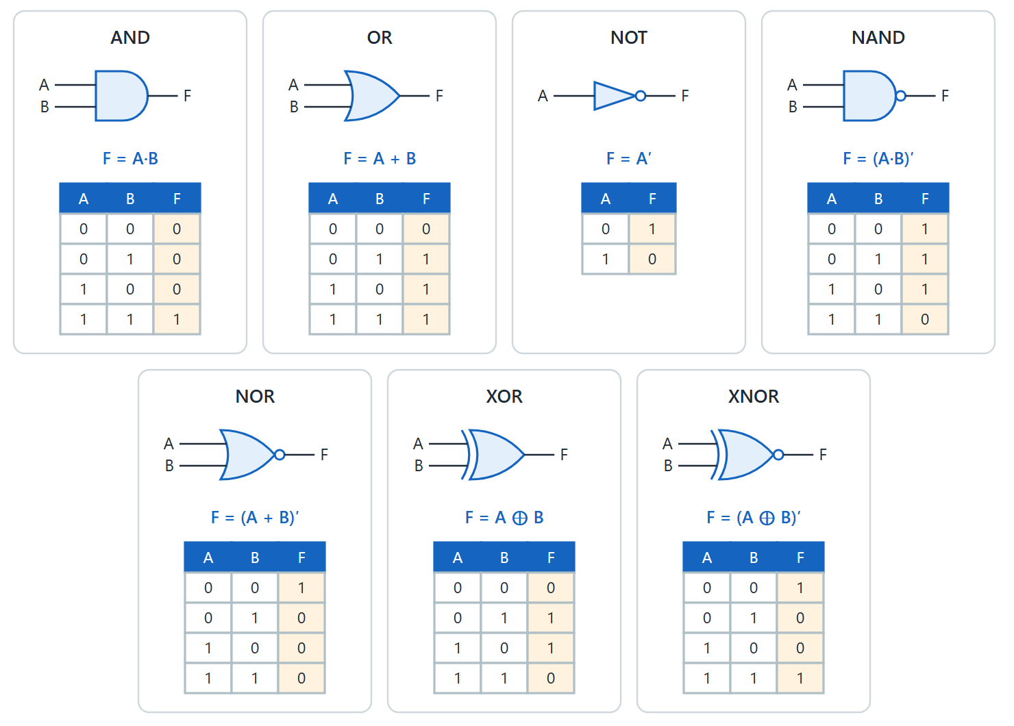
The seven basic gates
Topic 1.8
Symbol, expression, and truth table for each of the seven basic gates.
Notes:
Symbol, expression and truth table for each of the seven basic gates. Every gate symbol follows the same visual grammar: the small bubble on an output means “inverted”, which is the entire visual difference between AND and NAND and between OR and NOR. AND, OR and NOT are the three basic operations with formal gate symbols. NAND and NOR are an AND or OR followed by an inversion. XOR is 1 when the inputs differ, and XNOR is 1 when they match.

Slide 55
DeMorgan’s theorem
Topic 1.8
(A + B)′ = A′ · B′
(A · B)′ = A′ + B′
Complementing an expression flips the operator (+ becomes ·, and vice versa) and complements every literal
Check for A = 0, B = 1: (A+B)′ = (0+1)′ = 1′ = 0 and A′·B′ = 1·0 = 0: match
True for all 4 input combinations, which is what makes it a theorem
Notes:
DeMorgan’s theorem is the most useful algebraic identity in digital design. It lets us turn ANDs into ORs and back, which is used when building circuits from NAND gates.

Slide 56
NAND and NOR are universal gates
Topic 1.8
Either one alone can build every other gate, NOT, AND and OR included
Real chips are built almost entirely from NAND (or NOR): one gate type made repeatedly is far cheaper
NOT from NAND: tie both inputs together: NAND(A,A) = (A·A)′ = A′
AND from NAND: a NAND followed by a second NAND wired as a NOT
OR from NAND: invert both inputs, then NAND: (A′·B′)′ = A + B
Notes:
The OR construction is DeMorgan’s theorem in physical form. Each construction uses only NAND gates.

Slide 57
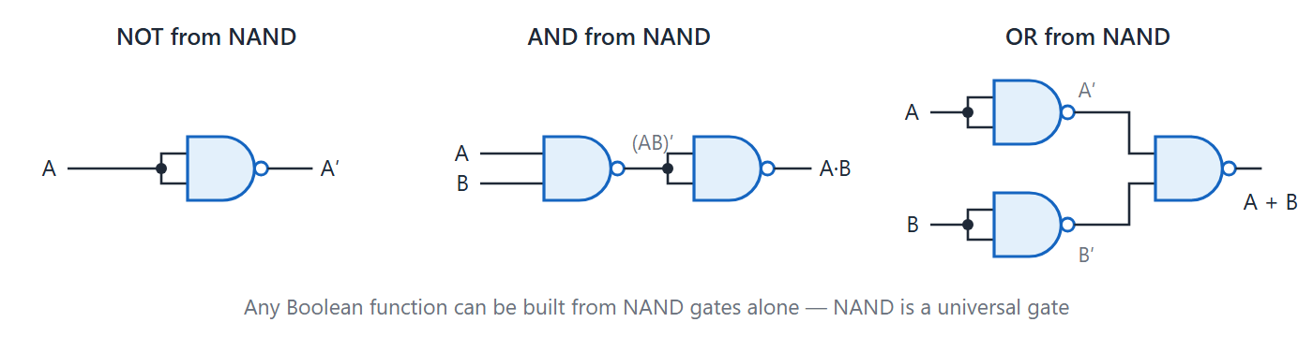
NOT, AND and OR from NAND gates
Topic 1.8
NOT, AND, and OR, each built using only NAND gates.
Notes:
NOT, AND and OR, each built using only NAND gates. The OR needs two NAND gates that invert the inputs first, then a third NAND.

Slide 58
Canonical form: minterms
Topic 1.8
F(A,B,C) is 1 for rows 1, 3, 5, 6 → F = Σm(1,3,5,6)
F = A′B′C + A′BC + AB′C + ABC′
A minterm is an AND term containing every variable exactly once: uncomplemented if the variable is 1 in that row, complemented if 0
Writing a function as the OR of all its minterms is the canonical sum-of-products (SOP) form
Guaranteed correct but rarely minimal: the starting point for Karnaugh maps
Notes:
The canonical form is the direct starting point for the K-map on the next topic. The function is 1 for rows 1, 3, 5 and 6.

Slide 59
1.9 K-Map Representation
Topic 1.9
IN SIMPLE TERMS
A K-map lays out the truth table so that neighbouring cells differ in one bit; circling neighbouring 1s in groups of 1, 2, 4 or 8 gives the simplest expression.
Notes:
Canonical SOP is correct but almost never minimal. The Karnaugh map turns simplification into a visual, reliable procedure. Read the box aloud and ask students to restate it in their own words.

Slide 60
Why a grid works
Topic 1.9
A K-map places truth-table rows in a grid so physically adjacent cells differ in exactly one variable
This reuses Gray code: headers are written 00, 01, 11, 10, never 00, 01, 10, 11
Neighbours are one bit-flip apart across, down, and even wrapping around the edges
Two cells that differ in one variable combine algebraically: the differing variable cancels
A K-map lets you see which cells qualify
Notes:
This is where the Gray code from the binary codes topic pays off. The K-map cell order 00, 01, 11, 10 is a Gray code.

Slide 61
Grouping rules
Topic 1.9
Group adjacent 1s in powers of two: 1, 2, 4, 8, … cells
Groups must be rectangular, including wraparound across top/bottom and left/right edges
Bigger groups are better: doubling a group removes one more variable from its term
Every 1 must be covered by at least one group, using as few groups as possible
Don’t-care cells (X) may join a group only if that makes the group larger
Notes:
Forcing every don’t-care to count as a 1 can give an incorrect, over-general function. A don’t-care may stay outside every group.

Slide 62
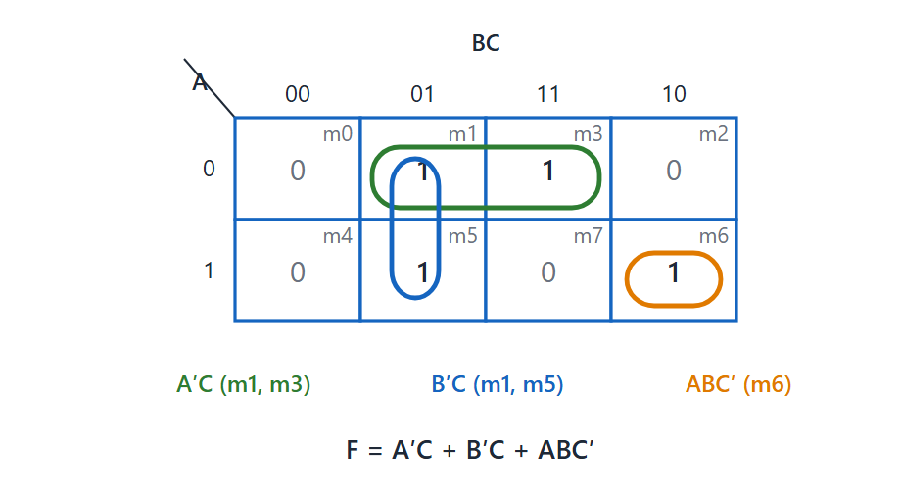
Three-variable K-map
Topic 1.9
Three-variable K-map for F = Σm(1,3,5,6): F = A′C + B′C + ABC′.
Notes:
Three-variable K-map for F = Σm(1,3,5,6): F = A′C + B′C + ABC′. Point out the three groups and the cells they cover.

Slide 63
Worked example: 3 variables
Topic 1.9
F(A,B,C) = Σm(1,3,5,6), the function from the previous topic
m1 and m3 (adjacent across BC = 01/11 in row A = 0): B differs and cancels → A′C
m5 pairs with m1 (same column, BC = 01) → B′C
m6 has no neighbouring 1 → it stays alone as ABC′
Minimal result: F = A′C + B′C + ABC′: three terms with fewer literals than the four-term canonical SOP
Notes:
Compare the result with the four-term canonical form from the gates topic. Three terms with fewer literals are simpler than four terms of three literals each.

Slide 64
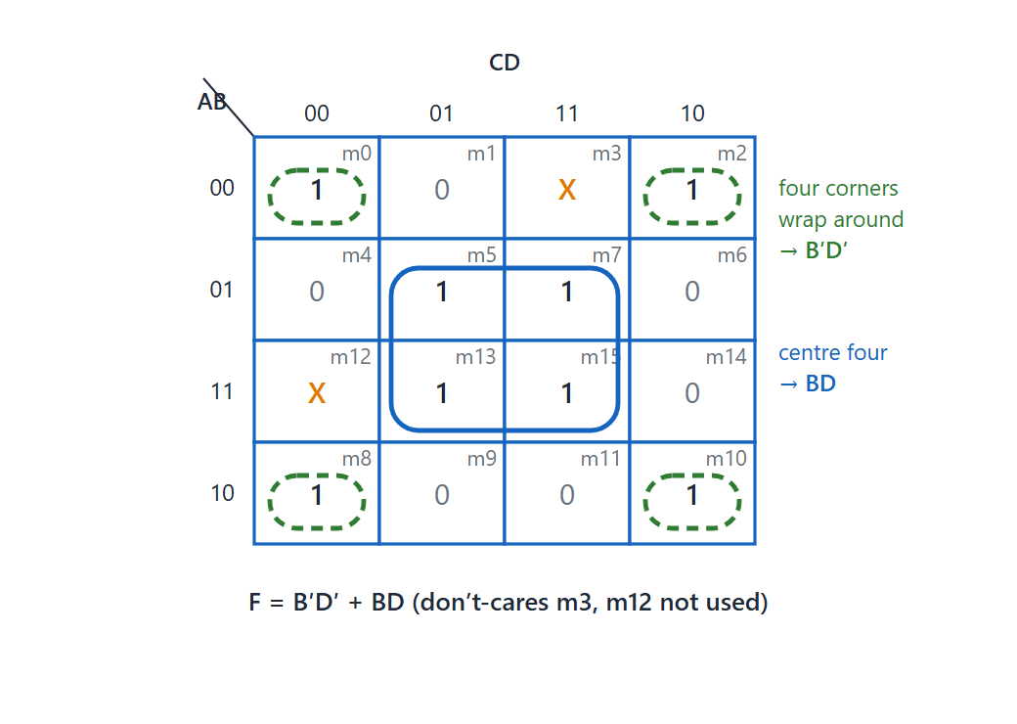
Four-variable K-map with don’t-cares
Topic 1.9
Four-variable K-map: the four corners wrap around to give B′D′, the centre four give BD; the don't-cares m3 and m12 are not needed.
Notes:
Four-variable K-map: the four corners wrap around to give B′D′, the centre four give BD; the don’t-cares m3 and m12 are not needed. The groups use wraparound at the map’s edges.

Slide 65
Worked example: 4 variables with don’t-cares
Topic 1.9
The four corner cells (m0, m2, m8, m10) are mutually adjacent through wraparound
Left edge connects to right edge, and top edge to bottom edge
Grouped together they simplify to the single term B′D′
The centre four 1s (m5, m7, m13, m15) form a second group: BD
Neither don’t-care enlarges any group, so both are left out
F = B′D′ + BD
Notes:
Only use a don’t-care when it lets a group grow. Here neither don’t-care is needed.

Slide 66
1.10 Introduction to Digital Computers
Topic 1.10
IN SIMPLE TERMS
A digital computer works with just two values, 0 and 1; groups of bits stand for numbers, letters and instructions.
Notes:
This topic is where the earlier building blocks start to assemble into an actual machine. Read the box aloud and ask students to restate it in their own words.

Slide 67
What “digital” means, and why binary
Topic 1.10
A digital computer is a digital system that performs computational tasks
Digital: information is represented by variables with a limited number of discrete values, e.g. the decimal digits 0–9
The earliest digital computers (late 1940s) were used mainly for numerical computation
Two states are more reliable than ten, and human logic is binary (true/false): components with two values are called binary
A single binary digit is a bit; information is stored in groups of bits
Notes:
Components distinguish fewer states more reliably. This is why two states, 0 and 1, are used.

Slide 68
The same bits can mean different things
Topic 1.10
Binary 1001011 as a number:
1×2⁶ + 0×2⁵ + 0×2⁴ + 1×2³ + 0×2² + 1×2¹ + 1×2⁰
= 64 + 0 + 0 + 8 + 0 + 2 + 1 = 75
Those same seven bits could just as easily represent the letter “K” under a binary code for the alphabet
Meaning comes entirely from the coding scheme applied to the bits
Notes:
It is like the same 26 letters building English and French: the symbols are shared, the interpretation is not. The meaning of a bit pattern depends on the code applied to it.

Slide 69
Hardware and software
Topic 1.10
Hardware: all the electronic components and electromechanical devices that make up the physical machine
Software: the instructions and data the computer manipulates for data processing
A sequence of instructions is a program; the data it manipulates is its data base
System software (the operating system) helps make more effective use of the computer; e.g. a compiler
Application programs are written by users to solve their own problems
A buyer needs both: hardware alone is useless without system software
Notes:
A compiler that translates a high-level language is system software, while the program written in that language is an application program. Hardware alone cannot solve a user’s problem without software.

Slide 70
1.11 Block Diagram of a Digital Computer
Topic 1.11
IN SIMPLE TERMS
Every computer has three parts: memory to hold programs and data, a CPU to process them, and an input-output processor to talk to the outside world.
Notes:
The previous topic said computer hardware has three major parts. This topic draws that division and explains it. Read the box aloud and ask students to restate it in their own words.

Slide 71
The three major hardware parts
Topic 1.11
Central Processing Unit (CPU): an arithmetic and logic unit, registers for storing data, and control circuits for fetching and executing instructions, all in one package
Memory: storage for instructions and data
Input-Output Processor (IOP): circuits for communicating with and controlling transfers to the outside world
Keyboards, printers, terminals and disk drives connect to the computer through the IOP
Notes:
This three-part division is the framing used in this course. The next slide draws the three parts and how they connect.

Slide 72
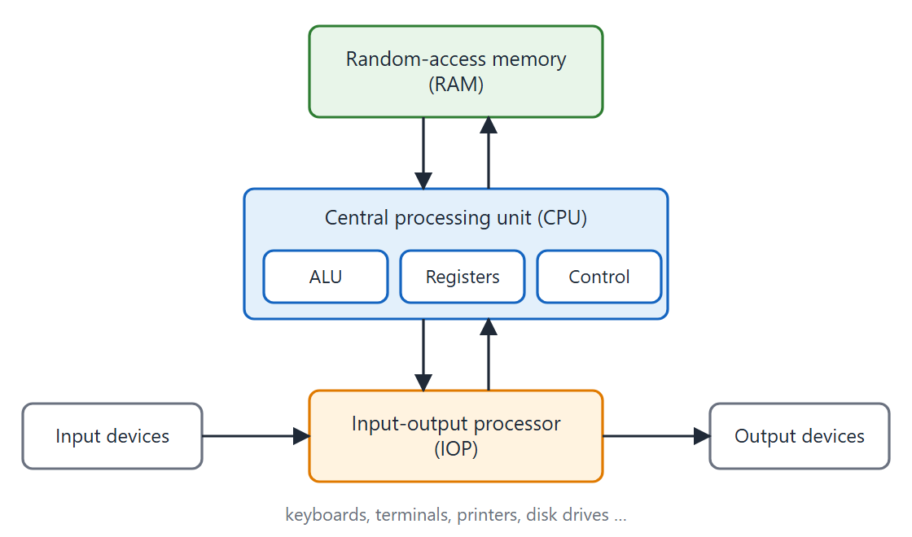
Block diagram of a digital computer
Topic 1.11
Block diagram of a digital computer. Adapted from M. Morris Mano, Computer System Architecture, Fig. 1-1.
Notes:
Block diagram of a digital computer. Adapted from M. Morris Mano, Computer System Architecture, Fig. 1-1.

Slide 73
Inside the CPU, and why “random-access”?
Topic 1.11
ALU: manipulates data with the arithmetic and logic operations built from logic gates
Registers: small, extremely fast storage inside the CPU, for data being worked on
Control circuits: fetch instructions from memory and execute them in the correct sequence
RAM: the CPU can access any location at random in a fixed interval of time, whichever location it is
The name is about the access pattern, not random data; contrast with sequential tape
Notes:
The CPU can jump straight to any memory location in the same fixed time, whichever location it accessed just before. Sequential media such as tape take longer to reach distant locations.

Slide 74
1.12 Computer Organization vs Architecture
Topic 1.12
IN SIMPLE TERMS
Architecture is what the programmer sees (the instruction set); organization is how the hardware actually carries it out.
Notes:
The course is named Computer Organization and Architecture, so the two terms must be precise. They are among the most commonly confused ideas in the subject. Read the box aloud and ask students to restate it in their own words.

Slide 75
Three perspectives on computer hardware
Topic 1.12
Computer organization: how the hardware components operate and are connected; the components are assumed already in place, and the task is to verify that they operate as intended
Computer design: the hardware design; once specifications exist, determine what hardware to use and how to connect it (also called computer implementation)
Computer architecture: the structure and behaviour of the computer as seen by the user: information formats, the instruction set, and addressing techniques
Notes:
Organization has a verification mindset, design has a construction mindset, and architecture ignores the hardware and asks what the programmer can see. Keep these three definitions precise, since they are often tested.

Slide 76
Architecture: the “what”
Topic 1.12
The instruction set: the operations the machine understands (add, load, jump, compare…)
Information formats: the data types the hardware directly supports
Addressing modes: the techniques for addressing memory
Architecture is a specification: a contract
Two machines with the same architecture run the same programs, even if built completely differently inside
Notes:
Organization examines hardware already built and confirms the pieces are connected and operating correctly. Architecture is the contract, and organization is how it is carried out.

Slide 77
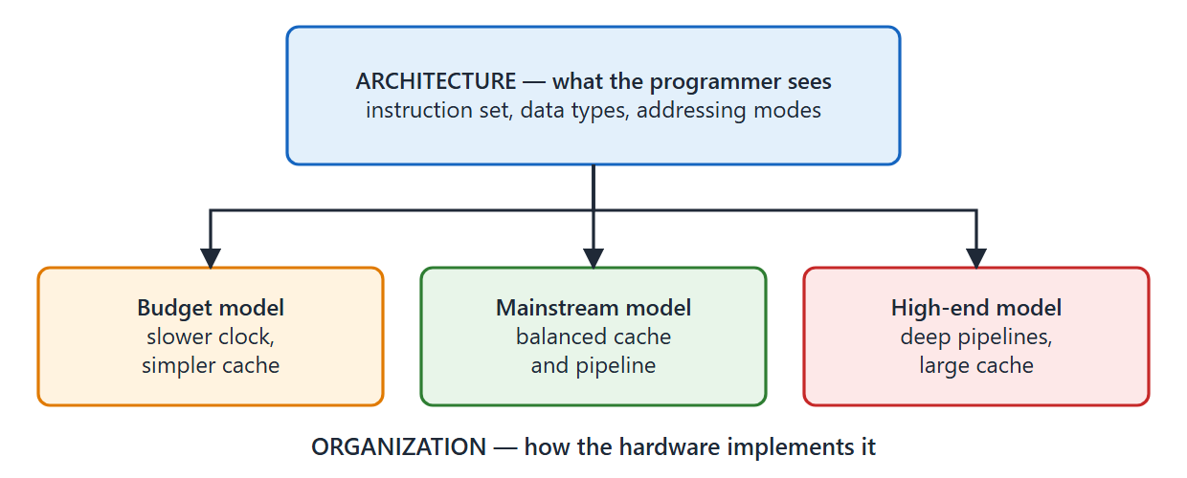
Same architecture, many organizations
Topic 1.12
The same architecture (instruction set) can be realized by many different organizations (hardware implementations) — a common illustration beyond the textbook's own examples.
Notes:
The same architecture (instruction set) can be realized by many different organizations (hardware implementations). This is a common illustration beyond the textbook’s own examples.

Slide 78
Why the distinction matters
Topic 1.12
Every chip implementing the same instruction set shares the same architecture
Different models have different organizations: clock speeds, cache sizes, numbers of execution units
Software portability: architecture is a stable contract, so software keeps working across hardware generations
Hardware innovation: organization can change without breaking the architecture
Careers: architecture work and organization work are different specializations
Notes:
Same architecture, different cost and performance trade-offs. Ask students for an example of a product family.

Slide 79
Architecture, organization and design compared
Topic 1.12
 | Architecture | Organization | Design
Question answered | What does the machine do? | Does the built hardware operate as intended? | What hardware should be built, and how connected?
Visible to | The programmer (user) | The hardware engineer verifying it | The hardware designer building it
Mindset | Specification / contract | Verification of components already in place | Construction from a specification
Includes | Instruction set, information formats, addressing modes | Control signals, interfaces, memory technology | Covered in the next topic
Notes:
Use this table as the summary of the topic. Design is covered in full in the next topic.

Slide 80
1.13 Computer Design
Topic 1.13
IN SIMPLE TERMS
Computer design goes from the big picture to the details: system blocks first, then the logic inside them, then the circuits.
Notes:
This topic is about computer design, the engineering process of building hardware. It closes out Unit 1. Read the box aloud and ask students to restate it in their own words.

Slide 81
Computer design
Topic 1.13
Computer design is concerned with the hardware design of the computer
Once specifications are formulated, the designer develops the hardware
It determines what hardware should be used and how the parts should be connected
Also called computer implementation
Organization examines existing hardware; design starts from a specification and builds hardware to satisfy it
Notes:
Later in the course you design and program an elementary digital computer step by step, using register transfer language to specify the requirements. This topic gives the general picture before that detailed design.

Slide 82
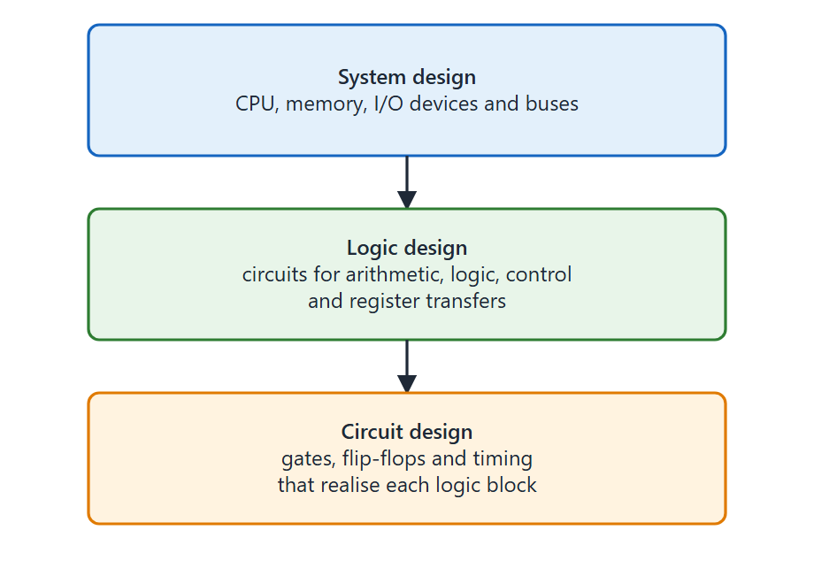
Three levels of design detail
Topic 1.13
System design: how CPU, memory, I/O and buses fit together
Logic design: circuits for arithmetic, logic, control and register transfers
Circuit design: gates, flip-flops and timing
Top-down: requirements flow from system to logic to circuits
Computer design flows top-down — system requirements shape logic design, which shapes circuit design.
Notes:
Computer design flows top-down. System design uses the block diagram of a digital computer as its map: decisions like how much memory, how many I/O ports and the overall performance target are made here. Logic design is where Boolean algebra, gates and K-maps become the tools used to build real circuits. Circuit design deals with real voltage levels, propagation delays and component tolerances.

Slide 83
Design considerations
Topic 1.13
At every level, computer design balances competing goals
Performance: how fast the resulting hardware runs
Cost: how expensive it is to manufacture, which often trades against performance
Compatibility: whether the design correctly implements the required architecture, so existing software keeps working
Notes:
A decision at the system level, such as supporting 32-bit addition, cascades down to which gates are used at the circuit level. Design therefore balances performance, cost and compatibility at every level.

Slide 84
Unit 1 summary (1 of 2)
1.1 Number systems: positional notation with radix r; repeated division or multiplication to convert; group bits for octal and hex
1.2 Complements: (r − 1)’s and r’s complements let one adder subtract; the end carry decides the sign
1.3 Fixed-point: a sign bit; signed-2’s-complement adds with one rule; overflow when the carries into and out of the sign bit differ
1.4 Floating-point: mantissa × 2^{exponent}; normalise the mantissa; zero is all zeros
1.5 Binary codes: BCD, Excess-3, Gray code (one bit changes), ASCII and parity
1.6 Storage and registers: a flip-flop stores one bit; n cells hold 2^{n} values
1.7 Binary logic: AND, OR and NOT on truth values
Notes:
Recap the data representation topics. Ask students to convert one decimal number to binary and write its 8-bit 2’s complement.

Slide 85
Unit 1 summary (2 of 2)
1.8 Logic gates: seven basic gates, DeMorgan’s theorem, NAND and NOR are universal, canonical SOP
1.9 K-maps: Gray-code headers; group adjacent 1s in powers of two to simplify
1.10 Digital computers: binary digits; the same bits mean different things under different codes; hardware and software
1.11 Block diagram: CPU (ALU, registers, control), memory (RAM) and the input-output processor
1.12 Organization vs architecture: architecture is what the programmer sees; organization is how the hardware works
1.13 Computer design: system, logic and circuit design, balancing performance, cost and compatibility
Key applications: 2’s complement in every CPU; hex for addresses, colour codes and networking; Gray code in rotary encoders
Notes:
Recap the computer structure topics and finish with where these ideas are used. Leave time for questions.

