Slide 1
Unit 3: Register Transfer, Micro-operations and Basic Computer Design
3
Computer Organization and Architecture
CHANDRAS EDU
Never stop learning
Notes:
Welcome. This unit covers register transfer language and micro-operations, then builds the Basic Computer: its instructions, registers, control unit, instruction cycle, and I/O with interrupts.

Slide 2
Agenda
3.1 Register Transfer Language
3.2 Register Transfer
3.3 Bus & Memory Transfers
3.4 Arithmetic Micro-operations
3.5 Logic Micro-operations
3.6 Shift Micro-operations
3.7 Arithmetic Logic Shift Unit
3.8 Instruction Codes
3.9 Computer Registers
3.10 Computer Instructions
3.11 Timing and Control
3.12 Instruction Cycle
3.13 Memory Reference Instructions
3.14 Input-Output and Interrupt
Notes:
Fourteen topics. The first seven build the micro-operations and the ALU; the last seven build the Basic Computer around it.

Slide 3
3.1 Register Transfer Language
IN SIMPLE TERMS
Register transfer language is a short way to write what the hardware does each clock: R2 ← R1 means copy R1 into R2; P: R2 ← R1 means do it only when P = 1.
Notes:
Topic 3.1: Register Transfer Language. Link it to the previous topic in one sentence, then read the box aloud and ask students to restate it. Start of the unit. Everything that follows is written in this notation.

Slide 4
What RTL is
Topic 3.1
A digital system is built from interacting modules: registers, decoders, arithmetic circuits
Register Transfer Language (RTL) is a short notation for what moves where, and under what condition
Registers are named with capital letters: MAR, PC, IR
A register is drawn as a box, one cell per bit, most significant bit on the left
Bits are addressed with brackets: R1(0) is one bit; R1(7–0) is a sub-field
Notes:
Ask: why not describe the system gate by gate? Because it would be unreadable. RTL works one level up, at the register level.

Slide 5
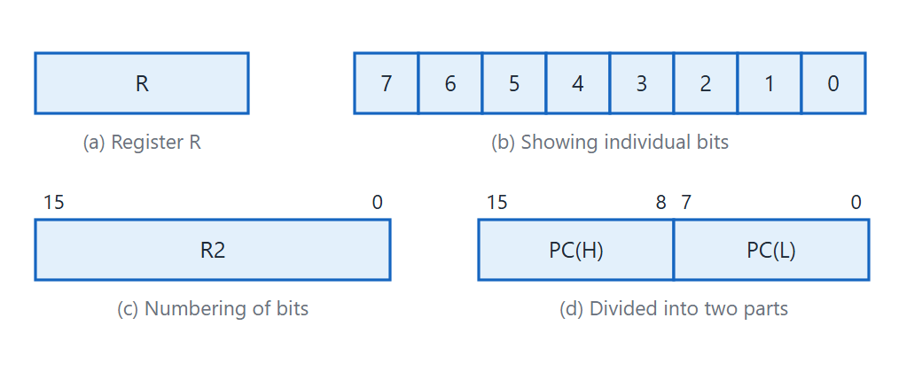
Register block diagram
Topic 3.1
Block diagram of a register: plain box, individual bits, 16-bit numbering, and high/low byte partition. Adapted from M. Morris Mano, Computer System Architecture, Fig. 4-1.
Notes:
Point out the plain box, the individual bits, the 16-bit numbering and the high/low byte split. A control unit uses exactly these names to refer to just the opcode bits.

Slide 6
The transfer statement
Topic 3.1
R2 ← R1 means: the content of R1 is transferred into R2
The transfer is nondestructive: R1 keeps its content, only R2 is overwritten
The arrow points to the destination
It names real hardware: lines from R1’s outputs to R2’s inputs, plus a load-enable on R2
Notes:
Stress the direction of the arrow. The source is never changed by a transfer.

Slide 7
Control conditions and simultaneous transfers
Topic 3.1
Statement | Meaning
R2 ← R1 | Copy R1 into R2
P: R2 ← R1 | If P = 1, transfer R1 into R2 at the next clock edge
P: R2 ← R1, R1 ← R2 | Both transfers at the same clock edge, using the values from before the edge (an exchange)
P is a single bit from other logic; the colon separates when a transfer happens from what it does
A comma separates statements that happen at the same clock edge
Notes:
An exchange works because edge-triggered flip-flops sample their inputs at the same moment. No temporary register is needed.

Slide 8
RTL symbols
Topic 3.1
Symbol | Meaning | Example
Capital letters | Register name | MAR, R2, IR
( ) | A designated bit or range within a register | R1(0–7)
← | Transfer of information | R2 ← R1
: | Control condition: if true, do this on the next clock | P: R2 ← R1
, | Separates simultaneous transfers | R2 ← R1, R1 ← R2
Notes:
Keep this table as a reference; every later topic uses these five symbols.

Slide 9
3.2 Register Transfer
IN SIMPLE TERMS
R1’s outputs are wired to R2’s inputs all the time; the load signal decides whether R2 actually takes the value at the next clock edge.
Notes:
Topic 3.2: Register Transfer. Link it to the previous topic in one sentence, then read the box aloud and ask students to restate it.

Slide 10
What the hardware needs
Topic 3.2
R1’s output lines are wired straight into R2’s input lines, always
R2 has a load-enable input: it lets R2 take the value only when P = 1
Both registers use the same clock, so transfers happen at the same instants
Only R2’s load is controlled by P; R1 keeps its content whatever P does
Notes:
This builds the hardware behind the statement P: R2 ← R1 from the last topic. The next slide’s figure uses the same signal name, P.

Slide 11
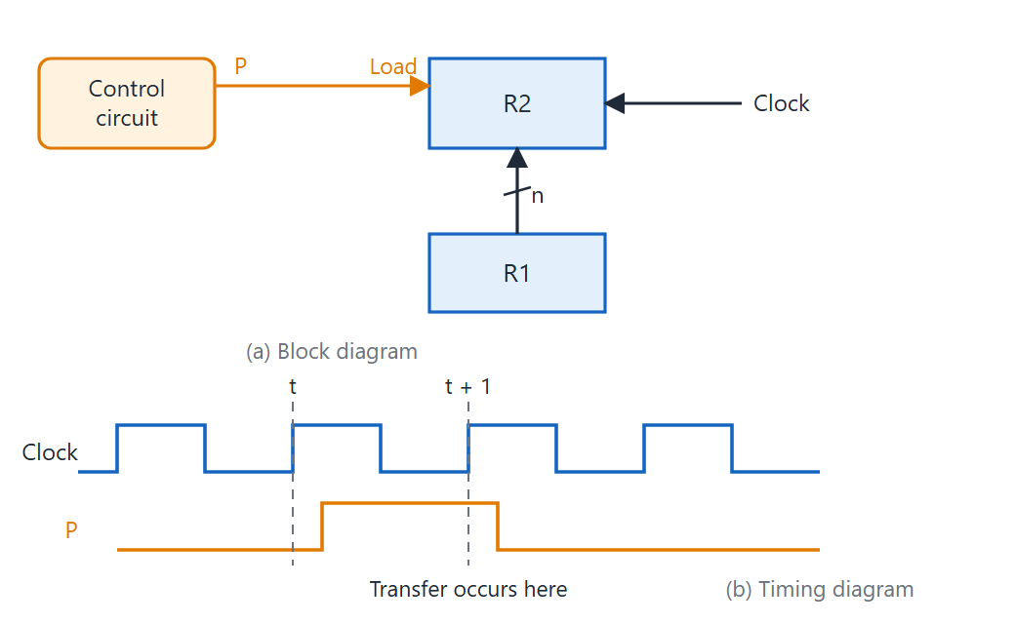
Transfer from R1 to R2
Topic 3.2
Transfer from R1 to R2 when P = 1: (a) block diagram, (b) timing diagram. Adapted from M. Morris Mano, Computer System Architecture, Fig. 4-2.
Notes:
In the figure the control signal is named P. Show (a) the wiring and (b) the timing: the transfer happens at the edge after P is asserted.

Slide 12
Why not just gate the clock?
Topic 3.2
Gate the clock (avoid)
Use load-enable (correct)
Clock AND P is sent to R2
P can change at any moment, not in step with the clock
The gated clock can glitch: a tiny false pulse or an edge at the wrong time
R2 may then load at the wrong time
The clock goes straight to R2, untouched
P only tells R2 whether to load at the clock edge
The clock never glitches
R2 loads only when P = 1 at a clock edge
Notes:
Gating the clock with a control signal is a well-known hazard. Real chips gate clocks only with dedicated, carefully timed cells.

Slide 13
Timing
Topic 3.2
P must be steady a short time before the clock edge (setup time)
If P = 1 at a clock edge, R2 loads R1 at that edge
In the figure, P goes high after edge t and is still 1 at edge t + 1, so R2 loads at t + 1
R2 then keeps the new value until the next load
Notes:
Go back to the timing diagram and trace the edges with a finger.

Slide 14
3.3 Bus & Memory Transfers
IN SIMPLE TERMS
Instead of wiring every register to every other, registers share one bus. The select lines decide which register’s value is on the bus at any moment.
Notes:
Topic 3.3: Bus & Memory Transfers. Link it to the previous topic in one sentence, then read the box aloud and ask students to restate it.

Slide 15
The wiring problem
Topic 3.3
Wiring every register to every other grows as roughly n² lines
Fix: one shared set of lines, the common bus; only one register drives it at a time
With multiplexers: one MUX per bit, with that bit from every register as its inputs
Four registers need a 4-to-1 MUX per bit, all sharing the same 2-bit select code
Notes:
Ask: how many point-to-point lines for 8 registers? About 28 pairs, and it grows quickly.

Slide 16
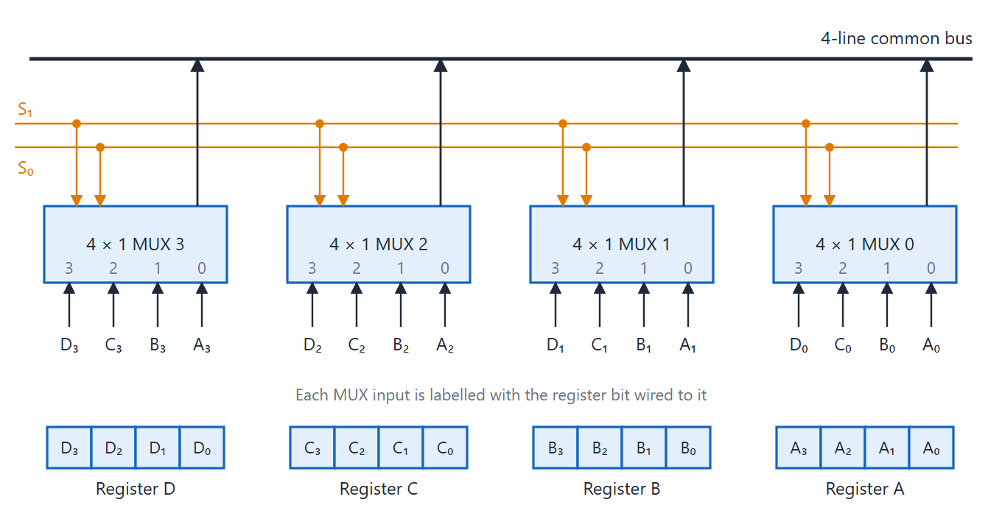
Bus system for four registers
Topic 3.3
Bus system for four registers using multiplexers. S₁S₀ select lines connect to all four 4×1 MUXes; each drives one line of the 4-line common bus. Adapted from M. Morris Mano, Computer System Architecture, Fig. 4-3.
Notes:
Follow one bit position: its MUX picks one of four register bits. All four MUXes share S₁S₀.

Slide 17
Using the bus
Topic 3.3
S₁S₀ = 10 (select C): BUS ← C, R1 ← BUS
One MUX handles one bit; an n-bit bus needs n identical MUXes
One 2-bit code chooses a register for the whole word
Routing is combinational: no clock involved
Only R1’s load needs a clock edge, so both steps fit in one clock period
Notes:
Walk through moving C into R1.

Slide 18
The three-state alternative
Topic 3.3
Real buses often use three-state buffers instead of a MUX per bit
Each buffer either drives 0 or 1, or is disconnected (high impedance, Z)
Enable exactly one register’s buffers at a time; the others do not interfere
This is why datasheets describe a pin as “TRI-STATE”
Notes:
No MUX gate tree is needed; the idea is the same.

Slide 19
Memory transfers
Topic 3.3
An address register (AR) selects a memory word
A data register (DR) holds the value being read or written
Read and Write control lines tell the memory what to do
Notes:
Set up the next figure.

Slide 20
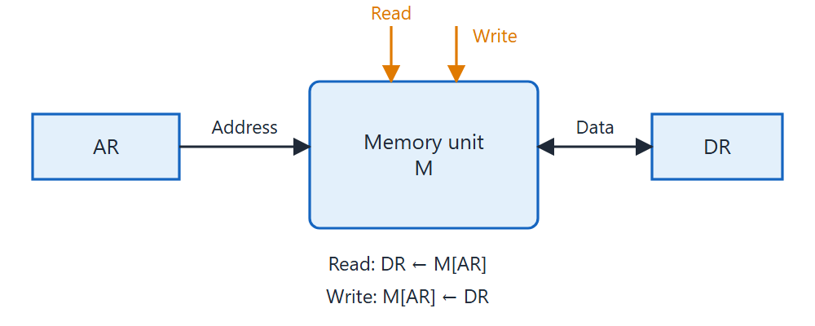
Memory with AR and DR
Topic 3.3
Memory connected to address register AR (supplying the address) and data register DR (receiving read data), with Read and Write control lines.
Notes:
AR supplies the address; DR receives read data. Read and Write are control lines.

Slide 21
Memory RTL
Topic 3.3
Read: DR ← M[AR]
Write: M[AR] ← DR
M[AR] means the memory word addressed by the current content of AR
The brackets name a location that depends on AR’s content, not a fixed register
Notes:
Two statements cover everything a memory unit does.

Slide 22
3.4 Arithmetic Micro-operations
IN SIMPLE TERMS
One parallel adder does all the arithmetic micro-operations (add, subtract, increment, decrement) by changing what is fed into its second input and its carry.
Notes:
Topic 3.4: Arithmetic Micro-operations. Link it to the previous topic in one sentence, then read the box aloud and ask students to restate it.

Slide 23
What is a micro-operation?
Topic 3.4
The smallest unit of work a CPU does in one clock cycle on data held in registers
One register transfer, possibly with a simple operation along the way
Three families in this unit: arithmetic, logic and shift
Together they are exactly what an ALU is built from
Notes:
Arithmetic first; logic and shift follow in the next topics.

Slide 24
Basic arithmetic micro-operations
Topic 3.4
Operation | RTL statement
Addition | R3 ← R1 + R2
Subtraction | R3 ← R1 − R2 (implemented as R3 ← R1 + R2′ + 1)
Increment | R1 ← R1 + 1
Decrement | R1 ← R1 − 1
Subtraction adds the 2’s complement: R2′ (bitwise complement) plus a carry-in of 1
Notes:
This is exactly what turns a plain binary adder into a subtractor with almost no extra hardware.

Slide 25
One circuit, four operations
Topic 3.4
All four run on a single n-bit adder-subtractor: a chain of full adders
A mode control M is XORed into the B input and feeds the first carry-in
M = 0 adds; M = 1 subtracts
Increment: one operand hardwired to all 0s and the carry-in forced to 1
Notes:
Link back to the binary adder-subtractor in Unit 2.

Slide 26
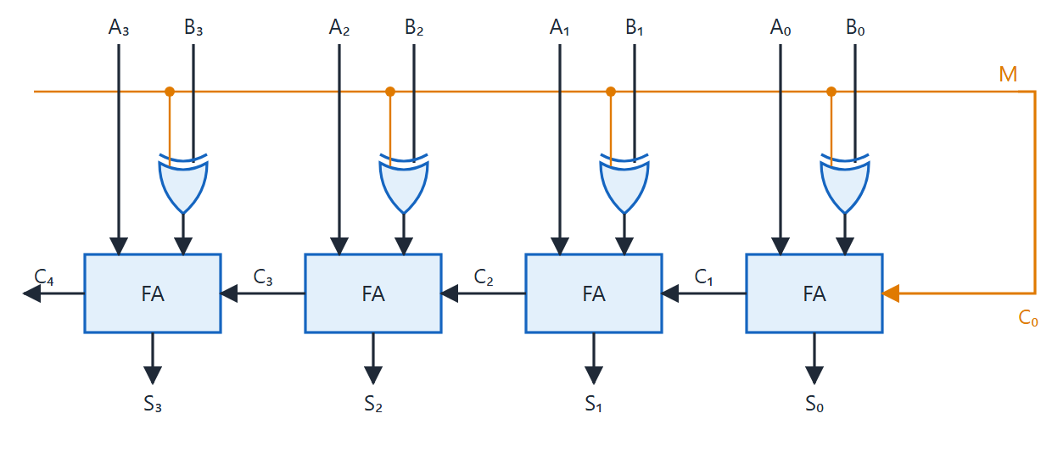
n-bit adder-subtractor
Topic 3.4
n-bit adder-subtractor: mode input M selects addition (M=0) or subtraction (M=1) via XOR gates and carry-in. Adapted from M. Morris Mano, Computer System Architecture, Fig. 4-7.
Notes:
Trace M = 0 and M = 1. The XOR gates pass B or its complement, and M is also the carry-in.

Slide 27
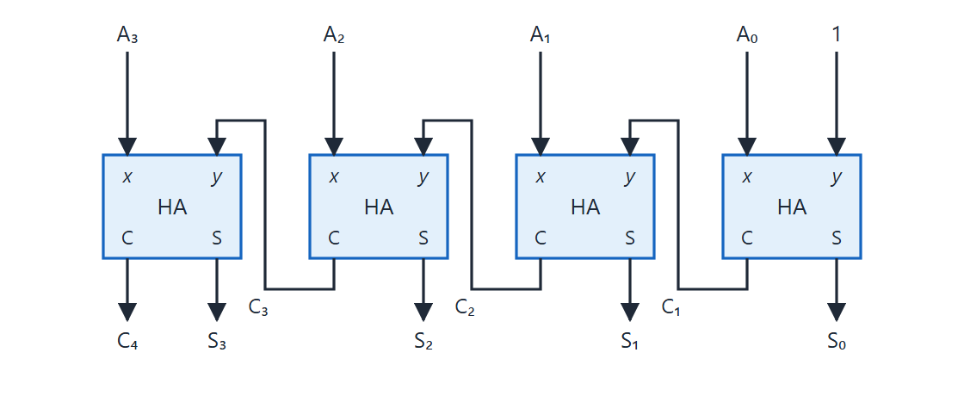
4-bit binary incrementer
Topic 3.4
4-bit binary incrementer. Adapted from M. Morris Mano, Computer System Architecture, Fig. 4-8.
Notes:
Increment is the same idea at smaller scale: a chain of half adders fed a constant 1.

Slide 28
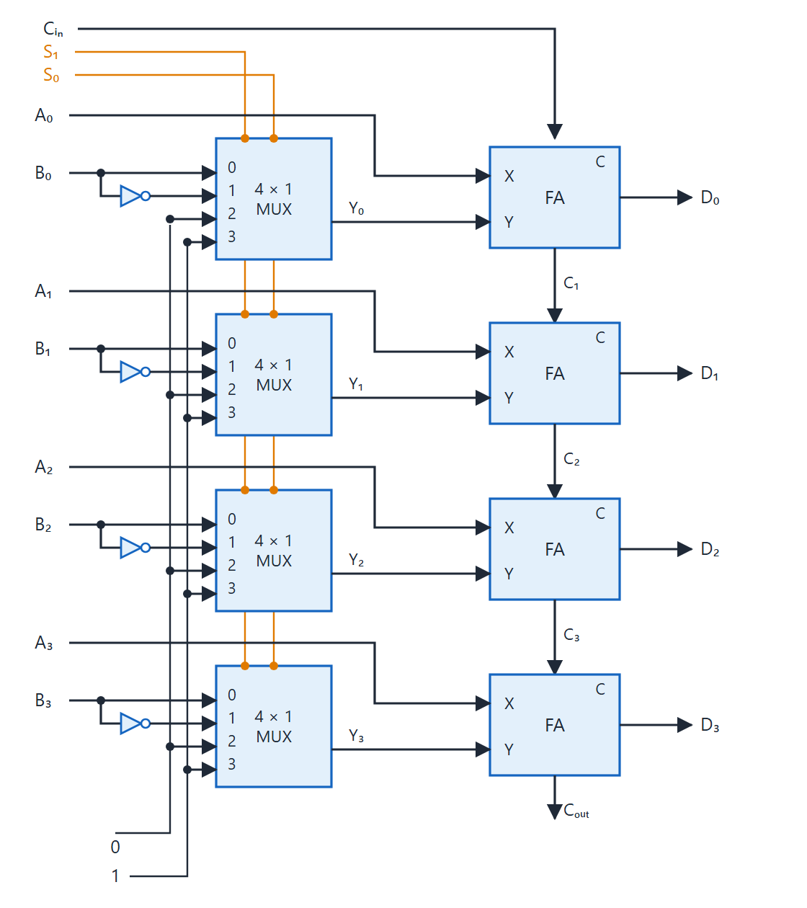
4-bit arithmetic circuit
Topic 3.4
One parallel adder; its Y inputs come from 4 × 1 multiplexers
S₁S₀ choose B, B′, all 0s or all 1s for Y
The input carry C_{in} adds 0 or 1
Output: D = A + Y + C_{in}
4-bit arithmetic circuit. Adapted from M. Morris Mano, Computer System Architecture, Fig. 4-9.
Notes:
One parallel adder whose Y inputs come from 4 × 1 multiplexers.

Slide 29
Arithmetic circuit function table
Topic 3.4
S₁ | S₀ | C_{in} | Y | D = A + Y + C_{in} | Micro-operation
0 | 0 | 0 | B | D = A + B | Add
0 | 0 | 1 | B | D = A + B + 1 | Add with carry
0 | 1 | 0 | B′ | D = A + B′ | Subtract with borrow
0 | 1 | 1 | B′ | D = A + B′ + 1 | Subtract
1 | 0 | 0 | 0 | D = A | Transfer A
1 | 0 | 1 | 0 | D = A + 1 | Increment A
1 | 1 | 0 | 1 | D = A − 1 | Decrement A
1 | 1 | 1 | 1 | D = A | Transfer A
Arithmetic circuit function table. Adapted from M. Morris Mano, Computer System Architecture, Table 4-4.
Notes:
Read each row as: select code, carry-in, what feeds Y, result, name.

Slide 30
Overflow detection
Topic 3.4
Adding two signed numbers can give a result outside the representable range
The adder itself still “succeeds”; that is overflow
Compare the carry into the sign bit with the carry out of it
V = C_{n} ⊕ C_{n−1}
C_{n} is the final carry-out; C_{n−1} is the carry into the sign bit
If the two disagree, the sign bit was corrupted: overflow
Notes:
No extra logic beyond what the adder already computes, except one XOR.

Slide 31
Worked example: overflow
Topic 3.4
0101 (+5)
+ 0100 (+4)
----
1001 reads as −7, but 5 + 4 = 9 does not fit
4-bit signed numbers, range −8 to +7
C₄ (carry out of bit 3) = 0 and C₃ (carry into bit 3) = 1
V = C₄ ⊕ C₃ = 0 ⊕ 1 = 1: overflow correctly flagged
Notes:
Ask students to try 0011 + 0010 and 1000 + 1000.

Slide 32
3.5 Logic Micro-operations
IN SIMPLE TERMS
Logic micro-operations work on each bit separately, with no carries. With a mask in a second register you can set, clear or flip chosen bits and leave the rest alone.
Notes:
Topic 3.5: Logic Micro-operations. Link it to the previous topic in one sentence, then read the box aloud and ask students to restate it.

Slide 33
Logic versus arithmetic
Topic 3.5
Arithmetic treats a register as one number, with carries between bit positions
Logic treats it as an array of independent bits: no interaction between neighbours
That independence makes it ideal for changing individual bits on purpose
Notes:
This is something arithmetic cannot do cleanly.

Slide 34
The four basic logic micro-operations
Topic 3.5
Operation | RTL statement | Per-bit rule
AND | A ← A ∧ B | 1 only where both bits are 1
OR | A ← A ∨ B | 1 where either bit is 1
XOR | A ← A ⊕ B | 1 where the bits differ
Complement | A ← A′ | every bit flipped
Notes:
Each operation needs only one gate per bit.

Slide 35
Hardware: one stage
Topic 3.5
Each logic micro-operation needs only one gate per bit
One stage has an AND, an OR, an XOR gate and an inverter
A 4 × 1 multiplexer with select inputs S₁S₀ passes one result to E_{i}
Repeat the stage n times for an n-bit logic circuit
Notes:
Next slide shows the stage and its function table.

Slide 36
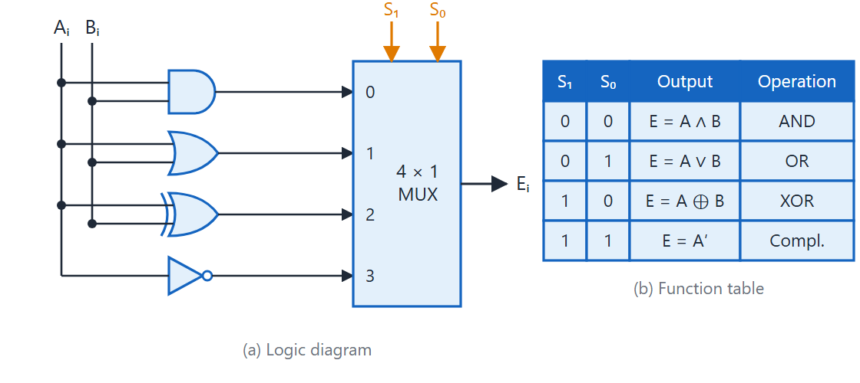
One stage of the logic circuit
Topic 3.5
One stage of logic circuit: (a) logic diagram, (b) function table. Adapted from M. Morris Mano, Computer System Architecture, Fig. 4-10.
Notes:
(a) the gates and MUX, (b) which S₁S₀ code selects which operation.

Slide 37
Selective bit manipulation with a mask
Topic 3.5
B is the mask: a 1 means “touch this bit of A”, a 0 means “leave it alone”.
Name | RTL | Effect on marked bits (B = 1)
Selective-set | A ← A ∨ B | Forced to 1
Selective-complement | A ← A ⊕ B | Flipped
Selective-clear | A ← A ∧ B′ | Forced to 0
Mask (AND) | A ← A ∧ B | Kept as is; unmarked bits (B = 0) are forced to 0
Notes:
Which operation you pick decides what happens to the marked bits.

Slide 38
Worked example: A = 1010 1100, B = 0000 1111
Topic 3.5
 | b₇ | b₆ | b₅ | b₄ | b₃ | b₂ | b₁ | b₀
A | 1 | 0 | 1 | 0 | 1 | 1 | 0 | 0
B (mask) | 0 | 0 | 0 | 0 | 1 | 1 | 1 | 1
Selective-set (A∨B) | 1 | 0 | 1 | 0 | 1 | 1 | 1 | 1
Sel.-complement (A⊕B) | 1 | 0 | 1 | 0 | 0 | 0 | 1 | 1
Selective-clear (A∧B′) | 1 | 0 | 1 | 0 | 0 | 0 | 0 | 0
Mask (A∧B) | 0 | 0 | 0 | 0 | 1 | 1 | 0 | 0
Only b₃–b₀ (highlighted, where B = 1) are affected by set, complement and clear
Mask keeps the marked bits but forces the unmarked ones to 0
Notes:
Compare the first three result rows: b7 to b4 never change. Mask is the odd one out.

Slide 39
Insert, and a free clear
Topic 3.5
A ← A ∧ 1111 0000 (clear the low nibble)
A ← A ∨ 0000 1010 (insert the new value 1010)
Insert is two micro-operations: clear the target field with a mask, then OR in the new field value
A ← A ⊕ A clears A to all 0s without a separate constant-0 source
Notes:
The new value is 0 everywhere outside the field, so it cannot disturb other bits.

Slide 40
3.6 Shift Micro-operations
IN SIMPLE TERMS
A shift moves every bit one place left or right. The three kinds differ only in what fills the empty end: a 0 (logical), the bit that fell off (circular), or a copy of the sign bit (arithmetic right).
Notes:
Topic 3.6: Shift Micro-operations. Link it to the previous topic in one sentence, then read the box aloud and ask students to restate it.

Slide 41
Three kinds of shift
Topic 3.6
A shift moves every bit of a register one position left or right in one clock cycle
The direction of movement is the same in all three kinds
They differ only in the value that fills the vacated bit
Logical: a 0 fills it
Circular: the bit that fell off fills it
Arithmetic right: a copy of the sign bit fills it
Notes:
Same movement, different fill.

Slide 42
Logical shift right (shr)
Topic 3.6
 | b₃ | b₂ | b₁ | b₀
Before (R = 1100) | 1 | 1 | 0 | 0
After shr | 0 | 1 | 1 | 0
A 0 always fills the vacated position; the bit that falls off is discarded
The rightmost bit (0) is lost and a fresh 0 (highlighted) enters at b₃
Right choice for unsigned data with no sign bit to protect
Notes:
The highlighted cell is the new 0.

Slide 43
Circular shift right (cir)
Topic 3.6
 | b₃ | b₂ | b₁ | b₀
Before (R = 1011) | 1 | 0 | 1 | 1
After cir | 1 | 1 | 0 | 1
The bit that falls off is fed back in at the other end
b₀’s original value (1) reappears at b₃ (highlighted); nothing is discarded
n circular shifts in the same direction return the register to its original value
Notes:
No information is ever lost; the register simply rotates.

Slide 44
Arithmetic shift
Topic 3.6
 | b₃ (sign) | b₂ | b₁ | b₀
Before (R = 1001, i.e. −7) | 1 | 0 | 0 | 1
After ashr | 1 | 1 | 0 | 0
Arithmetic right shift fills the vacated bit with a copy of the sign bit
1100₂ = −4, and −7 ÷ 2 rounded toward −∞ is −4; a logical shift would turn the number positive
Arithmetic left shift moves bits exactly like a logical left shift (0 fills the bottom)
It means “multiply by 2”, so check overflow: if the sign bit changes, the result no longer fits
Notes:
Arithmetic and logical left shift give the same bit pattern; only the overflow check differs.

Slide 45
A combinational shifter
Topic 3.6
Built from four 2-input multiplexers sharing one select line S
S = 0: each output H_{i} takes the bit above it, so the data shifts right; serial input I_{R} enters H₀
S = 1: each H_{i} takes the bit below it, so the data shifts left; I_{L} enters H₃
One gate delay, no clock edge; the result is loaded into a register at the next clock
No shift-register wiring needed; this is what feeds a CPU’s ALU
Notes:
Contrast with the sequential shift register from Unit 2.

Slide 46
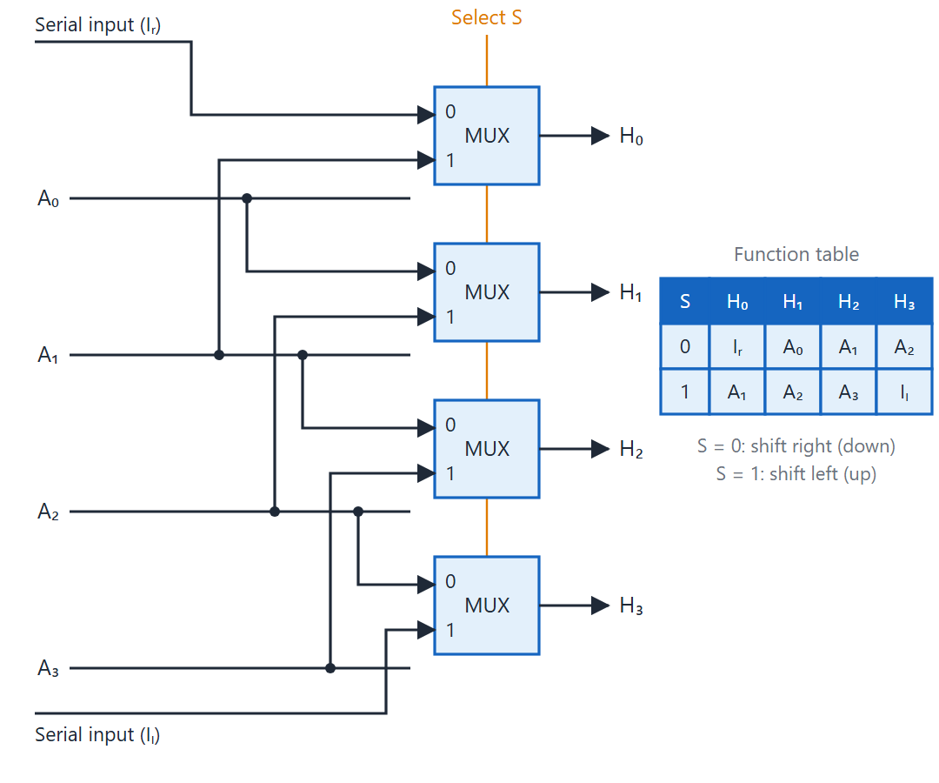
4-bit combinational shifter
Topic 3.6
Four 2-input MUXes share one select line S
S = 0: shift right; serial input I_{R} enters H₀
S = 1: shift left; I_{L} enters H₃
One gate delay, no clock edge
4-bit combinational circuit shifter. Adapted from M. Morris Mano, Computer System Architecture, Fig. 4-12.
Notes:
Show S = 0 and S = 1 paths for one output bit. Note where I_R and I_L enter.

Slide 47
3.7 Arithmetic Logic Shift Unit
IN SIMPLE TERMS
The ALU computes arithmetic, logic and shift results side by side; the select lines decide which one becomes the output.
Notes:
Topic 3.7: Arithmetic Logic Shift Unit. Link it to the previous topic in one sentence, then read the box aloud and ask students to restate it.

Slide 48
The structure
Topic 3.7
One combined block does any of the three families: the Arithmetic Logic Shift Unit (ALU)
An arithmetic circuit, a logic circuit and a shifter are fed the same operands
All three compute every cycle, in parallel
S₃S₂ select, through a 4 × 1 multiplexer, which result reaches F
It selects an entire n-bit result, not a single bit
Notes:
The same MUX-based selection idea used throughout the course, one level up.

Slide 49
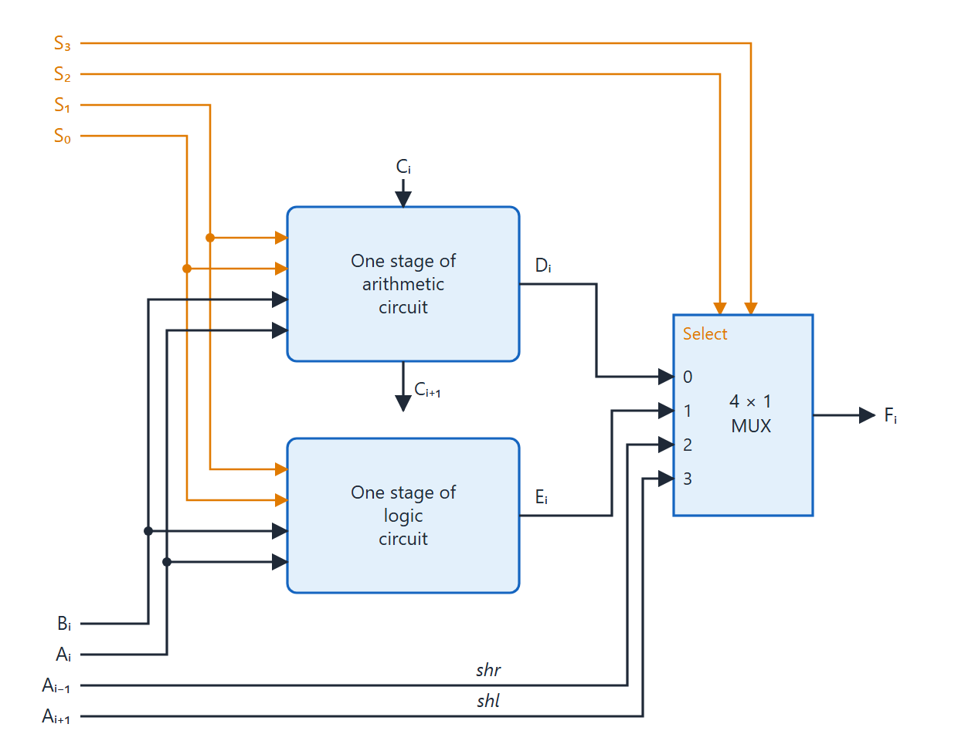
One stage of the ALU
Topic 3.7
All circuits compute every cycle, in parallel
S₃S₂ select, through a 4 × 1 MUX, which result reaches F
It selects an entire n-bit result, not one bit
Five selection variables give 14 operations
One stage of arithmetic logic shift unit. Adapted from M. Morris Mano, Computer System Architecture, Fig. 4-13.
Notes:
Trace the three paths into the final multiplexer. Only the select lines decide which one reaches F.

Slide 50
The select code
Topic 3.7
Five selection variables, S₃, S₂, S₁, S₀ and C_{in}, give 14 operations
S₃S₂ = 00 selects an arithmetic operation
S₃S₂ = 01 selects a logic operation
S₃S₂ = 10 or 11 selects a shift
Every row is a micro-operation from the last three topics; the ALU adds only the selection logic
Notes:
Two table slides follow: arithmetic first, then logic and shift.

Slide 51
ALU function table: arithmetic
Topic 3.7
S₃ | S₂ | S₁ | S₀ | C_{in} | Operation | Function
0 | 0 | 0 | 0 | 0 | F = A | Transfer A
0 | 0 | 0 | 0 | 1 | F = A + 1 | Increment A
0 | 0 | 0 | 1 | 0 | F = A + B | Addition
0 | 0 | 0 | 1 | 1 | F = A + B + 1 | Add with carry
0 | 0 | 1 | 0 | 0 | F = A + B′ | Subtract with borrow
0 | 0 | 1 | 0 | 1 | F = A + B′ + 1 | Subtraction
0 | 0 | 1 | 1 | 0 | F = A − 1 | Decrement A
0 | 0 | 1 | 1 | 1 | F = A | Transfer A
Function table for arithmetic logic shift unit. Adapted from M. Morris Mano, Computer System Architecture, Table 4-8.
Notes:
S3 S2 = 00 for every row here.

Slide 52
ALU function table: logic and shift
Topic 3.7
S₃ | S₂ | S₁ | S₀ | C_{in} | Operation | Function
0 | 1 | 0 | 0 | × | F = A ∧ B | AND
0 | 1 | 0 | 1 | × | F = A ∨ B | OR
0 | 1 | 1 | 0 | × | F = A ⊕ B | XOR
0 | 1 | 1 | 1 | × | F = A′ | Complement A
1 | 0 | × | × | × | F = shr A | Shift right A into F
1 | 1 | × | × | × | F = shl A | Shift left A into F
× means don’t care
Function table for arithmetic logic shift unit. Adapted from M. Morris Mano, Computer System Architecture, Table 4-8.
Notes:
For logic the carry-in is a don’t care; for shifts S1 and S0 are too.

Slide 53
3.8 Instruction Codes
IN SIMPLE TERMS
An instruction tells the computer what to do (opcode) and where the data is (address). The I bit says whether the address is the data’s location itself or the location of its address.
Notes:
Topic 3.8: Instruction Codes. Link it to the previous topic in one sentence, then read the box aloud and ask students to restate it.

Slide 54
The Basic Computer
Topic 3.8
From here to the end of the unit we build one concrete machine: the Basic Computer
Memory: 4096 words of 16 bits each, so a 12-bit address
Stored program: the same memory holds data and instructions
A word is an instruction when the CPU treats it as one, not because of its bit pattern
Notes:
A small but complete machine that makes instruction execution explicit.

Slide 55
The 16-bit instruction word
Topic 3.8
Every instruction is one 16-bit word with three fields: I (bit 15), opcode (bits 14–12), address (bits 11–0)
The 3-bit opcode distinguishes 8 categories
7 are memory-reference instructions, each with a 12-bit address: exactly enough for 4096 words
The 8th pattern, 111, has no address: its 12 bits are individually decoded
That frees two more categories, register-reference and I/O, without using address space
Notes:
Preview of the next topic, which lists all 25 instructions.

Slide 56
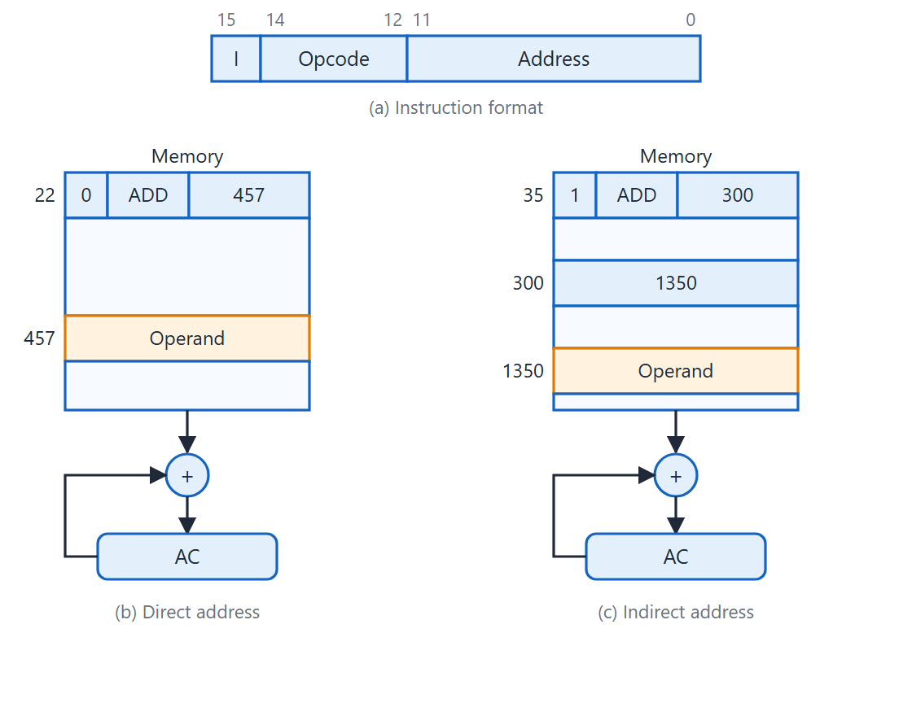
Direct and indirect address
Topic 3.8
(b) Direct: address field 457 is the operand’s address
(c) Indirect: field 300 points to a word holding 1350, the effective address
Indirect costs one extra memory read
Instruction format with direct and indirect address. Adapted from M. Morris Mano, Computer System Architecture, Fig. 5-2.
Notes:
Compare (b) and (c): the same format, but the address field is used differently. Reading the figure: (b) Direct: the address field 457 is the operand’s address. (c) Indirect: the address field 300 points to a word holding 1350, the effective address of the operand. Indirect costs one extra memory read.

Slide 57
Direct versus indirect addressing
Topic 3.8
I | Mode | Meaning
0 | Direct | The address field is the effective address: AR ← IR(0–11)
1 | Indirect | The address field points to a word that holds the effective address: AR ← M[IR(0–11)], one extra memory read
Indirect trades one extra memory access for an effective address that can change at runtime: array indexing, pointer following
Notes:
Bit 15 is I.

Slide 58
Recognising the instruction category
Topic 3.8
Opcode (IR bits 14–12) | I | Category
not 111 | 0 or 1 | Memory-reference (bits 11–0 are the address)
111 | 0 | Register-reference (bits 11–0 individually decoded)
111 | 1 | Input-output (bits 11–0 individually decoded)
Indirect addressing (I = 1) only means something for a memory-reference instruction
For opcode 111 the same bit switches between register-reference and I/O
Notes:
One bit, two jobs, disambiguated by the opcode it appears with.

Slide 59
3.9 Computer Registers
IN SIMPLE TERMS
The Basic Computer has a handful of registers and one memory, all sharing a single 16-bit bus. Three select lines choose who talks on the bus; a load signal chooses who listens.
Notes:
Topic 3.9: Computer Registers. Link it to the previous topic in one sentence, then read the box aloud and ask students to restate it.

Slide 60
The register set
Topic 3.9
Register | Bits | Function
DR | 16 | Data Register: the memory operand being worked with
AR | 12 | Address Register: the memory address for the current access
AC | 16 | Accumulator: the general-purpose register most operations use
IR | 16 | Instruction Register: the instruction being executed
PC | 12 | Program Counter: address of the next instruction
TR | 16 | Temporary Register: intermediate values
INPR | 8 | Input Register: one character from an input device
OUTR | 8 | Output Register: one character for an output device
SC | 4 | Sequence Counter: times the control unit; not programmer-visible
Notes:
Every register named here reappears in the RTL of the following topics.

Slide 61
Control flip-flops
Topic 3.9
Flip-flop | Meaning
I | Indirect-addressing bit of the current instruction
S | Start/stop: clearing it halts the clock
E | Extended AC bit: carry-out of addition, extra bit in a circular shift
R | Interrupt flip-flop: an interrupt is pending and about to be serviced
IEN | Interrupt Enable: master switch for interrupts
FGI | Input flag: a new character is ready in INPR
FGO | Output flag: the output device can accept a character in OUTR
Notes:
FGI, FGO, IEN and R are used in the last topic of the unit.

Slide 62
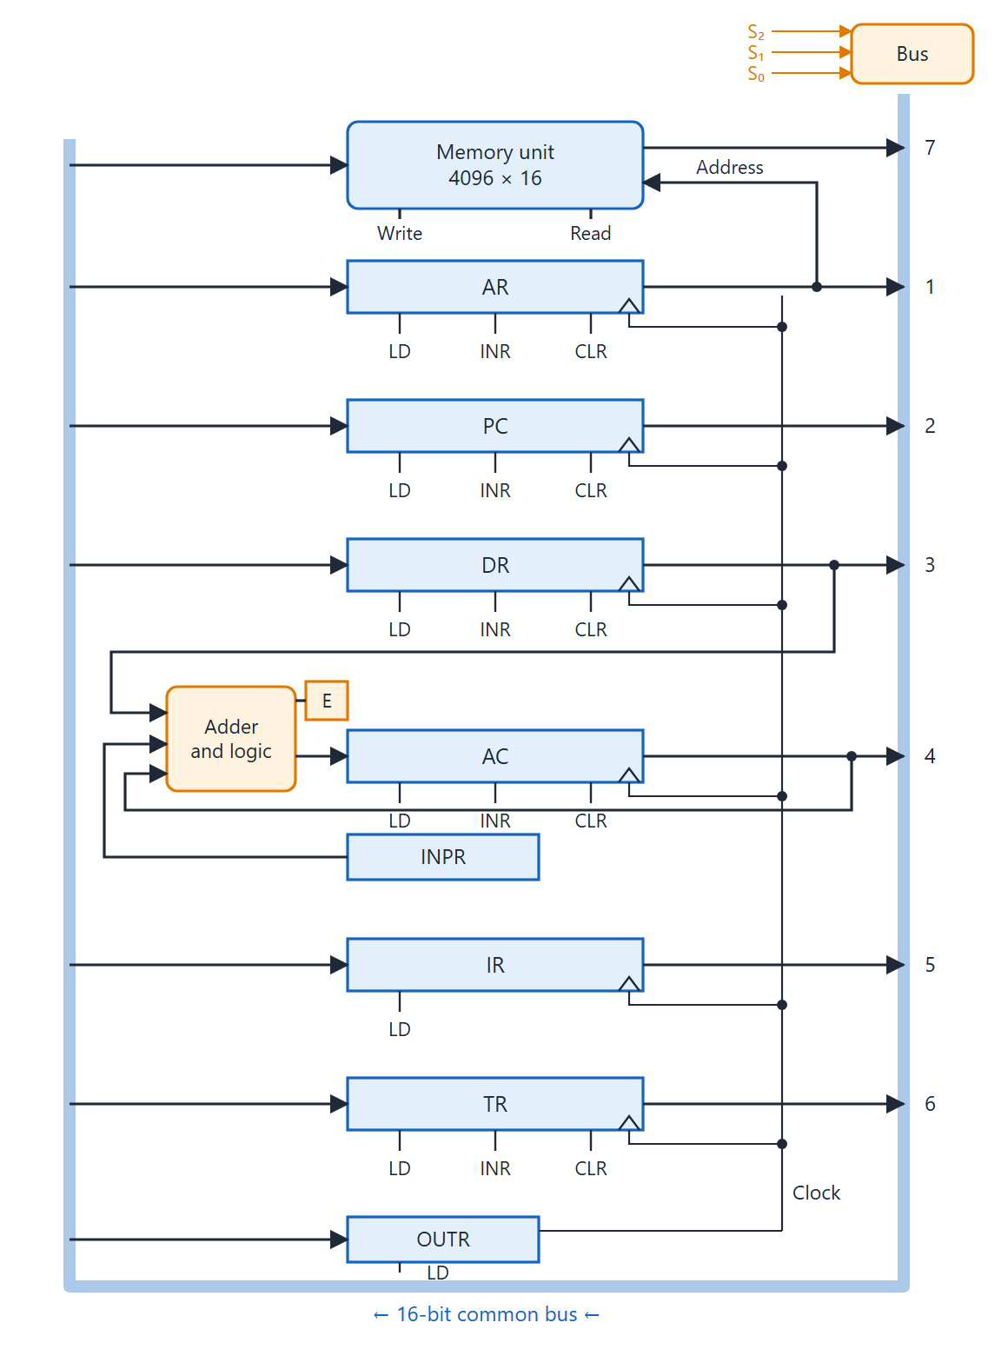
Registers on one common bus
Topic 3.9
S₂S₁S₀ pick the bus source: 1 = AR, 2 = PC, 3 = DR, 4 = AC, 5 = IR, 6 = TR, 7 = memory
AR alone supplies the memory address
AC loads from the adder and logic circuit, not the bus; the carry goes to E
LD, INR, CLR load, increment and clear; IR and OUTR can only be loaded
Basic computer registers connected to a common bus. Adapted from M. Morris Mano, Computer System Architecture, Fig. 5-4.
Notes:
Use the select codes: 1 = AR, 2 = PC, 3 = DR, 4 = AC, 5 = IR, 6 = TR, 7 = memory.

Slide 63
3.10 Computer Instructions
IN SIMPLE TERMS
Opcodes 000–110 are memory instructions with an address; opcode 111 means “no address”. Then the I bit picks register instructions or I/O instructions, and one bit of the low 12 names the exact operation.
Notes:
Topic 3.10: Computer Instructions. Link it to the previous topic in one sentence, then read the box aloud and ask students to restate it.

Slide 64
How opcode 111 splits in two
Topic 3.10
Opcodes 000–110 are memory-reference: the address field points at an operand
Opcode 111 means the instruction needs no memory address
Its 12 bits become individual one-hot flags
The I bit (bit 15) picks the decoder: I = 0 register-reference, I = 1 input-output
25 instructions in total, in three families
The control unit tests opcode 111, the I bit and one of bits 11–0
Notes:
7 memory-reference, 12 register-reference, 6 input-output.

Slide 65
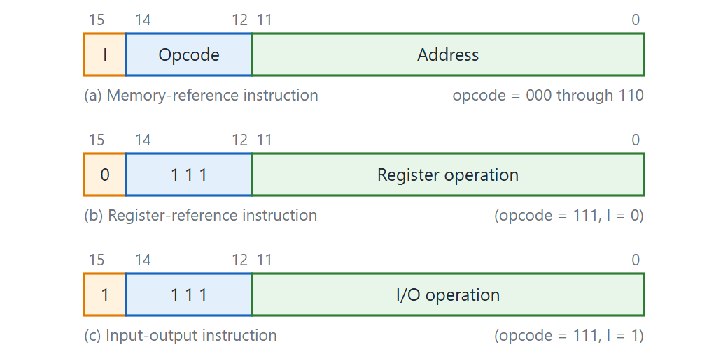
Basic computer instruction formats
Topic 3.10
Basic computer instruction formats. Adapted from M. Morris Mano, Computer System Architecture, Fig. 5-5.
Notes:
Compare the three formats. For register-reference and I/O, each of bits 11–0 specifies one operation.

Slide 66
Memory-reference instructions (7)
Topic 3.10
Symbol | Opcode | Description
AND | 000 | AND memory word into AC
ADD | 001 | Add memory word to AC; carry-out goes to E
LDA | 010 | Load AC from memory
STA | 011 | Store AC into memory
BUN | 100 | Branch unconditionally to the address
BSA | 101 | Branch and Save return Address (subroutine call)
ISZ | 110 | Increment memory word; skip next instruction if the result is zero
Notes:
RTL for each of these comes in the topic on memory-reference instructions.

Slide 67
Register-reference instructions (12)
Topic 3.10
Opcode 111, I = 0. Each hex code is the full 16-bit word, since there is no separate address.
Symbol | Hex | Description
CLA | 7800 | Clear AC
CLE | 7400 | Clear E
CMA | 7200 | Complement AC
CME | 7100 | Complement E
CIR | 7080 | Circular shift right (AC, E)
CIL | 7040 | Circular shift left (AC, E)
Symbol | Hex | Description
INC | 7020 | Increment AC
SPA | 7010 | Skip if AC is positive
SNA | 7008 | Skip if AC is negative
SZA | 7004 | Skip if AC is zero
SZE | 7002 | Skip if E is zero
HLT | 7001 | Halt: clear the S flip-flop
Notes:
Exactly one bit is set in each valid word.

Slide 68
Input-output instructions (6)
Topic 3.10
Opcode 111, I = 1.
Symbol | Hex | Description
INP | F800 | Input a character into INPR; clear FGI
OUT | F400 | Output the character in OUTR; clear FGO
SKI | F200 | Skip next instruction if FGI = 1
SKO | F100 | Skip next instruction if FGO = 1
ION | F080 | Set IEN: interrupts enabled
IOF | F040 | Clear IEN: interrupts disabled
Notes:
Used in the last topic of the unit.

Slide 69
3.11 Timing and Control
IN SIMPLE TERMS
The sequence counter ticks T₀, T₁, T₂…; the decoded opcode says which instruction it is. Every control signal is “this instruction AND this tick”.
Notes:
Topic 3.11: Timing and Control. Link it to the previous topic in one sentence, then read the box aloud and ask students to restate it.

Slide 70
Hardwired control
Topic 3.11
Registers hold data and instructions say what to do, but something must decide when each register latches
That is the control unit’s job
The Basic Computer uses a hardwired control unit: fixed logic gates, not a program, generate every control signal
Unit 4’s microprogrammed control is the ROM-based alternative
Notes:
Contrast with microprogrammed control in the next unit.

Slide 71
Generating timing signals
Topic 3.11
SC, the 4-bit Sequence Counter, feeds a decoder with one active line per state: T₀, T₁, T₂…
Every clock pulse increments SC, so the active timing signal advances one step per cycle
Control logic clears SC to 0 to start the next instruction’s fetch
Most instructions never reach T₆; a simple register-reference instruction can finish by T₃
SC only counts as far as the current instruction needs
Notes:
Link to SC in the register set.

Slide 72
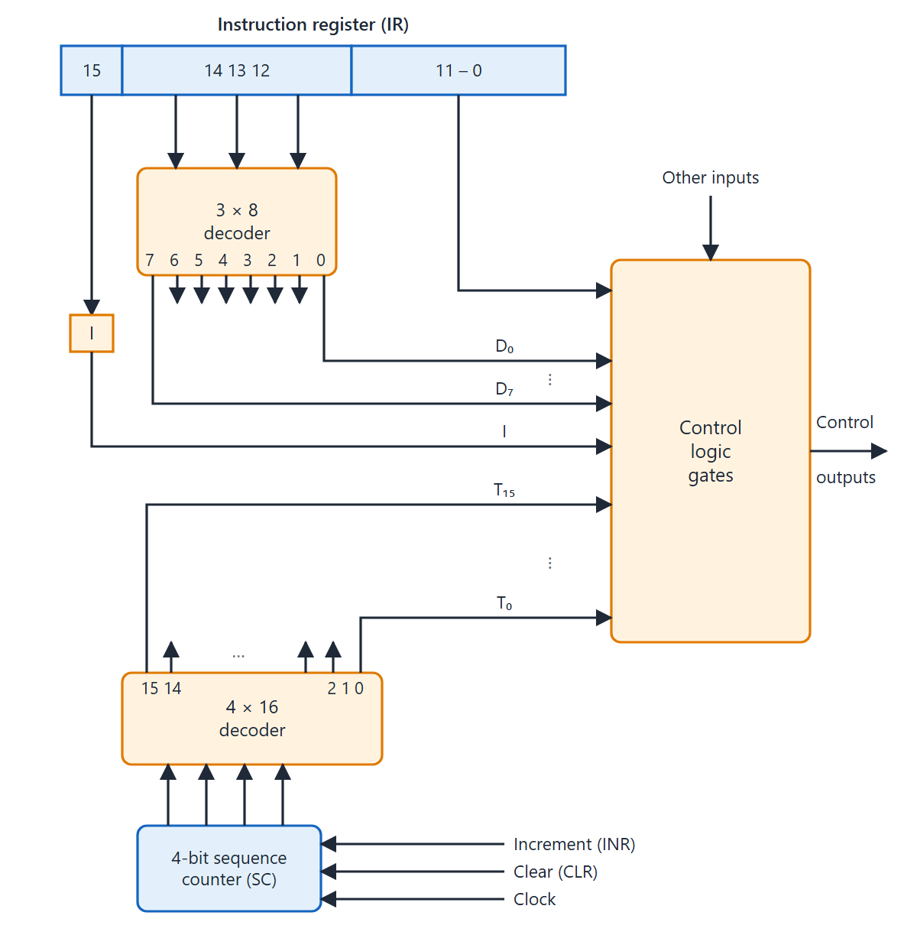
Control unit of the Basic Computer
Topic 3.11
The 3 × 8 decoder turns the opcode into D₀–D₇
The 4 × 16 decoder turns SC into T₀–T₁₅
Control logic gates combine them with I and IR bits 0–11
Each control signal = decoder output AND timing signal
Control unit of basic computer. Adapted from M. Morris Mano, Computer System Architecture, Fig. 5-6.
Notes:
Follow the opcode through the 3 × 8 decoder and SC through the 4 × 16 decoder.

Slide 73
Forming a control statement
Topic 3.11
A timing signal alone does nothing
It becomes an action when ANDed with an opcode-decoder output and, when needed, a flip-flop condition
The 3-to-8 decoder reads IR bits 14–12 and produces D₀ through D₇
Each control signal is the AND of a decoder output and a timing signal
This is the whole “hardwired” idea in one picture
Notes:
Next: an example with LDA.

Slide 74
Example: LDA (D₂)
Topic 3.11
D₂T₄: DR ← M[AR]
D₂T₅: AC ← DR, SC ← 0
LDA is opcode 010, so its decoder output is D₂
It takes two steps, one at T₄ and one at T₅
The last step clears SC to start the next fetch
Notes:
The AND of decoder output and timing signal is what makes it specific.

Slide 75
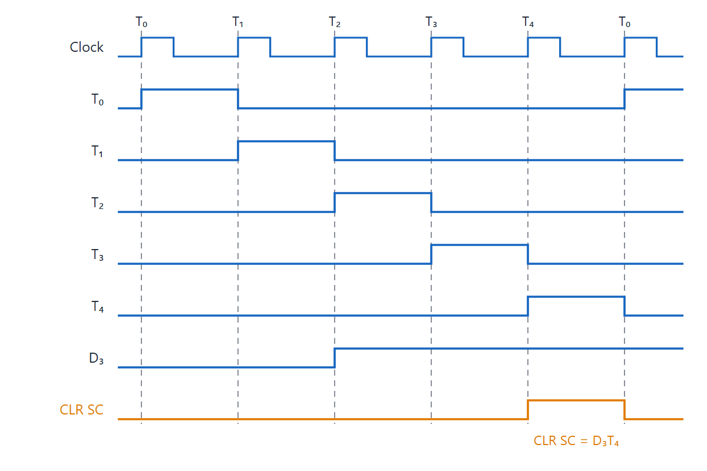
Example of control timing signals
Topic 3.11
Example of control timing signals. Adapted from M. Morris Mano, Computer System Architecture, Fig. 5-7.
Notes:
Find D₃ and T₄ in the timing diagram. Reading the figure: D3 (STA) is active after T2. At T4 the control function D3T4 also clears SC. The next instruction starts again at T0, instead of going on to T5.

Slide 76
3.12 Instruction Cycle
IN SIMPLE TERMS
Every instruction runs the same three opening steps (fetch, decode, find the address) and then follows one of four short execute paths before starting again.
Notes:
Topic 3.12: Instruction Cycle. Link it to the previous topic in one sentence, then read the box aloud and ask students to restate it.

Slide 77
One repeating loop
Topic 3.12
Everything in this unit exists to run one loop: fetch an instruction, decode it, execute it
Then do it again for the next instruction
T₀, T₁ and T₂ are identical for every instruction
Notes:
All earlier topics come together here.

Slide 78
Fetch and decode: T₀, T₁, T₂
Topic 3.12
T₀: AR ← PC
T₁: IR ← M[AR], PC ← PC + 1
T₂: D₀,…,D₇ ← Decode IR(14-12),
AR ← IR(11-0), I ← IR(15)
T₀ points AR at the next instruction
T₁ reads it into IR and advances PC, so PC already points past the current instruction
T₂ decodes the opcode, copies the low 12 bits into AR as a tentative address, and captures I
Notes:
Three things happen at once at T2.

Slide 79
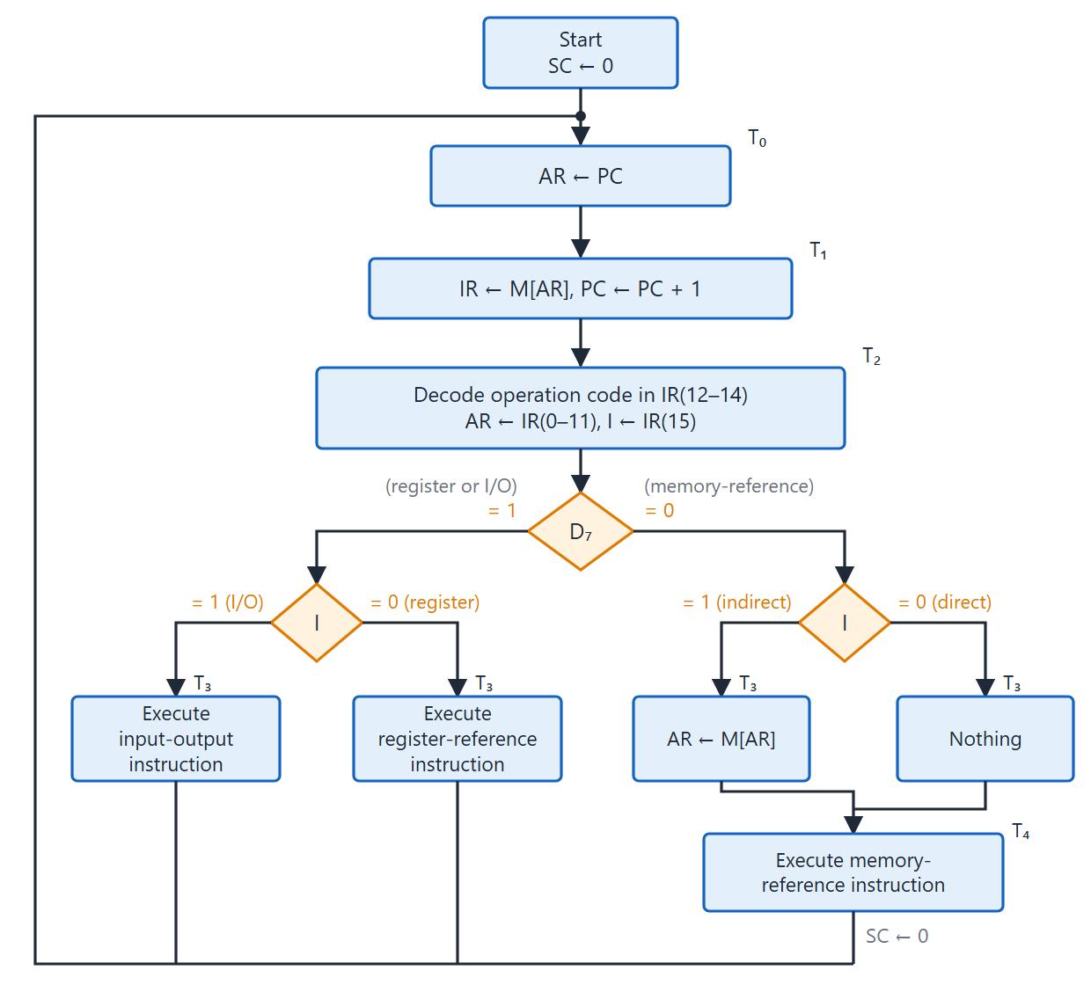
Instruction cycle flowchart
Topic 3.12
D₇ splits the two kinds of instruction
D₇ = 0: if I = 1, T₃ does AR ← M[AR]; execution starts at T₄
D₇ = 1: I = 0 register-reference, I = 1 input-output, both at T₃
Every path clears SC; next fetch at T₀
Flowchart for instruction cycle (initial configuration). Adapted from M. Morris Mano, Computer System Architecture, Fig. 5-9.
Notes:
Start at T₀ and follow the two decisions: D₇, then I.

Slide 80
After decoding at T₂
Topic 3.12
D₇ separates the two kinds of instruction
D₇ = 0 (memory-reference): I = 1 fetches the effective address at T₃ (AR ← M[AR]); I = 0 does nothing
Execution of a memory-reference instruction then starts at T₄
D₇ = 1: I = 0 is a register-reference instruction, I = 1 is input-output; both execute at T₃
Every path ends by clearing SC, which starts the next fetch at T₀
Notes:
Four execute paths in total.

Slide 81
3.13 Memory Reference Instructions
IN SIMPLE TERMS
Each memory instruction is a few register transfers, one per clock tick, starting at T₄; most read the memory word into DR first and then use it.
Notes:
Topic 3.13: Memory Reference Instructions. Link it to the previous topic in one sentence, then read the box aloud and ask students to restate it.

Slide 82
Where execution starts
Topic 3.13
D₇′ I T₃: AR ← M[AR]
The flowchart compressed all seven instructions into one box; this topic expands it
Execution always starts at T₄, never T₃
T₃ only resolves an indirect address (when I = 1)
By T₄, AR holds the operand’s real address either way
Notes:
AND, ADD, LDA, STA, BUN, BSA and ISZ.

Slide 83
Memory-reference RTL (1 of 2)
Topic 3.13
Instruction | Timing step and RTL
AND (D₀) | D₀T₄: DR ← M[AR]
 | D₀T₅: AC ← AC ∧ DR, SC ← 0
ADD (D₁) | D₁T₄: DR ← M[AR]
 | D₁T₅: AC ← AC + DR, E ← C_{out}, SC ← 0
LDA (D₂) | D₂T₄: DR ← M[AR]
 | D₂T₅: AC ← DR, SC ← 0
STA (D₃) | D₃T₄: M[AR] ← AC, SC ← 0
Notes:
Every one ends by clearing SC.

Slide 84
Memory-reference RTL (2 of 2)
Topic 3.13
Instruction | Timing step and RTL
BUN (D₄) | D₄T₄: PC ← AR, SC ← 0
BSA (D₅) | D₅T₄: M[AR] ← PC, AR ← AR + 1
 | D₅T₅: PC ← AR, SC ← 0
ISZ (D₆) | D₆T₄: DR ← M[AR]
 | D₆T₅: DR ← DR + 1
 | D₆T₆: M[AR] ← DR, if (DR = 0) then (PC ← PC + 1), SC ← 0
Notes:
ISZ is the only one that needs T6.

Slide 85
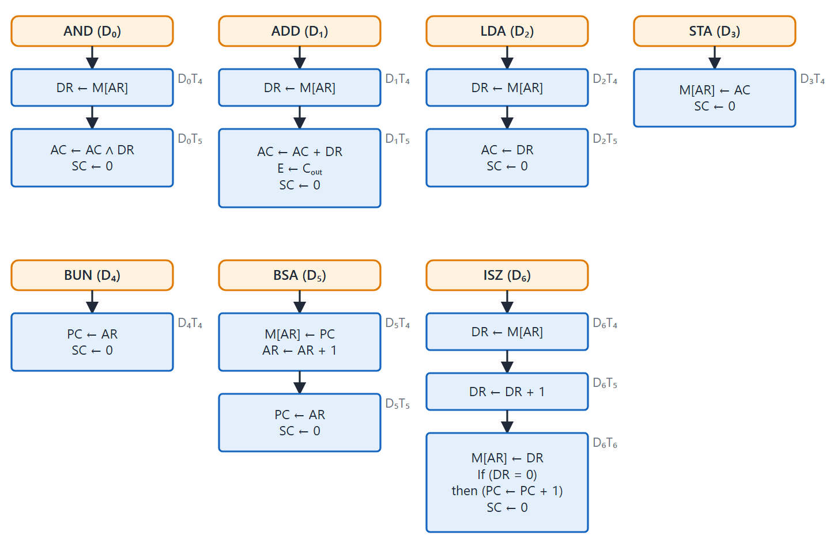
Memory-reference flowchart
Topic 3.13
Flowchart for memory-reference instructions. Adapted from M. Morris Mano, Computer System Architecture, Fig. 5-11.
Notes:
Match each branch of the flowchart with a row of RTL on the previous two slides.

Slide 86
Why DR shows up so often
Topic 3.13
AND, ADD, LDA and ISZ all read memory into DR first
This is a hard constraint: the common bus carries one value per clock pulse
A memory word must land in a register before it can be combined with AC on the next pulse
DR exists to be that landing spot
Notes:
Link back to the bus and memory topic.

Slide 87
Two instructions worth slowing down on
Topic 3.13
Instruction | What is actually happening
BSA | Stores the return address (PC, already past this instruction) at the target location, then increments AR and jumps there. The subroutine starts right after its own stored return address, and an indirect BUN through that location returns.
ISZ | Increments the memory word first, then tests whether the new value is zero, not the original. A built-in loop counter that counts up to zero.
Notes:
These two cause the most confusion.

Slide 88
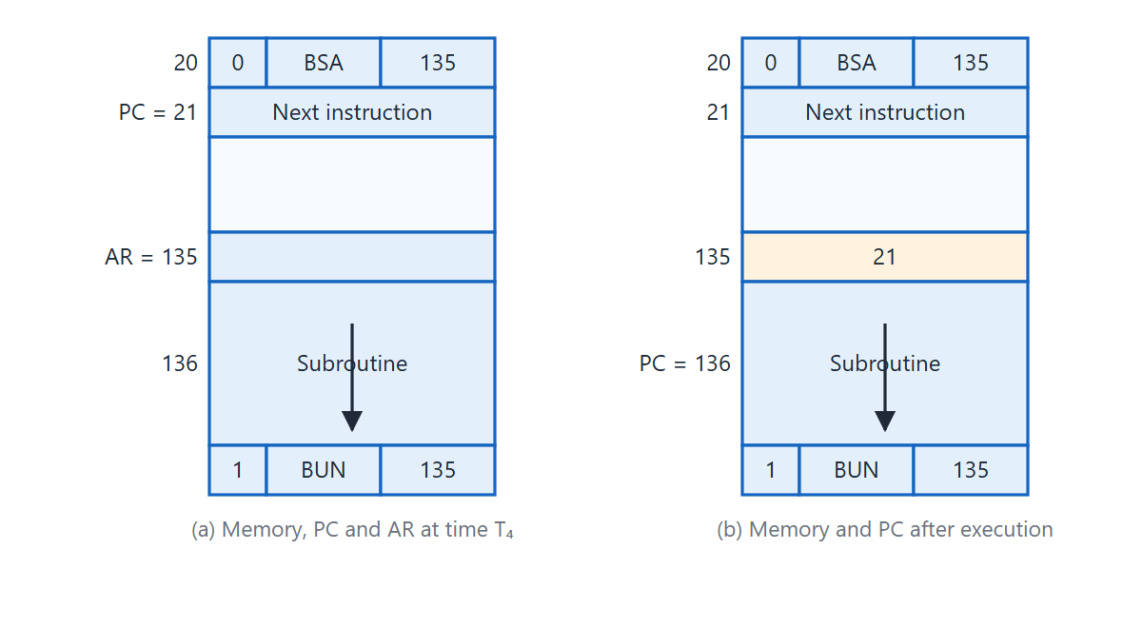
BSA instruction example
Topic 3.13
Example of BSA instruction execution. Adapted from M. Morris Mano, Computer System Architecture, Fig. 5-10.
Notes:
Follow the return address into location 135 and back out with the indirect BUN. Reading the figure: BSA at address 20 stores the return address 21 in location 135. It then jumps to 136. The subroutine returns with an indirect BUN 135.

Slide 89
3.14 Input-Output and Interrupt
IN SIMPLE TERMS
Devices raise a flag when ready. With interrupts enabled, the computer finishes the current instruction, saves where it was, runs the device’s service program and then comes back.
Notes:
Topic 3.14: Input-Output and Interrupt. Link it to the previous topic in one sentence, then read the box aloud and ask students to restate it.

Slide 90
The I/O model
Topic 3.14
The picture is a terminal: a keyboard feeding INPR and a printer fed by OUTR
Each has a ready flag that the device itself sets
FGI = 1: the input device has put a character in INPR
FGO = 1: the output device has finished and can take another character
The CPU only clears these flags; it never sets them
Notes:
Flags are independent of whatever the CPU is doing.

Slide 91
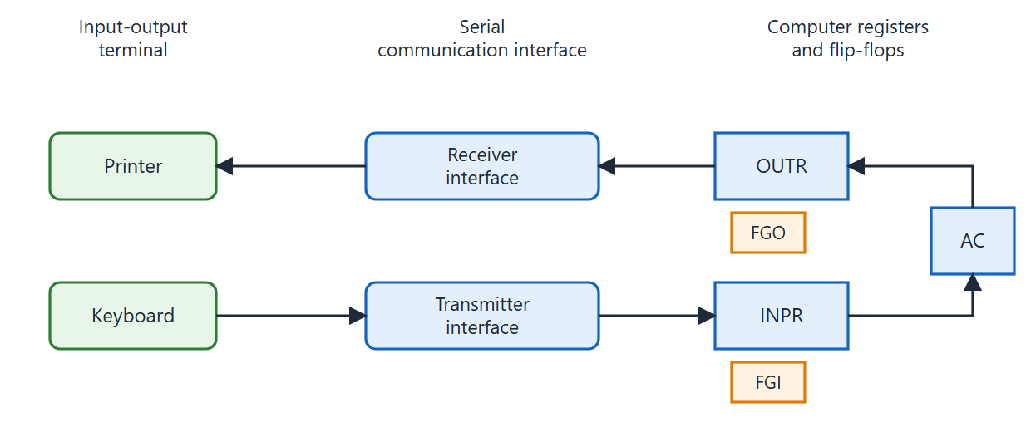
Input-output configuration
Topic 3.14
Input-output configuration. Adapted from M. Morris Mano, Computer System Architecture, Fig. 5-12.
Notes:
Show the keyboard to INPR path and the OUTR to printer path, each with its flag.

Slide 92
RTL for the I/O instructions
Topic 3.14
p = D₇ I T₃ (opcode 111, I = 1, timing T₃)
pB₁₁ (INP): AC(0–7) ← INPR, FGI ← 0
pB₁₀ (OUT): OUTR ← AC(0–7), FGO ← 0
pB₉ (SKI): if (FGI = 1) then (PC ← PC + 1)
pB₈ (SKO): if (FGO = 1) then (PC ← PC + 1)
pB₇ (ION): IEN ← 1
pB₆ (IOF): IEN ← 0
all: SC ← 0
All six execute in one state, T₃: no indirect-address detour
Notes:
The opcode 111 instructions do not use the address field.

Slide 93
From polling to interrupts
Topic 3.14
SKI and SKO let a program poll: loop on SKI until it skips, then INP
Polling is exactly the problem interrupts exist to solve
IEN (interrupt enable) and R (interrupt flip-flop) are checked at the boundary between instructions
That is where SC would normally reset to 0 for the next fetch
Notes:
Next figure: the interrupt cycle.

Slide 94
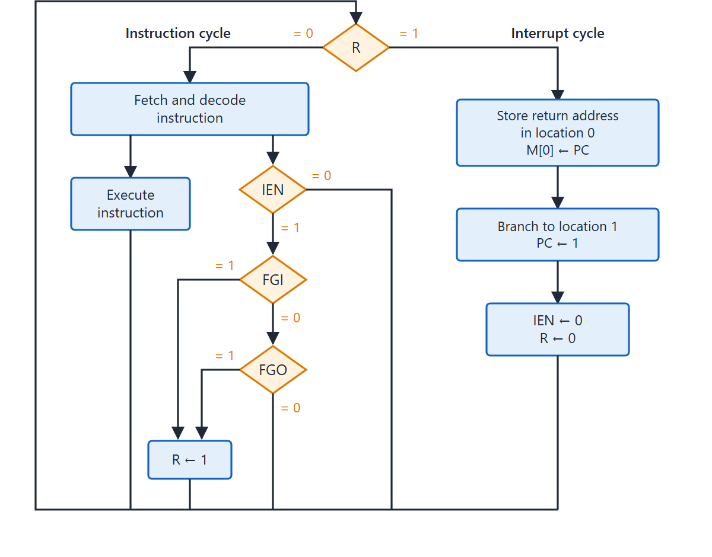
Interrupt cycle flowchart
Topic 3.14
IEN and R are checked between instructions
Interrupt cycle saves PC at location 0 and sets PC to 1
Location 1 holds a BUN to the service routine
IEN and R are then cleared
Flowchart for interrupt cycle. Adapted from M. Morris Mano, Computer System Architecture, Fig. 5-13.
Notes:
Find the point where IEN and R are checked, between instructions.

Slide 95
When the interrupt is granted
Topic 3.14
The interrupt cycle saves the return address (the interrupted program’s PC) at fixed memory location 0
It then sets PC to 1
Location 1 is expected to hold a BUN to the interrupt-service routine
Execution resumes there, with the way back already stored
Notes:
Next figure: a concrete example.

Slide 96
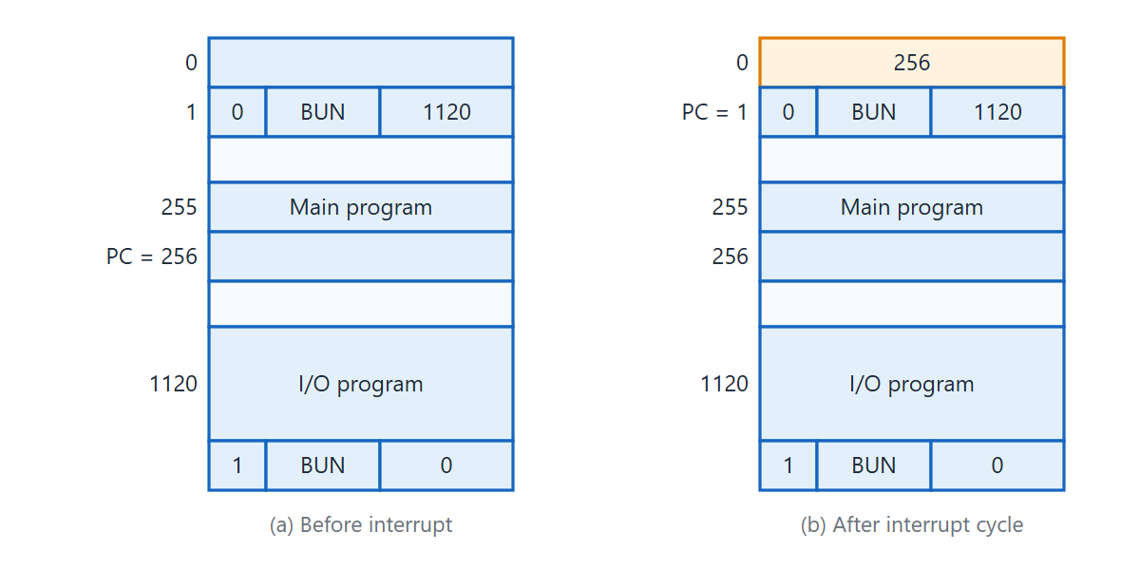
Demonstration of the interrupt cycle
Topic 3.14
Demonstration of the interrupt cycle. Adapted from M. Morris Mano, Computer System Architecture, Fig. 5-14.
Notes:
Follow PC = 256 into location 0 and back. Reading the figure: An interrupt arrives while the instruction at 255 executes. The interrupt cycle saves PC = 256 in location 0 and sets PC to 1. The BUN at 1 jumps to the I/O program at 1120. That program ends with an indirect BUN 0, which returns to 256.

Slide 97
Unit 3 summary
RTL writes register transfers as R2 ← R1; a control condition before a colon makes a transfer conditional
A shared bus (multiplexers or three-state buffers) lets many registers use one set of lines; memory uses AR, DR and M[AR]
Arithmetic, logic and shift micro-operations combine into one ALU, chosen by a select code
The Basic Computer has 16-bit instructions (I, opcode, address) and registers on one common bus
The hardwired control unit: SC and decoders give T and D signals; each control signal is D AND T
The instruction cycle is fetch, decode, execute; I/O flags and the interrupt let devices get the CPU’s attention
Notes:
Recap the arc: notation, buses, micro-operations, ALU, then the Basic Computer. Leave time for questions.

Slide 98
Unit 3: key applications
3.1–3.3: RTL appears in datapath documents and in Verilog and VHDL; every register load uses a load-enable; CPU and system buses share wires with MUXes or three-state buffers
3.4–3.7: add, subtract and compare go through one adder; PC ← PC + 1 is an increment; masks extract and set bit fields; shifts multiply, divide and mix bits; ALUs such as the 74181 select among all of these
3.8–3.10: real instruction sets use a fixed opcode field; indirect addressing is the ancestor of pointers; BSA is the ancestor of CALL
3.11–3.12: hardwired control (counter, decoder, AND gates); fetch, decode, execute is the baseline that pipelining overlaps
3.13–3.14: DR staging and ISZ loop counters; interrupt vector tables and device ready flags
Notes:
Where each group of topics shows up in real machines. Ask students to name one example from a computer they have used.

