Slide 1
Unit 4: Microprogrammed Control, CPU and Computer Arithmetic
4
Computer Organization and Architecture
CHANDRAS EDU
Never stop learning
Notes:
Welcome to Unit 4. We start with microprogrammed control, then the CPU: registers, stacks, instruction formats, addressing modes, data manipulation and program control. We finish with computer arithmetic: addition, subtraction, multiplication, division and floating point.

Slide 2
Agenda
4.1 Control Memory
4.2 Address Sequencing
4.3 General Register Organization
4.4 Stack Organization
4.5 Instruction Formats
4.6 Addressing Modes
4.7 Data Transfer and Manipulation
4.8 Program Control
4.9 Addition and Subtraction
4.10 Multiplication Algorithms
4.11 Division Algorithms
4.12 Floating-Point Arithmetic Operations
Notes:
Twelve topics. The first two cover microprogrammed control, the next six cover the CPU, and the last four cover computer arithmetic.

Slide 3
4.1 Control Memory
Topic 4.1
IN SIMPLE TERMS
A microprogrammed control unit is a tiny computer inside the CPU. Its program (the microprogram) lives in a ROM called control memory. Each word it reads out (a microinstruction) switches on the control signals for one clock cycle.
Notes:
Unit 4 begins with how the control unit itself can be built from a memory. Read the box aloud and ask what a "program inside the CPU" might look like.

Slide 4
Microprogrammed control
Topic 4.1
Every machine instruction triggers an ordered sequence of register transfers and ALU operations
Hardwired control (logic gates alone) is fast but inflexible
Microprogrammed control stores the control signals as binary patterns in the control memory
The control unit reads them out one word at a time, like a processor reading instructions from main memory
Notes:
Contrast the two approaches: a network of logic gates versus a memory of control words. Hardwired is fast but inflexible, while a microprogram is stored and can be changed by changing the memory.

Slide 5
Microinstructions and the microprogram
Topic 4.1
Each word in control memory is a microinstruction: the microoperations (register transfers, ALU selections, memory-access signals) active in one clock cycle
A sequence of microinstructions that implements one machine instruction is a microprogram
The microprogram never changes, so control memory can be a ROM
ROM is combinational: address in, word out; no clock edge is needed to read it
Dynamic microprogramming: a writable control memory (RAM) lets a new microprogram be loaded from disk at boot, so one processor can emulate another
Notes:
A microinstruction is to the control unit what a machine instruction is to the CPU. Because the microprogram is fixed, a ROM is enough in most designs.

Slide 6
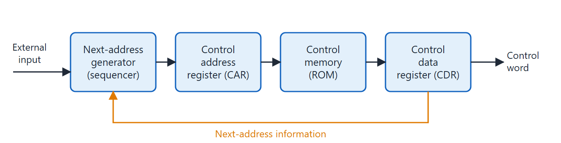
Microprogrammed control organization
Topic 4.1
Microprogrammed control organization. Adapted from M. Morris Mano, Computer System Architecture, Fig. 7-1.
Notes:
Walk through the four blocks from left to right: the CAR holds the current address, the ROM outputs the microinstruction, the sequencer computes the next address. The CDR (pipeline register) holds the fetched word while the next address is computed.

Slide 7
The four components
Topic 4.1
CAR (control address register): the address of the current microinstruction
Sequencer: computes the next address
ROM: outputs the microinstruction at the CAR address
CDR (pipeline register): holds the fetched microinstruction while the next address is computed
Mano’s Chapter 7 example omits the CDR and uses a single-phase clock, reading the control word straight from the ROM output
Notes:
Ask students which block is the "program counter" of the microprogram. The CAR is that block.

Slide 8
The microinstruction format
Topic 4.1
Mano’s example control memory is 128 × 20: 128 microinstructions, each 20 bits wide, in six fields
F1, F2, F3 (nine bits): select up to three simultaneous microoperations; code 000 means no operation in that field
AD (7 bits): the address field; 2⁷ = 128 matches the control memory size
CD: selects which status bit to test
BR: specifies the type of address transition
Notes:
The 20 bits are divided into six fields. The AD field is exactly wide enough to address every location in the control memory.

Slide 9
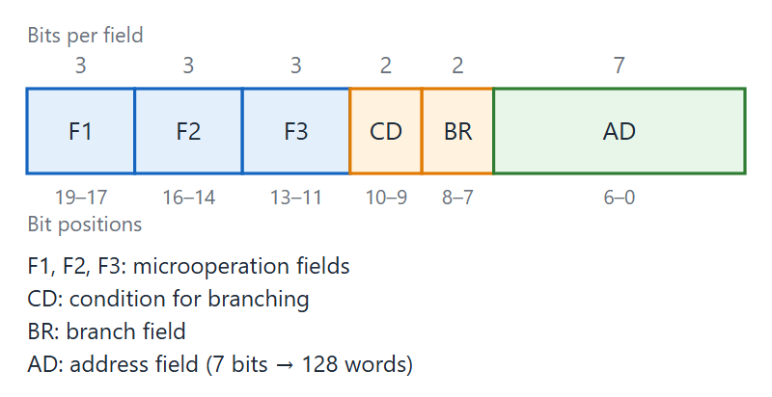
Microinstruction code format (20 bits)
Topic 4.1
Microinstruction code format (20 bits). Adapted from M. Morris Mano, Computer System Architecture, Fig. 7-6.
Notes:
Point to the three nine-bit F fields, then CD, BR and AD. If the control memory size changes, the AD field width changes with it.

Slide 10
4.2 Address Sequencing
Topic 4.2
IN SIMPLE TERMS
After each microinstruction the CAR must get a new address. It can step to the next one, jump to the AD address, jump to the start of the routine for the current machine instruction (mapping), or jump into and back from a subroutine.
Notes:
The CAR needs a new address after every microinstruction. This topic shows the four ways it can get one.

Slide 11
The microprogram sequencer
Topic 4.2
A microprogram is not executed strictly from beginning to end
Each machine instruction maps to its own microprogram routine
The routines share a common fetch sequence
Conditional branches may take different paths, depending on status bits
The hardware that computes the next CAR address is the microprogram sequencer
Notes:
The sequencer is the heart of this topic. Its four capabilities are listed on the next slide.

Slide 12
Four required capabilities
Topic 4.2
1. Increment the CAR: execute the next microinstruction in sequence
2. Branch: jump to the AD address, always (unconditional) or only when a tested status bit has a given value (conditional)
3. Map: at the start of each execute phase, jump to the routine for the current machine instruction (opcode → control memory address)
4. Subroutine call and return: jump to a shared microprogram subroutine and return to the calling address
Notes:
These are the four operations the sequencer must support. The figure on the next slide shows the hardware behind them.

Slide 13
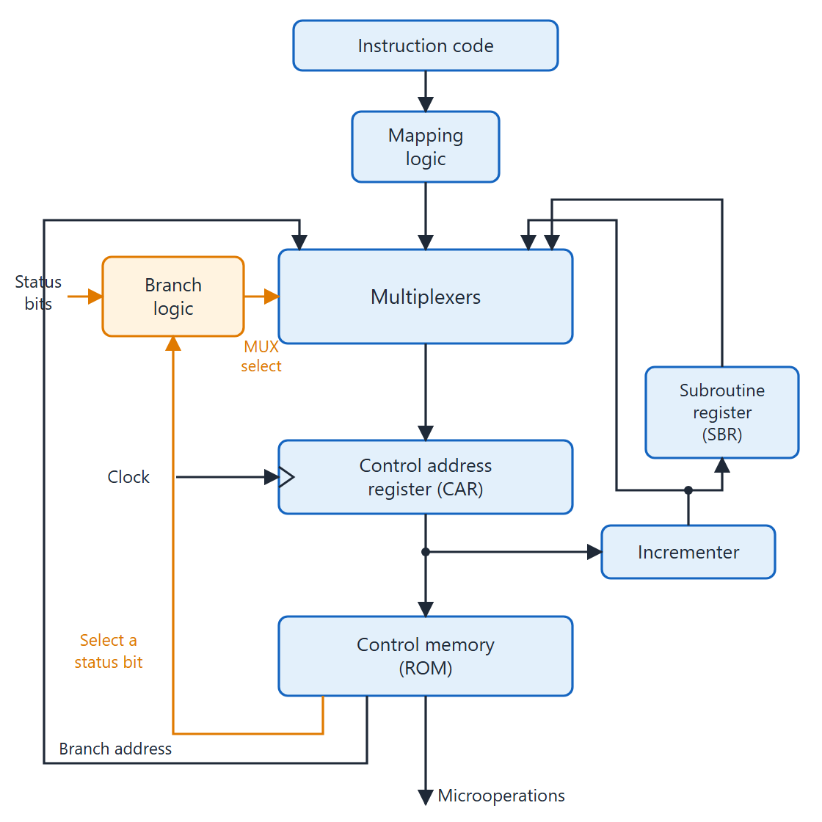
Selection of address for control memory
Topic 4.2
The multiplexers choose the next address from four sources: CAR + 1, the AD field, the mapping logic and the SBR
The incrementer output also feeds the SBR during a subroutine call
The branch logic tests the status bit chosen by CD and drives the MUX selects
The mapping logic turns the opcode into a starting address
Selection of address for control memory. Adapted from M. Morris Mano, Computer System Architecture, Fig. 7-2.
Notes:
The four sources feed the multiplexers: the incrementer (CAR + 1), the branch address from AD, the mapping logic and the SBR. The SBR (subroutine register) saves the return address. The branch logic tests the status bit selected by CD and drives the MUX select lines.

Slide 14
The BR field
Topic 4.2
BR | Symbol | Function
00 | JMP | CAR ← AD if condition = 1; CAR ← CAR + 1 if condition = 0
01 | CALL | CAR ← AD and SBR ← CAR + 1 if condition = 1; CAR ← CAR + 1 if condition = 0
10 | RET | CAR ← SBR (return from subroutine)
11 | MAP | CAR(2–5) ← DR(11–14), CAR(0, 1, 6) ← 0
Adapted from M. Morris Mano, Computer System Architecture, Table 7-1
Notes:
BR selects the kind of address transition. Together with CD it decides what the CAR loads next.

Slide 15
The CD field and the mapping logic
Topic 4.2
CD selects the condition: 00 = U (always 1), 01 = I (DR(15), the indirect bit), 10 = S (AC(15), the sign), 11 = Z (AC = 0)
With CD = 00, JMP and CALL always take the branch
The mapping logic is a PLD or a small ROM that turns opcode bits into a control memory address
Nested subroutine calls need a hardware stack in the SBR, since one register saves only one return address
Notes:
CD answers "which status bit?" and BR answers "what kind of transition?". Both fields act together for a conditional branch.

Slide 16
4.3 General Register Organization
Topic 4.3
IN SIMPLE TERMS
Pick two registers (SELA, SELB), pick an operation (OPR), pick where the answer goes (SELD). Those four choices, 14 bits in total, make one control word.
Notes:
A CPU needs fast temporary storage inside the chip. This topic shows a small register file wired to one shared ALU.

Slide 17
Why a register file
Topic 4.3
Processors need fast temporary storage: partial products, pointer values, return addresses
Main memory is too slow for this: a memory access is the slowest operation a CPU performs
Solution: a small register file inside the CPU, connected through a shared bus and a single ALU
This general register organisation is the internal datapath most modern CPUs are built around
Notes:
Ask why not keep all intermediate values in main memory. The answer is speed.

Slide 18
The bus-organised register file
Topic 4.3
Seven registers R1–R7 plus an external input path
Every register output goes to two multiplexers
The single ALU output goes back to all seven registers and to the external output
A 3×8 decoder decides which one register loads the result
Sharing one ALU needs far less wiring than connecting every register to every other
Notes:
One shared ALU serves all the registers, which keeps the wiring small. Only the register chosen by the decoder loads the result.

Slide 19
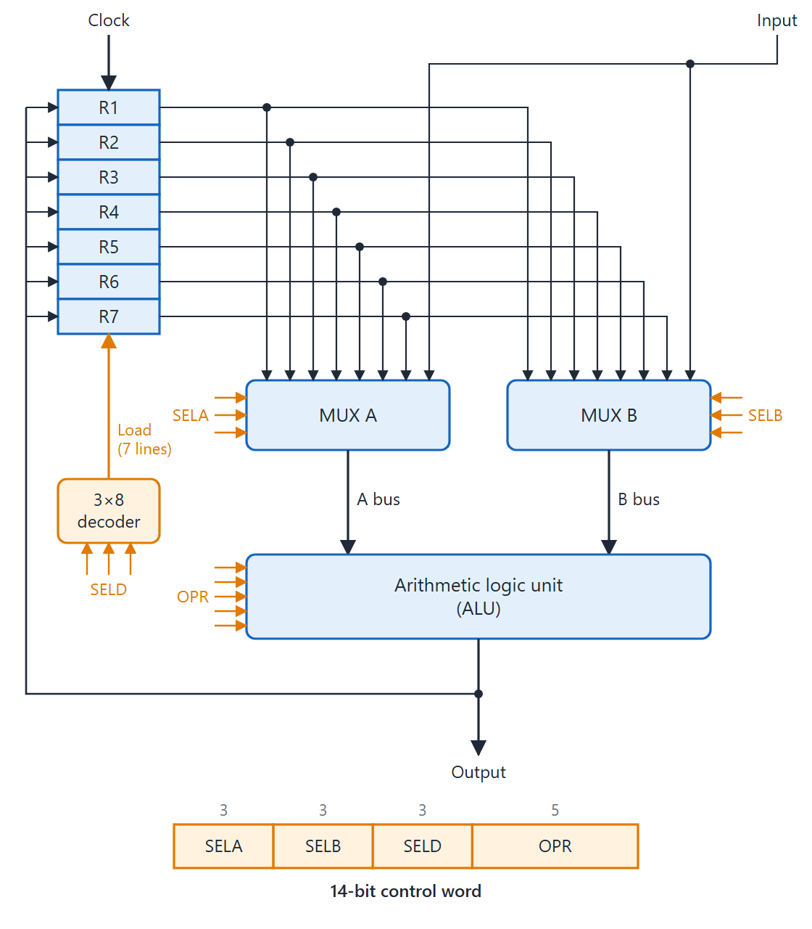
Register set with common ALU
Topic 4.3
MUX A (SELA) and MUX B (SELB) pick the source registers for buses A and B
The ALU performs the operation chosen by OPR
The 3×8 decoder (SELD) loads exactly one destination register
Code 000 means external Input (SELA, SELB) or no destination (SELD)
Register set with common ALU (block diagram and 14-bit control word). Adapted from M. Morris Mano, Computer System Architecture, Fig. 8-2.
Notes:
The block diagram is on top and the 14-bit control word below. Both multiplexers drive the ALU. The ALU result is placed on the output bus, which reaches all registers, and only the register chosen by SELD loads it at the clock edge. When SELD = 000 the result is available on the external output only.

Slide 20
The 14-bit control word
Topic 4.3
Four selector fields: SELA (3 bits) + SELB (3 bits) + SELD (3 bits) + OPR (5 bits) = 14 bits
Code 000 selects the external Input (SELA/SELB) or no destination (SELD)
Codes 001–111 select R1–R7
There are eleven named ALU operations; some of them are listed on the next slide
Notes:
The control word is just four numbers packed together. Next we see some of the OPR codes.

Slide 21
Some ALU operation codes
Topic 4.3
OPR | Operation
00010 | ADD
00101 | SUB
01000 | AND
01010 | OR
01100 | XOR
01110 | COMA
10000 | SHRA
11000 | SHLA
Notes:
These eight are among the eleven named operations. For single-operand operations such as COMA or the shifts, the ALU uses only bus A.

Slide 22
Worked example: R1 ← R2 + R3
Topic 4.3
SELA = 010 (R2 on bus A)
SELB = 011 (R3 on bus B)
OPR = 00010 (ADD)
SELD = 001 (result into R1)
Control word: 010 011 001 00010
On the clock edge the ALU result is loaded into R1
Notes:
Fill the four fields one at a time. Then write them together as the 14-bit control word.

Slide 23
4.4 Stack Organization
Topic 4.4
IN SIMPLE TERMS
A stack works like a pile of plates: the last item put on top is the first one taken off. The stack pointer (SP) always holds the address of the top item; push adds an item, pop removes one.
Notes:
A stack is last-in, first-out. This topic covers a register stack, a memory stack and the reverse Polish notation that makes a stack so useful.

Slide 24
Stack basics and the register stack
Topic 4.4
A stack is last-in, first-out (LIFO): the most recently stored item is retrieved first
It is a memory unit paired with a stack pointer (SP) that points to the top item
Register stack: a 64-word unit; SP is a 6-bit address (2⁶ = 64)
FULL = 1 when the stack holds 64 items; EMTY = 1 when it is empty (Mano spells it EMTY)
The data register DR is the channel through which all words enter and leave
Notes:
Ask students to explain LIFO with the pile-of-plates example. Note the spelling EMTY, used throughout the textbook.

Slide 25
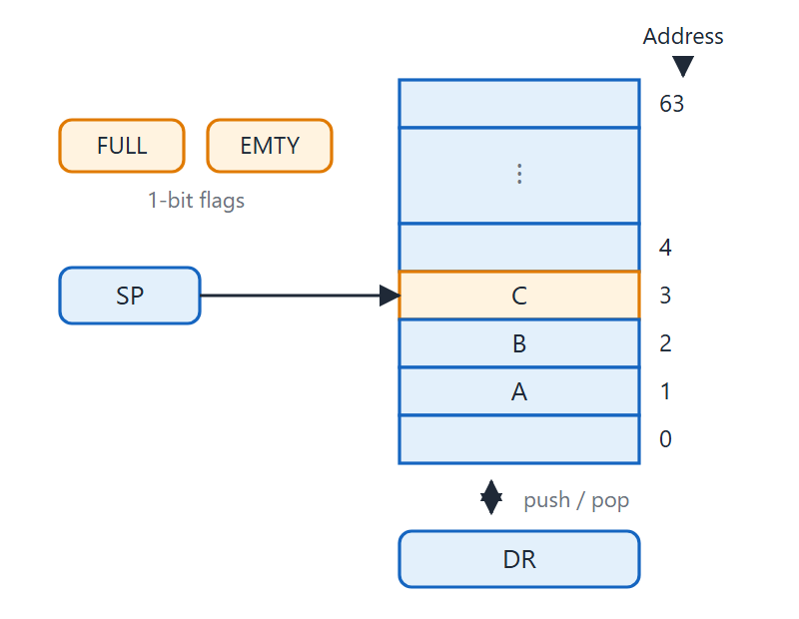
Register stack
Topic 4.4
SP (6 bits) points to the top item
FULL = 1 when the stack holds 64 items; EMTY = 1 when it is empty
DR is the channel for every word entering or leaving
Initially SP = 0, EMTY = 1, FULL = 0; the first item goes to address 1
Adapted from M. Morris Mano, Computer System Architecture, Fig. 8-3
Notes:
When SP wraps around from 63 back to 0 in 6-bit arithmetic, the stack is full. The first item pushed goes to address 1.

Slide 26
Push and pop RTL
Topic 4.4
Push (when FULL = 0):
SP ← SP + 1 Increment stack pointer
M[SP] ← DR Write item on top of stack
If (SP = 0) then (FULL ← 1) Check if stack is full
EMTY ← 0 Mark stack not empty
Pop (when EMTY = 0):
DR ← M[SP] Read item from top of stack
SP ← SP − 1 Decrement stack pointer
If (SP = 0) then (EMTY ← 1) Check if stack is empty
FULL ← 0 Mark stack not full
Notes:
Push increments SP first and then writes. Pop reads first and then decrements SP. Each ends by updating the FULL and EMTY flags.

Slide 27
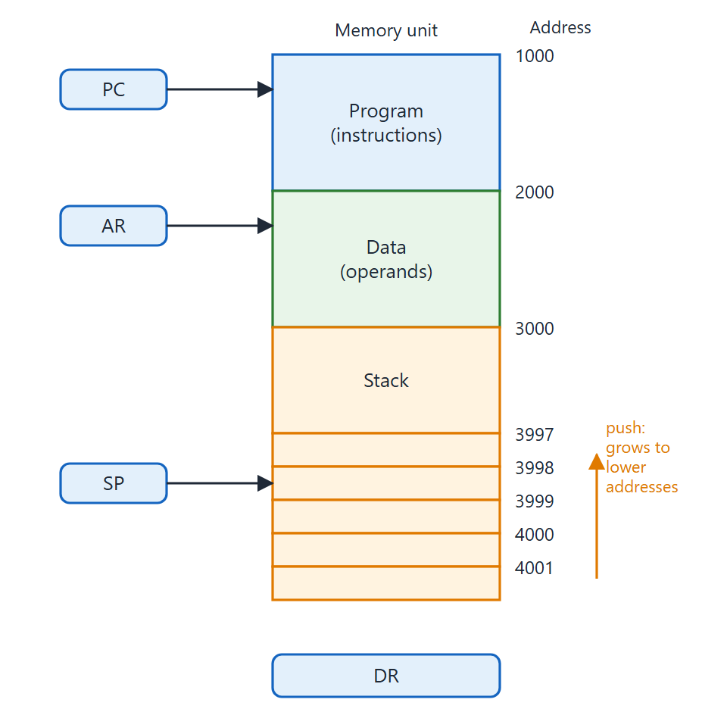
Memory stack
Topic 4.4
A segment of main memory; SP is a processor register; PC, AR and SP supply addresses
SP starts at 4001; the stack grows by decreasing address; lowest usable address is 3000
Push: decrement SP, then write M[SP]. Pop: read M[SP], then increment SP
Software checks the limits using two registers for the bounds
Adapted from M. Morris Mano, Computer System Architecture, Fig. 8-4
Notes:
Most CPUs use a memory stack: a segment of main memory with a processor register as SP. Three registers provide addresses to memory: PC for instructions, AR for operands, SP for the stack. Here the stack grows downward, so the order of the two microoperations is reversed compared with the register stack.

Slide 28
Reverse Polish notation
Topic 4.4
Infix puts the operator between operands (A + B); reverse Polish notation (RPN), also called postfix, puts it after: AB+
RPN suits a stack: scan left to right and push each operand
At an operator, pop the top two operands, apply it and push the result
The final result stays on top of the stack
Compilers routinely convert infix to RPN: it is the most efficient way to translate arithmetic into machine instructions
Notes:
RPN removes the need for brackets. For subtraction and division the first operand popped is the right operand.

Slide 29
RPN evaluation: (3 × 4) + (5 × 6)
Topic 4.4
In RPN the expression is: 3 4 * 5 6 * +
Symbol | Stack (bottom → top) | Action
3 | 3 | Push 3
4 | 3, 4 | Push 4
* | 12 | Pop 4 and 3; push 3×4 = 12
5 | 12, 5 | Push 5
6 | 12, 5, 6 | Push 6
* | 12, 30 | Pop 6 and 5; push 5×6 = 30
+ | 42 | Pop 30 and 12; push 12+30 = 42
Notes:
Follow the stack column from top to bottom. The answer, 42, is left on top of the stack.

Slide 30
4.5 Instruction Formats
Topic 4.5
IN SIMPLE TERMS
An instruction is a row of bits split into fields: what to do (opcode), where the data is (address) and how to find it (mode). Fewer address fields make each instruction shorter but the program longer.
Notes:
An instruction format is the binary layout of an instruction. We compare how many address fields an instruction carries.

Slide 31
Fields in an instruction
Topic 4.5
An instruction format is the binary layout of a machine instruction, divided into fields
Opcode field: specifies the operation
Address field: a memory address or a processor register; a k-bit register address selects one of 2^{k} registers (16 registers need 4 bits)
Mode field: how the operand or effective address is determined
Special fields exist, e.g. a shift-count field in a shift instruction
The number of address fields sets the CPU organisation: single accumulator, general register or stack
Notes:
Most computers use one of three CPU organisations. The number of explicit address fields depends on which one.

Slide 32
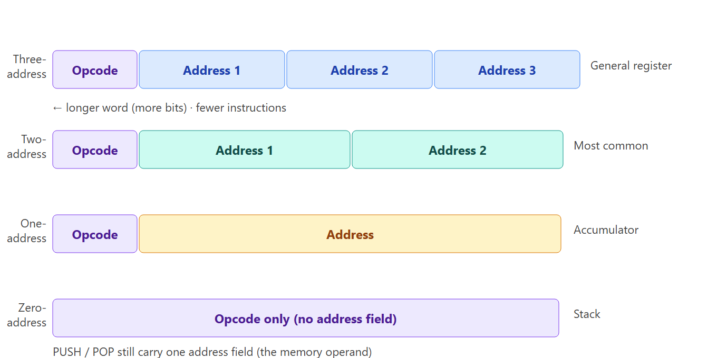
Instruction format types
Topic 4.5
Adapted from M. Morris Mano, Computer System Architecture, §8-4
Notes:
Compare the four formats shown. The more address fields an instruction has, the wider the instruction word becomes.

Slide 33
X = (A+B)*(C+D): three-address
Topic 4.5
ADD R1, A, B R1 ← M[A] + M[B]
ADD R2, C, D R2 ← M[C] + M[D]
MUL X, R1, R2 M[X] ← R1 * R2
Operands are in memory at A, B, C, D; the result is stored at X
Three instructions in total
Notes:
Three-address programs are short in instruction count, but each instruction word is wider because it holds three addresses. Ask students to count the instructions: there are only three.

Slide 34
X = (A+B)*(C+D): two-address
Topic 4.5
MOV R1, A R1 ← M[A]
ADD R1, B R1 ← R1 + M[B]
MOV R2, C R2 ← M[C]
ADD R2, D R2 ← R2 + M[D]
MUL R1, R2 R1 ← R1 * R2
MOV X, R1 M[X] ← R1
MOV is needed to set up the registers
Notes:
In two-address format MOV R1, A means R1 ← M[A]: the register is the destination. We follow the textbook convention.

Slide 35
X = (A+B)*(C+D): one-address
Topic 4.5
LOAD A AC ← M[A]
ADD B AC ← AC + M[B]
STORE T M[T] ← AC
LOAD C AC ← M[C]
ADD D AC ← AC + M[D]
MUL T AC ← AC * M[T]
STORE X M[X] ← AC
All operations go through the implied accumulator AC
Notes:
The result of A+B must be stored in T before computing C+D, because LOAD C overwrites AC. That is why one-address programs need a temporary memory location.

Slide 36
X = (A+B)*(C+D): zero-address
Topic 4.5
PUSH A TOS ← A
PUSH B TOS ← B
ADD TOS ← (A + B)
PUSH C TOS ← C
PUSH D TOS ← D
ADD TOS ← (C + D)
MUL TOS ← (C+D)*(A+B)
POP X M[X] ← TOS
Stack computer; TOS = top of stack
Notes:
Zero-address programs have more instructions, but each word is narrower. PUSH and POP still carry a memory address; zero-address refers to arithmetic instructions such as ADD and MUL.

Slide 37
4.6 Addressing Modes
Topic 4.6
IN SIMPLE TERMS
An addressing mode is the rule the CPU uses to find the data. The operand may be inside the instruction, in a register, in memory, or at an address the CPU must first calculate.
Notes:
The same address field can mean different things depending on the mode. We end with a numerical example of all nine modes.

Slide 38
The idea of an addressing mode
Topic 4.6
The mode gives the rule for interpreting or modifying the address field before the operand is referenced
Two purposes: programmer flexibility (pointers, loop counters, array indexing, relocation) and fewer address bits
The effective address is the final memory address computed by the mode
The mode may be a separate field next to the opcode, or folded into one code with the opcode
The control unit reads the mode during decode to locate the operand
Two modes need no address field (implied, immediate); the other seven interpret it differently
Notes:
Every instruction goes through fetch, decode and execute. During decode the control unit reads the mode field.

Slide 39
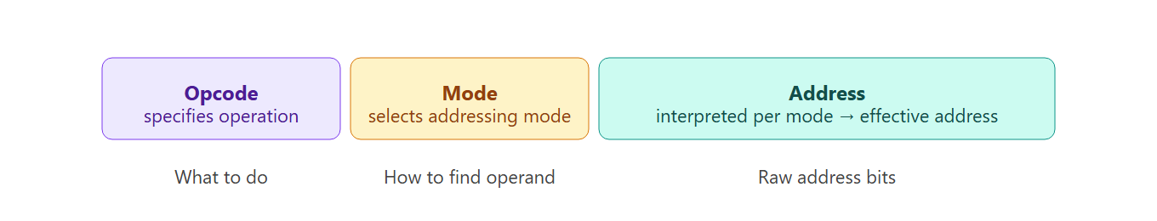
Instruction format with mode field
Topic 4.6
Adapted from M. Morris Mano, Computer System Architecture, Fig. 8-6
Notes:
Show the opcode, mode and address fields in the instruction word. Some computers use a distinct mode field, others fold opcode and mode into one code.

Slide 40
Modes 1–3
Topic 4.6
1. Implied: the operand is implicit in the instruction definition; no address field. Accumulator instructions and zero-address stack instructions are implied-mode
2. Immediate: the operand field holds the actual operand, not its address; no memory access. The effective address is the address of the instruction’s second word (201 in the example)
3. Register: the address field names a processor register that holds the operand; no memory access; a k-bit field selects one of 2^{k} registers
Notes:
The first three modes need no memory access for the operand itself. Implied and immediate use no address field at all.

Slide 41
Modes 4–6
Topic 4.6
4. Register indirect: the register’s contents give the memory address of the operand; fewer bits than a direct address; the programmer loads the address into the register first
5. Autoincrement or autodecrement: like register indirect, but the register is incremented after (autoincrement) or decremented before (autodecrement) the access; good for stepping through a table or implementing a stack
6. Direct address: the address field is the effective address; one access fetches the operand; in branches it is the branch target
Notes:
Autoincrement steps forward through a table, while autodecrement steps backward or builds a stack. Autoincrement changes the register after the access, and autodecrement before it.

Slide 42
Modes 7–9
Topic 4.6
7. Indirect address: the address field points to a memory word that holds the effective address; two memory accesses beyond the instruction fetch
8. Relative address: EA = address field (a signed displacement) + PC, already incremented past the instruction; gives position-independent code with few address bits
9. Indexed: EA = address field + index register XR; the field holds the array base and XR the element offset; XR can be incremented to reach successive elements
Base register mode is computed like indexed, but the register is used for program relocation; it is not a separate row in the table
Notes:
In relative mode the PC has already been incremented when the effective address is computed. Base register mode is calculated like indexed mode but is used for relocation.

Slide 43
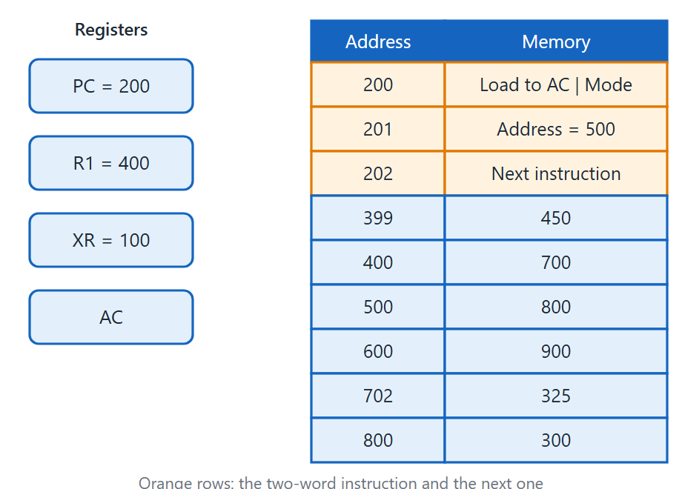
Numerical example of addressing modes
Topic 4.6
Instruction at address 200: “Load to AC”, address part = 500
After fetch: PC = 202, R1 = 400, XR = 100
M[500] = 800, M[800] = 300, M[400] = 700
M[702] = 325, M[600] = 900, M[399] = 450
Adapted from M. Morris Mano, Computer System Architecture, Fig. 8-7
Notes:
Here the instruction at address 200 is "Load to AC" with address part 500. The registers and memory values shown on the right are used for all nine modes in the next table.

Slide 44
Effective address and operand for the nine modes
Topic 4.6
Mode | Effective address | Operand (AC) | How computed
Direct address | 500 | 800 | EA = address part = 500
Immediate operand | 201 | 500 | Operand = address part itself; EA = 201
Indirect address | 800 | 300 | EA = M[500] = 800; operand = M[800] = 300
Relative address | 702 | 325 | EA = PC + 500 = 202 + 500 = 702
Indexed address | 600 | 900 | EA = XR + 500 = 100 + 500 = 600
Register | — | 400 | Operand = R1 = 400; no memory EA
Register indirect | 400 | 700 | EA = R1 = 400; operand = M[400] = 700
Autoincrement | 400 | 700 | EA = R1 = 400; R1 incremented to 401 after access
Autodecrement | 399 | 450 | R1 decremented to 399 before access; EA = 399
Adapted from M. Morris Mano, Computer System Architecture, Table 8-4
Notes:
Go down the table with the memory values from the previous slide. Check the relative row: PC is 202 after fetch, not 200.

Slide 45
4.7 Data Transfer and Manipulation
Topic 4.7
IN SIMPLE TERMS
Most instructions either move data (load, store, move) or change it (add, AND, shift). This topic lists the typical instructions in each group.
Notes:
An instruction set divides into four groups: data transfer, arithmetic, logic and bit manipulation, and shift. We go through the typical mnemonics of each group.

Slide 46
Data transfer instructions
Topic 4.7
8 instructions. No arithmetic is performed: only the location of the data changes.
Name | Mnemonic | Typical action
Load | LD | Memory → processor register (usually the accumulator)
Store | ST | Processor register → memory
Move | MOV | Register → register (or memory ↔ memory on some architectures)
Exchange | XCH | Swap two registers, or a register and a memory word
Input | IN | I/O terminal → processor register
Output | OUT | Processor register → I/O terminal
Push | PUSH | Processor register → top of memory stack
Pop | POP | Top of memory stack → processor register
Typical data transfer instructions. Adapted from M. Morris Mano, Computer System Architecture, Table 8-5.
Notes:
Each of these can occur with a variety of addressing modes. For example, load in immediate mode is sometimes written LDI, and mnemonic conventions vary between architectures.

Slide 47
Arithmetic instructions
Topic 4.7
9 instructions. Multiply and divide may be absent on small processors.
Name | Mnemonic
Increment | INC
Decrement | DEC
Add | ADD
Subtract | SUB
Multiply | MUL
Divide | DIV
Add with carry | ADDC
Subtract with borrow | SUBB
Negate (2’s complement) | NEG
Typical arithmetic instructions. Adapted from M. Morris Mano, Computer System Architecture, Table 8-7.
Notes:
Where they are absent, software subroutines perform them. Many computers have variants for different data types, such as ADDI for integers, ADDF for floating point and ADDD for BCD decimal. Add with carry supports double-precision arithmetic by including the carry from the lower word.

Slide 48
Logical and bit manipulation instructions (1 of 2)
Topic 4.7
10 instructions in total. AND clears selected bits, OR sets them, XOR complements them.
Name | Mnemonic | Effect
Clear | CLR | All bits of operand → 0
Complement | COM | 1’s complement of operand
AND | AND | Bit-by-bit AND: used to clear selected bits (mask)
OR | OR | Bit-by-bit OR: used to set selected bits
Exclusive-OR | XOR | Bit-by-bit XOR: used to complement selected bits
Typical logical and bit manipulation instructions. Adapted from M. Morris Mano, Computer System Architecture, Table 8-8.
Notes:
AND is also called a mask, because ANDing with a pattern of 0s clears those bit positions and leaves the rest unchanged. OR sets selected bits and XOR complements them, all without disturbing the other bits.

Slide 49
Logical and bit manipulation instructions (2 of 2)
Topic 4.7
Name | Mnemonic | Effect
Clear carry | CLRC | Carry flag → 0
Set carry | SETC | Carry flag → 1
Complement carry | COMC | Carry flag ← NOT carry
Enable interrupt | EI | Interrupt flip-flop → 1
Disable interrupt | DI | Interrupt flip-flop → 0
Typical logical and bit manipulation instructions. Adapted from M. Morris Mano, Computer System Architecture, Table 8-8.
Notes:
The carry and interrupt control instructions work on single flag flip-flops rather than whole registers. They complete the list of ten logical and bit manipulation instructions.

Slide 50
Shift instructions
Topic 4.7
8 instructions covering 4 types: logical, arithmetic, rotate and rotate-through-carry; each has a left and a right variant.
Name | Mnemonic | Bit shifted in at the vacated end
Logical shift right | SHR | 0
Logical shift left | SHL | 0
Arithmetic shift right | SHRA | Sign bit (leftmost bit preserved)
Arithmetic shift left | SHLA | 0 (same as logical shift left)
Rotate right | ROR | Rightmost bit wraps to leftmost
Rotate left | ROL | Leftmost bit wraps to rightmost
Rotate right through carry | RORC | Carry bit; rightmost bit → carry
Rotate left through carry | ROLC | Carry bit; leftmost bit → carry
Typical shift instructions. Adapted from M. Morris Mano, Computer System Architecture, Table 8-9.
Notes:
Read the last column: it is the only thing that distinguishes the four types of shift. Each type has both a left and a right variant.

Slide 51
Shift types
Topic 4.7
Logical shift: inserts 0 at the vacated end; useful for unsigned multiplication or division by powers of 2
Arithmetic shift right: preserves the sign bit, keeping the sign correct in 2’s complement arithmetic
Arithmetic shift left: inserts 0; identical to logical shift left
Rotate: circular; no bit is lost, the bit shifted out reappears at the other end
Rotate through carry: the carry flag acts as an extra bit, giving a 9-bit (17-bit on a 16-bit machine) circular shift
Notes:
Applying a logical right shift to a negative signed number gives a wrong result. Use the arithmetic right shift for signed data.

Slide 52
Shift instruction format
Topic 4.7
Some processors encode all shift information in one multi-field instruction
Five fields: OP, REG, TYPE (2 bits), RL (1 bit), COUNT (k bits)
TYPE (2 bits) encodes the four shift variants
RL (1 bit) selects the direction
COUNT allows up to 2^{k} − 1 positions in one instruction
One instruction specifies the type, direction and count together
Notes:
The next slide shows the five fields of this format in the figure. With such a format a single instruction can specify the shift type, direction and count at once.

Slide 53
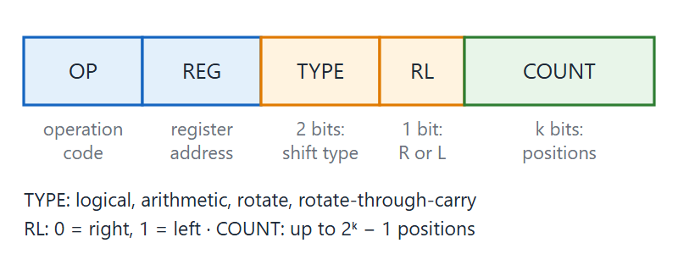
Shift instruction format
Topic 4.7
Shift instruction format. Adapted from M. Morris Mano, Computer System Architecture, §8-6.
Notes:
Point to the five fields from left to right: OP, REG, TYPE, RL and COUNT. TYPE is 2 bits, RL is 1 bit and COUNT is k bits.

Slide 54
4.8 Program Control
Topic 4.8
IN SIMPLE TERMS
The CPU normally runs instructions one after another. Program control instructions change that order by branching, calling a subroutine or handling an interrupt, often based on status bits set by the last ALU operation.
Notes:
Normally the PC just increments. This topic covers the instructions that change it, and the status bits that conditional branches test.

Slide 55
Changing the program flow
Topic 4.8
Normally the PC is incremented after every fetch, so instructions run in memory order
Program control instructions load a new value into the PC, so the CPU branches elsewhere
They cover branches, calls, returns and interrupts
Compare and test instructions update status bits; a later conditional branch then tests them
Notes:
Ask what must change in the CPU for a branch to happen. The answer is the PC.

Slide 56
Program control instructions
Topic 4.8
7 instructions. Branch and jump are used interchangeably in many architectures.
Name | Mnemonic | Action
Branch | BR | PC ← branch address (conditional or unconditional)
Jump | JMP | Unconditional transfer to specified address
Skip | SKP | Increment PC by 1 extra if condition is met (skip next instruction)
Call | CALL | Save return address; transfer to subroutine
Return | RET | Restore return address into PC; resume caller
Compare (by subtraction) | CMP | Set status bits from A − B; result discarded
Test (by ANDing) | TST | Set status bits from A AND B; result discarded
Typical program control instructions. Adapted from M. Morris Mano, Computer System Architecture, Table 8-10.
Notes:
Compare and test do not change the flow directly. They update the status bits, and the original operands are preserved.

Slide 57
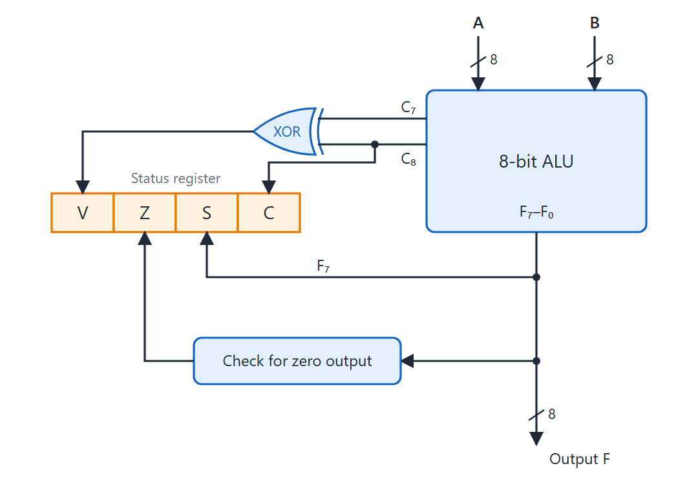
Status register bits
Topic 4.8
Status register bits. Adapted from M. Morris Mano, Computer System Architecture, Fig. 8-8.
Notes:
This is an 8-bit ALU with a 4-bit status register. The four bits are C, S, Z and V, set or cleared after each ALU operation.

Slide 58
The four status bits
Topic 4.8
C (carry): 1 if the end carry C₈ is 1 after an addition; otherwise 0
S (sign): 1 if the highest-order bit F₇ of the result is 1 (negative in 2’s complement)
Z (zero): 1 if all bits of the ALU output are 0
V (overflow): 1 if C₇ ⊕ C₈ = 1: 2’s complement overflow
For an 8-bit ALU, V = 1 means the result is greater than +127 or less than −128
Overflow occurs exactly when the carry into the sign bit differs from the carry out of it
Notes:
C is relevant for unsigned arithmetic and V for signed arithmetic. They are independent of each other.

Slide 59
Conditional branch instructions (1 of 3)
Topic 4.8
Each mnemonic starts with B (branch), followed by an abbreviation of the condition.
Mnemonic | Branch condition | Tested condition
Flag-based conditions
BZ | Branch if zero | Z = 1
BNZ | Branch if not zero | Z = 0
BC | Branch if carry | C = 1
BNC | Branch if no carry | C = 0
BP | Branch if plus | S = 0
BM | Branch if minus | S = 1
BV | Branch if overflow | V = 1
BNV | Branch if no overflow | V = 0
Conditional branch instructions. Adapted from M. Morris Mano, Computer System Architecture, Table 8-11.
Notes:
The first group tests the status bits directly. Each mnemonic starts with B for branch.

Slide 60
Conditional branch instructions (2 of 3)
Topic 4.8
The words higher and lower apply to unsigned comparison.
Mnemonic | Branch condition | Tested condition
Unsigned compare conditions (A − B)
BHI | Branch if higher | A > B
BHE | Branch if higher or equal | A ≥ B
BLO | Branch if lower | A < B
BLOE | Branch if lower or equal | A ≤ B
BE | Branch if equal | A = B
BNE | Branch if not equal | A ≠ B
Conditional branch instructions. Adapted from M. Morris Mano, Computer System Architecture, Table 8-11.
Notes:
After CMP A, B these instructions treat A and B as unsigned numbers. Higher and lower are the words used for unsigned comparison.

Slide 61
Conditional branch instructions (3 of 3)
Topic 4.8
Greater than and less than apply to signed comparison, where V and S must both be considered. BE and BNE appear in both groups: the equality test (Z = 1) is the same.
Mnemonic | Branch condition | Tested condition
Signed compare conditions (A − B)
BGT | Branch if greater than | A > B
BGE | Branch if greater or equal | A ≥ B
BLT | Branch if less than | A < B
BLE | Branch if less or equal | A ≤ B
BE | Branch if equal | A = B
BNE | Branch if not equal | A ≠ B
Conditional branch instructions. Adapted from M. Morris Mano, Computer System Architecture, Table 8-11.
Notes:
The same bit patterns can give different results for BHI and BGT when the values are negative. For signed comparison both V and S must be considered.

Slide 62
Subroutine call and return
Topic 4.8
CALL subroutine:
SP ← SP − 1 Decrement stack pointer
M[SP] ← PC Push return address onto stack
PC ← effective address Transfer control to subroutine
Return from subroutine (RET):
PC ← M[SP] Pop return address into PC
SP ← SP + 1 Increment stack pointer
Notes:
A subroutine can be called from many points, so the return address must be saved. Using a stack means nested and recursive calls are handled automatically, since each return pops the most recent address.

Slide 63
Program interrupt
Topic 4.8
An interrupt transfers control to a service routine in response to an asynchronous event or an error
External: from I/O devices, timing circuits or power-failure detectors; asynchronous
Internal (traps): illegal or erroneous instructions, such as overflow, division by zero, invalid opcode, stack overflow, protection violation; synchronous
Software: a special instruction (supervisor call), e.g. to switch from user mode to supervisor mode
The CPU pushes the PC and the program status word (PSW) on the stack and loads the service routine’s address into the PC
Return from interrupt pops the PSW and PC, restoring the CPU state exactly
Notes:
The mechanism is similar to a subroutine call. The extra step is that the PSW is saved as well.

Slide 64
4.9 Addition and Subtraction
Topic 4.9
IN SIMPLE TERMS
With signs stored separately, the hardware first looks at the operation and the two signs, then either adds the magnitudes or subtracts them. Subtraction is done by adding the 2’s complement, so one adder handles both.
Notes:
The arithmetic unit has to handle two ways of storing negative numbers: signed-magnitude and signed-2’s complement. This topic develops the hardware and algorithms for both.

Slide 65
Signed-magnitude addition and subtraction
Topic 4.9
A signed-magnitude number is a magnitude plus a separate sign bit
The operation on the magnitudes depends on the operation and on both signs: 8 combinations
Add magnitudes when the signs are identical (addition) or different (subtraction); the result takes the sign of A
Subtract magnitudes otherwise: if A ≥ B the result has the sign of A; if A < B the result is B − A with the complement of A’s sign
A zero result must get a positive sign (+0, not −0)
Notes:
The rule reduces to two cases. Try an example with opposite signs on the board.

Slide 66
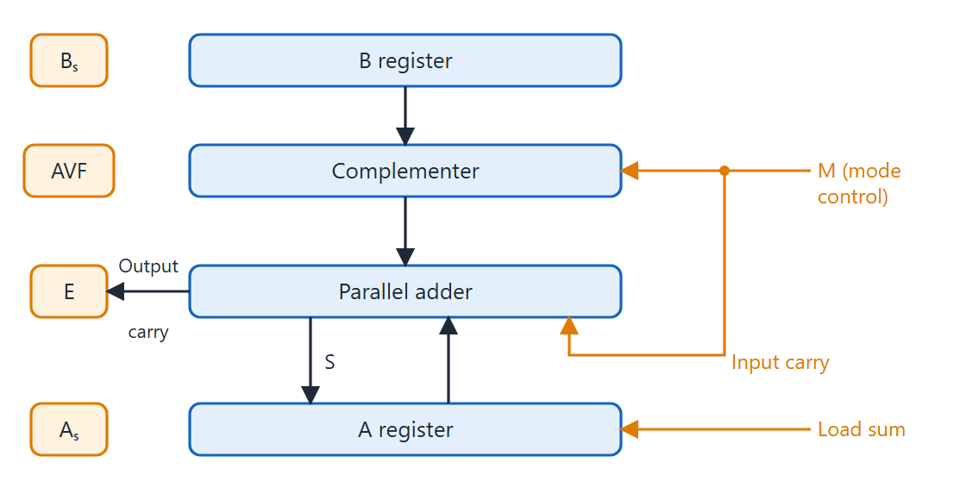
Hardware for signed-magnitude addition and subtraction
Topic 4.9
Hardware for signed-magnitude addition and subtraction. Adapted from M. Morris Mano, Computer System Architecture, Fig. 10-1.
Notes:
The key idea is that subtraction of magnitudes is done by 2’s complement addition, so no separate subtractor circuit is needed. Follow B through the complementer, into the parallel adder and then to A and E.

Slide 67
Hardware components
Topic 4.9
B register: holds the magnitude of the second operand
Complementer (mode bit M): M = 0 passes B; M = 1 passes the 1’s complement of B and sets the input carry to 1, so the adder computes A + B′ + 1 = A − B
Parallel adder: computes the sum; its output carry goes to flip-flop E, showing A ≥ B after a subtraction
A register: receives the result
Sign flip-flops A_{s} and B_{s}: their XOR decides whether to add or subtract magnitudes
AVF (add-overflow flip-flop): captures E when magnitudes are added; signals overflow
Notes:
These are the six components in the figure. M is the single control bit that selects addition or subtraction.

Slide 68
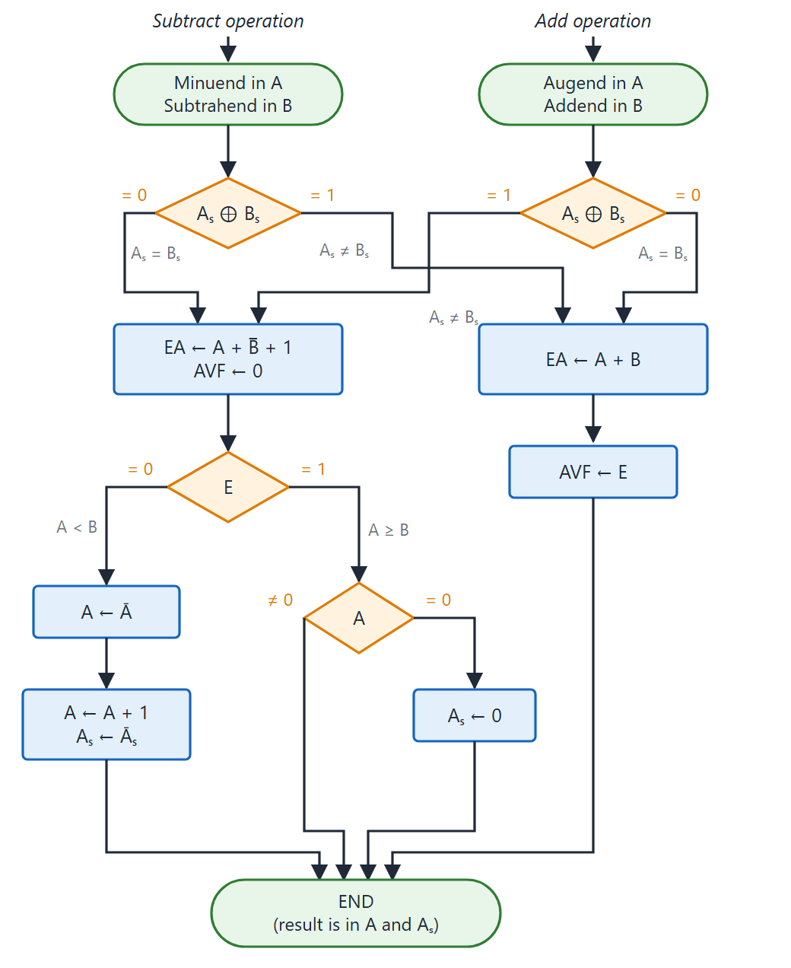
Add and subtract flowchart
Topic 4.9
Compute A_{s} ⊕ B_{s}: 0 means subtract magnitudes (EA ← A + B′ + 1, AVF ← 0); 1 means add magnitudes (EA ← A + B, AVF ← E)
Subtract path, E = 1: A ≥ B; if A = 0 force A_{s} ← 0 to avoid −0
Subtract path, E = 0: A < B; take the 2’s complement of A and complement the sign
Both columns share the same END node
Flowchart for add and subtract operations. Adapted from M. Morris Mano, Computer System Architecture, Fig. 10-2.
Notes:
The two columns are the subtract and add operations. They share the same END node, since both place the result in A and A_s.

Slide 69
Signed-2’s complement arithmetic
Topic 4.9
Most computers use signed-2’s complement; the algorithm is much simpler
Addition: add the numbers including the sign bits; discard the carry out of the sign position
Subtraction: take the 2’s complement of the subtrahend and add it to the minuend
Same complementer-adder, but no separate sign flip-flops; the registers are AC and BR
Overflow rule: adding two numbers of the same sign gives a result of the opposite sign
V = C₇ ⊕ C₈, where C₇ is the carry into the sign bit and C₈ the carry out of it
Notes:
Overflow flip-flop V is set when the XOR of the last two carries equals 1. This is the same rule used earlier for the status register.

Slide 70
4.10 Multiplication Algorithms
Topic 4.10
IN SIMPLE TERMS
The computer multiplies the way you do on paper: add the multiplicand when the multiplier bit is 1, then shift. But it shifts the partial product right instead of shifting the multiplicand left. Booth’s method does the same for signed numbers by subtracting at the start of a run of 1s and adding at its end.
Notes:
Multiplying two n-bit numbers gives a 2n-bit product. This topic covers the signed-magnitude hardware algorithm, Booth’s algorithm and the array multiplier.

Slide 71
Signed-magnitude multiplication: hardware
Topic 4.10
Paper and pencil: add shifted copies of the multiplicand whenever the multiplier bit is 1
Hardware: shift the partial product right after each addition, so everything stays in fixed-width registers
B: multiplicand (magnitude); A: partial product, cleared to 0 initially
Q: multiplier; its rightmost bit Q_{n} is tested each step
E: carry extension left of A, cleared initially; SC: counts down from n − 1 to 0
Sign flip-flops: the product sign is A_{s} = Q_{s} ⊕ B_{s}
Notes:
The hardware extends the add/subtract hardware with a Q register for the multiplier. The SC counts down from n − 1 to control the loop.

Slide 72
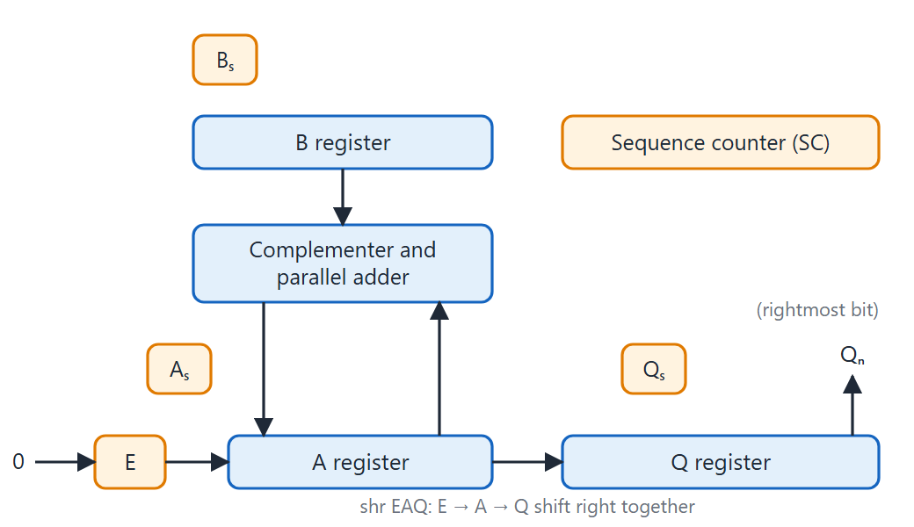
Hardware for multiply operation
Topic 4.10
Hardware for multiply operation. Adapted from M. Morris Mano, Computer System Architecture, Fig. 10-5.
Notes:
This extends the add/subtract hardware with the Q register and the sequence counter SC. The combined register EAQ is shifted right after each step.

Slide 73
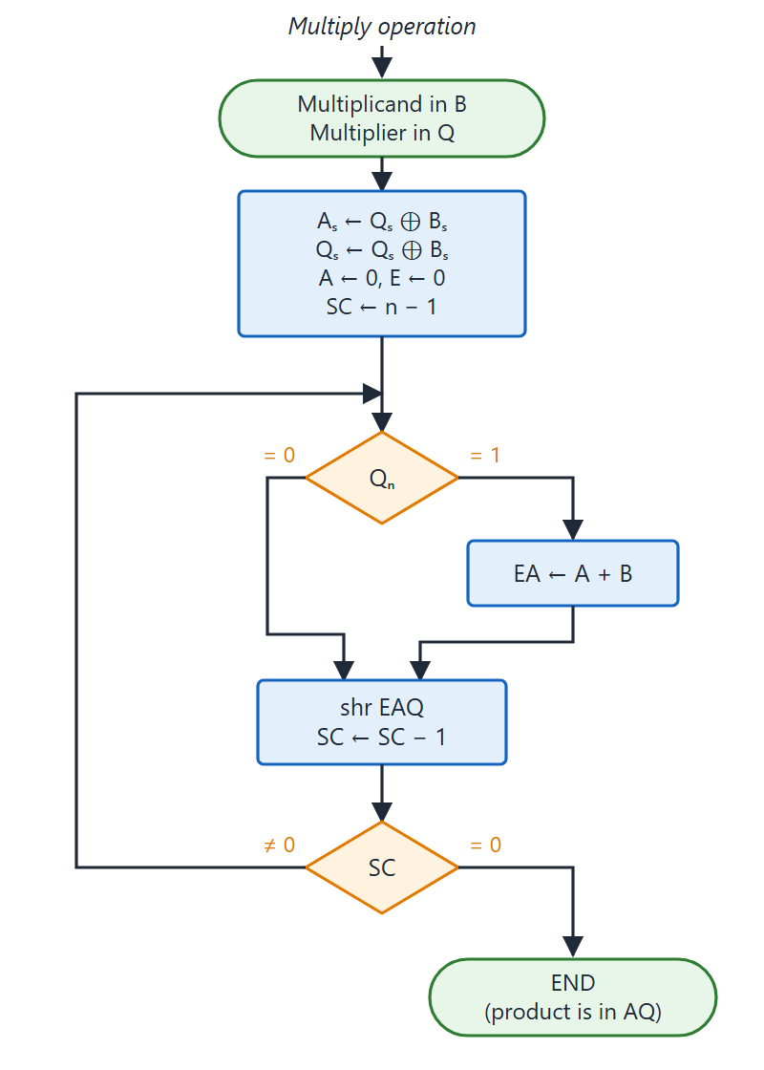
Multiply flowchart
Topic 4.10
If Q_{n} = 1 (rightmost bit of Q), EA ← A + B
Then shr EAQ and SC ← SC − 1
After n steps (SC = 0) the product is in AQ
SC starts at n − 1: the first partial product is added before the first shift
Flowchart for multiply operation. Adapted from M. Morris Mano, Computer System Architecture, Fig. 10-6.
Notes:
Each iteration tests Q_n, adds B to A if it is 1, then shifts EAQ right and decrements SC. After n steps SC = 0 and the product is in AQ: A holds the most significant half and Q the least significant half.

Slide 74
Booth’s algorithm: action for each bit pair
Topic 4.10
Booth multiplies signed 2’s complement numbers directly. A string of 1s is replaced by a subtraction at its low end and an addition at its high end. After any arithmetic, ashr is applied to AC and QR together, preserving the sign of AC.
Q_{n} | Q_{n+1} | Action | Meaning
1 | 0 | AC ← AC + BR′ + 1 (subtract BR) | Beginning of a string of 1s
0 | 1 | AC ← AC + BR (add BR) | End of a string of 1s
0 | 0 | No arithmetic (shift only) | Middle of a string of 0s
1 | 1 | No arithmetic (shift only) | Middle of a string of 1s
Booth algorithm: action for each bit pair
Notes:
Booth looks at two bits at a time: the current multiplier bit and the bit shifted out before it. This reduces the number of additions when the multiplier has long runs of 1s.

Slide 75
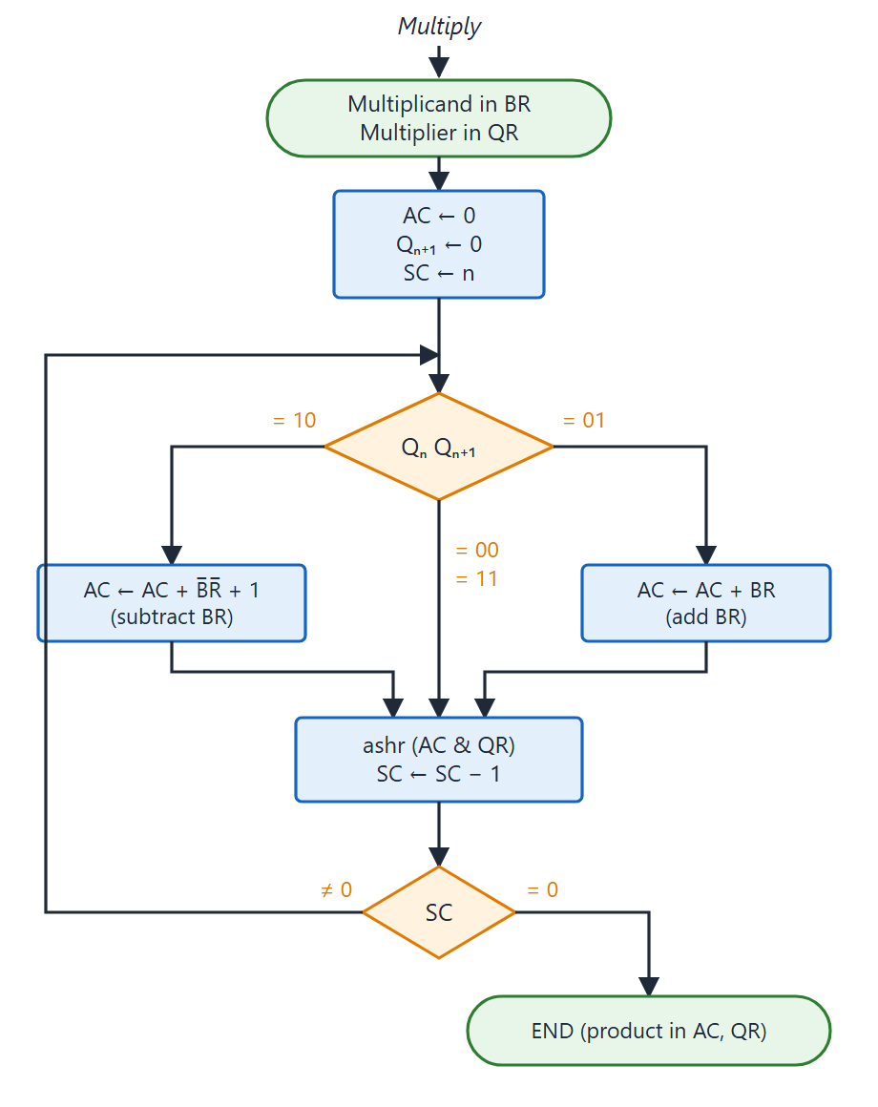
Booth algorithm flowchart
Topic 4.10
Initialise: AC ← 0, Q_{n+1} ← 0, SC ← n
Repeat n times: inspect Q_{n}Q_{n+1} and do the action from the table
Then ashr (AC & QR) and decrement SC
When SC = 0 the product is in AC and QR
Booth algorithm for multiplication of signed-2's complement numbers. Adapted from M. Morris Mano, Computer System Architecture, Fig. 10-8.
Notes:
The loop runs n times. Each pass inspects Q_n and Q_n+1, performs the action from the table, then does ashr (AC & QR) and decrements SC.

Slide 76
Booth example: (−9) × (−13), n = 5 (1 of 2)
Topic 4.10
BR = 10111 (−9), QR = 10011 (−13), BR′ + 1 = 01001
Q_{n} Q_{n+1} | Operation | AC | QR | Q_{n+1} | SC
Initial |  | 00000 | 10011 | 0 | 101
1 0 | Subtract BR | 01001
 | ashr | 00100 | 11001 | 1 | 100
1 1 | ashr | 00010 | 01100 | 1 | 011
0 1 | Add BR | 10111 → 11001
 | ashr | 11100 | 10110 | 0 | 010
Booth algorithm trace: BR = 10111 (−9), QR = 10011 (−13), product = +117. Adapted from M. Morris Mano, Computer System Architecture, Table 10-3.
Notes:
Check each ashr step. The AC and QR move right together, and the bit shifted out of QR becomes the new Q_n+1.

Slide 77
Booth example: (−9) × (−13), n = 5 (2 of 2)
Topic 4.10
Q_{n} Q_{n+1} | Operation | AC | QR | Q_{n+1} | SC
0 0 | ashr | 11110 | 01011 | 0 | 001
1 0 | Subtract BR | 01001 → 00111
 | ashr | 00011 | 10101 | 1 | 000
Product in AC·QR |  | 0001110101 = +117 ✓
Booth algorithm trace: BR = 10111 (−9), QR = 10011 (−13), product = +117. Adapted from M. Morris Mano, Computer System Architecture, Table 10-3.
Notes:
When SC reaches 0 the product 0001110101 is in AC and QR. It equals +117, which is (−9) × (−13).

Slide 78
Array multiplier
Topic 4.10
The sequential algorithm needs n clock cycles
A combinational array multiplier produces the product in a single step, using parallel hardware
For j multiplier bits and k multiplicand bits it needs j × k AND gates and (j − 1) k-bit adders, producing a product of j + k bits
Combinational (single step) but expensive in hardware
Notes:
This trades hardware for speed. The sequential method uses little hardware but takes n steps.

Slide 79
4.11 Division Algorithms
Topic 4.11
IN SIMPLE TERMS
The hardware divides like long division in binary. Each step shifts the partial remainder left and tries subtracting the divisor; if it fits, the quotient bit is 1, otherwise the remainder is restored and the bit is 0.
Notes:
Binary division is simpler than decimal because each quotient digit is 0 or 1. This topic develops the hardware algorithm for signed-magnitude division.

Slide 80
Division hardware: overview
Topic 4.11
The hardware reuses the complementer-and-adder used for add, subtract and multiply
The double-length dividend is in registers A and Q; the divisor is in B
Each step: 1. shl EAQ (shift the partial remainder left); 2. EA ← A + B′ + 1 (trial subtraction)
3. If E = 1 (A ≥ B), Q_{n} ← 1; if E = 0 (A < B), restore A by adding B back and the quotient bit stays 0
4. Decrement SC
After n steps the quotient is in Q and the remainder is in A
Notes:
Each quotient bit is just the carry E from a trial subtraction. After n steps the quotient is in Q and the remainder in A.

Slide 81
Divide overflow
Topic 4.11
Overflow: the quotient needs more bits than the register holds
It is detected before the main loop: if the high half of the dividend (initial A) is ≥ the divisor B, the quotient would exceed n bits
Then the divide-overflow flip-flop DVF is set to 1 and the operation is aborted; hardware typically raises an interrupt
Condition: DVF ← 1 when E = 1 after the first EA ← A + B′ + 1, i.e. A ≥ B before any shift
Division by zero is also caught here, since any dividend is greater than zero
Notes:
The check costs one extra trial subtraction, which is why SC starts at n − 1. Hardware typically generates an interrupt when DVF is set.

Slide 82
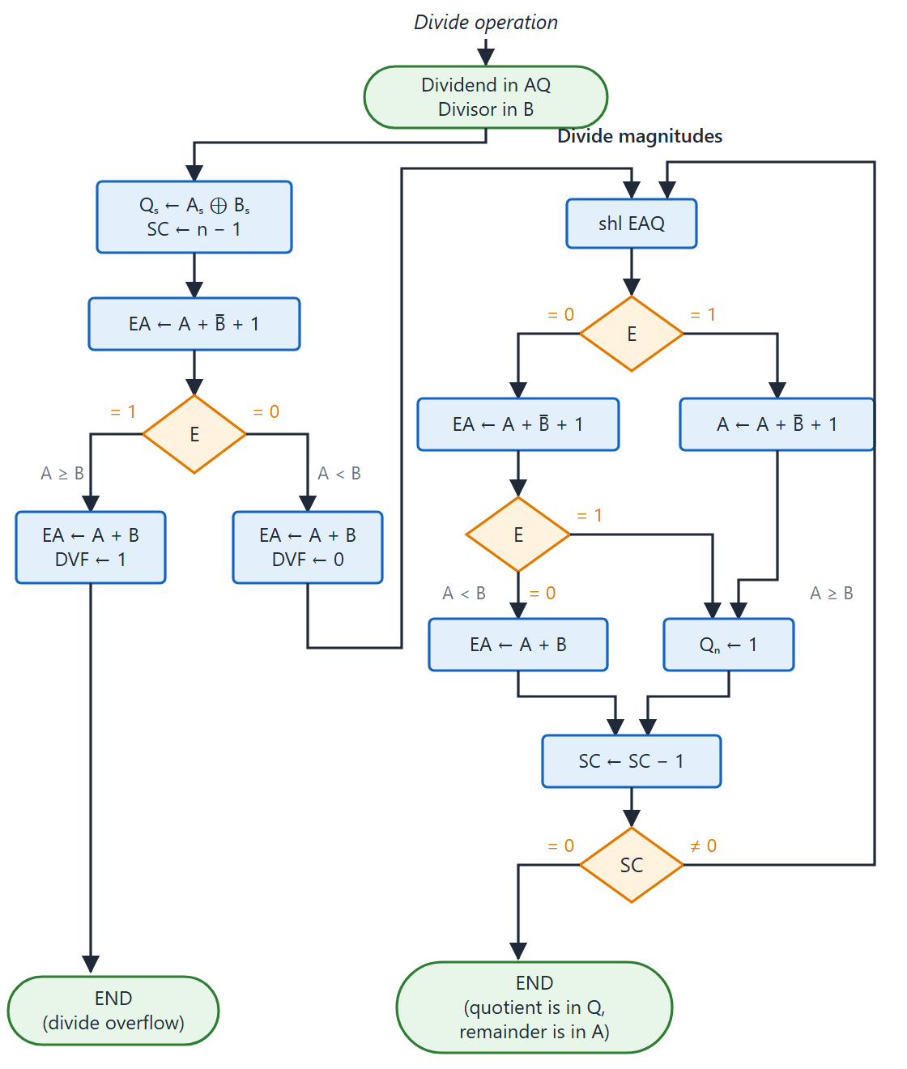
Divide flowchart (signed-magnitude)
Topic 4.11
Initialise: Q_{s} ← A_{s} ⊕ B_{s}, SC ← n − 1
Overflow check: EA ← A + B′ + 1; E = 1 sets DVF ← 1 and ends, E = 0 enters the loop
Loop n times: shl EAQ, trial subtract; E = 1 sets Q_{n} ← 1, E = 0 restores A; SC ← SC − 1
SC starts at n − 1: the overflow-check step counts as one
Flowchart for divide operation (signed-magnitude). Adapted from M. Morris Mano, Computer System Architecture, Fig. 10-13.
Notes:
Follow the initialise step, the overflow check, and then the divide-magnitudes loop. In the overflow check A is restored in both cases (EA ← A + B), and DVF is set or cleared depending on E.

Slide 83
Division example: 448 ÷ 17 (1 of 2)
Topic 4.11
Dividing 0111000000 (448) by B = 10001 (17), following the steps of the book’s worked example.
Step | Operation | E | A | Q | SC
Init | Dividend in AQ, divisor B = 10001, B′ + 1 = 01111 | 0 | 01110 | 00000 | 5
1 | shl EAQ | 0 | 11100 | 00000
 | Add B′ + 1 → E = 1: set Q_{n} = 1 | 1 | 01011 | 00001 | 4
2 | shl EAQ | 0 | 10110 | 00010
 | Add B′ + 1 → E = 1: set Q_{n} = 1 | 1 | 00101 | 00011 | 3
Binary division with digital hardware (Dividend = 01110 00000, Divisor B = 10001). Adapted from M. Morris Mano, Computer System Architecture, Fig. 10-12.
Notes:
Each pair of rows is one step: shift left, then a trial subtraction. E = 1 means the divisor fits and the quotient bit becomes 1.

Slide 84
Division example: 448 ÷ 17 (2 of 2)
Topic 4.11
Quotient in Q = 11010 (26), remainder in A = 00110 (6): 448 ÷ 17 = 26 remainder 6.
Step | Operation | E | A | Q | SC
3 | shl EAQ | 0 | 01010 | 00110
 | Add B′ + 1 → E = 0: leave Q_{n} = 0, add B (restore) | 1 | 01010 | 00110 | 2
4 | shl EAQ | 0 | 10100 | 01100
 | Add B′ + 1 → E = 1: set Q_{n} = 1 | 1 | 00011 | 01101 | 1
5 | shl EAQ | 0 | 00110 | 11010
 | Add B′ + 1 → E = 0: leave Q_{n} = 0, add B (restore) | 1 | 00110 | 11010 | 0
Binary division with digital hardware (Dividend = 01110 00000, Divisor B = 10001). Adapted from M. Morris Mano, Computer System Architecture, Fig. 10-12.
Notes:
In steps 3 and 5 the divisor does not fit, so A is restored and the quotient bit stays 0. After step 5, Q = 11010 is 26 and A = 00110 is 6.

Slide 85
4.12 Floating-Point Arithmetic Operations
Topic 4.12
IN SIMPLE TERMS
A floating-point number is a mantissa times a power of 2. To add, first make the exponents equal by shifting a mantissa; to multiply, add the exponents and multiply the mantissas; to divide, subtract the exponents and divide the mantissas. Then normalise.
Notes:
Floating-point numbers appear wherever a program uses real numbers. This topic develops the hardware algorithms for all four floating-point operations.

Slide 86
Floating-point basics
Topic 4.12
A floating-point number has a mantissa m and an exponent e: the value is m × r^{e}, with radix r
The radix and the radix point are implied, not stored; here r = 2 and the mantissa is a fraction
A number is normalised when the most significant digit of the mantissa is nonzero; this maximises the significant digits
Zero cannot be normalised: it is all 0s in both the mantissa and exponent fields
Notes:
Normalising puts the largest possible number of significant digits in the mantissa. Zero is the one number that cannot be normalised.

Slide 87
Biased exponent
Topic 4.12
The exponent can be stored as signed-magnitude, signed-2’s complement, signed-1’s complement or biased
Biased is the most common: a positive bias is added to every exponent before storing
Example: bias 50, exponent range −50 to +49, stored values 0 to 99: all positive, no sign bit
Advantage: all stored exponents are positive, so a magnitude comparator can compare them; this simplifies the mantissa alignment hardware
Notes:
The bias turns every stored exponent into a non-negative number, which is easy to compare. No sign bit is needed for the exponent.

Slide 88
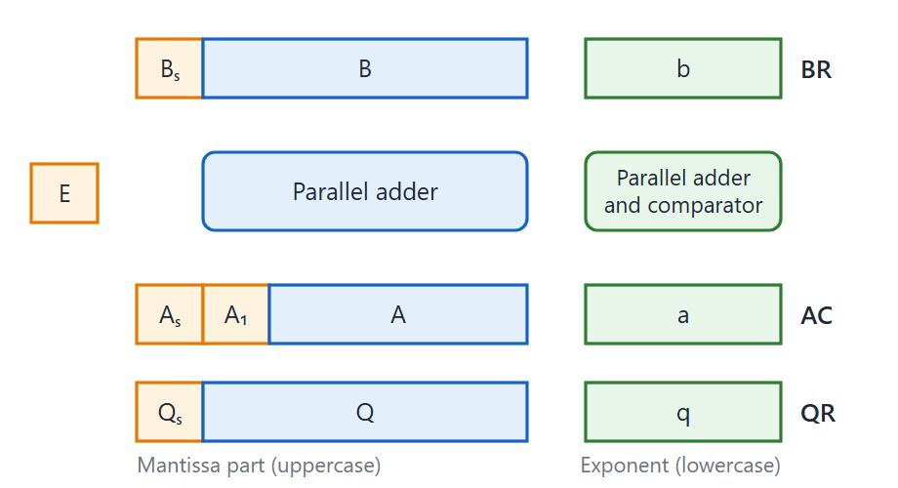
Register configuration for floating-point operations
Topic 4.12
Register configuration for floating-point arithmetic operations. Adapted from M. Morris Mano, Computer System Architecture, Fig. 10-14.
Notes:
Each register has a mantissa part (uppercase B, A, Q) and an exponent part (lowercase b, a, q). The sign of the mantissa is kept separately as B_s, A_s and Q_s.

Slide 89
The registers
Topic 4.12
BR (B_{s}, B, b): one operand: its sign, mantissa and biased exponent
AC (A_{s}, A₁, A, a): the accumulator; A₁ is the MSB of the mantissa and must be 1 for a normalised number
QR (Q_{s}, Q, q): the multiplier/quotient register in multiplication and division
A parallel adder handles the mantissa arithmetic, the same circuit as fixed point
A separate parallel adder and comparator handles the exponents
Notes:
Keep this register naming in mind for the next slides. Uppercase letters are the mantissa parts and lowercase letters are the exponent parts.

Slide 90
Addition and subtraction: four phases
Topic 4.12
1. Check for zeros: if BR = 0 the result is already in AC; if AC = 0, AC ← BR (for subtraction the sign of AC is complemented)
2. Align mantissas: shift the mantissa with the smaller exponent right, incrementing its exponent, until the exponents are equal
3. Add or subtract mantissas by the signed-magnitude algorithm; if the carry E = 1 after addition, shift the sum right and increment the exponent
4. Normalise: shift left and decrement the exponent until A₁ = 1; if the mantissa is all zeros, clear AC
Notes:
Shifting right rather than left preserves the most significant digits. Left shifts would lose precision.

Slide 91
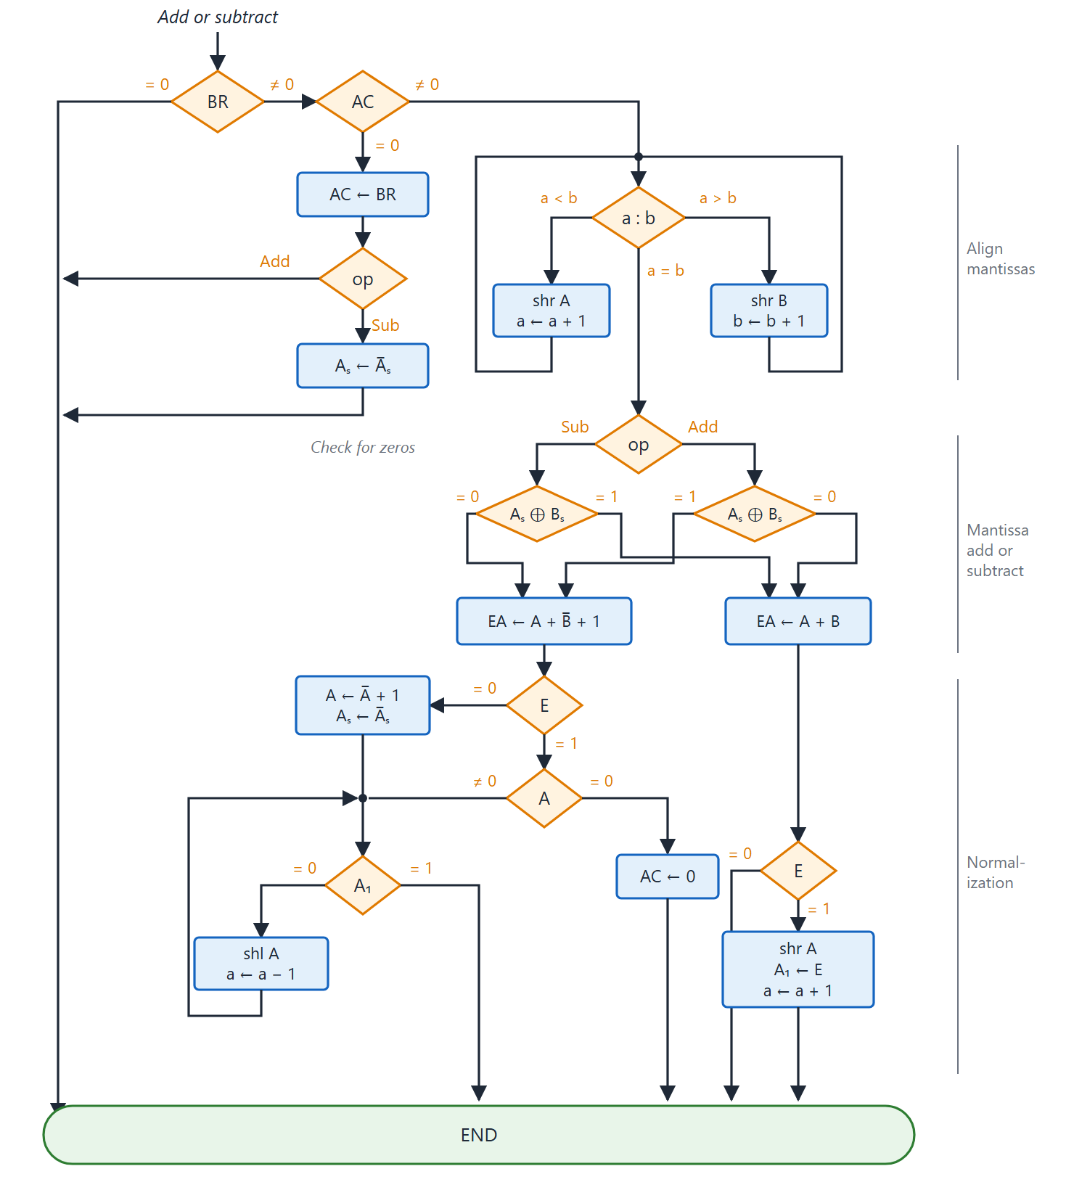
Addition and subtraction of floating-point numbers
Topic 4.12
Four phases: zero check, align, add or subtract, normalise
Align: shift the mantissa with the smaller exponent right (left shifts would lose precision)
Normalise: shift left and decrement the exponent until A₁ = 1
A carry E = 1 after addition: shift right once, increment the exponent
Addition and subtraction of floating-point numbers (four phases). Adapted from M. Morris Mano, Computer System Architecture, Fig. 10-15.
Notes:
The flowchart shows the four phases from top to bottom. The first phase checks for zeros, the second compares the exponents and aligns, the third adds or subtracts, and the fourth normalises the result.

Slide 92
Multiplication
Topic 4.12
No mantissa alignment is needed
1. Check for zeros: if either operand is zero, AC ← 0 and stop
2. Add exponents: a ← q, then a ← a + b; the sum carries double the bias, so subtract the bias: a ← a − bias
3. Multiply mantissas with the shift-and-add algorithm; the double-precision product is in AQ; only the single-precision part in AC is kept
4. Normalise: if A₁ = 0, shift AQ left and decrement the exponent once (at most one leading zero is possible); if A₁ = 1 it is already normalised
Notes:
Both inputs were normalised, so the product can have at most one leading zero. That is why at most one left shift is needed.

Slide 93
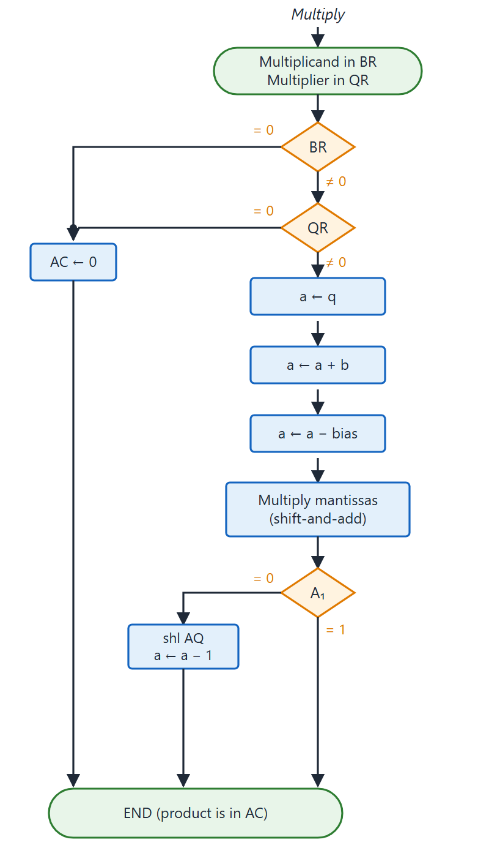
Floating-point multiplication
Topic 4.12
Exponents: a + b = true a + true b + 2 × bias
Subtracting one bias gives true a + true b + bias
Normalise: at most one left shift of AQ (check A₁)
No mantissa alignment is needed
Multiplication of floating-point numbers. Adapted from M. Morris Mano, Computer System Architecture, Fig. 10-16.
Notes:
Follow the flowchart: zero check, add the exponents and subtract the bias, multiply the mantissas, then normalise. The panel explains why the bias is subtracted once.

Slide 94
Division
Topic 4.12
1. Check for zeros: BR = 0 is divide by zero, so terminate with an error; AC = 0 gives zero: QR ← 0 and stop
2. Initialise: Q_{s} ← A_{s} ⊕ B_{s}, Q ← 0, SC ← n − 1
3. Align the dividend: EA ← A + B′ + 1; if E = 1 (A ≥ B), shift A right and increment a so that A < B; if E = 0, restore A. This prevents mantissa divide overflow
4. Subtract exponents: a ← a + b′ + 1; add the bias back and transfer to q
5. Divide mantissas by the division algorithm; since A < B the result is already normalised
Notes:
Dividend alignment guarantees that the mantissa quotient is a fraction less than 1. So division needs no separate normalisation step.

Slide 95
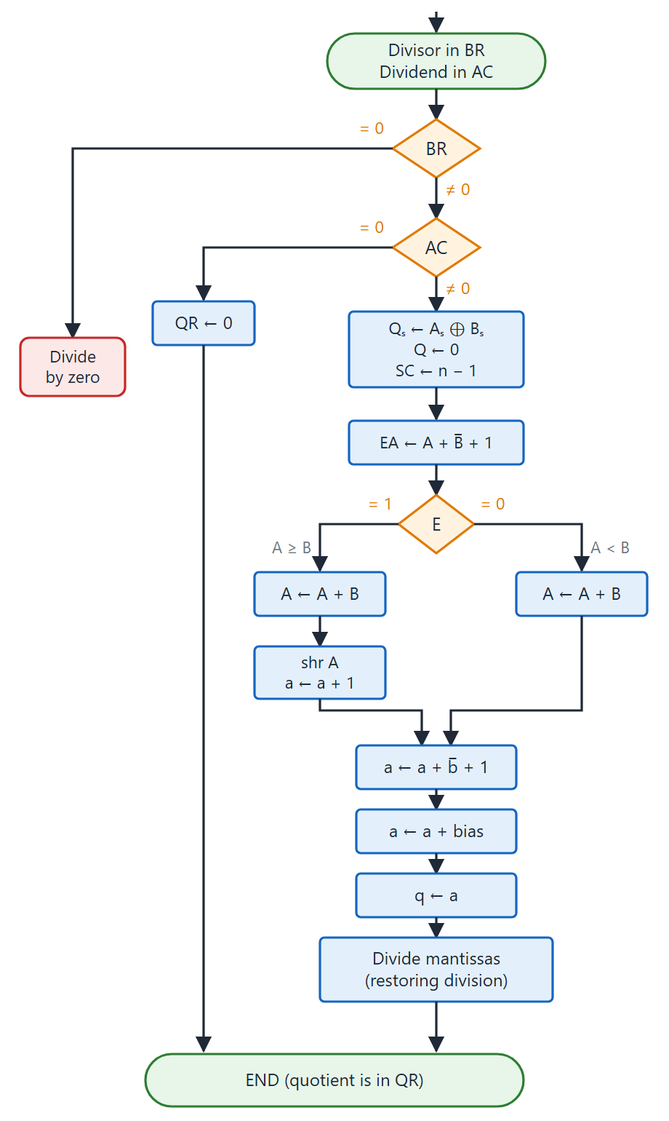
Floating-point division
Topic 4.12
Dividend alignment: if A ≥ B shift A right and increment a, so that A < B
Then the mantissa quotient is a fraction below 1, already normalised
Division is the only operation with no separate normalisation step
Subtract the exponents, add the bias back and transfer to q
Division of floating-point numbers. Adapted from M. Morris Mano, Computer System Architecture, Fig. 10-17.
Notes:
Follow the five steps in the flowchart. The dividend alignment step is the one that is special to division.

Slide 96
Summary: floating-point arithmetic operations
Topic 4.12
Operation | Exponent step | Mantissa step | Normalisation needed?
Add / Subtract | Compare; align smaller exponent | Add or subtract (signed-magnitude) | Yes: shift left until A₁ = 1, or shift right if overflow
Multiply | Add exponents; subtract bias | Multiply (shift-and-add); keep high half | At most one left shift (A₁ check)
Divide | Subtract exponents; add bias | Divide | No: dividend alignment guarantees a normalised result
Summary: floating-point arithmetic operations
Notes:
Use this table to compare the four operations. All four share the same registers BR, AC and QR and the same mantissa adder as fixed-point arithmetic.

Slide 97
Unit 4 summary (1 of 2)
4.1 Control memory: a ROM of microinstructions; the CAR addresses it; one microprogram per machine instruction
4.2 Address sequencing: increment, branch, map, call/return, chosen by the BR and CD fields
4.3 General registers: SELA, SELB, SELD and OPR form a 14-bit control word for one shared ALU
4.4 Stack: last-in, first-out with an SP; push and pop RTL; RPN is evaluated with a stack
4.5 Instruction formats: opcode, address and mode fields; fewer address fields give shorter instructions but longer programs
4.6 Addressing modes: nine rules for finding the operand through an effective address
Notes:
Recap the control and CPU topics. Ask students to explain one of the six in a single sentence.

Slide 98
Unit 4 summary (2 of 2)
4.7 Data transfer and manipulation: transfer, arithmetic, logic and shift instruction groups
4.8 Program control: branches, CALL/RET and interrupts, driven by the status bits C, S, Z and V
4.9 Addition and subtraction: one adder for both; add or subtract magnitudes by the signs; V = C₇ ⊕ C₈
4.10 Multiplication: shift-and-add, Booth’s algorithm for signed numbers, and the array multiplier
4.11 Division: shift left, trial subtract, restore; DVF flags divide overflow
4.12 Floating point: align exponents to add or subtract, add or subtract exponents to multiply or divide, then normalise
Key applications: stacks and RPN in compilers; relative addressing for position-independent code; microprogramming so one processor can emulate another
Notes:
Recap the arithmetic topics and finish with where these ideas are used. Leave time for questions.

