Slide 1
Unit 5: Input-Output and Memory Organization
5
Computer Organization and Architecture
CHANDRAS EDU
Never stop learning
Notes:
Welcome to Unit 5. We first study how the CPU communicates with peripherals: the I/O interface, modes of transfer, priority interrupts and DMA. Then we study memory organisation: hierarchy, main, auxiliary, associative and cache memory.

Slide 2
Agenda
5.1 Input-Output Interface
5.2 Modes of Transfer
5.3 Priority Interrupt
5.4 Direct Memory Access
5.5 Memory Hierarchy
5.6 Main Memory
5.7 Auxiliary Memory
5.8 Associative Memory
5.9 Cache Memory
Notes:
Nine topics. The first four are about input-output organization, and the last five are about memory organization.

Slide 3
5.1 Input-Output Interface
Topic 5.1
IN SIMPLE TERMS
An interface is a translator between the fast, electronic CPU and a slower, different peripheral. It holds the data, commands and status in its own registers so the two sides can work at their own speeds.
Notes:
Unit 5 starts with how the CPU talks to the outside world. Read the box aloud and ask what could go wrong if a fast CPU were wired directly to a slow printer.

Slide 4
Why an interface is needed
Topic 5.1
Peripherals differ from the CPU in four ways
Signal type: electromechanical or electromagnetic devices versus a purely electronic CPU
Speed: peripherals are far slower, so synchronisation is needed
Data codes: different word lengths or encoding, e.g. 7-bit ASCII in an 8-bit byte
Operating modes: each peripheral has its own command set
Each peripheral gets an interface unit between the CPU bus and the device controller
Notes:
Walk through the four differences one by one. The interface unit is the hardware that resolves all four so the CPU does not need to know device details.

Slide 5
The I/O bus and the four commands
Topic 5.1
A shared I/O bus carries data lines, address lines and control lines
Each interface monitors the address lines and activates when its own address appears
Control command: activates the peripheral and sets its mode (e.g. rewind tape)
Status command: reads the status register: ready or error?
Data output command: CPU data bus → interface buffer register
Data input command: interface buffer register → CPU data bus
Notes:
The CPU selects an interface and sends a function code on the control lines. The function code names one of the four commands.

Slide 6
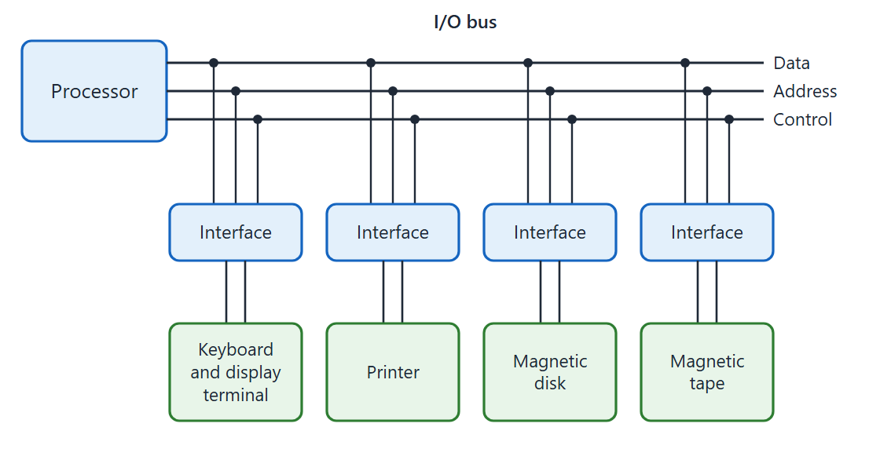
I/O bus and devices
Topic 5.1
Connection of I/O bus to input-output devices. Adapted from M. Morris Mano, Computer System Architecture, Fig. 11-1.
Notes:
Point out the shared data, address and control lines, and how each interface sits between the bus and its device. Only the interface whose address appears on the bus responds.

Slide 7
Isolated versus memory-mapped I/O
Topic 5.1
Isolated I/O: separate address spaces for memory and I/O
Dedicated I/O read and I/O write lines; the CPU uses IN/OUT instructions; addresses cannot clash
Memory-mapped I/O: interface registers occupy part of the memory address space
The CPU uses ordinary load and store instructions: more flexible, but less memory address range
Advantage: all memory-reference instructions (AND, OR, shift, compare…) can work directly on I/O data
Notes:
These are the two ways of giving addresses to interface registers. Ask students which one needs special I/O instructions.

Slide 8
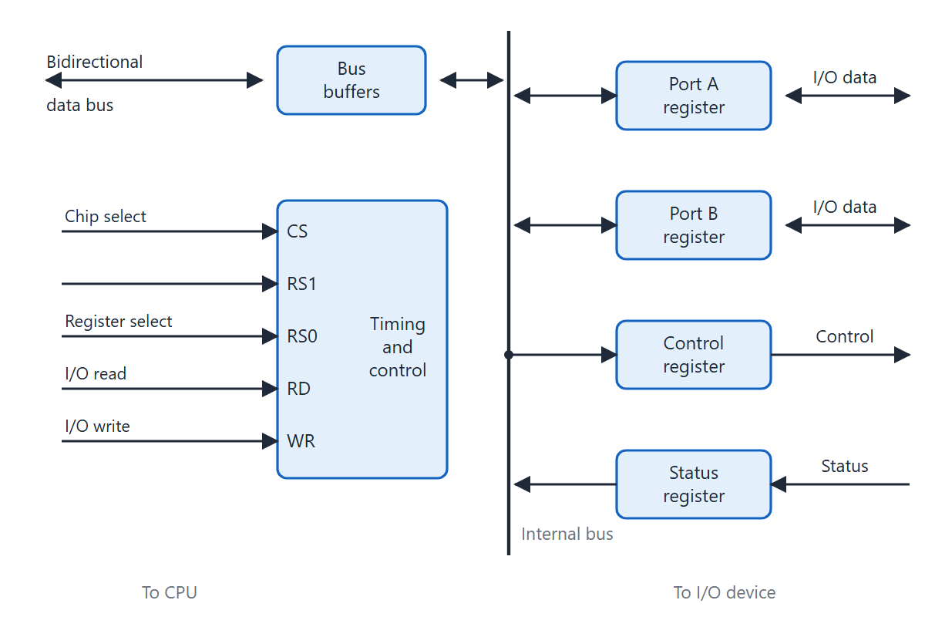
Interface unit registers
Topic 5.1
I/O interface unit registers and bus connections. Adapted from M. Morris Mano, Computer System Architecture, Fig. 11-2.
Notes:
The interface chip has two data registers (Port A and Port B), a control register and a status register, all reached through the bidirectional data bus. The CPU picks a register with chip select CS, register selects RS₁ and RS₀, and the read or write line.

Slide 9
Register selection
Topic 5.1
CS | RS₁ | RS₀ | Register selected
0 | × | × | None: data bus in high impedance
1 | 0 | 0 | Port A register
1 | 0 | 1 | Port B register
1 | 1 | 0 | Control register
1 | 1 | 1 | Status register
Register selection for the interface in the figure on the previous slide
Notes:
Read the table row by row. When CS = 0 no register is selected and the chip leaves the data bus alone.

Slide 10
5.2 Modes of Transfer
Topic 5.2
IN SIMPLE TERMS
There are three ways to move I/O data: the CPU keeps checking (programmed I/O), the device taps the CPU on the shoulder when ready (interrupt), or a DMA controller moves whole blocks while the CPU does other work.
Notes:
Once an interface exists, the CPU must decide how to coordinate data movement. Each of the three modes trades simplicity against CPU efficiency.

Slide 11
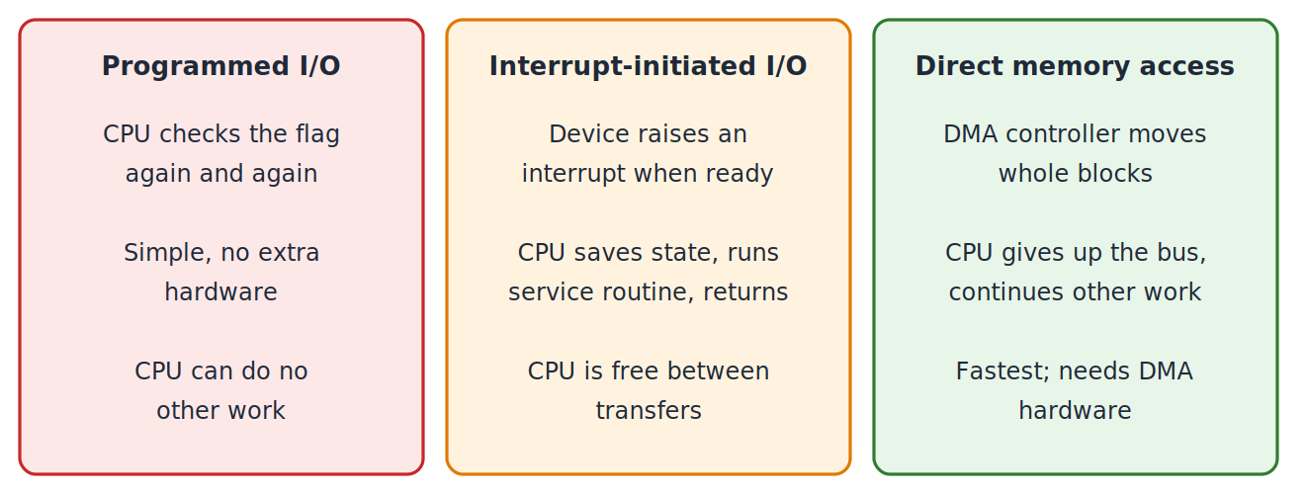
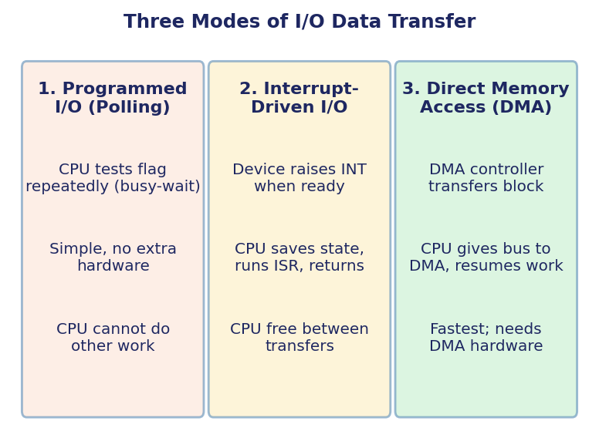
Three modes of I/O data transfer
Topic 5.2
The three modes of I/O data transfer — overview
Notes:
This overview shows all three modes side by side. Programmed I/O is simplest but ties up the CPU, interrupt-initiated I/O frees the CPU between transfers, and DMA is fastest but needs a DMA controller. Programmed I/O: the CPU polls the flag and waits. Interrupt-initiated I/O: the device interrupts when it is ready. DMA: a controller moves a whole block. CPU effort falls from the first mode to the third.

Slide 12
Mode 1: programmed I/O (polling)
Topic 5.2
The interface sets a flag bit F when a new byte is ready; the CPU does everything else
Step 1: read the status register
Step 2: if F = 0, go back to step 1 (busy-wait)
Step 3: when F = 1, read the data register, store the byte in memory, clear the flag
Efficiency problem: 1 byte per 10,000 µs and 1 poll per µs means 10,000 checks per byte, 9,999 wasted
Practical only for very fast devices or embedded systems with nothing else to do
Notes:
This is the polling loop. Work out the efficiency example on the board: the CPU checks the flag 10,000 times to get one byte.

Slide 13
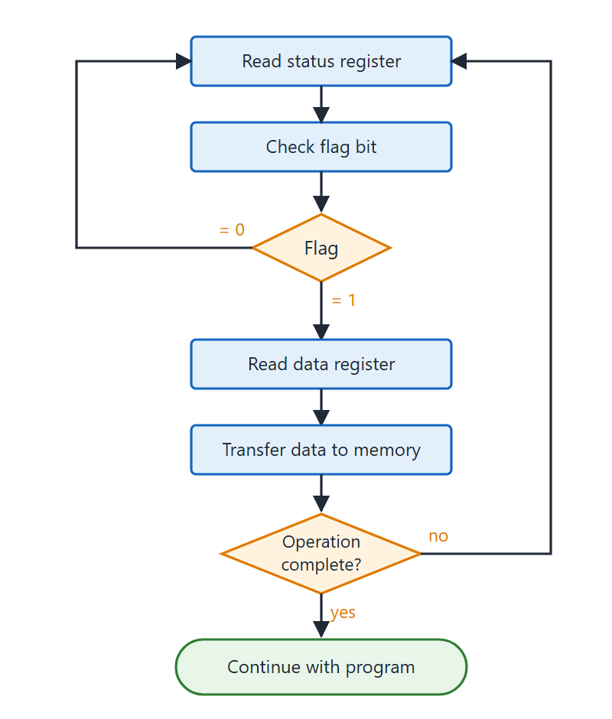
Programmed I/O flowchart
Topic 5.2
Read the status register
If F = 0, go back and read it again (busy-wait)
When F = 1, read the data register
Store the byte in memory and clear the flag
Flowchart for CPU program to input data (programmed I/O). Adapted from M. Morris Mano, Computer System Architecture, Fig. 11-11.
Notes:
Trace the loop: read the status, test the flag, repeat while F = 0, then read the data and store it. The boxes follow the program steps in the text.

Slide 14
Mode 2: interrupt-initiated I/O
Topic 5.2
The interface may interrupt the CPU when data is ready; the CPU runs its main program meanwhile
The interface asserts the interrupt line INT
At the end of the current instruction the CPU saves its PC on the stack and branches to the interrupt service routine (ISR)
The ISR reads the data register, stores the byte, clears the flag; the CPU then resumes
Non-vectored: fixed branch address; the CPU then polls devices to find the interrupter
Vectored: the device puts a vector (its ISR address or a pointer) on the data bus; no polling
Notes:
The CPU is free between transfers. Ask how the CPU finds out which device interrupted in each of the two approaches.

Slide 15
Mode 3: direct memory access (DMA)
Topic 5.2
For high-speed devices (disk, network) one interrupt per byte is too much overhead
A DMA controller handles the whole block
1. CPU programs the controller: start address, byte count, direction
2. CPU releases the bus and continues (if it has a cache or separate bus), or halts bus access briefly
3. Controller transfers the block: address +1, count −1 per byte
4. At count zero the controller interrupts the CPU
Notes:
DMA delegates the entire block transfer. The CPU only sets up the transfer and is interrupted once at the end.

Slide 16
Comparison of the three I/O transfer modes
Topic 5.2
Property | Programmed I/O | Interrupt-initiated | DMA
CPU during transfer | Busy-waiting (polls) | Runs other code; ISR on interrupt | Continues; DMA owns bus
Hardware needed | Interface only | Interface + interrupt logic | Interface + DMA controller
Transfer unit | 1 byte per poll | 1 byte per interrupt | Block (many bytes)
Suitable for | Slow/simple devices | Medium-speed devices | High-speed block devices
CPU efficiency | Lowest | Good | Highest
Notes:
Use this table to summarise the topic. Efficiency rises, and hardware needs rise, from left to right.

Slide 17
5.3 Priority Interrupt
Topic 5.3
IN SIMPLE TERMS
When several devices interrupt at once, the computer serves the most urgent first. The order is set either by a program checking devices in turn, by their position in a chain (daisy chain), or by a priority encoder.
Notes:
Any device can interrupt at any time, even at the same moment. This topic shows how the system decides who goes first.

Slide 18
The priority problem and software polling
Topic 5.3
Each device gets a priority; if several interrupt together, the highest is served first
Disks get high priority (a missed transfer can lose data); keyboards get low priority
Two approaches: software polling or hardware
Software polling: all devices share one interrupt line and one common service routine
The routine tests each device’s status flag, highest priority first; the first flag set is served
Simple and flexible, but slow when there are many devices
Notes:
In software polling the order of testing is the priority, so priority can be changed just by editing the program. The cost is time, since every device above the winner must be tested first.

Slide 19
Hardware priority: daisy chain
Topic 5.3
Devices form a serial chain; each has Priority In (PI) and Priority Out (PO)
The CPU sends INTACK into Device 1 at its PI
A device with no pending interrupt passes it on: its PO feeds the next PI
The first device with a pending interrupt intercepts INTACK: PO = 0 and it puts its vector address (VAD) on the data bus
The CPU reads VAD and jumps to that service routine
Priority is by position: closest to the CPU is highest
Notes:
Walk the INTACK signal down the chain on the board. Stress that priority is decided by physical position.

Slide 20
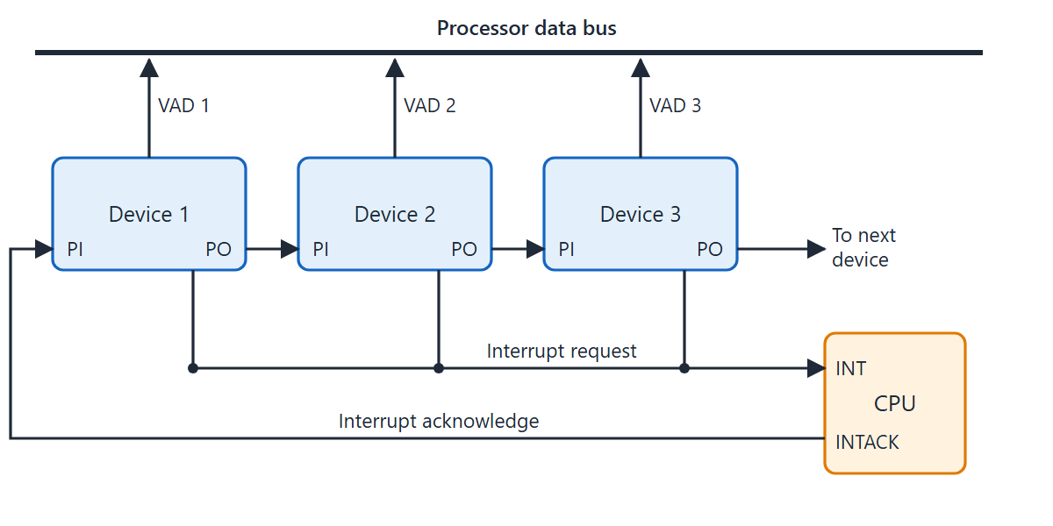
Daisy-chain priority interrupt
Topic 5.3
Daisy-chain priority interrupt (three devices). Adapted from M. Morris Mano, Computer System Architecture, Fig. 11-12.
Notes:
Follow INTACK from the CPU through PI and PO of each device. Each stage has a request flip-flop RF that is set by the device’s interrupt request.

Slide 21
One daisy-chain stage
Topic 5.3
RF is the request flip-flop, set by the device’s interrupt request.
PI | RF | PO | VAD
0 | any | 0 | Disabled: INTACK blocked
1 | 0 | 1 | Disabled: INTACK passed on
1 | 1 | 0 | Enabled: this device is served
Notes:
The three rows are the whole logic of one stage. With PI = 1 and RF = 1 the device blocks INTACK and places its VAD on the bus.

Slide 22
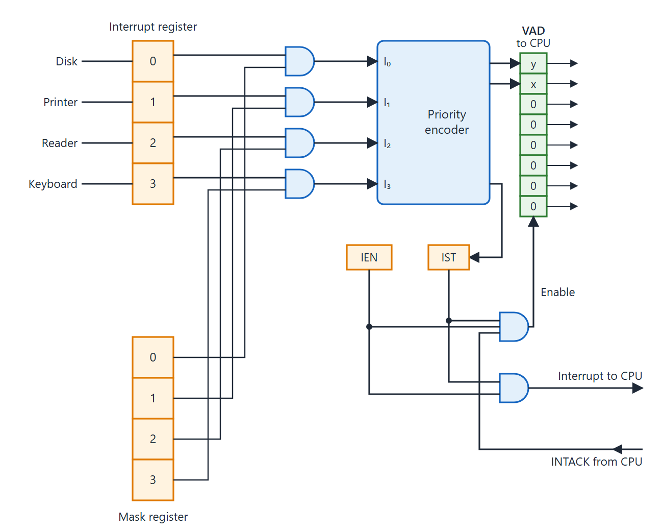
Parallel priority interrupt hardware
Topic 5.3
Four devices: disk, printer, reader, keyboard (priority 0 to 3)
Each interrupt bit is ANDed with its mask bit
The priority encoder outputs two bits, x and y, which form part of the vector address (VAD) of the highest-priority device
I₀ (disk) has the highest priority
Priority interrupt hardware (interrupt register, mask register, priority encoder). Adapted from M. Morris Mano, Computer System Architecture, Fig. 11-14.
Notes:
This is the parallel method for four devices: disk, printer, reader, keyboard, with priority 0 to 3. Each device has its own wire to the central controller, which makes priority resolution faster.

Slide 23
Parallel method: components
Topic 5.3
Interrupt register: one bit per device, set by its request, cleared by program
Mask register: one bit per device, set or cleared by program; masked (0) devices are ignored
Priority encoder: takes I₀–I₃ and gives a 2-bit VAD for the highest-priority active device
IST (interrupt status flip-flop): set when any unmasked interrupt is active
IEN (interrupt enable): global switch; IST AND IEN = interrupt to the CPU
INTACK from the CPU enables the VAD buffers so the winner’s address reaches the data bus
Notes:
The mask register lets software switch individual sources on or off without changing any hardware. IEN switches all of them at once.

Slide 24
5.4 Direct Memory Access
Topic 5.4
IN SIMPLE TERMS
Instead of the CPU carrying every byte between a fast device and memory, a DMA controller borrows the memory bus and moves the data itself. The CPU only sets it up at the start and gets one interrupt at the end.
Notes:
DMA removes the CPU from the data path for block transfers. Keep the three registers AR, WC and control/status in mind throughout this topic.

Slide 25
The DMA idea and its registers
Topic 5.4
In programmed and interrupt-initiated I/O every word flows through the CPU, a bottleneck for fast devices
The DMA controller takes temporary ownership of the memory bus; data flows directly between device and memory
Address Register (AR): starting memory address; +1 after each word
Word Count Register (WC): words to transfer; −1 after each word; at zero the CPU is interrupted
Control/Status Register: direction and start command in; done and error status out
Notes:
The CPU initialises all three registers, issues a start command and returns to its own program. The controller takes over from there, and the CPU is interrupted only once at the end.

Slide 26
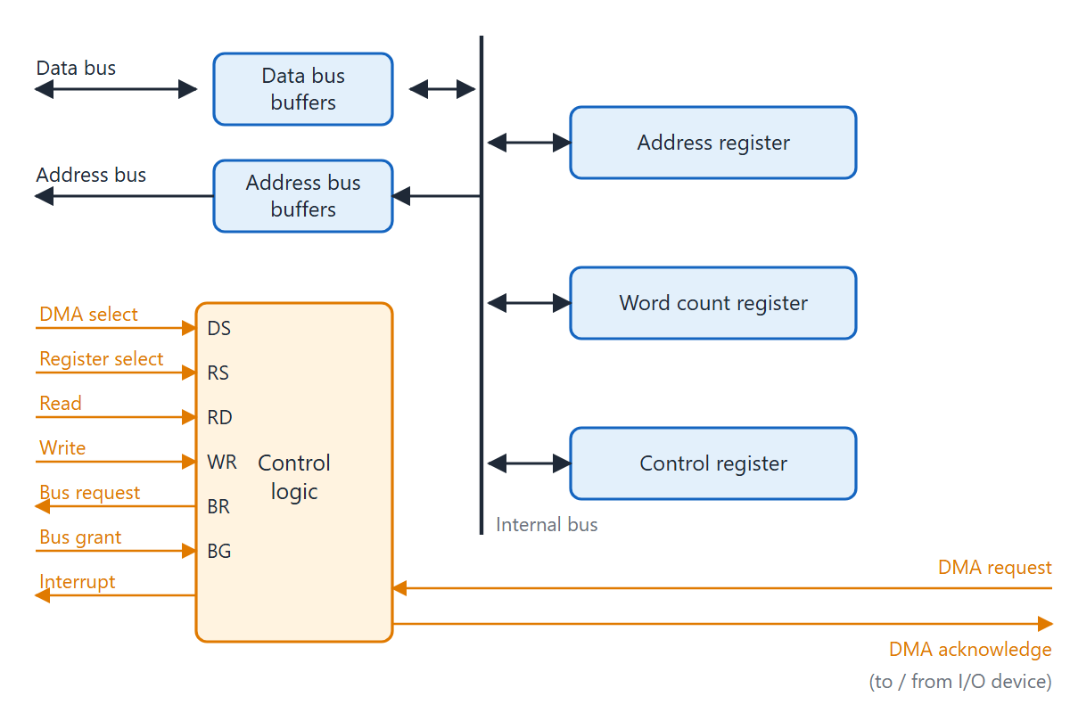
DMA controller
Topic 5.4
Block diagram of DMA controller. Adapted from M. Morris Mano, Computer System Architecture, Fig. 11-18.
Notes:
The controller sits between the memory bus and the I/O bus. The CPU selects it with the DMA select DS and register select RS inputs, like any interface. It talks to the device through two lines: DMA request (device is ready) and DMA acknowledge (controller is transferring).

Slide 27
Bus request and bus grant
Topic 5.4
The DMA controller and the CPU share the memory bus
Bus Request (BR): the controller asks for the bus
Bus Grant (BG): the CPU answers after finishing its current bus cycle
While BG is active the CPU puts its address, data and read/write lines in high impedance
The controller transfers, then releases the bus; the CPU resumes normal operation
Notes:
BR and BG form the handshake that hands the bus from CPU to DMA and back. High impedance means the CPU disconnects from the bus electrically.

Slide 28
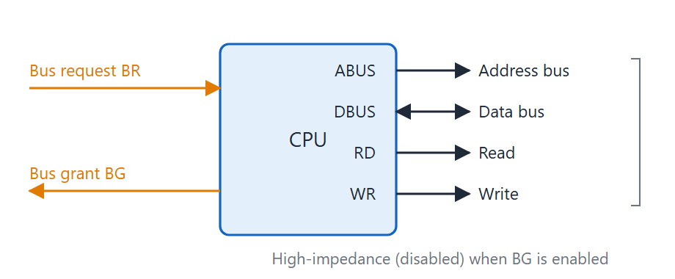
CPU bus signals for DMA
Topic 5.4
CPU bus signals for DMA transfer. Adapted from M. Morris Mano, Computer System Architecture, Fig. 11-17.
Notes:
Show BR going active, BG answering, and the CPU bus lines going to high impedance while the DMA controller drives them. The CPU resumes when the controller releases the bus.

Slide 29
Burst transfer and cycle stealing
Topic 5.4
Burst transfer: the controller keeps the bus for a whole block in one go; fast, used for fast devices such as disks
Cycle stealing: the controller takes the bus for one word at a time and gives it back
Cycle stealing is the most common method: one stolen bus cycle per word
Effect on the CPU: slightly slowed (held off the bus for one cycle per steal) but it keeps executing between steals
Far more efficient than interrupt-initiated I/O for large blocks
Notes:
The CPU is held off the bus only for the stolen cycle. Between steals it continues executing instructions.

Slide 30
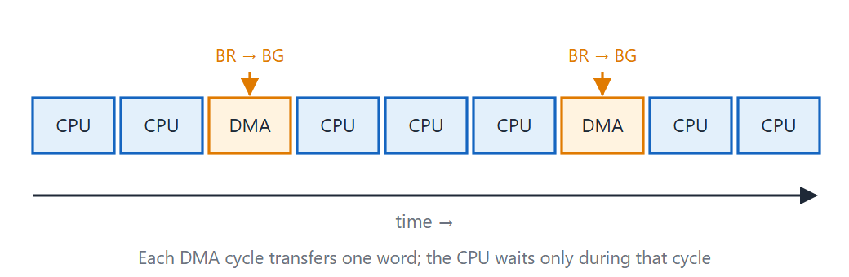
DMA cycle stealing
Topic 5.4
DMA cycle stealing — one bus cycle is stolen per word transferred
Notes:
Each stolen bus cycle moves exactly one word. Between the stolen cycles the CPU uses the bus as normal.

Slide 31
Sequence for each stolen cycle
Topic 5.4
1. The DMA controller asserts BR
2. The CPU finishes its current bus cycle and asserts BG
3. The controller transfers one word (address from AR, data to or from the device)
4. The controller increments AR, decrements WC and releases the bus
5. The CPU resumes; if WC ≠ 0, repeat from step 1 after the next device-ready signal
Notes:
Ask students to trace the five steps for a block of three words. WC reaches zero after the third pass.

Slide 32
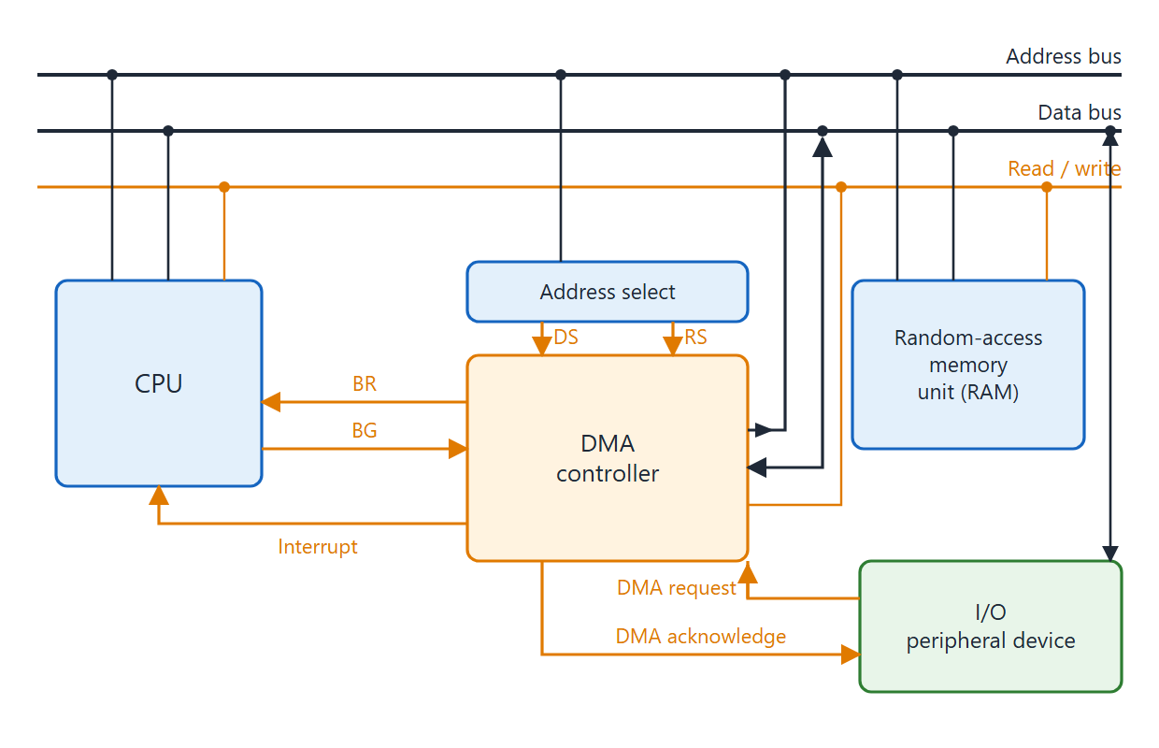
DMA transfer in a computer system
Topic 5.4
DMA transfer in a computer system. Adapted from M. Morris Mano, Computer System Architecture, Fig. 11-19.
Notes:
Summary of a whole transfer. First the CPU writes the start address to AR, the word count to WC and the direction to the control register, then issues the start command. The CPU continues with its own program while the DMA transfers one stolen cycle per word: BR, BG, transfer, increment AR, decrement WC, release the bus. When WC = 0 the controller asserts an interrupt, and the CPU checks the status register and handles any errors.

Slide 33
DMA compared with the other modes
Topic 5.4
Property | Programmed I/O | Interrupt-initiated | DMA
CPU during transfer | Busy-wait (polling) | Runs other code; ISR per byte | Runs other code; 1 interrupt total
Transfer unit | 1 byte per poll | 1 byte per interrupt | Block (many bytes)
CPU involvement | Every byte | Every byte (ISR) | Initialise + completion only
Hardware needed | Interface only | Interface + interrupt logic | Interface + DMA controller
Best for | Slow/simple devices | Medium-speed devices | High-speed block devices (disk, network)
Comparison of the three I/O transfer modes
Notes:
DMA needs the CPU only at the start and at the end. That is why it is essential for disk and network I/O.

Slide 34
5.5 Memory Hierarchy
Topic 5.5
IN SIMPLE TERMS
Fast memory is expensive and small; cheap memory is slow and large. Computers combine several kinds (registers, cache, main memory, disk, tape) and keep the data needed right now in the fastest levels.
Notes:
No single memory type gives unlimited size, zero delay and zero cost. The hierarchy mixes several types to get a good balance.

Slide 35
Why a hierarchy
Topic 5.5
No single technology gives unlimited capacity, zero access time and zero cost
A memory hierarchy uses several levels, each faster and costlier than the one below
Going up: speed and cost per bit rise; practical capacity falls
Goal: the impression of fast, large, cheap memory
Keep the most-used data in the fast levels and the rest in slower ones
Notes:
The reason for the hierarchy is economics. Ask why we do not simply build everything from the fastest memory.

Slide 36
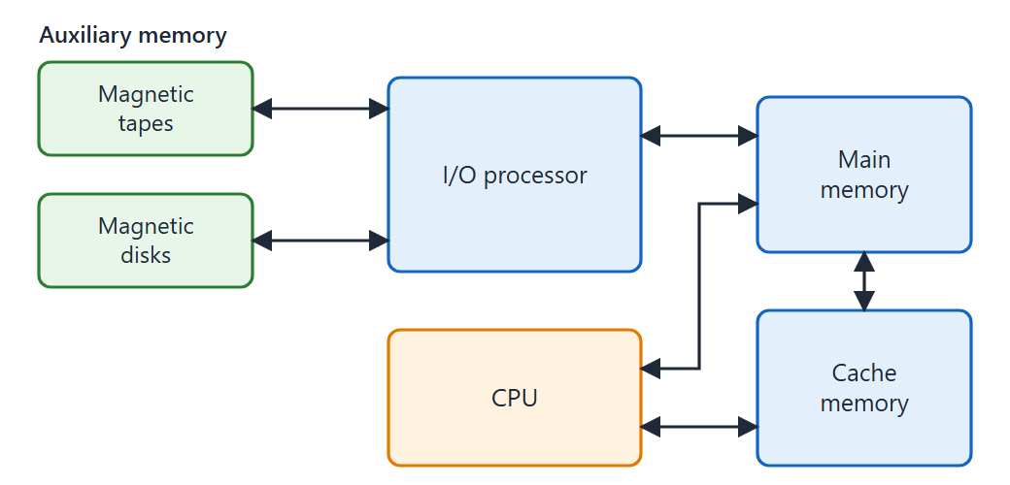
Memory hierarchy
Topic 5.5
Memory hierarchy in a computer system. Adapted from M. Morris Mano, Computer System Architecture, Fig. 12-1.
Notes:
Read the figure from the slowest, cheapest, largest level at the bottom to the fastest, costliest, smallest level at the top. The I/O processor links auxiliary memory to main memory.

Slide 37
The five levels
Topic 5.5
Magnetic tape: removable, sequential, very large, very slow; archival and backup
Magnetic disk: random access, large, slower than main memory; primary auxiliary storage
Main memory (RAM/ROM): directly accessed by the CPU; ~100–700 ns
Cache memory: very small and fast (~10–100 ns); holds the active parts of programs and data
CPU registers: fastest; a few words inside the processor; one clock cycle
Notes:
Go from bottom to top. Each level holds a copy of what is currently needed from the level below.

Slide 38
Typical characteristics at each level
Topic 5.5
Level | Typical access time | Relative cost/bit | Capacity
CPU registers | 1 clock cycle (<1 ns) | Highest | Bytes
Cache memory | ~10–100 ns | High | KB – MB
Main memory | ~100–700 ns | Medium | MB – GB
Magnetic disk | ~5–20 ms | Low | GB – TB
Magnetic tape | Seconds (sequential) | Lowest | TB+
Typical characteristics at each hierarchy level
Notes:
Read down the columns: access time grows, cost per bit falls and capacity grows as we go down the hierarchy. This is why only a small amount of the fastest memory is used.

Slide 39
Cache and the access-time ratios
Topic 5.5
Cache is about 7× faster than main memory (100 ns versus 700 ns)
Auxiliary memory (disk) is about 1000× slower than main memory
Block sizes: auxiliary memory 256–2048 words; cache 1–16 words
Cache sits between CPU and main memory; the CPU looks there first
Hit: data found, obtained quickly. Miss: fetched from main memory, often a whole block
This works because of locality of reference: programs reuse recently used locations
Notes:
These ratios explain why a cache pays off. Cache mapping is covered in detail in the last topic of this unit.

Slide 40
Auxiliary memory, IOP and multiprogramming
Topic 5.5
The CPU cannot access auxiliary memory directly; the I/O processor (IOP) moves data using DMA
The CPU asks the IOP for data, then continues with another task
The IOP interrupts the CPU when the transfer is done
Multiprogramming: several programs at different levels at once: one running (using cache), others in main memory, others on disk
The memory management system (software + hardware) moves programs between levels
This keeps the CPU, IOP and I/O devices all busy
Notes:
Multiprogramming maximises throughput. While one program waits for the disk, another one runs.

Slide 41
5.6 Main Memory
Topic 5.6
IN SIMPLE TERMS
Main memory is built from RAM chips (read and write, lost at power-off) and ROM chips (read-only, kept at power-off). The address decides which chip answers: low address bits pick a byte inside a chip, high bits pick the chip.
Notes:
Main memory talks directly to the CPU. It is made of semiconductor chips, mainly RAM and ROM.

Slide 42
RAM: random access memory
Topic 5.6
Most of main memory is RAM, in two technologies
Static RAM (SRAM): each bit in a flip-flop; stable while powered; faster, more silicon per bit
Dynamic RAM (DRAM): each bit as charge on a MOS capacitor; must be refreshed every few ms; higher density, lower power per bit
RAM is volatile: contents are lost at power-off
Used for programs and data that change while the computer runs
Notes:
SRAM is simple and fast; DRAM is denser but needs refresh circuitry. Both lose their data when power is removed.

Slide 43
ROM: read-only memory
Topic 5.6
ROM is non-volatile: it keeps its contents when power is off
It holds programs that must always be present: the bootstrap loader, firmware, constant tables
At power-on the CPU sets its PC to the bootstrap loader address
The bootstrap loads the OS from disk into RAM, then hands control to the OS
Notes:
Ask what would happen at power-on if all of main memory were RAM. Nothing would be there to start the system.

Slide 44
RAM and ROM chip structure
Topic 5.6
A RAM chip has a cell array, a bidirectional data bus, and address, read and write inputs
Chip selects: CS₁ and CS₂′; the chip is active only when CS₁ = 1 and CS₂′ = 0
Three-state bus buffers let several chips share one data bus
A ROM chip is organised similarly but has no WR input: its data bus is output-only
For the same chip area a ROM can hold more bits than a RAM, because its cells are simpler
Notes:
The figure on the next slide shows both chips. Notice the select inputs and the three-state buffers.

Slide 45
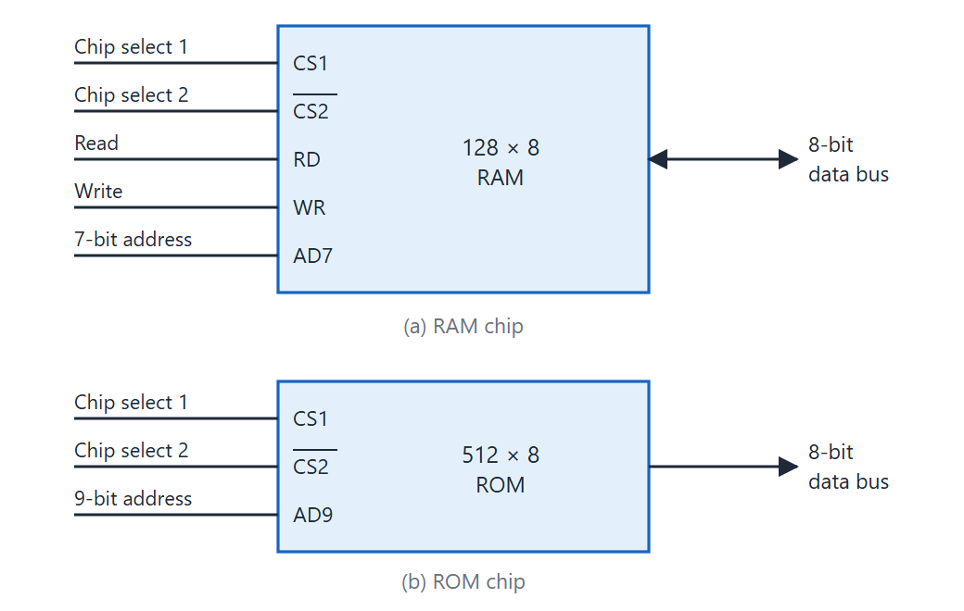
RAM and ROM chips
Topic 5.6
Typical RAM and ROM chips. Adapted from M. Morris Mano, Computer System Architecture, Figs. 12-2 and 12-3.
Notes:
Left: a typical RAM chip with CS₁, CS₂′, RD, WR and the address input. Right: a ROM chip, which has no WR input.

Slide 46
Memory address map
Topic 5.6
Example: a 1 KB memory from four 128×8 RAM chips and one 512×8 ROM chip.
Component | Hex address range | A₉–A₈ | A₁₀
RAM 1 | 0000–007F | 00 | 0
RAM 2 | 0080–00FF | 01 | 0
RAM 3 | 0100–017F | 10 | 0
RAM 4 | 0180–01FF | 11 | 0
ROM | 0200–03FF | xx | 1
Memory address map for microcomputer example. Adapted from M. Morris Mano, Computer System Architecture, Table 12-1.
Notes:
The designer gives each chip its own address range. No two ranges overlap, so every address selects exactly one chip.

Slide 47
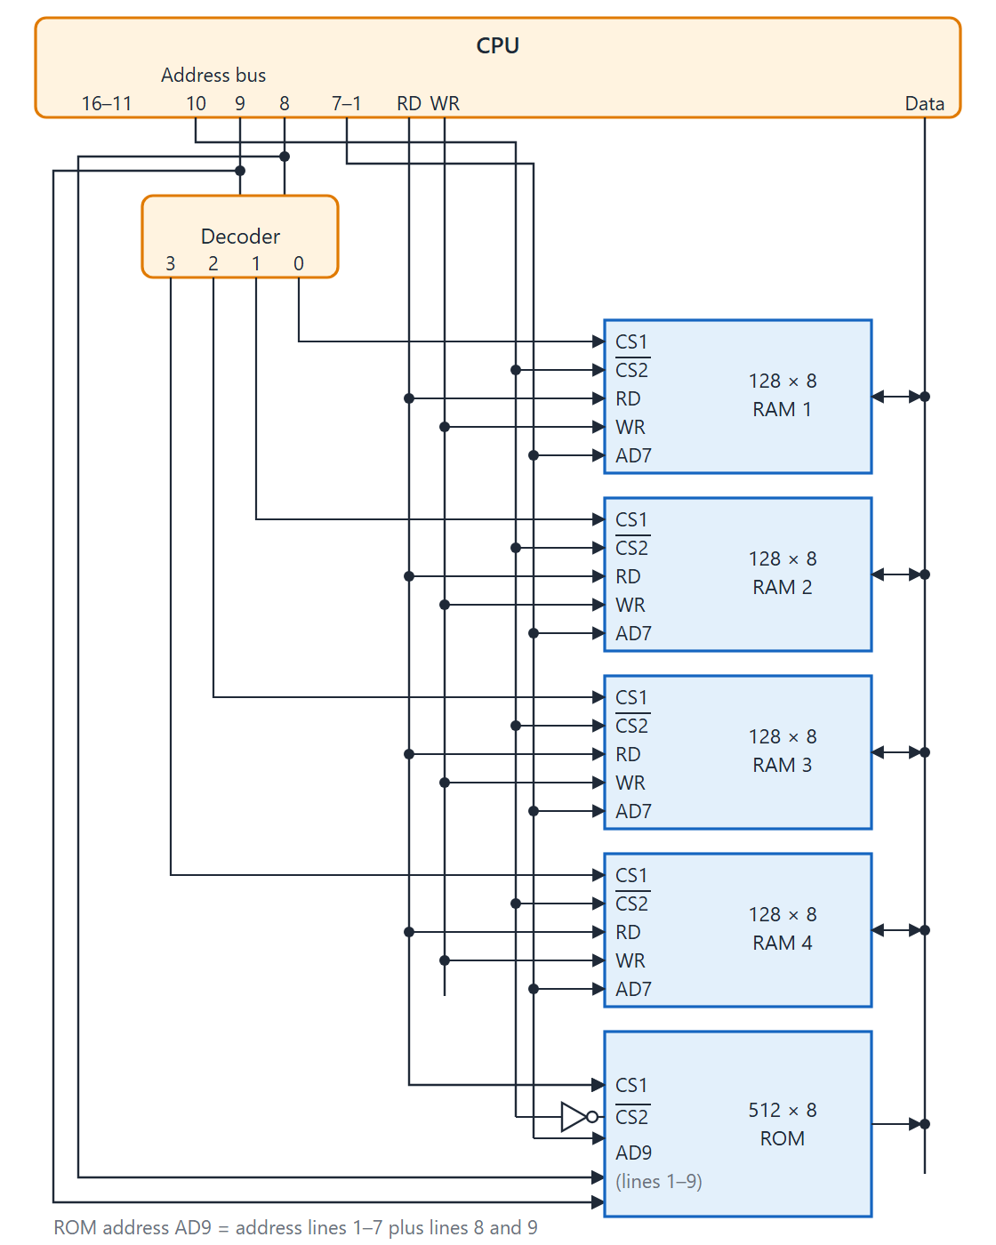
Memory connection to the CPU
Topic 5.6
Low-order lines A₁–A₇ select one of 128 bytes inside each RAM chip
A 2 × 4 decoder on A₈ and A₉ picks one RAM chip when A₁₀ = 0
A₁₀ = 1 enables the ROM
Design rule: exactly one chip selected, all others in high impedance
Memory connection to the CPU. Adapted from M. Morris Mano, Computer System Architecture, Fig. 12-4.
Notes:
All chips share the same bidirectional 8-bit data bus. Three-state buffers make sure only the selected chip drives the bus at any time.

Slide 48
5.7 Auxiliary Memory
Topic 5.7
IN SIMPLE TERMS
Auxiliary memory (disk, tape) stores everything not needed right now. It is cheap and huge but slow, because a head must first move to the right place, so data is always moved in large blocks.
Notes:
Auxiliary memory trades speed for capacity and low cost. The CPU does not address it directly.

Slide 49
General characteristics
Topic 5.7
Holds programs and data not needed right now: large, low cost, slow
Five parameters: access mode, access time, transfer rate, capacity, cost
Seek time: positioning the head over the right track; the dominant part, usually several ms
Transfer time: reading or writing once the head is in place
Seek time ≫ transfer time, so data is organised in records
Reads and writes use complete records, to spread the seek overhead
Notes:
Access time for a mechanical device has two parts. Because seeking dominates, we move data in blocks rather than byte by byte.

Slide 50
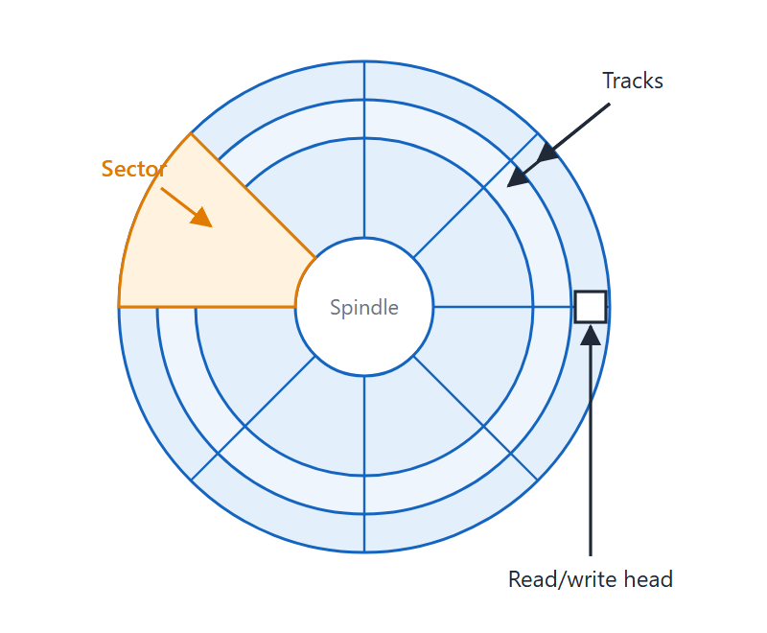
Magnetic disk
Topic 5.7
Data is stored along concentric tracks
Each track is divided into sectors, the smallest unit transferred
A disk is addressed by disk number, surface, sector number and track
Seek moves the head; rotational latency waits for the sector
Magnetic disk: concentric tracks divided into sectors. Adapted from M. Morris Mano, Computer System Architecture, Fig. 12-5.
Notes:
A disk is a circular plate coated with magnetic material. Data is stored as magnetic spots along concentric tracks, and each track is divided into sectors. After the head seeks to the right track, the system waits for the correct sector to come under the head (rotational latency) and then transfers the data.

Slide 51
Hard disks and floppy disks
Topic 5.7
Hard disks: permanently attached, metal surfaces, high speed and capacity
One movable head per surface is cheaper; one head per track is faster but costlier
Floppy disks: removable, flexible plastic coated with magnetic material
Two standard sizes: 5.25-inch and 3.5-inch
Used for software distribution and small data files
Notes:
Two types of disk unit exist. The main difference for students to remember is permanent versus removable.

Slide 52
Magnetic tape
Topic 5.7
A strip of plastic coated with magnetic material
Bits are recorded across 7 or 9 parallel tracks, one character per column; one head per track
Access is sequential: data only in the order stored
A drive cannot stop and start between characters, so data is grouped in records separated by blank inter-record gaps
The tape stops in a gap and speeds up before the next record
Each record has an identification pattern at its start and end
Notes:
Tape is sequential: to reach a record you must wind to it. The gaps give the tape room to stop and reach full speed.

Slide 53
Magnetic disk compared with tape
Topic 5.7
Key difference: a disk gives random access to any sector; a tape gives sequential access only.
Property | Magnetic disk | Magnetic tape
Access mode | Random (sector addressable) | Sequential only
Access time | Seek + rotational latency (ms) | Must wind to correct record (seconds)
Transfer unit | Sector | Record
Typical use | Active programs and data, OS | Backup, archival, removable storage
Removable? | Floppy yes; hard disk no | Yes
Comparison of magnetic disk and tape
Notes:
Disk is used for online active data and tape for archival backup and offline storage. Seek time and winding time explain the access-time row.

Slide 54
5.8 Associative Memory
Topic 5.8
IN SIMPLE TERMS
A normal memory is asked “what is at address 25?”. An associative memory is asked “where is the word that looks like this?” and checks every word at the same time.
Notes:
Many tasks need a table search. Ordinary RAM searches one word at a time, associative memory searches all words together.

Slide 55
Basic concept
Topic 5.8
Many tasks search a table: a symbol table, an account number, a cache block
Ordinary RAM searches sequentially, one word at a time
Associative memory (content-addressable memory, CAM) searches all words at once in hardware
You supply a data pattern (the argument), not an address; every stored word is compared in parallel
Matching words are flagged in the match register; read by addressing only those words
Costlier per bit than RAM; used where search time is critical: cache tag arrays, TLBs
Notes:
The key idea: the memory is addressed by content, not by address. Every cell has its own comparison logic, which is why it costs more.

Slide 56
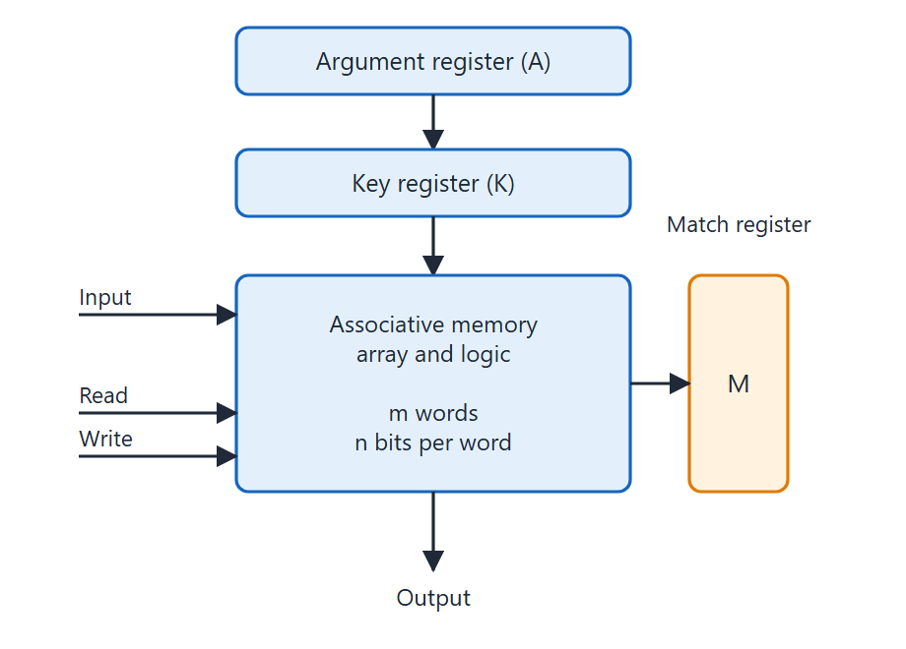
Associative memory block diagram
Topic 5.8
Argument register A (n bits) holds the search pattern
Key register K (n bits) is a mask: K_{j} = 1 compares bit j, K_{j} = 0 ignores it
Memory array: m words × n bits of CAM cells
Match register M (m bits): M_{i} = 1 if word i matched all unmasked bits
Block diagram of associative memory. Adapted from M. Morris Mano, Computer System Architecture, Fig. 12-6.
Notes:
Show the four parts: argument register A, key register K, the memory array and the match register M. The match register has one bit per stored word.

Slide 57
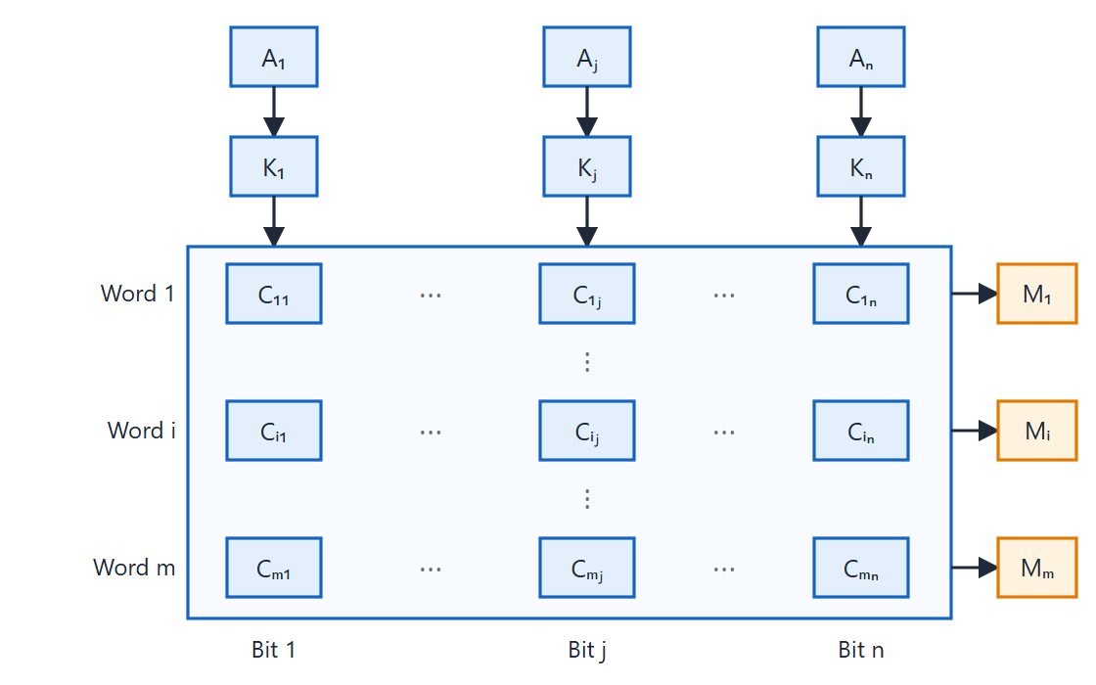
Associative memory cell array
Topic 5.8
Associative memory of m words, n cells per word. Adapted from M. Morris Mano, Computer System Architecture, Fig. 12-7.
Notes:
The array has m words of n cells each. Cell Cᵢⱼ stores bit j of word i. Each row of cells produces one bit Mᵢ of the match register, and all n cells in a row contribute to a single AND result.

Slide 58
Cell logic and match equations
Topic 5.8
x_{j} = A_{j}F_{ij} + A_{j}′F_{ij}′
term_{j} = x_{j} + K_{j}′
M_{i} = (x₁ + K₁′)(x₂ + K₂′) ⋯ (x_{n} + K_{n}′)
Cell C_{ij} has a flip-flop F_{ij} for storage, plus read, write and match circuitry
x_{j} = 1 if A_{j} equals F_{ij}; otherwise 0
If K_{j} = 0 then K_{j}′ = 1, so term_{j} = 1 and bit j is ignored
Word i matches if and only if all n terms equal 1
Notes:
The match logic compares the argument bit with the stored bit only when its key bit is 1. The product of all terms gives the match bit for the word.

Slide 59
Worked example: three-bit match
Topic 5.8
A = 101 111100 and K = 111 000000: only the three leftmost bits are compared (K_{j} = 1 for j = 1, 2, 3).
Word | Stored bits | Three-bit match? | M_{i}
Word 1 | 100 111100 | 100 ≠ 101: no match | 0
Word 2 | 101 000001 | 101 = 101: match | 1
Notes:
The key register hides the six rightmost bits, so only the first three bits decide the match. Word 2 matches and Word 1 does not.

Slide 60
Read and write operations
Topic 5.8
Read: after a search, M shows which words matched
If exactly one word matched, its data goes to the output automatically
If several matched, they are read one at a time by applying a read signal to each matched word line
Write: address each location in turn (acting as a RAM), or scan the tag register for an unused location (tag bit = 0) and write there
Notes:
Read follows a search. Write can either use ordinary addressing or find a free slot using the tag bits.

Slide 61
5.9 Cache Memory
Topic 5.9
IN SIMPLE TERMS
A cache keeps copies of recently used words in a small, fast memory next to the CPU. Because programs reuse the same instructions and data again and again, most requests are found in the cache.
Notes:
Cache is a small, fast memory between the CPU and main memory that cuts the average access time. It works because of locality of reference.

Slide 62
Locality of reference
Topic 5.9
Over a short interval, memory accesses stay in a small, localised region
Instruction loops: the same instructions are fetched repeatedly
Subroutine calls: a subroutine’s instructions sit in one address range
Array and table accesses: data in contiguous or nearby locations
Hit: the word is already in the cache
Miss: fetch from main memory and load a block of adjacent words
Notes:
These three habits of programs are why a small cache catches most requests. The block of adjacent words prepares for the next accesses.

Slide 63
Hit ratio and average access time
Topic 5.9
h = hits / (hits + misses)
T_{avg} = h · T_{c} + (1 − h) · (T_{c} + T_{m})
T_{c} is the cache access time; T_{m} is the main memory access time
On a miss the cache is checked first, so a miss costs T_{c} + T_{m}
Hit ratios of 0.9 and higher are common
Notes:
The formula weights the hit time and the miss time by how often each happens. The next slide works one example.

Slide 64
Worked example: average access time
Topic 5.9
T_{c} = 100 ns, T_{m} = 1000 ns, h = 0.9
Miss cost = T_{c} + T_{m} = 1100 ns
T_{avg} = 0.9 × 100 + 0.1 × 1100 = 200 ns
Main memory alone takes 1000 ns
With the cache the average is 200 ns: five times faster
Notes:
Work through the three steps on the board. Then ask what happens to the average time if the hit ratio drops to 0.5.

Slide 65
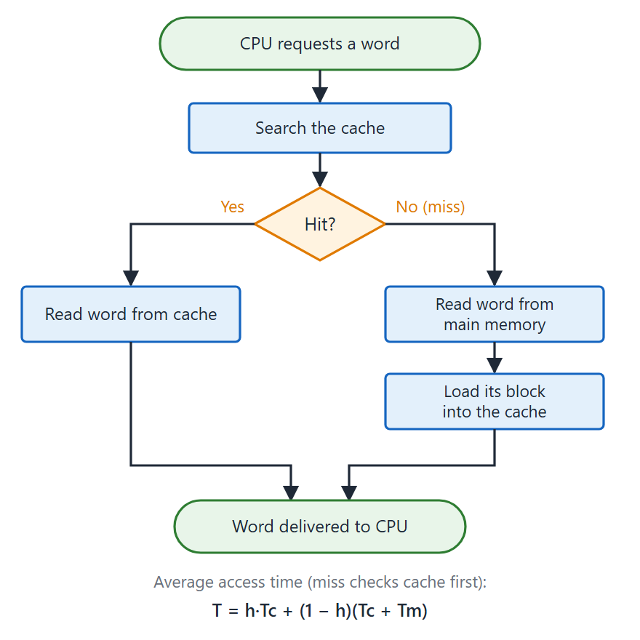
Cache hit and miss
Topic 5.9
Hit: the requested word is in the cache
Miss: fetch it from main memory, loading a block of adjacent words
Hit ratio h = hits / (hits + misses)
Hit ratios of 0.9 and higher are common
Cache hit / miss operation and hit ratio formula
Notes:
On a hit the word comes from the cache. On a miss it is fetched from main memory. The figure also shows the hit ratio formula.

Slide 66
Mapping method 1: associative
Topic 5.9
The mapping decides where a main memory block lives in the cache and where to look for it
Example used: 32K × 12 main memory, 512 × 12 cache, 15-bit CPU address
Advantage: any block can go to any cache location: no conflict misses
Disadvantage: the associative search hardware is expensive; suited only to small caches
Notes:
The associative cache is built from an associative memory, as in the previous topic. The next slide shows it with octal numbers.

Slide 67
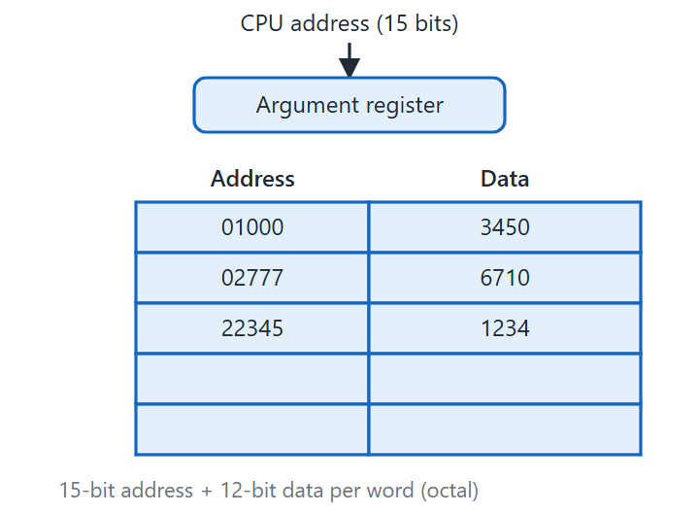
Associative mapping cache
Topic 5.9
The cache stores the full 15-bit address and the 12-bit data word together
The CPU address is searched against all entries at once
A match is a hit and the data is returned
All numbers are in octal
Associative mapping cache (all numbers in octal). Adapted from M. Morris Mano, Computer System Architecture, Fig. 12-11.
Notes:
Associative mapping cache with all numbers in octal. The address is stored together with the data, and the CPU address is compared with every stored address at once.

Slide 68
Mapping method 2: direct
Topic 5.9
The 15-bit address splits into a tag field (6 bits) and an index field (9 bits)
The index selects one of 512 cache lines
The tag stored there is compared with the address tag to confirm a hit
Advantage: fast; no search, only one tag comparison
Disadvantage: conflict misses: two addresses with the same index and different tags keep evicting each other
With 8-word blocks, the 9-bit index = 6-bit block field + 3-bit word field; a miss loads a whole block of 8 words
Notes:
Direct mapping is the simplest and fastest. Its weakness is that blocks with the same index compete for one line.

Slide 69
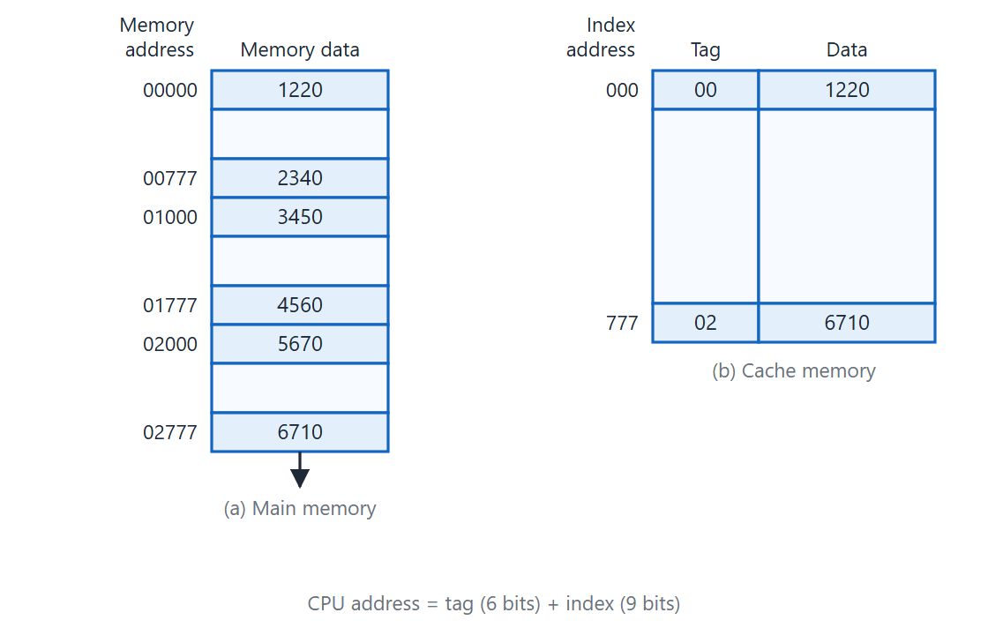
Direct mapping cache
Topic 5.9
Direct mapping cache organization. Adapted from M. Morris Mano, Computer System Architecture, Fig. 12-13.
Notes:
Follow the index to one cache line, then compare the stored tag with the tag of the CPU address. A hit needs just this one comparison.

Slide 70
Mapping method 3: set-associative
Topic 5.9
A compromise: the cache is organised into sets of k locations
The index selects a set; the k tag–data pairs in it are searched associatively
Two-way example: 512 sets, each with two tag–data pairs
Cache word = 2 × (6 + 12) = 36 bits: a 512 × 36 cache holding 1024 words of main memory
Advantage: k words with the same index can coexist: fewer conflict misses
Disadvantage: a little more complex than direct mapping; cost between direct and fully associative
Notes:
Set-associative mapping gives direct mapping a second chance when two blocks share an index. The two-way example doubles the storage per index.

Slide 71
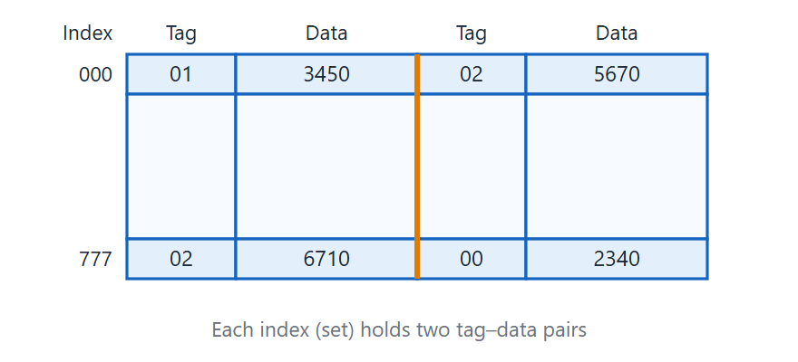
Two-way set-associative cache
Topic 5.9
Two-way set-associative mapping cache. Adapted from M. Morris Mano, Computer System Architecture, Fig. 12-15.
Notes:
Each index holds two tag–data pairs, so two words with the same index can stay in the cache together. This reduces conflict misses compared with direct mapping.

Slide 72
Comparison of the three mapping methods
Topic 5.9
Property | Associative | Direct | Set-associative (k = 2)
Address partition | Full 15-bit address stored | Tag (6b) + Index (9b) | Tag (6b) + Index (9b)
Lookup method | Parallel associative search | Index → compare 1 tag | Index → compare k tags
Conflict misses | None | High (1 block per index) | Low (k blocks per index)
Hardware cost | Highest | Lowest | Moderate
Comparison of the three mapping methods (32K × 12 memory, 512 × 12 cache, 15-bit address)
Notes:
Use this table to compare the three methods on lookup, conflict misses and cost. Direct mapping is cheapest and associative is costliest.

Slide 73
Replacement algorithms
Topic 5.9
When a miss finds the target line or set full, a block must be evicted
Random: choose any block; simple hardware, acceptable performance
FIFO (first-in, first-out): evict the block that has been in the set longest; a few extra bits per line
LRU (least recently used): evict the block used least recently; best hit ratio in practice; usage order tracked per set
Notes:
Replacement only matters for set-associative and associative caches. In direct mapping there is only one place a block can go.

Slide 74
Write policies and the valid bit
Topic 5.9
Write-through: write to cache and main memory together; memory always up to date (DMA gets current data); more bus traffic
Write-back (copy-back): write to cache only; mark the block with a dirty bit; update memory when the block is evicted
Write-back means fewer bus writes, but main memory can be stale
Each cache word has a valid bit, cleared at power-up: every first access is a miss
The valid bit is set to 1 when a block is loaded, so old data is never supplied
Notes:
Write-through is simple and consistent. Write-back saves bus traffic but needs the dirty bit.

Slide 75
Unit 5 summary (1 of 2)
5.1 I/O interface: resolves four CPU–peripheral differences; four command types; isolated or memory-mapped addressing
5.2 Modes of transfer: programmed I/O polls a flag; interrupt-initiated I/O lets the device interrupt; DMA moves whole blocks
5.3 Priority interrupt: highest priority first, by software polling, daisy chain or parallel hardware (interrupt register, mask register, priority encoder)
5.4 DMA: the controller (AR, WC, control/status) moves a block by BR/BG cycle stealing and interrupts once at WC = 0
5.5 Memory hierarchy: registers, cache, main memory, auxiliary memory; fast and costly at the top, large and cheap at the bottom
Notes:
Recap the input-output half of the unit. Ask students to explain in one sentence why DMA is needed for disks.

Slide 76
Unit 5 summary (2 of 2)
5.6 Main memory: SRAM, DRAM (needs refresh) and ROM (non-volatile); the address map makes each address select exactly one chip
5.7 Auxiliary memory: disk (random access, tracks and sectors) and tape (sequential); seek time dominates
5.8 Associative memory: searches all words in parallel using A, K and M; match logic in every cell
5.9 Cache memory: works by locality of reference; associative, direct or set-associative mapping; random, FIFO or LRU replacement; write-through or write-back
Key applications: DMA for disk and network I/O; ROM bootstrap loader starts the OS; associative memory in cache tag arrays and TLBs
Notes:
Recap the memory half of the unit and finish with where these ideas are used. Leave time for questions.

