Slide 1
Unit 2: Combinational and Sequential Logic
2
Computer Organization and Architecture
CHANDRAS EDU
Never stop learning
Notes:
Welcome to Unit 2. We build combinational circuits first: adders, subtractors, multipliers, comparators, decoders, encoders and multiplexers. Then we add memory with latches and flip-flops and build registers and counters.

Slide 2
Agenda
2.1 Combinational Circuits
2.2 Analysis Procedure
2.3 Design Procedure
2.4 Binary Adder
2.5 Binary Subtractor
2.6 Decimal (BCD) Adder
2.7 Binary Multiplier
2.8 Magnitude Comparator
2.9 Decoders
2.10 Encoders
2.11 Multiplexers
2.12 Sequential Circuits
2.13 Latches
2.14 Flip-Flops
2.15 Analysis of Clocked Sequential Circuits
2.16 Registers
2.17 Shift Registers
2.18 Ripple Counters
2.19 Synchronous Counters
2.20 Other Counters
Notes:
Twenty topics in two groups. Topics 2.1 to 2.11 are combinational logic, and topics 2.12 to 2.20 are sequential logic.

Slide 3
2.1 Combinational Circuits
Topic 2.1
IN SIMPLE TERMS
A combinational circuit has no memory: its outputs depend only on the inputs right now.
Notes:
Unit 2 builds real circuits from gates. All of them share one property, and this topic names it. Read the box aloud and ask students to restate it in their own words.

Slide 4
Combinational circuits
Topic 2.1
A combinational circuit is a group of logic gates whose output depends only on the current inputs: never on past inputs and never on a clock
It has no feedback; no gate output loops back to an earlier gate
If flip-flops store the circuit’s past output and feed it back, it is a sequential circuit
The output settles shortly after the inputs change: propagation delay
For n inputs there are 2^{n} input combinations, so a truth table fully describes the circuit; 3 inputs give 2³ = 8 rows
Every row needs a defined output
Notes:
The same inputs always give the same output. A circuit with feedback can get stuck or keep changing, and that is memory, which a combinational circuit must not have.

Slide 5
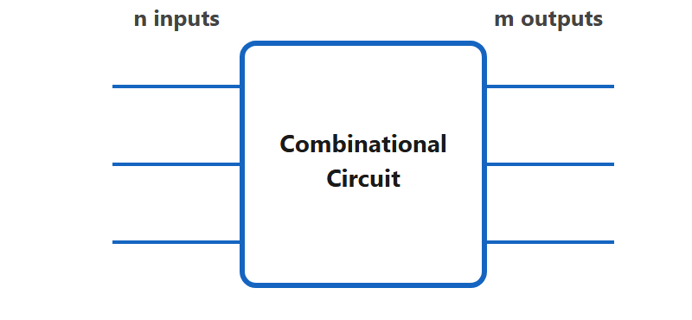
n inputs, m outputs
Topic 2.1
The general shape every combinational circuit takes — n inputs in, m outputs out, decided purely by the present input combination.
Notes:
Every combinational circuit has this shape: n inputs in, m outputs out. Each output is a Boolean function of the inputs, with no feedback.

Slide 6
2.2 Analysis Procedure
Topic 2.2
IN SIMPLE TERMS
Analysis goes from circuit to function: name every gate output, write its expression, then substitute until only the inputs remain.
Notes:
Analysis means starting from a circuit diagram and finding what it does. You use it whenever someone hands you a circuit you did not design. Read the box aloud and ask students to restate it in their own words.

Slide 7
The analysis procedure
Topic 2.2
1. Label every gate output with a variable name, from the inputs toward the output
2. Write the Boolean expression for each labelled signal
3. Substitute until the final output uses only the original inputs
4. Tabulate: build the truth table by evaluating the final expression for all 2^{n} input combinations, if needed
Most common mistake: skipping step 1 and writing the final expression straight from the diagram
Notes:
Labelling first is slower but far less error-prone. Ask students why naming the in-between signals helps.

Slide 8
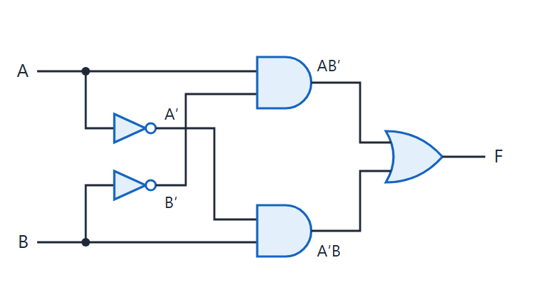
Worked example 1: a 2-input circuit
Topic 2.2
Circuit for Worked Example 1: F = A′B + AB′.
Notes:
Circuit for Worked Example 1: F = A′B + AB′. Follow the two AND gates into the OR gate.

Slide 9
Example 1: checking all four input combinations
Topic 2.2
F = A′B + AB′. F is 1 exactly when A and B differ: the XOR function, built here from AND, OR and NOT gates.
A | B | A′B | AB′ | F = A′B + AB′
0 | 0 | 0 | 0 | 0
0 | 1 | 1 | 0 | 1
1 | 0 | 0 | 1 | 1
1 | 1 | 0 | 0 | 0
Notes:
Evaluate each row from the equation. The result is the XOR function, here made from three kinds of gates instead of one XOR gate.

Slide 10
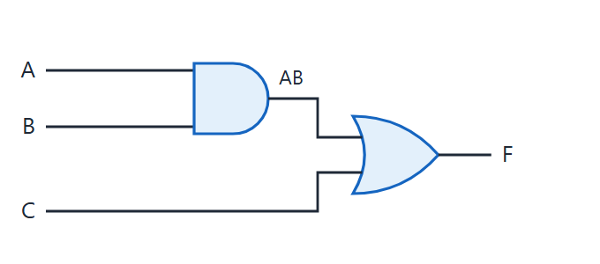
Worked example 2: a 3-input circuit
Topic 2.2
Circuit for Worked Example 2: F = AB + C.
Notes:
Circuit for Worked Example 2: F = AB + C. Label the AND gate output w₁ first.

Slide 11
Example 2: F = AB + C
Topic 2.2
Step 1: label the AND gate output w1 = AB
Step 2: the OR gate combines w1 and C F = w1 + C
Step 3: substitute F = AB + C
F is 1 whenever C is 1, or whenever both A and B are 1
Labelling w1 first made this easier than reading the whole expression at once
Notes:
Three steps give the final expression. Notice that C alone can make F equal 1, whatever A and B are.

Slide 12
2.3 Design Procedure
Topic 2.3
IN SIMPLE TERMS
Design goes from words to circuit: truth table, simplify, draw, then check the drawing gives the same truth table.
Notes:
Design is the opposite of analysis: start from a description and end with a logic diagram. Every circuit in this unit was built with this same procedure. Read the box aloud and ask students to restate it in their own words.

Slide 13
The design procedure
Topic 2.3
1. Specification: state the problem; decide the number of inputs and outputs and give each a letter symbol
2. Truth table: the required output for every input combination
3. Simplify: the simplified Boolean function for each output, by K-map or algebra
4. Draw and verify: draw the logic diagram and re-derive its truth table to compare with step 2
Notes:
Example 1 in the notes: two inputs A, B with F = 1 when exactly one input is 1. The 1-rows give F = A′B + AB′, which is already simplest because the two minterms are diagonal on the K-map. The result is the same circuit as in the analysis topic, equivalent to one XOR gate.

Slide 14
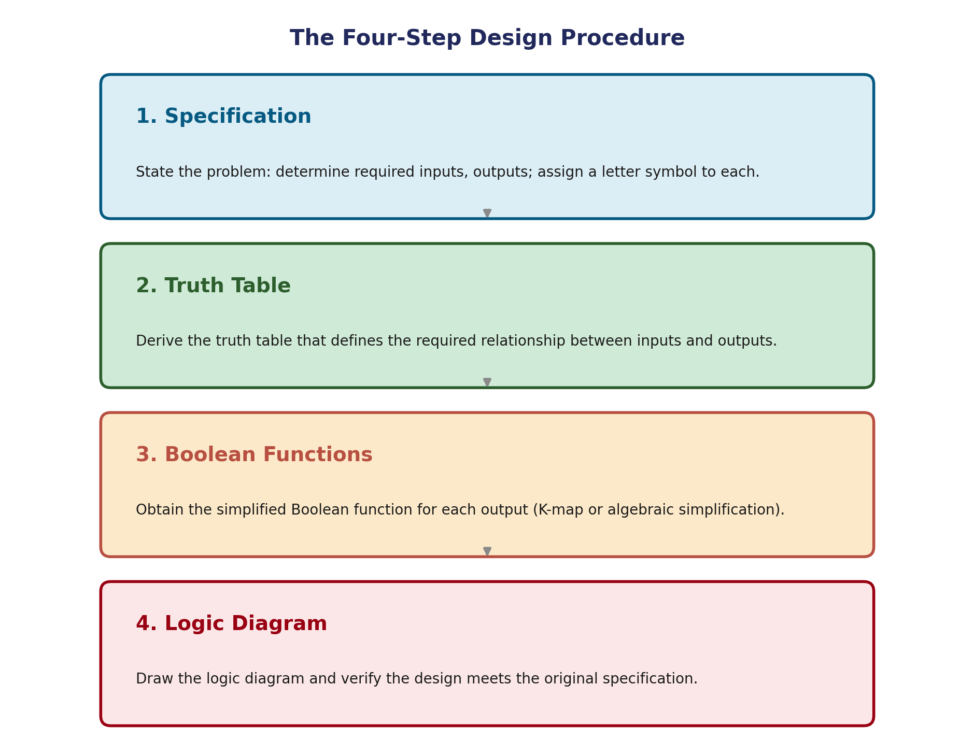
The four-step design procedure
Topic 2.3
1. Specification: inputs, outputs and a letter symbol for each
2. Truth table: the required output for every input combination
3. Simplify: K-map or algebra
4. Draw and verify: re-derive the truth table and compare
The four-step design procedure, applied to every combinational circuit in this unit.
Notes:
Walk through the four boxes in order. The same four steps apply to every circuit in this unit.

Slide 15
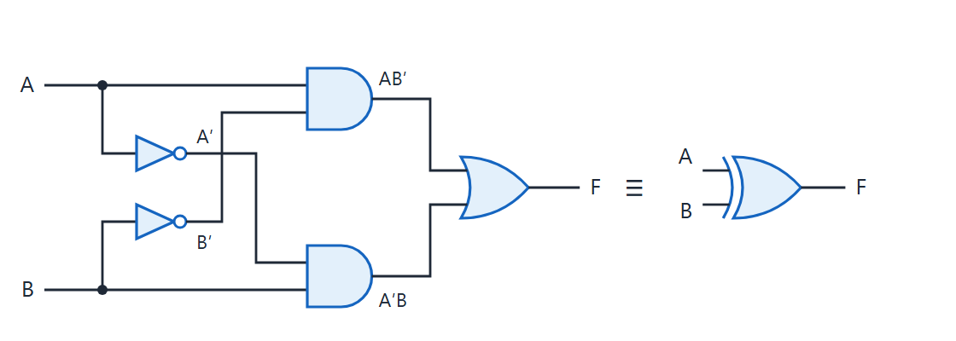
Example 1: the same circuit, and the XOR gate
Topic 2.3
Same circuit as in Analysis Procedure — and the single XOR gate it's equivalent to
Notes:
Two NOT gates, two AND gates and one OR gate give the same function as a single XOR gate. The function is common enough to have its own gate symbol.

Slide 16
Example 2: 3-input majority function
Topic 2.3
F = 1 when 2 or more inputs are 1: F(A,B,C) = Σm(3,5,6,7).
A | B | C | F | minterm
0 | 0 | 0 | 0 | m0
0 | 0 | 1 | 0 | m1
0 | 1 | 0 | 0 | m2
0 | 1 | 1 | 1 | m3
1 | 0 | 0 | 0 | m4
1 | 0 | 1 | 1 | m5
1 | 1 | 0 | 1 | m6
1 | 1 | 1 | 1 | m7
Notes:
F is 1 for the rows with two or three 1s. Next the K-map groups the minterms.

Slide 17
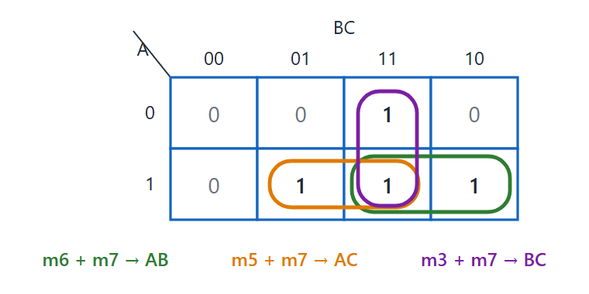
Majority function: K-map
Topic 2.3
K-map for the majority function: three overlapping pairs give F = AB + AC + BC.
Notes:
Three overlapping pairs give F = AB + AC + BC. All three pairs share cell m7, and a 1-cell can belong to more than one group.

Slide 18
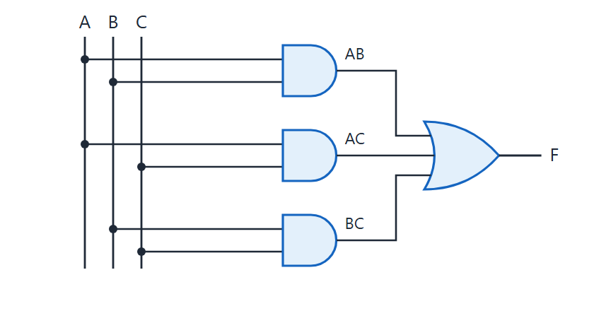
Majority circuit
Topic 2.3
Majority circuit: three AND gates feeding one three-input OR gate.
Notes:
Three AND gates, one per term in F, feed a single three-input OR gate: 4 gates in total. Ask which gate produces which of the terms AB, AC and BC.

Slide 19
2.4 Binary Adder
Topic 2.4
IN SIMPLE TERMS
A half adder adds two bits; a full adder also adds the carry from the bit before; chaining full adders adds whole numbers.
Notes:
Addition is one of the most basic operations in a computer. We build an adder in three steps: half adder, full adder, and a chain of full adders. Read the box aloud and ask students to restate it in their own words.

Slide 20
Half adder
Topic 2.4
S = A ⊕ B C = A · B. A half adder has no carry-in, so it works only for the lowest bit.
A | B | S (Sum) | C (Carry)
0 | 0 | 0 | 0
0 | 1 | 1 | 0
1 | 0 | 1 | 0
1 | 1 | 0 | 1
Notes:
Both equations can be read straight off the truth table: the sum column is XOR and the carry column is AND. Check each row of the table against S = A ⊕ B and C = A · B.

Slide 21
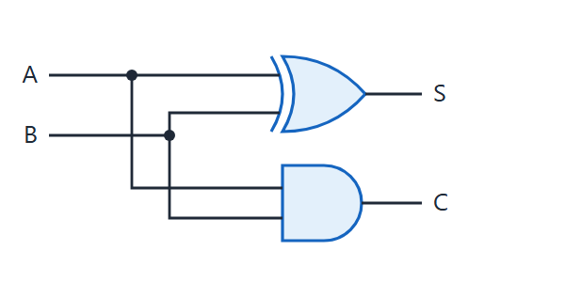
Half adder
Topic 2.4
Half adder — one XOR gate makes the sum, one AND gate makes the carry.
Notes:
One XOR gate makes the sum and one AND gate makes the carry. Trace the inputs A and B to both gates: each input drives the XOR and the AND.

Slide 22
Full adder
Topic 2.4
S = A ⊕ B ⊕ C_{in} C_{out} = AB + BC_{in} + AC_{in}
A | B | C_{in} | S | C_{out}
0 | 0 | 0 | 0 | 0
0 | 0 | 1 | 1 | 0
0 | 1 | 0 | 1 | 0
0 | 1 | 1 | 0 | 1
1 | 0 | 0 | 1 | 0
1 | 0 | 1 | 0 | 1
1 | 1 | 0 | 0 | 1
1 | 1 | 1 | 1 | 1
Notes:
The carry-out is 1 whenever at least two of the three inputs are 1: a majority function. The extra carry-in is what lets full adders be chained.

Slide 23
Building the full adder
Topic 2.4
Reuse two half adders plus one OR gate
HA₁ adds A and B: partial sum S₁ and carry C₁
HA₂ adds S₁ and C_{in}: final sum S and a second carry C₂
C₁ and C₂ can never both be 1, so OR-ing them gives the correct C_{out}
Notes:
This avoids wiring the equations from scratch. No three-input gate is needed.

Slide 24
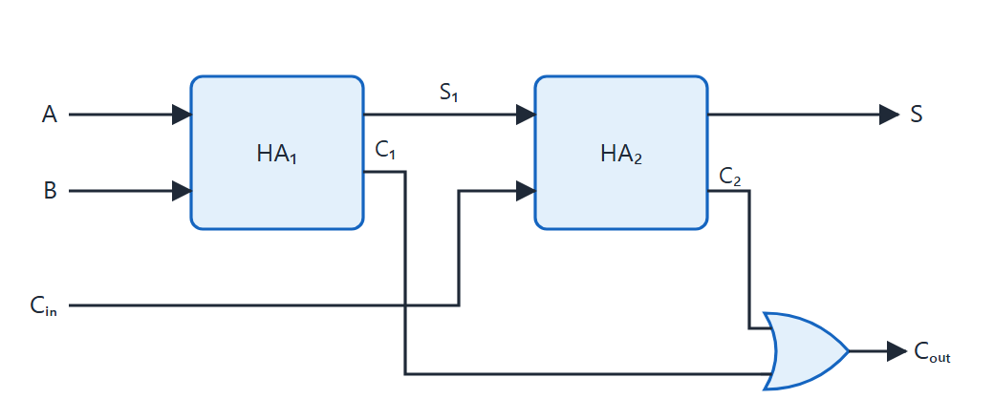
Full adder from two half adders
Topic 2.4
A full adder built from two half adders and one OR gate. Adapted from M. Morris Mano and Michael D. Ciletti, Digital Design, Fig. 4.8.
Notes:
A full adder built from two half adders and one OR gate. Follow A and B into HA₁, then S₁ and C_in into HA₂.

Slide 25
The ripple carry adder
Topic 2.4
A binary adder adds two multi-bit numbers: connect full adders in a chain
Each stage’s carry-out feeds the next stage’s carry-in
A carry made at the lowest bit can ripple through every stage: a ripple carry adder
Adding two n-bit numbers needs n full adders
The lowest stage can use a full adder with its carry-in tied to 0, which keeps every stage identical
Notes:
Adding two 4-bit numbers takes four full adders. C₀ is the carry into the first stage and C₄ is the final carry-out.

Slide 26
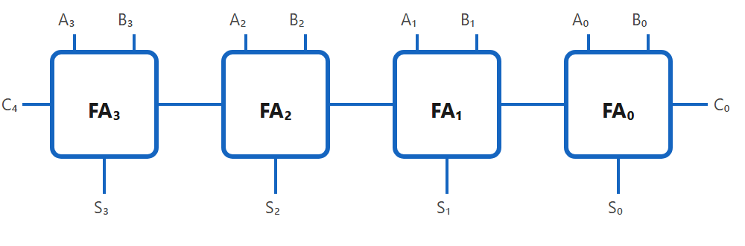
4-bit ripple carry adder
Topic 2.4
A 4-bit ripple carry adder — four full adders, each carry-out feeding the next carry-in. C₀ is the carry into the very first (rightmost) stage, normally tied to 0; C₄ is the final carry-out.
Notes:
Four full adders, each carry-out feeding the next carry-in. C₀ is the carry into the very first (rightmost) stage, normally tied to 0; C₄ is the final carry-out.

Slide 27
Worked example: A = 1001 (9) + B = 0110 (6)
Topic 2.4
Work right to left. The result is 01111₂ = 15; bit 4 is the final carry-out C₄ = 0. Check: 9 + 6 = 15 ✓
Bit position | 4 | 3 | 2 | 1 | 0
Carry into this bit | — | 0 | 0 | 0 | 0
A | — | 1 | 0 | 0 | 1
B | — | 0 | 1 | 1 | 0
Result | 0 | 1 | 1 | 1 | 1
Notes:
No position has two 1s, so no carry is generated at any stage. Try 0111 + 0011 to see carries ripple.

Slide 28
2.5 Binary Subtractor
Topic 2.5
IN SIMPLE TERMS
Subtraction is addition in disguise: invert B and add 1, so one adder with an XOR on each B input can do both.
Notes:
We build subtraction like addition: half subtractor, full subtractor, then a trick that lets one circuit do both operations. Read the box aloud and ask students to restate it in their own words.

Slide 29
Half subtractor
Topic 2.5
D = A ⊕ B B_{out} = A′B. A borrow of 1 means this position could not subtract on its own and had to borrow from the next position.
A | B | D (Difference) | B_{out} (Borrow)
0 | 0 | 0 | 0
0 | 1 | 1 | 1
1 | 0 | 1 | 0
1 | 1 | 0 | 0
Notes:
D is exactly XOR, the same as a half adder sum. The borrow is 1 only when A = 0 and B = 1.

Slide 30
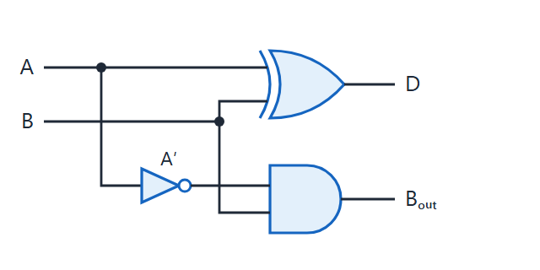
Half subtractor
Topic 2.5
Half subtractor — one XOR gate makes the difference, one NOT + AND gate makes the borrow.
Notes:
One XOR gate makes the difference, one NOT + AND gate makes the borrow. Notice that only the borrow needs the inverter on A.

Slide 31
Full subtractor
Topic 2.5
D = A ⊕ B ⊕ B_{in} B_{out} = A′B + A′B_{in} + BB_{in}
A | B | B_{in} | D | B_{out}
0 | 0 | 0 | 0 | 0
0 | 0 | 1 | 1 | 1
0 | 1 | 0 | 1 | 1
0 | 1 | 1 | 0 | 1
1 | 0 | 0 | 1 | 0
1 | 0 | 1 | 0 | 0
1 | 1 | 0 | 0 | 0
1 | 1 | 1 | 1 | 1
Notes:
D is the same equation as the full adder sum. The borrow equation is similar to the carry equation, with A inverted.

Slide 32
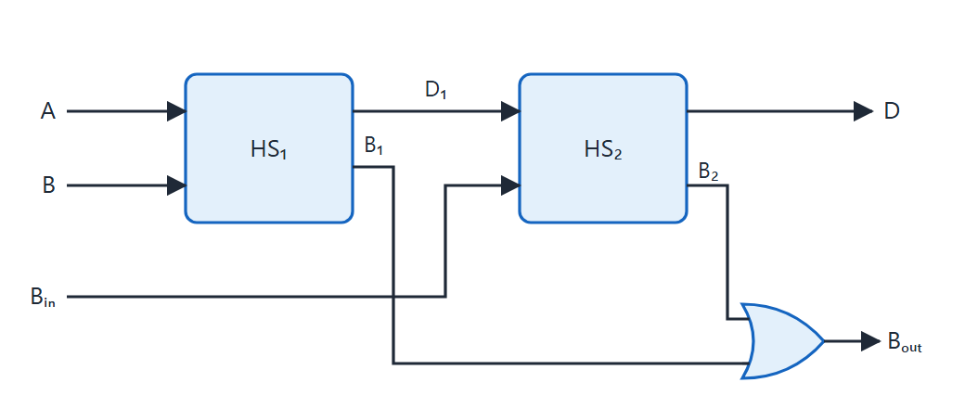
Full subtractor from two half subtractors
Topic 2.5
A full subtractor built from two half subtractors and one OR gate — HS₁ computes A−B, HS₂ then subtracts Bᵢₙ from that result.
Notes:
HS₁ computes A−B and HS₂ then subtracts B_in from that result. B₁ and B₂ can never both be 1, so OR-ing them gives the correct borrow-out.

Slide 33
Combined adder–subtractor
Topic 2.5
2’s complement turns subtraction into addition: A − B = A + B′ + 1
One line M (0 = add, 1 = subtract) controls both operations
One XOR gate in front of every bit of B; M also feeds the first stage’s carry-in
M = 0: B passes unchanged, carry-in 0: computes A + B
M = 1: B is inverted, carry-in 1: computes A + B′ + 1 = A − B
Overflow (signed): V = C₃ ⊕ C₄; the final carry matters only for unsigned numbers
Notes:
The same four full adders and four XOR gates serve both operations. Only the single control bit M changes.

Slide 34
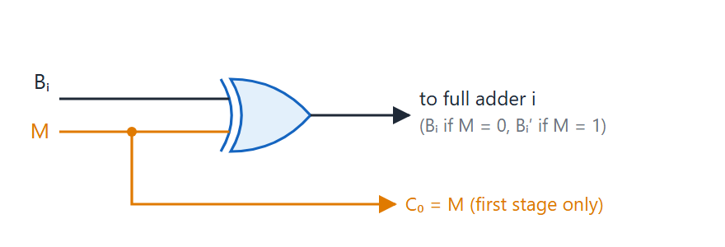
One XOR gate per bit of B
Topic 2.5
One XOR gate per bit of B — the same M line that flips this gate also becomes the first stage's carry-in.
Notes:
The same M line that flips this gate also becomes the first stage’s carry-in. For the XOR gate: M = 0 passes B and M = 1 gives B′.

Slide 35
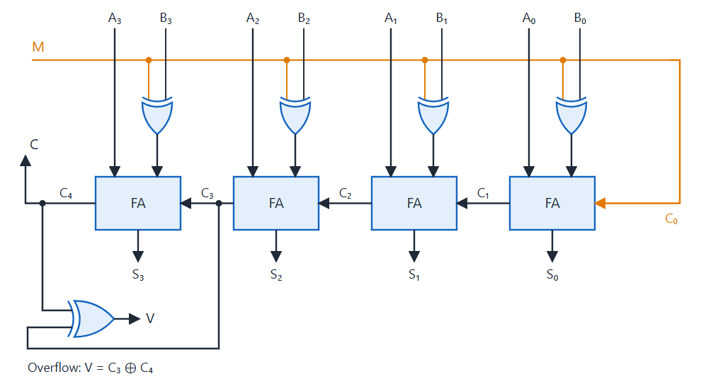
Four-bit adder-subtractor
Topic 2.5
Four-bit adder-subtractor: M = 0 adds, M = 1 subtracts; V = C₃ ⊕ C₄ flags overflow. Adapted from M. Morris Mano and Michael D. Ciletti, Digital Design, Fig. 4.13.
Notes:
M = 0 adds, M = 1 subtracts; V = C₃ ⊕ C₄ flags overflow. Same four full adders as the ripple carry adder, with one XOR gate added in front of each B input.

Slide 36
Worked example: A = 1001 (9), B = 0101 (5)
Topic 2.5
M = 0 (add): 1001 + 0101 = 01110 = 14 (9 + 5 ✓)
M = 1 (subtract): 1001 + 1010 + 1 = 10100
drop the final carry → 0100 = 4 (9 − 5 ✓)
B′ = 1010 when M = 1, and the carry-in to bit 0 is 1
The final carry-out is discarded: it is expected when A ≥ B
Notes:
Same hardware, both operations. The discarded carry-out of 1 is normal during subtraction when A ≥ B, and it is not an overflow.

Slide 37
2.6 Decimal (BCD) Adder
Topic 2.6
IN SIMPLE TERMS
Add the two digits in binary; if the result is more than 9 (or a carry came out), add 6 to skip the six unused codes and pass a 1 to the next digit.
Notes:
A BCD adder reuses the binary adder and adds one correction step. BCD uses the patterns 0000–1001 for digits 0–9, and 1010–1111 never occur. Read the box aloud and ask students to restate it in their own words.

Slide 38
The correction rule
Topic 2.6
Add two BCD digits (plus any carry-in) in a 4-bit binary adder: raw sum Z (0–19) and carry K
If Z ≤ 9 and K = 0: already valid BCD; use it as is
If Z ≥ 10, or K = 1: add 0110 (6); the correction’s decade carry goes to the next decade
Z ≥ 10 is detected by Z₈Z₄ + Z₈Z₂
Output carry = K + Z₈Z₄ + Z₈Z₂: 1 means “add 6” and is also the carry into the next decade
Notes:
9 + 9 = 18 is 10010 in binary, which is not valid BCD. The next two slides list every sum from 0 to 19.

Slide 39
Binary sum and BCD sum (1 of 2)
Topic 2.6
Up to 9 the raw sum and the BCD digit are identical: no correction needed.
Decimal | K | Z₈Z₄Z₂Z₁ | Output carry | S₈S₄S₂S₁
0 | 0 | 0000 | 0 | 0000
1 | 0 | 0001 | 0 | 0001
2 | 0 | 0010 | 0 | 0010
3 | 0 | 0011 | 0 | 0011
4 | 0 | 0100 | 0 | 0100
5 | 0 | 0101 | 0 | 0101
6 | 0 | 0110 | 0 | 0110
7 | 0 | 0111 | 0 | 0111
8 | 0 | 1000 | 0 | 1000
9 | 0 | 1001 | 0 | 1001
Notes:
Raw binary sum Z and the correct BCD sum S match column for column up to 9. Notice the output carry stays 0 for all of these rows.

Slide 40
Binary sum and BCD sum (2 of 2)
Topic 2.6
From 10 onward the two diverge; adding 0110 brings S back into range every time.
Decimal | K | Z₈Z₄Z₂Z₁ | Output carry | S₈S₄S₂S₁
10 | 0 | 1010 | 1 | 0000
11 | 0 | 1011 | 1 | 0001
12 | 0 | 1100 | 1 | 0010
13 | 0 | 1101 | 1 | 0011
14 | 0 | 1110 | 1 | 0100
15 | 0 | 1111 | 1 | 0101
16 | 1 | 0000 | 1 | 0110
17 | 1 | 0001 | 1 | 0111
18 | 1 | 0010 | 1 | 1000
19 | 1 | 0011 | 1 | 1001
Notes:
The output carry is 1 exactly when the correction is needed and carries into the next decade. Compare the last column with the raw sum: it is lower by 10 in every row from 10 to 19.

Slide 41
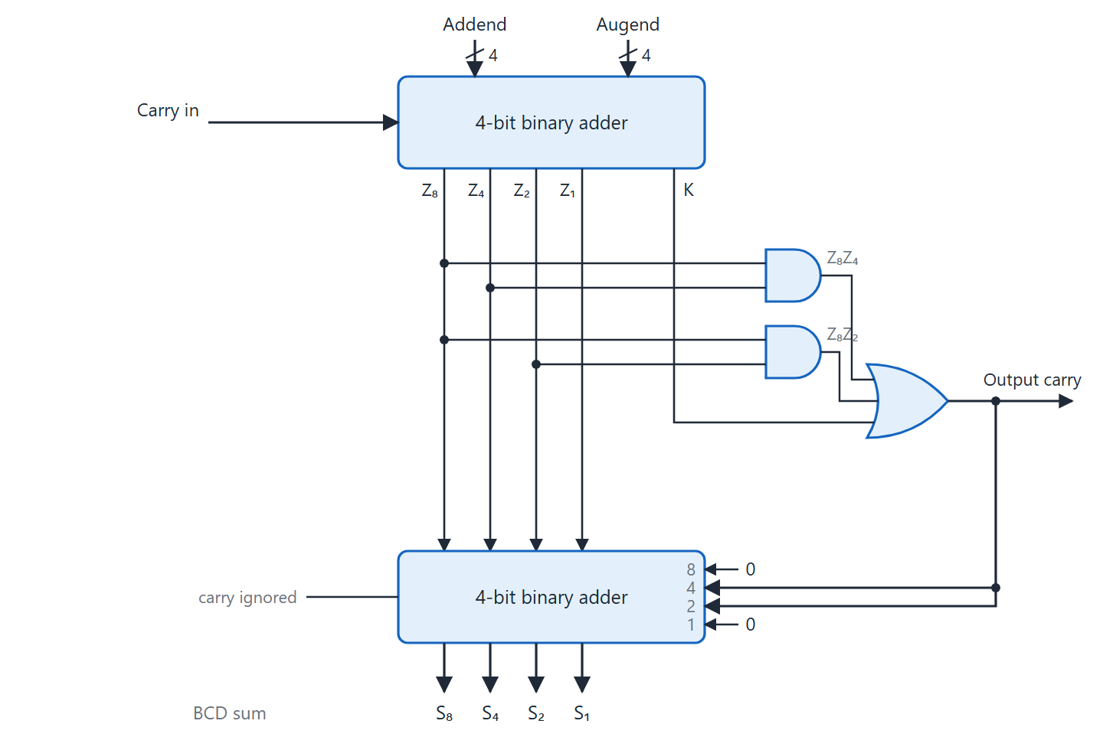
Block diagram of a BCD adder
Topic 2.6
Block diagram of a BCD adder. Adapted from M. Morris Mano and Michael D. Ciletti, Digital Design, Fig. 4.14.
Notes:
The second adder adds 0110 if Output carry = 1, or 0000 if it is 0. The Output carry wire connects straight to the 4 and 2 bit positions of the constant; the other two positions are tied low. S is always valid BCD, and Output carry is the carry into the next decade.

Slide 42
Worked example 1: 8 + 7 (Z ≥ 10 case)
Topic 2.6
A = 1000 (8), B = 0111 (7), C_{in} = 0
Binary adder: 1000 + 0111 = 1111 → Z = 1111 (15), K = 0
Z₈Z₄ = 1 → Output carry = 0 + 1 + 1 = 1 (add 6)
Correction adder: 1111 + 0110 = 1 0101
S = 0101 (5), decade carry = 1
Result: “1” and “5”, which is 15 in BCD; check 8 + 7 = 15 ✓
Notes:
Z alone is 15, so the Z₈Z₄ term triggers the correction. The correction adder then adds 0110 to 1111.

Slide 43
Worked example 2: 9 + 9 (K = 1 case)
Topic 2.6
A = 1001 (9), B = 1001 (9), C_{in} = 0
Binary adder: 1001 + 1001 = 1 0010 → Z = 0010 (2), K = 1
Z₈Z₄ = 0, Z₈Z₂ = 0, but K = 1 → Output carry = 1 (add 6)
Correction adder: 0010 + 0110 = 1000
S = 1000 (8), decade carry = 1
Result: “1” and “8”, which is 18 in BCD; check 9 + 9 = 18 ✓
Z alone (0010) looks small: only checking K catches it
Notes:
This case shows why the adder’s own carry K must be part of the condition. Ask students what the answer would be if only Z were checked.

Slide 44
2.7 Binary Multiplier
Topic 2.7
IN SIMPLE TERMS
Multiplying bits is just AND; the partial products are then added column by column with half and full adders.
Notes:
A binary multiplier is a grid of AND gates plus adders: the two building blocks from the previous topics wired in a new arrangement. Read the box aloud and ask students to restate it in their own words.

Slide 45
2-bit × 2-bit multiplier: A = 10 (2), B = 11 (3)
Topic 2.7
A1 A0
× B1 B0
----------------
A1B0 A0B0 ← PP0 = A·B0
A1B1 A0B1 ← PP1 = A·B1, shifted left 1
P3 P2 P1 P0 = 0 1 1 0 = 6 ✓
Each partial product is all zeros (multiplier bit 0) or a copy of the multiplicand (bit 1)
Each partial product bit is the AND of a multiplicand bit and a multiplier bit
m-bit × n-bit: product up to m + n bits; the AND array needs m × n gates
Half adders where 2 bits share a column; full adders once 3 or more do
Notes:
Column P₀ is just A₀B₀. Column P₁ adds two bits with a half adder, and column P₂ adds A₁B₁ to that carry with another half adder; the final carry becomes P₃.

Slide 46
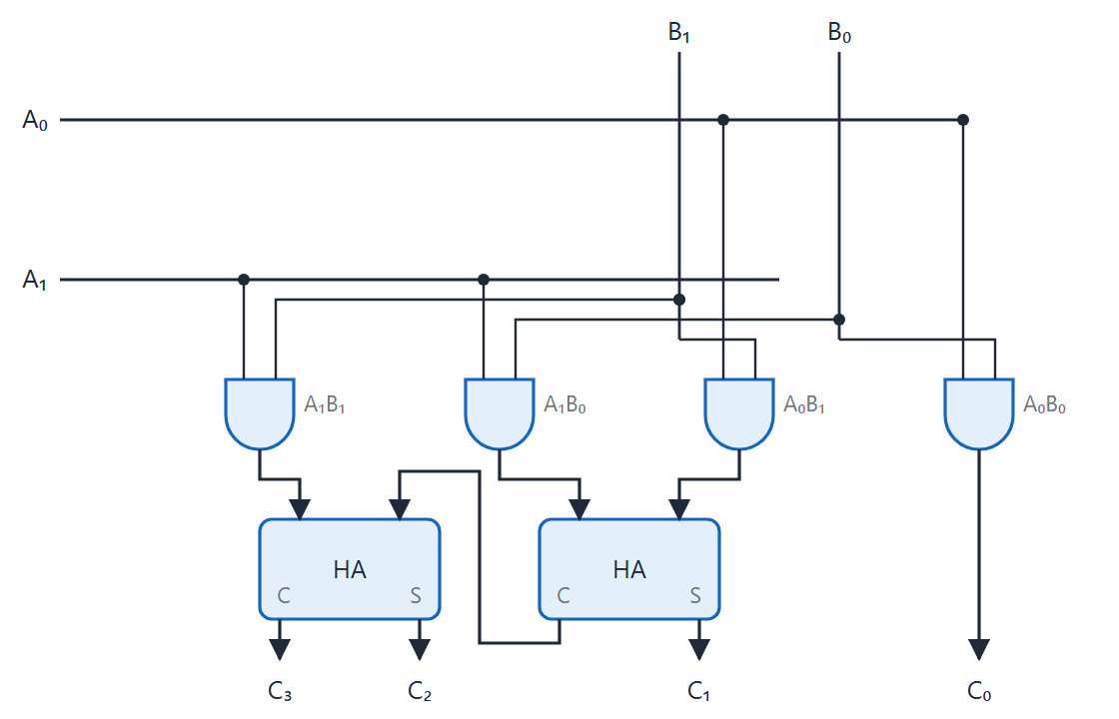
Two-bit by two-bit binary multiplier
Topic 2.7
Two-bit by two-bit binary multiplier. Adapted from M. Morris Mano and Michael D. Ciletti, Digital Design, Fig. 4.15.
Notes:
One AND gate per partial-product bit and two half adders sum the columns. Verify with A = 11 (3), B = 11 (3): A₁B₀ = 1 and A₀B₁ = 1 give P₁ = 0 with a carry; A₁B₁ = 1 plus the carry gives P₂ = 0 and P₃ = 1. The product 1001 is 9 = 3 × 3. Wider multipliers follow the same pattern.

Slide 47
2.8 Magnitude Comparator
Topic 2.8
IN SIMPLE TERMS
Compare from the most significant bit down: the first bit position where the numbers differ decides which is larger.
Notes:
A magnitude comparator reports which of two binary numbers is larger, using three mutually exclusive outputs. Exactly one of them is 1. Read the box aloud and ask students to restate it in their own words.

Slide 48
1-bit comparator
Topic 2.8
(A>B) = AB′ (A<B) = A′B (A=B) = A′B′ + AB = (A ⊕ B)′ (the XNOR of A and B)
A | B | A>B | A=B | A<B
0 | 0 | 0 | 1 | 0
0 | 1 | 0 | 0 | 1
1 | 0 | 1 | 0 | 0
1 | 1 | 0 | 1 | 0
Notes:
All three read off directly, with no K-map needed. Exactly one output is 1 for any pair of inputs.

Slide 49
Cascading to n bits
Topic 2.8
Comparison starts at the most significant bit: if the MSBs differ, lower bits cannot change the outcome
Only when a pair of bits is equal does the comparison continue to the next bit
With x_{i} = (A_{i} = B_{i}), for 2 bits: (A>B) = A₁B₁′ + x₁A₀B₀′
(A<B) = A₁′B₁ + x₁A₀′B₀ (A=B) = x₁x₀
Each stage passes a running (GT, EQ, LT) decision to the next; the first cascade input is (0, 1, 0), “equal so far”
Only the last stage’s outputs are the overall result
Notes:
If the incoming cascade already says GT or LT, a stage passes it through unchanged. Only if it says EQ does the stage’s own bit comparison decide.

Slide 50
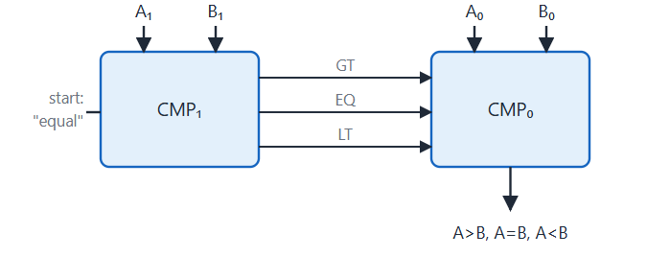
Two-bit comparison as two cascaded stages
Topic 2.8
Two-bit comparison as two cascaded 1-bit stages, most significant bit first.
Notes:
CMP₁ compares A₁ with B₁ and outputs (GT, EQ, LT). Its EQ output is the x₁ signal. CMP₀ applies the rule: if CMP₁ already decided, pass that decision through; only if CMP₁ says EQ does CMP₀ decide.

Slide 51
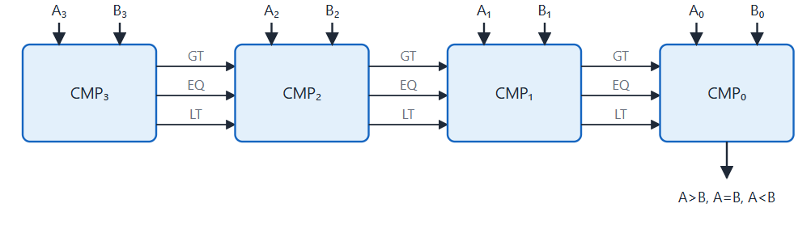
Four-bit comparison as a chain
Topic 2.8
Four-bit comparison as a chain of 1-bit stages, each passing GT, EQ, LT to the next.
Notes:
Each cascade line carries the full running (GT, EQ, LT) decision from every bit compared so far. The cascade entering CMP₃ is fixed at (0, 1, 0). Every earlier stage’s outputs are consumed internally by the next stage.

Slide 52
Four-bit comparator: gate-level equations
Topic 2.8
x_{i} = A_{i}B_{i} + A_{i}′B_{i}′ (XNOR: 1 when bit i of A and B are equal)
(A = B) = x₃x₂x₁x₀
(A > B) = A₃B₃′ + x₃A₂B₂′ + x₃x₂A₁B₁′ + x₃x₂x₁A₀B₀′
(A < B) is the same as (A > B) with A and B swapped in each term
Notes:
This is how the textbook builds the same 4-bit comparator directly from gates. The x terms are XNOR outputs, one for each bit position.

Slide 53
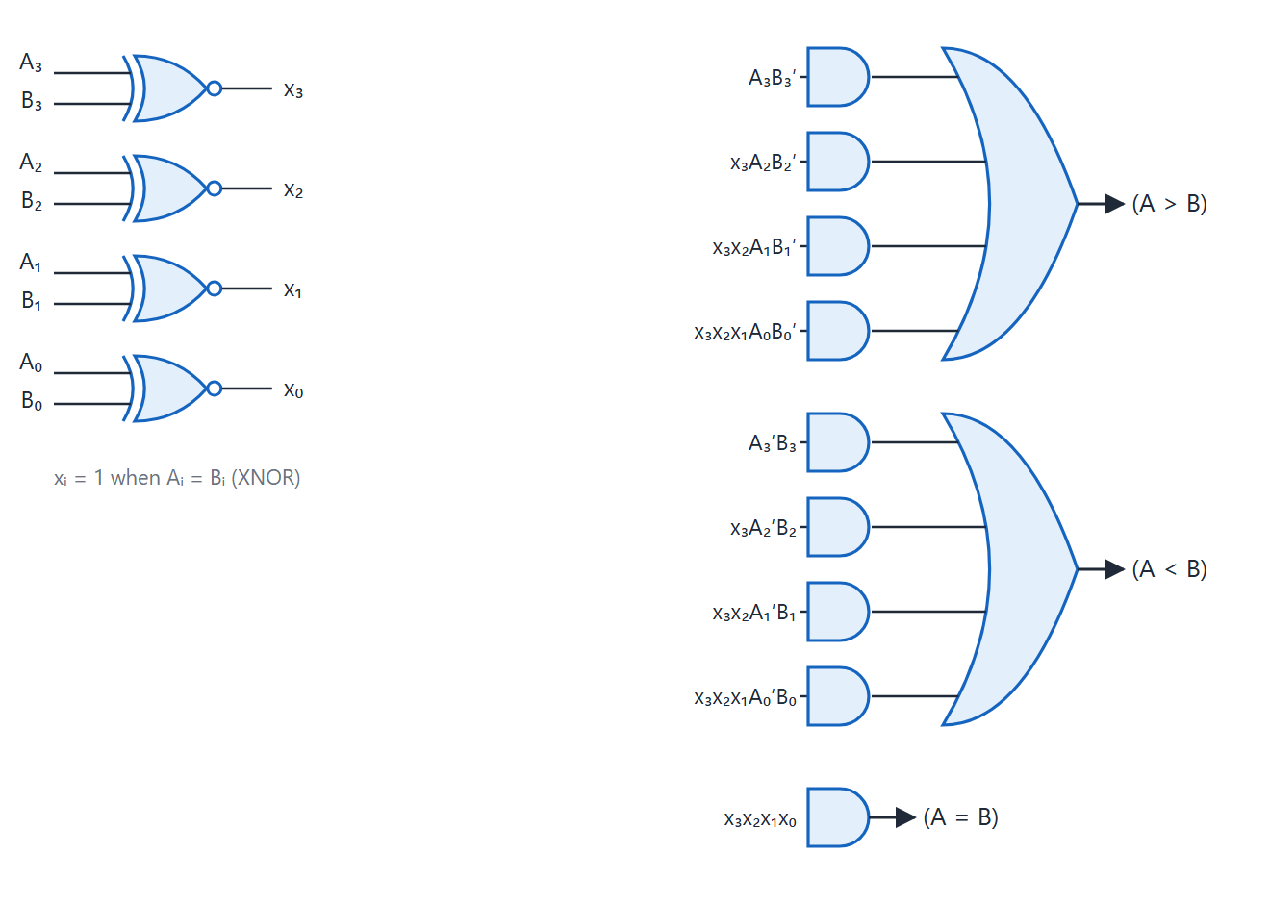
Four-bit magnitude comparator
Topic 2.8
Four-bit magnitude comparator. Adapted from M. Morris Mano and Michael D. Ciletti, Digital Design, Fig. 4.17.
Notes:
Four XNOR gates produce x₃…x₀, which feed the AND and OR gates for A = B, A > B and A < B. The three output gates correspond to the three equations on the previous slide.

Slide 54
Worked example: A = 1011 (11), B = 1010 (10)
Topic 2.8
Bit 3: A3=1, B3=1 → equal, still equal to bit 2
Bit 2: A2=0, B2=0 → equal, still equal to bit 1
Bit 1: A1=1, B1=1 → equal, still equal to bit 0
Bit 0: A0=1, B0=0 → A0 > B0, every higher bit tied
Result: A > B (11 > 10) ✓
Decided entirely by the least significant bit, because every bit above it matched
Notes:
Walk down from bit 3 to bit 0. A difference only counts at the first position where the bits differ.

Slide 55
2.9 Decoders
Topic 2.9
IN SIMPLE TERMS
A decoder turns a binary number into “one wire high”: input 101 lights up output 5 and nothing else.
Notes:
A decoder converts n input lines into up to 2ⁿ output lines, with at most one output active. It is used from memory addressing to instruction decoding. Read the box aloud and ask students to restate it in their own words.

Slide 56
2-to-4 decoder
Topic 2.9
D₀ = A₁′A₀′ D₁ = A₁′A₀ D₂ = A₁A₀′ D₃ = A₁A₀. A decoder is a physical implementation of minterm generation: each output is one minterm.
A₁ | A₀ | D₀ | D₁ | D₂ | D₃
0 | 0 | 1 | 0 | 0 | 0
0 | 1 | 0 | 1 | 0 | 0
1 | 0 | 0 | 0 | 1 | 0
1 | 1 | 0 | 0 | 0 | 1
Notes:
Each output is a minterm of the inputs. This is the hardware form of the minterm step from the K-map topic.

Slide 57
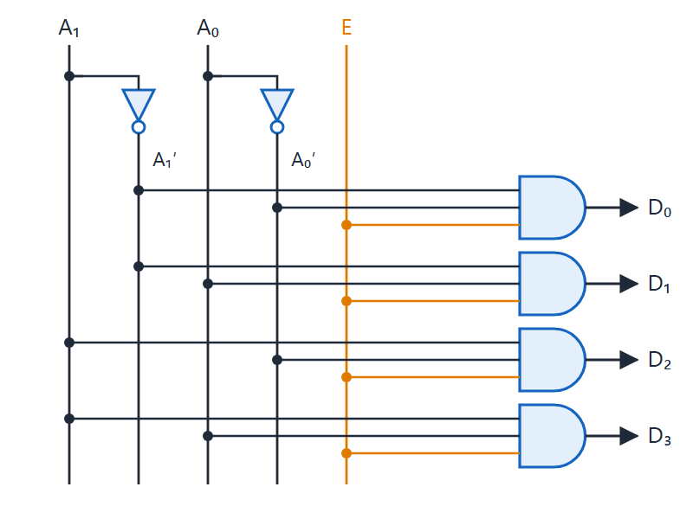
2-to-4 decoder with enable
Topic 2.9
Each output AND gate also receives E
E = 0 forces every output to 0
E = 1: the address inputs select one output
This makes a decoder useful as chip-select logic
2-to-4 decoder with enable: each output AND gate also receives E, so all outputs are 0 when E = 0.
Notes:
2-to-4 decoder with enable: each output AND gate also receives E, so all outputs are 0 when E = 0. Compare with the plain decoder: the only change is the third input on each AND gate.

Slide 58
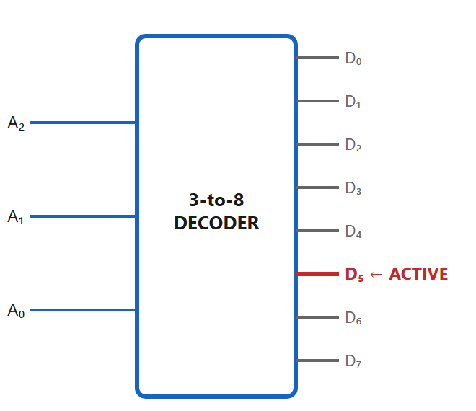
3-to-8 decoder
Topic 2.9
Inputs A₂ A₁ A₀ activate exactly one of the outputs D₀–D₇
Input 101 (5) activates only D₅
Every other output stays at 0
Each memory chip or bank is wired to one output, so only one is selected
A 3-to-8 decoder selects exactly one of eight outputs — here, input 101 (5) activates only D₅.
Notes:
A 3-to-8 decoder selects exactly one of eight outputs. Here input 101 (5) activates only D₅.

Slide 59
Enable and implementing functions
Topic 2.9
An enable input E: when E = 0 every output is 0, so only the addressed chip’s select line goes active
E = 0 silences the whole decoder; it does not choose a default output
Every output is already a minterm, so any function is: feed n variables into an n-to-2^{n} decoder and OR the outputs for its minterms
Example: F(A,B) = Σm(1,2) = D₁ + D₂: one 2-input OR gate
No AND gates and no K-map work are needed
Notes:
This is the canonical sum-of-products idea built directly in hardware. A decoder with enable is also exactly what a demultiplexer is.

Slide 60
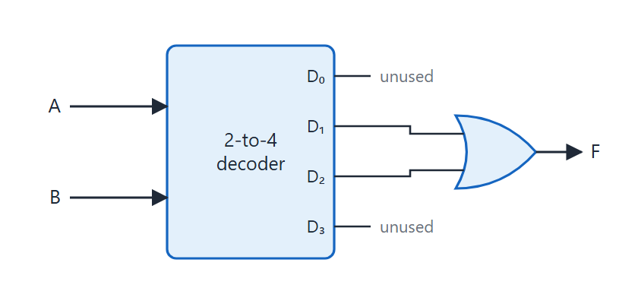
F(A,B) = Σm(1,2) from a decoder
Topic 2.9
F(A,B) = Σm(1,2) = D₁ + D₂ from a 2-to-4 decoder and one OR gate.
Notes:
F(A,B) = Σm(1,2) = D₁ + D₂ from a 2-to-4 decoder and one OR gate. Only two of the four outputs are used; the others are left unconnected.

Slide 61
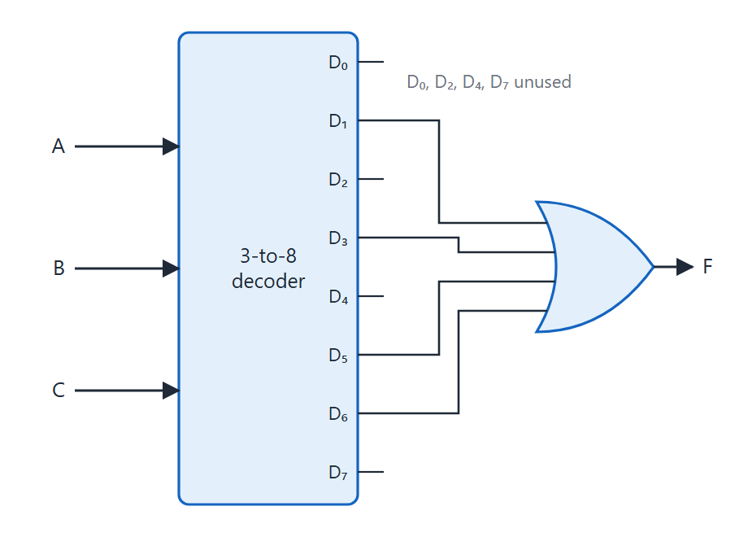
F(A,B,C) = Σm(1,3,5,6)
Topic 2.9
F = D₁ + D₃ + D₅ + D₆
One four-input OR gate combines the four chosen outputs
No K-map simplification is needed
The price is a full decoder, which uses more gates than a minimised circuit
F(A,B,C) = Σm(1,3,5,6): decoder outputs D₁, D₃, D₅ and D₆ feed one four-input OR gate.
Notes:
F(A,B,C) = Σm(1,3,5,6): decoder outputs D₁, D₃, D₅ and D₆ feed one four-input OR gate. The decoder-plus-OR approach trades gate-minimisation effort for a mechanical implementation.

Slide 62
2.10 Encoders
Topic 2.10
IN SIMPLE TERMS
An encoder does the reverse: it reports which input wire is high as a binary number; a priority encoder picks the highest one if several are high.
Notes:
An encoder is the inverse of a decoder. It has up to 2ⁿ inputs, exactly one of them active, and produces the n-bit code of the active input. Read the box aloud and ask students to restate it in their own words.

Slide 63
8-to-3 (octal-to-binary) encoder
Topic 2.10
A0 = D1 + D3 + D5 + D7 (inputs whose index has bit 0 set)
A1 = D2 + D3 + D6 + D7 (inputs whose index has bit 1 set)
A2 = D4 + D5 + D6 + D7 (inputs whose index has bit 2 set)
Each output is an OR of the four inputs whose index has that bit set: three 4-input OR gates, no AND gates, no K-maps
Example: only D₅ active → A₂ = 1, A₁ = 0, A₀ = 1 → A₂A₁A₀ = 101 ✓
Notes:
A plain encoder reads each output straight from which inputs include that bit position in their index. The worked example shows D₅ active: only A₂ and A₀ are 1.

Slide 64
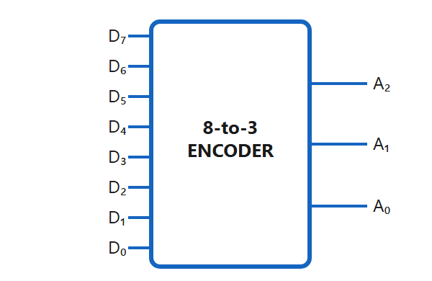
Octal-to-binary encoder
Topic 2.10
Octal-to-binary encoder
Notes:
Every input and output of the 8-to-3 encoder is drawn individually. Each output is an OR of four input lines.

Slide 65
The priority problem and priority encoder
Topic 2.10
A plain encoder assumes exactly one input is active; with two or more, the outputs become the OR of several codes: garbage
A priority encoder outputs the code of the highest-priority input: conventionally the highest index
V is a valid-output flag: 0 only when no input is active, so A₁ = A₀ = 0 is not ambiguous
Example: D₂ = D₁ = 1 (D₃ = D₀ = 0) → output 10 (2); D₁ is ignored
Highest index wins, not lowest: always check the convention of a chip or textbook
Notes:
Priority resolves conflicts: once D₃ is 1, the lower inputs genuinely do not matter, which is why the table has X entries. Ask students what would happen to a plain encoder with D₂ and D₁ both active.

Slide 66
4-input priority encoder
Topic 2.10
X means don’t care: once D₃ is 1, D₂, D₁, D₀ do not matter.
D₃ | D₂ | D₁ | D₀ | A₁ | A₀ | V
0 | 0 | 0 | 0 | X | X | 0
0 | 0 | 0 | 1 | 0 | 0 | 1
0 | 0 | 1 | X | 0 | 1 | 1
0 | 1 | X | X | 1 | 0 | 1
1 | X | X | X | 1 | 1 | 1
Notes:
Read the table from the bottom up: D₃ wins whatever the other inputs are. The valid flag V is 0 only in the first row.

Slide 67
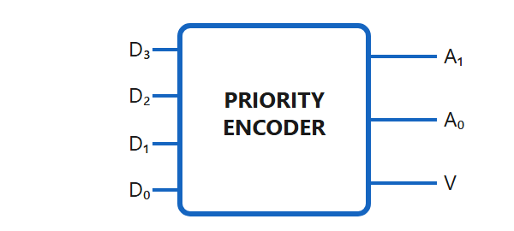
4-input priority encoder block
Topic 2.10
4-input priority encoder block
Notes:
As a block, the priority encoder looks like a plain encoder with one extra output pin, V. The gate-level circuit comes next.

Slide 68
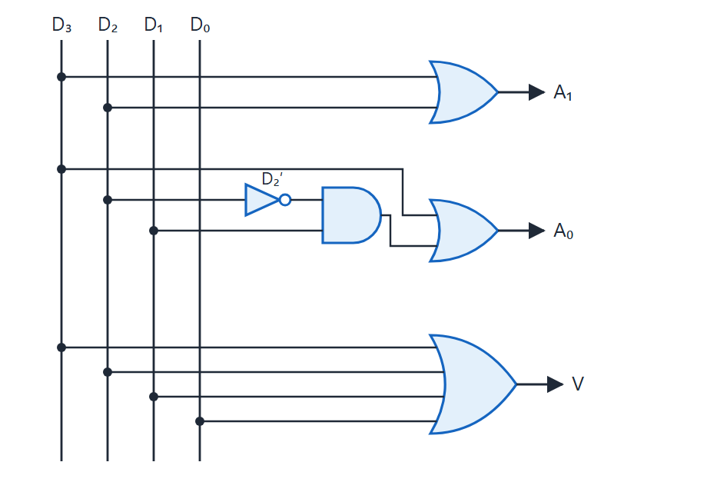
Four-input priority encoder
Topic 2.10
Four-input priority encoder: A₁ = D₃ + D₂, A₀ = D₃ + D₂′D₁, V = D₃ + D₂ + D₁ + D₀. Adapted from M. Morris Mano and Michael D. Ciletti, Digital Design, Fig. 4.23.
Notes:
Four-input priority encoder: A₁ = D₃ + D₂, A₀ = D₃ + D₂′D₁, V = D₃ + D₂ + D₁ + D₀. A₁ is 1 whenever D₃ or D₂ is active. D₁ sets A₀ only if D₂ is not active (D₂′), since D₂ outranks it. V is built from two 2-input OR gates feeding a third, and is 1 when any input is active.

Slide 69
2.11 Multiplexers
Topic 2.11
IN SIMPLE TERMS
A multiplexer is a selector switch: the select lines choose which one of several inputs is passed to the single output.
Notes:
Where a decoder routes one input to many outputs, a multiplexer does the reverse. This simple idea can implement almost any Boolean function. Read the box aloud and ask students to restate it in their own words.

Slide 70
What a multiplexer does
Topic 2.11
A multiplexer (MUX) selects one of 2^{n} input lines and routes it to a single output, using n select lines
The select lines act as an address
A 2-to-1 MUX has 1 select line; a 4-to-1 MUX has 2
An n-select-line MUX handles exactly 2^{n} inputs: never more, never fewer
Notes:
Think of the select lines as an address that picks which input is connected to the output at that instant. Compare this with a decoder, which does the opposite.

Slide 71
4-to-1 multiplexer
Topic 2.11
Y = S₁′S₀′I₀ + S₁′S₀I₁ + S₁S₀′I₂ + S₁S₀I₃. Only one AND term is enabled at a time, so Y equals exactly one data input.
S₁ | S₀ | Y
0 | 0 | I₀
0 | 1 | I₁
1 | 0 | I₂
1 | 1 | I₃
Notes:
Only the term matching the current select value can be 1, so Y never mixes inputs. This is why the MUX can be read as a sum of minterms.

Slide 72
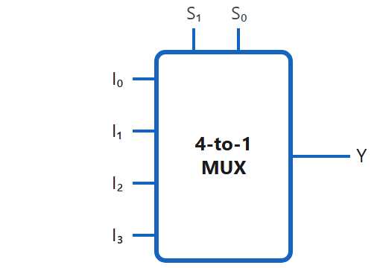
4-to-1 MUX
Topic 2.11
A 4-to-1 MUX — the 2-bit select address S₁S₀ (entering the top) picks which of I₀–I₃ reaches the output Y.
Notes:
A 4-to-1 MUX: the 2-bit select address S₁S₀ (entering the top) picks which of I₀–I₃ reaches the output Y. Try S₁S₀ = 10: the output is I₂.

Slide 73
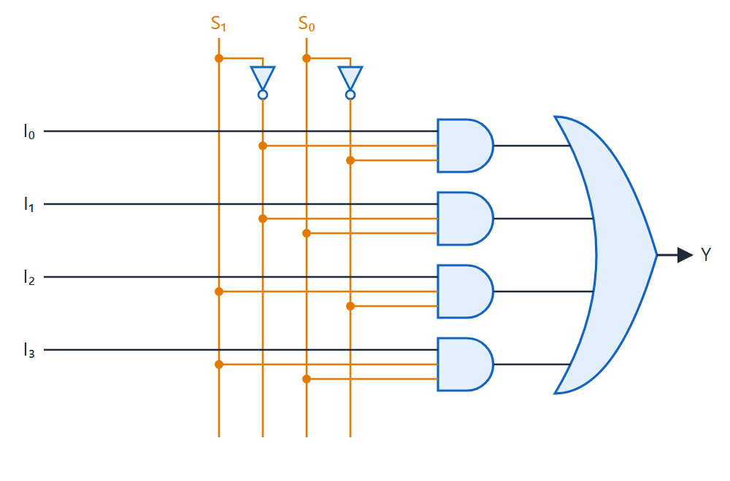
Four-to-one-line multiplexer
Topic 2.11
Four-to-one-line multiplexer. Adapted from M. Morris Mano and Michael D. Ciletti, Digital Design, Fig. 4.25.
Notes:
Gate-level view: four AND gates, each enabled by one select combination, feed one OR gate. Only one AND gate can pass its data input at a time.

Slide 74
Implementing Boolean functions with a MUX
Topic 2.11
The MUX equation has the shape of a sum of minterms: each term is a minterm of the select lines times a data input
Tie each data input to 0 or 1 to match a truth table, and the MUX is the function
An n-variable function needs a 2^{n}-to-1 MUX and no other gates
Example: XOR with S₁ = A, S₀ = B: I₀ = 0, I₁ = 1, I₂ = 1, I₃ = 0
Check: A = 1, B = 0 selects I₂ = 1, and 1 ⊕ 0 = 1 ✓
Notes:
The constants are ground and supply voltage in real hardware. The MUX’s internal structure is the entire circuit.

Slide 75
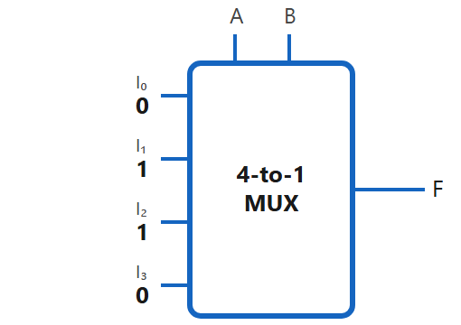
XOR from a MUX
Topic 2.11
Tying constants to the four data inputs, with A and B as the select lines, turns the MUX itself into an XOR circuit — no AND, OR, or XOR gates anywhere.
Notes:
Tying constants to the four data inputs, with A and B as the select lines, turns the MUX itself into an XOR circuit: no AND, OR or XOR gates anywhere. Constants are ground and supply voltage in real hardware.

Slide 76
Demultiplexer: the inverse operation
Topic 2.11
A DEMUX routes one data input D to one of 2^{n} outputs, chosen by n select lines
All other outputs stay 0
1-to-4 DEMUX: Y₀ = S₁′S₀′D Y₁ = S₁′S₀D Y₂ = S₁S₀′D Y₃ = S₁S₀D
A MUX answers “which input do I read?”; a DEMUX answers “which destination gets this value?”
A demultiplexer is a decoder: D takes the place of the shared enable input
Notes:
Any decoder with an enable pin can be used as a demultiplexer for free, and vice versa. Both circuits have the same structure; only the role of the extra input differs.

Slide 77
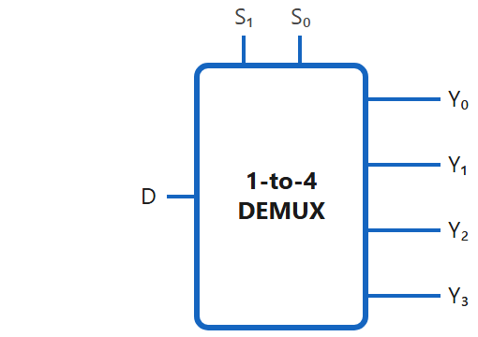
1-to-4 DEMUX
Topic 2.11
A 1-to-4 DEMUX — the select address S₁S₀ picks which single output D is routed to; every other output stays 0.
Notes:
A 1-to-4 DEMUX: the select address S₁S₀ picks which single output D is routed to; every other output stays 0. Try S₁S₀ = 01: D appears at Y₁ and all other outputs are 0.

Slide 78
2.12 Sequential Circuits
Topic 2.12
IN SIMPLE TERMS
A sequential circuit remembers: its output depends on what happened before (its state) as well as on the inputs now.
Notes:
Everything so far was combinational. A CPU cannot be built from combinational logic alone, because a program counter has to remember which instruction comes next. Read the box aloud and ask students to restate it in their own words.

Slide 79
Sequential circuits
Topic 2.12
Output depends on the present inputs and the current state: stored information about what happened before
State comes from feeding part of the output back through storage elements (latches or flip-flops)
Next State = f(Inputs, Present State)
A combinational block computes the outputs and the next state; memory elements store the next state and feed it back as the present state
Remove the present-state feedback and the circuit collapses into a combinational one
The smallest sequential circuit, the latch, stores one bit with gates and feedback alone
Notes:
Gate count is irrelevant. What makes a circuit sequential is the feedback path that stores state.

Slide 80
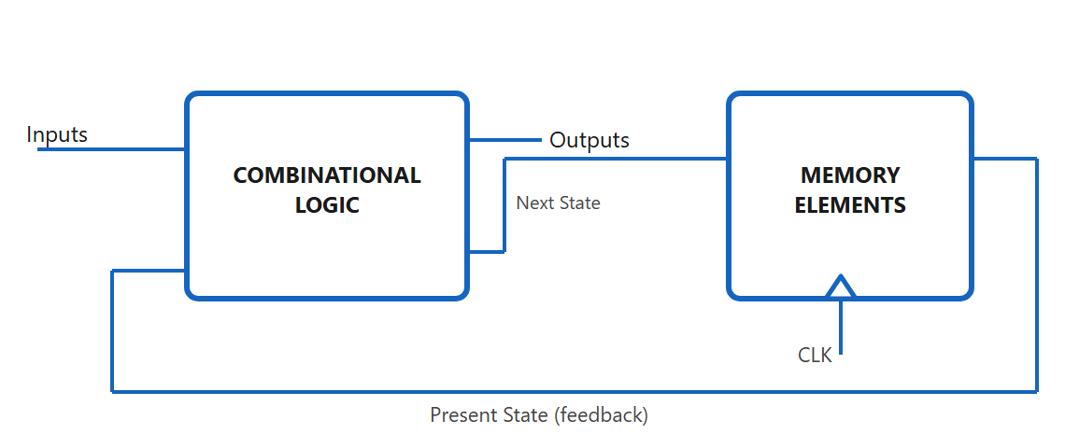
General shape of a sequential circuit
Topic 2.12
The general shape of every sequential circuit — outputs and the next state both come from the combinational block, and the present state loops back from memory to influence the next computation.
Notes:
Outputs and the next state both come from the combinational block, and the present state loops back from memory to influence the next computation. Hide the present-state feedback line and the diagram becomes combinational.

Slide 81
2.13 Latches
Topic 2.13
IN SIMPLE TERMS
A latch is two gates feeding each other, so it holds a 1 or a 0 by itself; Set and Reset change what it holds.
Notes:
A latch is the simplest sequential circuit: a single stored bit built from ordinary gates cross-wired so each output feeds the other gate. Read the box aloud and ask students to restate it in their own words.

Slide 82
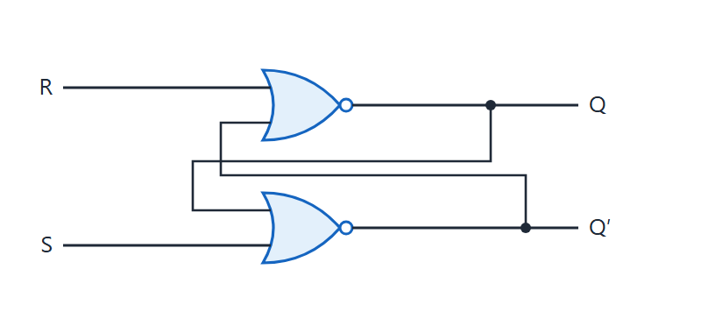
SR latch with cross-coupled NOR gates
Topic 2.13
SR latch with two cross-coupled NOR gates.
Notes:
SR latch with two cross-coupled NOR gates. Top gate: Q = NOR(R, Q′). Bottom gate: Q′ = NOR(S, Q).

Slide 83
SR latch
Topic 2.13
Q = NOR(R, Q′) Q′ = NOR(S, Q). S = R = 1 forces both Q and Q′ to 0, breaking the complement relationship the latch depends on: always avoid it.
S | R | Q_{next} | State
0 | 0 | Q | Hold
1 | 0 | 1 | Set
0 | 1 | 0 | Reset
1 | 1 | Invalid | Forbidden
Notes:
Two cross-coupled NOR gates give two stable states, which is exactly what is needed to remember one bit. S = R = 1 is the forbidden combination.

Slide 84
Worked example: tracing a sequence (start Q = 0)
Topic 2.13
Set (S=1, R=0): Q becomes 1
Hold (S=0, R=0): Q stays 1
Reset (S=0, R=1): Q returns to 0
In Hold the output stays at its last value while both inputs are 0
That hold-in-between behaviour is the whole point: it is memory
Notes:
After Set, the latch still remembers the 1 even though neither input asserts it any more. Hold is the state in which both inputs are 0.

Slide 85
The gated D latch
Topic 2.13
Drive S = D and R = D′: S and R are always complements, so the forbidden state cannot happen by construction
An Enable (EN) input, through two AND gates gating D and D′, controls when the latch updates
While EN = 1, Q follows D continuously: the latch is “transparent”
When EN drops to 0, Q freezes at whatever D was last
This is level-sensitive behaviour; a flip-flop (next topic) adds edge triggering on top
Notes:
Any glitch on D while EN is high passes straight through to Q. Gated is not the same as clocked: EN is a level, not an edge.

Slide 86
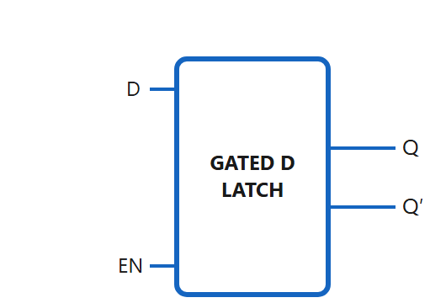
Gated D latch
Topic 2.13
Gated D latch
Notes:
Two AND gates gate D and D′ with EN before they reach the SR core. While EN = 0 neither AND gate passes anything, so the SR core holds.

Slide 87
2.14 Flip-Flops
Topic 2.14
IN SIMPLE TERMS
A flip-flop is a latch that changes only at the clock edge, so every flip-flop in a system updates at the same instant.
Notes:
A flip-flop is edge-triggered. That single change is what makes reliable counters, registers and an entire CPU datapath possible. Read the box aloud and ask students to restate it in their own words.

Slide 88
Latch versus flip-flop; race-around; master–slave
Topic 2.14
A gated D latch is level-sensitive: Q tracks D the whole time EN is high
A flip-flop is edge-triggered: it samples its inputs and updates Q only at the clock edge (↑ or ↓)
Race-around: a level-triggered JK latch with J = K = 1 toggles again and again while the clock stays high; the final state is unpredictable
Master–slave fix: two latches on opposite clock phases are never transparent together
CLK = 1: master absorbs J, K into Y; slave is latched and isolates Q
CLK = 0: master locks Y; slave becomes transparent and copies Q = Y: Q changes only on the falling edge
Notes:
Because the master is already locked when Q changes, there is no race however long either clock phase lasts. Ask students why one latch alone would race-around.

Slide 89
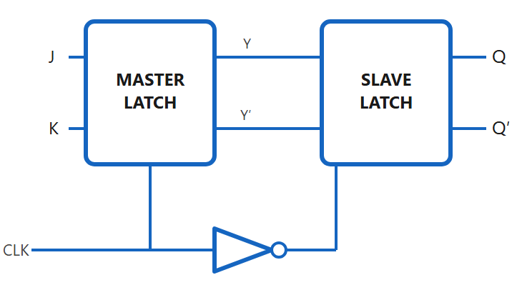
Master–slave JK flip-flop
Topic 2.14
Master–slave JK flip-flop
Notes:
Follow the two latches: while CLK = 1 the master is transparent and the slave is latched; while CLK = 0 the master is locked and the slave copies Y to Q. The inverter in the clock path gives the slave the opposite phase.

Slide 90
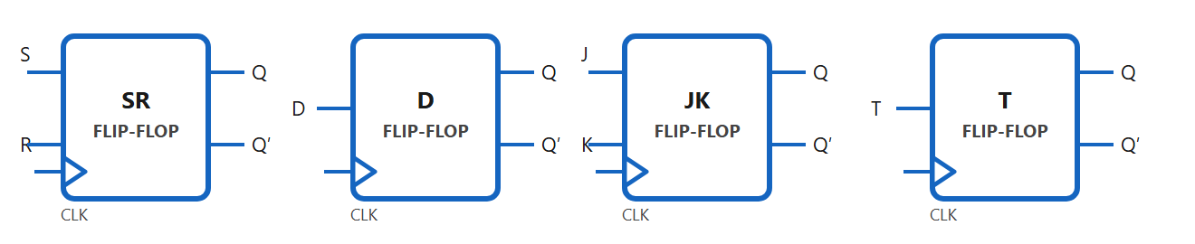
Flip-flop block symbols
Topic 2.14
SR (Set/Reset), D (single data line), JK (no forbidden state), and T (Toggle) — the CLK triangle at bottom-left is present on all four.
Notes:
SR (Set/Reset), D (single data line), JK (no forbidden state) and T (Toggle). The CLK triangle at bottom-left is present on all four, and every type has the same Q and Q′ outputs.

Slide 91
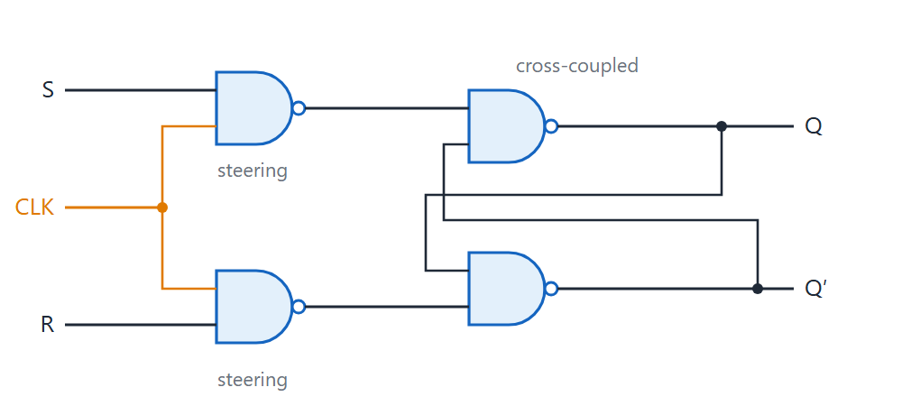
Gate-level clocked SR flip-flop
Topic 2.14
While CLK=0, both steering gates output 1 regardless of S/R, so the cross-coupled pair simply holds its last state. While CLK=1, S and R (inverted by the steering NANDs) can set or reset the latch — which is exactly why this simple design still race-arounds if CLK stays high too long, and why the master-slave structure above is needed in practice.
Notes:
While CLK = 0, both steering gates output 1 regardless of S/R, so the cross-coupled pair simply holds its last state. While CLK = 1, S and R can set or reset the latch, which is why this simple design still race-arounds if CLK stays high too long and why the master–slave structure is needed in practice.

Slide 92
Characteristic and excitation equations (1 of 2)
Topic 2.14
The characteristic equation gives Q_{n+1} from the inputs and Q_{n}; the excitation table gives the inputs needed for a wanted transition.
Type | Characteristic equation | Q_{n} → Q_{n+1} | Required input(s)
D | Q_{n+1} = D | 0 → 0 | D = 0
 |  | 0 → 1 | D = 1
 |  | 1 → 0 | D = 0
 |  | 1 → 1 | D = 1
T | Q_{n+1} = T ⊕ Q_{n} | 0 → 0 | T = 0
 |  | 0 → 1 | T = 1
 |  | 1 → 0 | T = 1
 |  | 1 → 1 | T = 0
Notes:
Read the excitation table in the direction needed for design: given the transition you want, what inputs are required. D and T have no don’t-cares.

Slide 93
Characteristic and excitation equations (2 of 2)
Topic 2.14
X (don’t-care) entries in JK are what a later K-map step exploits to get a smaller circuit. SR has don’t-cares here too; D and T do not.
Type | Characteristic equation | Q_{n} → Q_{n+1} | Required input(s)
JK | Q_{n+1} = JQ_{n}′ + K′Q_{n} | 0 → 0 | J = 0, K = X
 |  | 0 → 1 | J = 1, K = X
 |  | 1 → 0 | J = X, K = 1
 |  | 1 → 1 | J = X, K = 0
SR | Q_{n+1} = S + R′Q_{n} (SR = 0) | 0 → 0 | S = 0, R = X
 |  | 0 → 1 | S = 1, R = 0
 |  | 1 → 0 | S = 0, R = 1
 |  | 1 → 1 | S = X, R = 0
Notes:
The X entries are what makes counter design simple, as the synchronous counter topic shows. Compare with the D and T tables on the previous slide, which have none.

Slide 94
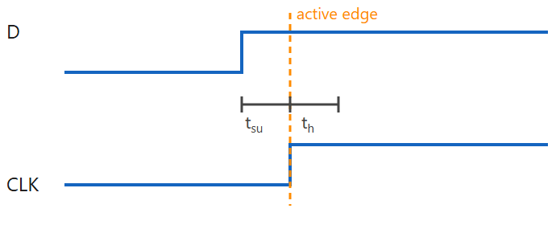
Setup time, hold time and clock skew
Topic 2.14
Setup time, hold time and clock skew
Notes:
The diagram shows D relative to the active clock edge: the window before the edge is the setup time and the window after it is the hold time. Setup time and hold time together form a window around the clock edge.

Slide 95
Setup time, hold time and clock skew
Topic 2.14
Setup time (t_{su}): the minimum time D must be stable before the active clock edge
Hold time (t_{h}): the minimum time D must stay stable after the active clock edge
Clock skew: the difference in clock arrival time at different flip-flops, from unequal interconnect delay; it eats into setup and hold margin
Violating setup or hold risks metastability: the output hovers between 0 and 1 before resolving unpredictably
Real designs budget setup and hold margin explicitly
Notes:
Enough skew can make a flip-flop sample data before it is stable, even if the design looks correct on paper. This is why designs budget margin instead of assuming perfect timing.

Slide 96
2.15 Analysis of Clocked Sequential Circuits
Topic 2.15
IN SIMPLE TERMS
To analyse a sequential circuit, write what each flip-flop input will be, then list every state and input to see where the circuit goes next.
Notes:
Sequential circuits have their own analysis procedure. It leads from a flip-flop circuit back to equations, a state table and a state diagram. Read the box aloud and ask students to restate it in their own words.

Slide 97
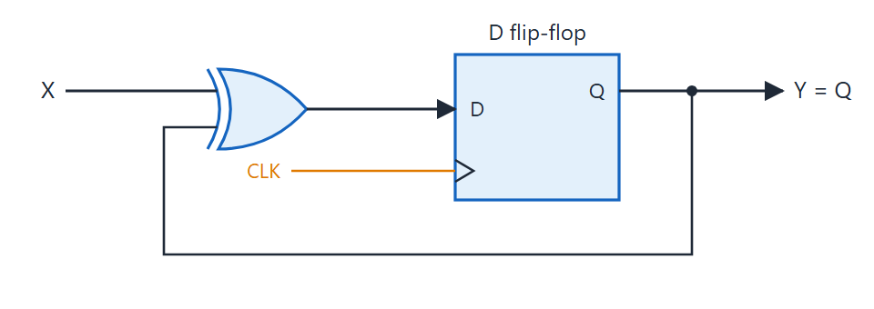
Worked example circuit
Topic 2.15
D = X ⊕ Q, and the flip-flop's own Q feeds straight back as one of the XOR's inputs.
Notes:
D = X ⊕ Q, and the flip-flop’s own Q feeds straight back as one of the XOR’s inputs. The output Y is simply Q.

Slide 98
Next-state and output equations
Topic 2.15
Next-state equation: D = X ⊕ Q
Output equation: Y = Q
D is what Q becomes after the next clock edge
Step 1: write the Boolean expression feeding each flip-flop input (next state) and each external output
One D flip-flop (present state Q), one input X, one output Y
Notes:
Whatever value reaches the D input is exactly what the flip-flop holds after the next clock edge. Next we tabulate every present state and input.

Slide 99
Step 2: state table
Topic 2.15
Every present-state/input combination appears exactly once. Y depends only on the present state: a Moore machine.
Present State (Q) | Input (X) | Next State (D) | Output (Y)
0 | 0 | 0 | 0
0 | 1 | 1 | 0
1 | 0 | 1 | 1
1 | 1 | 0 | 1
Notes:
Read a row like this: in state Q = 0, when X = 1 arrives the next state becomes 1, and the output Y was 0. The table has four rows for one flip-flop and one input.

Slide 100
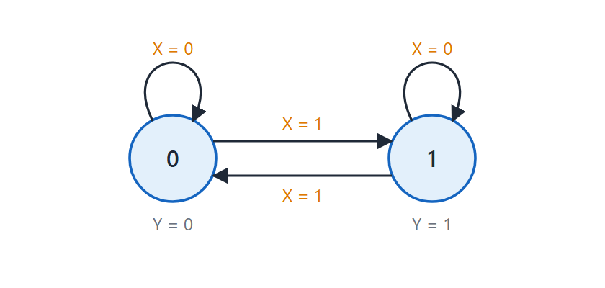
Step 3: state diagram
Topic 2.15
State diagram — X=0 keeps the circuit in its current state, X=1 always flips it. Each circle's output Y is shown attached to the state, since Y depends only on present state here.
Notes:
X = 0 keeps the circuit in its current state and X = 1 always flips it. Each circle’s output Y is shown attached to the state, since Y depends only on the present state. One circle per state, and a directed arrow for every present-state/input combination, labelled with the input. From state 0, an X = 0 self-loop stays at 0 and an X = 1 arrow leaves for state 1. State 1 behaves as the mirror image. This circuit is a T flip-flop in disguise: D = X ⊕ Q is the T characteristic equation with T renamed X.

Slide 101
2.16 Registers
Topic 2.16
IN SIMPLE TERMS
A register is a row of flip-flops that store a binary word together, all updated by the same clock.
Notes:
A single flip-flop stores one bit. Several flip-flops sharing one clock form a register that can hold and move multi-bit data. Read the box aloud and ask students to restate it in their own words.

Slide 102
Registers and parallel load
Topic 2.16
An n-bit register is n D flip-flops, one per bit, all clocked together
Each D input has its own data line: bits load independently and in parallel
On every active clock edge it captures its data inputs and holds them until the next edge
A plain register captures new data on every clock edge
Add a LOAD line and a 2-to-1 MUX at each D input: LOAD = 0 selects Q (hold), LOAD = 1 selects new data I (load)
All bits share the same LOAD and clock: the register holds everything or loads everything
Notes:
This is the circuit behind every named register in a CPU, shown down at flip-flop level. The LOAD control comes next.

Slide 103
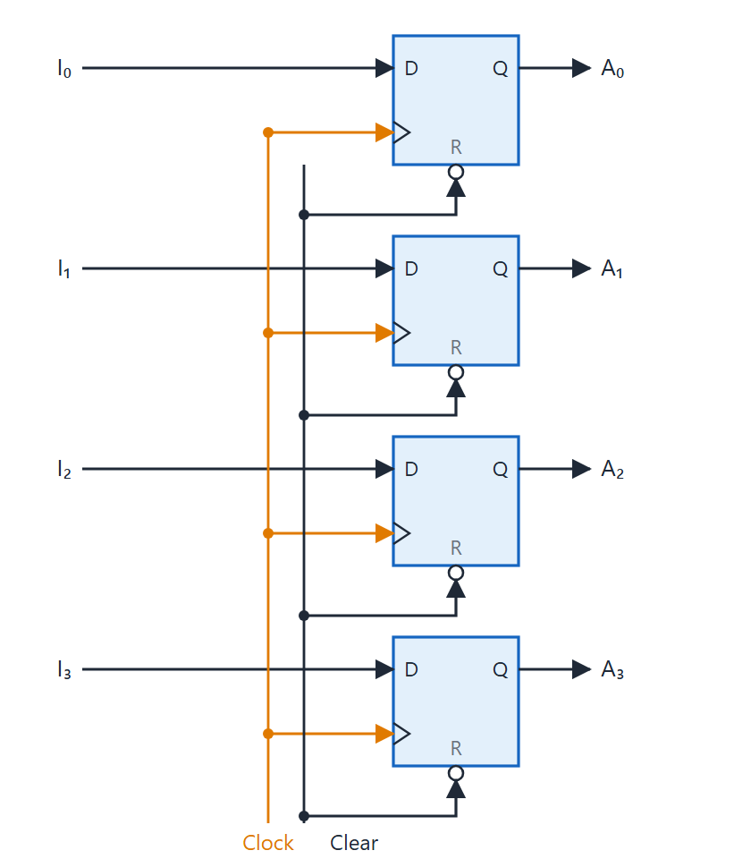
Four-bit register
Topic 2.16
Four D flip-flops share one clock
Each flip-flop has its own dedicated data line
An active-low Clear input resets the register
On every active clock edge the register captures its inputs and holds them until the next edge
Four-bit register: four D flip-flops sharing Clock, with an active-low Clear. Adapted from M. Morris Mano and Michael D. Ciletti, Digital Design, Fig. 6.1.
Notes:
Four D flip-flops share one clock, and each has its own data input. An active-low Clear input resets the register.

Slide 104
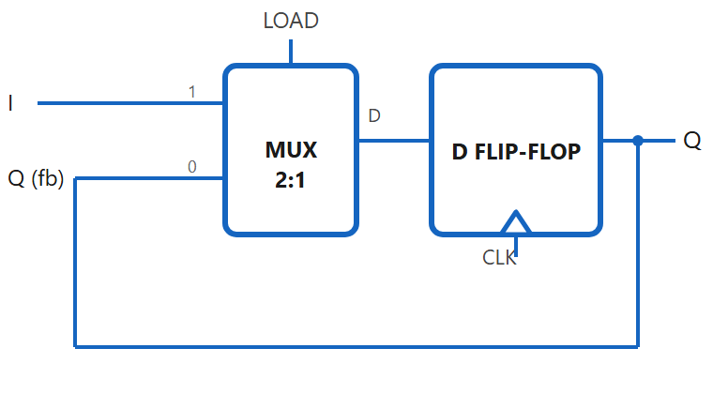
One bit of a register with parallel load
Topic 2.16
One bit of a register with parallel load. LOAD=0 selects input 0 (Q fed back, hold); LOAD=1 selects input 1 (new data I, load). Every bit repeats this exact circuit.
Notes:
LOAD = 0 selects input 0 (Q fed back, hold); LOAD = 1 selects input 1 (new data I, load). Every bit repeats this exact circuit.

Slide 105
Worked example: hold, load, hold (Q = 0, I = 1 throughout)
Topic 2.16
Clock 1: LOAD=0 → MUX selects Q(=0) → D=0 → Q stays 0 (hold)
Clock 2: LOAD=1 → MUX selects I(=1) → D=1 → Q becomes 1 (load)
Clock 3: LOAD=0 → MUX selects Q(=1) → D=1 → Q stays 1 (hold)
I = 1 is present on every clock edge, but only Clock 2 captures it
Notes:
The MUX decides, clock by clock, whether new data is allowed in at all. Ask students what Q would be if LOAD stayed 0 throughout.

Slide 106
2.17 Shift Registers
Topic 2.17
IN SIMPLE TERMS
A shift register passes its bits along one place per clock, like a bucket brigade for bits, so data can enter or leave one bit at a time.
Notes:
A shift register is a chain of flip-flops where each stage’s D input is the previous stage’s Q. Serial or parallel refers only to how data enters and leaves. Read the box aloud and ask students to restate it in their own words.

Slide 107
Shift registers, SISO and SIPO
Topic 2.17
A shift register is a cascade of flip-flops sharing one clock; each stage’s D is the previous stage’s Q
On every clock pulse every stored bit moves one position down the chain
Serial/parallel describes only how data goes in and out; the shifting structure never changes
SISO: in one bit at a time, out one bit at a time from the last stage: delay lines and buffering (output = input delayed by N clocks)
SIPO: same chain, every stage’s Q tapped out: serial-to-parallel conversion, e.g. a UART receiver
Notes:
The first letter is how data enters and the second is how it leaves. The next slide shows the basic chain.

Slide 108
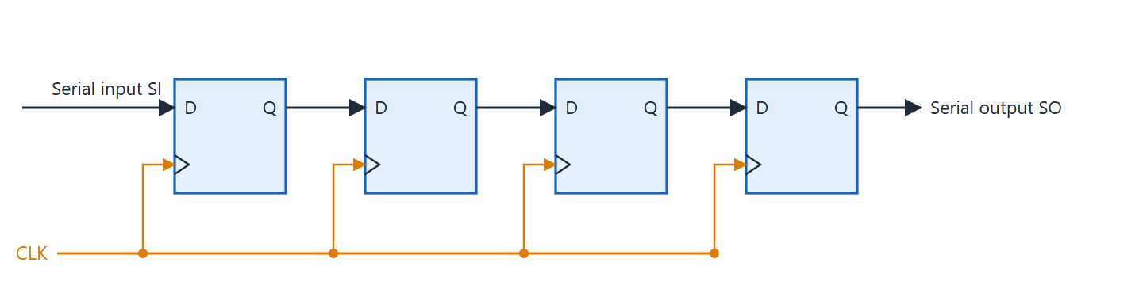
Four-bit shift register
Topic 2.17
Four-bit shift register: each Q feeds the next D on every clock edge. Adapted from M. Morris Mano and Michael D. Ciletti, Digital Design, Fig. 6.3.
Notes:
Each Q feeds the next D on every clock edge. The serial input enters the first stage and the serial output leaves the last stage.

Slide 109
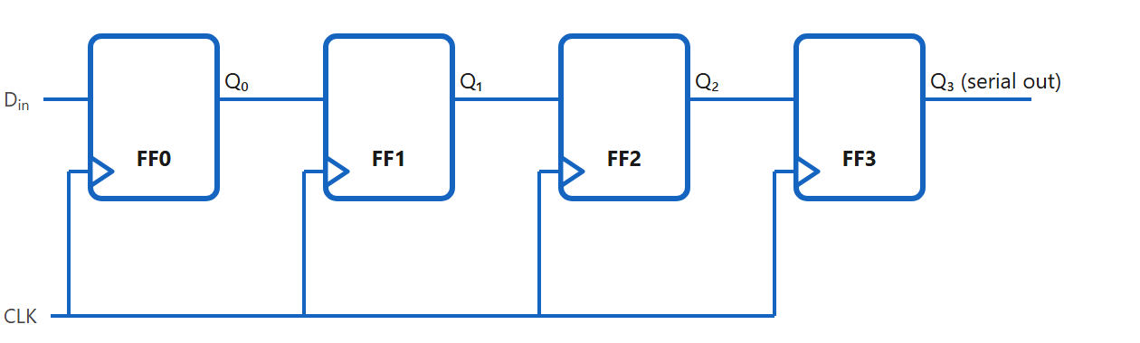
SISO: serial-in, serial-out
Topic 2.17
SISO: serial-in, serial-out
Notes:
Data enters at Din and exits one bit at a time from the last stage, Q₃. After four clocks, the first bit entered has reached Q₃.

Slide 110
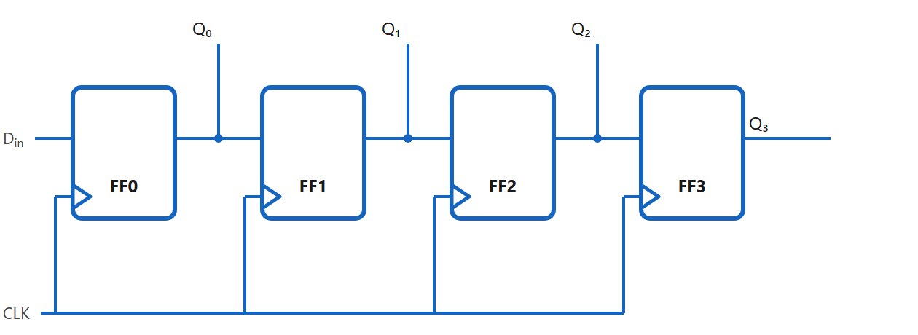
SIPO: serial-in, parallel-out
Topic 2.17
SIPO: serial-in, parallel-out
Notes:
Same chain and serial input, but every stage’s Q is also a separate pin. After four clocks the bits Q₀–Q₃ are read together.

Slide 111
PISO and PIPO
Topic 2.17
PISO: a 2-to-1 MUX in front of each D chooses the previous stage’s Q (shift) or an external parallel bit In (load)
One shared SHIFT/LOAD′ control line: 1 = shift, 0 = load
Typical use: parallel-to-serial conversion, e.g. a UART transmitter loads a byte in one clock and shifts it out
PIPO: all 4 bits load and read independently, with no connections between stages
PIPO is functionally the plain register from the previous topic: the “no shifting” end of the family
SISO and SIPO have no MUX and no control line: they only shift
Notes:
Leaving SHIFT/LOAD′ at 0 after the load clock keeps reloading the same data instead of shifting. PIPO is the same as a plain register.

Slide 112
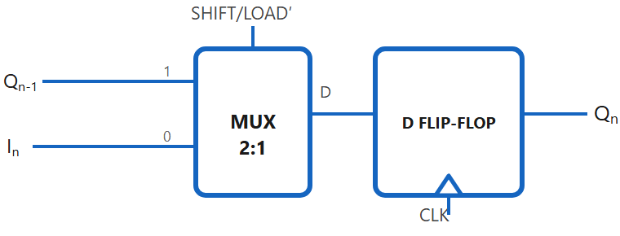
One PISO cell
Topic 2.17
One PISO cell. SHIFT/LOAD′=1 selects Qn-1 (shift in from the previous stage); =0 selects In (load this stage's parallel bit directly). The final stage's Q is the serial output.
Notes:
One PISO cell. SHIFT/LOAD′ = 1 selects Q(n−1), shifting in from the previous stage; 0 selects In, loading this stage’s parallel bit directly. The final stage’s Q is the serial output.

Slide 113
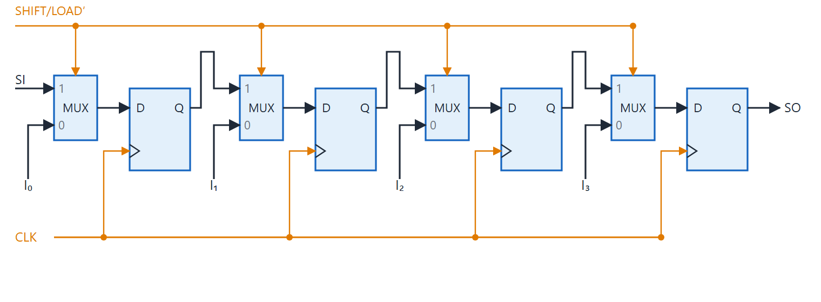
4-bit PISO register
Topic 2.17
SI (serial-in) ties the very first stage's shift input low when there's no earlier stage to shift from. I₀–I₃ are the four parallel-load pins, and every MUX shares the same SHIFT/LOAD′ control line and CLK.
Notes:
SI ties the very first stage’s shift input low when there is no earlier stage to shift from. I₀–I₃ are the four parallel-load pins, and every MUX shares the same SHIFT/LOAD′ control line and CLK.

Slide 114
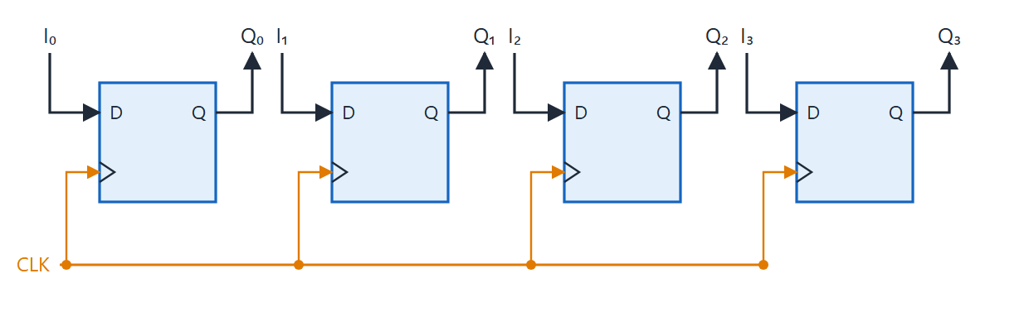
PIPO: parallel-in, parallel-out
Topic 2.17
Parallel-in, parallel-out: no connections between stages — all four bits load together on the clock edge.
Notes:
Parallel-in, parallel-out: no connections between stages. All four bits load together on the clock edge.

Slide 115
Shift versus parallel-load operation
Topic 2.17
SHIFT/LOAD′ | Each stage’s D input becomes | Result
1 (Shift) | Previous stage’s Q (serial-in for the first stage) | Data moves one position per clock
0 (Load) | External parallel bit I_{n} | All stages capture parallel data simultaneously
Notes:
PISO and PIPO need this control line. SISO and SIPO do not, since they have no parallel-load path.

Slide 116
2.18 Ripple Counters
Topic 2.18
IN SIMPLE TERMS
In a ripple counter each flip-flop toggles the next one, so a count change ripples down the chain instead of happening all at once.
Notes:
A counter cycles through a fixed sequence of binary states on every clock pulse. In a ripple counter only the first flip-flop gets the external clock. Read the box aloud and ask students to restate it in their own words.

Slide 117
Asynchronous (ripple) up-counter
Topic 2.18
In an asynchronous (ripple) counter only the first flip-flop gets the external clock; every later stage is clocked by the previous stage’s output
The new count ripples through the chain one stage at a time
3-bit up-counter: negative-edge T flip-flops, each with T = 1
FF0 (LSB) toggles every clock; FF1 toggles when Q₀ falls; FF2 when Q₁ falls
Each stage runs at half the frequency of the one before: binary counting
Sequence: 000 → 001 → 010 → 011 → 100 → 101 → 110 → 111 → 000 …
Notes:
Each successive Q is half the frequency of the previous one, so a ripple counter is also a divide-by-2ⁿ circuit. The sequence is plain binary counting.

Slide 118
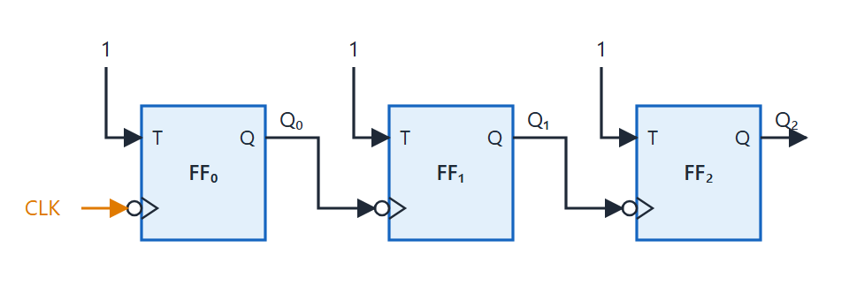
3-bit ripple up-counter
Topic 2.18
Three-bit ripple up-counter: negative-edge T flip-flops (bubble on the clock input), each clocked by the previous Q.
Notes:
Three-bit ripple up-counter: negative-edge T flip-flops (bubble on the clock input), each clocked by the previous Q. Follow the clock from the external pin to FF0, then from Q₀ to FF1 and from Q₁ to FF2.

Slide 119
Up and down counter rules
Topic 2.18
Negative-edge + Q, or positive-edge + Q′, count up; the other two combinations count down.
Clock triggering | Next stage driven by | Counter mode
Negative edge (↓) | Q | UP
Negative edge (↓) | Q′ | DOWN
Positive edge (↑) | Q | DOWN
Positive edge (↑) | Q′ | UP
Notes:
Q′ falls exactly when Q rises, so driving the next stage from Q′ flips which transition ripples the carry forward. Check each of the four rows of the table against this rule.

Slide 120
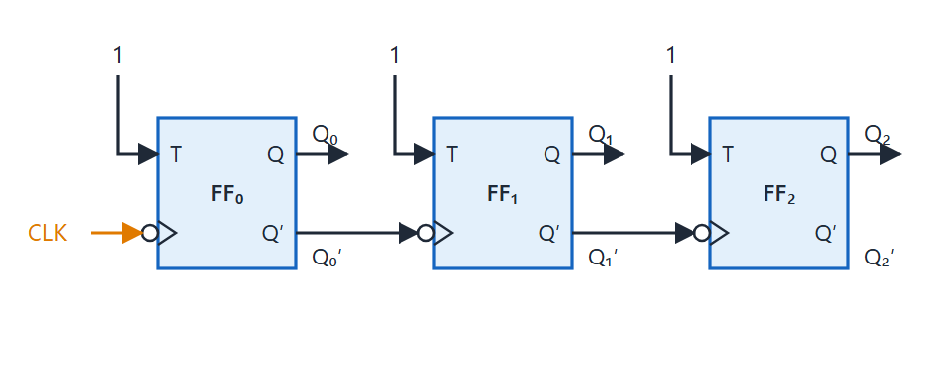
3-bit ripple down-counter
Topic 2.18
Three-bit ripple down-counter: the same chain, each stage clocked by the previous Q′.
Notes:
Three-bit ripple down-counter: the same chain, each stage clocked by the previous Q′. Sequence: 111 → 110 → 101 → 100 → 011 → 010 → 001 → 000 → 111 … Compare the wiring with the up-counter: only the source of each clock changes.

Slide 121
Modulo-10 (BCD) ripple counter
Topic 2.18
Required FFs: 2^{n} ≥ 10 ⟹ n = 4 flip-flops (Q3Q2Q1Q0)
Reset state: Q3Q2Q1Q0 = 1010 (Q3 = 1 and Q1 = 1)
Clear logic: CLR′ = (Q3 · Q1)′
A plain 4-bit ripple counter is mod-16; reset to 0000 the instant it would reach 1010
The NAND output CLR′ drops to 0 and asynchronously clears every stage
The brief 1010 can glitch the outputs; a synchronous clear after 1001 avoids it
Notes:
The count never settles at 1010; it flashes through it as a reset trigger. The trigger uses the bit pattern of the target count, not the number 10.

Slide 122
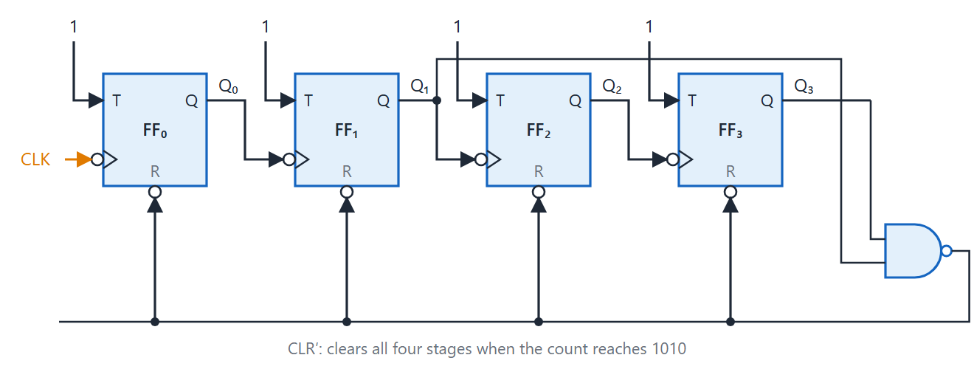
Mod-10 ripple counter
Topic 2.18
Mod-10 ripple counter: a NAND gate detects 1010 (Q₃ = Q₁ = 1) and clears all four stages.
Notes:
Mod-10 ripple counter: a NAND gate detects 1010 (Q₃ = Q₁ = 1) and clears all four stages. Q₃ and Q₁ tap off the main chain and CLR′ runs along the bottom into every CLR pin.

Slide 123
2.19 Synchronous Counters
Topic 2.19
IN SIMPLE TERMS
In a synchronous counter every flip-flop hears the same clock tick; gates decide which ones toggle, so all bits change together.
Notes:
Every flip-flop shares one common clock, so all stages update at the same instant. That removes the accumulated ripple delay but needs extra logic for each stage’s inputs. Read the box aloud and ask students to restate it in their own words.

Slide 124
Synchronous counters: design procedure
Topic 2.19
Every flip-flop uses the same clock; no ripple delay accumulates
Cost: extra combinational logic to compute each stage’s inputs
1. State table: each present state → required next state
2. Excitation table: inputs each transition requires
3. K-map minimisation: each flip-flop input is a function of the present state
4. Circuit: wire the simplified logic and tie every clock to one common line
Notes:
These four steps generalise to any finite state machine. Example: a 3-bit up-counter with JK flip-flops, state A B C with A the MSB.

Slide 125
3-bit up-counter with JK flip-flops
Topic 2.19
Steps 1 and 2 combined: the required next state and the JK excitation values.
A_{n}B_{n}C_{n} | A_{n+1}B_{n+1}C_{n+1} | J_{A},K_{A} | J_{B},K_{B} | J_{C},K_{C}
000 | 001 | 0, X | 0, X | 1, X
001 | 010 | 0, X | 1, X | X, 1
010 | 011 | 0, X | X, 0 | 1, X
011 | 100 | 1, X | X, 1 | X, 1
100 | 101 | X, 0 | 0, X | 1, X
101 | 110 | X, 0 | 1, X | X, 1
110 | 111 | X, 0 | X, 0 | 1, X
111 | 000 | X, 1 | X, 1 | X, 1
Notes:
Each row gives the present state, the next state and the J, K values that produce the transition. The X entries are don’t-cares.

Slide 126

K-map for J of flip-flop A
Topic 2.19
K-map for J_{A}: the 1 at m3 groups with don't-care m7, giving J_{A} = BC.
Notes:
K-map for JA: the 1 at m3 groups with don’t-care m7, giving JA = BC. Both J and K for flip-flop A end up equal to BC.

Slide 127

K-map for K of flip-flop A
Topic 2.19
K-map for K_{A}: the 1 at m7 groups with don't-care m3, giving K_{A} = BC.
Notes:
K-map for KA: the 1 at m7 groups with don’t-care m3, giving KA = BC. The groups use the don’t-care cells.

Slide 128
Stages B and C; the circuit
Topic 2.19
Both maps group the same pair (BC = 11, both A rows): J_{A} = K_{A} = BC
J_{C} = 1, K_{C} = 1: C toggles every clock, like the ripple counter’s LSB
J_{B} = C, K_{B} = C: B toggles precisely when C is 1
In each stage J and K are tied together: “toggle when this condition is true”
Down-counter: every toggle condition is the same with B and C inverted: J_{C} = K_{C} = 1; J_{B} = K_{B} = C′; J_{A} = K_{A} = B′C′
Two inverters feed an AND gate in place of the up-counter’s direct AND of B and C
Notes:
All clock triangles tap one CLK line: that single shared bus is the structural difference from the ripple counter. Compare this with the ripple counter, where each stage had its own clock.

Slide 129

3-bit synchronous up-counter
Topic 2.19
Three-bit synchronous up-counter: J and K of each flip-flop are tied together; all clocks share CLK.
Notes:
Three-bit synchronous up-counter: J and K of each flip-flop are tied together; all clocks share CLK. FF(C) always toggles, FF(B) takes C, and FF(A) takes the AND of B and C.

Slide 130

3-bit synchronous down-counter
Topic 2.19
Three-bit synchronous down-counter: inverters supply C′ and B′; the AND gate forms B′C′.
Notes:
Three-bit synchronous down-counter: inverters supply C′ and B′; the AND gate forms B′C′. Same three flip-flops and shared clock as the up-counter.

Slide 131
2.20 Other Counters
Topic 2.20
IN SIMPLE TERMS
A ring counter passes a single 1 around a loop of flip-flops; a Johnson counter feeds back the inverted bit, so it gets twice as many states from the same flip-flops.
Notes:
The ring and Johnson counters are built directly from a shift register. A decade counter is a general building block that we meet at the end. Read the box aloud and ask students to restate it in their own words.

Slide 132
Ring counter
Topic 2.20
Feed the last stage’s output back to the first stage’s input of a shift register: no external serial data
N states for N flip-flops: a single 1 (or single 0) circulates
4-bit sequence, pre-loaded to 1000: 1000 → 0100 → 0010 → 0001 → 1000 …
Must be pre-loaded: reset gives 0000, a stuck state (Q₃ = 0 feeds D₀ = 0 forever)
Notes:
A ring counter needs an explicit preset pulse before the first clock. It is the basis of LED chaser displays.

Slide 133

Four-bit ring counter
Topic 2.20
Four-bit ring counter: Q₃ feeds back to D₀.
Notes:
Four-bit ring counter: Q₃ feeds back to D₀. Pre-load 1000 and watch the single 1 move one place per clock.

Slide 134
Johnson counter (twisted-ring counter)
Topic 2.20
Feed back the inverted last output: the circulating bit becomes a spreading and retreating band
2N states for N flip-flops: twice the ring counter
4-bit sequence from reset (0000): 0000 → 1000 → 1100 → 1110 → 1111 → 0111 → 0011 → 0001 → 0000 …
Self-starting from 0000: Q₃′ = 1 feeds D₀ = 1 on the next clock
Notes:
Each state differs from its neighbour in one bit, which avoids decoding glitches. Identifying a state needs a 2-input gate per state.

Slide 135

Four-bit Johnson counter
Topic 2.20
Four-bit Johnson counter: Q₃′ feeds back to D₀.
Notes:
Four-bit Johnson counter: Q₃′ feeds back to D₀. Start from 0000 and watch the band of 1s grow and then shrink.

Slide 136
Ring counter versus Johnson counter
Topic 2.20
Feature | Ring counter | Johnson counter
Number of states | N | 2N
Feedback connection | D₀ = Q_{N-1} | D₀ = Q′_{N-1}
Initialization | Requires pre-loading (e.g., 1000) | Self-starting from reset (0000)
Decoding a state | Single bit is already the decoded output | Needs a 2-input gate per state to decode
Notes:
Use this table to compare the two counters on states, feedback, start-up and decoding. Ask which counter needs more decoding.

Slide 137

Decade counter
Topic 2.20
Decade counter: counts 0000 to 1001, with a carry output at 9 for the next decade.
Notes:
Decade counter: counts 0000 to 1001, with a carry output at 9 for the next decade. A decade counter is any counter with 10 states that wraps 9 → 0: the ripple version adds a NAND reset gate, and a synchronous version needs no reset gate. The 7490 is a ripple decade counter, and the 74160/74162 family is synchronous with parallel load.

Slide 138
Unit 2 summary (1 of 2)
2.1 Combinational circuits: output depends only on current inputs; no feedback
2.2 Analysis: label gate outputs, write expressions, substitute, tabulate
2.3 Design: specification, truth table, simplify, draw and verify
2.4 Binary adder: half adder, full adder, ripple carry chain of full adders
2.5 Binary subtractor: A − B = A + B′ + 1; XOR gates and M make an adder–subtractor
2.6 BCD adder: binary add, then add 0110 when Output carry = K + Z₈Z₄ + Z₈Z₂
2.7 Binary multiplier: AND gates for partial products, adders for the columns
2.8 Magnitude comparator: compare from the MSB; the first differing bit decides
2.9 Decoders: n inputs select one of 2^{n} outputs; each output is a minterm
2.10 Encoders: output the code of the active input; a priority encoder picks the highest
Notes:
Recap the combinational logic topics. Ask students which building block they would use to select one of eight memory chips.

Slide 139
Unit 2 summary (2 of 2)
2.11 Multiplexers: select one of 2^{n} inputs; with constants on the inputs a MUX implements a function
2.12 Sequential circuits: output depends on inputs and state; next state = f(inputs, present state)
2.13 Latches: cross-coupled gates hold a bit; the gated D latch is level-sensitive
2.14 Flip-flops: edge-triggered; characteristic and excitation tables; setup and hold time
2.15 Analysis of sequential circuits: next-state equations, state table, state diagram
2.16 Registers: D flip-flops sharing a clock; LOAD with a MUX gives hold or load
2.17 Shift registers: SISO, SIPO, PISO and PIPO; SHIFT/LOAD′ picks shift or load
2.18 Ripple counters: each stage clocks the next; mod-10 by NAND reset at 1010
2.19 Synchronous counters: one shared clock; J and K from state table, excitation table and K-map
2.20 Other counters: ring (N states), Johnson (2N states), decade counter
Key applications: adders in every ALU; decoders for memory address selection; MUXes for data routing; registers and counters in CPUs
Notes:
Recap the sequential logic topics and finish with where these blocks are used. Leave time for questions.

