Slide 1
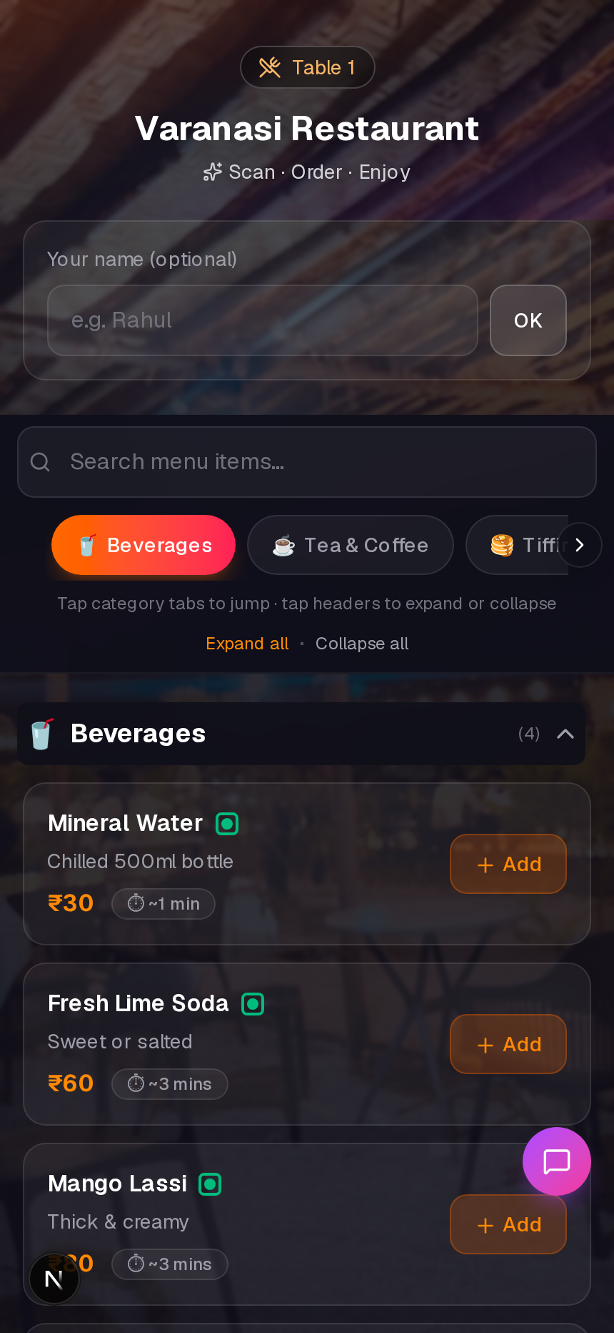
RESTAURANT OPERATING SYSTEM
TableTap
Scan · Order · Serve · Grow
QR dining + kitchen ops + payments + Swiggy/Zomato — one platform, zero app download for guests.
📱 No guest app
Scan & order
👨‍🍳 Live kitchen
Timers + KDS
🛵 Aggregator sync
Swiggy · Zomato
📊 Owner control
Menu · QR · Reports
TableTap · 1/18
01

Slide 2
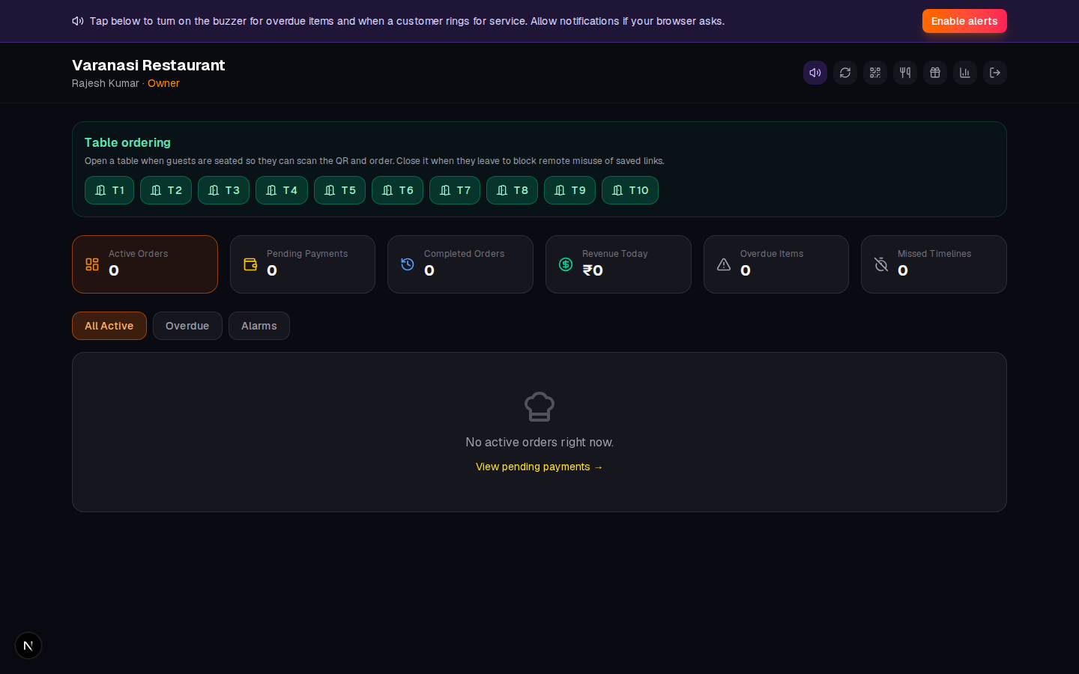
OWNER PAIN POINTS
Problems every restaurant faces
Before TableTap
Slow ordering
Guests wait for staff during rush
Kitchen chaos
Paper chits, shouting, mistakes
Payment delays
Tables blocked, turnover drops
Remote fraud
Saved QR links order from home
Aggregator overload
Swiggy + Zomato + dine-in = 3 systems
No visibility
Owner finds out revenue at day end
TableTap · 2/18
02

Slide 3
COMPLETE SOLUTION
One platform — full service
Guest QR ordering
Secure check-in, cart, rewards
Staff dashboard
Live board, alerts, payments
Kitchen KDS
Station-routed tickets
Floor plan
Table map + server assign
Takeaway & delivery
Walk-in, pack, ship
Swiggy / Zomato
Auto ingest + menu sync
Core included · Premium modules toggle on without downtime
TableTap · 3/18
03

Slide 4
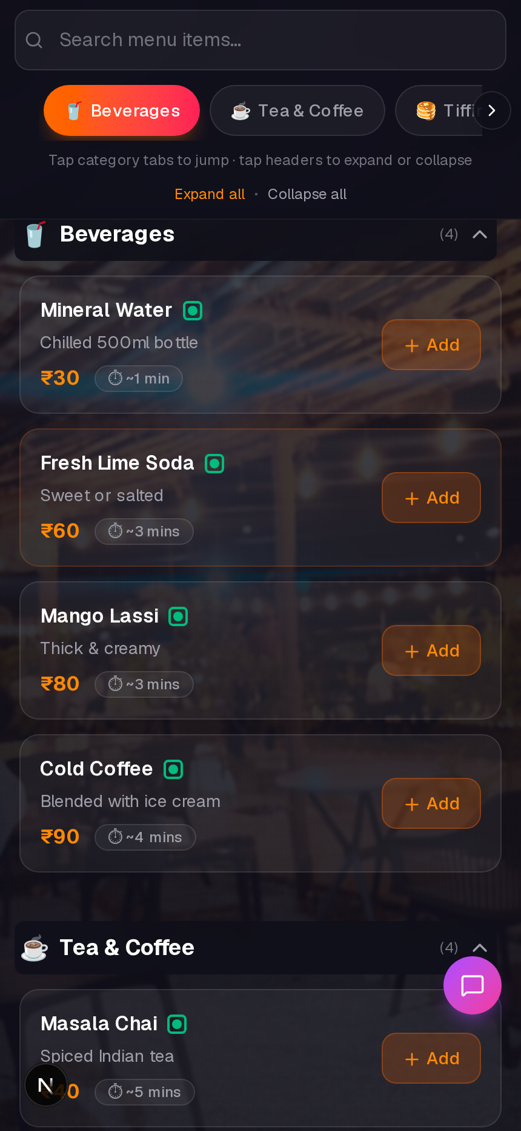
NO APP · NO LOGIN
Guest experience guests love
Secure check-in
Staff opens table first
Browse & order
Categories, prep times
Track & pay
Timer + PhonePe QR
Rewards
Spin wheel while waiting
TableTap · 4/18
04

Slide 5
SECURITY BUILT IN
Stops remote order misuse
Staff opens table
Only seated guests can order
Guest scans QR
Check-in cookie issued
Orders flow
Saved links stay blocked
Table closes
Auto after payment or manual
1
2
3
4
LESS FOOD WASTE
STAFF IN CONTROL
SESSION LIMITS
TableTap · 5/18
05

Slide 6
LIVE OPERATIONS
Staff dashboard — mission control
Live order board
All tables, all channels
Prep timers
Overdue alerts + sound
Mark ready / served
Full item lifecycle
Open / close tables
One tap control
TableTap · 6/18
06

Slide 7
PREMIUM · ENDS PAPER CHITS
Kitchen Display System
🔥 Station routing
Hot · Grill · Bar · Cold
📺 Large ticket UI
Cook-friendly, high contrast
🔄 Same order stream
Dine-in + takeaway + Swiggy
🖨️ Auto kitchen chit print
Bluetooth ESC/POS when enabled
✅ Status → aggregators
Ready / picked up pushed to Swiggy/Zomato
PREMIUM MODULE: kds
TableTap · 7/18
07

Slide 8
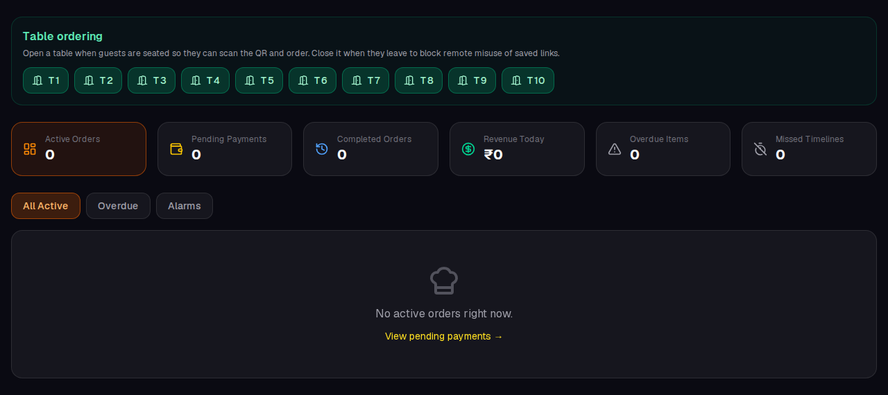
PREMIUM · VISUAL TABLE MAP
Floor plan for servers
Seat & assign
Server ownership
Live bill total
Per-table revenue
Timer per table
Turnover insight
Open / close
Table control
TableTap · 8/18
08

Slide 9
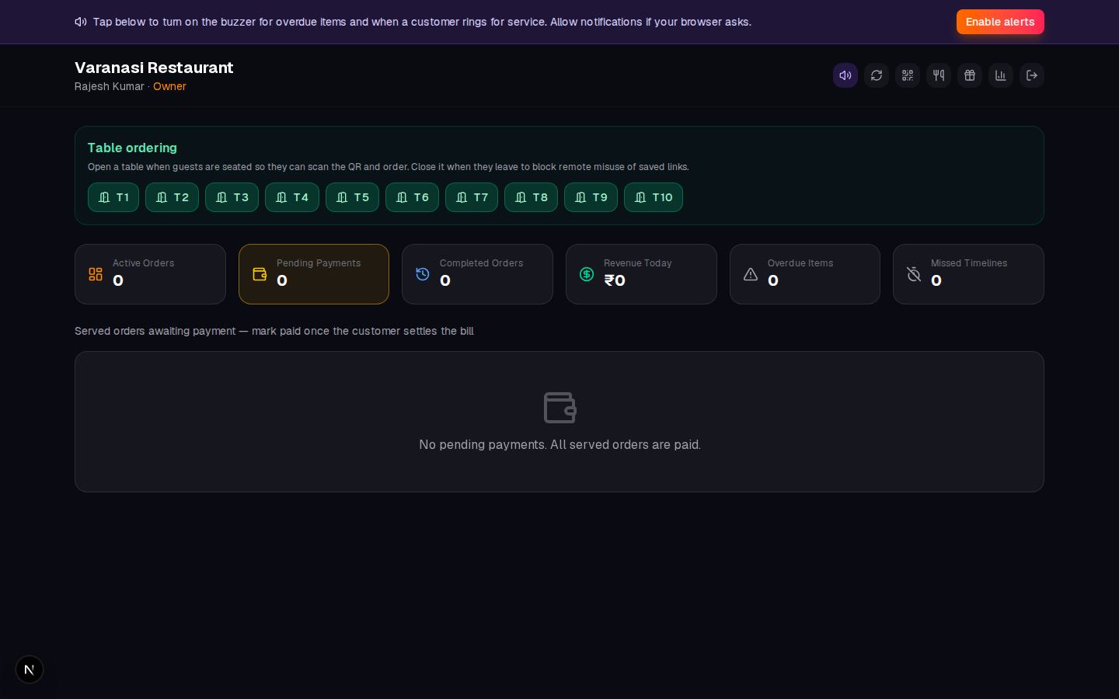
CASH · UPI · PARTIAL PAY
Payments & split bill
PhonePe QR on guest phone
Upload once in admin
Split by item or evenly
Premium split_bill
Pending vs completed
Revenue = paid only
Thermal receipt on pay
Bluetooth ESC/POS
TableTap · 9/18
09

Slide 10
PREMIUM · NO SECOND POS
Takeaway & delivery
Walk-in / table
Staff places order for seated guest
One kitchen board
Dine-in + takeaway + delivery + aggregators — same workflow, same printers, same reports.
Takeaway
Pack and hand over — no table
Delivery
Phone + address notes
PREMIUM: phone_orders
TableTap · 10/18
10

Slide 11
PREMIUM · READY MODE
Swiggy & Zomato — automatic
1
Save credentials
Admin → Integrations
🛵 Full loop closed
Ingest → confirm → prepare → ready → picked up. Owner never re-enters orders in Swiggy/Zomato apps.
2
Register webhook
One-time with partner team
3
Orders auto-flow
Kitchen board — zero manual entry
4
Menu sync out
Price & stock pushed back
5
Status sync back
Ready → picked up → delivered
PREMIUM: aggregator_inbox
TableTap · 11/18
11

Slide 12
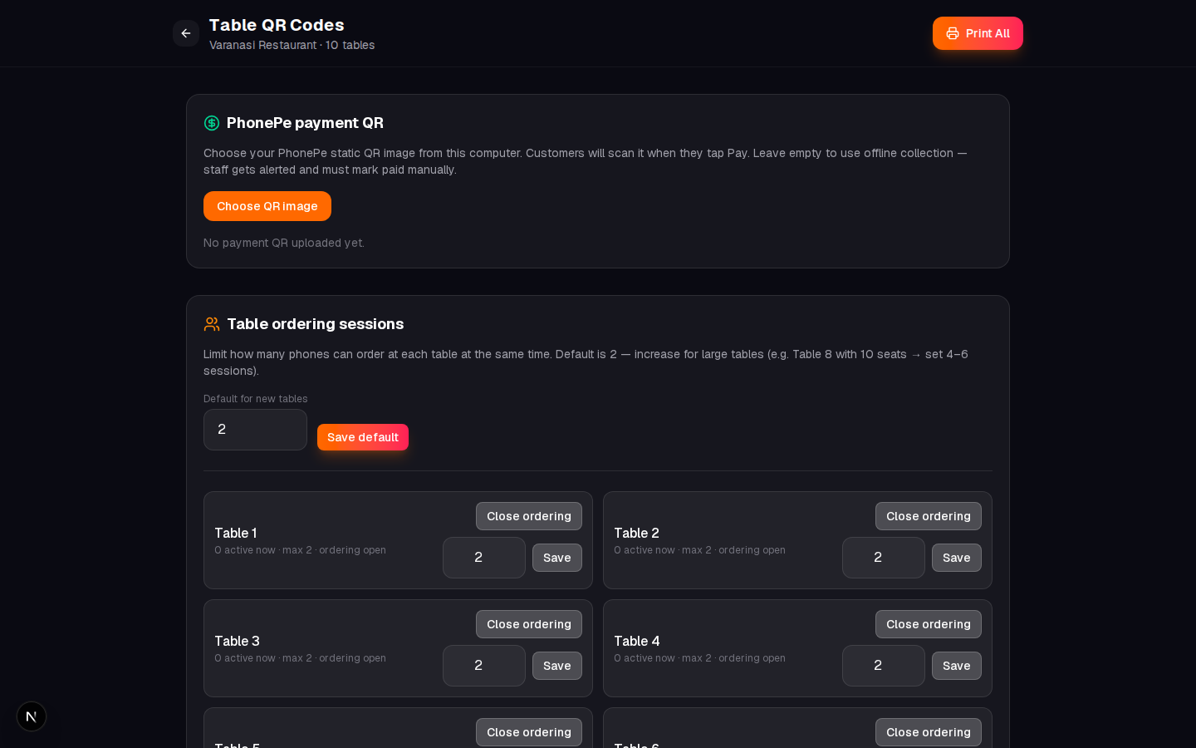
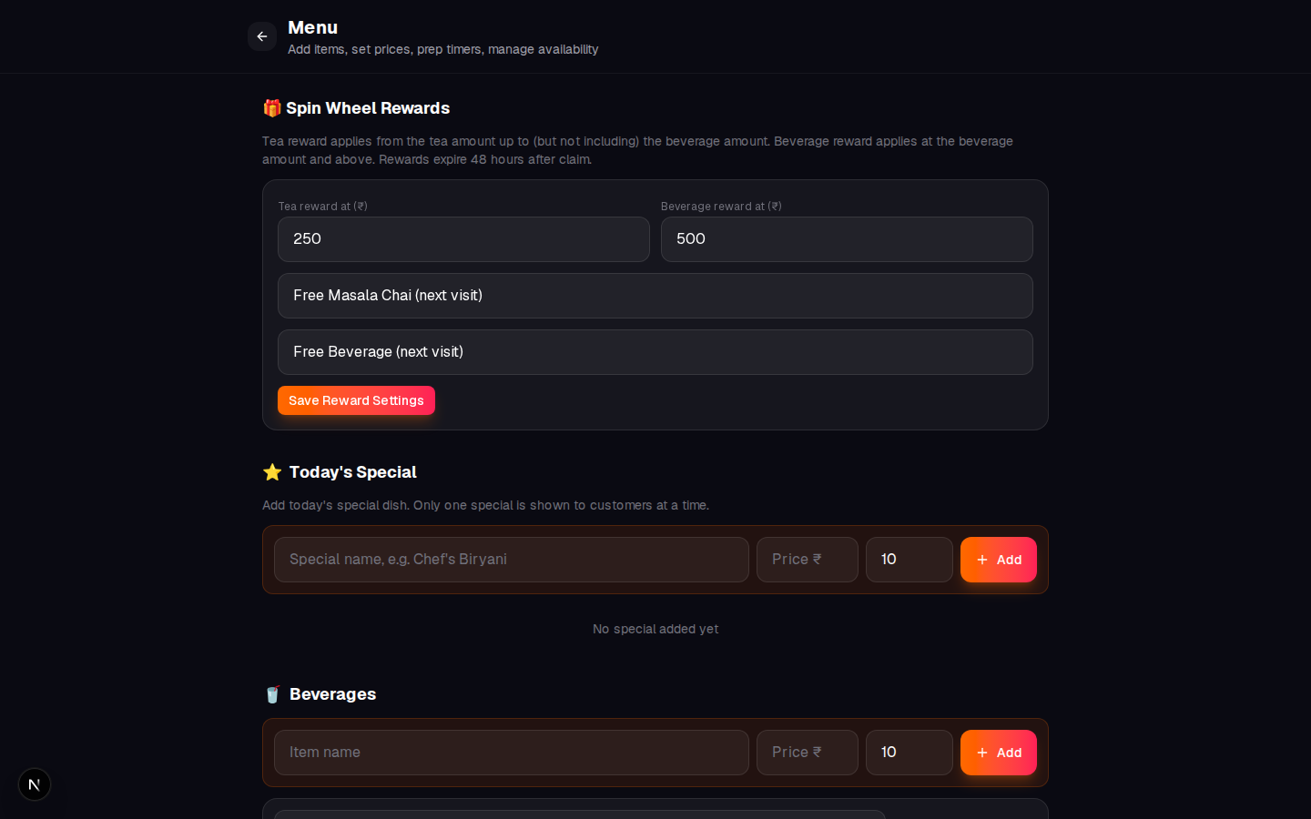
MENU · QR · REPORTS · INTEGRATIONS
Owner admin tools
PRINT TABLE QR
PHONEPE QR UPLOAD
EDIT MENU & STOCK
SWIGGY / ZOMATO
TableTap · 12/18
12

Slide 13
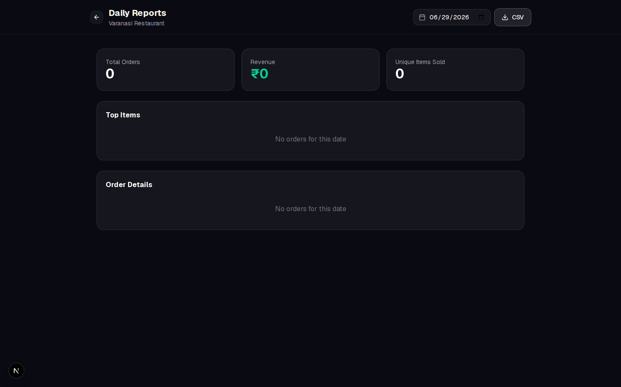
DATA OWNERS ACTUALLY USE
Reports & team performance
Daily revenue & orders
CSV export
Item & table breakdown
What sells
Team performance
Prep · serve · collect
Aggregator last sync
Menu + order health
TableTap · 13/18
13

Slide 14
CORE INCLUDED · PREMIUM ADD-ONS
Flexible pricing tiers
CORE (always on)
PREMIUM (toggle per restaurant)
QR ordering · Staff dashboard · Menu admin · Table QR · Payments · PhonePe QR · Sessions · Rewards · Reports · Alerts
KDS · Floor plan · Split bill · Thermal receipts · Takeaway/delivery · Swiggy/Zomato sync · GST receipts · Staff performance
Starter
All core features
Pro
Core + chosen premium
Enterprise
Full platform + roadmap
Toggle modules live — no downtime, no redeploy
TableTap · 14/18
14

Slide 15
PERMISSIONS
Right access for every role
👑 Owner
Reports · admin · integrations
📋 Manager
Menu · payments · QR
👨‍🍳 Cook
KDS · prepare · stock
🍽️ Server
Floor · serve · tables
Super admin (hidden) toggles premium per restaurant
TableTap · 15/18
15

Slide 16
SETUP
Go live in one day
① Config
One JSON file — name, staff, menu, tables
② Deploy
npm run setup or Docker Compose
③ Print QR
Place on every table
④ Train staff
Open table → scan → serve → paid
⑤ Aggregators
Credentials + webhook (optional)
Full guide: SETUP_GUIDE.md in the repo
TableTap · 16/18
16

Slide 17
BUSINESS IMPACT
Why owners choose TableTap
Faster turnover
Digital order + faster pay
Fewer mistakes
Tickets straight to kitchen
One system
Dine-in + takeaway + aggregators
Less waste
Stock + remote blocking
Modern brand
Premium guest UX
Actionable data
Daily CSV + team stats
40%
faster order
0
manual Swiggy entry
1
platform
TableTap · 17/18
17

Slide 18
Ready for a live demo?
Open a table · Scan the QR · Place an order · Watch the kitchen
Staff login
owner@dvadtech.com
Password
admin123
Super admin
/platform/login
TableTap
Scan · Order · Serve · Grow — the complete restaurant platform
tabletap · SETUP_GUIDE.md · AGGREGATOR_SETUP.md
TableTap · 18/18
18

