Slide 1
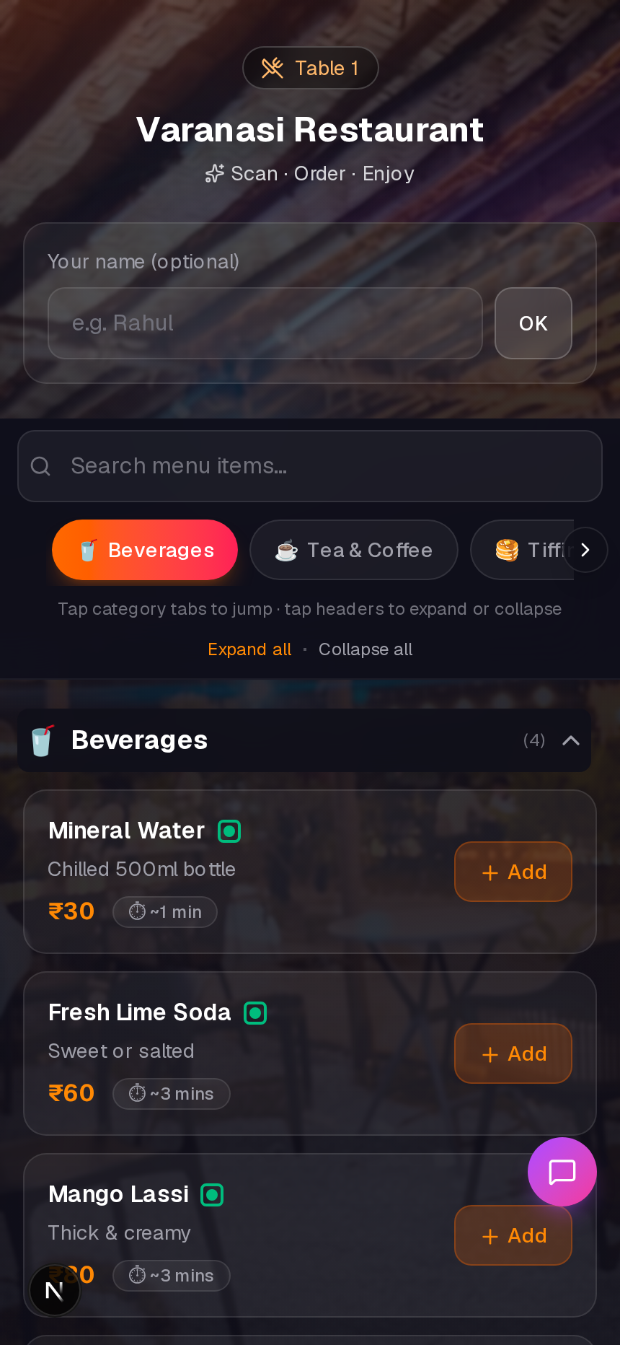
RESTAURANT QR ORDERING
TableTap
Scan. Order. Serve faster.
A modern dining experience that helps owners reduce waiting, mistakes, and remote order misuse.
No app
Guests scan QR
Live kitchen
Timers + alerts
Secure tables
Open / close access
01

Slide 2
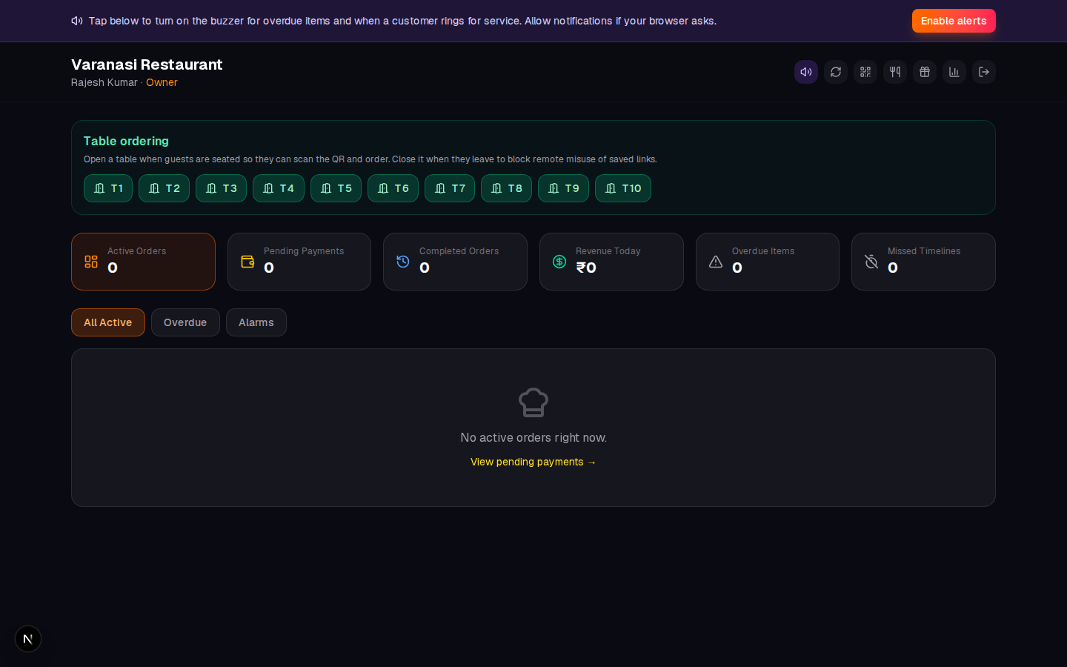
OWNER PAIN POINTS
Restaurant problems TableTap solves
Slow ordering
Guests wait for staff
Order mistakes
Kitchen gets unclear requests
Payment delays
Bills block table turnover
Fake remote orders
Saved links waste food
One platform controls the full table journey.
02

Slide 3
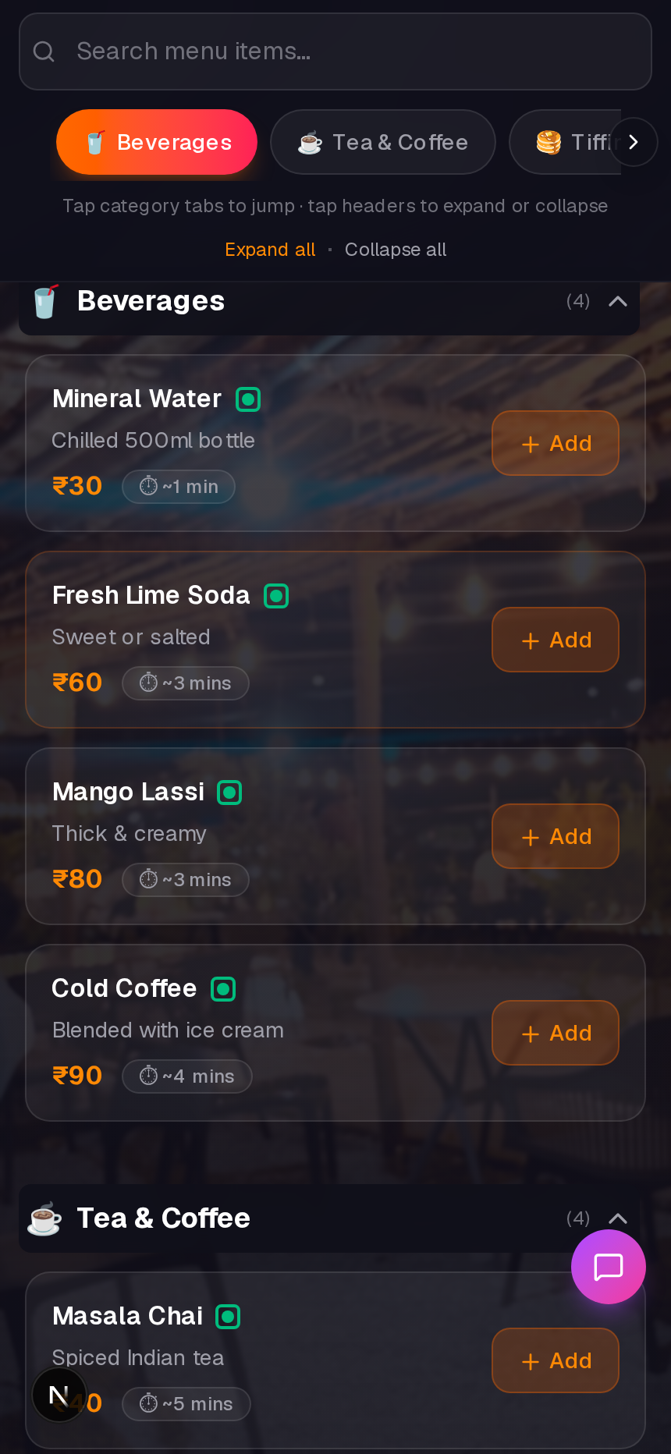
GUEST EXPERIENCE
Beautiful customer menu
Browse by category
Fast search, clear prices, prep time
Add to cart instantly
No app download, no login
Track the order
Countdown + item status
03

Slide 4
LIVE OPERATIONS
Kitchen & staff dashboard
Live order board
Cook, server, manager views
Timers & alarms
Overdue items highlighted
Out-of-stock notes
Customer sees apology automatically
04

Slide 5
SECURITY
Stops remote misuse
1
Staff opens table
Only seated guests can start
2
Guest scans QR
Secure check-in cookie
3
Order allowed
Saved links stay blocked
LESS FOOD WASTE
LESS FRAUD
STAFF CONTROL
05

Slide 6
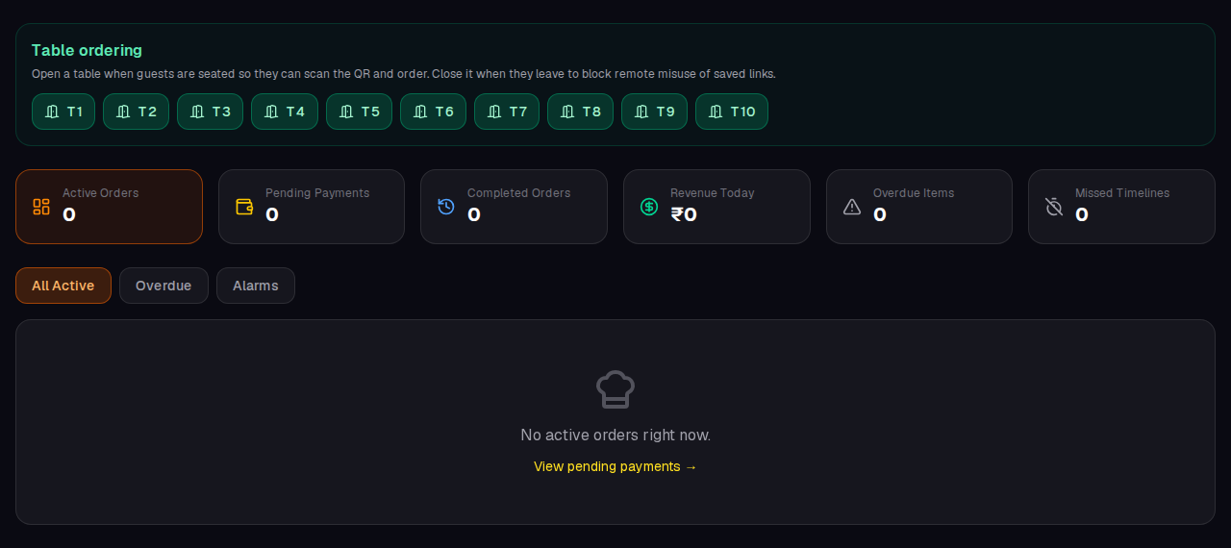
SERVER CONTROL
Open table. Close waste.
Open when seated
Close when they leave
Auto-close after paid
06

Slide 7
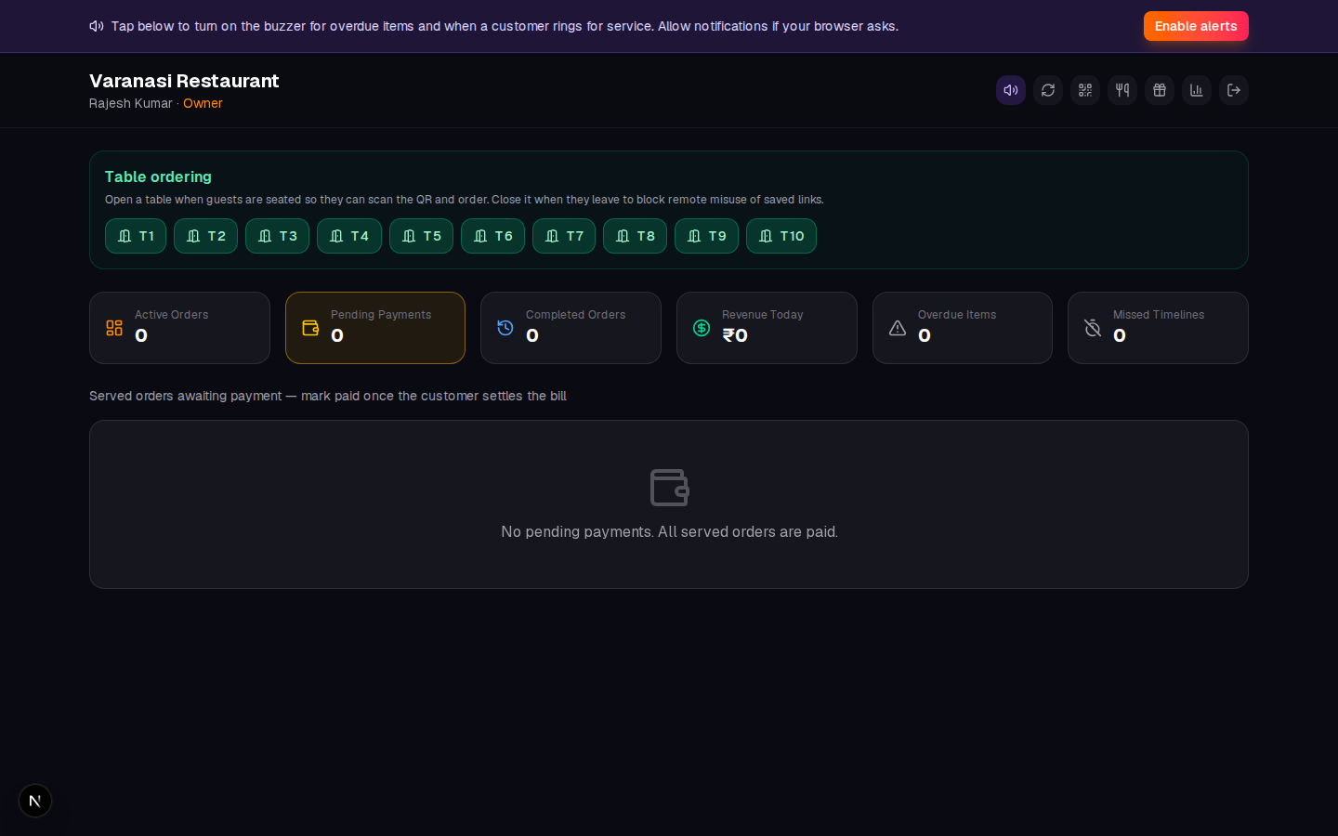
PHONEPE + STAFF VERIFICATION
Payments are tracked clearly
PhonePe QR
Upload once, customers scan
Pending payments
Staff verifies before closing
Revenue accuracy
Only paid orders count
07

Slide 8
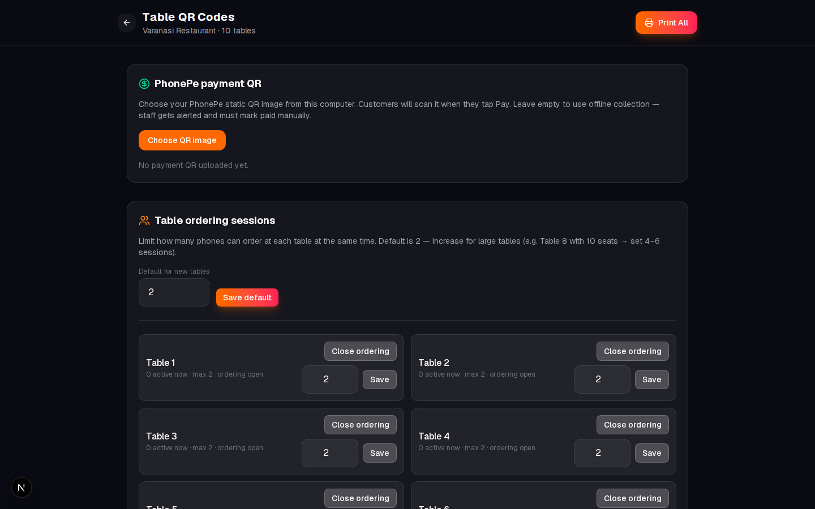
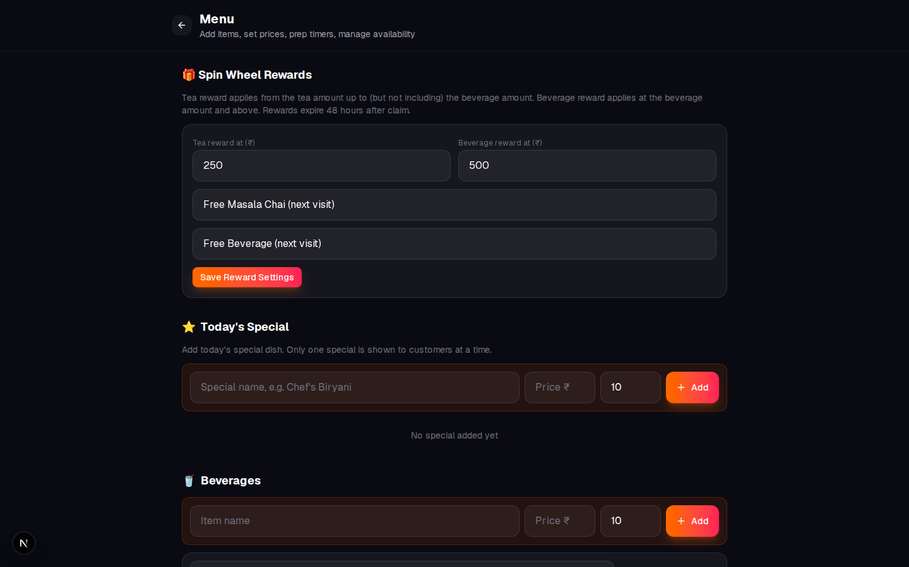
SIMPLE ADMIN CONTROLS
Owner tools
PRINT TABLE QR
UPLOAD PHONEPE QR
EDIT MENU
TOGGLE STOCK
08

Slide 9
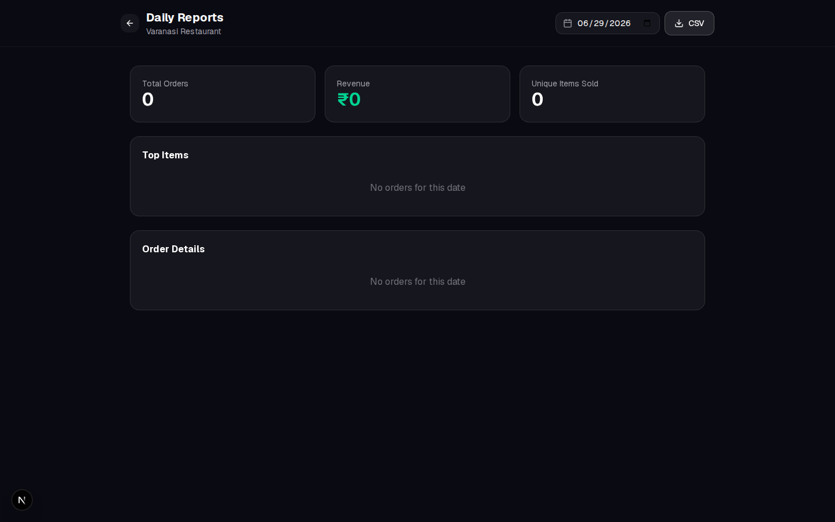
REPORTS
Know your numbers
Daily revenue
Completed orders
CSV export
09

Slide 10
TEAM PERMISSIONS
Right access for every role
Owner
Reports + admin
Manager
Menu + payments
Cook
Prepare + stock
Server
Tables + serve
Everyone sees only what they need.
10

Slide 11
BUSINESS VALUE
Why owners love it
Faster service
No waiting to order
Fewer mistakes
Digital kitchen flow
Less waste
Stock + misuse control
Better turnover
Faster payments
Modern brand
Premium guest experience
Actionable data
Reports you can use
11

Slide 12
Ready for a live demo?
Open a table. Scan the QR. Place an order.
Staff login
owner@varanasi.com
Password
admin123
Customer
Scan Table QR
TableTap - Scan. Order. Enjoy.
12

