Slide 1
Angular JS
An open source web application framework.
Originally developed in 2009 by Misko Hevery and Adam Abrons.
Maintained by Google and latest version 1.5.x for Angular 1 and 2.2 for Angular 2
Largest developer community.
Cross-browser compliant.
AngularJS code is unit testable.
Provides a complete client side solution.
Create Single Page Application in a very clean and maintainable way.

Slide 2
Why Angular JS?
With AngularJS, developer write less code and get more functionality.
Very easy to develop application in a clean MVC way.
Everything you need to build a CRUD app in a cohesive set: Data-binding, basic templating directives, form validation, routing, deep-linking, reusable components and dependency injection.
Angular frees you from the following pains:
Manipulating HTML DOM programmatically
Marshaling data to and from the UI
Writing tons of initialization code just to get started

Slide 3
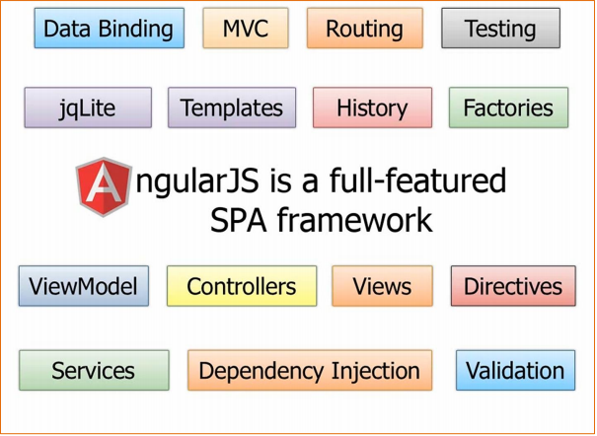
Angular features

Slide 4
Common concepts
Concept | Description
Template | HTML with additional markup. Ex. <input ng-model=“y”/>
Directives | Extend (add specific behavior) to HTML with custom attributes and elements
Scope | Context where the model is stored so that controllers, directives and expressions can access it
Model | Data shown to the user in the view and with which the user interacts i.e. properties on $scope
Expressions | JavaScript-like code snippets that are mainly placed in interpolation bindings. Ex. - <span title="{{ attrBinding }}">{{ textBinding }}</span>
Data binding | Sync between the model and the view
Module | Chunks of code which provides specific functionality or
View | Whatever visible to users
Filter | Formats the value of an expression for display to the user
Service | Reusable business logic independent of views

Slide 5
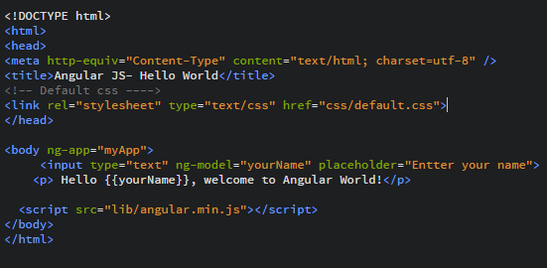
Angular First Application
ng-app :- tells AngularJS that this is the root element of the app and defines boundaries.
ng-model: - binds the value of HTML controls (input, select, textarea) to application data

Slide 6
Expressions and interpolative Directive
The interpolation directive inserts the result of an expression into the HTML template.
Syntax: {{expression}}
Expressions:
Angular Number : {{ 1+ 2}}
Angular String: {{ firstName + ‘ ‘+ lastname }} ($scope.firstName = ‘abc’; ($scope.firstName = ‘xyz’; ouput -=> abc xyz
Angular Objects - {{obj.property}}
Angular Array - {{ Array[0] }}
Can use filters with expressions - {{string|uppercase] }}

Slide 7
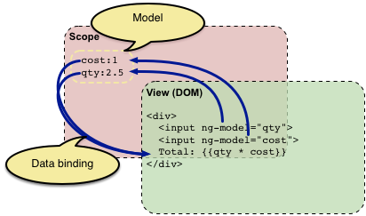
Data binding
Automatic synchronization between the model and the view.
When data in the model changes, the view reflects the change, and when data in the view changes, the model is updated as well.

Slide 8
Controllers
A JavaScript constructor function that is used to augment the $scope
Register with DOM – ng-controller
Register controller with Angular module
Roles of controllers:
Setting up the initial state of a $scope object
Adding Behavior/functions to a Scope Object
Example:
var myApp = angular.module('spicyApp1', []);
myApp.controller('SpicyController', ['$scope', function($scope) {
$scope.firstName= Chandrashekhar';
$scope.showName = function() {
return $scope.firstName;
};
}]);

Slide 9
$scope and $rootScope
It’s execution context for expressions
Acts as glue between Views and controller
It’s controller’s responsibility to add properties and methods on $scope
Each Angular application has exactly one rootScope but can have multiple child scopes
Characteristics:
provide APIs ($watch) to observe model mutations.
provide context against which expressions are evaluated.
Nested: child scopes are inherited from Parent scope
$watch
The $scope.watch() function creates a watch of some variable
$scope.$watch(function(scope) { return scope.data.myVar }, function() {} );

Slide 10
Angular Events
ng-click
ng-dbl-click
ng-mousedown
ng-mouseup
ng-mouseenter
ng-mouseleave
ng-mousemove
ng-mouseover
ng-keydown
ng-keyup
ng-keypress
ng-change

Slide 11
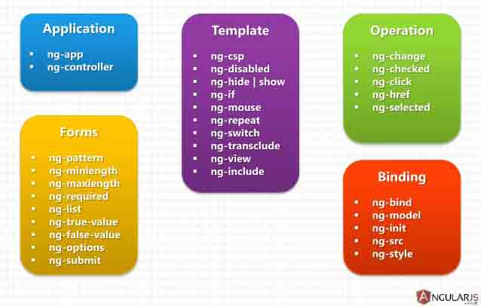
Angular in-built directives
AngularJS has a set of built-in directives which offers functionality to your applications.

Slide 12
Directives
A directive is something that introduces new syntax
Directives are markers on a DOM element (such as an attribute, element name, comment or CSS class) that tell AngularJS's HTML compiler to attach a specified behavior to that DOM.
Makes your HTML interactive and most amazing
Can create custom HTML elements
Anything that prefixed with ng- is directive in angular

