Slide 1


Automated Web Testing using

Slide 2
The Approach
Our work is divided in two Modules:
Test Plan Preparation

Slide 3
Test Plan Preparation
QLabs performs both Auto and Manual Testing using a Universal Test Plan format. In our Test Plan format, test cases are written in such a way that the same test plans can be used for Manual as well as Automation testing.
Test Plans are written in a Microsoft Excel File.
Screen Shots of Test Plan have been provided in the next slides.

Slide 4
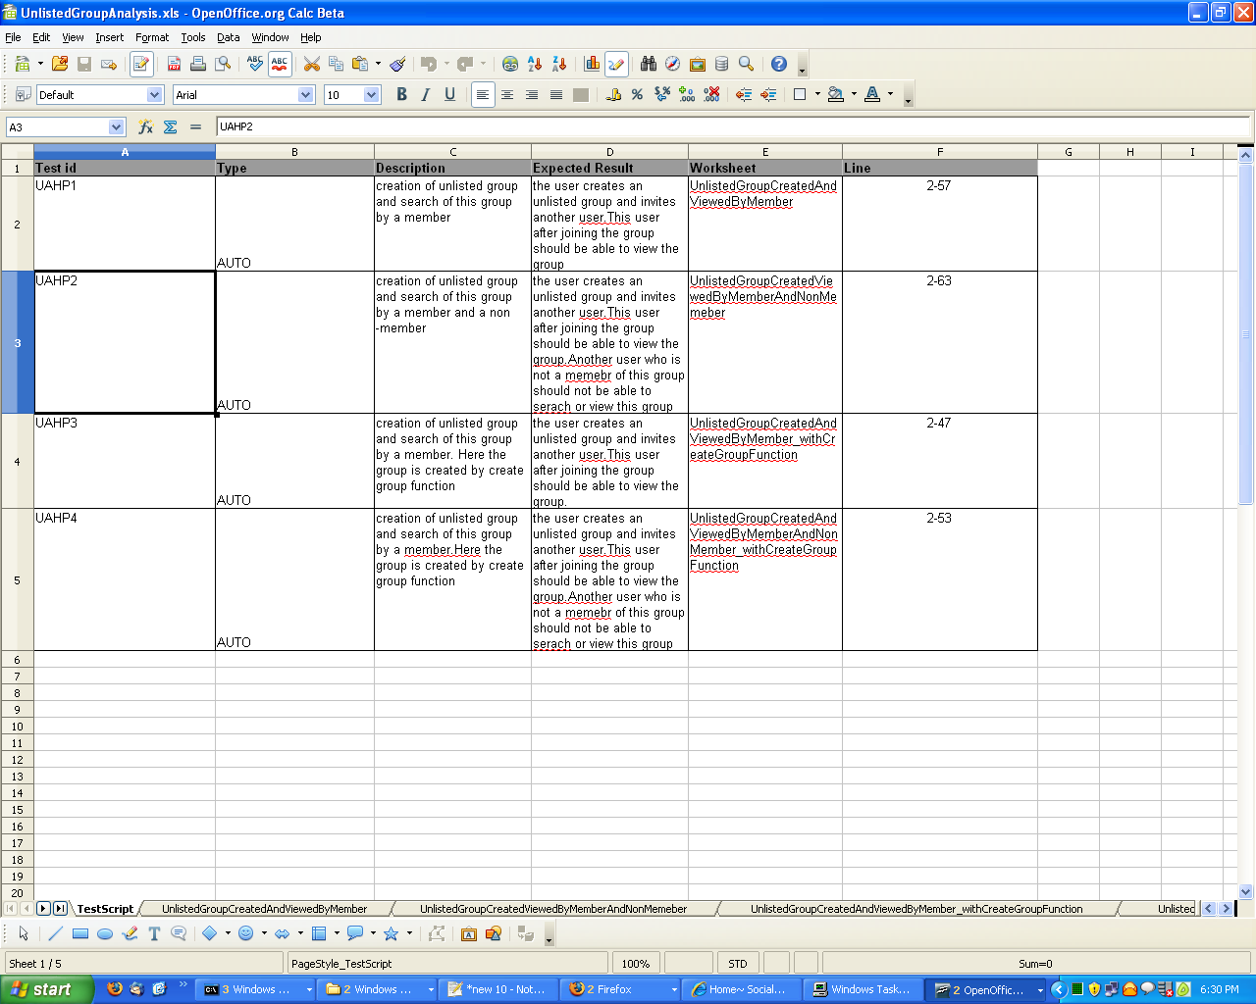
Test Plan Preparation
It Contains Worksheet Name where Test Steps for this Test Case a are written
Test ID
Sort Description of Test Case
This Column gives information that this test case going to for Automated Testing or Manual
Expected Result
It Contains Row number for this test case
2nd row of this test Plan says that Steps for Test ID 'UAHP1' is written in worksheet 'UnlistedGroupCreatedAndViewedByMember' from Rows 2 to 57.

Slide 5
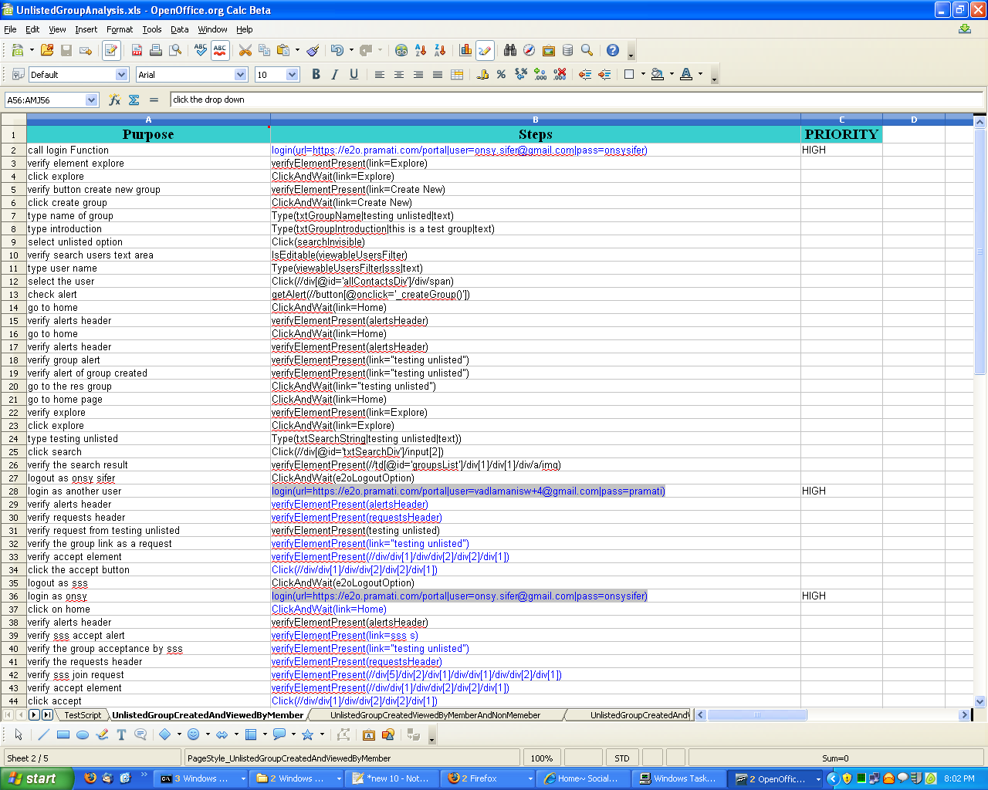
Test Plan Preparation
This Column Contains Information for Manual Testing
This Column Contains Input for Automated Testing
If Value is High then it decide effect of this step on Test Case means if This Step is Passed then Test Case may be Pass but if it fail then Test will be Fail.
Default Value is LOW
This workbook (UnlistedGroupCreatedAndViewedByMember) contains steps for Test Case 'UAHP1'

Slide 6
BrighTest
Why BrighTest
BrighTest Modules
BrighTest work flow
Error Handling
How to use BrighTest-Runner

Slide 7

Why BrighTest?
BrighTest is an in-house tool.
We can easily customize it according to our requirements.
We can store reports in our own format for future use.
Easy to install.
We can easily redefine parameters.
We can get alerts.
Easy to add new features.

Slide 8
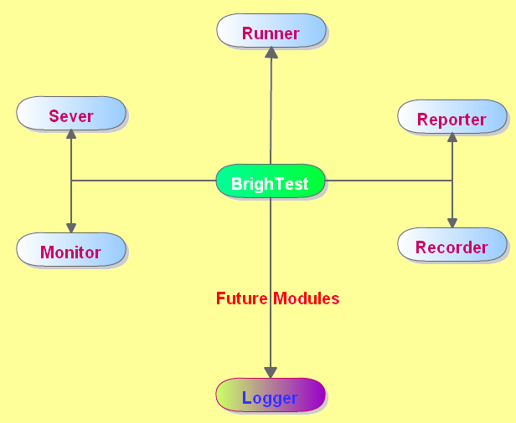
BrighTest Modules

Slide 9
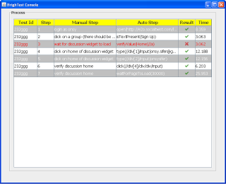
BrighTest-Runner
BrighTest-Runner is Frame
work to Run Test Cases.
It take Excel Test file/files
as in put and start real
time web testing.

Slide 10
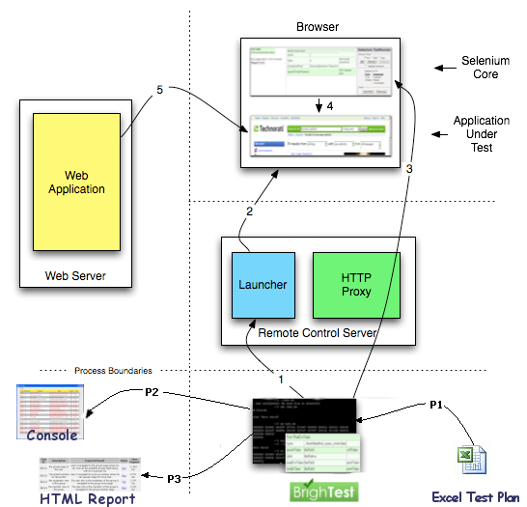
How does BrighTest-Runner work?
Web server is requested for Instruction
Selenium-Core acts on that instruction
Instruction from BrighTest built into the Selenium RC Server.
Selenium-Server launches a browser
reaches out to the selenium-server.
Read Test Step form Test Plan and convert them in to Selenium Syntax.
Report is Created
Console is updated

Slide 11
How does BrighTest-Runner work?
BrighTest takes the excel file as input and generates the final report derived from the excel file name.
It first reads the work sheet and then row by row in the respective sheet.
For example lets say test1.xls is the excel file and it contains two work sheets testScript and createGroup.
testScript sheet lists the details about the createGroup sheet, such as id, description , sheetname,lines(the lines that are inputted for automation).
The automation process i.e backend is written compeletely in java and it imports respective selenium packages .
CreateGroup sheet contains the lines numbers ,purpose,steps and priority respectively.
defines the description of the respective test case, steps include the x-path functionality of the respective test case and is derived from the selenium ID

Slide 12
How BrighTest-Runner Works ...
For example
1. go to profile {purpose} ClickAndWait(link=Profile){Steps}.
Here ClickAndWait is the function supported by the selenium framework and link =Profile represents that profile is a link which can be accessed by clicking .
So, for this x-path to be automated , corresponding ClickAndWait function should be implemented in java.
When this test case is run , the java internally calls the ClickAndWait function on the profile link .
1 represents the line number and go to profile is the respective description.

Slide 13
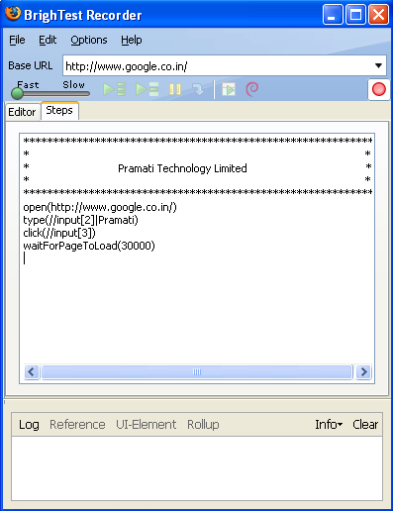
BrighTest-Recorder
BrighTest-Recorder is implemented as a Firefox extension, and allows to record, edit, and debug tests in Qlabs format.

Slide 14
How to write step for BrighTest
Syntax : function_name(Target|data) [if operation requires data]
Syntax : function_name(Target) [if operation doesn't require data]
Example :
Operations with data
Type(txtSearchString|Test_Group_name)‏
VerifyText(//div/div[1]/div/div[2]/div[2]/div[1]|Accept)‏
Operations without data
open(https://e2o.pramati.com/login/login)‏
This is optional input. It is data require for operation.
BrighTest function like Click, ClickAndWait, Type, verifyText,isElement Present, etc..
This is Target element of web page where you want to do operation. It may be ID, Name, Xpath, or Dome
PIPE

Slide 15
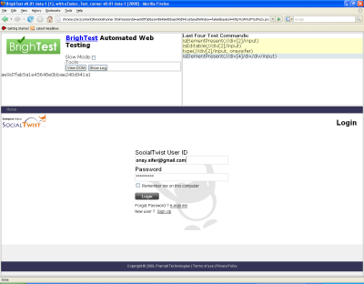
BrighTest-Server
BrighTest-Server automatically launches and kills browsers, and acts as a HTTP proxy for web requests from them. BrighTest-Server is great for testing complex AJAX-based web user interfaces under a Continuous Integration system.

Slide 16
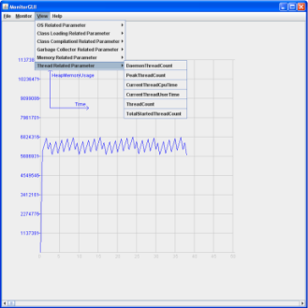
BrighTest - Monitor
This module contains the following sub-modules:
Load Monitor: The Load Monitor generates load to Web application server and collects Load and stress related data.
Server Monitor: This monitors the server performance. It collects server related data like memory, garbage collector, Class Loading, Garbage Collector, CPU usage, CPU Time etc. It also support Real time monitoring. All collected data is sent to the BrighTest-Reporter.

Slide 17
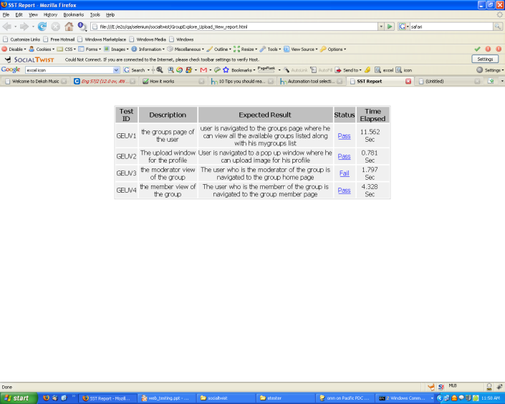
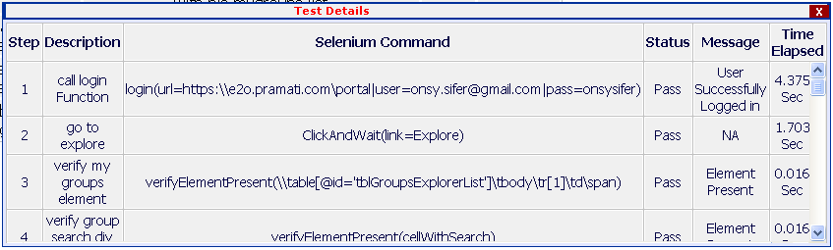
BrighTest Report
Why BrighTest
How BrighTest work
BrighTest Report
Report page contains Test Case result. Click Status to see the Step Level information

Slide 18
Functions Supported by BrighTest(Till date)
Browser related Functions
Open
Click
ClickAndWait
Type
IsElementPresent
IsTextPresent
Many More...

Slide 19
Functions Supported by BrighTest(Till date) .....
Verification Related functions
isElementNotPresent
isTextNotPresent
getelement
isEditable
Many More

Slide 20
Functions Supported by BrighTest(Till date) .....
Qontext Specific functions
login
create_group
auto_verify
auto_reject
Many More

Slide 21
Error Handling
BrighTest is capable of handling all the test cases even if they are modified provided they are in a pre declared format.
If the Test Plan is modified and the modification has some errors like
1. If the line numbers is missing for a test case in “TestScript”, tool gives status to this case as failed and gives a message “steps not found”.
2. If the workbook name is given wrong, the message “workbook not found” is displayed and the test fails.
3. If the target given in the step is invalid then this step will fail with the message “Element not found”
4. If the function given is incorrect the steps fails and the message displayed is “function not found” .

Slide 22
How to use BrighTest-Runner
Get source Code
get from CVS
Build
To build : go to folder by command line and type 'ant'
Run
Type 'ant run'
Note : it will open one ie and one firefox browser and start doing real time functional testing.
To view Report :
go to '\testplan\report' folder . Report will be saved in ff and ie folder
Note : Test Cases are saved in tests folder

Slide 23
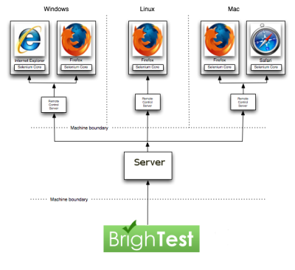
Future Plan
Integrate Performance Monitor.
Integrate Load Monitor.
Integrate Stress Monitor.
Integrate Auto Bug Logger
Apply Grid System.
Make GUI.

Slide 24
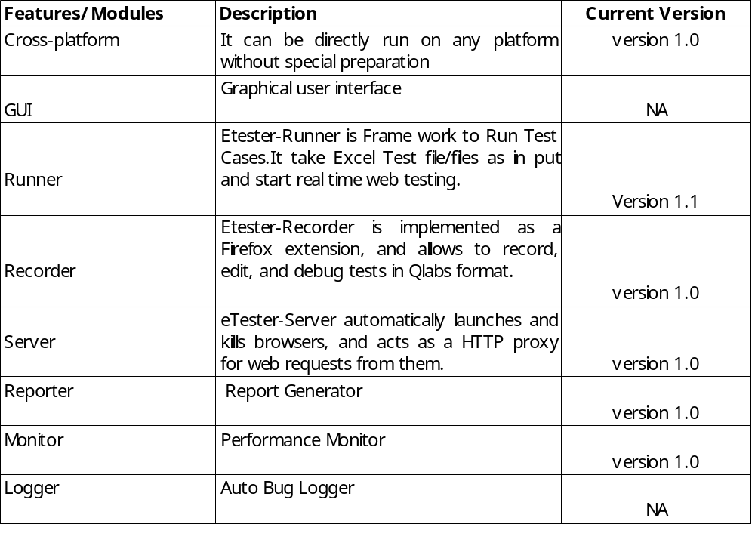
Future Plan ....
BrighTest
Features/Modules | Description | Status
Cross-platform | It can be directly run on any platform without special preparation | version 1.0
GUI | Graphical user interface | version 3.0
Runner | Etester-Runner is Frame work to Run Test Cases.It take Excel Test file/files as in put and start real time web testing. | version 1.0
Recorder | Etester-Recorder is implemented as a Firefox extension, and allows to record, edit, and debug tests in Qlabs format. | version 2.0
Server | eTester-Server automatically launches and kills browsers, and acts as a HTTP proxy for web requests from them. | version 2.0
Reporter | Report Generator | version 2.0
Monitor | Performance Monitor | version 3.0
Logger | Auto Bug Logger | version 3.0

Slide 25
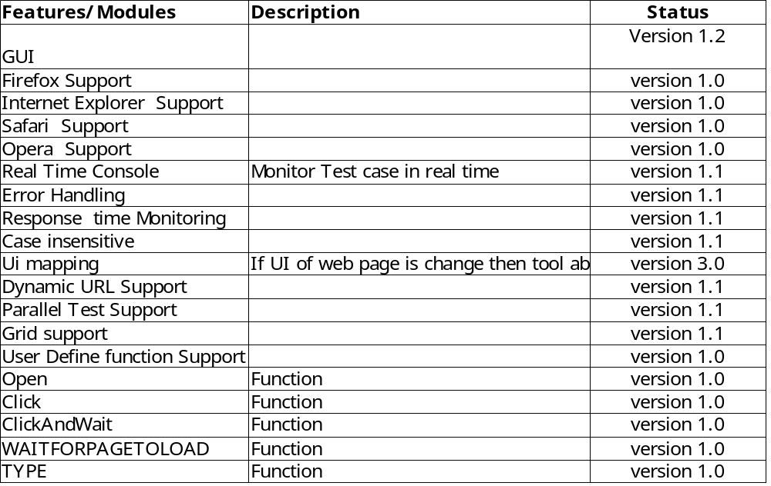
Future Plan ....
Runner
Features/Modules | Description | Status
Cross-platform | It can be directly run on any platform without special preparation | version 1.0
GUI | Graphical user interface | version 3.0
Runner | Etester-Runner is Frame work to Run Test Cases.It take Excel Test file/files as in put and start real time web testing. | version 1.0
Recorder | Etester-Recorder is implemented as a Firefox extension, and allows to record, edit, and debug tests in Qlabs format. | version 2.0
Server | eTester-Server automatically launches and kills browsers, and acts as a HTTP proxy for web requests from them. | version 2.0
Reporter | Report Generator | version 2.0
Monitor | Performance Monitor | version 3.0
Logger | Auto Bug Logger | version 3.0

Slide 26
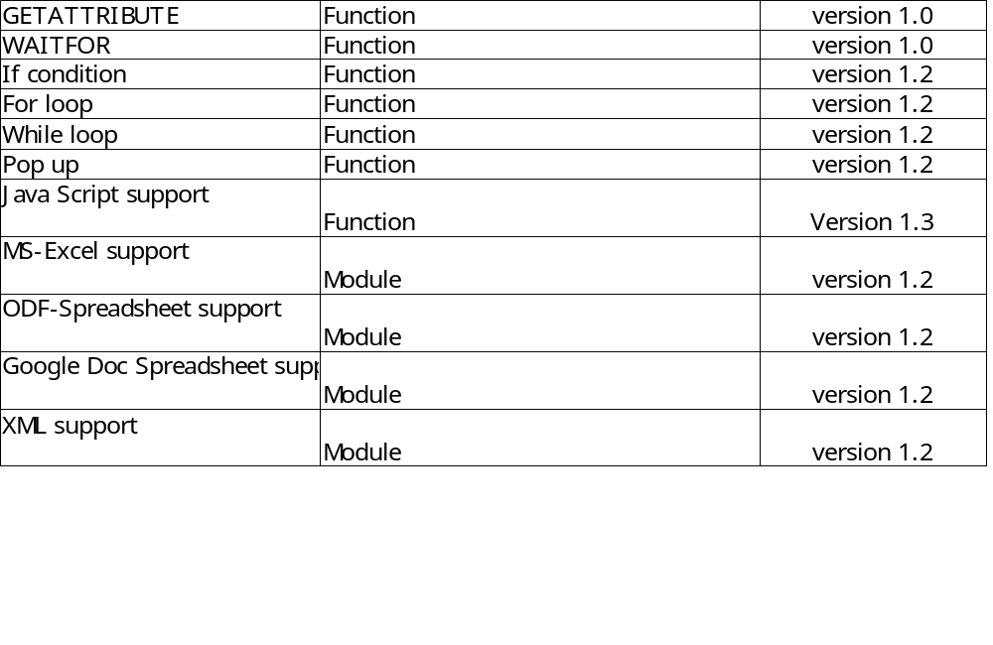
Future Plan ....
Recorder
Features/Modules | Description | Status
Cross-platform | It can be directly run on any platform without special preparation | version 1.0
GUI | Graphical user interface | version 3.0
Runner | Etester-Runner is Frame work to Run Test Cases.It take Excel Test file/files as in put and start real time web testing. | version 1.0
Recorder | Etester-Recorder is implemented as a Firefox extension, and allows to record, edit, and debug tests in Qlabs format. | version 2.0
Server | eTester-Server automatically launches and kills browsers, and acts as a HTTP proxy for web requests from them. | version 2.0
Reporter | Report Generator | version 2.0
Monitor | Performance Monitor | version 3.0
Logger | Auto Bug Logger | version 3.0

Slide 27
Future Plan ...
BrighTest-Monitor
Implement more functions to basic Load Testing frame.

Slide 28
Future Plan ...
BrighTest-Logger
Develop Bug logger system with mail support or use Bugzilla
Connect all modules to this module

Slide 29
Thank You!!

