Slide 1
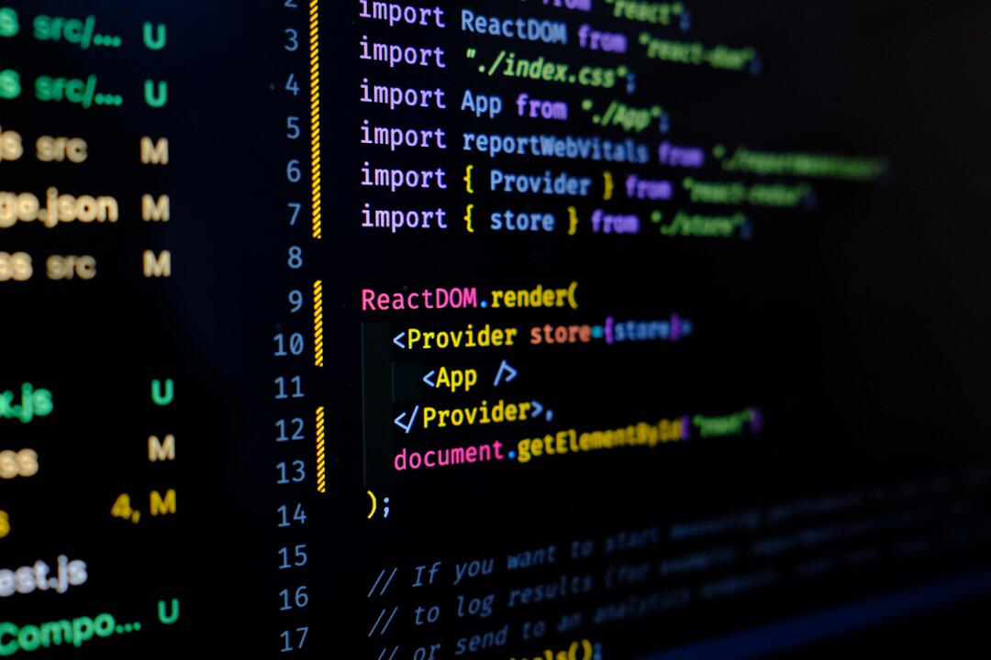
Brief Introduction To Programming Languages
Presented By:
P.CHANDRIKA
(20KN1A05C4)

Slide 2
Contents
Abstract
Introduction
Objectives
Need Of Programming Languages
Geo Tagged Photos
Certificate
Outcomes
Conclusion

Slide 3
Abstract
Programming languages have been around for ages, and every decade sees the launch of a new language sweeping developers off their feet.
Python is considered as one of the most popular and in-demand programming language. A recent Stack Overflow survey showed that Python has taken over languages such as Java, C, C++ and has made its way to the top.

Slide 4
Introduction
A programming language is a set of instructions and syntax used to create software programs. Some of the key features of programming languages include: Syntax, Data Types, Variables, OPerators, Control Structures, Libraries and Frameworks, Paradigms.
Examples of popular programming languages include Python, Java, C++, JavaScript, and Ruby. Each language has its own strengths and weaknesses and is suited for different types of projects.

Slide 5
Objectives
To enable programmers to express their ideas clearly and concisely, using a syntax and semantics that are easy to understand and write.
To provide abstraction mechanisms that allow programmers to hide unnecessary details and focus on the essential aspects of a problem.
To support multiple programming paradigms, such as imperative, functional, object-oriented, and logic, that offer different ways of organizing and manipulating data and code.

Slide 6
Need of Programming Languages
Programming languages allow the programmer to structure the instructions into functions, procedures, etc. This also allows the program to be broken into "chunks" which can be developed by a group of developers. It also provides portability, whereby the low-level instructions of one computer will be different from that of another computer. A high-level language hides that.

Slide 7
3 Categories
System Languages
Architectural Languages
Application Languages
System Languages:
C
C++
Assembler
i

Slide 8
i
Architectural Language:
Java
C#
Application Languages:
PHP
Ruby
Perl
Python

Slide 9


Geo Tagged Photos

Slide 10
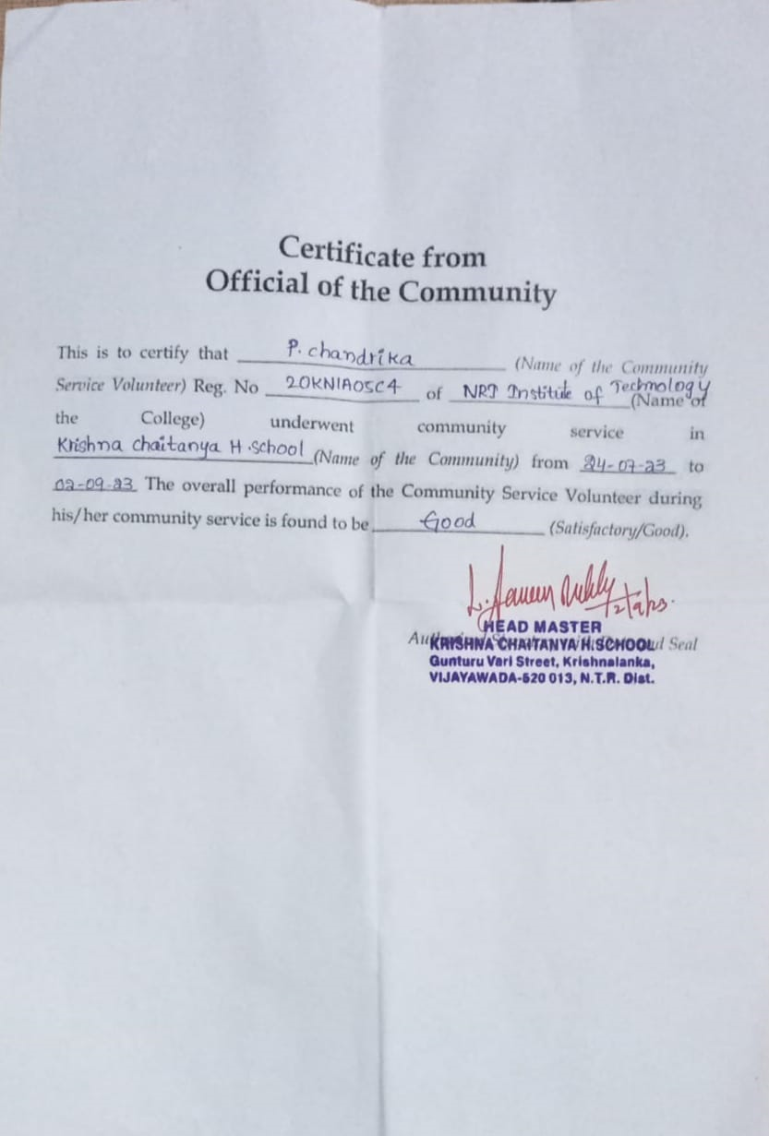
Certificate

Slide 11
Outcomes
To learn major programming paradigms and techniques involved in design and implementation of modern programming languages.
To learn the structure of a compiler and interpretation.
To learn syntax and semantics of programming language.

Slide 12
Conclusion
The future of programming languages is bright as new technologies and new needs are driving the development of new languages more powerful, efficient and reliable. Over the next decade, we anticipate several key trends and developments that will shape how we create software and interact with digital systems. The multi-faceted language ecosystem will continue diversifying, catering to an increasingly tailored array of domains.

Slide 13
i
THANK YOU

