Slide 1

EV Adoption Trends and Charging Station Optimization
Course:- DATA WAREHOUSE AND MINING Course Code:-23DSB3303R
Team Details:
2320030106
2320030118
2320030283
2320030323

Slide 2

Problem Statement
Despite rapid EV growth, charging infrastructure remains unevenly distributed across regions.
This creates range anxiety and limits mass adoption.
There is a need for a data-driven system to analyze EV adoption trends and optimize charging station locations.

Slide 3
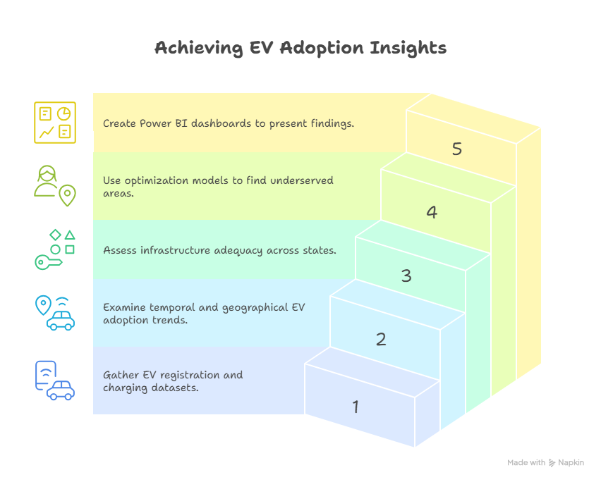
Objectives
1. Collect and clean EV registration and charging datasets.
2. Analyze temporal and geographical EV adoption trends.
3. Evaluate infrastructure adequacy across states.
4. Identify underserved areas using optimization models.
5. Visualize insights through Power BI dashboards.

Slide 4

Solution Proposed
Integrated Data Pipeline: Combine EV registration and charging station data from NITI Aayog, VAHAN, and other public sources into a unified dataset.
Automated Data Cleaning: Standardize state names, handle missing values, and validate charger locations using Python (Pandas, NumPy).
Trend & Coverage Analysis: Perform temporal and geographical analysis to identify EV growth patterns and infrastructure gaps.
Optimization Model: Recommend optimal charging station locations using analytical models like K-Means or p-Median based on EV density and charger scarcity.
Interactive Visualization: Develop a Power BI dashboard showing adoption trends, charger distribution, and underserved regions for better decision-making.

Slide 5

Existing Solutions
NITI Aayog Reports: Provide state-wise EV adoption statistics and national policy insights but lack granular, location-based charger distribution data.
VAHAN Portal: Offers detailed EV registration records but does not integrate with charging infrastructure information or trend analysis tools.
FAME-II Dashboard: Tracks government-funded charging stations under the subsidy scheme but excludes private and OMC-installed chargers.
Research Studies: Many academic works analyze EV growth or optimize charging placement, but they focus on limited regions or static datasets.
Gap Identified: Existing systems operate in isolation — there is no comprehensive, data-driven framework that combines EV adoption trends with charger availability to guide infrastructure expansion.

Slide 6
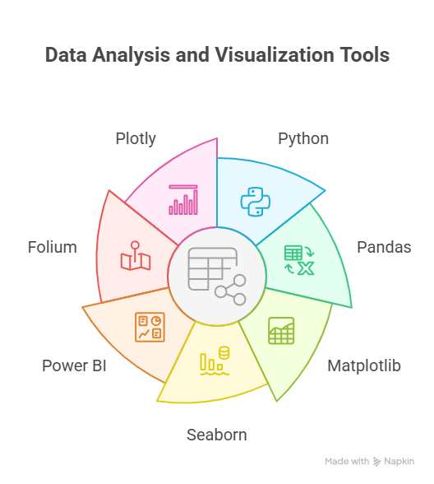
Tools & Technologies Used

Slide 7
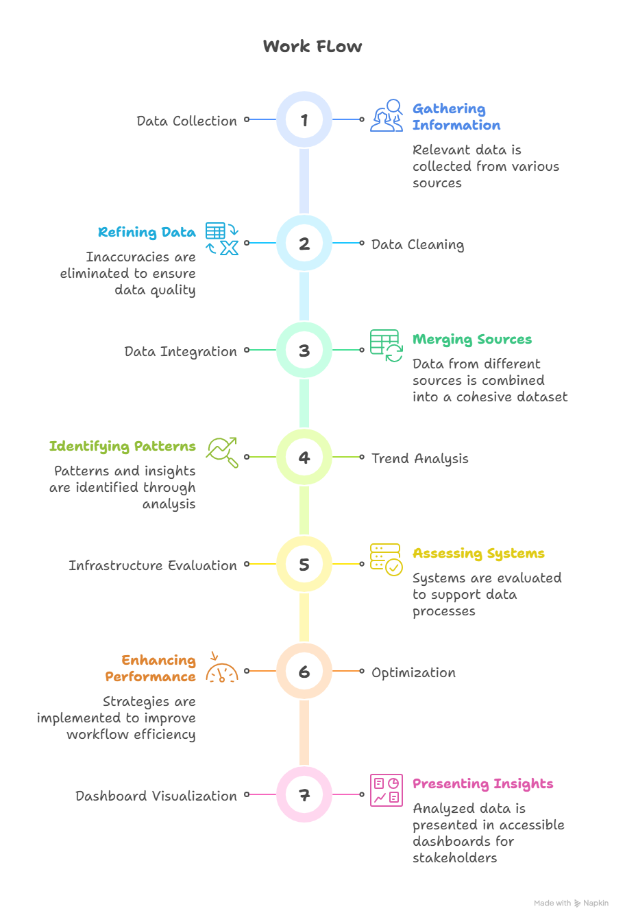
Project Working

Slide 8

Work Done So Far
Created synthetic EV adoption dataset (2020–2024)
Integrated NITI Aayog charging data
Performed EDA and trend visualization in Colab
Built Power BI prototype dashboard

Slide 9

Challenges Faced
Limited access to real EV registration data
Inconsistent state naming formats
Missing geolocation details for many charging stations
Balancing real and synthetic datasets for prototyping

Slide 10

Conclusion
Our analysis highlights uneven EV infrastructure distribution across states.
Identified underserved regions for new charging stations.
Future Work:
Integrate live VAHAN API data.
Implement optimization models (p-median / location-allocation).
Deploy interactive web dashboard.

