Slide 1
The Fundamental Unit of Life: Cell
Class 9 Biology · chandrika
Cell
Powered by Savra
1

Slide 2
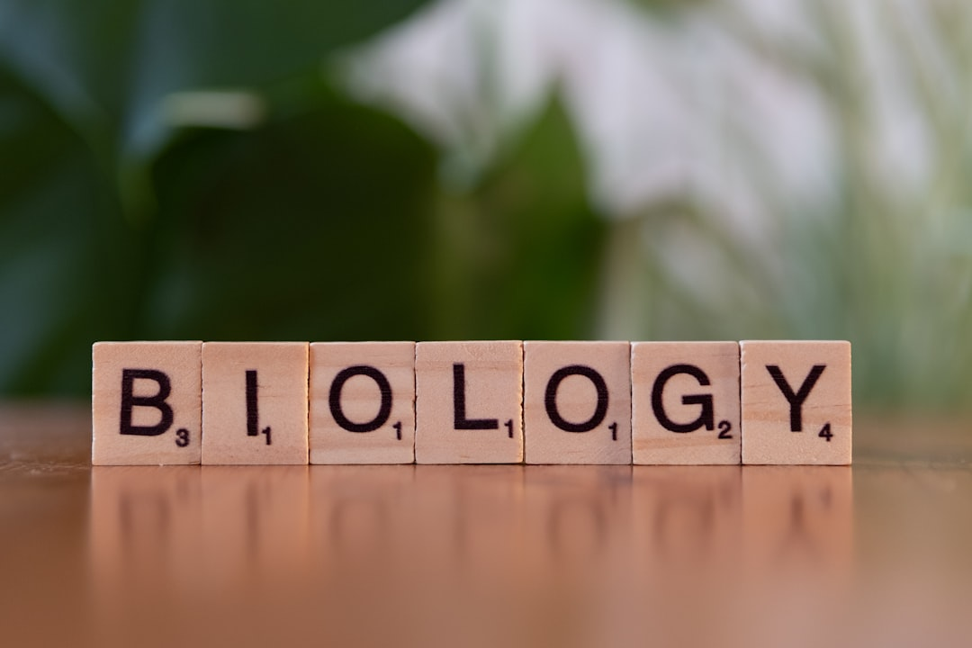
Learning Outcomes
LEARNING OUTCOMES
1
Define cell and describe its discovery
2
Differentiate between prokaryotic and eukaryotic cells
3
Compare the structures of plant and animal cells
4
Identify major cell organelles and their functions
5
Analyse why the cell is the structural and functional unit of life (HOTS)
Powered by Savra
2

Slide 3
STORY FLOW
Journey of Cell Discovery
Robert Hooke (1665)
1
Observed thin slices of cork under a primitive microscope. Noticed honeycomb-like compartments, which he called 'cells'.
Leeuwenhoek (1674)
2
First to observe free-living cells in pond water with improved microscopes. Called them 'animalcules'.
Schleiden & Schwann (1838-39)
3
Proposed the Cell Theory: all plants and animals are composed of cells, and the cell is the basic unit of life.
Rudolf Virchow (1855)
4
Further expanded Cell Theory: 'Omnis cellula e cellula' (all cells arise from pre-existing cells).
Powered by Savra
3

Slide 4
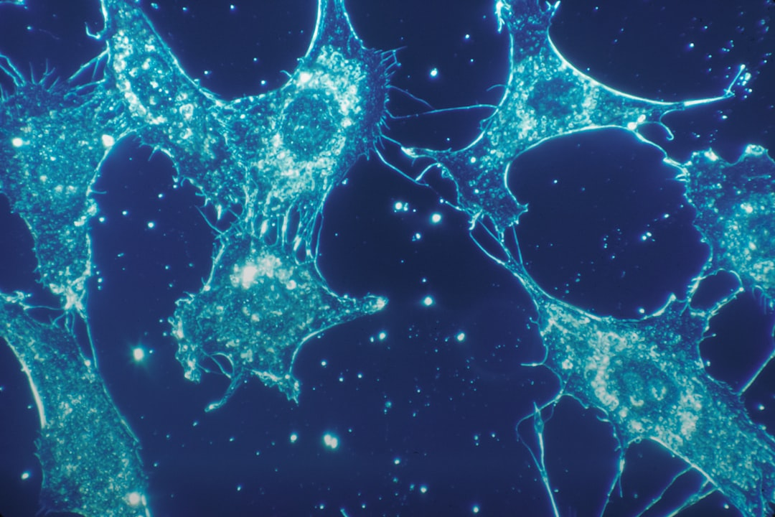
Cell
The basic structural and functional unit of all known living organisms. It is the smallest unit of life that can replicate independently.
EXAMPLE
A single-celled Amoeba, commonly found in a pond near the Yamuna river, performs all life functions like digestion, respiration, and reproduction independently.
Powered by Savra
4

Slide 5
Four Core Cell Components
1
Cell Membrane
2
Cytoplasm
The outer boundary of the cell, made of lipids and proteins. It is selectively permeable, controlling the movement of substances in and out of the cell.
A jelly-like substance filling the cell, between the cell membrane and the nucleus. It contains various organelles and is the site of many metabolic reactions.
3
Nucleus
4
Cell Wall (Plant Cells)
The control center of the cell, containing the cell's genetic material (DNA). It regulates cell growth, metabolism, and reproduction.
A rigid outer layer found only in plant cells, fungi, and bacteria. It provides structural support, protection, and prevents excessive water uptake.
Powered by Savra
5

Slide 6
Prokaryotic vs. Eukaryotic Cells
Prokaryotic
Eukaryotic
No true nucleus (nucleoid region)
True nucleus with nuclear membrane
1
1
Membrane-bound organelles absent
Membrane-bound organelles present
2
2
Smaller in size (1-10 µm)
Larger in size (5-100 µm)
3
3
Single circular chromosome
Multiple linear chromosomes
4
4
E.g., Bacteria, Blue-green algae
E.g., Plants, Animals, Fungi
5
5
Powered by Savra
6

Slide 7
Plant Cell vs. Animal Cell
Plant Cell
Animal Cell
Cell wall present (outermost layer)
Cell wall absent
Plastids (e.g., chloroplasts) present
Plastids absent
Large central vacuole (90% volume)
Small, temporary vacuoles (if any)
Fixed, rectangular shape
Irregular, roundish shape
Centrosomes usually absent
Centrosomes present for cell division
Powered by Savra
7

Slide 8
Important Cell Organelles
Mitochondria
Plastids
Vacuoles
Known as the 'powerhouse of the cell', responsible for cellular respiration and producing ATP (energy currency).
Double-membraned organelles found in plant cells. Chloroplasts, a type of plastid, perform photosynthesis.
Membrane-bound sacs primarily for storage of water, nutrients, and waste products. Large and central in plant cells, small in animal cells.
e.g.
Muscle cells of a cricketer playing in Mumbai have thousands of mitochondria to generate the energy needed for intense activity.
e.g.
Chloroplasts in the leaves of a Banyan tree convert sunlight into glucose, providing food for the plant.
e.g.
A large central vacuole in a plant cell helps maintain turgor pressure, preventing the plant from wilting during a dry Indian summer.
Powered by Savra
8

Slide 9
Endoplasmic Reticulum: Key Roles
Membrane Biogenesis
Protein Synthesis
Both RER and SER contribute to the formation of new cell membranes and other organelles.
Rough ER (RER) with ribosomes synthesizes proteins destined for secretion or insertion into membranes.
5
1
Transport Network
4
2
Lipid Synthesis
Forms an intracellular transport system, moving materials within the cytoplasm and to other organelles.
Smooth ER (SER) synthesizes lipids, steroids, and phospholipids for cell membranes.
Detoxification
3
SER detoxifies drugs and poisons, especially abundant in liver cells, like those protecting from toxins in polluted environments.
The Endoplasmic Reticulum acts as a dynamic network for synthesis, transport, and detoxification, vital for overall cell function and maintenance.
Powered by Savra
9

Slide 10
Generalized Animal Cell Structure
1
Cell Membrane
2
Cytoplasm
3
Nucleus
4
Mitochondria
5
Endoplasmic Reticulum
6
Golgi Apparatus
A simplified diagram showing the major components of a typical animal cell.
Powered by Savra
10

Slide 11
HOTS · ANALYSE
Cell: Structural & Functional Unit?
Justify why the cell is universally regarded as the 'structural and functional unit of life' for all organisms, providing two distinct reasons with examples.
5 Marks
THINK ABOUT
THINK ABOUT
THINK ABOUT
Consider the smallest independent unit capable of life.
Think about how complex organisms are organized from this basic unit.
Relate functions of individual cells to the organism's overall life processes.
Powered by Savra
11

Slide 12
QUESTION
3 Marks
A student places a peeled potato half into a concentrated salt solution. After 30 minutes, what change would be observed in the potato, and why? Explain the underlying biological process.
?
HINT
Recall the movement of water molecules across a semi-permeable membrane and its direction in different solutions.
Powered by Savra
12

Slide 13
ANSWER
Understanding Osmosis in Cells
ANSWER
The potato half would shrink and become soft.
EXPLANATION
This change occurs due to osmosis. The concentrated salt solution is hypertonic, meaning it has a lower water concentration than the potato cells. Water molecules from the potato cells move out into the surrounding salt solution across the semi-permeable cell membrane (from higher to lower water concentration), causing the potato to lose water, become flaccid, and shrink.
Powered by Savra
13

Slide 14
Cell: Key Points Revisited
1
Cells are the fundamental building blocks of all living organisms.
2
Prokaryotic cells lack a true nucleus, while eukaryotic cells possess one.
3
Plant cells are distinct from animal cells due to cell walls, plastids, and large vacuoles.
4
Various organelles within a cell perform specific, vital functions.
5
The Cell Theory explains the universal presence and origin of cells.
Powered by Savra
14

Slide 15
Happy learning!
Explore the microscopic world around you.
Powered by Savra
15

