Slide 1

2
Heart disease prediction web app using Machine Learning
19PA1A1297 - PENUMALA SRAVANI
19PA1A12B1 - SANGINEEDI SRI SESHA SAI CHANDRIKA
19PA1A12B9 - TALLAPUDI SATYASAI NAGA MANIKANTA
Under the guidance of
D. Uday Kumar Sir

Slide 2
Abstract:
Prediction of occurrences of heart diseases in the medical field is significant work. Data analytics is useful for prediction from more information and it helps the medical center to predict various diseases. A huge amount of patient-related data is maintained on monthly basis. The stored data can be useful for the source of predicting the occurrence of future diseases. Some of the data mining and machine learning techniques are used to predict heart diseases, such as Artificial Neural Network (ANN), Random Forest and Support Vector Machine (SVM). In this project we used logistic regression in order to develop the web app.

Slide 3
Problem statement:
Heart-related diseases or Cardiovascular Diseases (CVDs) are the main reason for a huge number of deaths in the world over the last few decades and has emerged as the most life threatening disease, not only in India but in the whole world. So, there is a need for a reliable, accurate, and feasible system to diagnose such diseases in time for proper treatment. Machine Learning algorithms and techniques have been applied to various medical datasets to automate the analysis of large and complex data. We have to develop a web app using a machine learning model to the heart disease prediction system.

Slide 4
Minimum Hardware Requirements
PROCESSOR: Intel I5
RAM : 4GB
HARD DISK: 256 GB
Minimum Software Requirements
OPERATING SYSTEM : Windows
IDE : Google Colab, Anaconda, Spyder
PYTHON LIBRARIES : Pandas, Numpy, Streamlit, Pickle

Slide 5
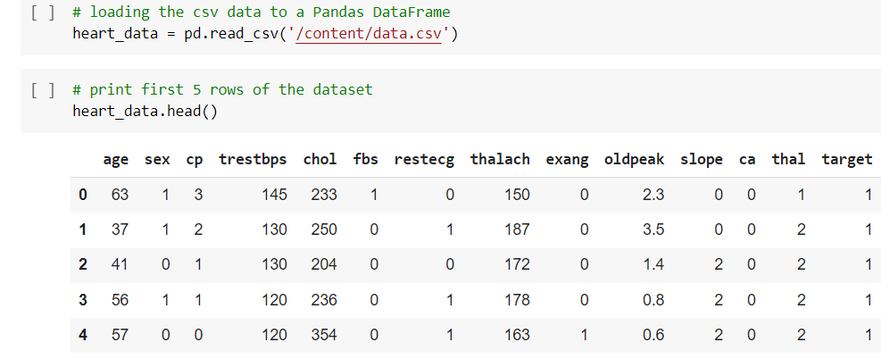
Dataset Description:
A sample dataset

Slide 6
SAMPLE CODE:
Make necessary imports:
import numpy as np
import pandas as pd
from sklearn.model_selection import train_test_split
from sklearn.linear_model import LogisticRegression
from sklearn.metrics import accuracy_score
Read the Dataframe
heart_data = pd.read_csv('/content/data.csv')
heart_data.head()
heart_data.shape
heart_data.info()
X = heart_data.drop(columns='target', axis=1)
Y = heart_data['target']
X_train, X_test, Y_train, Y_test = train_test_split(X, Y, test_size=0.2, stratify=Y, random_state=2)

Slide 7
Initialize Logistic Regression:
model = LogisticRegression()
model.fit(X_train, Y_train)
X_train_prediction = model.predict(X_train)
training_data_accuracy = accuracy_score(X_train_prediction, Y_train) print('Accuracy on Training data : ', training_data_accuracy)
Output: Accuracy on Training data : 0.8512396694214877
X_test_prediction = model.predict(X_test)
test_data_accuracy = accuracy_score(X_test_prediction, Y_test)
print('Accuracy on Test data : ', test_data_accuracy)
Output: Accuracy on Test data : 0.819672131147541

Slide 8
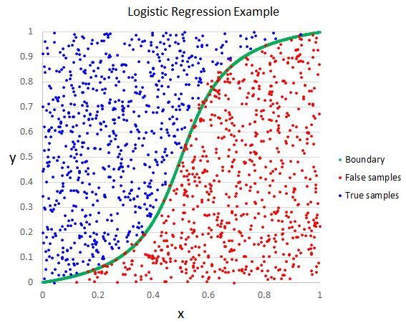
Model used:
Logistic Regression:
Logistic regression is one of the most popular Machine Learning algorithms, which comes under the Supervised Learning technique. It is used for predicting the categorical dependent variable using a given set of independent variables.
Logistic regression predicts the output of a categorical dependent variable. Therefore the outcome must be a categorical or discrete value. It can be either Yes or No, 0 or 1, true or False, etc. but instead of giving the exact value as 0 and 1, it gives the probabilistic values which lie between 0 and 1.

Slide 9
Developing web app
Spyder:
Spyder is short for Scientific PYthon Development EnviRonment
Think of it as an IDE for scientific programming within Python.
Spyder is a free and open source scientific environment written in Python, for Python, and designed by and for scientists, engineers and data analysts.
Code which predicts the output:
def heartdiseasepredict(input_data):
input_data_as_numpy_array= np.asarray(input_data,dtype=float)
input_data_reshaped=input_data_as_numpy_array.reshape(1,-1)
prediction = loaded_model.predict(input_data_reshaped)
print(prediction)
if (prediction[0]== 0):
return 'The Person does not have a Heart Disease'
else:
return 'The Person has Heart Disease'

Slide 10
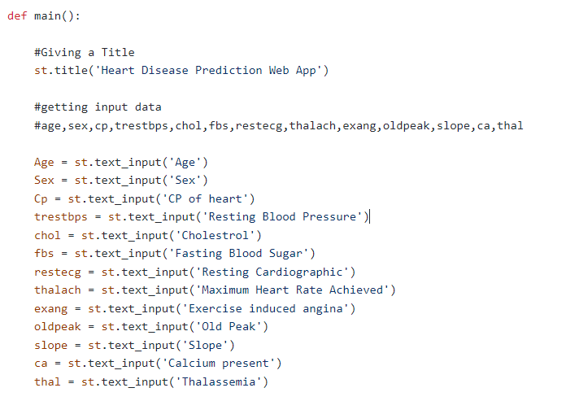
STREAMLIT:
Streamlit turns data scripts into shareable web apps in minutes All in pure Python. No front‑end experience required.
Streamlit is an open-source python framework for building web apps for Machine Learning and Data Science. We can instantly develop web apps and deploy them easily using Streamlit.
Streamlit allows you to write an app the same way you write a python code.
Streamlit makes it seamless to work on the interactive loop of coding and viewing results in the web app.
SAMPLE CODE :

Slide 11
UPLOADING FILES TO GITHUB
We need to upload the .py file and the .sav file which we have saved from the colab.
In addition to that we have to include the three more files
Procfile
Requirements.txt
Runtime.txt
Setup.sh

Slide 12
DEPLOYING APP ON HEROKU
Till now we run the website in the local machine.
Inorder to deploy the website we use the Heroku platform.
By logging into the Heroku we have to create the new app and then we have to connect to the github repository.
Now we have click on the deploy button in the Heroku then after running all the modules the Heroku creates the app and provide a URL for the app.
Link for the app : https://heart-disease-predictionapp1.herokuapp.com/.

Slide 13
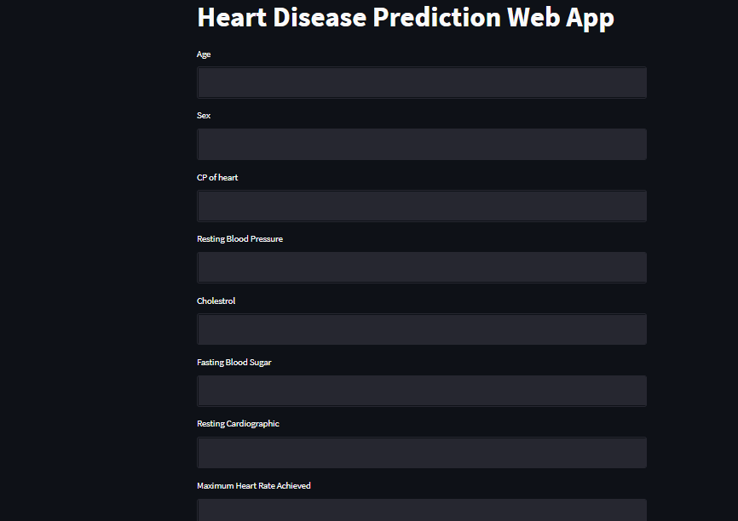
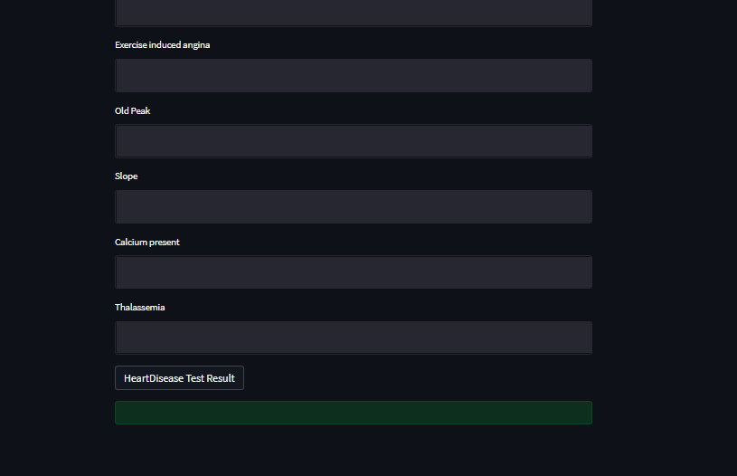
OUTPUTS/RESULTS

Slide 14
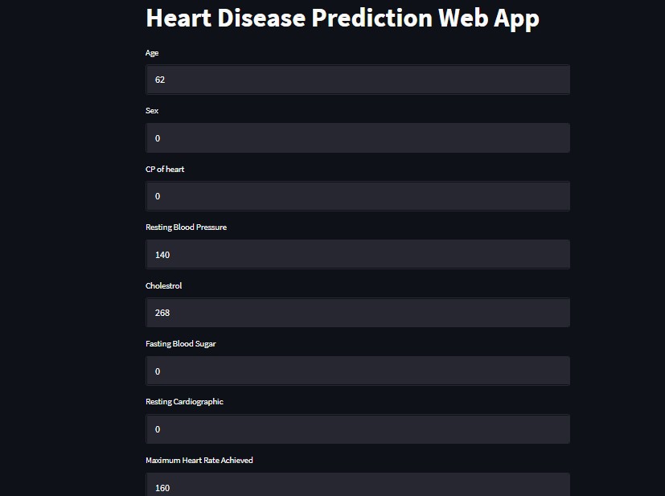
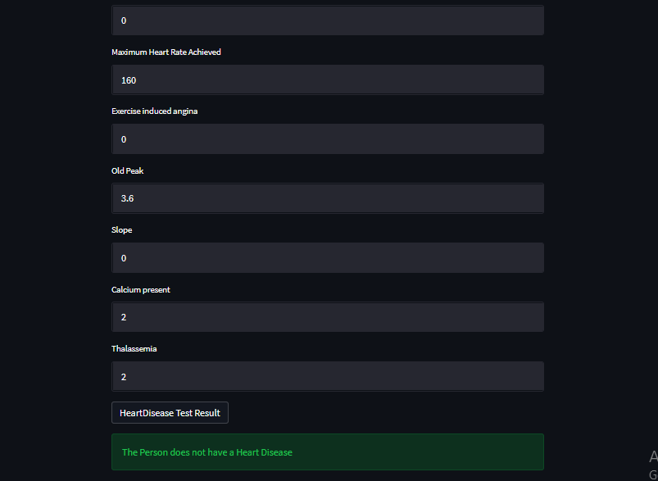

Slide 15
Thank You

