Slide 1
Knowledge and Expert Systems

Slide 2
Contents
What is Knowledge?
What is Knowledge Acquisition?
The Expert Systems Development Team.
Rules and Knowledge Representation
Rule-based Expert Systems.
Characteristics of Expert Systems.

Slide 3
What is Knowledge?
Knowledge is a theoretical or practical understanding of a subject or a domain. Knowledge is also the sum of what is currently known, and apparently knowledge is power.
Those who possess knowledge are called experts.
Anyone can be considered a domain expert if he or she has deep knowledge (of both facts and rules) and strong practical experience in a particular domain. The area of the domain may be limited.
In general, an expert is a skilful person who can do things other people cannot.

Slide 4
Acquiring Knowledge
Knowledge acquisition can be regarded as a method by which a knowledge engineer gathers information mainly from experts, but also from text books, technical manuals, research papers and other authoritative sources for ultimate translation into a knowledge base, understandable by both machines and humans.
The person undertaking the knowledge acquisition, the knowledge engineer, must convert the acquired knowledge into an electronic format that a computer program can use.

Slide 5
Acquiring Knowledge
The important characteristics of knowledge are that it is experiential, descriptive, qualitative, largely undocumented and constantly changing.
There are certain domains where all these properties are found and some where there are only a few.
The lack of documentation and the fact that experts carry a lot of information in their heads, makes it difficult to gain access to their knowledge for developing information systems in general and expert systems in particular.
Therefore, knowledge engineers have devised specialised techniques to extract and document this information in an efficient and expedient manner.

Slide 6
Characteristics of Knowledge Acquisition
Knowledge acquisition is a labour and time intensive process.
Currently knowledge bases for knowledge based systems are crafted by hand, this is a severe limitation on the rapid deployment of such systems.
Biggest ‘bottleneck’ in system development.
Most expensive part (money, time & labour).
Automating KA the ultimate goal.

Slide 7
Players in the Development Team
There are five members of the expert system development team:
  the domain expert
  the knowledge engineer
  the programmer
  the project manager
  the end-user.
The success of their expert system entirely depends on how well the members work together.

Slide 8
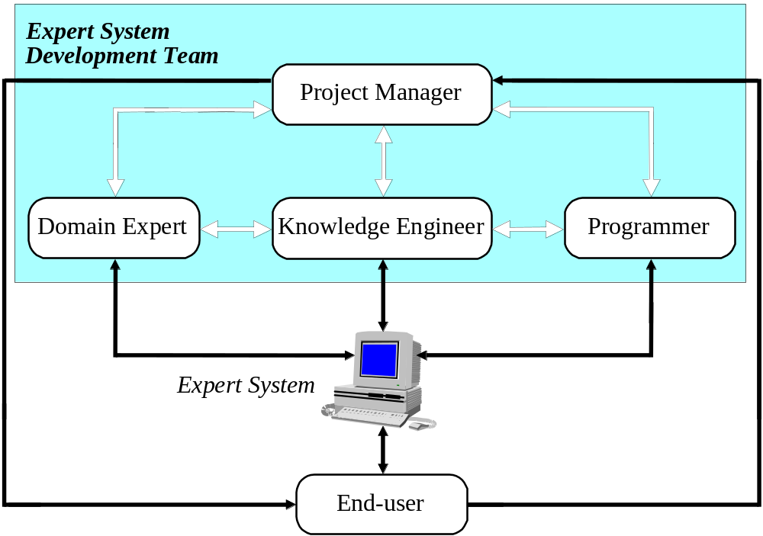
Players in the Development Team

Slide 9
Domain Expert
The domain expert is a knowledgeable and skilled person capable of solving problems in a specific area or domain.
This person has the greatest expertise in a given domain.
This expertise is to be captured in the expert system.
Therefore, the expert must:
  be able to communicate his or her knowledge
  be willing to participate in the expert system development
  commit a substantial amount of time to the project.
The domain expert is the most important player in the expert system development team.

Slide 10
Knowledge Engineer
The knowledge engineer is someone who is capable of designing, building and testing an expert system.
The knowledge engineer's main tasks are:
  interviews the domain expert to find out how a particular problem is solved.
  establishes what reasoning methods the expert uses to handle facts and rules and decides how to represent them in the expert system.
  chooses some development software or an expert system shell, or looks at programming languages for encoding the knowledge.
  responsible for testing, revising and integrating the expert system into the workplace.

Slide 11
Programmer
The programmer is the person responsible for the actual programming, describing the domain knowledge in terms that a computer can understand.
The programmer needs to have skills in symbolic programming in such AI languages as LISP, Prolog and OPS5 and also some experience in the application of different types of expert system shells.
In addition, the programmer should know conventional programming languages like Prolog ,Java, C, Pascal, FORTRAN and Basic.

Slide 12
Project Manager
The project manager is the leader of the expert system development team, responsible for keeping the project on track.
The project manager makes sure that all deliverables and milestones are met, interacts with the expert, knowledge engineer, programmer and end-user.

Slide 13
End-User
The end-user, often called just the user, is a person who uses the expert system when it is developed.
The user must not only be confident in the expert system performance but also feel comfortable using it.
Therefore, the design of the user interface of the expert system is also vital for the project’s success; the end-user’s contribution here can be crucial.

Slide 14
Knowledge and Rules
The human mental process is internal, and it is too complex to be represented as an algorithm. However, most experts are capable of expressing their knowledge in the form of rules for problem solving.
IF the ‘traffic light’ is green
THEN the action is go
IF the ‘traffic light’ is red
THEN the action is stop

Slide 15
Rules and Knowledge Representation
The term rule in AI, which is the most commonly used type of knowledge representation, can be defined as an IF-THEN structure that relates given information or facts in the IF part to some action in the THEN part.
A rule provides some description of how to solve a problem. Rules are relatively easy to create and understand.
Any rule consists of two parts:
  the IF part, called the antecedent (premise or condition)
  and the THEN part called the consequent (conclusion or action).

Slide 16
Rules and Knowledge Representation
A rule can have multiple antecedents joined by the keywords AND (conjunction), OR (disjunction) or a combination of both.
  IF <antecedent 1> IF <antecedent 1>
  AND <antecedent 2> OR <antecedent 2>
  . .
  . .
  . .
  AND <antecedent n> OR <antecedent n>
  THEN <consequent> THEN <consequent>

Slide 17
Rules and Knowledge Representation
The antecedent of a rule incorporates two parts: an object (linguistic object) and its value. The object and its value are linked by an operator.
The operator identifies the object and assigns the value. Operators such as is, are, is not, are not are used to assign a symbolic value to a linguistic object.
Expert systems can also use mathematical operators to define an object as numerical and assign it to the numerical value.
OBJECT OPERATOR VALUE
IF ‘age of the customer’ < 18
AND ‘cash withdrawal’ > 1000
THEN ‘signature of the parent’ is required

Slide 18
Rules and Knowledge Representation
Rules can represent relations, recommendations, directives, strategies and heuristics:
Relation
  IF the ‘fuel tank’ is empty
  THEN the car is dead
Recommendation
  IF the season is autumn
  AND the sky is cloudy
  AND the forecast is drizzle
  THEN the advice is ‘take an umbrella’
Directive
  IF the car is dead
  AND the ‘fuel tank’ is empty
  THEN the action is ‘refuel the car’

Slide 19
Rules and Knowledge Representation
Strategy
  IF the car is dead
  THEN the action is ‘check the fuel tank’;
  step1 is complete
  IF step1 is complete
  AND the ‘fuel tank’ is full
  THEN the action is ‘check the battery’;
  step2 is complete
Heuristic
  IF the spill is liquid
  AND the ‘spill pH’ < 6
  AND the ‘spill smell’ is vinegar
  THEN the ‘spill material’ is ‘acetic acid’

Slide 20
Knowledge-Based Expert Systems
In the early seventies, Newell and Simon from Carnegie-Mellon University proposed a production system model, the foundation of the modern rule-based expert systems.
The production model is based on the idea that humans solve problems by applying their knowledge (expressed as production rules) to a given problem represented by problem-specific information.
The production rules are stored in the long-term memory and the problem-specific information or facts in the short-term memory.

Slide 21
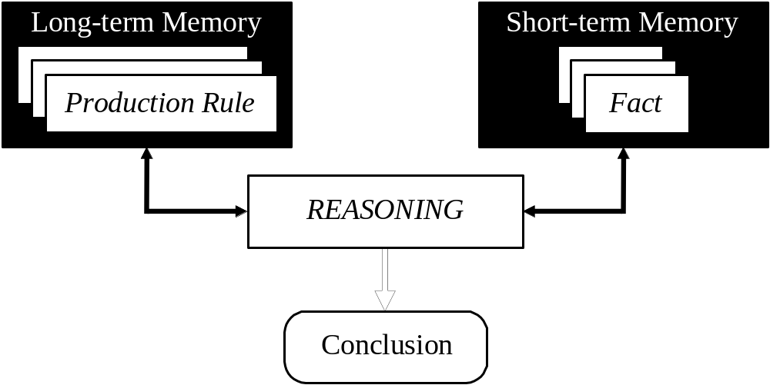
Production System Model

Slide 22
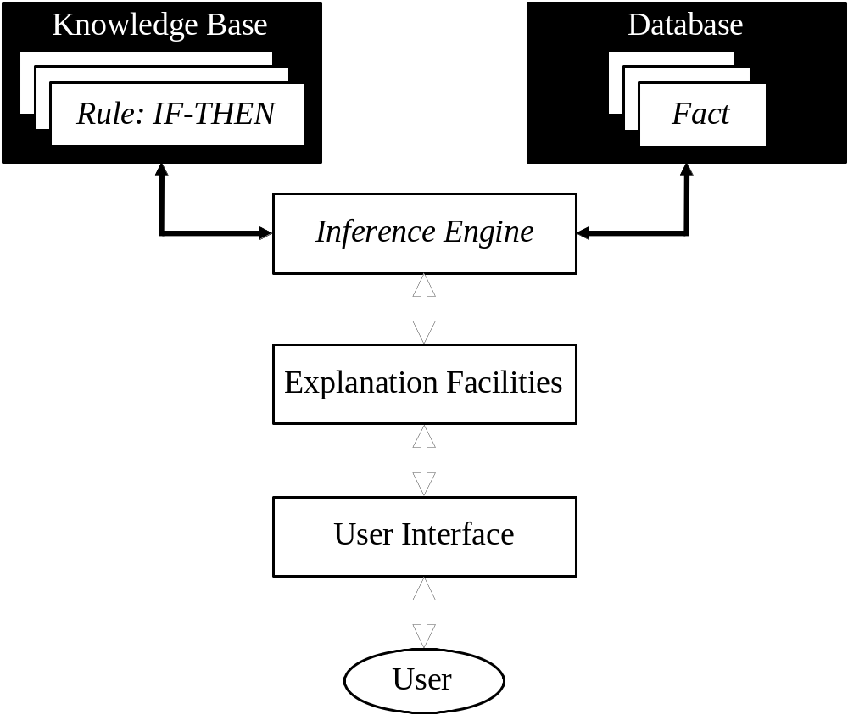
Basic Rule-Based Expert System

Slide 23
Structure of a Rule-based Expert System
The knowledge base contains the domain knowledge useful for problem solving. In a rule-based expert system, the knowledge is represented as a set of rules. Each rule specifies a relation, recommendation, directive, strategy or heuristic and has the IF (condition) THEN (action) structure. When the condition part of a rule is satisfied, the rule is said to fire and the action part is executed.
The database includes a set of facts used to match against the IF (condition) parts of rules stored in the knowledge base.

Slide 24
Structure of a Rule-based Expert System
The inference engine carries out the reasoning whereby the expert system reaches a solution. It links the rules given in the knowledge base with the facts provided in the database.
The explanation facilities enable the user to ask the expert system how a particular conclusion is reached and why a specific fact is needed. An expert system must be able to explain its reasoning and justify its advice, analysis or conclusion.
The user interface is the means of communication between a user seeking a solution to the problem and an expert system.

Slide 25
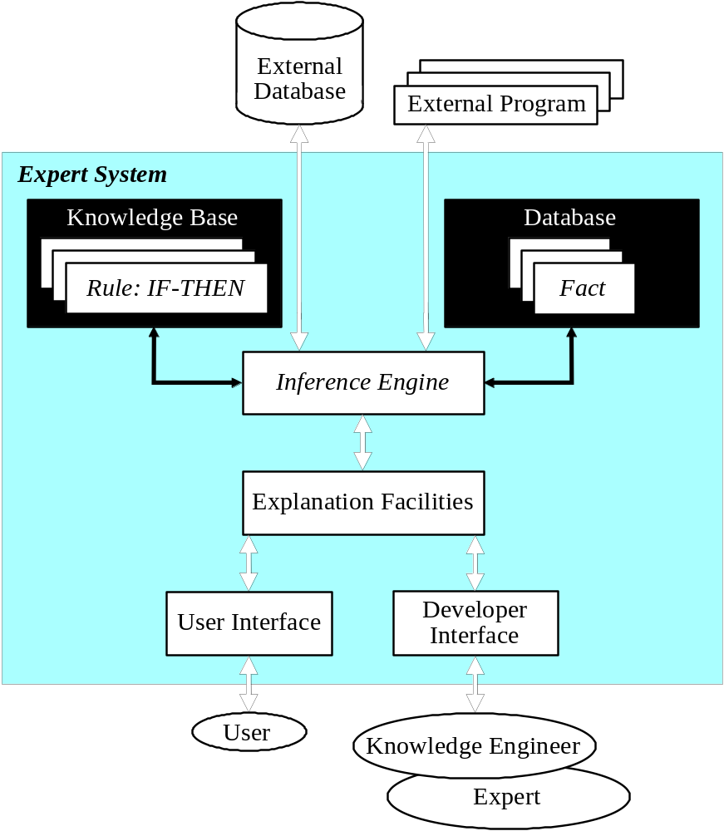
Common Rule-Based Expert System

Slide 26
Characteristics of an Expert System
An expert system is built to perform at a human expert level in a narrow, specialised domain. Thus, the most important characteristic of an expert system is its high-quality performance.
No matter how fast the system can solve a problem, the user will not be satisfied if the result is wrong!
On the other hand, the speed of reaching a solution is very important. Even the most accurate decision or diagnosis may not be useful if it is too late to apply, for instance, in an emergency, when a patient dies or a nuclear power plant explodes.

Slide 27
Characteristics of an Expert System
Expert systems apply heuristics to guide the reasoning and thus reduce the search area for a solution.
A unique feature of an expert system is its explanation capability. It enables the expert system to review its own reasoning and explain its decisions.
Expert systems employ symbolic reasoning when solving a problem. Symbols are used to represent different types of knowledge such as facts, concepts and rules.

Slide 28
Characteristics of an Expert System
We should be aware that an expert is only a human and thus can make mistakes, and therefore, an expert system built to perform at a human expert level also should be "allowed" to make mistakes.
In expert systems, knowledge is separated from its processing (knowledge base and inference engine are split up). A conventional program is a mixture of knowledge and the control structure to process this knowledge.
When an expert system shell is used, a knowledge engineer or an expert simply enters rules in the knowledge base. Each new rule adds some new knowledge and makes the expert system smarter.

Slide 29
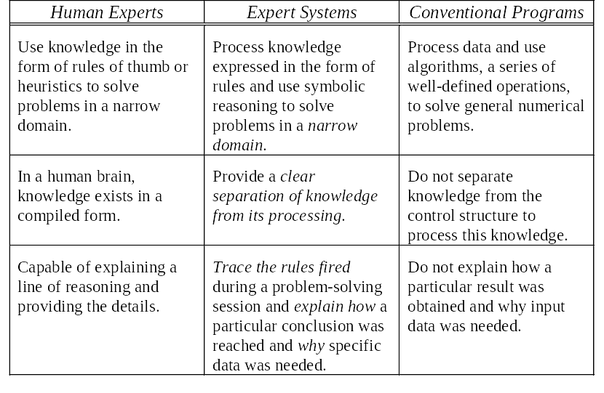
Expert Systems Comparison

Slide 30
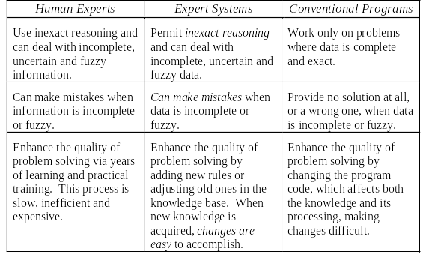
Expert Systems Comparison

