Slide 1
Artificial Intelligence
Introduction to Fuzzy Logic
Classical logic or Crisp Logic

Slide 2
Contents
Definitions
Bit of History
Fuzzy Applications
Fuzzy Sets
Fuzzy Boundaries
Fuzzy Representation
Linguistic Variables and Hedges

Slide 3
Definition
Experts rely on common sense when they solve problems.
How can we represent expert knowledge that uses vague and ambiguous terms in a computer?
Fuzzy logic is not logic that is fuzzy, but logic that is used to describe fuzziness. Fuzzy logic is the theory of fuzzy sets, sets that calibrate vagueness.
Fuzzy logic is based on the idea that all things admit of degrees. Temperature, height, speed, distance, beauty – all come on a sliding scale.
  The motor is running really hot.
  Tom is a very tall guy.

Slide 4
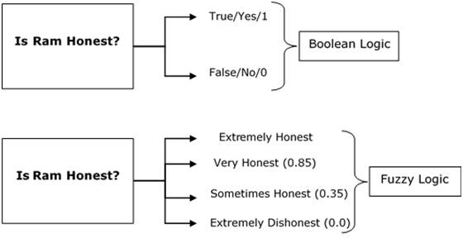
The word fuzzy refers to things which are not clear or are vague. Any event, process, or function that is changing continuously cannot always be defined as either true or false, which means that we need to define such activities in a Fuzzy manner.
What is Fuzzy Logic?
Fuzzy Logic resembles the human decision-making methodology. It deals with vague and imprecise information. This is gross oversimplification of the real-world problems and based on degrees of truth rather than usual true/false or 1/0 like Boolean logic.
Take a look at the following diagram. It shows that in fuzzy systems, the values are indicated by a number in the range from 0 to 1. Here 1.0 represents absolute truth and 0.0 represents absolute falseness. The number which indicates the value in fuzzy systems is called the truth value.
In other words, we can say that fuzzy logic is not logic that is fuzzy, but logic that is used to describe fuzziness. There can be numerous other examples like this with the help of which we can understand the concept of fuzzy logic.
Fuzzy Logic was introduced in 1965 by Lofti A. Zadeh in his research paper “Fuzzy Sets”. He is considered as the father of Fuzzy Logic.

Slide 5
Definition
The concept of a set and set theory are powerful concepts in mathematics. However, the principal notion underlying set theory, that an element can (exclusively) either belong to set or not belong to a set, makes it well nigh impossible to represent much of human discourse. How is one to represent notions like:
  large profit
  high pressure
  tall man
  moderate temperature
Ordinary set-theoretic representations will require the maintenance of a crisp differentiation in a very artificial manner:
  high
  not quite high
  very high … etc.

Slide 6
Definition
Many decision-making and problem-solving tasks are too complex to be understood quantitatively, however, people succeed by using knowledge that is imprecise rather than precise.
Fuzzy set theory resembles human reasoning in its use of approximate information and uncertainty to generate decisions.
It was specifically designed to mathematically represent uncertainty and vagueness and provide formalized tools for dealing with the imprecision intrinsic to many problems.

Slide 7
Definition
Since knowledge can be expressed in a more natural way by using fuzzy sets, many engineering and decision problems can be greatly simplified.
Boolean logic uses sharp distinctions. It forces us to draw lines between members of a class and non-members. For instance, we may say, Tom is tall because his height is 181 cm. If we drew a line at 180 cm, we would find that David, who is 179 cm, is small.
Is David really a small man or we have just drawn an arbitrary line in the sand?

Slide 8
Bit of History
Fuzzy, or multi-valued logic, was introduced in the 1930s by Jan Lukasiewicz, a Polish philosopher. While classical logic operates with only two values 1 (true) and 0 (false), Lukasiewicz introduced logic that extended the range of truth values to all real numbers in the interval between 0 and 1.
For example, the possibility that a man 181 cm tall is really tall might be set to a value of 0.86. It is likely that the man is tall. This work led to an inexact reasoning technique often called possibility theory.
In 1965 Lotfi Zadeh, published his famous paper “Fuzzy sets”. Zadeh extended the work on possibility theory into a formal system of mathematical logic, and introduced a new concept for applying natural language terms. This new logic for representing and manipulating fuzzy terms was called fuzzy logic.

Slide 9
Why?
Why fuzzy?
As Zadeh said, the term is concrete, immediate and descriptive; we all know what it means. However, many people in the West were repelled by the word fuzzy, because it is usually used in a negative sense.
Why logic?
Fuzziness rests on fuzzy set theory, and fuzzy logic is just a small part of that theory.

Slide 10
The Term “Fuzzy Logic”
The term fuzzy logic is used in two senses:
  Narrow sense: Fuzzy logic is a branch of fuzzy set theory, which deals (as logical systems do) with the representation and inference from knowledge. Fuzzy logic, unlike other logical systems, deals with imprecise or uncertain knowledge. In this narrow, and perhaps correct sense, fuzzy logic is just one of the branches of fuzzy set theory.
  Broad Sense: fuzzy logic synonymously with fuzzy set theory

Slide 11
Fuzzy Applications
Theory of fuzzy sets and fuzzy logic has been applied to problems in a variety of fields:
  taxonomy; topology; linguistics; logic; automata theory; game theory; pattern recognition; medicine; law; decision support; Information retrieval; etc.
And more recently fuzzy machines have been developed including:
  automatic train control; tunnel digging machinery; washing machines; rice cookers; vacuum cleaners; air conditioners, etc.

Slide 12


Fuzzy Applications
Advertisement: …
Extraklasse Washing Machine - 1200 rpm. The Extraklasse machine has a number of features which will make life easier for you.
Fuzzy Logic detects the type and amount of laundry in the drum and allows only as much water to enter the machine as is really needed for the loaded amount. And less water will heat up quicker - which means less energy consumption.
Foam detection
Too much foam is compensated by an additional rinse cycle: If Fuzzy Logic detects the formation of too much foam in the rinsing spin cycle, it simply activates an additional rinse cycle. Fantastic!
Imbalance compensation
In the event of imbalance, Fuzzy Logic immediately calculates the maximum possible speed, sets this speed and starts spinning. This provides optimum utilization of the spinning time at full speed […]
Washing without wasting - with automatic water level adjustment
Fuzzy automatic water level adjustment adapts water and energy consumption to the individual requirements of each wash programme, depending on the amount of laundry and type of fabric […]

Slide 13
In this chapter, we will discuss the fields where the concepts of Fuzzy Logic are extensively applied.
Aerospace
In aerospace, fuzzy logic is used in the following areas −
Altitude control of spacecraft
Satellite altitude control
Flow and mixture regulation in aircraft deicing vehicles
Automotive
In automotive, fuzzy logic is used in the following areas −
Trainable fuzzy systems for idle speed control
Shift scheduling method for automatic transmission
Intelligent highway systems
Traffic control
Improving efficiency of automatic transmissions
Business
In business, fuzzy logic is used in the following areas −
Decision-making support systems
Personnel evaluation in a large company

Slide 14
Defense
In defense, fuzzy logic is used in the following areas −
Underwater target recognition
Automatic target recognition of thermal infrared images
Naval decision support aids
Control of a hypervelocity interceptor
Fuzzy set modeling of NATO decision making
Electronics
In electronics, fuzzy logic is used in the following areas −
Control of automatic exposure in video cameras
Humidity in a clean room
Air conditioning systems
Washing machine timing
Microwave ovens
Vacuum cleaners
Finance
In the finance field, fuzzy logic is used in the following areas −
Banknote transfer control
Fund management
Stock market predictions

Slide 15
Industrial Sector
In industrial, fuzzy logic is used in following areas −
Cement kiln controls heat exchanger control
Activated sludge wastewater treatment process control
Water purification plant control
Quantitative pattern analysis for industrial quality assurance
Control of constraint satisfaction problems in structural design
Control of water purification plants
Manufacturing
In the manufacturing industry, fuzzy logic is used in following areas −
Optimization of cheese production
Optimization of milk production
Marine
In the marine field, fuzzy logic is used in the following areas −
Autopilot for ships
Optimal route selection
Control of autonomous underwater vehicles
Ship steering

Slide 16
Medical
In the medical field, fuzzy logic is used in the following areas −
Medical diagnostic support system
Control of arterial pressure during anesthesia
Multivariable control of anesthesia
Modeling of neuro pathological findings in Alzheimer's patients
Radiology diagnoses
Fuzzy inference diagnosis of diabetes and prostate cancer
Securities
In securities, fuzzy logic is used in following areas −
Decision systems for securities trading
Various security appliances
Transportation
In transportation, fuzzy logic is used in the following areas −
Automatic underground train operation
Train schedule control
Railway acceleration
Braking and stopping

Slide 17
Pattern Recognition and Classification
In Pattern Recognition and Classification, fuzzy logic is used in the following areas −
Fuzzy logic based speech recognition
Fuzzy logic based
Handwriting recognition
Fuzzy logic based facial characteristic analysis
Command analysis
Fuzzy image search
Psychology
In Psychology, fuzzy logic is used in following areas −
Fuzzy logic based analysis of human behavior
Criminal investigation and prevention based on fuzzy logic reasoning

Slide 18
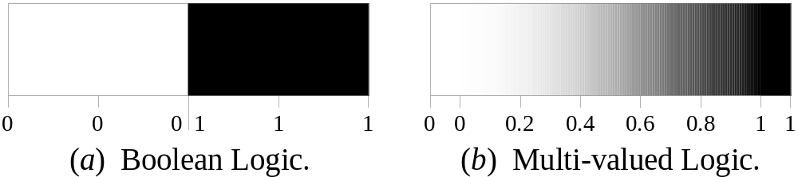
More Definitions
Fuzzy logic is a set of mathematical principles for knowledge representation based on degrees of membership.
Unlike two-valued Boolean logic, fuzzy logic is multi-valued. It deals with degrees of membership and degrees of truth.
Fuzzy logic uses the continuum of logical values between 0 (completely false) and 1 (completely true). Instead of just black and white, it employs the spectrum of colours, accepting that things can be partly true and partly false at the same time.

Slide 19
Fuzzy Sets
The concept of a set is fundamental to mathematics.
However, our own language is also the supreme expression of sets. For example, car indicates the set of cars. When we say a car, we mean one out of the set of cars.
The classical example in fuzzy sets is tall men. The elements of the fuzzy set “tall men” are all men, but their degrees of membership depend on their height. (see table on next page)

Slide 20
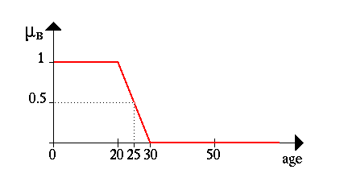
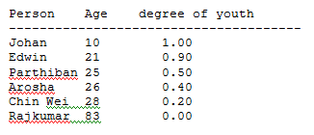
The whole concept can be illustrated with this example. Let's talk about people and "youthness". In this case the set S (the universe of discourse) is the set of people. A fuzzy subset YOUNG is also defined, which answers the question "to what degree is person x young?" To each person in the universe of discourse, we have to assign a degree of membership in the fuzzy subset YOUNG. The easiest way to do this is with a membership function based on the person's age.
young(x) = { 1, if age(x) <= 20,
(30-age(x))/10, if 20 < age(x) <= 30,
0, if age(x) > 30 }
A graph of this looks like:
Given this definition, here are some example values:

Slide 21
So given this definition, we'd say that the degree of truth of the statement "Parthiban is YOUNG" is 0.50.
Note: Membership functions almost never have as simple a shape as age(x). They will at least tend to be triangles pointing up, and they can be much more complex than that. Furthermore, membership functions so far is discussed as if they always are based on a single criterion, but this isn't always the case, although it is the most common case. One could, for example, want to have the membership function for YOUNG depend on both a person's age and their height (Arosha's short for his age). This is perfectly legitimate, and occasionally used in practice. It's referred to as a two-dimensional membership function. It's also possible to have even more criteria, or to have the membership function depend on elements from two completely different universes of discourse.

Slide 22
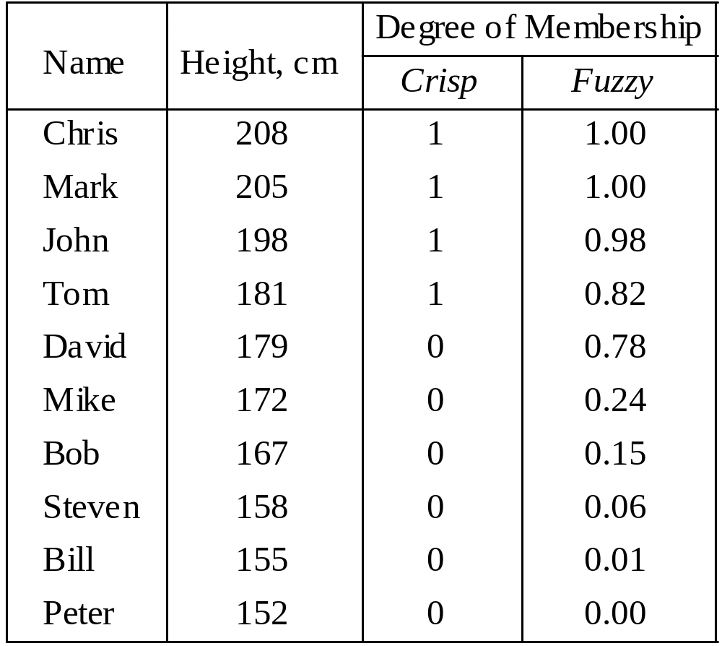
Fuzzy Sets

Slide 23
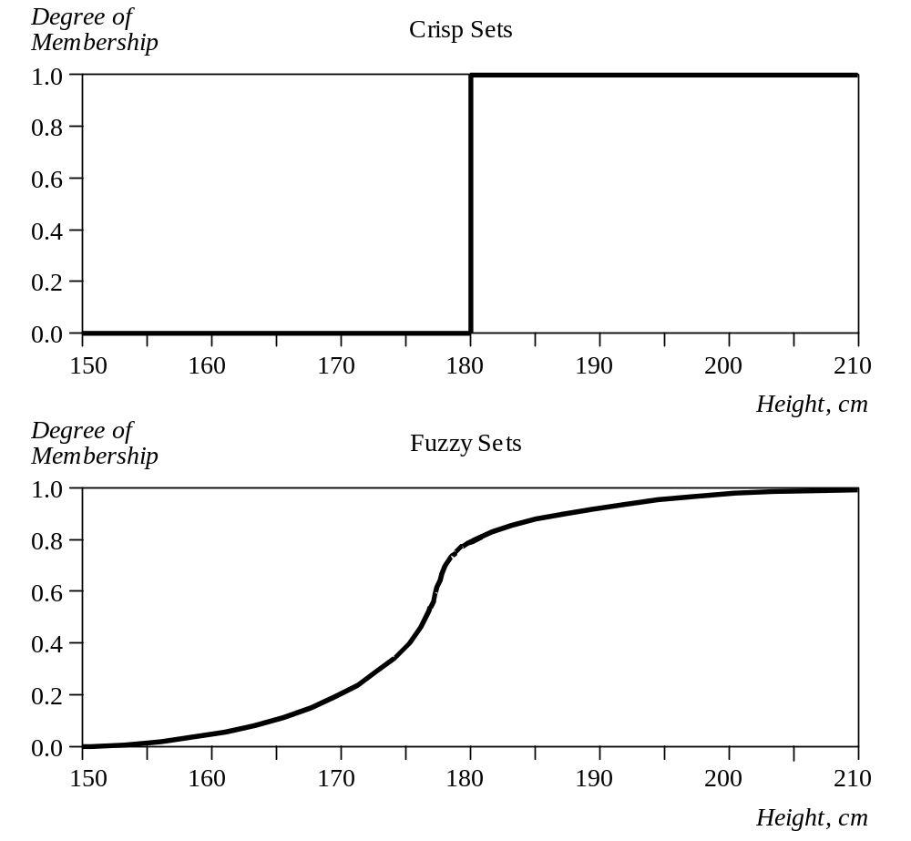
Crisp Vs Fuzzy Sets
The x-axis represents the universe of discourse – the range of all possible values applicable to a chosen variable. In our case, the variable is the man height. According to this representation, the universe of men’s heights consists of all tall men.
The y-axis represents the membership value of the fuzzy set. In our case, the fuzzy set of “tall men” maps height values into corresponding membership values.

Slide 24
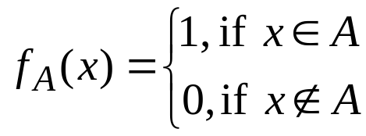
A Fuzzy Set has Fuzzy Boundaries
Let X be the universe of discourse and its elements be denoted as x. In the classical set theory, crisp set A of X is defined as function f_{A}(x) called the characteristic function of A:
f_{A}(x) : X → {0, 1}, where
This set maps universe X to a set of two elements. For any element x of universe X, characteristic function f_{A}(x) is equal to 1 if x is an element of set A, and is equal to 0 if x is not an element of A.

Slide 25
A Fuzzy Set has Fuzzy Boundaries
In the fuzzy theory, fuzzy set A of universe X is defined by function µ_{A}(x) called the membership function of set A
µ_{A}(x) : X → {0, 1}, where µ_{A}(x) = 1 if x is totally in A;
µ_{A}(x) = 0 if x is not in A;
0 < µ_{A}(x) < 1 if x is partly in A.
This set allows a continuum of possible choices. For any element x of universe X, membership function µ_{A}(x) equals the degree to which x is an element of set A. This degree, a value between 0 and 1, represents the degree of membership, also called membership value, of element x in set A.

Slide 26
Fuzzy Set Representation
First, we determine the membership functions. In our “tall men” example, we can obtain fuzzy sets of tall, short and average men.
The universe of discourse – the men’s heights – consists of three sets: short, average and tall men. As you will see, a man who is 184 cm tall is a member of the average men set with a degree of membership of 0.1, and at the same time, he is also a member of the tall men set with a degree of 0.4. (see graph on next page)

Slide 27
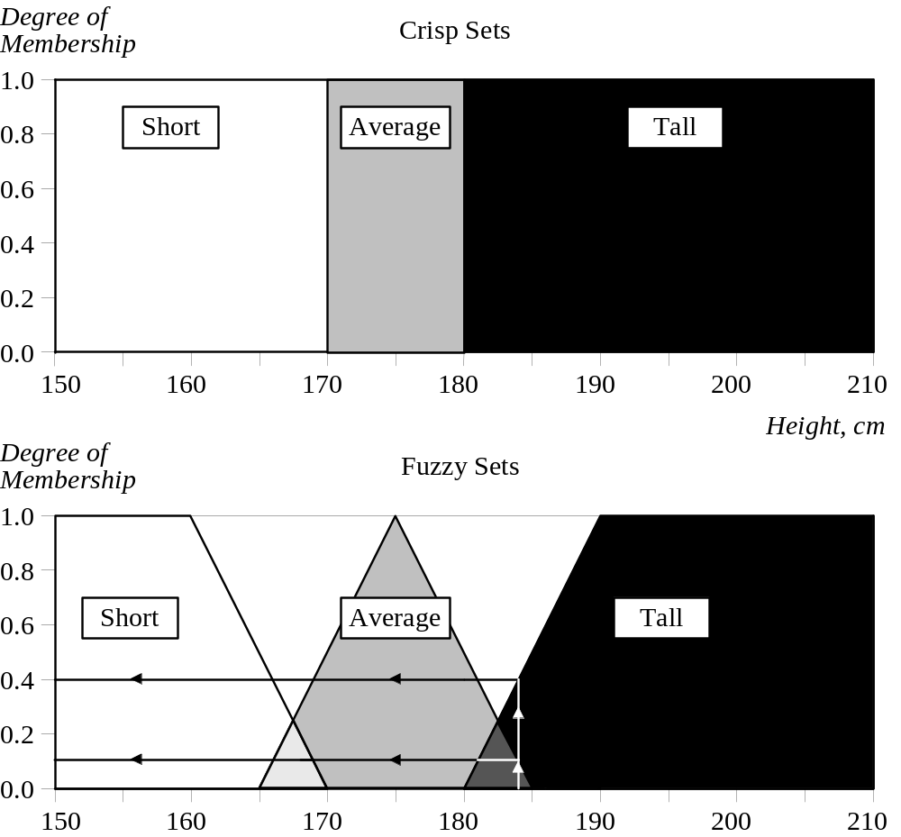
Fuzzy Set Representation

Slide 28
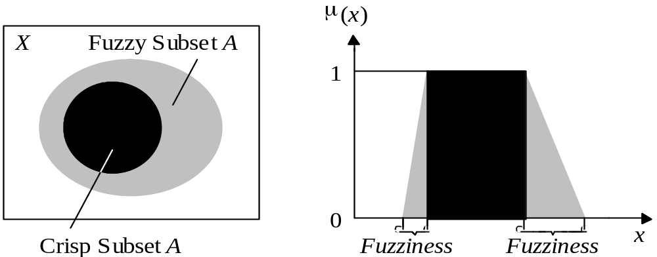
Fuzzy Set Representation
Typical functions that can be used to represent a fuzzy set are sigmoid, gaussian and pi. However, these functions increase the time of computation. Therefore, in practice, most applications use linear fit functions.

Slide 29
Linguistic Variables and Hedges
At the root of fuzzy set theory lies the idea of linguistic variables.
A linguistic variable is a fuzzy variable. For example, the statement “John is tall” implies that the linguistic variable John takes the linguistic value tall.
In fuzzy expert systems, linguistic variables are used in fuzzy rules. For example:
IF wind is strong
THEN sailing is good
IF project_duration is long
THEN completion_risk is high
IF speed is slow
THEN stopping_distance is short

Slide 30
Linguistic Variables and Hedges
The range of possible values of a linguistic variable represents the universe of discourse of that variable. For example, the universe of discourse of the linguistic variable speed might have the range between 0 and 220 km/h and may include such fuzzy subsets as very slow, slow, medium, fast, and very fast.
A linguistic variable carries with it the concept of fuzzy set qualifiers, called hedges.
Hedges are terms that modify the shape of fuzzy sets. They include adverbs such as very, somewhat, quite, more or less and slightly.

Slide 31
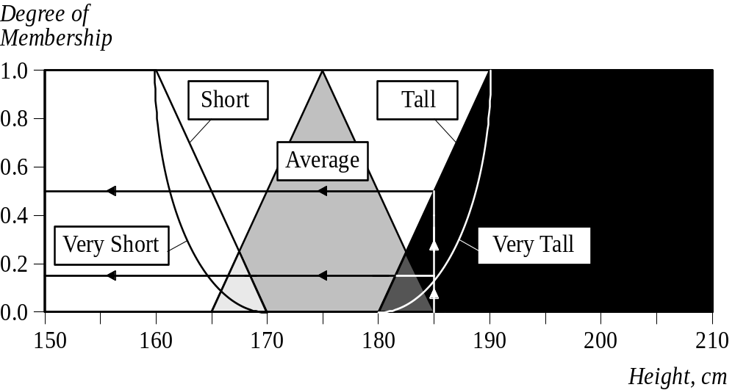
Linguistic Variables and Hedges

Slide 32
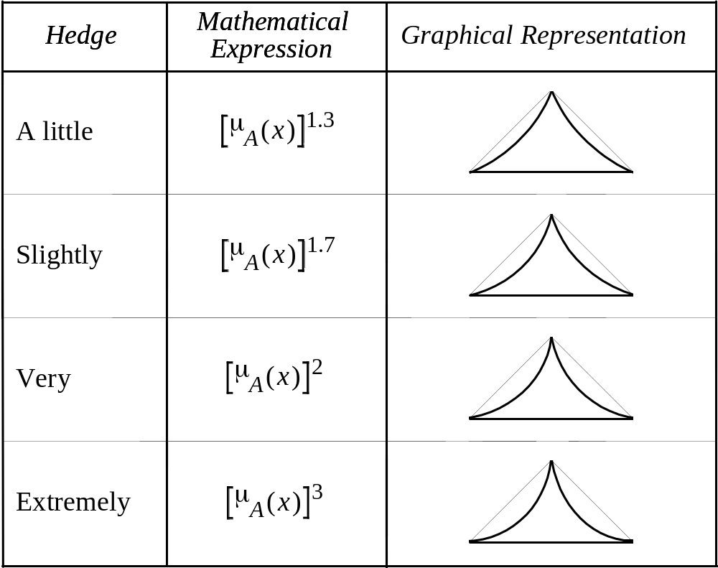
Linguistic Variables and Hedges

Slide 33
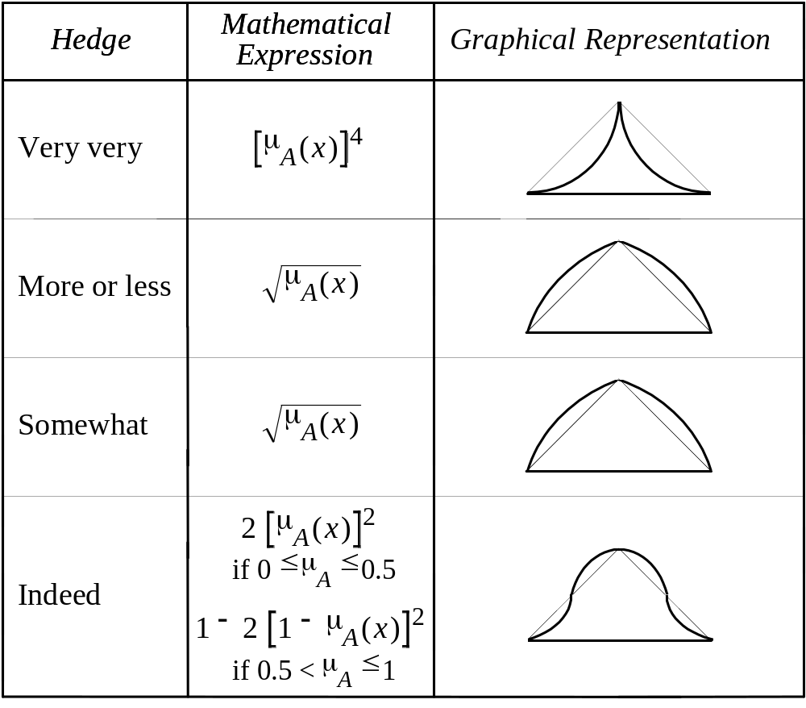
Linguistic Variables and Hedges

Slide 34
Closing
Questions???
Remarks???
Comments!!!
Evaluation!

Slide 35
06th October 2005
Bogdan L. Vrusias © 2005

