Slide 1


Slide 2
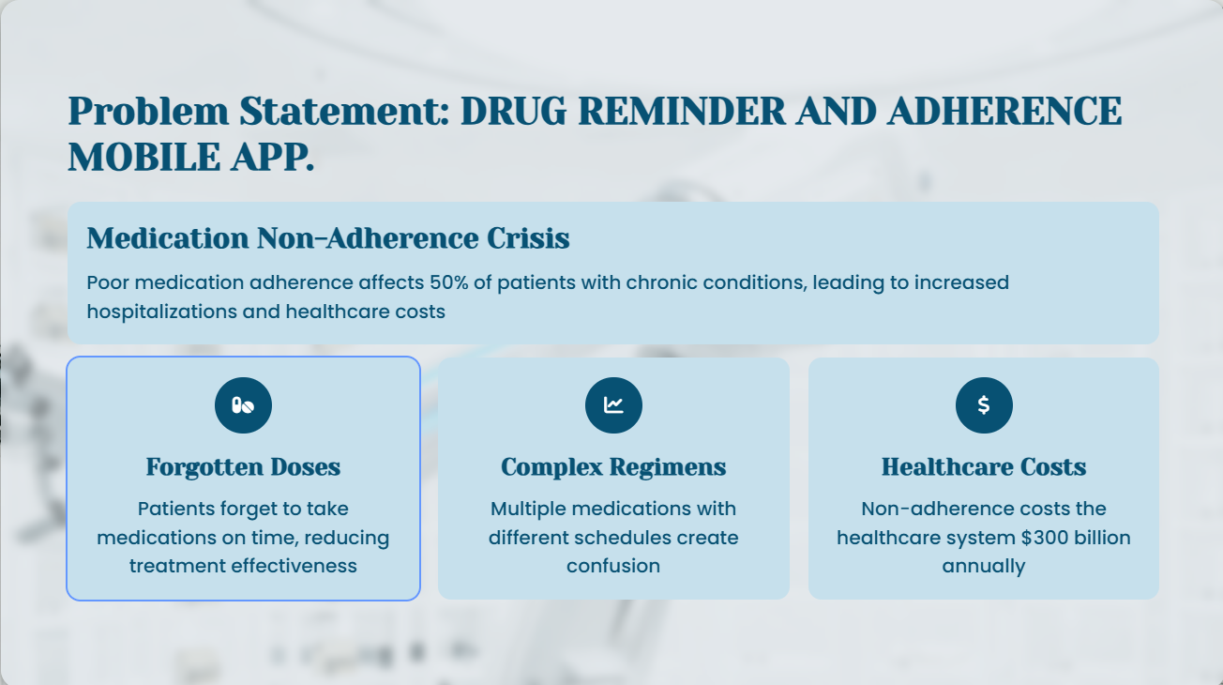
Problem Statement

Slide 3
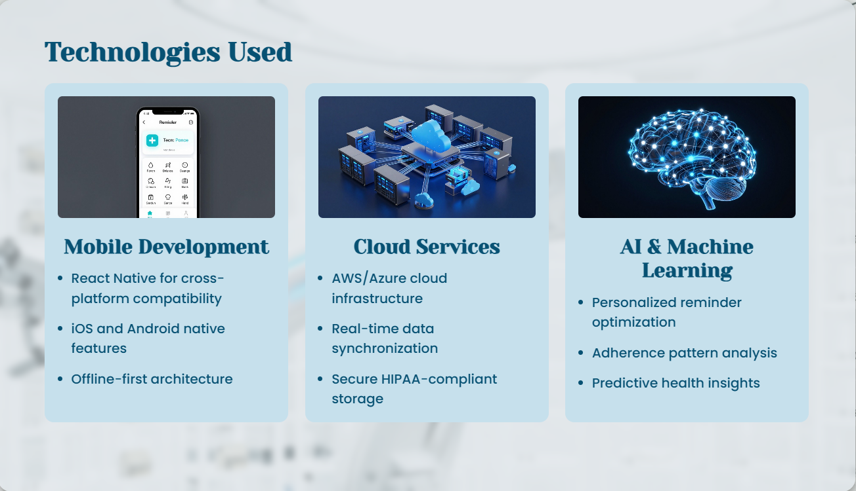
Technologies Used

Slide 4

Challenges Faced during the Hackathon

Slide 5
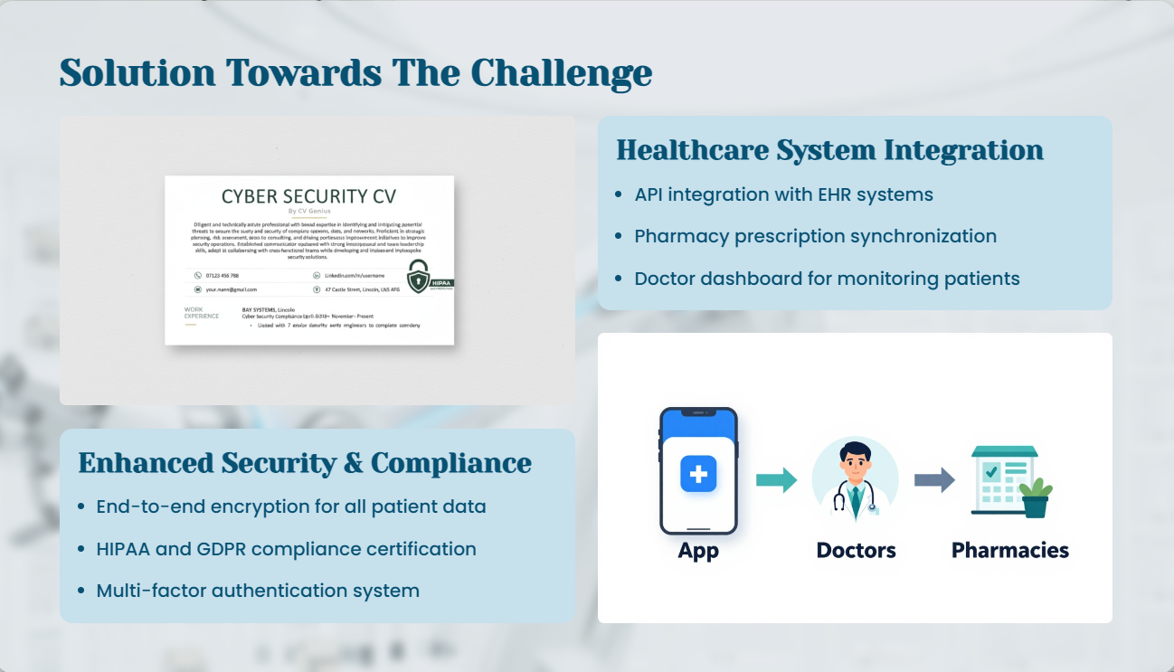
Solution Towards The Challenge

Slide 6
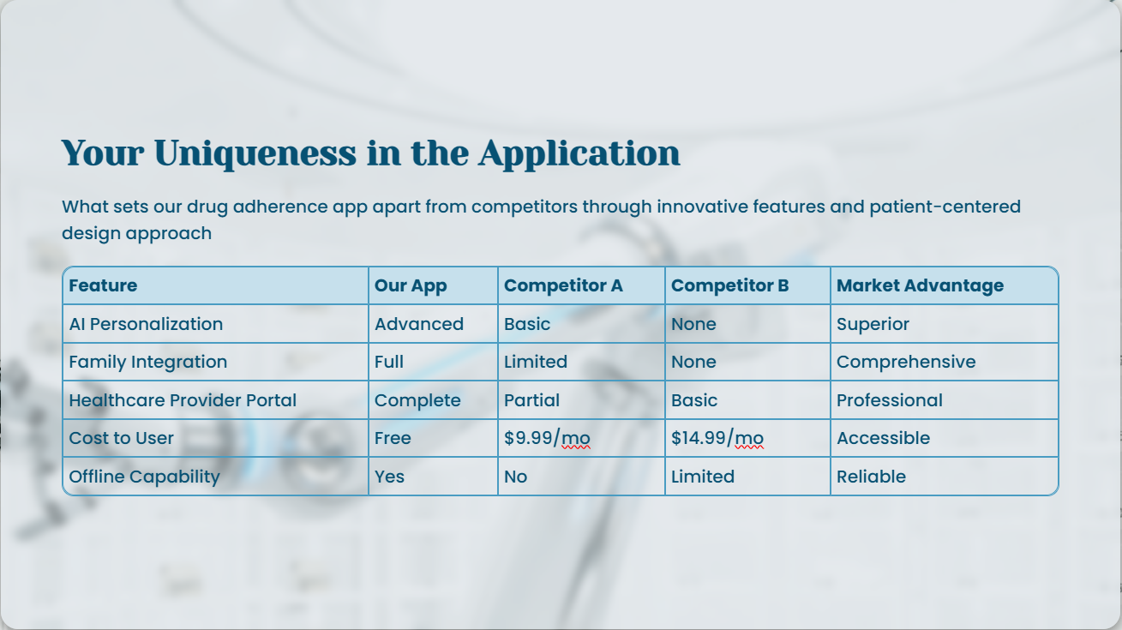
Your Uniqueness in the Application

