Slide 1
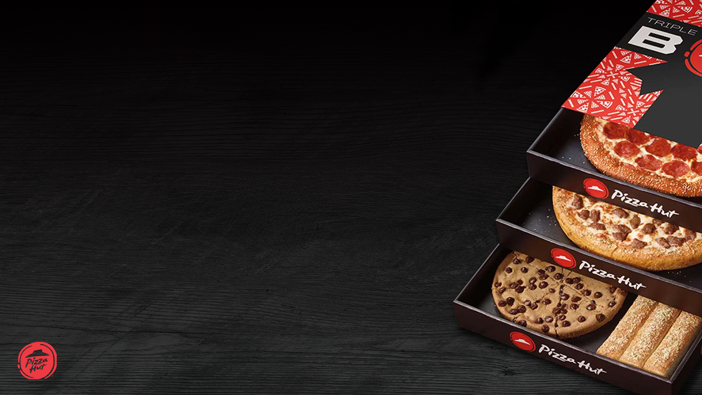
Chandrika Mungelkar
Aspiring Data Analyst
Email:chandrika.mungelkar@gmail.com | +91 8639479550
Tools: SQL, Excel, Power BI, Tableau
Pizza Sales SQL Project

Slide 2
Order_details: order_details_id, order_id, pizza_id, quantity. Orders: order_id, date, time Pizzas: pizza_id, pizza_type_id, size, price Pizza_types: pizza_type_id, name, category
Dataset: Order_details, orders, Pizza_types, pizzas.

Slide 3
Data Cleaning & Preparation Handled null values, removed duplicates, standardized data formats. Joins & Aggregations Combined Orders, Pizzas, and Categories tables using SQL joins; applied SUM, COUNT, and AVG for key metrics. Window Functions Used RANK and ROW_NUMBER to identify top pizzas by revenue and quantity. Business Metrics Analysis Calculated revenue contribution %, order distribution by time, and customer segmentation for actionable insights.
SQL Skills Demonstrated

Slide 4
SQL Skills Demonstrated 1) Data Cleaning (nulls, duplicates) 2) Joins (Orders, Pizzas, Categories) 3) Aggregations (SUM, COUNT, AVG) 4) Window Functions (RANK, ROW_NUMBER) 5) Business Metrics (revenue, order distribution, contribution %)
Objective: Analyze pizza sales to uncover trends, revenue drivers, and customer preferences

Slide 5
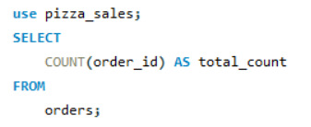

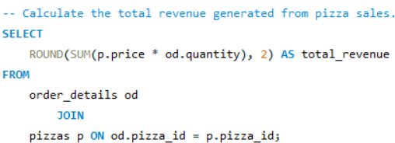

Total orders placed Total revenue generated
Basic Analysis

Slide 6
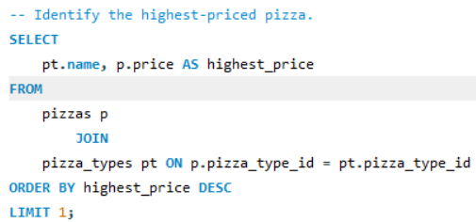

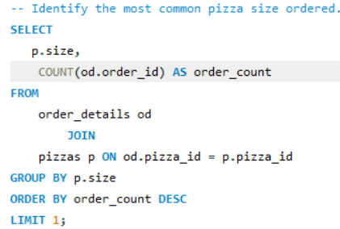

Highest‑Priced Pizza Most Common Pizza Size Ordered

Slide 7
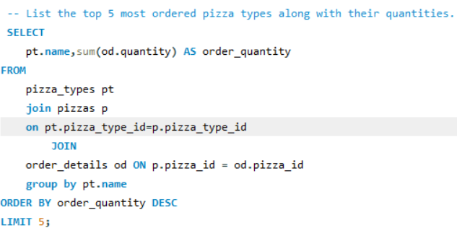
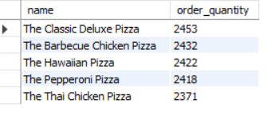
List the top 5 most ordered pizza along with their quantities

Slide 8
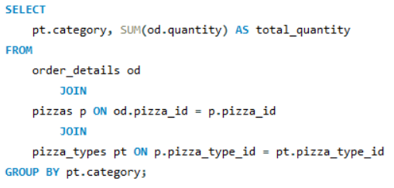
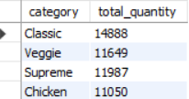
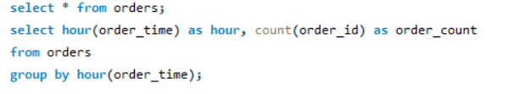
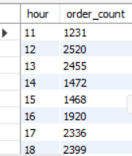
Intermediate Analysis
Join the necessary tables to find the total quantity of each pizza category ordered.
Determine the distribution of orders by hour of the day.

Slide 9

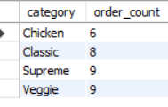
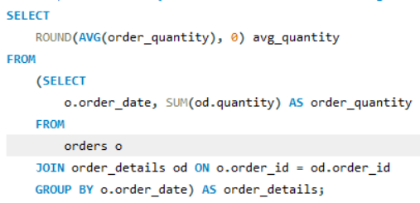

Join relevant tables to find the category-wise distribution of pizzas
Group the orders by date and calculate the average number of pizzas ordered per day.

Slide 10
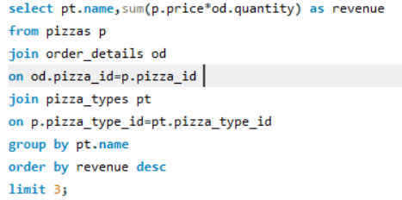
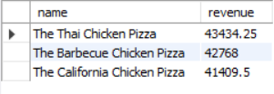
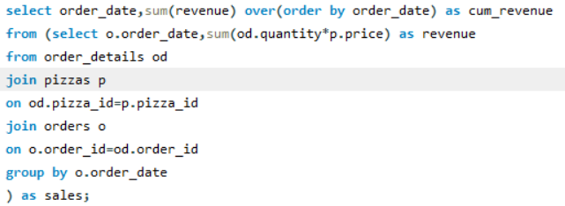
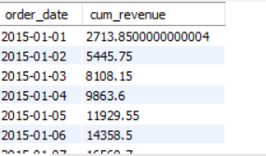
Determine the top 3 most ordered pizza types based on revenue.
Advanced Analysis
Analyze the cumulative revenue generated over time.

Slide 11
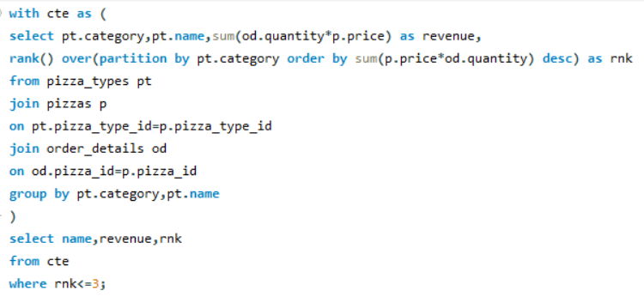
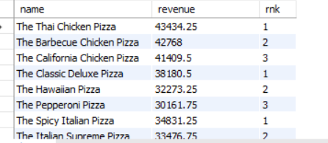
Determine the top 3 most ordered pizza types based on revenue for each pizza category.

Slide 12
Business Insights
Inventory Planning → Medium size pizzas are most popular, stock accordingly.
Promotions → Pepperoni & BBQ Chicken generate high revenue, target them in offers.
Staffing Optimization → Peak orders around lunch/dinner hours, adjust shifts.
Menu Strategy → Supreme & Classic categories contribute most revenue, expand variety.

Slide 13
Conclusion
SQL enabled data cleaning, joins, aggregations, and window functions
Analysis revealed top pizzas, revenue drivers, and customer preferences
Business insights support better inventory, marketing, and staffing decisions
Next step: Build interactive dashboards in Power BI/Tableau for real‑time monitoring
and window functions
Analysis revealed top pizzas, revenue drivers, and customer preferences
Business insights support better inventory, marketing, and staffing decisions

Slide 14
Thank You!
Pizza Sales SQL Project
Presented by: Chandrika Mungelkar
Pizza Sales SQL Project
📧 chandrika.mungelkar@gmail.com | 📞 +91 8639479550
Questions welcome!

