Slide 1
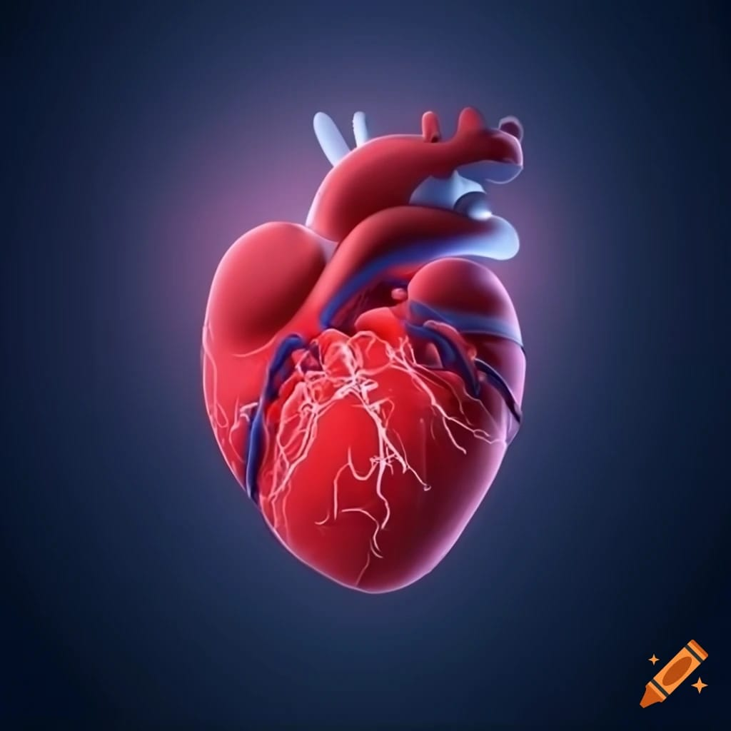
Heart Disease Detection: Machine Learning Classification for Identifying Heart Disease (Minor Project)

Slide 2
Members of the Team
P.Chandrika Ratna(Y20ADS421)
P.Greeshma(Y20ADS423)
U.Nagendra Obuldasu(Y20ADS428)

Slide 3
Contents
Abstract
Literature survey
Existing System
Disadvantages
Proposed System
Advantages
Block diagram of the proposed system
System requirements
Algorithms
Applications
Detailed work plan
References
Conclusion

Slide 4
Abstract
Heart Disease remains a leading cause of mortality worldwide, emphasizing the need for effective prediction and prevention strategies. In this study, we propose a machine learning approach for s heart disease risk using a comprehensive set of patient data. Our methodology involves the integration of various demographic, clinical, and lifestyle factors, along with advanced machine learning algorithms, to develop accurate prediction models. We utilize a diverse dataset comprising electronic health records,Through extensive experimentation and evaluation, we demonstrate the effectiveness of our approach in accurately predicting cardiovascular disease risk. Our findings suggest that machine learning-based predictive models hold significant promise for improving Heart disease risk assessment and informing personalized preventive interventions.

Slide 5
Literature survey
Author | Title | Purpose | Algorithm Used and Accuracy
1)Mr.Santhana Krishnan J, Dr.Geetha S | Prediction of Heart Diesease Using Machine Learning Algorithms | In this system, a heart disease data set is used. The main aim of this system is to predict the possibilities of occurring heart disease of the patients in terms of percentage. This is performed through data mining classification techniques | Decision tree 91% Naive Bayes 87%
2) M. Marimuthu, S.Deivarani, Gayathri R | Analysis of Heart Disease Prediction using Various Machine Learning | To achieve better accuracy and to make the system more efficient so that it can predict the chances of heart attack. | KNN 83.60% NB 80.66% Decision tree 75.58% SVM 65.56%
3)Sanchayita Dhar Pritha Datta Ankur Biswas, Tanusree Dey, Krishna Roy | Hybrid Machine Learning Approach for Prediction of Heart Disease | In this paper, to develop a prediction system that be capable to envisage heart diseases based on measurements, are extracted from The ERIC laboratory consisting of 209 test cases.. | Naive Bayes Decision tree Random Forest
4)Rajesh N. T Maneesha, Shaik Hafeez, Hari Krishna | Prediction of Heart Disease Using Machine Learning Algorithms | this paper, processing patient's dataset and a data of patients to whom we need to predict the occurrence of a heart disease | Naive Bayes Decision tree (ID3 Algorithm)

Slide 6
Existing System
The Existing system is a machine learning-based approach for predicting heart disease. The authors outline a methodology that involves collecting data on various health factors from patients, preprocessing the data (including cleaning, removing outliers, and feature selection), and then applying machine learning algorithms to build prediction models. Specifically, they mention the use of Multilayer Perceptron (MLP), Support Vector Machine (SVM), Random Forest (RF), and Naïve Bayes (NB) algorithms for classification.
The Existing system aims to leverage machine learning techniques to accurately predict the probability of developing cardiovascular disease based on the identified risk factors. By utilizing algorithms trained on electronic health data, the system seeks to provide efficient early diagnosis, potentially reducing the risk and global burden of cardiovascular disease by initiating treatment promptly and preventing further health deterioration.

Slide 7

Disadvantages
Limited Dataset Description
Algorithm Selection
Feature Selection
Interpretability
Accuracy

Slide 8
Proposed System
Our proposed system aims to develop a machine learning-based approach for predicting heart disease, coupled with a user-friendly web interface to facilitate easy access and utilization of the predictive models. The system will address the following key components:
Data Collection
Feature Engineering
Model Development
Web Interface Development
Continuous improvement

Slide 9

Advantages
Improved Accuracy
User Friendly Interface
Automation and Efficiency
Personalized Risk Assessment
Scalability and Accessibility

Slide 10
Block Diagram
Heart Diesese Dataset
Data Preprocessing
Feature Selection Methods
Full Features
training dataset
Testing dataset
Training Models
Evaluating Models

Slide 11

System Requirements
Hardware Requirements
A computer with sufficient processing power: Modern CPUs (e.g., Intel Core i5 or better)
Memory (RAM): At least 8GB of RAM is recommended for processing moderate-sized datasets
Storage: Adequate storage space for your datasets, libraries, and model files. SSDs are preferable for faster data access

Slide 12

System Requirements
Software Requirements
Programming Language: Python is the most commonly used language for machine learning projects. You'll need Python installed along with libraries like NumPy, Pandas, scikit-learn depending on your chosen framework.
Integrated Development Environment (IDE): Jupyter Notebook
Data Visualization Tools: Matplotlib, Seaborn, and Plotly are commonly used for data visualization.

Slide 13

Algorithms
Decision Tree
SVM
Logistics regression
Random Forest
KNN
Gradient Boosting

Slide 14


Applications
Applications
Wearable Technology Integration
Tele Medicine

Slide 15
Detailed work plan
S.NO | Project Task | Description
1 | Project Defination and Planning | Preparing the required resources and planning the project
2 | Data Collection | Colleting the data which is necessary for the project from various resources
3 | Data Preprocessing | Preprocessing the data involves cleaning,reamoving null values outliers
4 | Feature Engineering | Selecting the nessary attributes for the prediction
5 | Model Building and Training | building a model using selected algorithms and training
6 | Model Evaluation and Validation | Evaluating the model using metrics
7 | Model Deployment and Integration | development of interface and deployment
8 | Testing and quality assurance | Testing the model

Slide 16
References
[1]McSanthana Krishnan J, Dr. Geetha S “Prediction of Heart Disease Using Machine Learning Algorithms” (2018)
[2]M. Marimuthu, S.Deivarani, Gayathri R “Analysis of Heart Disease Prediction using Various Machine Learning Techniques”(2018)
[3]Sanchayita Dhar Pritha Datta Ankur Biswas, Tanusree Dey Krishna Roy “A Hybrid Machine Learning Approach for Prediction of Heart Diseases” (2018)
[4]Rajesh N. T Maneesha, Shaik Hafeez. Hari Krishna “Prediction of Heart Disease Using Machine Learning Algorithms “(2018)

Slide 17
Conclusion
In conclusion, this project aimed to develop a machine learning model for predicting heart disease risk based on patient data. Through rigorous preprocessing, feature engineering, and model selection, we achieved promising results. Insights gleaned highlighted key factors such as age, blood pressure, and cholesterol levels in predicting heart disease. While challenges like imbalanced datasets were encountered, the models demonstrate potential in aiding early diagnosis and risk assessment. Further research could refine models and incorporate additional data sources for enhanced accuracy. Overall, this project underscores the significance of machine learning in healthcare, offering valuable tools for improving patient outcomes and advancing predictive analytics in cardiology.

