Slide 1
Resume Match: Job Role Matching and Skill Assessment System
Group Members
Vangapandu Chandrika 20MH1A05C0
Mallipudi Bhaskar Satya Pavan Kumar 20MH1A0594
Vundavalli Bhargavi Devi 20MH1A05C8
Kadavala Nikhil Kumar 20MH1A0585
Under the Guidance of
Mrs. P.N.S.LAKSHMI, M.Tech
Assistant Professor

Slide 2
ABSTRACT
"Resume Match: Job Role Matching and Skill Assessment System" is a critical concept in today's rapidly evolving job market. Identifying the intersection between individuals' current skill sets and the skills that will be in demand in the future is crucial for long-term career success. This strategic approach not only enhances employability but also ensures resilience in the face of technological advancements and economic changes. As technological advancements continue to shape industries, the need for individuals to possess relevant and adaptable skills becomes increasingly important. This paper explores the concept of correlating existing skill sets with the evolving demands of future careers, emphasizing the significance of aligning one's competencies with emerging trends and job requirements. By understanding the correlation between current skills and future job prospects, individuals can proactively enhance their skill sets and remain competitive in the ever-changing workplace landscape. Through the utilization of tools such as skills assessments, training programs, and career development resources, individuals can identify areas for improvement and acquire new skills that are in demand by employers. Ultimately, the goal is to equip individuals with the necessary skills and knowledge to thrive in future-proofed careers, ensuring their long-term employability and success in an increasingly dynamic job market.
Key words: Resume, Gen AI, Correlation, Natural Language Processing(NLP)

Slide 3
REQUIREMENTS
Hardware Requirements:-
Microsoft Server enabled computers, preferably workstations
Higher RAM, of about 4GB or above
Processor of frequency 1.5GHz or above
Software Requirements :-
Streamlit
Python 3.11.8 and higher
Operating system : Windows

Slide 4
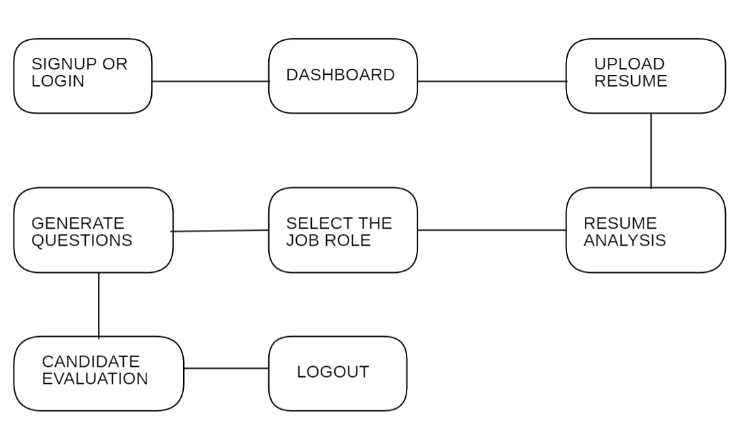
ANALYSIS
BLOCK DIAGRAM OF PROPOSED SYSTEM:-

Slide 5
MODULES IDENTIFED IN PROPOSED SYSTEM
1: Skills Assessment and Analysis
This module will focus on identifying and assessing an individual's current skill set through various tools and assessments. It will analyze skills gaps and areas for improvement to help guide the individual towards future-proofed careers. The module will also provide personalized recommendations and resources for skill development based on the assessment results.
2: Career Path Mapping
In this module, the system will help individuals explore potential career paths based on their current skills, interests, and market trends. It will provide insights into emerging industries and job roles that align with their skills and future career goals. The module will also offer guidance on how to pivot or enhance their skills to adapt to the changing job market.
3: Skill Matching and Training
The final module will focus on matching individuals with relevant training programs, courses, and certifications to develop the skills needed for future-proofed careers. It will leverage AI algorithms to match individuals with training opportunities that align with their skill gaps and career aspirations. The module will also track progress and provide recommendations for ongoing learning and development to ensure continuous skill enhancement.

Slide 6
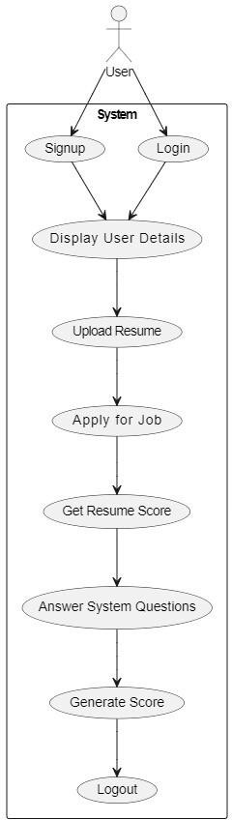
SYSTEM DESIGN(UML DIAGRAMS)
USECASE DIAGRAM

Slide 7
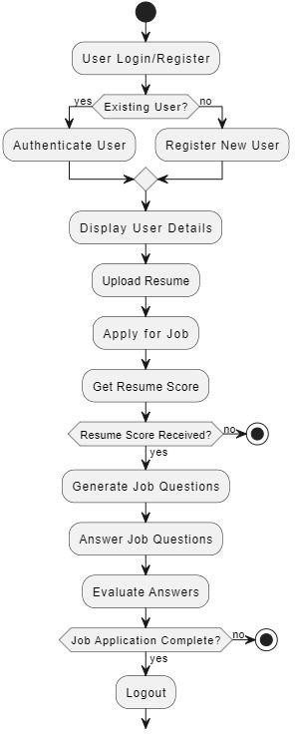
ACTIVITY DIAGRAM

Slide 8
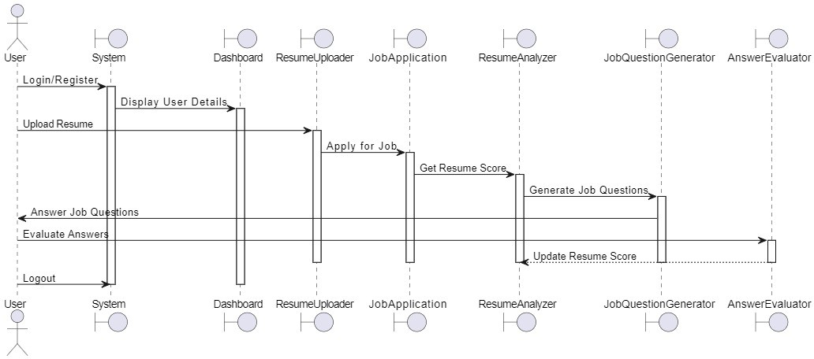
SEQUENCE DIAGRAM

Slide 9
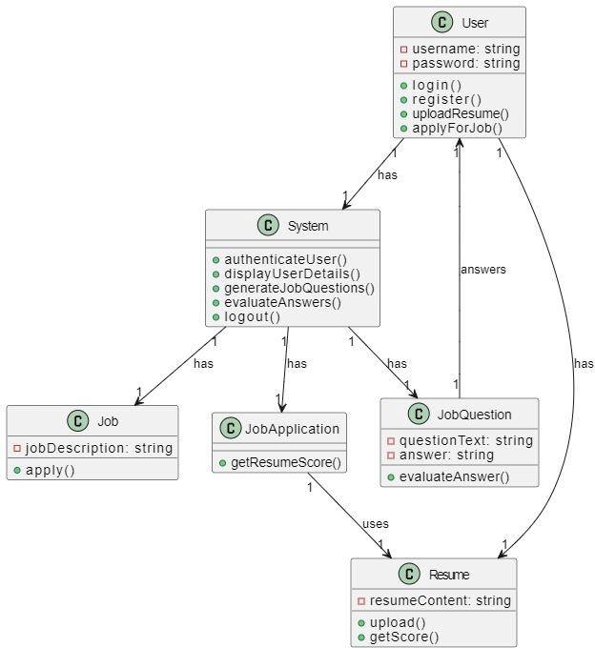
CLASS DIAGRAM

Slide 10
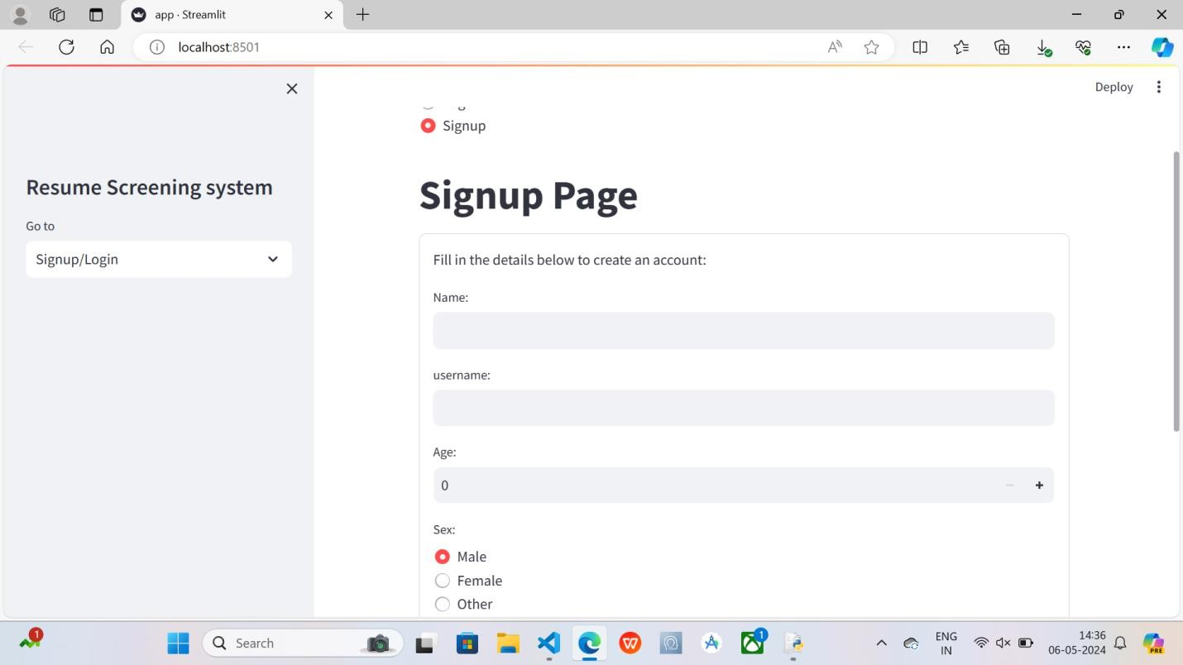
OUTPUTS
Signup Page

Slide 11
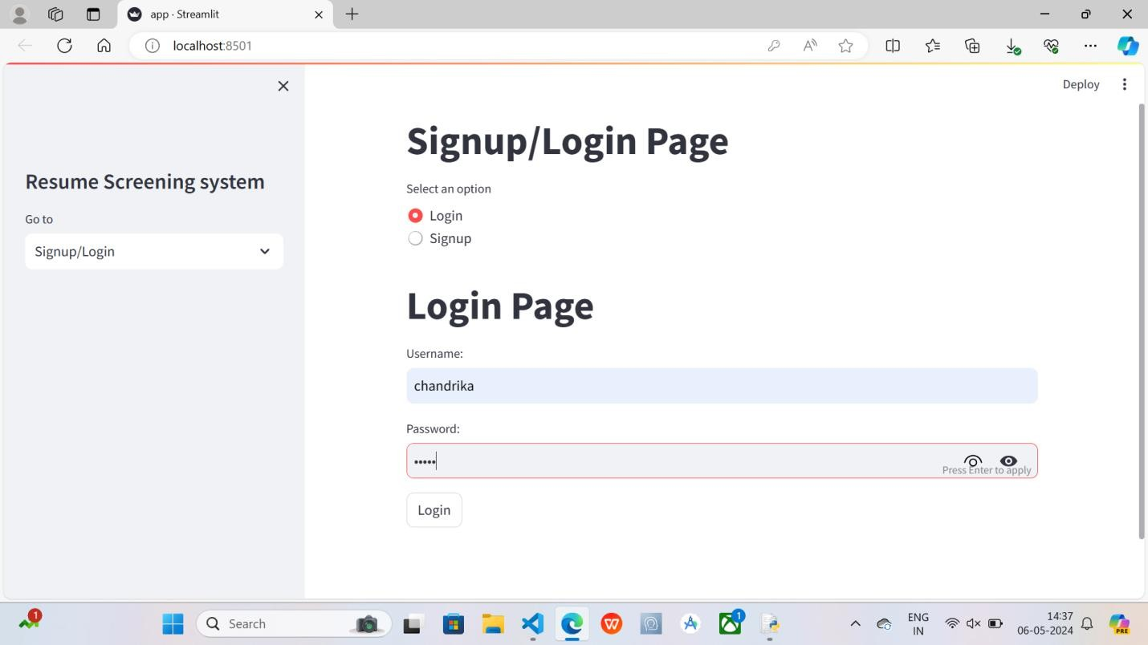
Login Page

Slide 12
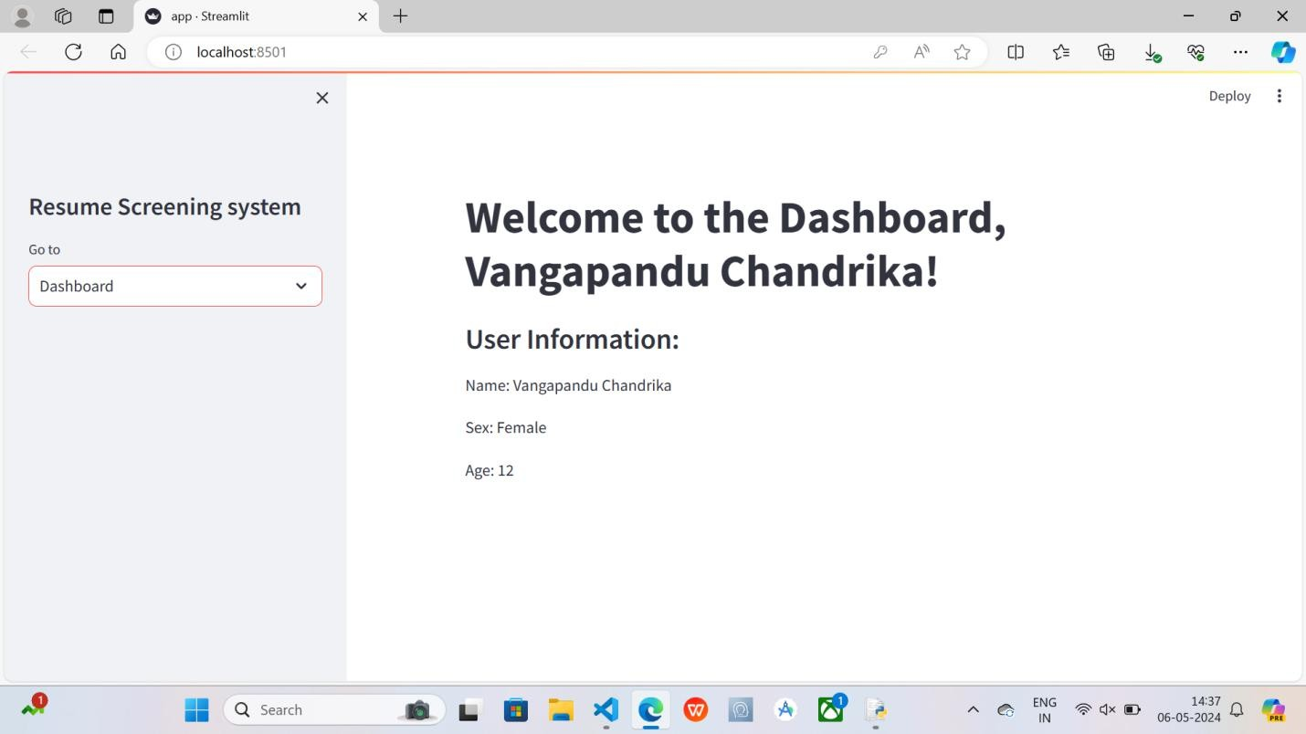
Dashboard

Slide 13
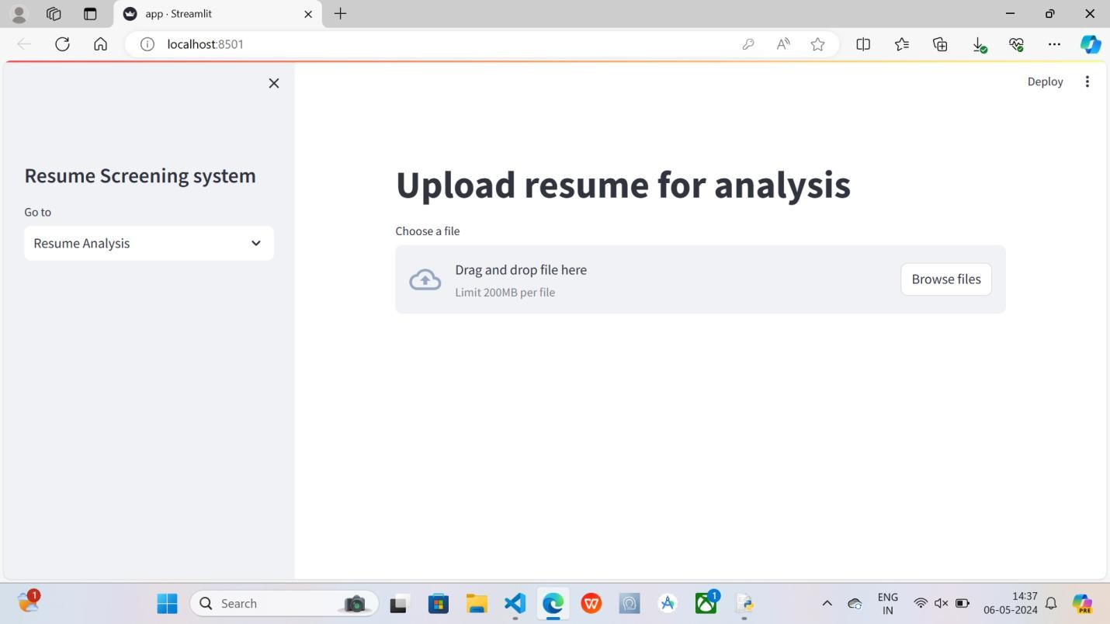
Resume Analysis

Slide 14
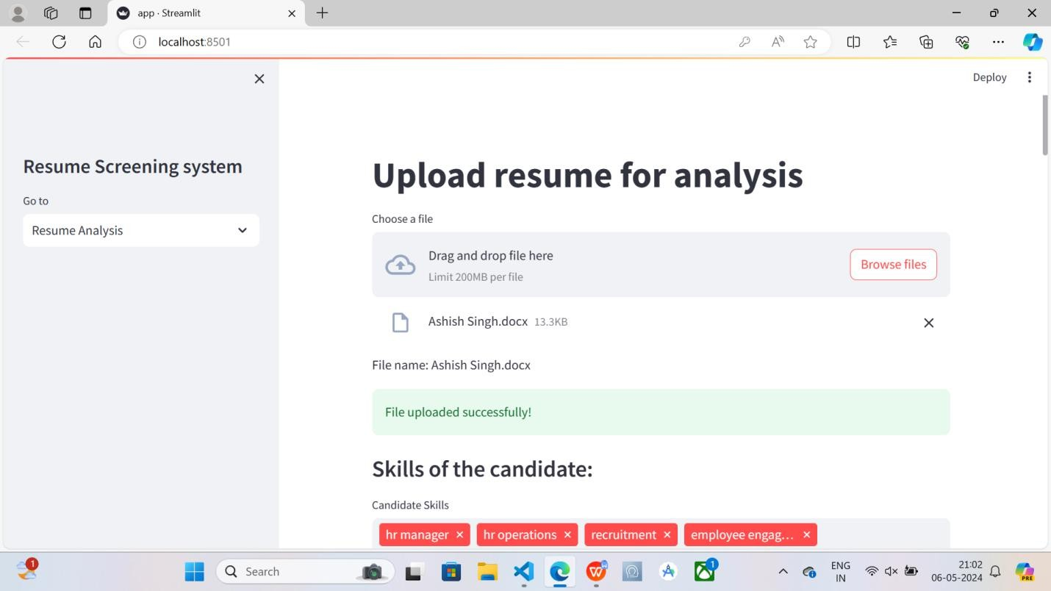

Slide 15
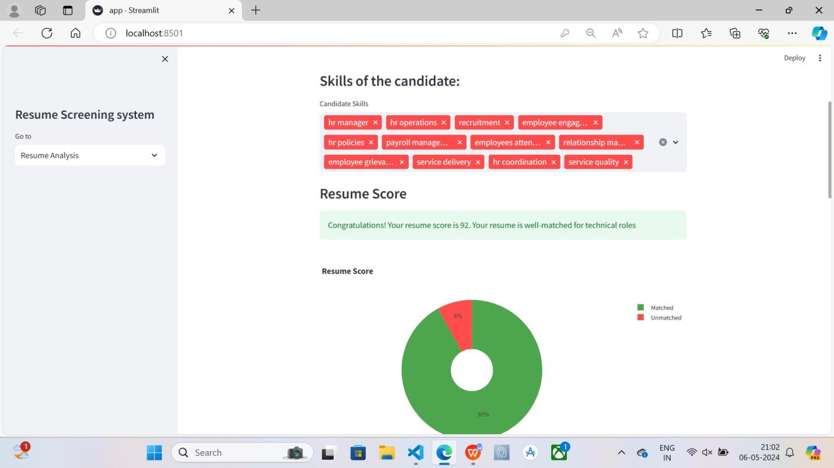

Slide 16
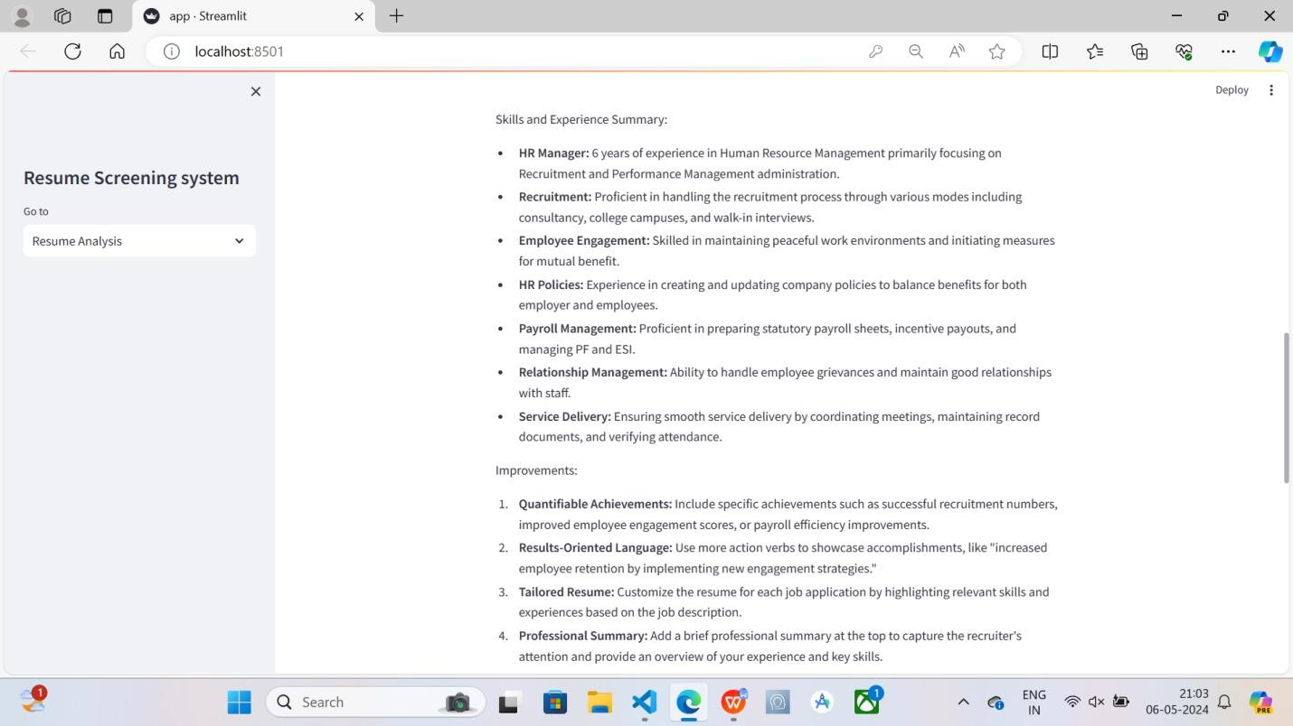

Slide 17
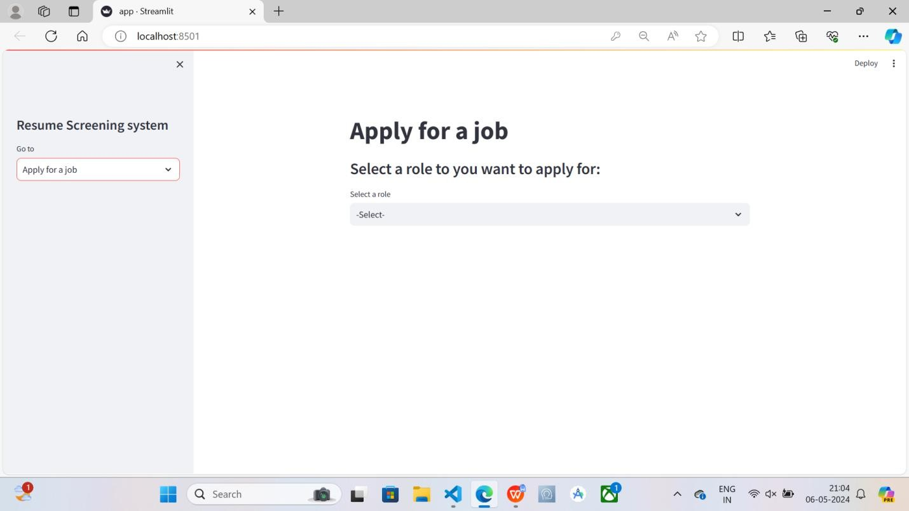
Apply for a job

Slide 18
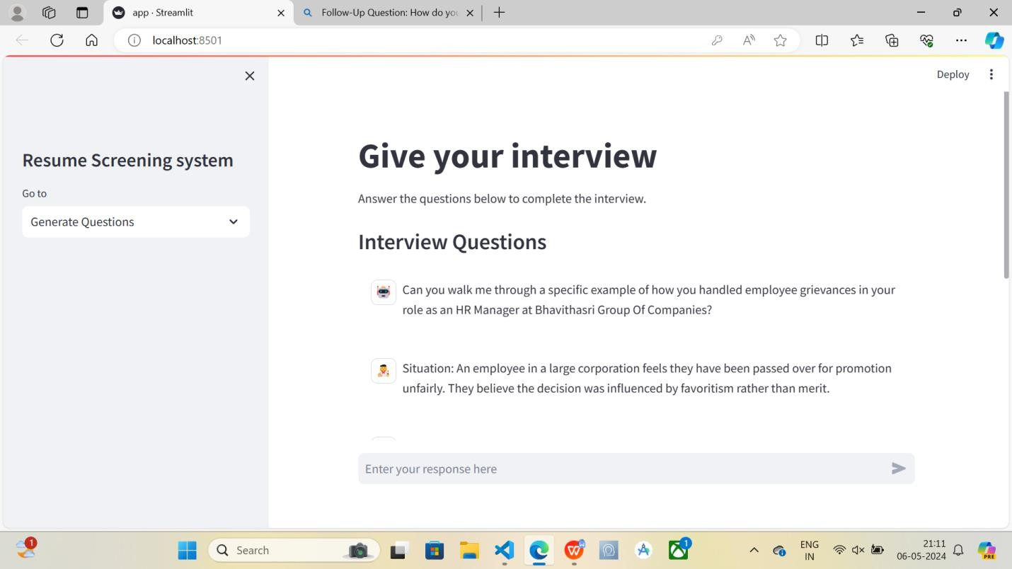
Generated Questions

Slide 19
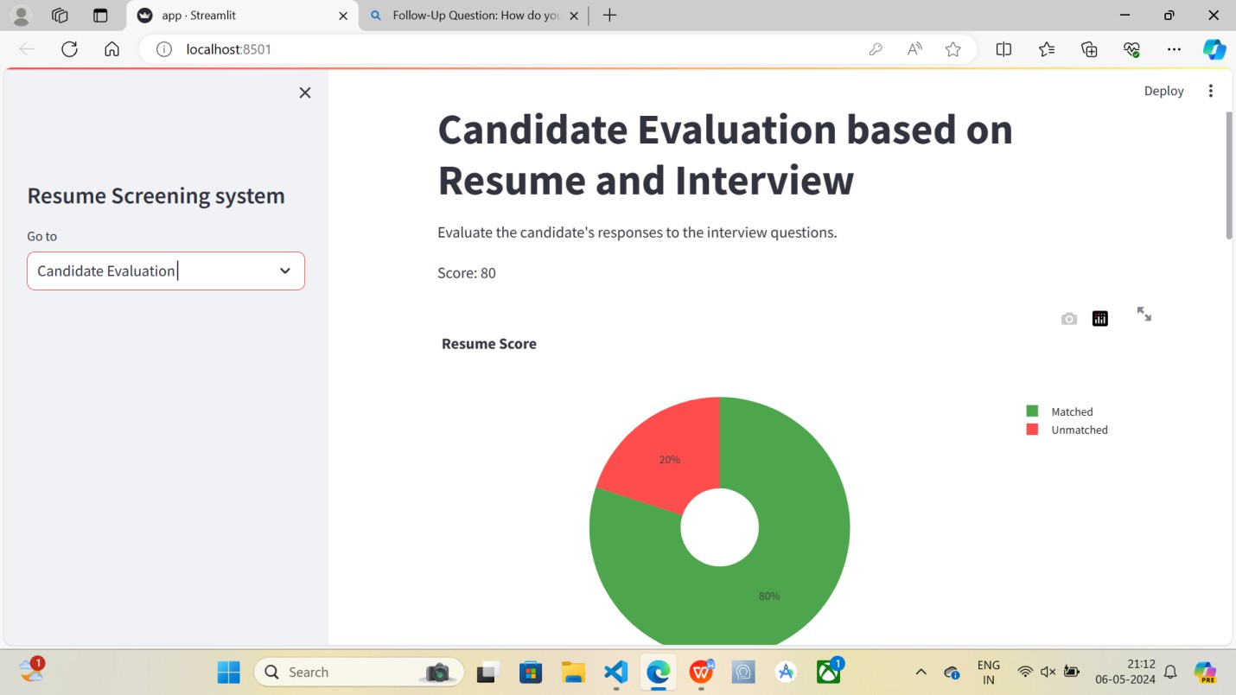
Candidate Evalution

Slide 20
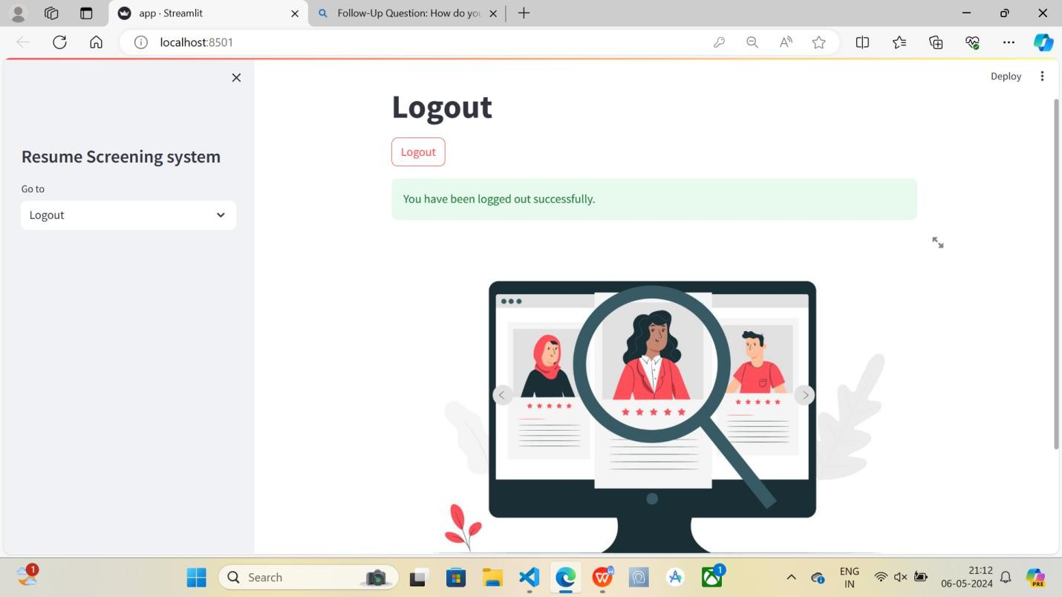
Logout

Slide 21
CONCLUSION
In conclusion, the correlation and matching of skills for careers is essential for individuals to thrive in the rapidly changing job market.
By identifying and developing skills that are in high demand and adaptable to new technologies, individuals can secure their career trajectory.
Leveraging tools like skills assessments and industry trends can help individuals align their skill sets with future job opportunities.
It is crucial for individuals to continuously upskill and reskill to remain relevant and competitive in an ever-evolving workforce landscape.

Slide 22
BIBLIOGRAPHY
[1] An Intelligent Career Guidance System using Machine Learning:Vignesh S, Shivani Priyanka C, Shree Manju H, Mythili K Information Technology
[2] Information Technology Roadmap: A Strategic Business Tool
[3] Influence of Digital Technology on Roadmap Development for Digital Business Transformation
[4]AI-Based Personalized E-Learning Systems: Issues, Challenges, and Solutions
[5]Resume Evaluation through Latent Dirichlet Allocation and Natural Language Processing for Effective Candidate Selection - Vidhita Jagwani, Smit Meghani, Sudhir Dhage, Krishna Pai
[6]Smart Resume Analyser - Ms. Y. Sowjanya |Mareddy Keerthana |Pulluri Suneeksha |
Dorgipati Sai Sri Harsha
[7]Automated Resume Screening Using Natural Language Processing - Dr. D. Lakshmi Padmaja1 , Ch. Vishnuvardhan2 , G. Rajeev3 , K. Nitish Sanjeev Kumar

Slide 23
Any Queries ????

Slide 24


