Slide 1
Approach and construction
- Chandrima Chakrabarty
(Chakrabartychandrima91@gmail.com)

Slide 2
Step-1 : Data overview check
Checked the downloaded “train_s3TEQDk.csv” and “test_mSzZ8RL.csv”.
Data size, object type, null value all the basic information was gathered.
Basic statistical file (corr, stat etc) was calculated to find out any overall relationship among the parameters.

Slide 3
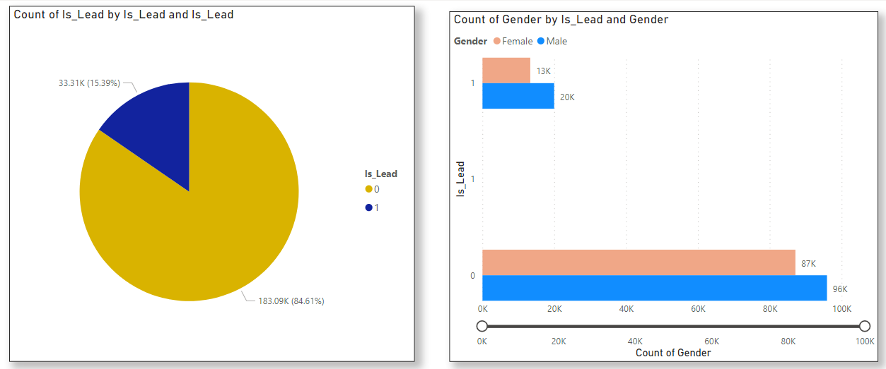
Step-2 : Feature Engineering
Male candidates are more in whole dataset
Same is also true for Is_Lead (1) also.

Slide 4
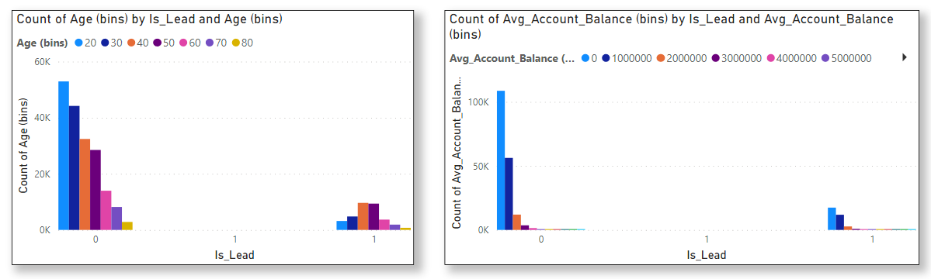
Age and avg_account_balance is divided into different classes and plotted with IS_Lead to understand the pattern of the data.
Age group 30-40 has maximum tendency to take the credit card.
avg_account_balance follows same pattern both for IS_Lead 0 and 1.
Observed that avg_account_balance is having a wide range – needs to be treated.

Slide 5
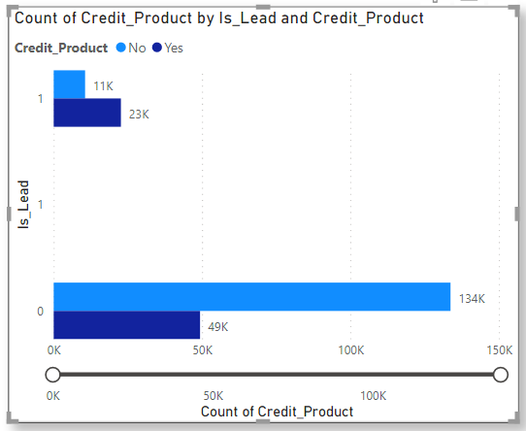
Credit_product is plotted with Is_Lead to understand the pattern of the data.
People with active credit_product have more tendency to take credit card.

Slide 6
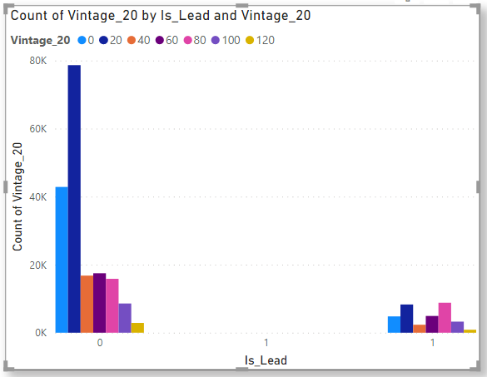
Vintage is classified in different groups and plotted against Is_Lead .
People with vintage 20-40 and 80-100 are having more tendency to take credit card.

Slide 7
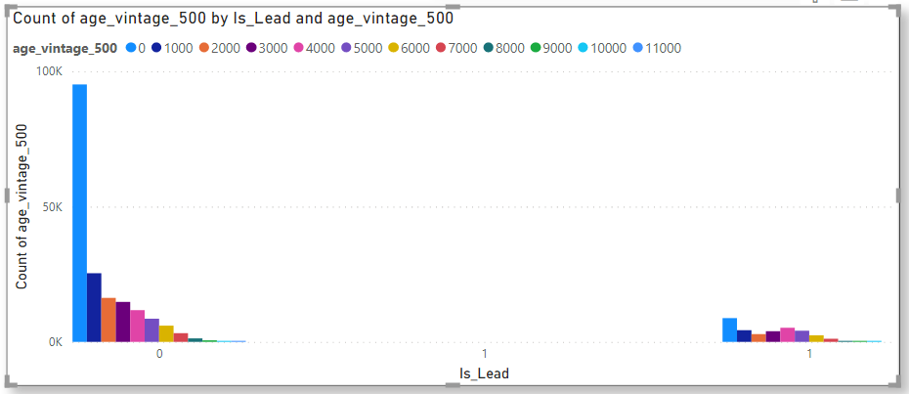
Vintage and age both have a similar pattern for IS_Lead -1. Also they follow distinct pattern for both IS_Lead -0 and IS_Lead -1.
Therefore Vintage and age is multiplied and classified in different groups and plotted against IS_Lead .

Slide 8
Observed that avg_account_balance is having a wide range. So it is taken in log scale to decrease its sensitivity.
Age is divided into various classes and that data included as input
New variable -1 (Age X vintage) is created and given in input.
NAN value in credit product is treated.
All the categorical variables are treated with one hot encoding.
Another variable created (new_var2 = Gender_Male X Occupation_Salaried) and added to input data.
Standardization of all value is done.
Principle component analysis (PCA) is performed to establish a linear relationship between continuous variables. Then First 3 PCs are taken.
To encounter the class imbalance problem we have used SMOTE(Synthetic Minority Oversampling Technique)

Slide 9
Step-3 : Model Structure
Random Forest
LGBM
XGBoost
AdaBoost
CatBoost
Ensemble Model
(Weighted Average)

Slide 10
Conclusion & Challenges
The ROC AUC score over the test data given is ~0.872
The best ROC score is ~0.874
Due to the limitation in resources hyper-parameter tuning of any of the model was not possible. ROC AUC score can be improved further with better resources.
The small discrepancy of 0.0019 in ROC AUC score with respect to the best result creates a miss of only 200 (0.0019X105312) Lead.

Slide 11
Thank You

