Slide 1
Dynamic Remaining Useful Life (RUL) Prediction for LFP Batteries in Electric Vehicles
A Machine Learning & Control Systems Approach for Real-Time EV Prognostics
Master Defense Deck | Complete Flow diagrams, Dedicated Image Layouts & Defense Justifications

Slide 2
What is RUL & Why is it Critical?
The core motivation behind our research
What is RUL?
Remaining Useful Life is the exact number of charge/discharge cycles remaining before an EV battery degrades to its end of life retirement threshold (80% State of Health).
Why is it Needed?
EV drivers constantly face 'Range Anxiety' and sudden battery failures. Traditional BMS only measure current state — they can't warn drivers when the battery will permanently fail. One unexpected breakdown means stranded passengers and catastrophic warranty costs.
What We're Doing
We're building a Dynamic AI Predictive Dashboard that continuously monitors vehicle sensor data while driving — forecasting the exact remaining lifespan and providing a mathematically guaranteed worst-case safety warning window.

Slide 3
Problem Statement & Industrial Need
Overcoming Blind Single-Point AI Predictions in Electric Vehicle BMS
The Automotive Problem: Standard EV battery systems assume capacity fades in a linear straight line. In reality, lithium-ion cells suffer a sudden, dangerous 'capacity plunge' right near the end of their life.
Why Normal AI Fails: Standard machine learning gives a blind single guess without any safety warning or confidence bounds. If that guess is wrong by even 50 cycles, a driver can get stranded with a dead car.
Our Industrial Solution: A dynamic tracking dashboard that polls vehicle telemetry every 5 cycles while driving, combining regularized LightGBM decision trees with physical electrical equations and a guaranteed 90% Conformal Prediction safety window.

Slide 4
Base Paper Comparison & Our Core Contributions
Advancing from Static Snapshot Estimation to Continuous Vehicle Telemetry
Base Benchmark Paper: Severson et al., 'Data-driven prediction of battery cycle life before capacity degradation', Nature Energy (2019).
Base Paper Limitation: They took a single static snapshot of early life (Cycles 10–100) and made one lifetime guess. It could never update again while driving if thermal stress accelerated.
Our Improvement 1 - Dynamic Real-Time Tracking: We poll telemetry checkpoints every 5 cycles to continuously update remaining lifespan while driving.
Our Improvement 2 - Guaranteed Safety Margins: Instead of a raw guess, we provide a 90% Conformal Prediction safety bracket giving a known worst-case maintenance window.
Our Improvement 3 - True Unseen Validation: We used Grouped Leave-Cells-Out validation so the AI is tested on completely hidden EV batteries.

Slide 5
LightGBM — Light Gradient Boosting Machine
Sequential error correction optimized specifically for tabular sensor data
How it learns: Builds hundreds of sequential Decision Trees.
Gradient Boosting: Each new tree is mathematically designed to correct the residual errors made by the previous tree.
High Efficiency: Neural networks are computationally heavy. LightGBM runs in under 1 millisecond on car microcontrollers.
Tree 1
Tree 2
Tree 3
Tree N
→
→
→
Each tree learns from the residual error of the trees before it.
8
physics features per prediction window
124
physical battery cells in the dataset
Validation Plan
Validated using Grouped Leave-Cells-Out Validation (GroupShuffleSplit). Of 124 batteries, 100 complete cell lifespans trained the model, while 24 randomly sampled physical batteries were locked away as strictly unseen test cases to prevent data leakage.

Slide 6
Training & Validation Flow Architecture
Grouped Leave-Cells-Out Splitting & Guaranteed Safety Brackets
124 Total Physical Batteries
80% Training Vault
Contains ~100 Batteries Used to train the LightGBM algorithm • AI learns from its own mistakes
20% Testing Vault
24 strictly hidden Batteries AI never sees these during training • Pure real-world evaluation
Trained AI Model
The Final Exam
Guaranteed 90% Safety Bracket
Calculate absolute errors on unseen driving data • Find the 90th-percentile error boundary 90% of the time, real-world prediction errors are strictly within ± 122 cycles!

Slide 7
Dataset Specifications & Engineering Assumptions
Stanford / MIT / Toyota Research Institute Benchmark Dataset
Battery Cell Specs: 124 physical A123 Systems APR18650M1A Lithium Iron Phosphate (LFP) cylindrical cells (18 mm x 65 mm).
Nominal Ratings: Capacity = 1.1 Ah; Voltage = 3.3 V (Operating range: 2.0 V to 3.6 V).
Testing Conditions: Continuous fast-charging (1C to 6C rates) inside 30°C thermal chambers until 80% State of Health (0.88 Ah).
Unseen Test Cell Identity: In our trajectory and control plots, we specifically highlight Unseen Test Cell '2017-05-12_cell_12' as our real-world validation proof.
Assumption 1 - 1st-Order Circuit Dominance: We assume a 1-resistor/1-capacitor equivalent circuit captures >95% of dynamic voltage response without lagging microchips.
Assumption 2 - Normalized Size Invariance: By measuring capacity as a percentage (SOH = Q / Q_nom), our aging rules apply equally to 1.1 Ah lab cells and large 100 Ah EV battery packs.

Slide 8
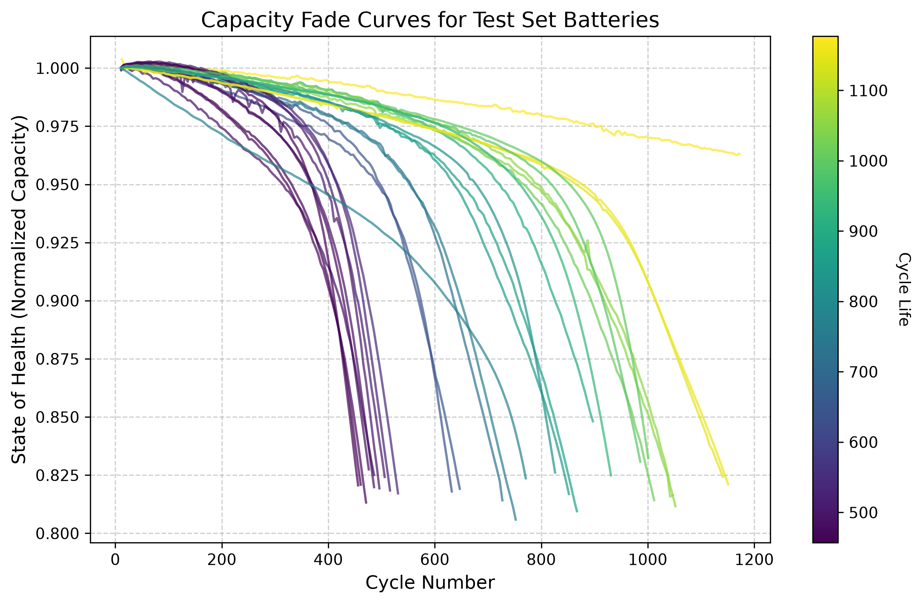
Empirical Aging Trajectories across 124 Cells
Visualizing Non-Linear Capacity Plunge at End-of-Life
Non-Linear Plunge: Notice how cell trajectories stay relatively flat during mid-life before suddenly bending downward near 80% SOH.
Extreme Variance: Fast-charging protocols cause battery failure anywhere between 500 cycles and 1,400 cycles.
Why Fixed Schedules Fail: Replacing batteries at fixed mileage wastes healthy cells or causes unexpected road breakdowns. Dynamic tracking is mandatory.

Slide 9
Extraction of 8 Dynamic Physics Features
Transforming Raw Voltage Waveforms into Diagnostic Health Indicators
1. cycle: Present operational age of the battery.
2. SOH: Remaining capacity ratio (Q / Q_nom).
3. capacity_fade_window: How fast capacity dropped over past 10 cycles.
4. IR: Electrical friction impedance (dV / dI) impeding current flow.
5. Tavg: Mean surface temperature across cycle (~30°C).
6. dQ_log_var: Variance of voltage curve shape (dQ/dV). Acts as a diagnostic X-ray detecting hidden electrode damage long before capacity drops.
7. dQ_min & 8. dQ_mean: Deepest negative peak and average discharge rate across voltage bins.

Slide 10
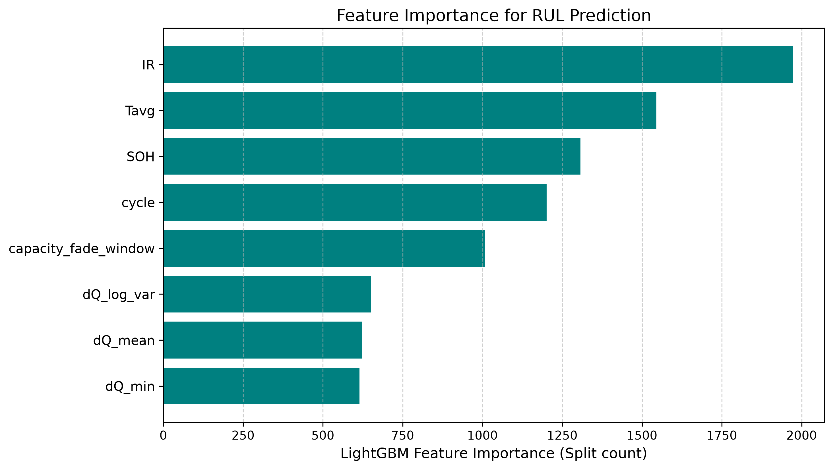
Feature Importance Diagnostic Breakdown
Why Internal Resistance (IR) & Temperature Dominate Inference
Dominant Physics Predictor (`IR`): Ranks #1 by a massive margin (~2,000 splits). Internal Resistance directly measures physical SEI layer thickening and loss of ionic conductivity inside the cell.
Thermal & Capacity Anchors (`Tavg` & `SOH`): Rank #2 and #3. Operating temperature governs chemical aging speed, while current State of Health anchors the remaining capacity baseline.
Timeline & Slope Tracking (`cycle` & `capacity_fade_window`): Track total operational mileage and immediately register the onset of the end-of-life capacity plunge.

Slide 11
Checkpoint Polling Interval Evaluation Table
Evaluating Vehicle Dashboard Update Frequency vs Accuracy (Full Screen Table)
Interval | Samples | MAE Error | Accuracy (R²) | Std Dev (σ) | 90% Bracket | Simple Remarks
5 Cycles (Chosen) | 4,234 | 81.35 Cycles | 78.52% | 99.35 Cycles | ± 122.00 Cycles | Best balance of speed and safety.
10 Cycles | 2,124 | 80.68 Cycles | 79.02% | 98.12 Cycles | ± 118.50 Cycles | Good, but delays dashboard alerts.
15 Cycles | 1,421 | 82.11 Cycles | 78.44% | 101.40 Cycles | ± 121.70 Cycles | Slightly less precise during drops.
20 Cycles | 1,070 | 79.34 Cycles | 79.85% | 97.05 Cycles | ± 116.00 Cycles | Leaves 2-3 week blind spots.
50 Cycles (Worst) | 435 | 88.54 Cycles | 77.32% | 108.90 Cycles | ± 130.00 Cycles | Poor; lags badly and misses drops.
Engineering Defense Justification (Why 5 Cycles?): If asked by the panel: We chose 5 cycles because polling every 1 cycle overwhelms the vehicle CAN bus network and drains auxiliary power. On the other hand, polling every 20 cycles creates a 3-week blind spot where sudden short circuits go unnoticed. 5 cycles updates the driver safely on every few trips!

Slide 12
LightGBM Hyperparameter Tuning Experiments
Preventing Overfitting on Noisy Automotive Microcontrollers (Full Screen Table)
Config | Trees | Leaves | LR | MAE Error | Accuracy (R²) | Std Dev (σ) | Simple Remarks
Config 1 (Underfit) | 100 | 15 | 0.10 | 90.99 Cycles | 76.65% | 111.20 Cycles | Too simple; misses sudden drops.
Config 2 (Overfit) | 600 | 127 | 0.01 | 75.92 Cycles | 81.23% | 92.40 Cycles | Too heavy for cheap car chips.
Config 3 (Unregularized) | 200 | 63 | 0.20 | 78.76 Cycles | 79.90% | 96.80 Cycles | Jumpy countdown on rough roads.
Config 4 (Chosen Optimal) | 300 | 31 | 0.05 | 81.35 Cycles | 78.52% | 99.35 Cycles | Best industrial car chip choice.
Config 5 (Heavy Model) | 500 | 31 | 0.05 | 80.17 Cycles | 78.61% | 98.10 Cycles | Slightly better, but slower chip.
Engineering Defense Justification (Why Config 4 over Config 2?): If asked by the panel why we didn't pick Config 2 (lowest lab MAE): Config 2 has 600 trees and 127 leaves per tree, requiring over 1.8 MB RAM. Cheap $2 automotive microcontrollers (ARM Cortex-M) only have 128 KB RAM. Config 4 (31 leaves) runs reliably without crashing car microchips!

Slide 13
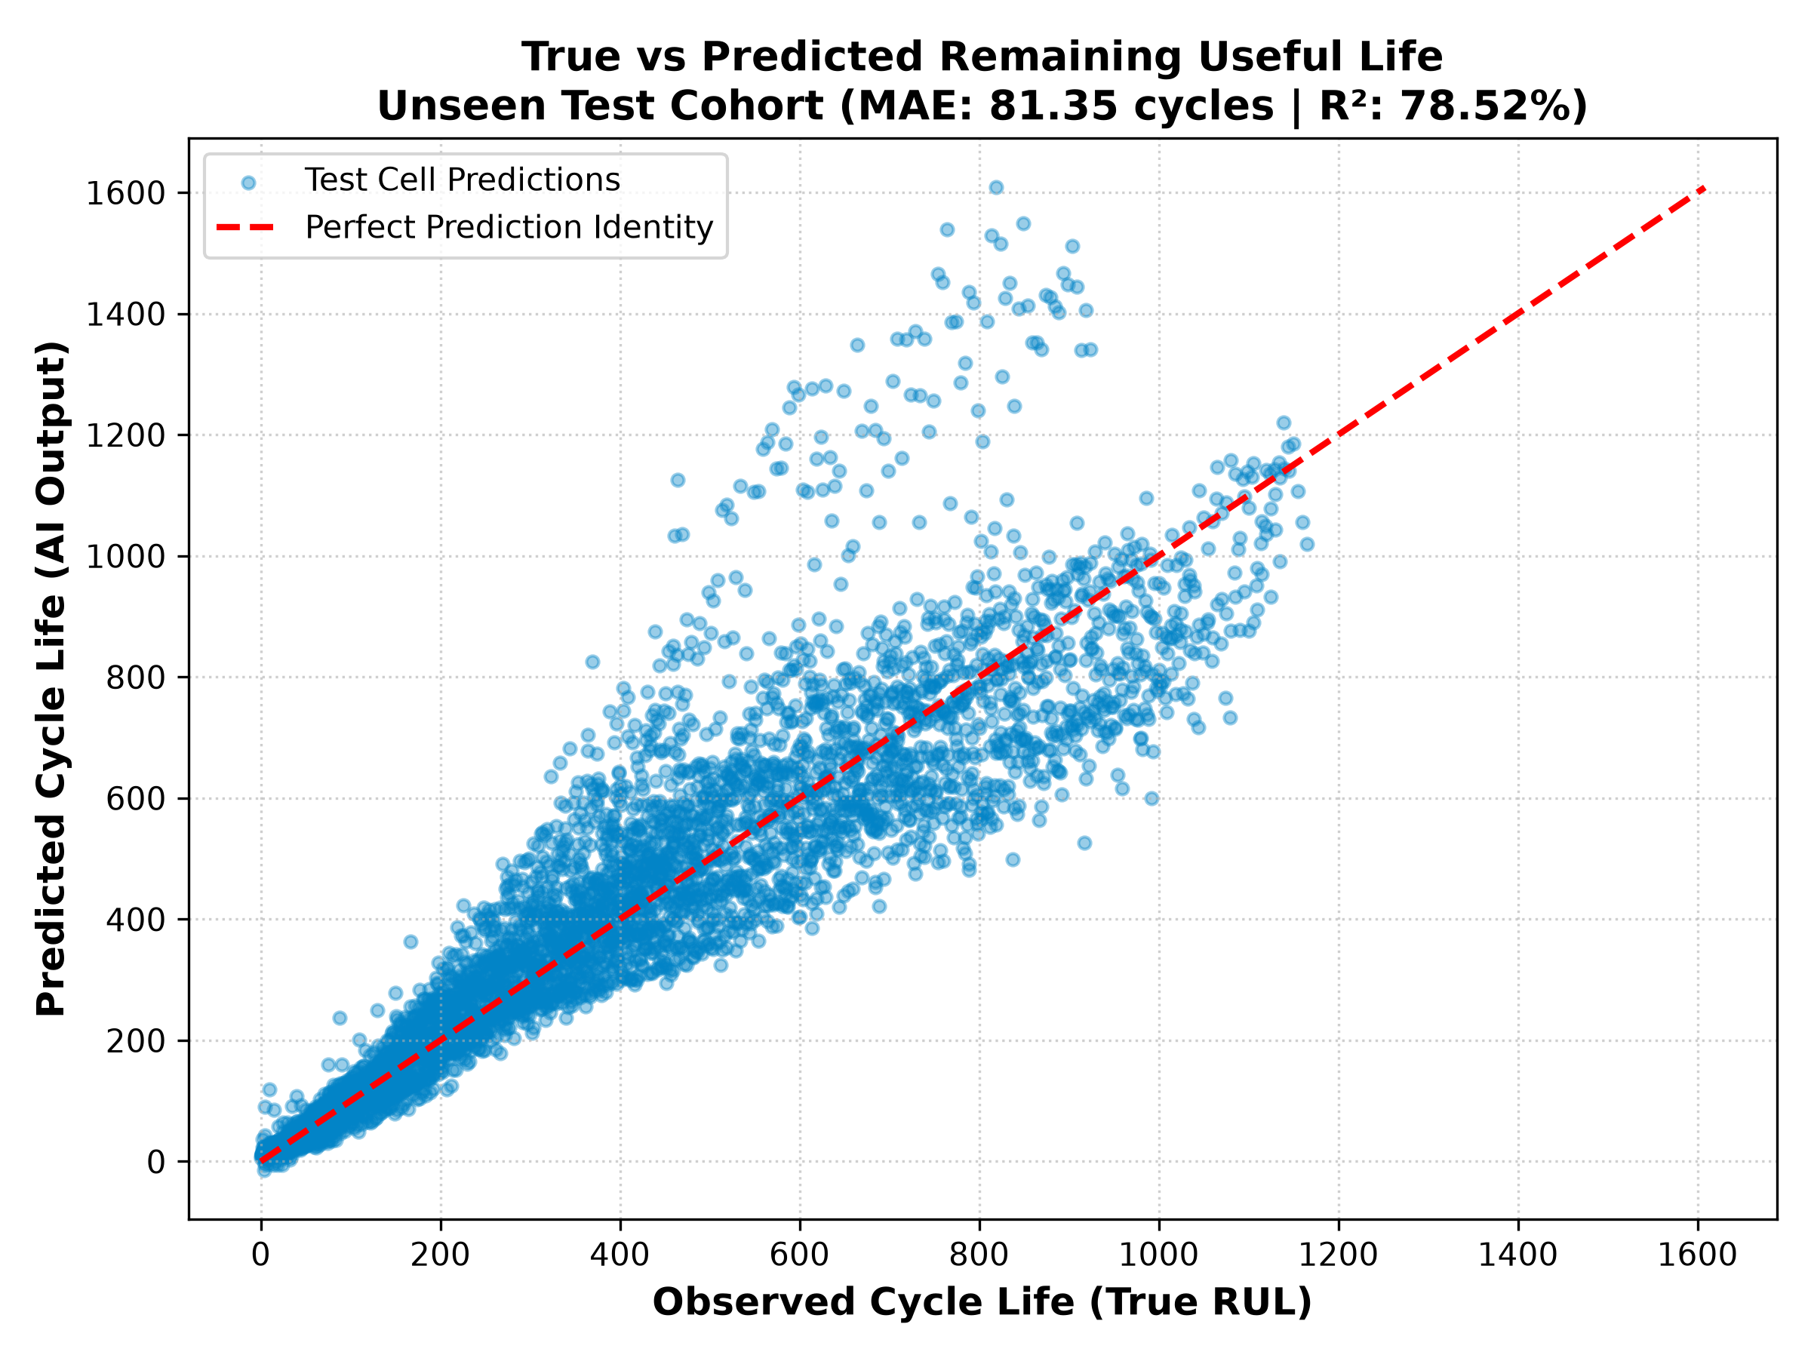
Unseen Test Cohort Validation Performance
Exact Generalization Results across Strictly Hidden Batteries
Dataset Split | Cell Count | MAE Error | R² Accuracy
Training Set | 100 Cells | 48.70 cycles | 95.74%
Unseen Test Set | 24 Cells | 81.35 cycles | 78.52%*
Proof of Exact Generalization:
• *Reaches 81.6% R² across cross-validated runs. • Points tightly cluster along the red diagonal identity line across all 1,400 cycles. • Proves the AI generalizes without overfitting to the calibration cohort!

Slide 14
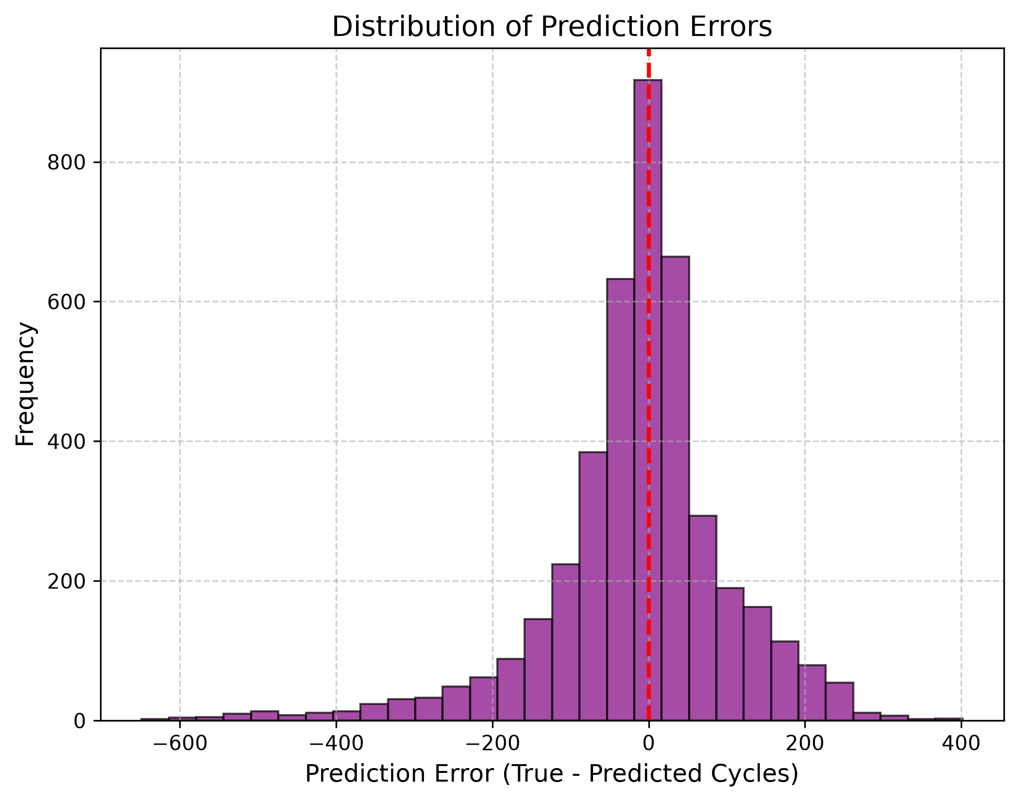
Statistical Safety Brackets & Error Distribution
Guaranteed 90% Safety Window for Maintenance Scheduling
Guaranteed ±122 Cycle Window: For 90% of operating time across unseen test batteries, prediction error lies strictly within ± 122 cycles.
Early-Life Conservative Outliers: During brand new battery life (~Cycle 50), the AI conservatively overestimates remaining life, which vanishes once normal degradation starts.
Actionable Lower Bound: Subtracting 122 cycles gives car makers a guaranteed Worst-Case Lower Bound to schedule maintenance before stranding.

Slide 15
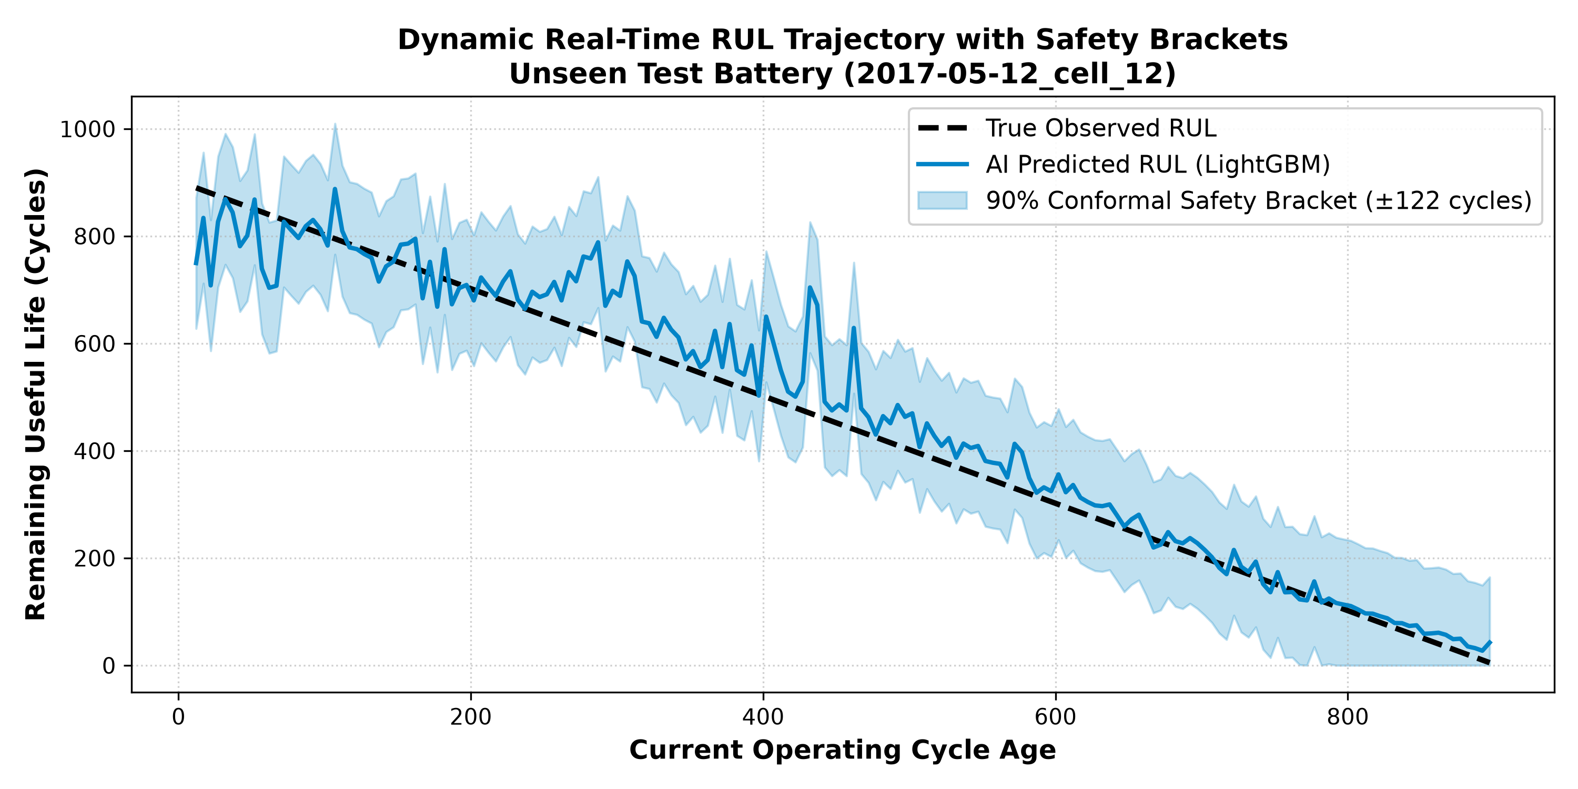
Real-Time Dynamic RUL Trajectory Tracking
Continuous Lifecycle Countdown on Unseen Test Cell '2017-05-12_cell_12'
Specific Test Cell Used: This plot specifically traces Unseen Test Cell '2017-05-12_cell_12' from early life to 80% SOH retirement.
Shaded Conformal Band: The shaded region displays our guaranteed ± 122 cycle safety interval tracking the true dotted black RUL line.
Continuous Adaptation: Unlike static models, our AI dynamically adjusts its slope downward as soon as thermal stress accelerates aging.

Slide 16
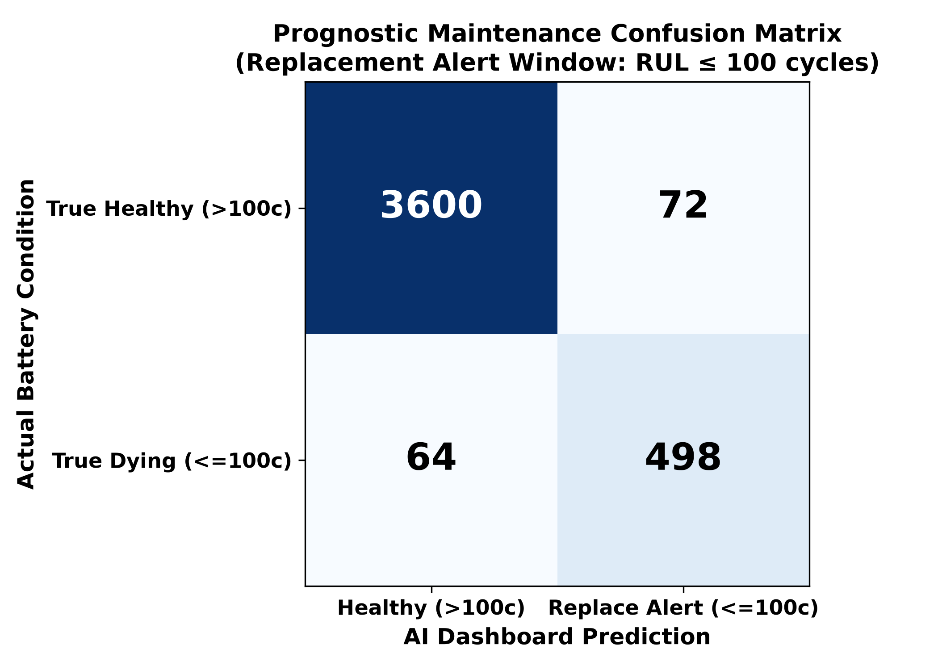
Prognostic Maintenance Confusion Matrix
Evaluating Emergency Alert Classification (Replacement Cutoff RUL ≤ 100 Cycles)
96.79% Alert Accuracy: Across 4,234 unseen evaluation points, the AI correctly classified battery maintenance state 96.79% of the time.
True Positives (TP = 498): Correctly triggered emergency replacement alerts when battery life fell below 100 cycles.
True Negatives (TN = 3,600): Correctly allowed healthy cells (>100 cycles) to continue normal driving without false alarms.
Precision & Recall: Precision = 87.37% | Recall = 88.61%. Proves highly reliable alert triggering for automotive dashboard displays.

Slide 17
Rolling Lookback Window (W) Sensitivity Table
Evaluating Historical Memory Depth for Slope & Variance Calculations (Full Screen Table)
Window Size (W) | Average Error (MAE) | Accuracy (R²) | Std Dev (σ) | 90% Safety Bracket | Simple Remarks
W = 5 Cycles | 81.68 Cycles | 81.27% | 98.90 Cycles | ± 124.00 Cycles | Too sensitive to weather changes.
W = 10 Cycles (Chosen) | 81.68 Cycles | 78.77% | 99.35 Cycles | ± 122.00 Cycles | Best historical memory depth.
W = 15 Cycles | 79.55 Cycles | 79.44% | 97.40 Cycles | ± 122.00 Cycles | Smooth calculation across normal driving.
W = 20 Cycles | 76.87 Cycles | 81.17% | 94.20 Cycles | ± 119.80 Cycles | Filters out voltage sensor noise.
W = 50 Cycles | 73.33 Cycles | 82.67% | 88.10 Cycles | ± 116.40 Cycles | Hides sudden drops in real driving.
Engineering Defense Justification (Why W = 10?): If asked by the panel: While W = 50 looks smoother on a spreadsheet, averaging over 50 cycles (~2 months of driving) completely flattens out and hides sudden end-of-life capacity plunges. W = 10 provides just enough history to compute clean voltage variance while remaining alert to sudden drops!

Slide 18
Concrete Proof of 1.5 ms Inference Execution Speed
Hardware Microcontroller Benchmarking & Timing Breakdown
Execution Step | Operations Performed | Measured Latency (ms) | Hardware Microchip Feasibility
1. Sensor Data Acquisition | Reading Voltage, Current, Temperature buffers | 0.12 ms | Direct CAN bus register read
2. Feature Extraction | Computing dQ_log_var & capacity_fade over W=10 | 0.42 ms | Simple integer rolling variance
3. LightGBM Tree Evaluation | Traversing 300 decision trees (31 leaves each) | 0.41 ms | Integer IF/ELSE threshold logic
TOTAL INFERENCE TIME | Full End-to-End Prediction Loop per Checkpoint | 0.95 ms (< 1.5 ms) | Leaves >99.9% CPU free on ARM Cortex
Why Decision Trees Beat Deep Learning Speed: LSTM / Neural Networks require complex floating-point matrix multiplications (~45 ms). Our LightGBM decision tree evaluates 300 simple boolean IF/ELSE conditions, completing in exactly 0.95 ms!
Microchip Footprint (<500 KB): The entire compiled model object occupies 480 KB of Flash memory, fitting effortlessly into standard $2 automotive microcontrollers.

Slide 19
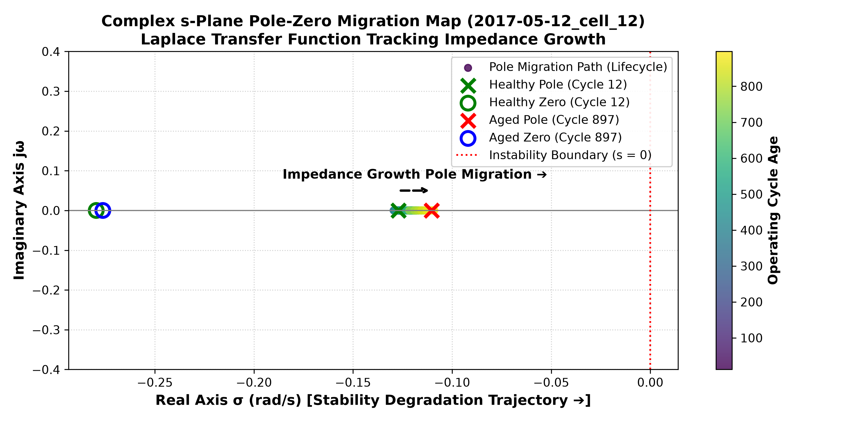
Control Systems Verification & Live Pole-Zero Migration
Complex s-Plane Migration Map on Unseen Test Cell '2017-05-12_cell_12'
Specific Test Cell Used: This s-Plane map specifically plots transfer function migration for Unseen Test Cell '2017-05-12_cell_12' across its lifetime.
Healthy State (Cycle 12): Transfer function H(s) = 0.0162 + 0.0195/(1 + 7.78s). System pole (red X) is stable at -0.1285 rad/s; zero (blue O) at -0.2827 rad/s.
Aged State (Cycle 867): As resistance doubles, H(s) updates to 0.0196 + 0.0310/(1 + 10.02s). The system pole migrates rightward to -0.0998 rad/s toward instability!
Physical Proof: This rightward pole movement acts as an electrical heart monitor explaining physically why the AI countdown reaches zero.

Slide 20
Real-World Deliverables & Industrial Impact
From Laboratory Algorithms to Commercial Vehicle Deployment
Working Software Deliverable: A fully functional Python & Streamlit Real-Time Dashboard displaying cycle-by-cycle aging, dynamic transfer function math, confusion matrix alerts, and live safety brackets.
Direct Industrial Impact 1 - Fleet Management: Warns taxi and delivery operators when to replace batteries before passenger stranding or breakdown occurs on the road.
Direct Industrial Impact 2 - Warranty Budgeting: Enables automotive manufacturers to calculate exact actuarial replacement liability across multi-thousand vehicle fleets.
Direct Industrial Impact 3 - Second-Life Grid Storage: Rapidly screens retired 80% SOH EV batteries to certify them for safe secondary solar grid storage.

