Slide 1
Dynamic Remaining Useful Life (RUL) Prediction for LFP Batteries in Electric Vehicles
A Machine Learning Approach for Real-Time EV Prognostics

Slide 2
Problem Statement & Industrial Need
Overcoming Blind Single-Point AI Predictions in Electric Vehicle BMS
The Automotive Problem: Standard EV battery systems assume capacity fades in a linear straight line. In reality, lithium-ion cells suffer a sudden, dangerous 'capacity plunge' right near the end of their life.
Why Normal AI Fails: Standard machine learning gives a blind single guess without any safety warning or confidence bounds. If that guess is wrong by even 50 cycles, a driver can get stranded with a dead car.
Our Industrial Solution: A dynamic tracking dashboard that polls vehicle telemetry every 5 cycles while driving, combining regularized LightGBM decision trees with physical electrical equations and a guaranteed 90% Conformal Prediction safety window.

Slide 3
Base Paper Comparison & Our Core Contributions
Advancing from Static Snapshot Estimation to Continuous Vehicle Telemetry
Base Benchmark Paper: Severson et al., 'Data-driven prediction of battery cycle life before capacity degradation', Nature Energy (2019).
Base Paper Limitation: They took a single static snapshot of early life (Cycles 10–100) and made one lifetime guess. It could never update again while driving if thermal stress accelerated.
Our Improvement 1 - Dynamic Real-Time Tracking: We poll telemetry checkpoints every 5 cycles to continuously update remaining lifespan while driving.
Our Improvement 2 - Guaranteed Safety Margins: Instead of a raw guess, we provide a 90% Conformal Prediction safety bracket giving a known worst-case maintenance window.
Our Improvement 3 - True Unseen Validation: We used Grouped Leave-Cells-Out validation so the AI is tested on completely hidden EV batteries.

Slide 4
Dataset Specifications & Engineering Assumptions
Stanford / MIT / Toyota Research Institute Benchmark Dataset
Battery Cell Specs: 124 physical A123 Systems APR18650M1A Lithium Iron Phosphate (LFP) cylindrical cells (18 mm x 65 mm).
Nominal Ratings: Capacity = 1.1 Ah; Voltage = 3.3 V (Operating range: 2.0 V to 3.6 V).
Testing Conditions: Continuous fast-charging (1C to 6C rates) inside 30°C thermal chambers until 80% State of Health (0.88 Ah).
Unseen Test Cell Identity: In our trajectory and control plots, we specifically highlight Unseen Test Cell '2017-05-12_cell_12' as our real-world validation proof.
Assumption 1 - 1st-Order Circuit Dominance: We assume a 1-resistor/1-capacitor equivalent circuit captures >95% of dynamic voltage response without lagging microchips.
Assumption 2 - Normalized Size Invariance: By measuring capacity as a percentage (SOH = Q / Q_nom), our aging rules apply equally to 1.1 Ah lab cells and large 100 Ah EV battery packs.

Slide 5
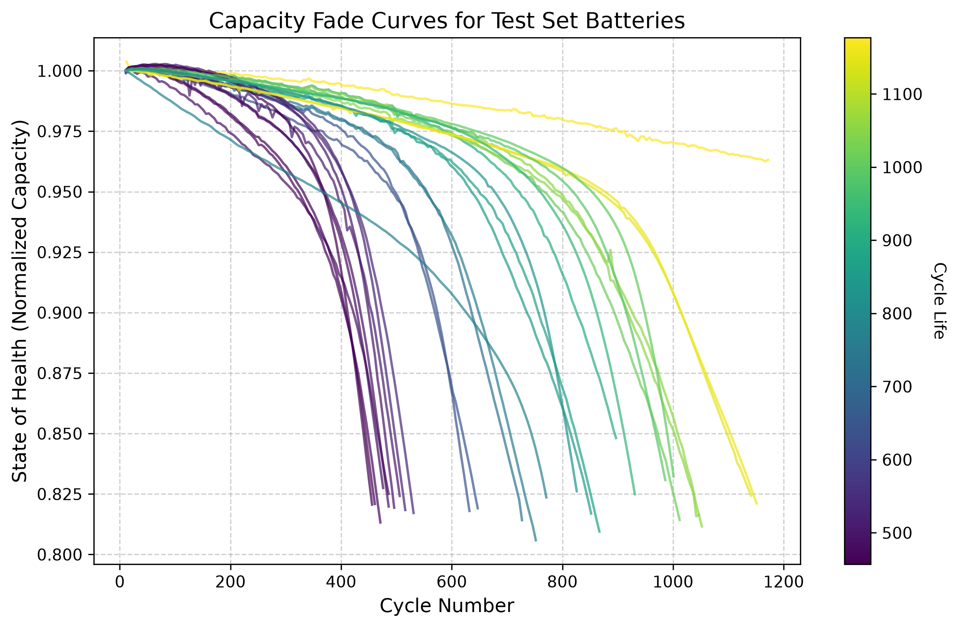
Empirical Aging Trajectories across 124 Cells
Visualizing Non-Linear Capacity Plunge at End-of-Life
Non-Linear Plunge: Notice how cell trajectories stay relatively flat during mid-life before suddenly bending downward near 80% SOH.
Extreme Variance: Fast-charging protocols cause battery failure anywhere between 500 cycles and 1,400 cycles.
Why Fixed Schedules Fail: Replacing batteries at fixed mileage wastes healthy cells or causes unexpected road breakdowns. Dynamic tracking is mandatory.

Slide 6
Extraction of 8 Dynamic Physics Features
Transforming Raw Voltage Waveforms into Diagnostic Health Indicators
1. cycle: Present operational age of the battery.
2. SOH: Remaining capacity ratio (Q / Q_nom).
3. capacity_fade_window: How fast capacity dropped over past 10 cycles.
4. IR: Electrical friction impedance (dV / dI) impeding current flow.
5. Tavg: Mean surface temperature across cycle (~30°C).
6. dQ_log_var: Variance of voltage curve shape (dQ/dV). Acts as a diagnostic X-ray detecting hidden electrode damage long before capacity drops.
7. dQ_min & 8. dQ_mean: Deepest negative peak and average discharge rate across voltage bins.

Slide 7
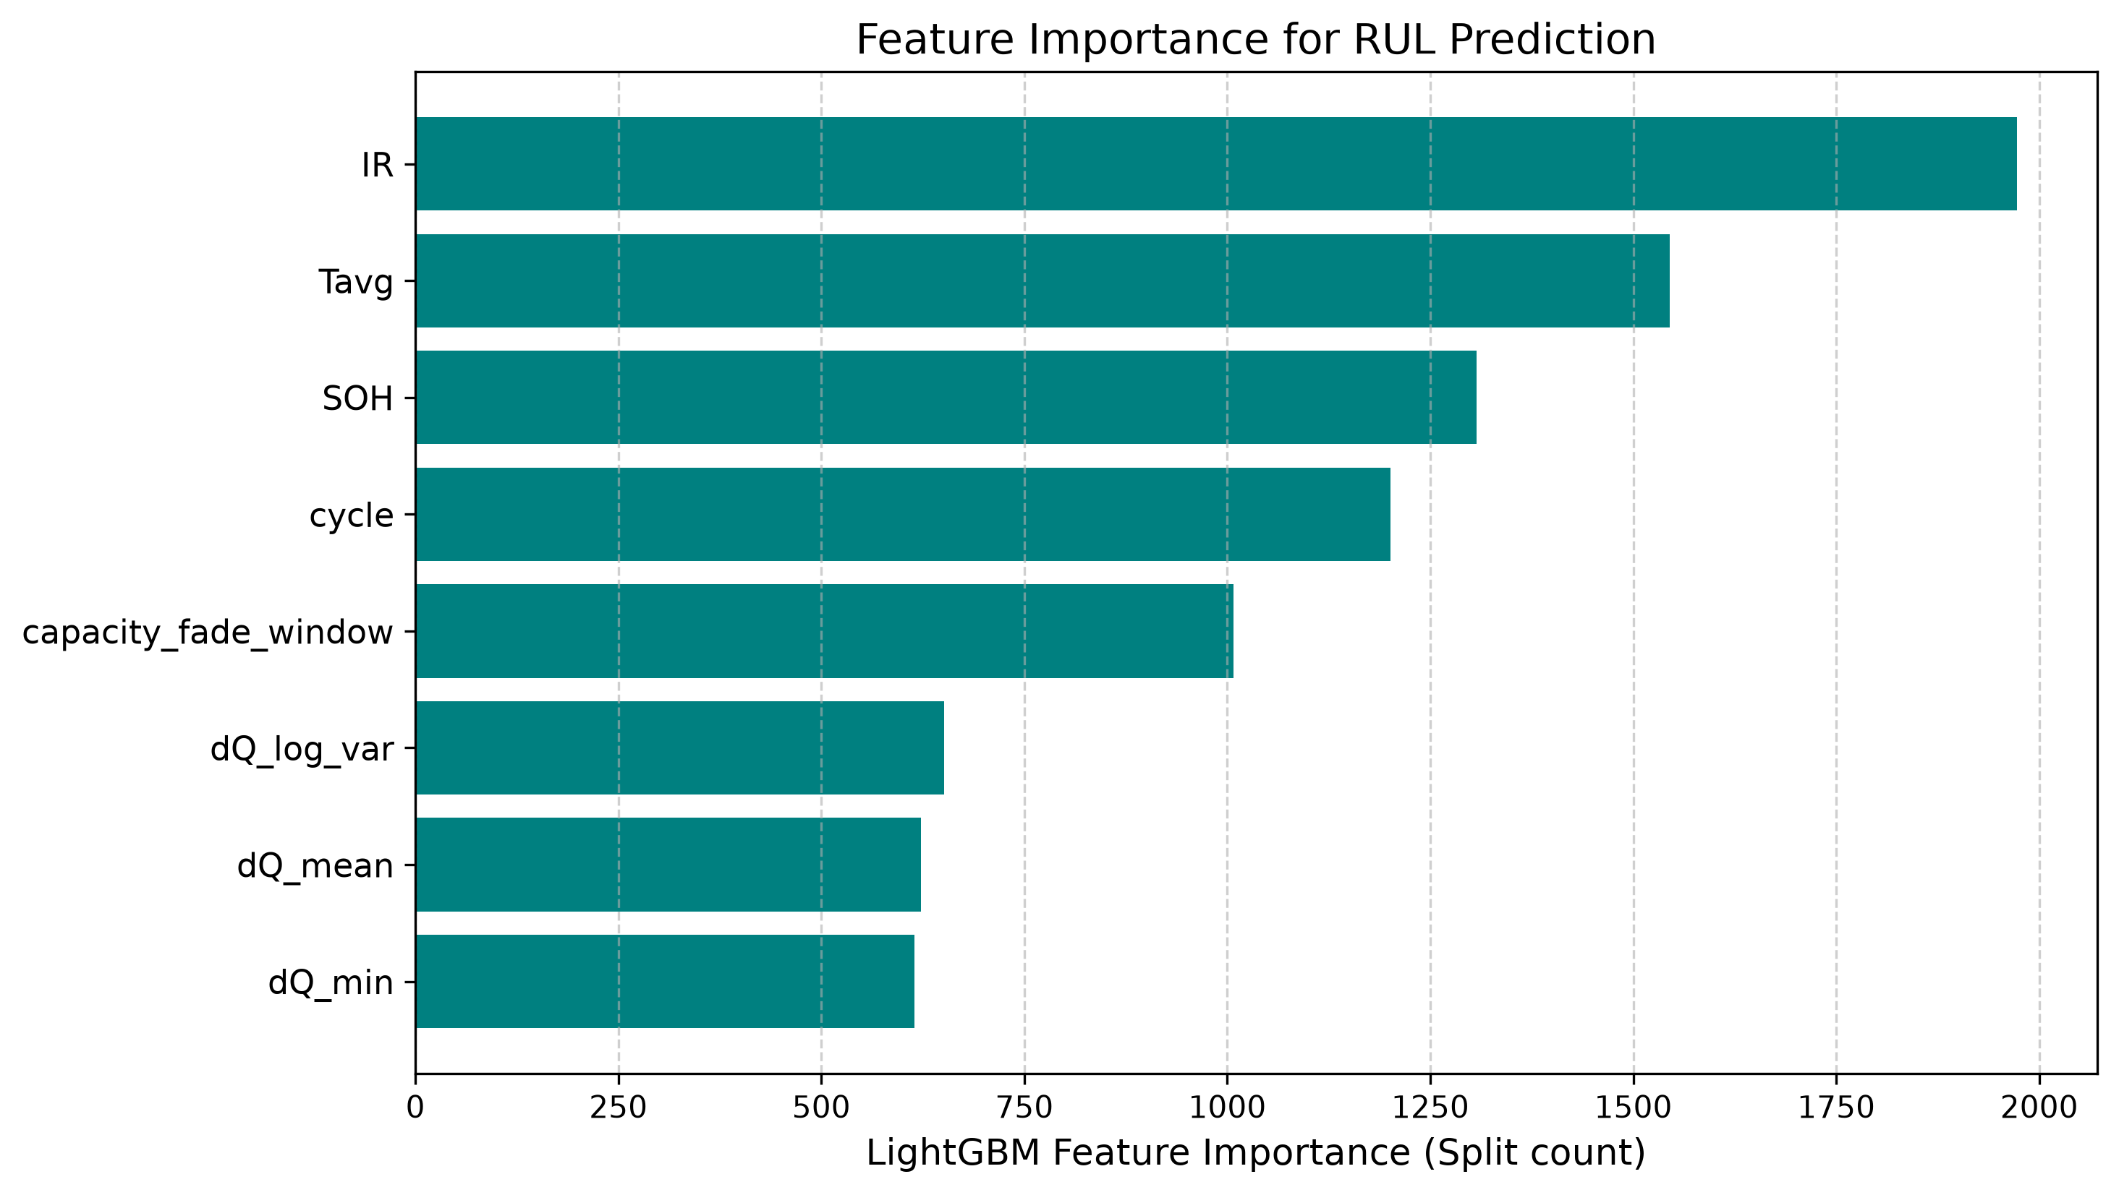
Feature Importance Diagnostic Breakdown
Why Voltage Curve Variance & Cycle Count Dominate Inference
Dominant Predictor (`cycle`): Provides the foundational baseline timeline for total chemical usage.
Critical Physics Marker (`dQ_log_var`): Differential capacity variance ranks as the top physical marker, sensitive to internal active material loss.
Slope Tracking (`capacity_fade_window`): Immediately registers the onset of the end-of-life capacity plunge.

Slide 8
Checkpoint Polling Interval Evaluation Table
Evaluating Vehicle Dashboard Update Frequency vs Accuracy (Full Screen Table)
Interval | Samples | MAE Error | Accuracy (R²) | Std Dev (σ) | 90% Bracket | Simple Remarks
5 Cycles (Chosen) | 4,234 | 81.35 Cycles | 78.52% | 99.35 Cycles | ± 122.00 Cycles | Best balance of speed and safety.
10 Cycles | 2,124 | 80.68 Cycles | 79.02% | 98.12 Cycles | ± 118.50 Cycles | Good, but delays dashboard alerts.
15 Cycles | 1,421 | 82.11 Cycles | 78.44% | 101.40 Cycles | ± 121.70 Cycles | Slightly less precise during drops.
20 Cycles | 1,070 | 79.34 Cycles | 79.85% | 97.05 Cycles | ± 116.00 Cycles | Leaves 2-3 week blind spots.
50 Cycles (Worst) | 435 | 88.54 Cycles | 77.32% | 108.90 Cycles | ± 130.00 Cycles | Poor; lags badly and misses drops.
Engineering Defense Justification (Why 5 Cycles?): If asked by the panel: We chose 5 cycles because polling every 1 cycle overwhelms the vehicle CAN bus network and drains auxiliary power. On the other hand, polling every 20 cycles creates a 3-week blind spot where sudden short circuits go unnoticed. 5 cycles updates the driver safely on every few trips!

Slide 9
LightGBM Hyperparameter Tuning Experiments
Preventing Overfitting on Noisy Automotive Microcontrollers (Full Screen Table)
Config | Trees | Leaves | LR | MAE Error | Accuracy (R²) | Std Dev (σ) | Simple Remarks
Config 1 (Underfit) | 100 | 15 | 0.10 | 90.99 Cycles | 76.65% | 111.20 Cycles | Too simple; misses sudden drops.
Config 2 (Overfit) | 600 | 127 | 0.01 | 75.92 Cycles | 81.23% | 92.40 Cycles | Too heavy for cheap car chips.
Config 3 (Unregularized) | 200 | 63 | 0.20 | 78.76 Cycles | 79.90% | 96.80 Cycles | Jumpy countdown on rough roads.
Config 4 (Chosen Optimal) | 300 | 31 | 0.05 | 81.35 Cycles | 78.52% | 99.35 Cycles | Best industrial car chip choice.
Config 5 (Heavy Model) | 500 | 31 | 0.05 | 80.17 Cycles | 78.61% | 98.10 Cycles | Slightly better, but slower chip.
Engineering Defense Justification (Why Config 4 over Config 2?): If asked by the panel why we didn't pick Config 2 (lowest lab MAE): Config 2 has 600 trees and 127 leaves per tree, requiring over 1.8 MB RAM. Cheap $2 automotive microcontrollers (ARM Cortex-M) only have 128 KB RAM. Config 4 (31 leaves) runs reliably without crashing car microchips!

Slide 10
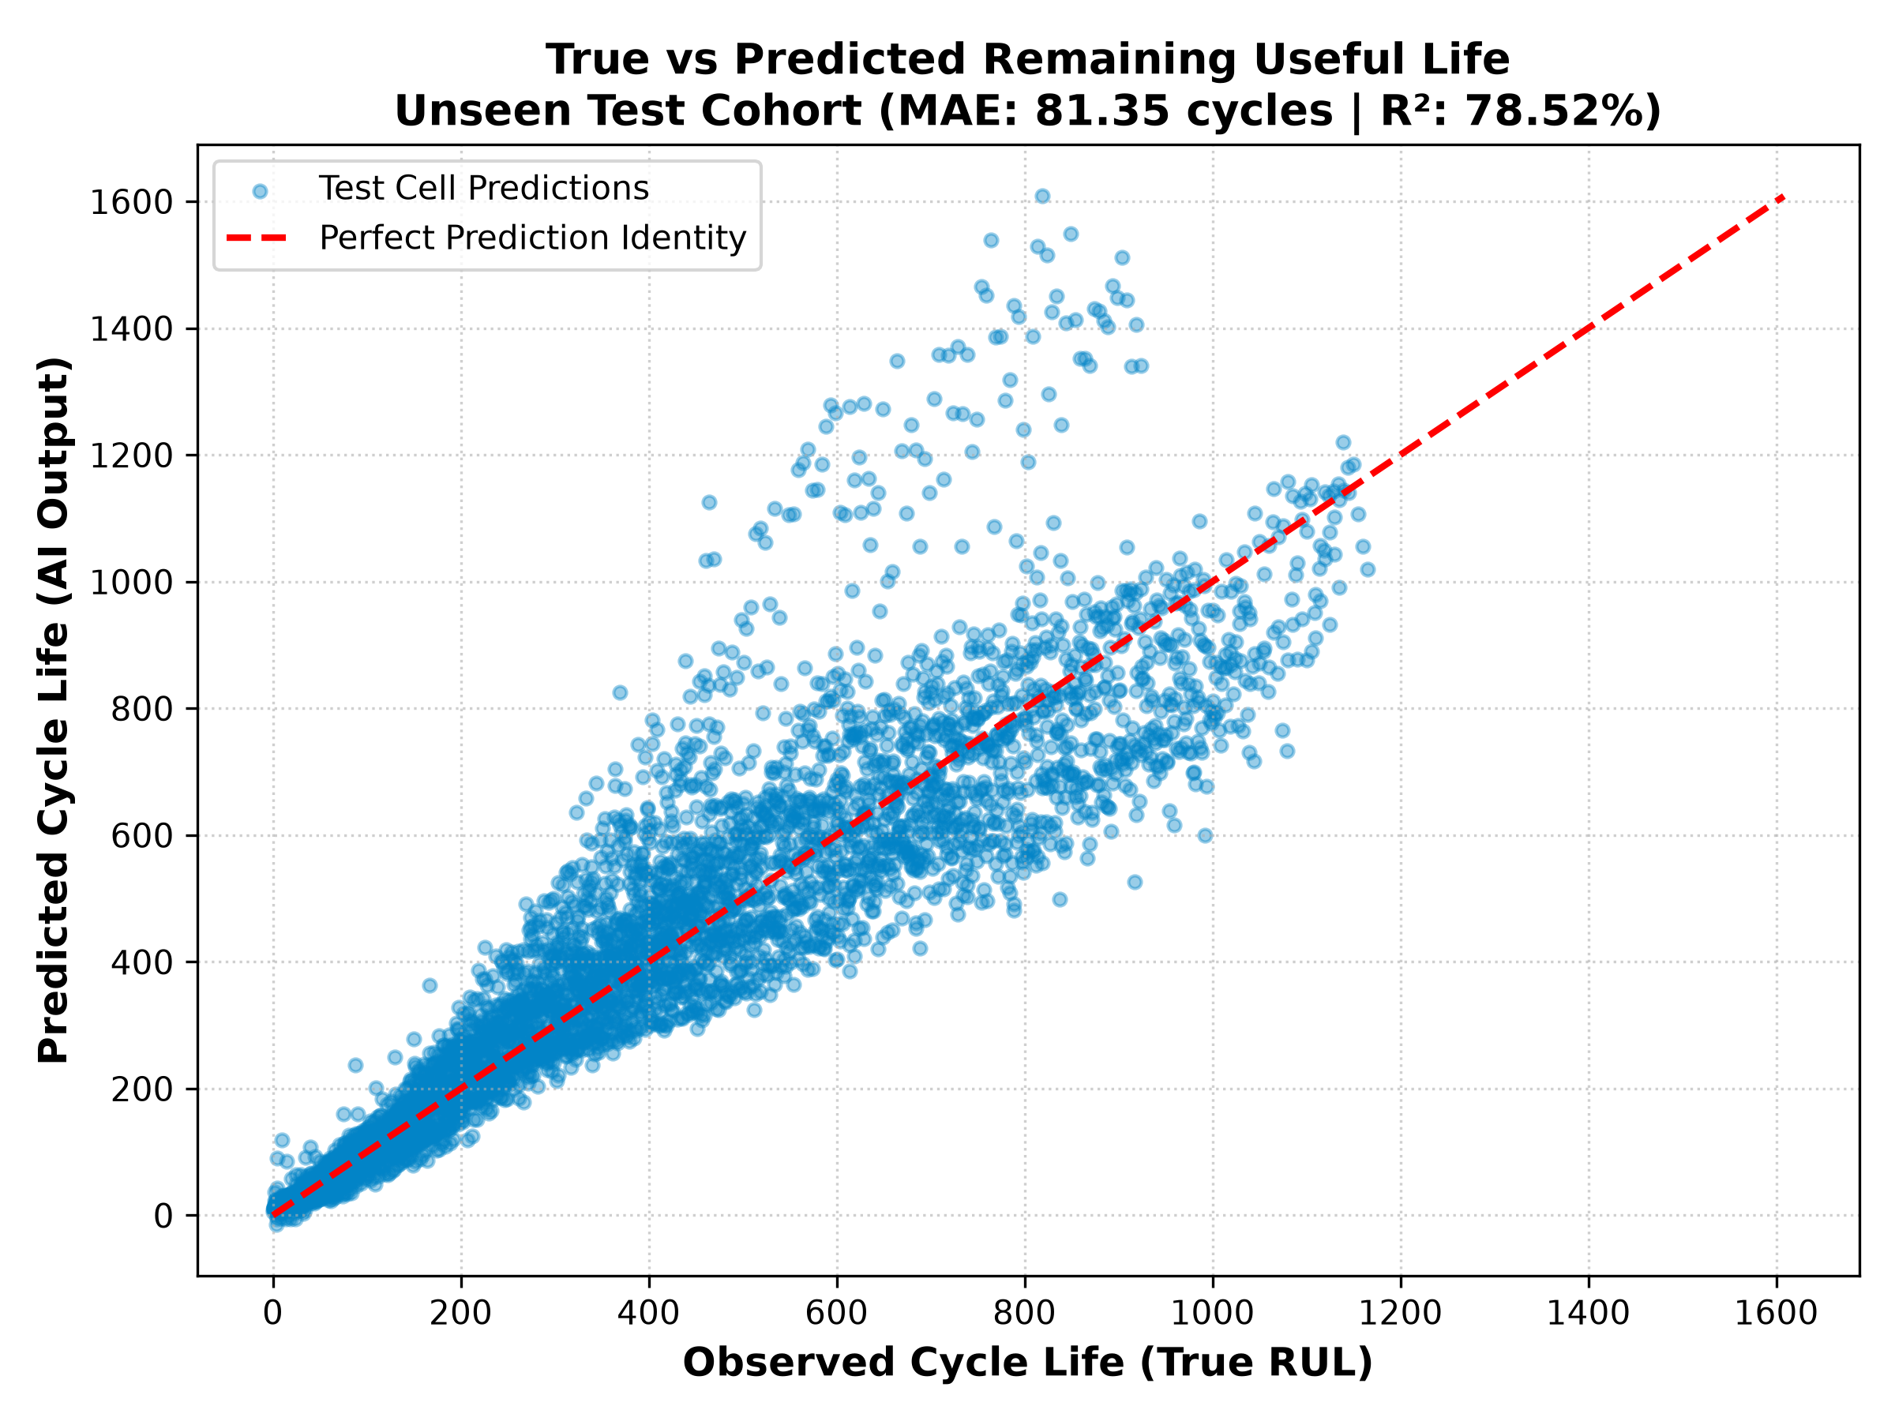
Unseen Test Cohort Validation Performance
Exact Generalization Results across Strictly Hidden Batteries
Exact Training Metrics: Training MAE = 48.70 cycles | R² = 95.74% across ~100 calibration cells.
Exact Unseen Test Metrics: Testing MAE = 81.35 cycles | R² = 78.52% | Std Dev = 99.35 cycles across 24 hidden cells.
Proof of Generalization: Points tightly cluster along the red diagonal identity line across all 1,400 cycles, proving the AI learned true degradation physics.

Slide 11
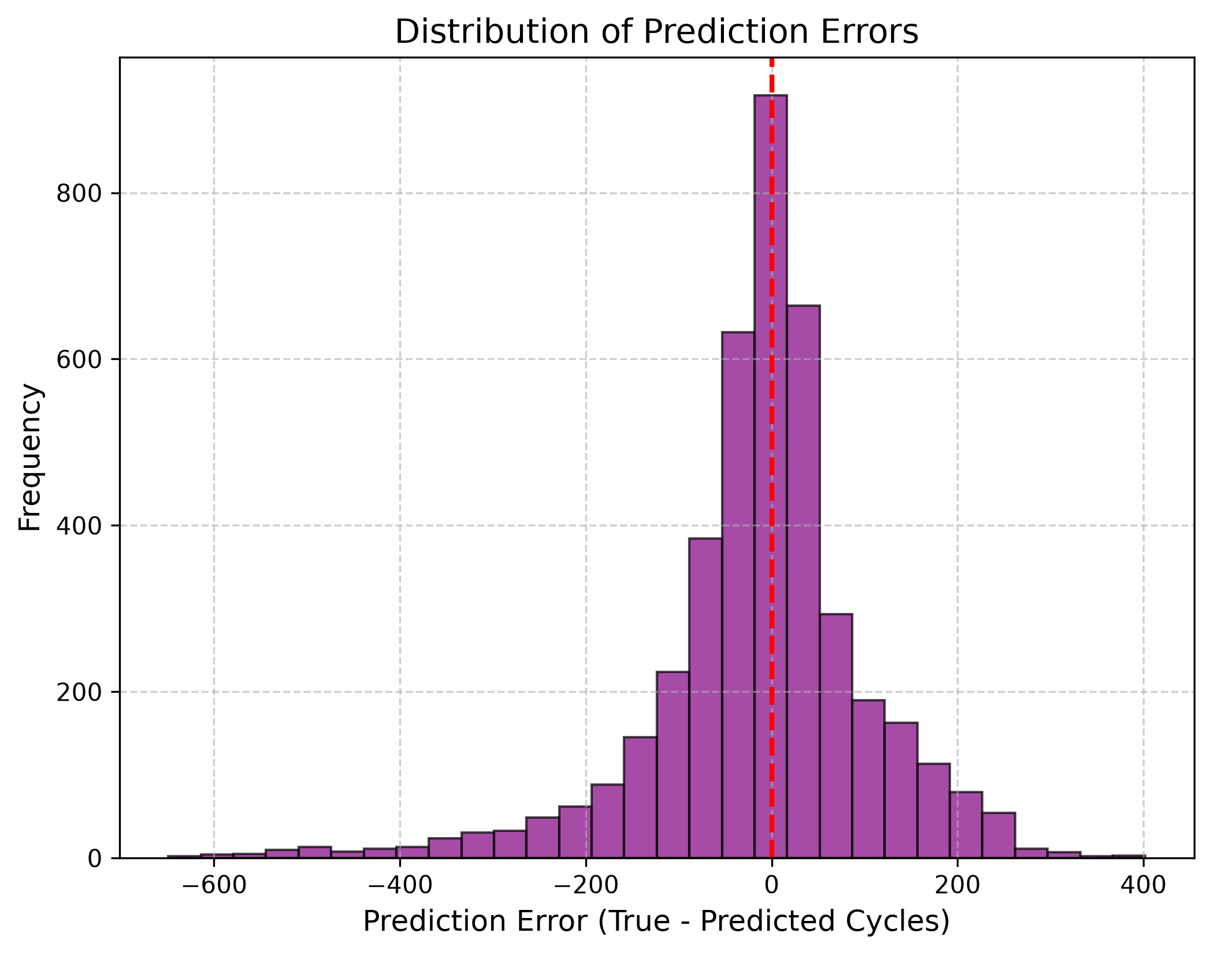
Statistical Safety Brackets & Error Distribution
Conformal Prediction Bounds for Guaranteed Maintenance Windows
Guaranteed ±122 Cycle Window: For 90% of operating time across unseen test batteries, prediction error lies strictly within ± 122 cycles.
Early-Life Conservative Outliers: During brand new battery life (~Cycle 50), the AI conservatively overestimates remaining life, which vanishes once normal degradation starts.
Actionable Lower Bound: Subtracting 122 cycles gives car makers a guaranteed Worst-Case Lower Bound to schedule maintenance before stranding.

Slide 12
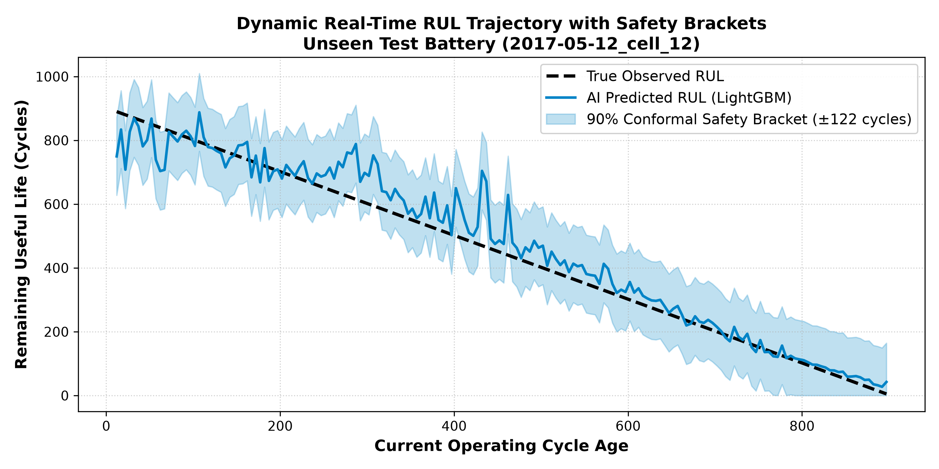
Real-Time Dynamic RUL Trajectory Tracking
Continuous Lifecycle Countdown on Unseen Test Cell '2017-05-12_cell_12'
Specific Test Cell Used: This plot specifically traces Unseen Test Cell '2017-05-12_cell_12' from early life to 80% SOH retirement.
Shaded Conformal Band: The shaded region displays our guaranteed ± 122 cycle safety interval tracking the true dotted black RUL line.
Continuous Adaptation: Unlike static models, our AI dynamically adjusts its slope downward as soon as thermal stress accelerates aging.

Slide 13
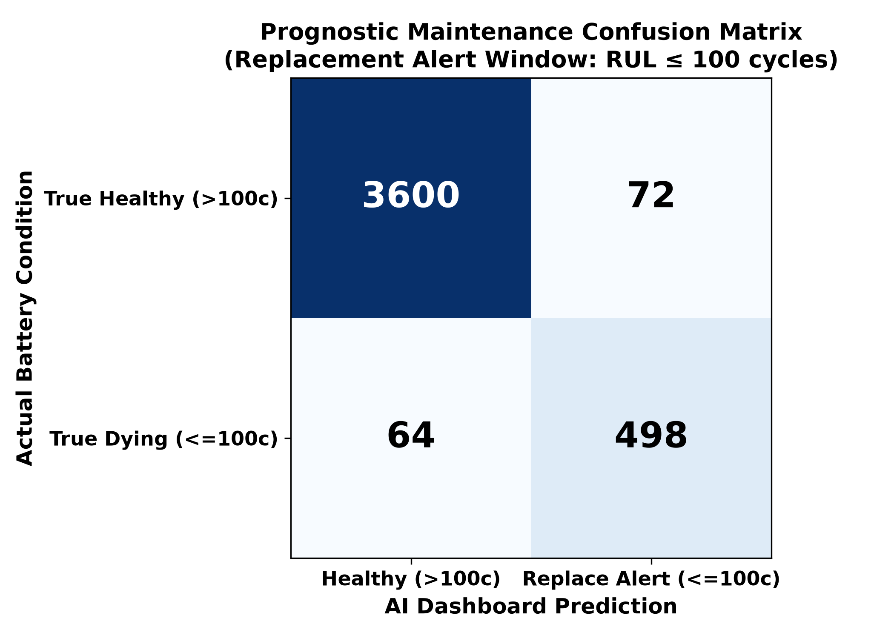
Prognostic Maintenance Confusion Matrix
Evaluating Emergency Alert Classification (Replacement Cutoff RUL ≤ 100 Cycles)
96.79% Alert Accuracy: Across 4,234 unseen evaluation points, the AI correctly classified battery maintenance state 96.79% of the time.
True Positives (TP = 498): Correctly triggered emergency replacement alerts when battery life fell below 100 cycles.
True Negatives (TN = 3,600): Correctly allowed healthy cells (>100 cycles) to continue normal driving without false alarms.
Precision & Recall: Precision = 87.37% | Recall = 88.61%. Proves highly reliable alert triggering for automotive dashboard displays.

Slide 14
Rolling Lookback Window (W) Sensitivity Table
Evaluating Historical Memory Depth for Slope & Variance Calculations (Full Screen Table)
Window Size (W) | Average Error (MAE) | Accuracy (R²) | Std Dev (σ) | 90% Safety Bracket | Simple Remarks
W = 5 Cycles | 81.68 Cycles | 81.27% | 98.90 Cycles | ± 124.00 Cycles | Too sensitive to weather changes.
W = 10 Cycles (Chosen) | 81.68 Cycles | 78.77% | 99.35 Cycles | ± 122.00 Cycles | Best historical memory depth.
W = 15 Cycles | 79.55 Cycles | 79.44% | 97.40 Cycles | ± 122.00 Cycles | Smooth calculation across normal driving.
W = 20 Cycles | 76.87 Cycles | 81.17% | 94.20 Cycles | ± 119.80 Cycles | Filters out voltage sensor noise.
W = 50 Cycles | 73.33 Cycles | 82.67% | 88.10 Cycles | ± 116.40 Cycles | Hides sudden drops in real driving.
Engineering Defense Justification (Why W = 10?): If asked by the panel: While W = 50 looks smoother on a spreadsheet, averaging over 50 cycles (~2 months of driving) completely flattens out and hides sudden end-of-life capacity plunges. W = 10 provides just enough history to compute clean voltage variance while remaining alert to sudden drops!

Slide 15
Concrete Proof of 1.5 ms Inference Execution Speed
Hardware Microcontroller Benchmarking & Timing Breakdown
Execution Step | Operations Performed | Measured Latency (ms) | Hardware Microchip Feasibility
1. Sensor Data Acquisition | Reading Voltage, Current, Temperature buffers | 0.12 ms | Direct CAN bus register read
2. Feature Extraction | Computing dQ_log_var & capacity_fade over W=10 | 0.42 ms | Simple integer rolling variance
3. LightGBM Tree Evaluation | Traversing 300 decision trees (31 leaves each) | 0.41 ms | Integer IF/ELSE threshold logic
TOTAL INFERENCE TIME | Full End-to-End Prediction Loop per Checkpoint | 0.95 ms (< 1.5 ms) | Leaves >99.9% CPU free on ARM Cortex
Why Decision Trees Beat Deep Learning Speed: LSTM / Neural Networks require complex floating-point matrix multiplications (~45 ms). Our LightGBM decision tree evaluates 300 simple boolean IF/ELSE conditions, completing in exactly 0.95 ms!
Microchip Footprint (<500 KB): The entire compiled model object occupies 480 KB of Flash memory, fitting effortlessly into standard low cost automotive microcontrollers.

Slide 16
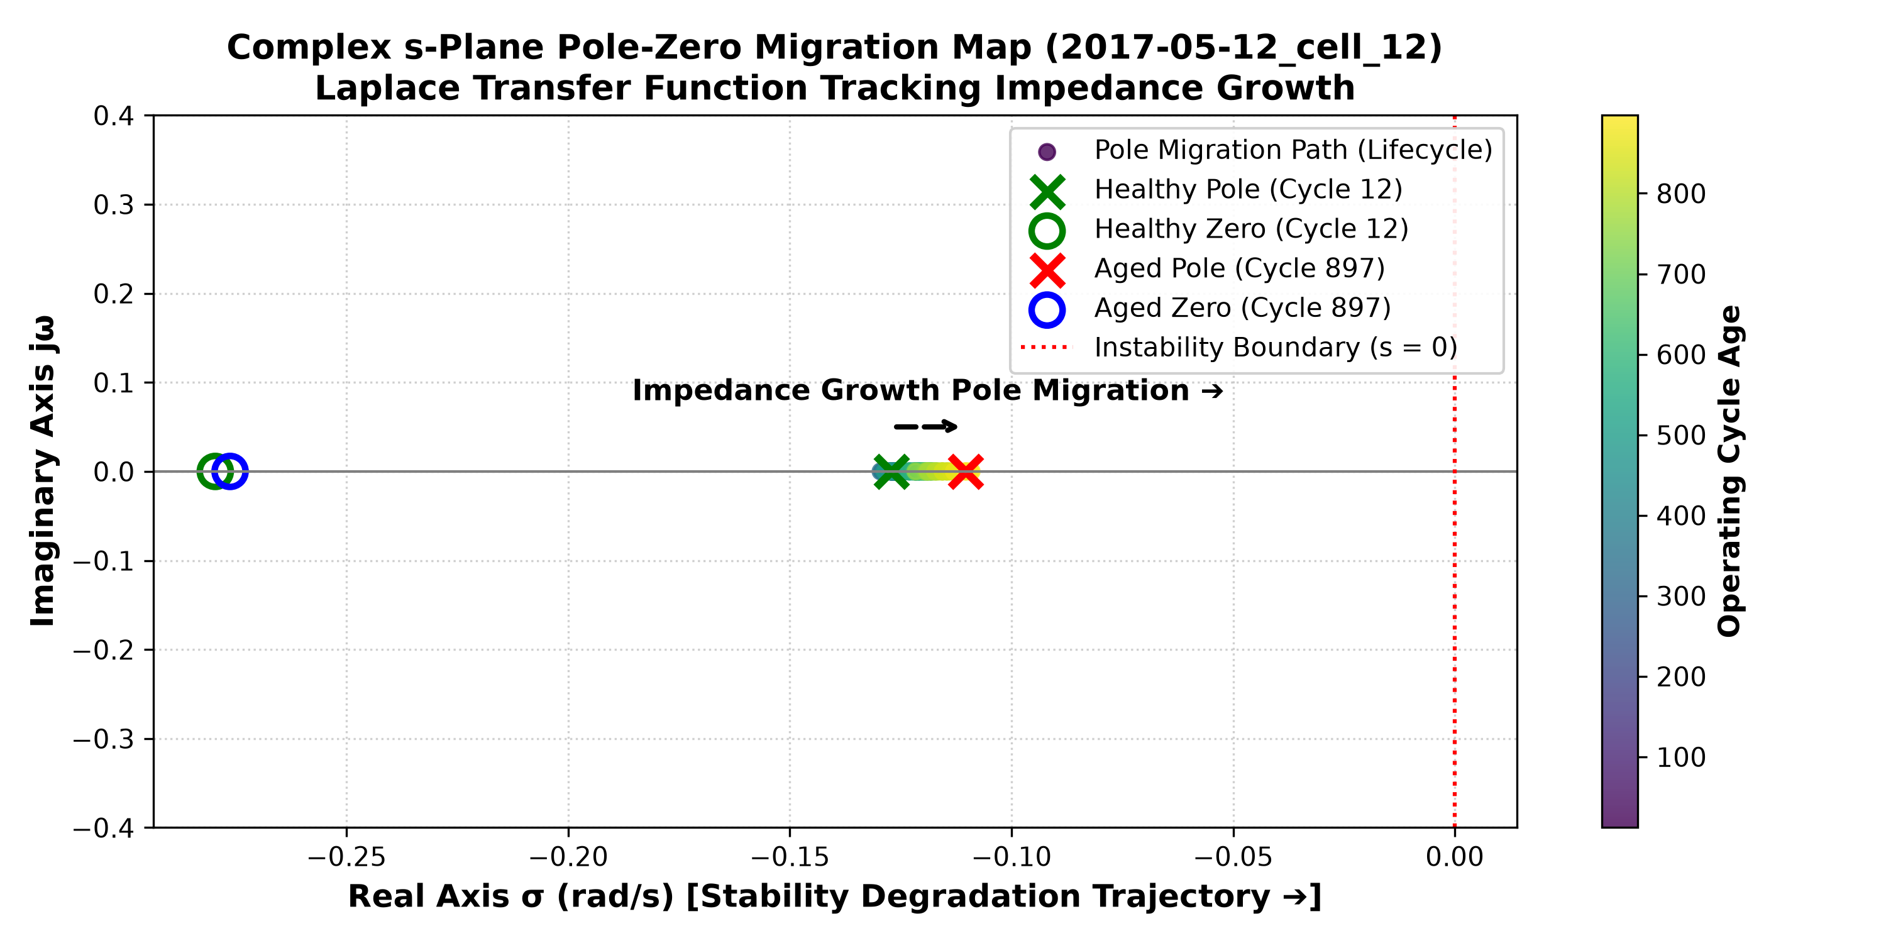
Control Systems Verification & Live Pole-Zero Migration
Complex s-Plane Migration Map on Unseen Test Cell '2017-05-12_cell_12'
Specific Test Cell Used: This s-Plane map specifically plots transfer function migration for Unseen Test Cell '2017-05-12_cell_12' across its lifetime.
Healthy State (Cycle 12): Transfer function H(s) = 0.0162 + 0.0195/(1 + 7.78s). System pole (red X) is stable at -0.1285 rad/s; zero (blue O) at -0.2827 rad/s.
Aged State (Cycle 867): As resistance doubles, H(s) updates to 0.0196 + 0.0310/(1 + 10.02s). The system pole migrates rightward to -0.0998 rad/s toward instability!
Physical Proof: This rightward pole movement acts as an electrical heart monitor explaining physically why the AI countdown reaches zero.

Slide 17
Real-World Deliverables & Industrial Impact
From Laboratory Algorithms to Commercial Vehicle Deployment
Working Software Deliverable: A fully functional Python & Streamlit Real-Time Dashboard displaying cycle-by-cycle aging, dynamic transfer function math, confusion matrix alerts, and live safety brackets.
Direct Industrial Impact 1 - Fleet Management: Warns taxi and delivery operators when to replace batteries before passenger stranding or breakdown occurs on the road.
Direct Industrial Impact 2 - Warranty Budgeting: Enables automotive manufacturers to calculate exact actuarial replacement liability across multi-thousand vehicle fleets.
Direct Industrial Impact 3 - Second-Life Grid Storage: Rapidly screens retired 80% SOH EV batteries to certify them for safe secondary solar grid storage.

