Slide 1

ONLINE
LIBRARY
MANAGEMENT
SYSTEM
Sankar Polytechnic College
A web-based digital library solution for colleges
(Autonomous)
Dept. of Computer Engineering
P246 – Scripting Language Project
PHP
MySQL
HTML/CSS
Aravind Raj U – 242103
XAMPP
JavaScript
Apache
Chandru A – 242107
Nambi Raj G – 242127
Selva Dinesh S – 242141
GUIDED BY
Dr. C. VIJESH JOE Ph.D.,

Slide 2




Objective
WHAT WE AIM TO ACHIEVE WITH THIS PROJECT
Digitise Library Operations
Replace slow, error-prone paper registers with a fast digital platform accessible from any browser on the college LAN.
Dual Role Access System
Separate dashboards for Admin (books, members, issue/return, reports) and Member (browse catalogue, track history).
Per-Copy LIB Numbering
Auto-generate a unique LIB number for every physical copy — enabling individual copy-level issue and return tracking.
Secure & Validated Platform
PHP sessions, role-based access control, SQL injection prevention and client-side validation at every layer.
ONLINE LIBRARY MANAGEMENT SYSTEM
Sankar Polytechnic College (Autonomous)
2

Slide 3
Existing System
MANUAL APPROACH vs PROPOSED DIGITAL SOLUTION
✕ Manual System — Drawbacks
✓ Proposed System — Benefits
Paper registers — slow & error-prone
Digital records — fast and always safe
No real-time book availability info
Real-time availability at a glance
Hard to track which copy is with whom
Unique LIB number per copy — precise
Risk of lost or damaged records
Secure database — no physical loss
Slow search — must flip every page
Instant search by title or LIB number
No automated overdue reminders
Overdue warnings highlighted in red
Difficult to generate usage reports
One-click report generation
ONLINE LIBRARY MANAGEMENT SYSTEM
Sankar Polytechnic College (Autonomous)
3

Slide 4
Requirement
HARDWARE AND SOFTWARE SPECIFICATIONS
⚙ Hardware Requirements
💻 Software Requirements
Processor
Intel Core i3 or above
Operating System
Windows 10 / 11
RAM
Minimum 4 GB
Web Server
Apache via XAMPP
Hard Disk
50 GB HDD / SSD
Backend
PHP 7 / PHP 8
Display
1366 × 768 or higher
Database
MySQL / MariaDB
Input Devices
Keyboard & Mouse
Frontend
HTML5, CSS3, JavaScript
Network
LAN / Wi-Fi (localhost)
Browser
Chrome / Firefox / Edge
ONLINE LIBRARY MANAGEMENT SYSTEM
Sankar Polytechnic College (Autonomous)
4

Slide 5


Introduction
ABOUT THE ONLINE LIBRARY MANAGEMENT SYSTEM
Online Library Management System
is a complete web-based application built with PHP, MySQL, HTML, CSS and JavaScript on Apache via XAMPP. It digitises all manual library operations — book cataloguing, member management, issuing, returning and overdue tracking — with a fast, accurate, role-based digital platform.
TWO ROLES
LIB NUMBERING
SECURE SYSTEM
Admin — Full control over books, members, issue & return, reports.
Every physical copy gets a unique LIB number (LIB001, LIB002…)
PHP sessions, role-based access, SQL injection prevention.
Member — Browse catalogue, view borrow history, reset password.
Enables precise per-copy tracking across every transaction.
Client-side validation adds safety at every single form.
ONLINE LIBRARY MANAGEMENT SYSTEM
Sankar Polytechnic College (Autonomous)
5

Slide 6
Project Description / Overview
KEY FEATURES AND LIVE SYSTEM STATISTICS
10
30
8
2
Book Titles
LIB Copies
Members
Active Issues
Web-based — access from any browser on the college LAN
Unique LIB numbering — auto-generated, continuous across titles
Admin: add, edit, delete titles and manage all physical copies
Member registration: Reg No, full name, username, password
Issue: assign specific LIB copy to member with date recorded
Return: marks copy available; dashboard updates in real time
Overdue books (> 14 days) highlighted in red automatically
Dashboard: 6 live stats — titles, copies, available, members, issued, returned
ONLINE LIBRARY MANAGEMENT SYSTEM
Sankar Polytechnic College (Autonomous)
6

Slide 7
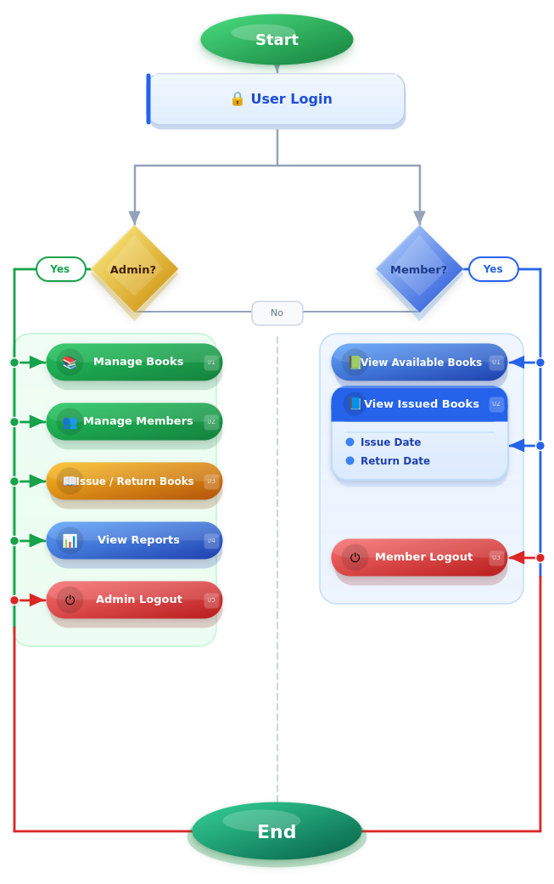
Flow Chart
SYSTEM FLOW: LOGIN → ROLE CHECK → OPERATIONS → LOGOUT
ONLINE LIBRARY MANAGEMENT SYSTEM
Sankar Polytechnic College (Autonomous)
7

Slide 8


Modules
SYSTEM MODULES — OVERVIEW
Admin Module
Member Module
• Dashboard · Manage Books
• Secure Login · Browse Catalogue
• Manage Members · Issue Books
• View Issue History
• Return Books · View Reports
• Overdue Alerts · Password Reset
Book Issue & Return
Security & Database
• 5-step Issue workflow
• PHP Sessions · Role-Based Access
• 5-step Return workflow
• SQL Injection Prevention
• Real-time database updates
• 4 Database Tables
ONLINE LIBRARY MANAGEMENT SYSTEM
Sankar Polytechnic College (Autonomous)
8

Slide 9



Module 1 — Admin Module
FULL CONTROL OVER ALL LIBRARY OPERATIONS
Dashboard
Manage Books
Manage Members
6 live counters: titles, copies, available, members, issued, returned.
Add titles + quantity (auto-LIB). Edit or delete titles and copies.
Register: Reg No, name, username & password. Edit or remove members.
Issue Book
Return Book
View Reports
Select member + LIB copy + date. Status → 'issued' in DB instantly.
Enter Issue ID + date. Copy → 'available'; dashboard updates live.
Full records table. Overdue entries (>14 days) highlighted in red.
ONLINE LIBRARY MANAGEMENT SYSTEM
Sankar Polytechnic College (Autonomous)
9

Slide 10
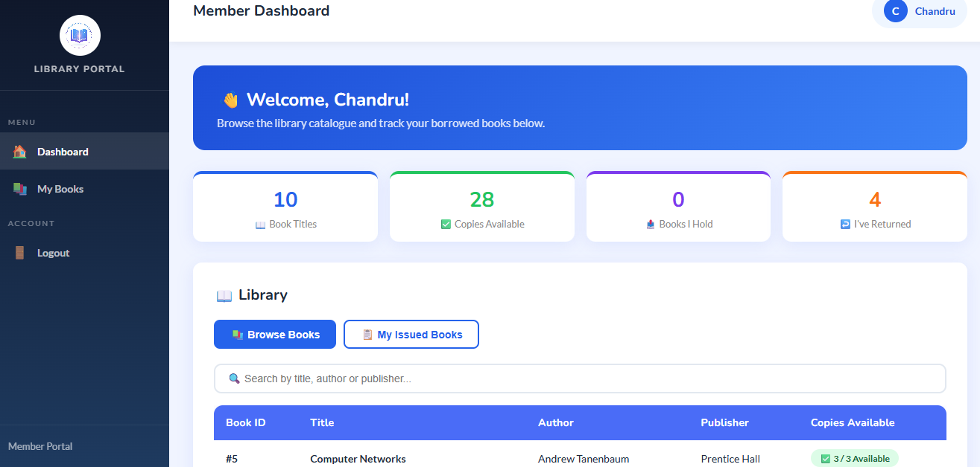


Module 2 — Member Module
SIMPLE, FOCUSED INTERFACE FOR LIBRARY MEMBERS
Secure Login
Session-managed login. Role check blocks members from all admin pages completely.
Browse Books
View all titles with real-time available copy count on the dashboard.
Issue History
Full borrowing history: LIB No., issue date, return date and current status.
Member Dashboard — Live Screenshot
Password Reset
Reset password via registered username — no admin intervention needed.
ONLINE LIBRARY MANAGEMENT SYSTEM
Sankar Polytechnic College (Autonomous)
10

Slide 11
Module 3 — Book Issue & Return
STEP-BY-STEP WORKFLOW WITH REAL-TIME DATABASE UPDATES
ISSUING A BOOK
RETURNING A BOOK
1
1
Admin selects Member from dropdown
Admin enters Issue ID from records
2
2
Admin selects available LIB Number
Admin sets Return Date
3
3
Admin enters Issue Date
System updates issued_books → 'returned'
4
4
System saves record in issued_books
book_copies status → 'available'
5
5
book_copies status → 'issued'
Dashboard stats update instantly
DB tables updated live: issued_books · book_copies · books · users
ONLINE LIBRARY MANAGEMENT SYSTEM
Sankar Polytechnic College (Autonomous)
11

Slide 12

Module 4 — Security & Database
AUTHENTICATION, ACCESS CONTROL AND DATA MANAGEMENT
PHP Sessions
Role-Based Access
Login state maintained server-side. session_destroy() on logout clears all session data.
Admin pages reject members; member pages reject admins. Enforced on every page request.
SQL Injection Prevention
Client-Side Validation
All inputs escaped with mysqli_real_escape_string() before any database query.
HTML required attributes + JavaScript checks prevent empty or malformed submissions.
Database Tables: users · books · book_copies · issued_books
ONLINE LIBRARY MANAGEMENT SYSTEM
Sankar Polytechnic College (Autonomous)
12

Slide 13
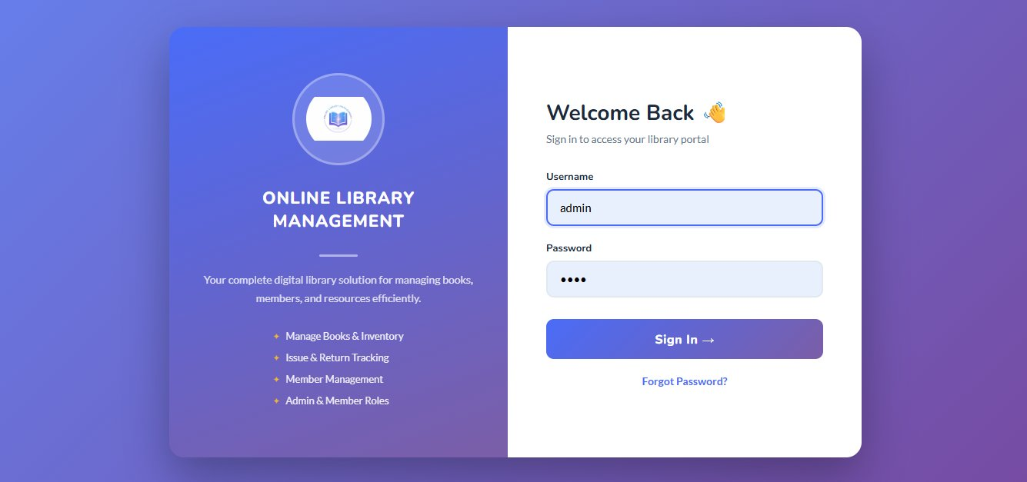
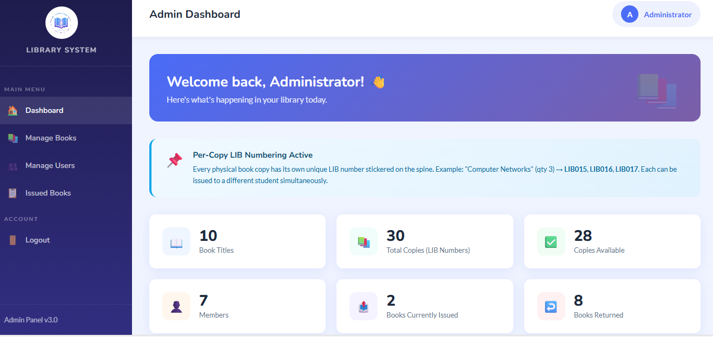
System Screenshots — Part 1
LOGIN PAGE AND ADMIN DASHBOARD
Login Page
Admin Dashboard
ONLINE LIBRARY MANAGEMENT SYSTEM
Sankar Polytechnic College (Autonomous)
13

Slide 14
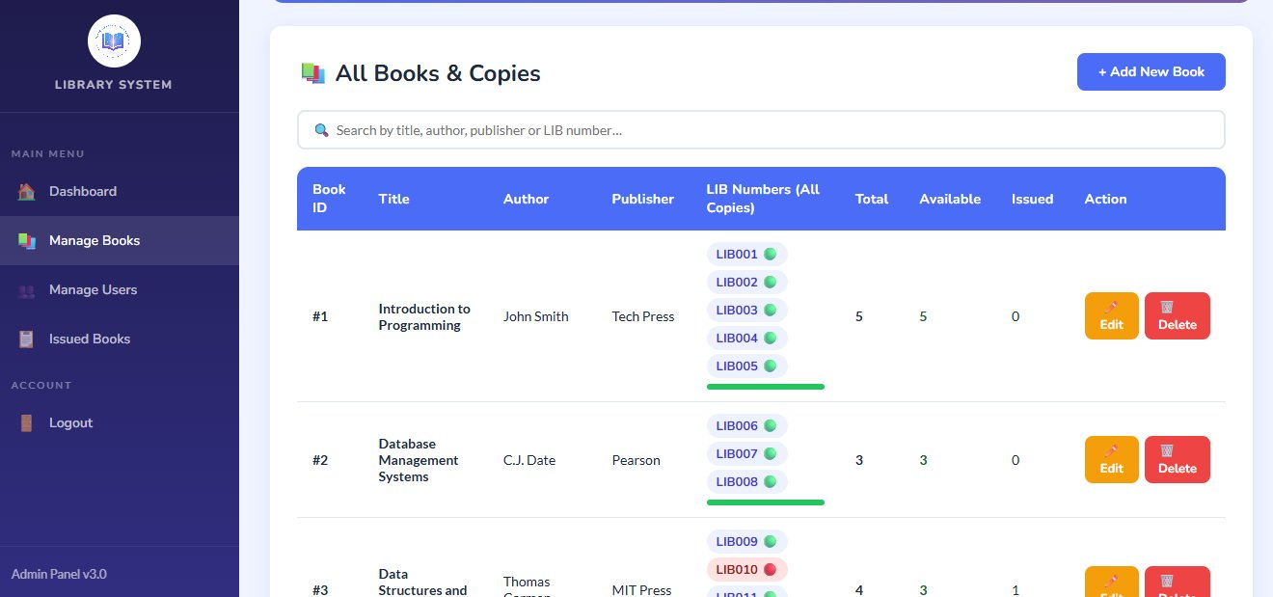
System Screenshots — Part 2
MANAGE BOOKS AND MEMBER DASHBOARD
Manage Books
Member Dashboard
ONLINE LIBRARY MANAGEMENT SYSTEM
Sankar Polytechnic College (Autonomous)
14

Slide 15
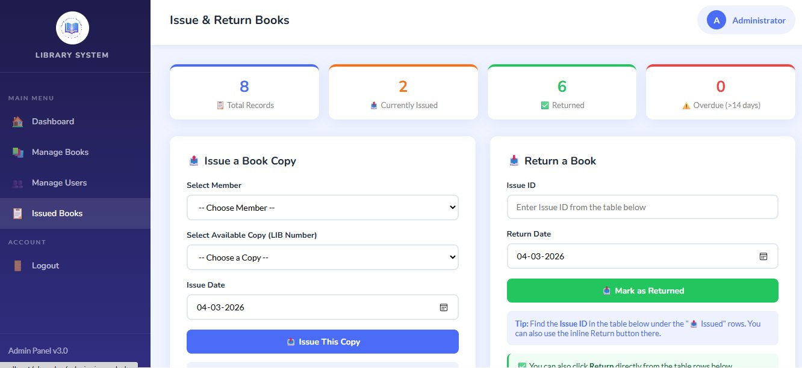
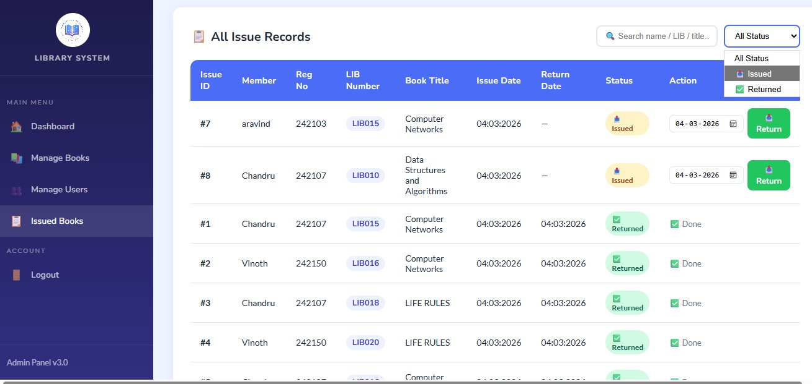
System Screenshots — Part 3
ISSUE BOOKS AND ISSUE RECORDS
Issue Books
Issue Records
ONLINE LIBRARY MANAGEMENT SYSTEM
Sankar Polytechnic College (Autonomous)
15

Slide 16



Conclusion
PROJECT SUMMARY AND KEY OUTCOMES
Production-Ready
Complete, secure web application — PHP, MySQL, HTML/CSS, XAMPP. Ready for deployment on any college LAN.
Precision Tracking
Per-copy LIB numbering enables precision tracking unavailable in any traditional manual library system.
Fully Secured
Role-based access, PHP sessions and SQL injection prevention protect all data at every single request.
Time & Error Saving
Replaces slow, error-prone paper registers — drastically reducing staff effort and manual errors.
Extendable Design
Architecture cleanly supports future modules: fines, reservations, email alerts and mobile access.
ONLINE LIBRARY MANAGEMENT SYSTEM
Sankar Polytechnic College (Autonomous)
16

Slide 17


Future Enhancement
PLANNED FEATURES FOR THE NEXT VERSION
Online Reservation
Fine Calculation
Email Notifications
Members reserve copies; admin notified when book becomes available.
Auto fine per overdue day with payment status on both dashboards.
Automated due-date reminders and overdue alerts sent to member email.
Advanced Reports
Mobile-Responsive
Barcode / QR Scan
Monthly usage stats, most-borrowed titles and member activity analytics.
Full tablet & phone optimisation — browse and track on the go.
Scan LIB spine stickers via barcode or QR for faster issue and return.
ONLINE LIBRARY MANAGEMENT SYSTEM
Sankar Polytechnic College (Autonomous)
17

Slide 18
Reference
SOURCES & DOCUMENTATION USED IN THIS PROJECT
01
PHP Official Documentation
php.net/docs.php
02
MySQL Reference Manual
dev.mysql.com/doc/
03
XAMPP Documentation
apachefriends.org/
04
W3Schools — HTML/CSS/JS/PHP
w3schools.com
05
MDN Web Docs — HTML5 & CSS3
developer.mozilla.org
06
Stack Overflow — Community Q&A
stackoverflow.com
07
Tutorialspoint — PHP & MySQL
tutorialspoint.com
ONLINE LIBRARY MANAGEMENT SYSTEM
Sankar Polytechnic College (Autonomous)
18

Slide 19
THANK YOU
Online Library Management System
P246 – Scripting Language Project · Sankar Polytechnic College (Autonomous)
Aravind Raj U
Chandru A
Nambi Raj G
Selva Dinesh S
242103
242107
242127
242141
GUIDED BY
Dr. C. VIJESH JOE Ph.D.,
Department of Computer Engineering
APRIL 2026

