Slide 1


Welcome
ENCRYPTION
COMPLIANCE
MANAGEMENT
DATA
SAFE GAURD
RISK
KAFKA
Big Data Security and Compliance in Healthcare
DATA
HADOOP
SECURITY
HEALTH
CARE
IDS
SPARK
By
G Chandru
192221063

Slide 2

Big Data Security and Compliance in Healthcare
The increasing adoption of big data technologies in healthcare presents both significant opportunities and challenges. Leveraging vast amounts of patient data can lead to improved diagnostics, personalized treatments, and more efficient healthcare delivery. However, safeguarding sensitive patient information is paramount. This presentation outlines a comprehensive security solution designed to address the unique challenges of protecting sensitive data within a large-scale big data infrastructure used by healthcare organizations.

Slide 3
Risk Assessment and Vulnerability Identification
1
Data Access Controls
2
Network Security
Assess the current access control mechanisms for Hadoop, Spark, and Kafka. Identify potential vulnerabilities in user authentication, authorization, and data access permissions.
Analyze the network infrastructure, including firewalls, intrusion detection systems (IDS), and VPNs, to identify potential entry points for unauthorized access or data breaches.
3
Data Storage Security
4
Compliance Gaps
Evaluate the security measures for data stored in HDFS, including encryption, access controls, and data retention policies.
Review existing policies and procedures against HIPAA regulations and other applicable industry standards to identify potential compliance gaps. This includes areas like data privacy, data security, and breach notification.

Slide 4
Authentication and Authorization
Hadoop
Spark
Kafka
Implement strong authentication mechanisms for users accessing Hadoop services. Consider using Kerberos for authentication and authorization within the Hadoop ecosystem, including HDFS, YARN, and MapReduce.
Extend authentication and authorization to Spark applications. Leverage existing security mechanisms like Kerberos or integrate with a centralized identity management system (IdM).
Ensure secure communication and authentication for Kafka brokers and producers/consumers. Consider using SSL/TLS encryption for secure data transfer and SASL (Simple Authentication and Security Layer) for authentication.
Integrate Spark with the existing IdM system for user authentication.
Enable Kerberos authentication for all users and services.
Enable SSL/TLS encryption for all Kafka brokers and client connections.
Implement role-based access control (RBAC) for Spark applications and resources.
Implement fine-grained access control policies for HDFS and YARN.
Implement SASL authentication for producers and consumers.
Configure audit logging to track user actions and access patterns.
Audit Spark job submissions and data access.
Configure access control lists (ACLs) for Kafka topics to restrict access.

Slide 5
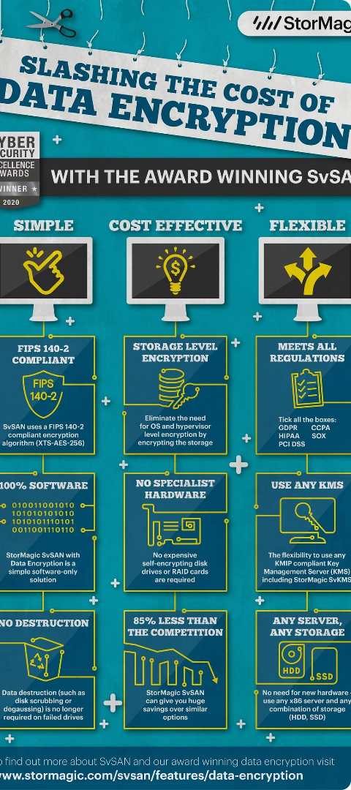
Data Encryption
1
Data at Rest
Encrypt data stored in HDFS and other storage systems. Utilize strong encryption algorithms and manage encryption keys securely. Consider using a Key Management System (KMS) for key storage and lifecycle management.
2
Data in Transit
Protect data transmitted between components of the big data infrastructure, including data transfer between Kafka brokers and consumers, and data access requests from Spark applications. Use SSL/TLS encryption for all communication channels.
3
Encryption Keys
Securely manage encryption keys, ensuring their availability and preventing unauthorized access. Implement strong key management practices, including key rotation, backup, and recovery procedures.

Slide 6
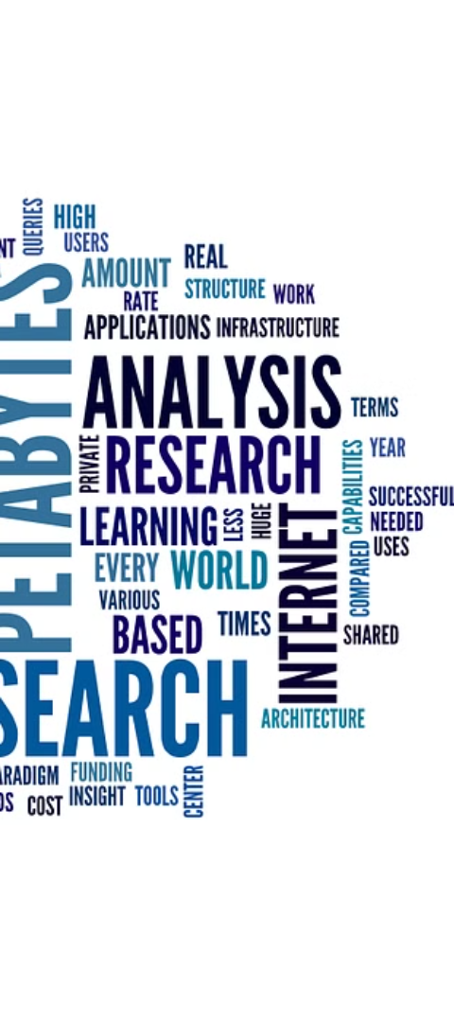



Auditing and Logging
User Activities
Log user actions, including login attempts, data access requests, and system configuration changes. This data can be used to identify suspicious activities and potential security breaches.
Data Access
Track all data access events, including who accessed what data, when, and from where. This provides a detailed audit trail for compliance and forensic analysis.
System Events
Log system events, such as application errors, system failures, and security alerts. This information can be used to identify potential security threats and troubleshoot system issues.

Slide 7
Security Monitoring and Alerting
Security Information and Event Management (SIEM)
Centralized collection, analysis, and correlation of security data from multiple sources.
Intrusion Detection Systems (IDS)
Monitor network traffic for malicious activity and generate alerts for suspicious patterns.
Vulnerability Scanners
Identify security vulnerabilities in the infrastructure and applications.
Data Loss Prevention (DLP)
Prevent sensitive data from leaving the organization's control.

Slide 8



Security Awareness Training
Staff Education
Regular Assessments
Continuous Improvement
Provide comprehensive training programs for all staff members, including security best practices, compliance requirements, and the importance of data privacy. Emphasize the importance of secure passwords, data handling procedures, and reporting suspicious activity.
Conduct regular security assessments and awareness training to reinforce security practices and keep staff informed of evolving threats and best practices. This includes reviewing security policies and procedures, conducting mock security drills, and providing ongoing updates and communication.
Continuously evaluate and improve security practices based on emerging threats, industry best practices, and feedback from staff and security audits. This ensures that the security solution remains effective and up-to-date in the ever-evolving threat landscape.

Slide 9

Documentation and Compliance
Security Policies
Compliance Documentation
Develop comprehensive security policies that define acceptable data access, security controls, and incident response procedures. These policies should be regularly reviewed and updated.
Maintain detailed documentation of all security controls, policies, and procedures to demonstrate compliance with HIPAA and other applicable regulations. This includes evidence of risk assessments, vulnerability scans, and security audits.
Training Materials
Develop training materials for staff members on data privacy and security best practices. This may include online courses, interactive modules, and reference guides that provide specific instructions and guidance on secure data handling practices.

Slide 10

Conclusion
In conclusion, securing big data in healthcare is paramount to protecting patient privacy and ensuring the integrity of medical records. The challenges are significant, given the volume, velocity, and variety of data, but with robust encryption, access controls, and continuous monitoring, we can mitigate risks. Looking ahead, as technology evolves, so too must our security measures. By staying vigilant and adapting to new threats, we can harness the power of big data to improve healthcare outcomes while safeguarding sensitive information.
Emphasize the role of data governance in establishing clear policies and procedures for data management and security.
Highlight the importance of employee training to ensure that all staff members are aware of best practices for data security.
Mention the potential of advanced analytics to not only improve healthcare outcomes but also to detect and prevent security breaches.
Discuss the need for collaboration between healthcare providers, technology vendors, and policymakers to create a unified approach to data security.
Consider the impact of international standards and regulations on shaping data security measures in healthcare.

Slide 11
Thank You

