Slide 1


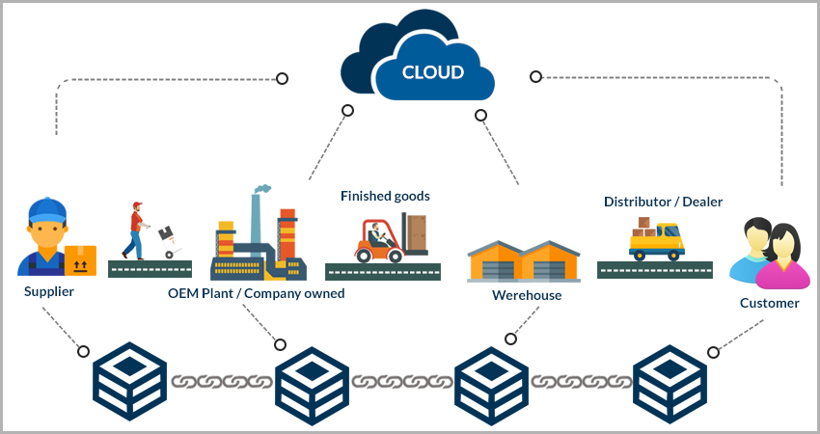
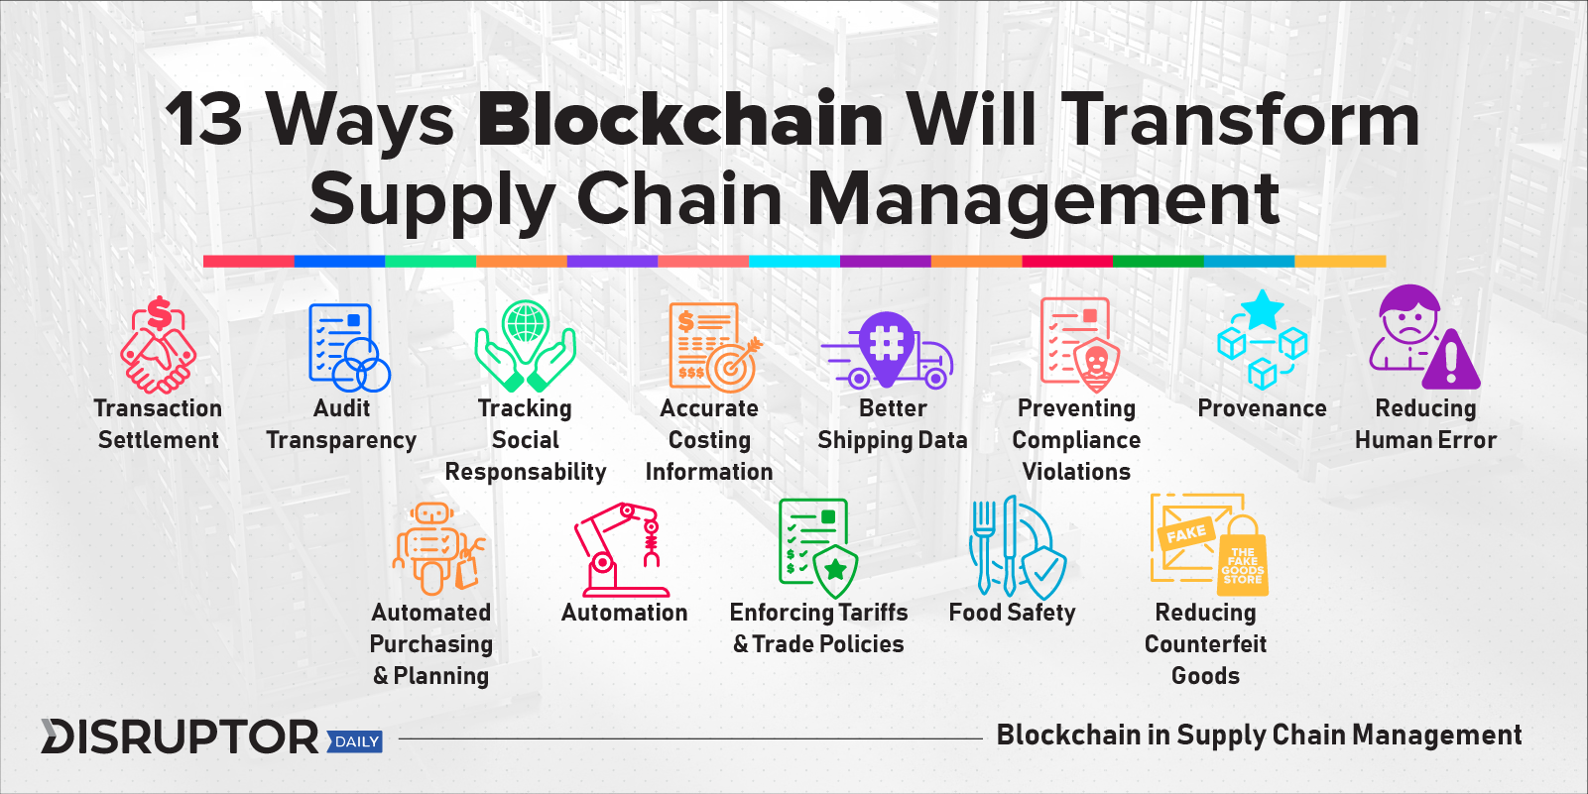
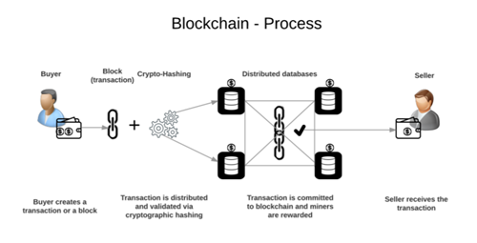
SUPPLY CHAIN TRANSPARENCY USING BLOCKCHHAIN
TEAM : (1) HARISHA G (2) HARSH RANJAN
(3) IDRIS SHAH HYDER (4) ARCHANA.B.PUJARI
GUIDE : PROF. KANHAIYA K KANZARIA
TOOLS AND TECHNOLOGY REQUIREMENT
Android Studio 3.0.3
Distributed Data base
QR code generator (website)
Android device
INTRODUCTION
METHODS
RESULTS
CONCLUSION
The market is deprived of quality products as a result the consumers are effected and suffer from many problem which include health, price for the product and on the other side the producers are not aware of the product which is being sold in the market by third parties.
This was a problem which was recognised by Walmart and It collaborated with IBM .
IBM came up with a prototype solution to use Block chain technology (hyper ledger concept). This tech create a transparency in the supply chain.
Here supply chain means the journey of a product from producer to the consumer.
Here the term supply chain transparency basically means the consumer and the producer should have knowledge about the whereabouts and the time lapsed and cost at which the product is sold or bought in each node in the supply chai
This problem can be solved by block chain technology’s derivative ledger concept.
This will create a stable market for the product in terms of quality and cost.
An app which will use the block chain technology to solve the problem of transparency in the supply chain and establish a trust between producer and consumer.
This will create a stable market for the product in terms of quality and cost.
This will also ensure a fair market which will help both the parties the consumer and the producer.
BLOCKCHAIN technology can transform supply chains, industries, and ecosystems. Interestingly, even organisations like banks, that would appear to be losing out to the new technology, can see opportunities to exploit it in the streamlining of their operations.
In-depth transformation of supply chains will not happen overnight. However, supply chains can already start using blockchain in some areas of their operations. Smart contracts can help eliminate costly delays and waste generated by manual handling of paperwork. From there, new doors may open to faster, more intelligent, and more secure processes throughout the entire supply chain.
BIBLIOGRAPHY
https://www.disruptordaily.com/blockchain-use-cases-supply-chain-management/
https://hackernoon.com/how-is-blockchain-disrupting-the-supply-chain-industry-f3a1c599daef?gi=6f5ab59fb1a6

