Slide 1
SA2.0 Curiosity – Production Environment Plan
PRO H4 (MapR)
PRO H4 (Hortonworks)
PRO H9 (Hortonworks)
01-June-2016

Slide 2
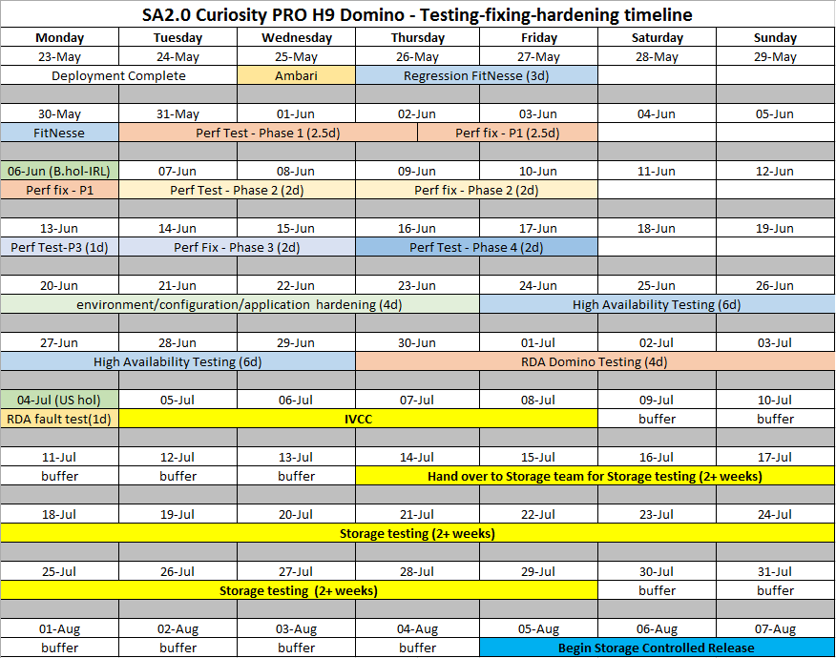
SA2.0 Curiosity (Domino) PRO H9 (Hortonworks) - testing timeline

Slide 3
SA2.0 Curiosity (Domino) PRO H4 (MapR) & H9 (HDP) – current
HPSD
Storage
Ambari, Regression, Performance & HA testing on PRO H9 Hortonworks.
RDA Domino testing on PRO H9 Hortonworks
(Midway servers x 4)
1
2
License Plate:
api.support.hpe.com
GSLB
sa-curiosity-pro.glb.itcs.hpe.com
Active
Passive
H4 LLB
curiosity-pro-h4.itcs.hpe.com
H9 LLB
curiosity-pro-h9.itcs.hpe.com
This schedule is based on the current Curiosity PRO H9 Domino testing schedule:
25-May to 29-June – Ambari, Regression, Performance & HA testing.
30-June to 04-July – RDA Domino functional and fault testing via the PRO H9 LLB.
Front End
Apache
[c4t17228/30/32]
Apache
[c9t197229/31/22400]
REST APIs
(curiosity-rest x 4 svrs)
REST APIs
(curiosity-rest x 6 svrs)
CSA –
Middle Layer
CSA - Middle Layer
[Data Tee, ELK, Prometheus, KAFKA, Zookeeper, Elastic Search]
CSA - Middle Layer
Data Tee
ELK
Prometheus
Map-R or Hortonworks
Map-R (BSD IT)
Hortonworks
(HDP-BSD-IT)
PRO H4
(Domino)
PRO H9
(Domino)

Slide 4
SA2.0 Curiosity PRO H4 (MapR) – move HPSD Storage to Temp H4 LLB
HPSD
Storage
Ambari, Regression, Performance & HA testing on PRO H4 Hortonworks.
RDA Domino testing on PRO H4 Hortonworks
(Midway servers x 4)
License Plate:
api.support.hpe.com
GSLB
sa-curiosity-pro.glb.itcs.hpe.com
Active
Passive
Temp H4 LLB
storage-pro-h4.itcs.hpe.com
H4 LLB
curiosity-pro-h4.itcs.hpe.com
H9 LLB
curiosity-pro-h9.itcs.hpe.com
Front End
Apache
[c4t22704/05/06]
Apache
[c4t17228/30/32]
Apache
[c9t197229/31/22400]
REST APIs
(curiosity-rest x 4 svrs)
REST APIs
(curiosity-rest x 6 svrs)
REST APIs
(curiosity-rest x 6 svrs)
CSA –
Middle Layer
CSA - Middle Layer
[Data Tee, ELK, Prometheus, KAFKA, Zookeeper, Elastic Search]
CSA - Middle Layer
Data Tee
ELK
Prometheus
CSA - Middle Layer
Data Tee
ELK
Prometheus
Hadoop - Hortonworks
Map-R (BSD IT)
Hortonworks
(HDP-BSD-IT)
Hortonworks
(HDP-BSD-IT)
PRO H4
(Domino)
PRO H4
(All Repos)
PRO H9
(Domino)

Slide 5
Steps to Reconfigure from PRO GSLB to Temp PRO H4 LLB
HPSD
Storage
TSS R&D
Verify that PRO H4 MapR is fully operational via the Temp PRO H4 LLB
Steps to change storage to Temp PRO H4 LLB:
TSS R&D – Configure health.html URL on the three new Apache servers and manually add SSL Certs.
  Date: ???
TSS R&D – Connect on the three new Apache servers to the four MapR REST servers.
  Date: ???
TSS R&D – Verify that PRO H4 MapR is fully operational via the Temp PRO H4 LLB.
  Date: ???
HPSD Storage – Reconfigure Storage to connect to PRO H4 MapR via the Temp PRO H4 LLB.
  Date: ???
HPSD Storage – Continue testing on PRO H4 MapR via the Temp PRO H4 LLB.
  Date: ???
4
3
License Plate:
api.support.hpe.com
GSLB
sa-curiosity-pro.glb.itcs.hpe.com
Active
H4 LLB
curiosity-pro-h4.itcs.hpe.com
Temp H4 LLB
storage-pro-h4.itcs.hpe.com
Apache
[c4t17228/30/32]
Apache
[c4t22704/05/06]
Rest #1
Rest #2
Rest #3
Rest #4
CSA - Middle Layer
[Data Tee, ELK, Prometheus, KAFKA, Zookeeper, Elastic Search]
Possible timeline to configure, test and switch HPSD Storage (MapR) to Temp H4 LLB
Step 1 |  | Step 2 |  | Step 3 |  | Step 4 |  | Step 5
Start | End | Start | End | Start | End | Start | End | Start
02-Jun | 07-Jun | 07-Jun | 08-Jun | 08-Jun | 10-Jun | 13-Jun | 20-Jun | 20-Jun
Map-R (BSD IT)
PRO H4
(Domino)

Slide 6
SA2.0 Curiosity (Domino) PRO H9 (HDP) - switch Active to H9
HPSD
Storage
TSS R&D Testing
License Plate:
api.support.hpe.com
GSLB
sa-curiosity-pro.glb.itcs.hpe.com
Passive
Active
Temp H4 LLB
storage-pro-h4.itcs.hpe.com
H4 LLB
curiosity-pro-h4.itcs.hpe.com
H9 LLB
curiosity-pro-h9.itcs.hpe.com
Front End
Apache
[c4t22704/05/06]
Apache
[c4t17228/30/32]
Apache
[c9t197229/31/22400]
REST APIs
(curiosity-rest x 4 svrs)
REST APIs
(curiosity-rest x 6 svrs)
REST APIs
(curiosity-rest x 6 svrs)
CSA –
Middle Layer
CSA - Middle Layer
[Data Tee, ELK, Prometheus, KAFKA, Zookeeper, Elastic Search]
CSA - Middle Layer
Data Tee
ELK
Prometheus
CSA - Middle Layer
Data Tee
ELK
Prometheus
Hadoop - Hortonworks
Map-R (BSD IT)
Hortonworks
(HDP-BSD-IT)
Hortonworks
(HDP-BSD-IT)
PRO H4
(Domino)
PRO H4
(All Repos)
PRO H9
(Domino)

Slide 7
SA2.0 Curiosity PRO H4 & H9 – 5th to 8th July – IVCC by IT
HPSD
Storage
TSS R&D
Testing after IVCC
TSS R&D
Testing after IVCC
License Plate:
api.support.hpe.com
GSLB
sa-curiosity-pro.glb.itcs.hpe.com
Passive
Active
Temp H4 LLB
storage-pro-h4.itcs.hpe.com
H4 LLB
curiosity-pro-h4.itcs.hpe.com
H9 LLB
curiosity-pro-h9.itcs.hpe.com
Front End
Apache
[c4t22704/05/06]
Apache
[c4t17228/30/32]
Apache
[c9t197229/31/22400]
REST APIs
(curiosity-rest x 4 svrs)
REST APIs
(curiosity-rest x 6 svrs)
REST APIs
(curiosity-rest x 6 svrs)
CSA –
Middle Layer
CSA - Middle Layer
[Data Tee, ELK, Prometheus, KAFKA, Zookeeper, Elastic Search]
CSA - Middle Layer
Data Tee
ELK
Prometheus
CSA - Middle Layer
Data Tee
ELK
Prometheus
Hadoop - Hortonworks
Map-R (BSD IT)
Hortonworks
(HDP-BSD-IT)
Hortonworks
(HDP-BSD-IT)
PRO H4
(Domino)
PRO H4
(All Repos)
PRO H9
(Domino)

Slide 8
SA2.0 Curiosity (Domino) – HPSD Storage Testing on PRO H9 (HDP)
HPSD
Storage
HPSD
Storage
14-July to 29-July – HPSD Storage testing on PRO H9 Hortonworks environment.
TSS R&D
Portal UAT & Beta
License Plate:
api.support.hpe.com
GSLB
sa-curiosity-pro.glb.itcs.hpe.com
Passive
Active
Temp H4 LLB
storage-pro-h4.itcs.hpe.com
H4 LLB
curiosity-pro-h4.itcs.hpe.com
H9 LLB
curiosity-pro-h9.itcs.hpe.com
Front End
Apache
[c4t22704/05/06]
Apache
[c4t17228/30/32]
Apache
[c9t197229/31/22400]
REST APIs
(curiosity-rest x 4 svrs)
REST APIs
(curiosity-rest x 6 svrs)
REST APIs
(curiosity-rest x 6 svrs)
CSA –
Middle Layer
CSA - Middle Layer
[Data Tee, ELK, Prometheus, KAFKA, Zookeeper, Elastic Search]
CSA - Middle Layer
Data Tee
ELK
Prometheus
CSA - Middle Layer
Data Tee
ELK
Prometheus
Hadoop - Hortonworks
Map-R (BSD IT)
Hortonworks
(HDP-BSD-IT)
Hortonworks
(HDP-BSD-IT)
PRO H4
(Domino)
PRO H4
(All Repos)
PRO H9
(Domino)

Slide 9
SA2.0 Curiosity PRO environments for TSS R&D Storage DR
TSS R&D
Storage DR
Date ??? – Deploy All Repos on PRO H9
Date ??? – Turn Replication “ON”
Date ??? – Complete initial fail over/fail-back testing
Date ??? – Go live with DR in PRO
License Plate:
api.support.hpe.com
GSLB
sa-curiosity-pro.glb.itcs.hpe.com
Passive
3
Active
H4 LLB
curiosity-pro-h4.itcs.hpe.com
H9 LLB
curiosity-pro-h9.itcs.hpe.com
Front End
Apache
[c4t17228/30/32]
Apache
[c9t197229/31/22400]
REST APIs
(curiosity-rest x 6 svrs)
REST APIs
(curiosity-rest x 6 svrs)
CSA –
Middle Layer
CSA - Middle Layer
Data Tee
ELK
Prometheus
CSA - Middle Layer
Data Tee
ELK
Prometheus
Hadoop - Hortonworks
Hortonworks
(HDP-BSD-IT)
Replication “ON”
Hortonworks
(HDP-BSD-IT)
2
1
PRO H4
(All Repos)
PRO H9
(All Repos)

