Slide 1
Digital Portfolio
STUDENT NAME : T.CHANDRU
REGISTER NO AND NMID :4033877C1FA907AB13C4EA70C0E957D3
DEPARTMENT : B.SC.COMPUTER SCIENCE
COLLEGE : VOORHEES COLLEGE VELLORE,
UNIVERSITY : THIRUVALLUVAR UNIVERSITY.

Slide 2
PROJECT TITLE STUDENT PORTFOLIO USING FRONT END DEVELOPMENT

Slide 3


AGENDA
Problem Statement
Project Overview
End Users
Tools and Technologies
Portfolio design and Layout
Features and Functionality
Results and Screenshots
Conclusion
Github Link
3/21/2024 Annual Review

Slide 4

PROBLEM STATEMENT
"In today’s competitive job market, freshers often face challenges in effectively presenting their skills and projects. Traditional resumes limit the ability to showcase technical expertise and creativity in a clear and interactive way. To solve this problem, I have developed a personal portfolio website that highlights my skills in HTML, CSS, JavaScript, Python, and C++, while also providing an organized space to demonstrate my projects and achievements."

Slide 5

PROJECT OVERVIEW
Personal Portfolio Website – A responsive website to showcase my skills, projects, and achievements.
To-Do List Application – A task manager app to add, edit, and track daily tasks.
Student Management System – A Python-based project to manage student records and performance.
Calculator – A simple web calculator for basic arithmetic operations.
E-Commerce Website (Mini Project) – A basic online shopping platform with product listings and cart system.

Slide 6

WHO ARE THE END USERS?
Personal Portfolio Website – A responsive website to showcase my skills, projects, and achievements.
To-Do List Application – A task manager app to add, edit, and track daily tasks.
Student Management System – A Python-based project to manage student records and performance.
Calculator – A simple web calculator for basic arithmetic operations.
E-Commerce Website (Mini Project) – A basic online shopping platform with product listings and cart system.

Slide 7

TOOLS AND TECHNIQUES
1. Personal Portfolio Website
Tools: VS Code, GitHub, Chrome DevTools
Techniques: Responsive Web Design, Clean UI/UX design, Semantic HTML
2. To-Do List Application
Tools: VS Code, GitHub
Techniques: DOM Manipulation, Event Handling, Local Storage (for saving tasks)
3. Student Management System
Tools: Python IDLE / VS Code, SQLite Database
Techniques: CRUD Operations (Create, Read, Update, Delete), Data Validation, File Handling
4. Calculator
Tools: VS Code, GitHub
Techniques: JavaScript Functions, Event Listeners, Interactive UI
5. E-Commerce Website (Mini Project)
Tools: VS Code, GitHub, Browser Developer Tools
Techniques: Frontend Development, Form Handling, Cart Management, Responsive Layout

Slide 8
POTFOLIO DESIGN AND LAYOUT
Header / Navbar – Name/Logo + links (Home, About, Skills, Projects, Contact).
Hero Section – Intro (Name, Role, Tagline, Resume Button).
About Me – Short bio + career goals.
Skills – List of technical skills (HTML, CSS, JS, Python, C++).
Projects – Cards with title, description, tools, features, links (Code / Demo).
Resume (optional) – Download button.
Contact – Form + social links (LinkedIn, GitHub).
Footer – Copyright + quick links.
8

Slide 9
FEATURES AND FUNCTIONALITY
Responsive Design → Works smoothly on desktop, tablet, and mobile.
Interactive Navigation → Easy scrolling and quick access to all sections.
About Me Section → Highlights education, skills, and career goals.
Skills Showcase → Displays technical skills (HTML, CSS, JavaScript, Python, C++).
Projects Section → Detailed project cards with description, tools, techniques, and links (Code/Demo).
Resume Download → Option to download CV directly.
Contact Form → Simple form to send messages easily.
Social Media Integration → Links to LinkedIn, GitHub, and Email.
Clean UI/UX → Minimal, modern, and recruiter-friendly design.

Slide 10
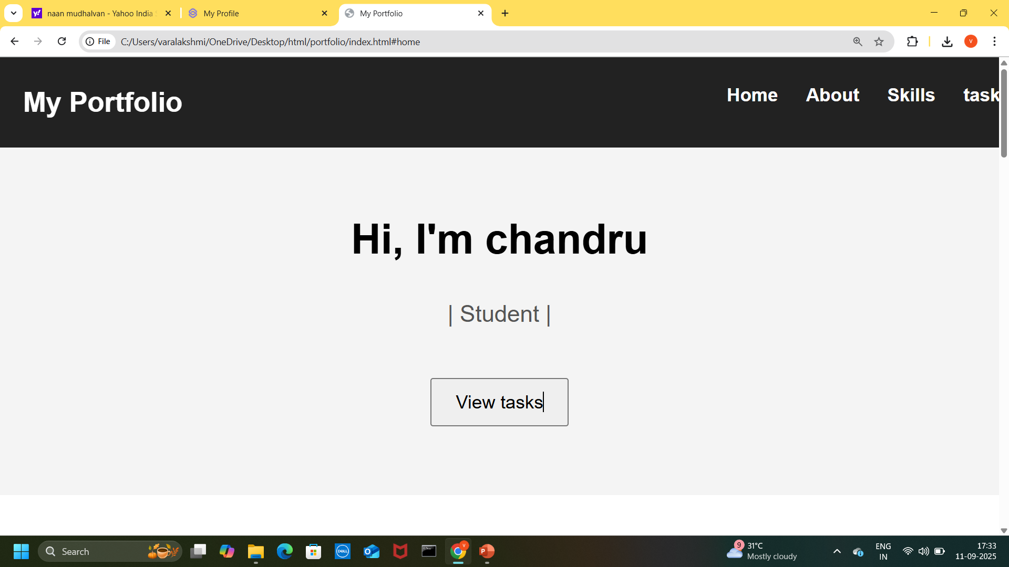
1.

Slide 11
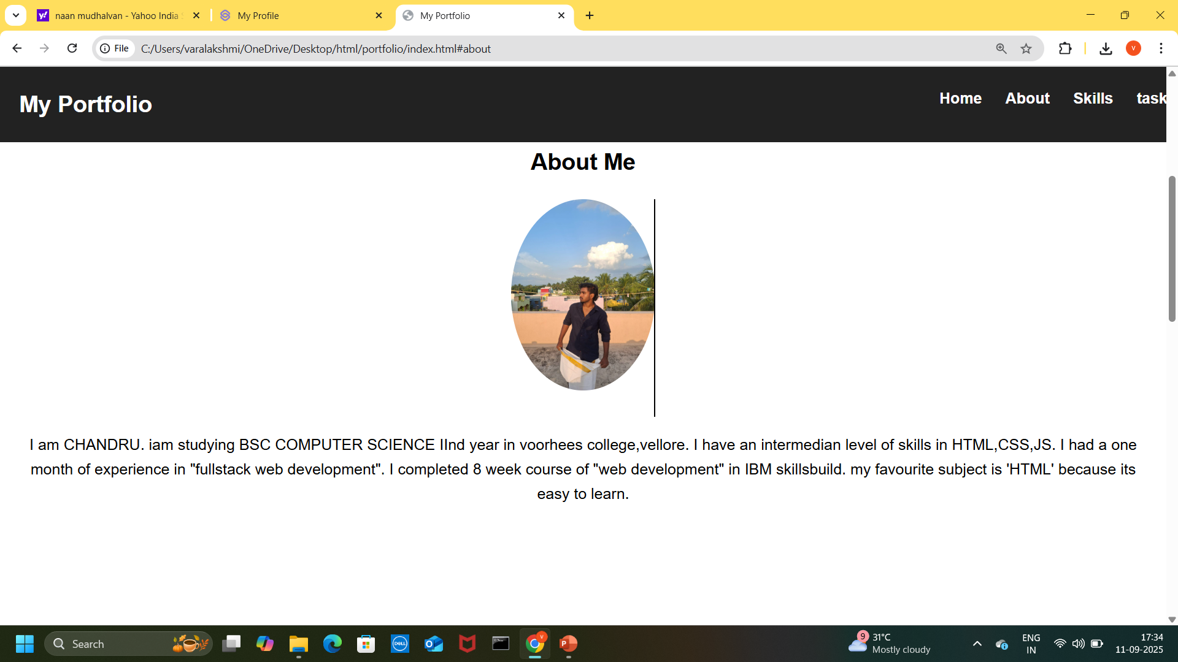
2.

Slide 12
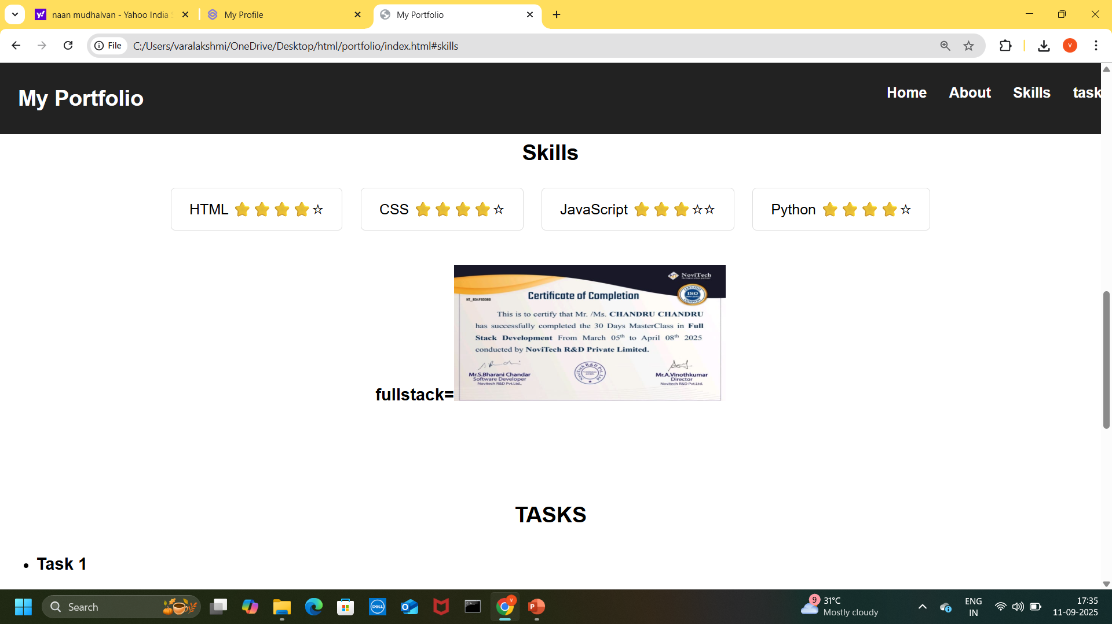
3.

Slide 13
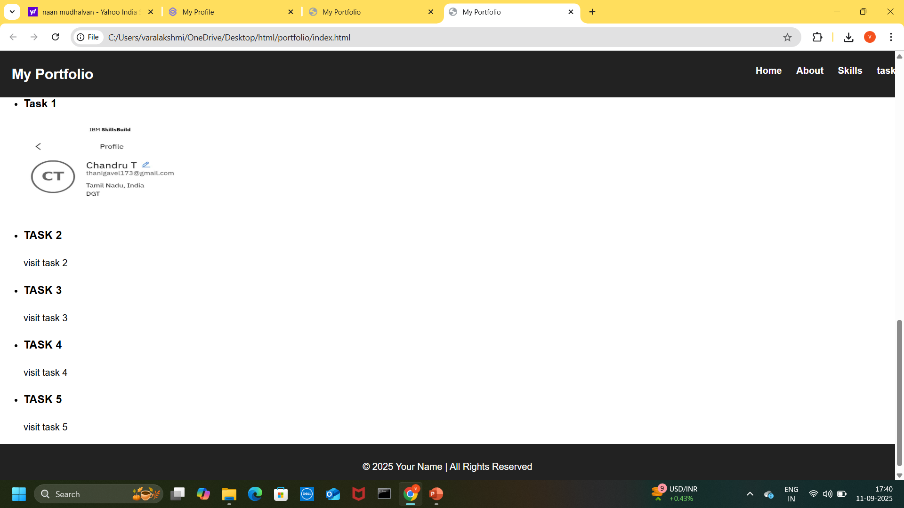
4.

Slide 14
CONCLUSION
Thank you for visiting my portfolio. This space reflects my journey as a learner and developer, showcasing my skills in HTML, CSS, JavaScript, Python, and C++. I am passionate about building creative and practical solutions while continuously improving my knowledge. I look forward to opportunities where I can apply my skills, contribute to meaningful projects, and grow as a professional.
14

