Slide 1
Servlet

Slide 2
Topics
Servlet-to-servlet communication
Filters
Listeners

Slide 3
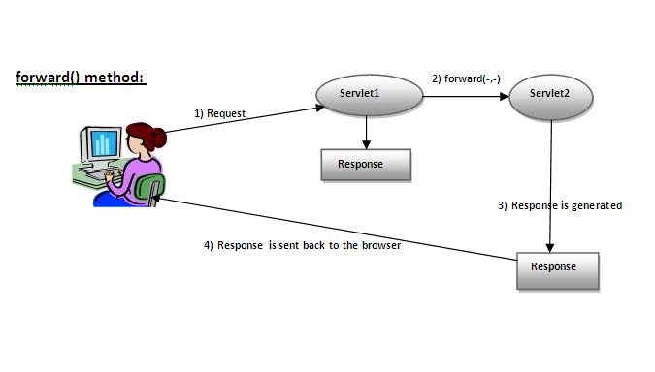
RequestDispatcher
WebServer

Slide 4
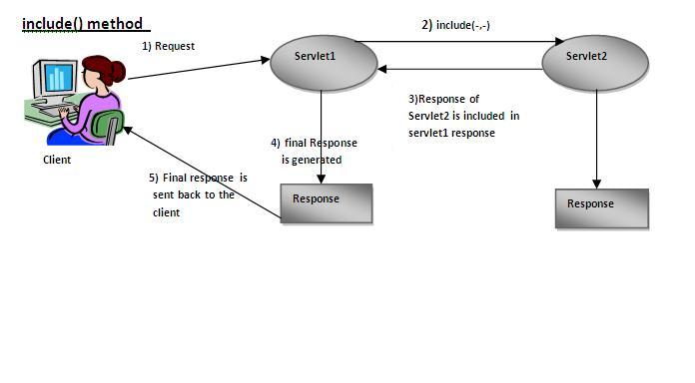
RequestDispatcher
WebServer

Slide 5
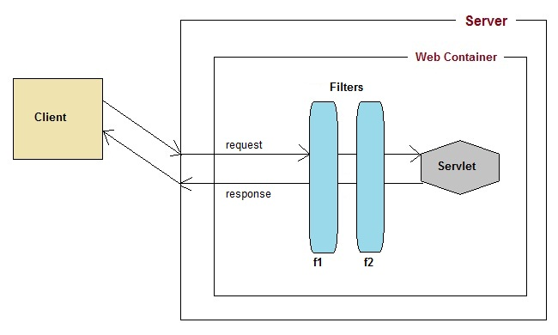
Filters
A filter is an object that performs filtering tasks on either the request to a resource (servlet/jsp/static content), or on the response from a resource, or both.

Slide 6
Filters
Usage of Filter
Recording all incoming requests
logs the IP addresses of the computers from which the requests originate
Conversion
Data compression
Encryption and decryption
input validation etc.

Slide 7
Listeners
Listeners listen for web application events such as application context started, application shutdown, create a session, place an attribute in a session etc..
To subscribe to these events we can configure a listener either in web.xml or through @Listener annotation.
There eight types of Listeners in a java web application.

Slide 8
To create a Filter implement the javax.sevlet.Filter interface
Filter lifecyle methods
init()
destroy()
doFilter()

Slide 9
Listeners
Few listeners...
ServletContextListener
  contextInitialized
  contextDestroyed
HttpSessionListener
  sessionCreated
  sessionDestroyed
ServletRequestListener
  requestInitialized
  requestDestroyed

Slide 10
HttpSessionAttributeListener
ServletContextAttributeListener
ServletRequestAttributeListener
  attributeAdded
  attributeRemoved
  attributeReplaced

