Slide 1
JSP

Slide 2
Java Server Pages
JSP Pages contains markup(usually HTML) interlaced with special JSP elements that provide logic for controlling the dynamic content.
Any markup that isn't a JSP element is known as Template Text (usually HTML, xml , plain text).
JSP will be translated to a servlet at request time by the JSP container.
JSP 2.0 specs introduced EL (Expression Language) and JSTL (JSP Standard Tag Library), which makes it much easier for developers not familiar with Java syntax to understarnd JSP logic.

Slide 3
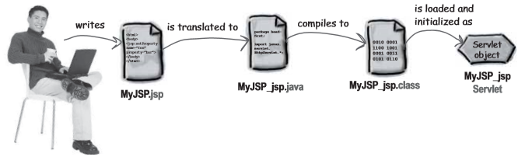
Translation

Slide 4
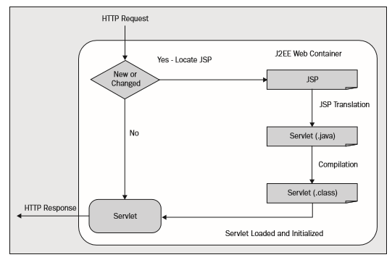
JSP Life Cycle

Slide 5
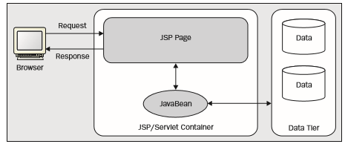
JSP Application Architecture
Model 1 Architecture

Slide 6
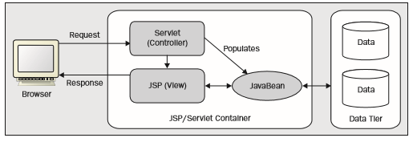
JSP Application Architecture
Model 2 Architecture

Slide 7
Scripting Elements
Comments
JSP Declarations
JSP Scriptlets
JSP Expressions
EL Expressions

Slide 8
Comments
<!-- This is a HTML Comment -->
    HTML comments can be viewed by the client by the view source option
<%-- This is a JSP comment --%>
    Jsp comments are not sent to the client as part of the response.

Slide 9
JSP Declarations
Allows us to declare variable and methods inside jsp page.
<%!
Date now = new Date();
private int calculate(...) {
}
%>
Content inside the jsp declarations will be placed outside the _jspService() method during translation phase

Slide 10
JSP Scriptlets
We can write any valid java code inside scriptlets
<%
%>
JSP Expressions
Expressions are similar to scriptlets, but they evaluate a java expression and return a result. This result must be a String or be convertible to a String.

Slide 11
JSP Implicit objects
All JSP Pages will have access to number of userful object provided by the JSP container that are known as implicit objects.
request - javax.servlet.http.HttpServletRequest
response – javax.servlet.http.HttpServletResponse
out - javax.servlet.jsp.JspWriter
session – javax.servlet.http.HttpSession
config - javax.servlet.ServletConfig
application – javax.servlet.ServletContext
page – java.lang.Object
exception - java.lang.Throwable
pageContext - PageContext

Slide 12
JSP Directives
Directives pass instructions to the JSP container
Page Directive
  Defines page dependent properties such as library dependency, error handling requirements etc.
  <%@page attributename=value %>
Include Directive
  Include directive executes at translation time and enables the content of the included resource to be statically merged inside the original page.
  <%@include file=”header.html” %>
Taglib Directive
  Is used to import tag libraries

Slide 13
JSP Standard Action tags
Action tags helps to eliminate java code from jsp page. Scripts free pages will be easy for page developers.
<jsp: useBean>
<jsp: setProperty>
<jsp: getProperty>
<jsp: include>
<jsp: forward>

Slide 14
JSTL
JSTL core Tags
  <c:set >
  <c:out>
  <c:if>
  <c:choose> , <c:when>, <c:otherwise>
  <c:forEach>
  <c:url>
  <c:import>

