Slide 1
Servlet

Slide 2
Topics
Introduction
Web Server
HTTP, TCP/IP
Anatomy of Request / Response
What is a Servlet
Servlet Life Cycle
Directory structure of Java Web Applications

Slide 3
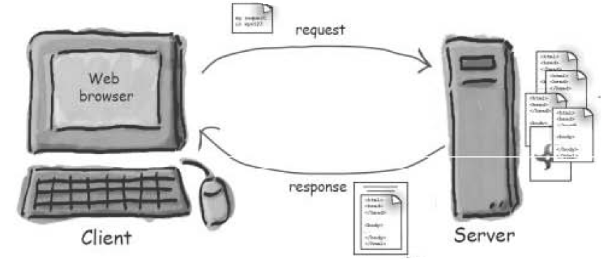
Web Server
A web server takes a client request and gives the requested resource back to the client.

Slide 4










URL(Uniform Resource Locator)
http://www.some.com:80/accounts/index.html

Slide 5
HTTP Protocol
HTTP (Hyper Text Transfer Protocol) is a protocol that clients and servers use on the web to communicate.
The client sends an HTTP request and the server answers with an HTTP response.
HTTP runs on top of TCP/IP

Slide 6
TCP/IP
TCP is responsible for making sure that a file sent from one network node to another ends up as a complete file at the destination, even though the file is splits into packets when its sent.
IP is the protocol that moves the packets from one host to another on their way to destination.
HTTP depends on TCP/IP to get the complete request and response from one place to another.

Slide 7
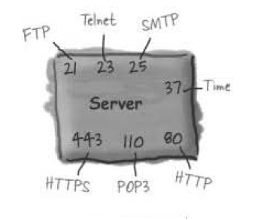
Portno
A port represents a logical connection to a particular software running on the server.
Without port numbers, the server would have no way of knowing which application a client wanted to connect to.

Slide 8
Anatomy of HTTP Request
Each request consist of 3 sections.
  Request Line
  Header
  Body
HTTP protocol has several request methods (GET,POST,PUT,DELETE,TRACE,OPTIONS)
The one you will use most often are GET and POST

Slide 9
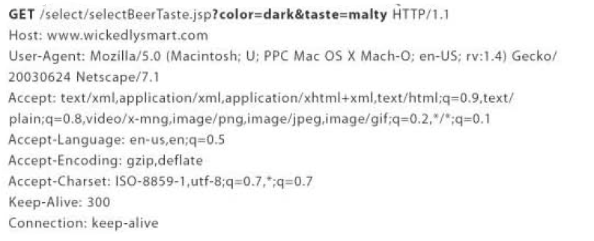
GET Request
A GET-request is used to download a resource (page, image, etc.) from the server. It can also sent little data to the server

Slide 10
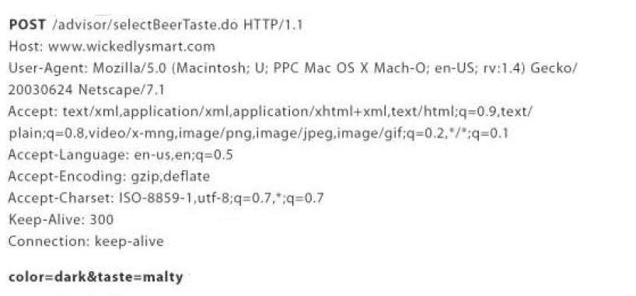
POST Request
POST-requests are used to pass some data to the server. They can contain form data, a file that should be uploaded, etc.

Slide 11
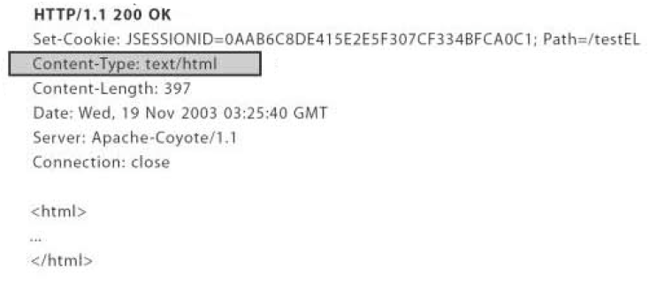
Anatomy of HTTP Response
HTTP response has both Header and Body.
Header includes protocol, response status code and content type. Body contains the contents (ex: HTML) for the browser to display.

Slide 12
Servlet
Servlets are part of JEE Specification (currently v3.1)
Servlets are server side Java programs.
Used to create dynamic web pages.
Servlets are multi-threaded to handle multiple concurrent client requests.
Are request / response oriented
Are not tied to any protocol, but, are most commonly used with HTTP
Servlets runs inside a Servlet-Container in the Web server
Mainly used as a Controller component in MVC Architecture

Slide 13
Servlet
Servlet API is defined in the following two packages
  javax.servlet
  javax.servlet.http
All servlets implements javax.servlet.Servlet interface
Servlet API provides two standard implementions
  javax.servlet.GenericServlet
  javax.servlet.http.HttpServlet
To create our own servlet we must extend one of the above class.
Web Application generally uses HttpServlet

Slide 14
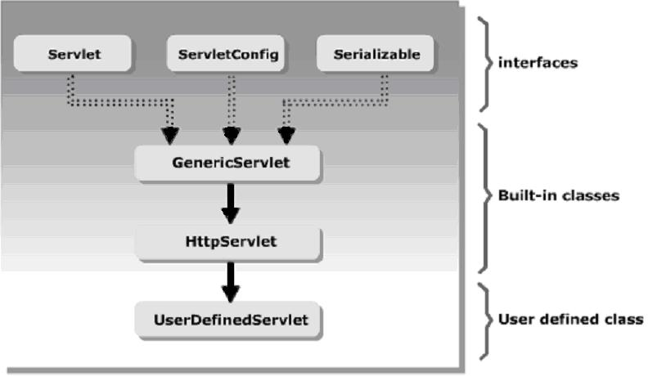
Class Hierarchy

Slide 15
Servlet Lifecycle
Servlets are instantiated and managed by Servlet container.
Servlet stays loaded until unloaded or servlets engine is shutdown.
Servlet life cycle methods are in javax.servlet.Servlet interface that all servlets should define.

Slide 16
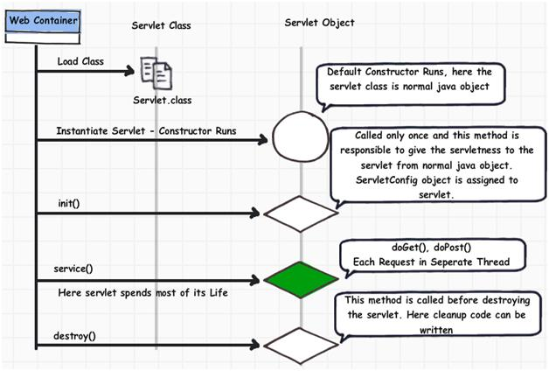
Servlet Life cycle

Slide 17
Servlet Container
Servlet container manages and runs the servlet.
It provides the following services to the servlet.
  Communication support
  Life cycle management
  Multi-threading support
  Declarative Security
  JSP Support

Slide 18
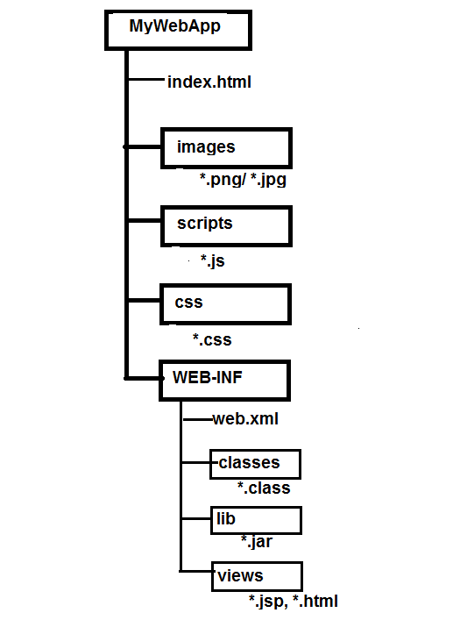
WAR – Folder structure

