Slide 1
CCura+
Network security
T.Chandirasekar
N.G.Karthikeyan
TCE

Slide 2
CCura+
A complete file security software
Very good Encryptor/Decryptor
Additional features such as Data compression and password protection
Capable for upgradation
Detailed documentation
Authentication capability
High security

Slide 3
Features
Designed in our own encryption algorithm
Very useful for online encryption
Application is intensive on DLL files
Main usage of data structures in C++
Random functions for deciding the size of the stack
Provisions for Fault tolerance

Slide 4
Algorithm
Usage of STACK data structure for online encryption
Wild sized stack using random number generation
Usage of two stacks instead of using a single stack

Slide 5
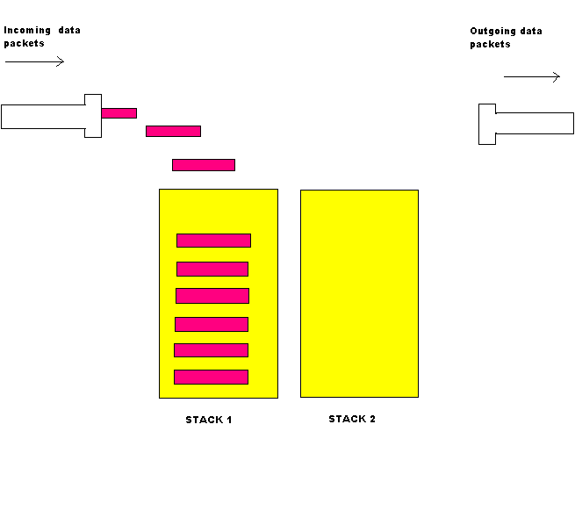
Step 1

Slide 6
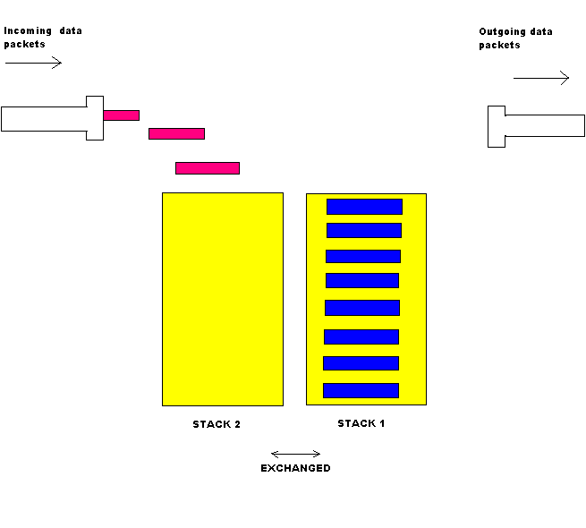
Step 2

Slide 7
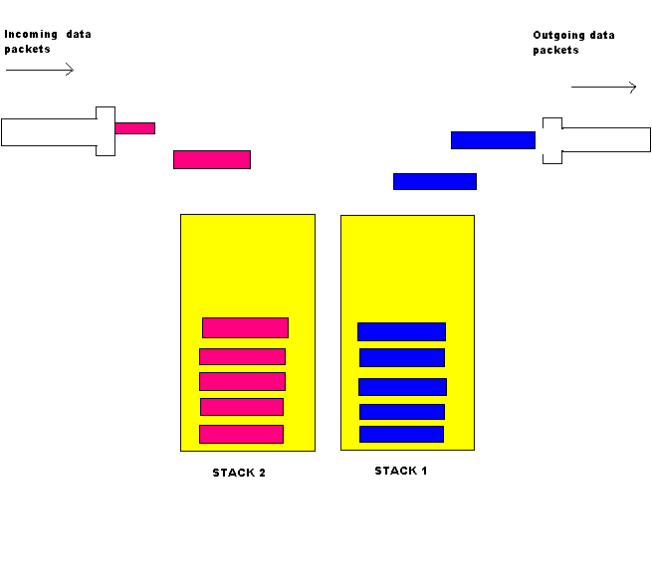
Step 3

Slide 8
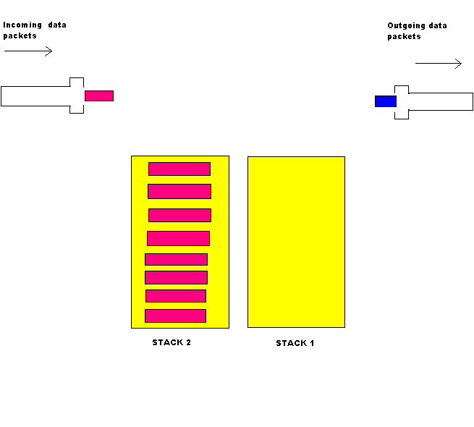
Step 4

Slide 9
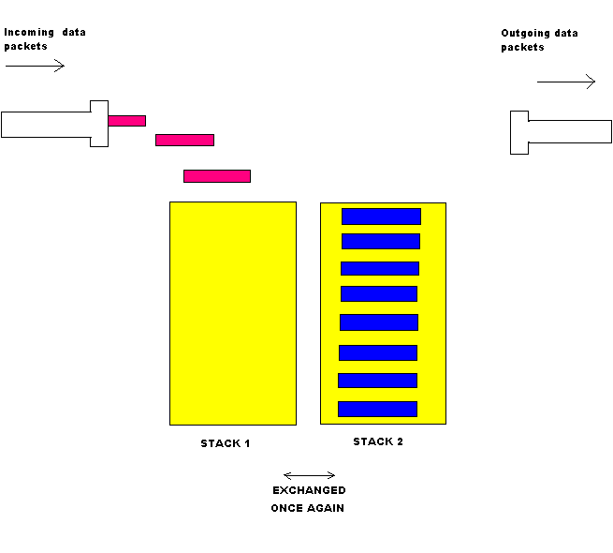
Step 5

Slide 10
Encrypting algorithm
Encryption done in three stages
    Reversing set of bytes using wild sized stack
    Using one’s compliment
    XOR with completely wild random numbers
    Faster encryption method

Slide 11
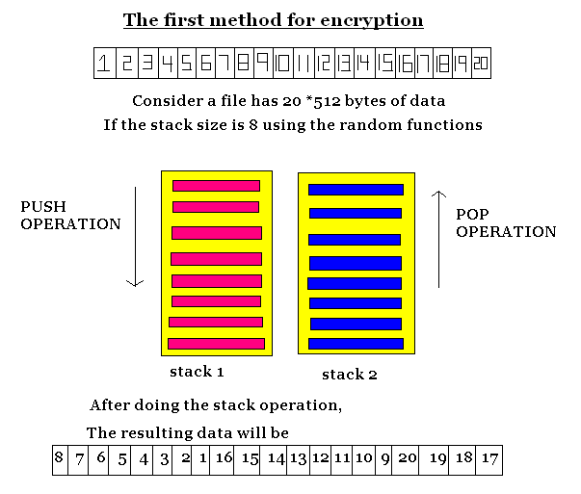
First step

Slide 12
Second step
After completion of first step it will create a temporary file “crypt.dat”
Then do the one’s compliment operation with all the data in “crypt.dat” file
Store the result in another file called “crypttemp.dat”
Inversion of bits in “crypt.dat”

Slide 13
Third step
At the end of second step it will create a file “crypttemp.dat”
Generate a random number using a random value
Do the XOR operation with the data in the file
Store the encrypted file in given name

Slide 14

Key file
Creation of key file
Key file contents
    Password given to encrypt the file
    Three random numbers used in encryption
    Key file also gets encrypted by doing XOR operation with int(password)

Slide 15
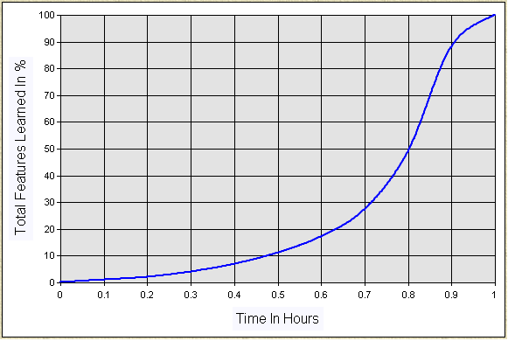
Learning curve

Slide 16
DLL engines
CCura+ combines individual modules of crypto-, compression, User Interface, Help into one smooth entity
A data structure-intensive coding – highly efficient
Compiling the key algorithms in binary DLLs – impossible to disassemble
Calling functions from DLL in VB allows the coding to become native to machine.
DLL files for FAULT TOLERANCE also have been coded and included

