Slide 1

CCura+®
Network Security
T.Chandirasekar,N.G.Karthikeyan
Dept of Computer Science and Engg
Thiagarajar College of Engg
Madurai

Slide 2

CCura+®
A complete file security software
Very good Encryptor/Decryptor
Additional features such as Data compression and password protection
Capable for upgradation
Detailed documentation
Authentication capability
High security

Slide 3
Features
Designed in our own encryption algorithm
Very useful for online encryption
Application is intensive on DLL files
Main usage of data structures in C++
Random functions for deciding the size of the stack
Provisions for Fault tolerance

Slide 4
Algorithm
Data structure
  Creation of “SMART NODE” class
  Overloaded constructor
  Capable of reacting themselves without external functions
  Usage of Stack data structures for encryption
  Conversion from C++ to DLL

Slide 5
Algorithm
Encryption /Decryption
  Encryption done in three consecutive methods
    Reversing set of bytes using wild sized stack
    Using one’s compliment
    XOR with completely wild random numbers
    Faster encryption method
The same encryption method is reversed while decrypting

Slide 6
Algorithm
Creation of DLL files
  C++ programs are converted into DLL files using Visual studio C++ editor
  Perfect use of DLL files
  Calling function for DLL file from VB
  DLL files also for Fault Tolerance
  Linking of several DLL files

Slide 7
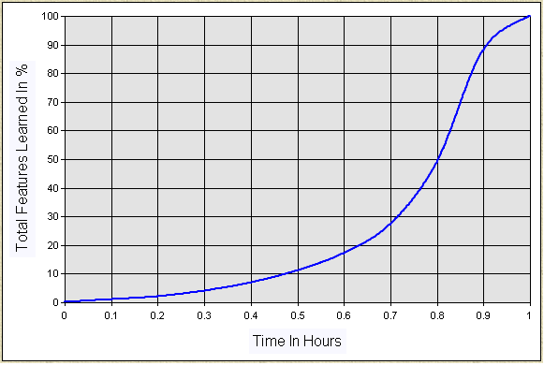
Learning curve

