Slide 1
Java Intro
Basics Lesson
Chapter 1 - Variables Loops Functions Branching

Slide 2
Java Basics
The common building blocks in programming languages are:
Variables
Loops
if statements
Functions (aka “methods”)
It’s expected that you have done programming with these already in some language
Over the next two weeks we’ll go over how these work in Java

Slide 3
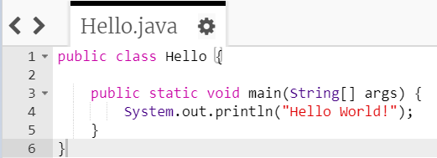
A basic Java “Hello World” program
Click on the link to the “Four 4s Challenge” of just go to CP Java Website
It might look complicated at first, but . . .

Slide 4
A basic Java program
It turns out that this line is much more important than the others
So we can ignore everything except the code circled in green

Slide 5
Statements
The circled code is an example of a statement
It’s like an English sentence
A semi-colon marks the end of a Java statement

Slide 6
String
"Hello World!" is a Java String
A String is a collection of letters, digits, punctuation and/or spaces
The beginning and end of the String are marked with double quotes (")

Slide 7
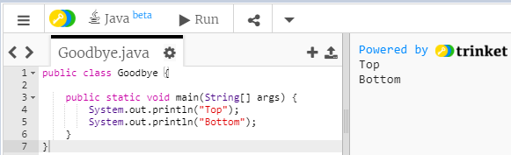
print() vs println()
System.out.println() prints first and then goes to the next line

Slide 8
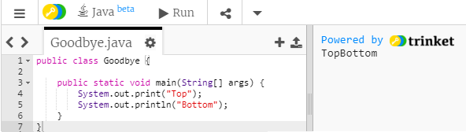
print() vs println()
System.out.print() prints, but it does NOT go to the next line
If we change the first statement to System.out.print() "Bottom" is printed on the same line as "Top"

Slide 9
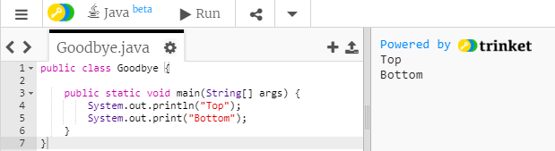
print() vs println()
Changing the second statement to System.out.print() doesn’t change the output since nothing is printed after "Bottom"

Slide 10
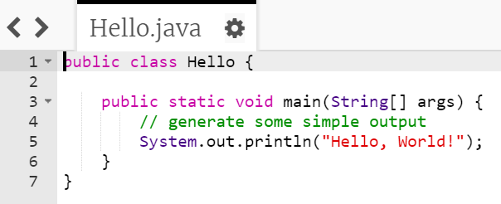
Lines that begins with two slashes // are ignored by Java
Comments have no effect on the execution of the program, but they make it easier for other programmers (and your future self) to understand what you meant to do
Comments

Slide 11
Escape Sequences
Special characters
In Java, Escape Sequences begin with a backslash \
A good way to remember the difference between a backslash and a forward slash is that a backslash leans backwards ( \ ), while a forward slash leans forward ( / )

Slide 12
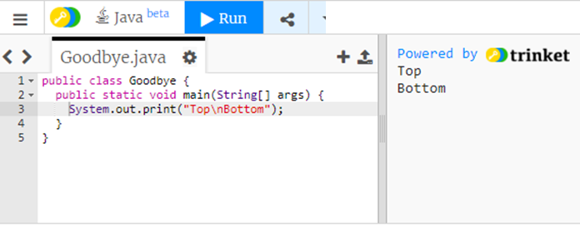
Common Java Escape Sequences
\n Insert a newline in the text at this point

Slide 13
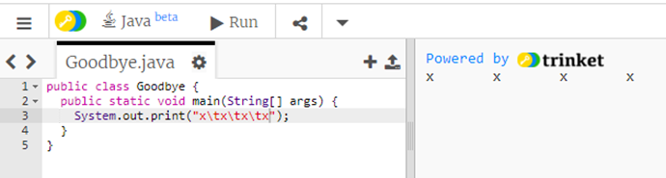
Common Java Escape Sequences
\t Insert a tab in the text at this point

Slide 14
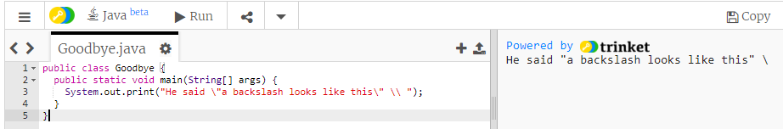
Common Java Escape Sequences
\' Insert a single quote character
\" Insert a double quote character
\\ Insert a backslash character

Slide 15
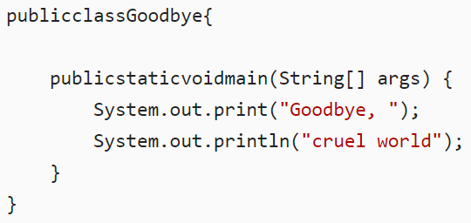
Formatting Java code
In Java programs, some spaces are required
For example, you need at least one space between keywords
The program below is not legal

Slide 16

Formatting Java code
But most other spaces are optional
For example, this program is legal but hard to read

Slide 17
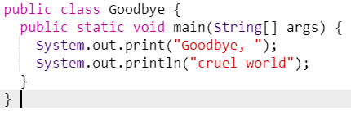
Formatting for easier reading
The blank space (also called “white space”) commonly used to format code is:
Indentation inside of { }
One statement per line

Slide 18
Debugging
Errors in programs are called “bugs”
The process of fixing program errors is called “debugging”
It’s good to work around other programmers when you are learning a new programming language
Asking for help with debugging is a part of learning

Slide 19
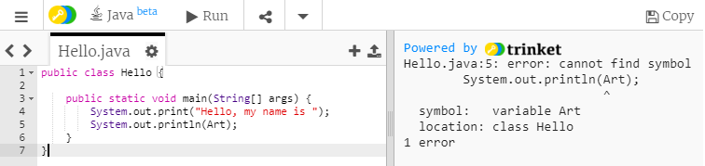
Errors
When you write Java programs you will often get an error message
When you are learning a new programming language, errors are a fact of life
Errors are ok, just fix them and move on

Slide 20
Syntax error
In this case I made a syntax error
Syntax is the grammar and spelling of a computer language
Here I forgot the double quotes around my name

Slide 21
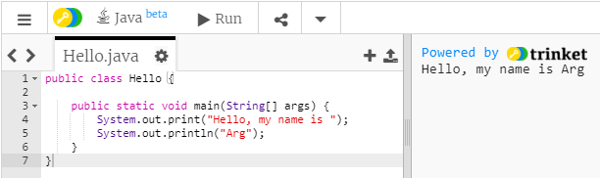
Logic error
This time I misspelled my name
The computer doesn’t know my name, so the program runs incorrectly without an error message

Slide 22
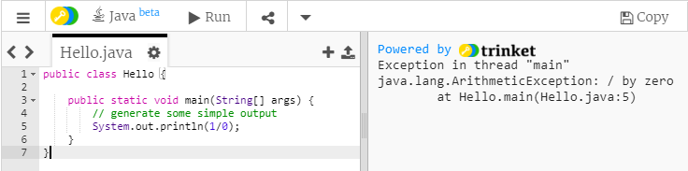
(Run time) Exceptions
Sometimes a logic error crashes the computer and stops the running program
Here I made the logic error of dividing by zero

Slide 23
Arithmetic in Java
+ - * /
Addition
Subtraction
Multiplication
Division

Slide 24
Literals vs. Expressions
Double quotes around text tells Java it is an expression
Java will print an expression exactly as written

Slide 25
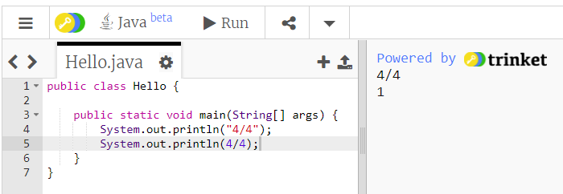
Literals vs. Expressions
Here’s an expression "4/4"
Java prints it in exactly the same form

Slide 26
Literals vs. Expressions
Here’s an expression 4/4
Java evaluates it to get an answer 1
And then prints it

Slide 27
Four 4s challenge
Use exactly four 4's to write an expression that evaluates to every integer from 1 to 10, using only + - * / and ()
No decimals, factorials, square roots, exponents, etc.

Slide 28
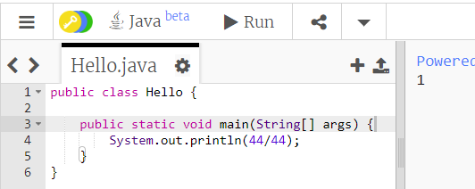
Four 4s challenge
Print 10 expressions that use arithmetic and four 4s that evaluate to 1 through 10
Here’s one way to do the first

Slide 29
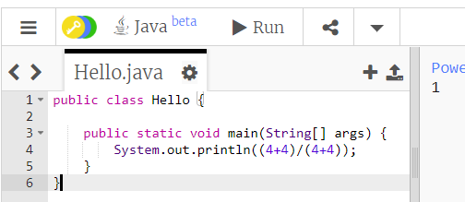
Four 4s challenge
Here’s another way to do the first
If you have extra time, try to get 11, 12, 13, etc.

Slide 30
Java Intro
Basics Lesson
Chapter 2 - Variable Types Integer & Modulo Division Strings

Slide 31
Chapter 2
Variables
Types
Declarations
Initializations
Comments
% (modulus) and Integer division
+ and Strings

Slide 32
Variables
Think of a variable as a place to store a value that you will use later
The value of a variable can change (think vary)
A Java variable has size limits for its type (for example, integers are limited to values between -2,147,483,648 and 2,147,483,647)
Every Java variable has a type and a name

Slide 33
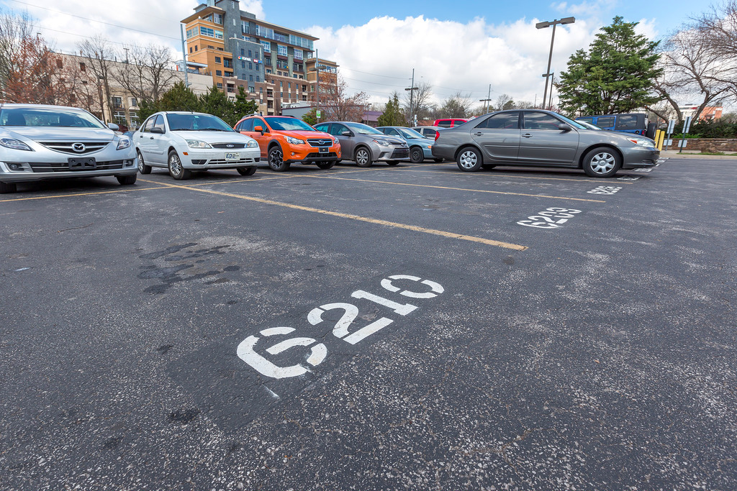
Variables: Parking space analogy
Like a parking space, a variable can store a value (think vehicle) until you need it later

Slide 34
Variables: Parking space analogy
Parking spaces are often labeled so you can find your car later when you need it
Lets say that G210 is the name of this parking space

Slide 35

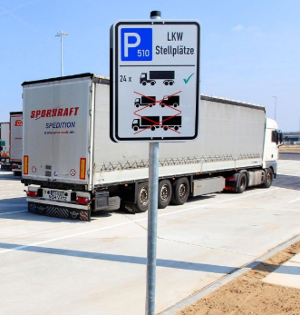
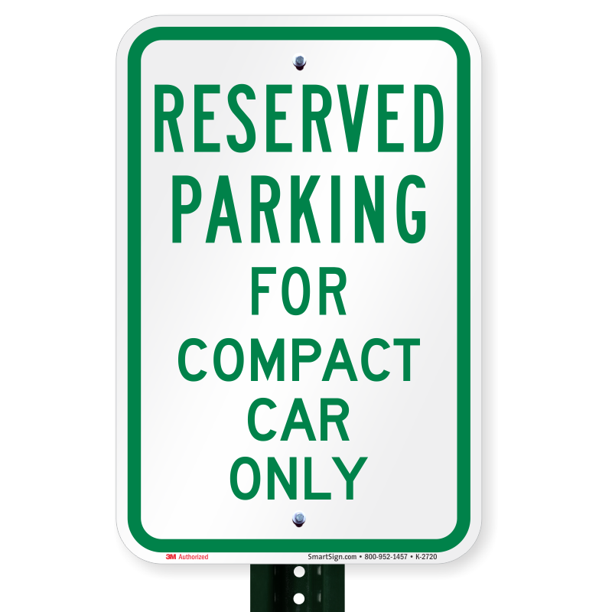
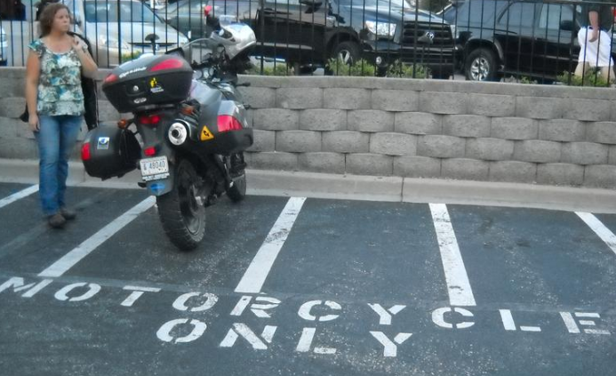
Variables: Parking space analogy
In addition to a name, parking spaces can have a type that sets size limits

Slide 36
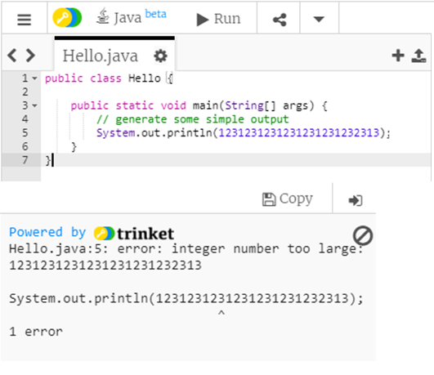
What is the error?
We are trying to print an integer that is too large for Java’s integer size

Slide 37
Primitive data types
In Java (unlike Python or JavaScript) variables have types
Each type has size limits
For this class, you need to know 5 basic (aka “primitive”) types:
int
float
double
boolean
char

Slide 38
Primitive data types
int holds a single integer value between -2,147,483,648 and 2,147,483,647
float a decimal value with up to 7 digits
double a decimal value with up to 15 digits
A boolean can only hold values that evaluate to either true or false
char holds a single letter, digit, space or punctuation mark and must be enclosed in single quotes, like this: 'G'

Slide 39
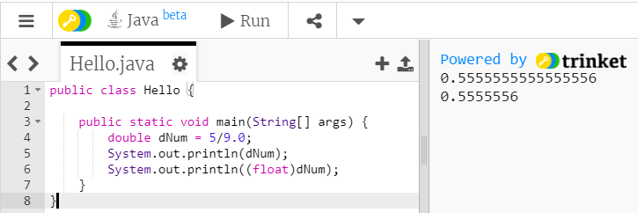
float vs. double
float is short for floating point, another name for decimal point
double gets its name because of its size, it has about twice as many digits as a float

Slide 40
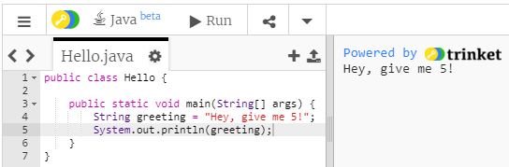
String variables
A String variable can store text with any number of letters, digits, punctuation marks and spaces
The beginning and end of the text is marked with double quotes (")

Slide 41
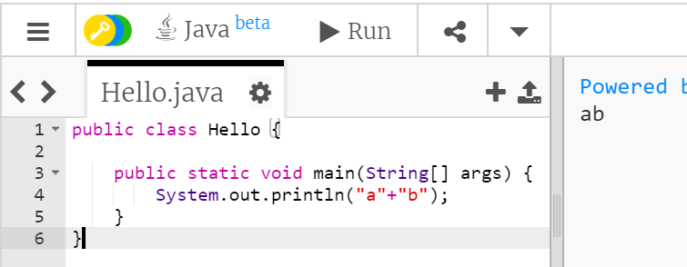
+ and Strings
Using + with Strings isn’t addition arithmetic, it’s called concatenation
That’s a fancy word that means making bigger Strings out of little ones

Slide 42
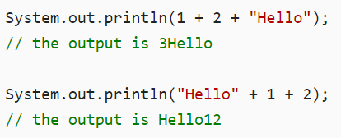
When numbers and Strings are combined with + Java converts the result to a String
Java executes from left to right so, 1 + 2 is 3, and 3 + "Hello" is "3Hello"
"Hello" + 1 is "Hello1", and "Hello1" + 2 is "Hello12"
+ and Strings

Slide 43
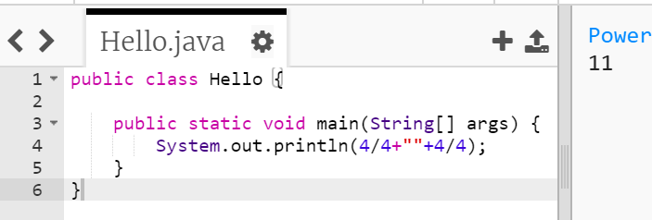
11
We could make 11 with four 4s by putting an empty String in the middle
(String concatenation is not allowed in the rules of the four 4s challenge though)

Slide 44
A Java variable declaration
The Java statement that sets up a variable is called a declaration
Here’s an example declaration
int num;
The first word of the declaration is the type
The second word is the name that the programmer chooses

Slide 45
Variable names and keywords
You can pretty much choose any name you want for a variable with a few limitations:
Variable names cannot
start with a number
contain a space
have a special meaning in Java
Java has about 50 reserved words or keywords that you are not allowed to use as variable names such as public, class, static, void, int …

Slide 46
camelCase
Because a Java variable name can’t have spaces, a style called camelCase is usually used for variable names with more than one word
camelCase capitalizes the first letter of each word except the first word
Examples: firstName, numberOfDogs
Java variable names are case-sensitive, so firstName is not the same as firstname or FirstName.

Slide 47
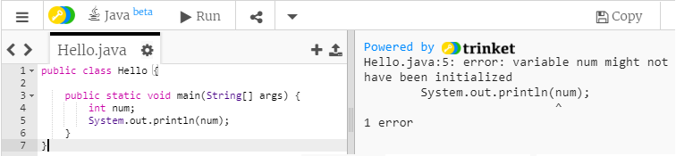
What’s the error?

Slide 48
Variable initialization
After a Java variable is declared, it needs to be initialized

Slide 49
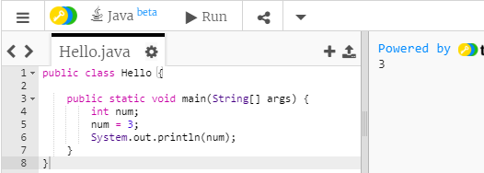
Variable initialization
The English word “initial” means first
We initialize a variable by assigning (“setting it equal to”) its first value

Slide 50
Declare and initialize
You can declare and initialize a variable with one line of code:
int num = 3;
Just remember that the one line of code is doing two different steps: the declaration and the initialization

Slide 51
Comments
//Single Line
/*
Multi
Line
*/
Tells the computer to ignore some text
Used to:
Write notes to yourself or other programmers
Temporarily disable code

Slide 52
Arithmetic operators
+ - * / %
Addition
Subtraction
Multiplication
Division
Modulus (also Mod or Modulo) calculates the remainder of dividing two integers

Slide 53

Modulus and integer division
Remember how you did math in grade school?
62

Slide 54

Modulus and integer division
Remember how you did math in grade school?
63

Slide 55

Modulus and integer division
Remember how you did math in grade school?
64

Slide 56

Modulus and integer division
Remember how you did math in grade school?
65

Slide 57
Modulus and integer division
The modulus operator gives the remainder of an integer division expression
8/5
8%5
66

Slide 58
